Slide 1

O-8
  Explosive Alfvén Event in HL-2A H-mode Plasmas
W. Chen¹, Z.Y. Qiu², L.M. Yu¹, P.W. Shi¹, R. Ke¹, X.Q. Ji¹, Z.B. Shi¹, W.L. Zhong¹, M. Jiang¹, R.R. Ma¹, Y.G. Li¹, Z.C. Yang¹, X.T. Ding¹, Q.W. Yang¹, J.Q. Li¹, M. Xu¹, and X.R. Duan¹
1Southwestern Institute of Physics, P.O. Box 432 Chengdu 610041, China
2 Institute for Fusion Theory and Simulation, Zhejiang Univ., Hangzhou 310027, China
Email: chenw@swip.ac.cn
16th IAEA Technical Meeting on Energetic Particles in Magetic Confinement Systems -Theory of Plasma Instabilities (EPPI2019), 3-6 Sep. 2019, Shizuoka, Japan

Slide 2
Introduction & background
I. Nonlinear dynamics of SAW fluctuations has become a major concern in magnetically confined fusion, since they can be driven unstable by EPs. There are two routes for the Alfvénic fluctuation nonlinear dynamic evolution, with one corresponding to wave-particle phase space nonlinear dynamics dominated by resonant particles, while the other, dubbed as nonlinear wave-wave interactions, describing nonlinear spectrum evolution due to the nonlinear couplings among modes.
II. ELMs are MHD instabilities in H-mode regime. They are fast periodic eruptions that deposit energy and particles into the plasma facing components. ELM onset is typically described by the linear ideal MHD PB instabilities localized in the steep density and temperature gradient regimes of the bulk plasma boundary. However, the PB model cannot explain all ELM onsets. The ELM-onset mechanism remains an open issue.

Slide 3
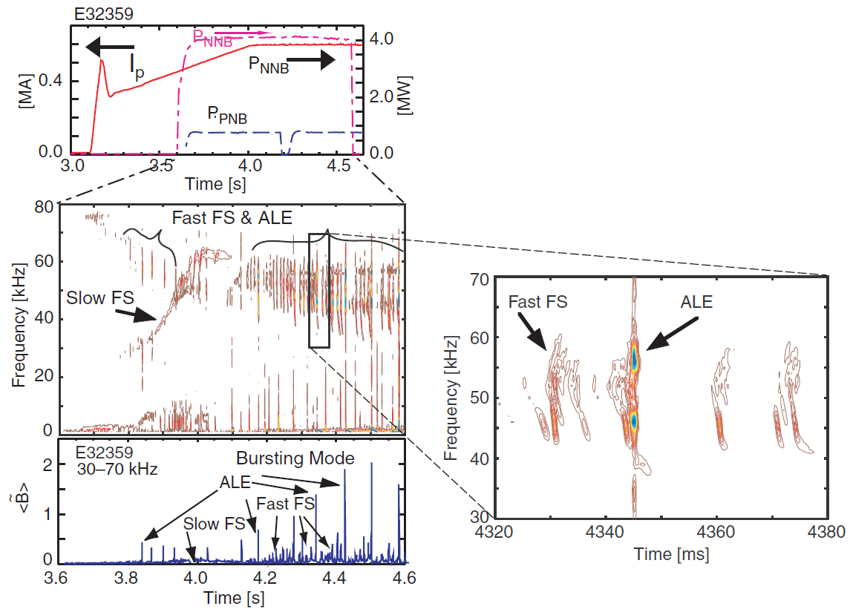
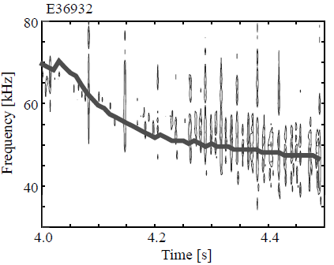
Abrupt Large-amplitude Event (ALE)
TAE freq.
“Eyes”
K. Shinohara, et al, Nucl. Fusion 45 (2001) 603; M. Ishikawa, et al, Nucl. Fusion 45 (2005) 1474; A. Bierwage, et al, Nucl. Fusion 57 (2017) 016036；Ozeki, PPCF 45 (2003) 645; Bierwage, et al, Nature Communications 3282 （2018）.

Slide 4
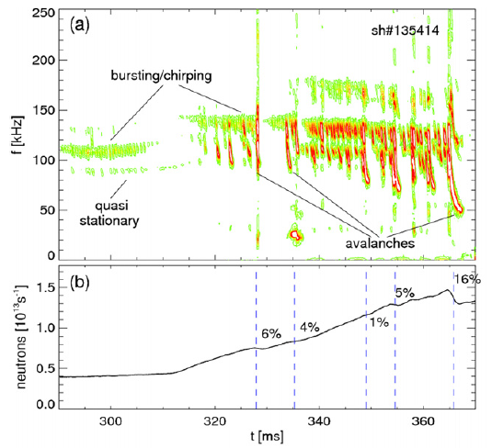
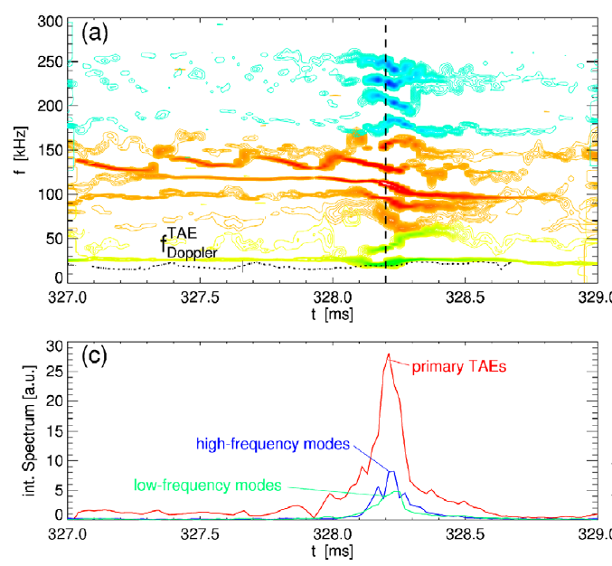
Nonlinear Mode Coupling and Avalanches
NSTX
“Eyes”
M. Podesta, et al, Nucl. Fusion 51 (2011) 063035
NMC can induce avalanches.

Slide 5
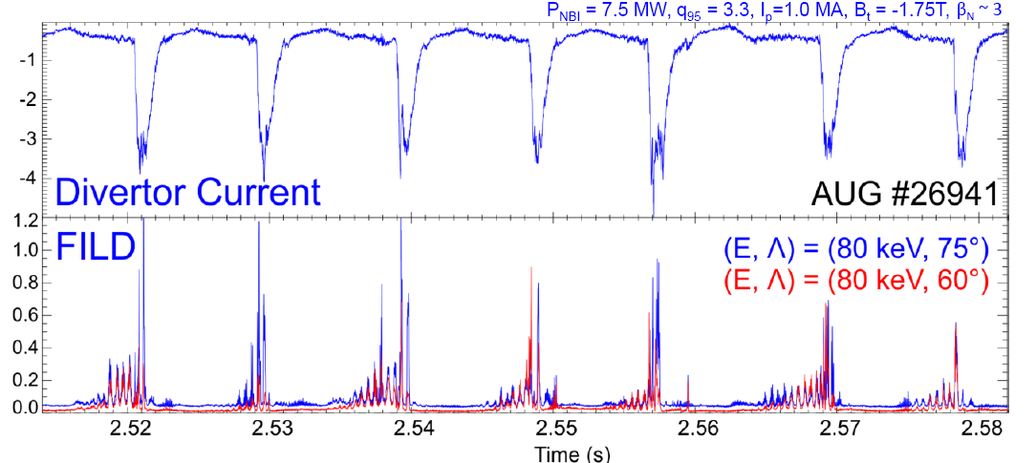
EP loss Induced by ELMs
Frequent, small ELMs are often accompanied by large fluxes of fast-ion losses during and pre-ELM crash.
AUG
Fast-ion losses increasing towards ELM crash
Deeply trapped particles are more strongly affected.
M. Garcia-Munoz ，12th IAEA TM on EPs Austin, Texas USA （2011），O-11

Slide 6
Large EP transport by ALE
Massive migrations of energetic beam ions due to ALE
Multi-mode nature
Nonlinearly driven magnetic reconnection
Bierwage, et al nature communications 3282 （2018）

Slide 7
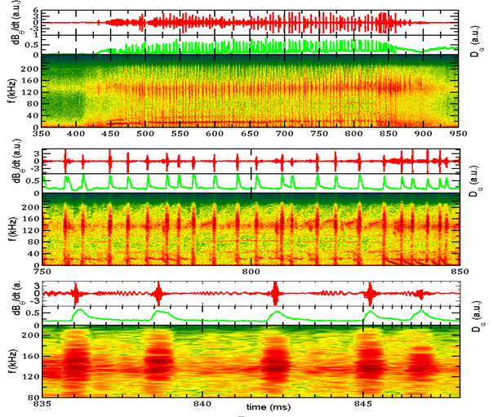
Typical H-mode discharge and ELM precursor on HL-2A
type2
type1
ELM
type3
At least, there are three type high-frequency coherent modes during inter-ELM period.

Slide 8
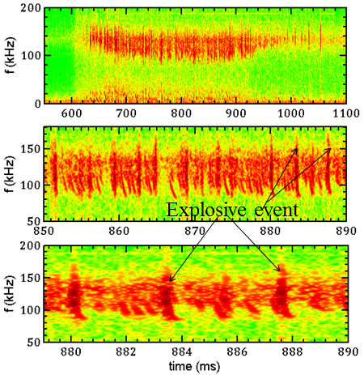
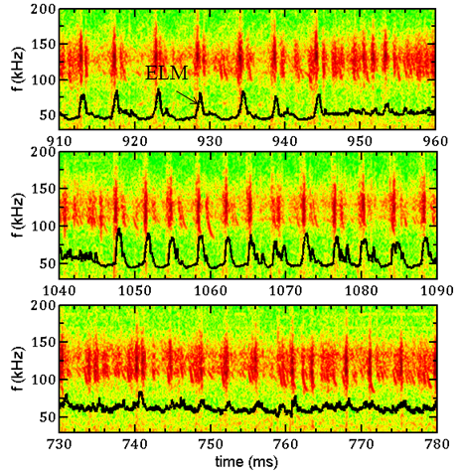
TAE evolution and ELM-crash
The pitch-fork（chaotic state）grows explosively and becomes an explosive instability.
Mode Evolution Links with the ELM-onset.

Slide 9
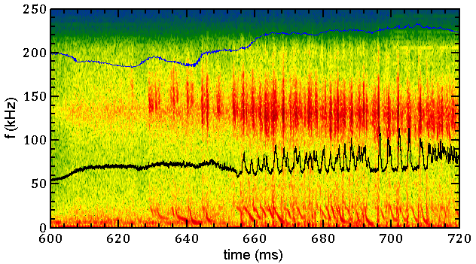
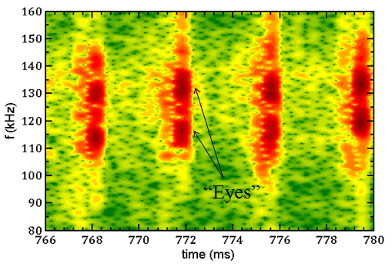
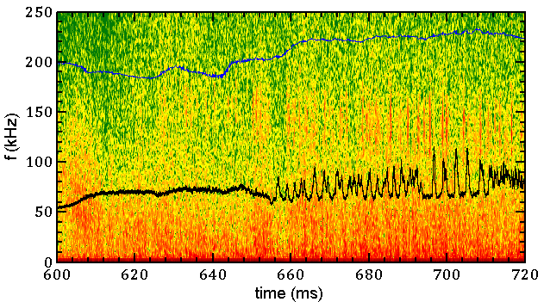
Mode Frequency versus Alfven velocity
Mirnov
The center frequency of large amplitude fluctuation depends on Alfven velocity.
100*ne
Micro. interferometer

Slide 10
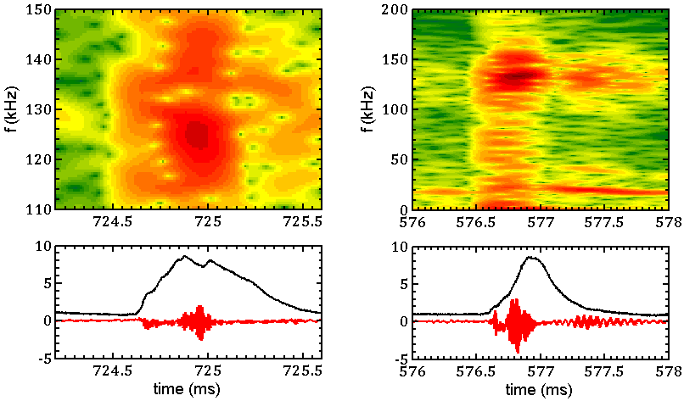
Pitch-fork and Nonlinear Mode Coupling
The nonlinear mode coupling and pitch-fork can trigger the onset of ELMs.

Slide 11
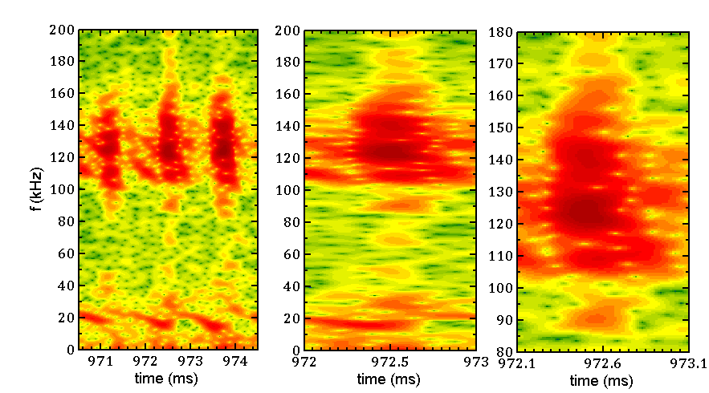
Nonlinear Mode Coupling and Pitch-fork
Pitch-fork
n=1
NMC
The explosive events have two kind fine structures, i.e., multi-modes and pitch-fork. The two kind structures can coexist, but the strong NMC induces that the pitch-fork weakens or vanishes (the NMC may redistribute energetic-ions and destroy hole-clump pairs in the phase-space).

Slide 12
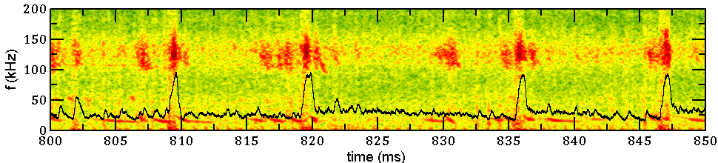
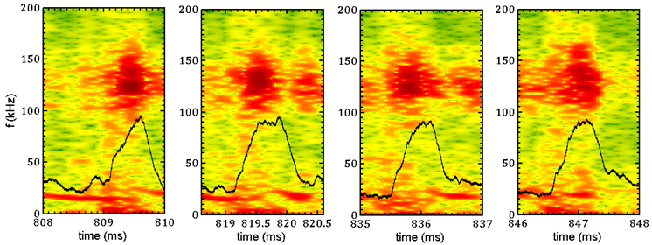
Pedestal Collapse Triggered by Nonlinear Mode Coupling
ELM
n=1
The nonlinear mode coupling triggers the onset of ELMs.

Slide 13
Pedestal Collapse Triggered by Nonlinear Mode Coupling

Slide 14
Related nonlinear dynamics affect the ELM features

Slide 15
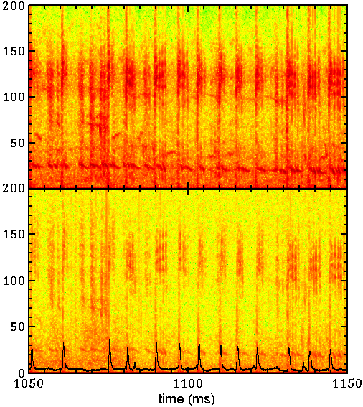
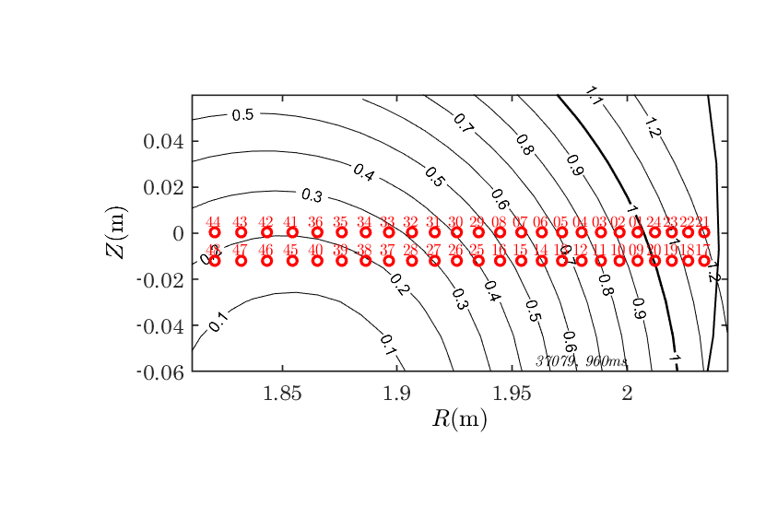
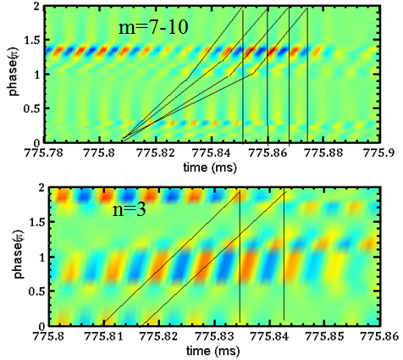
Localized position of TAE
BES arrangement
Mirnov
BES

Slide 16
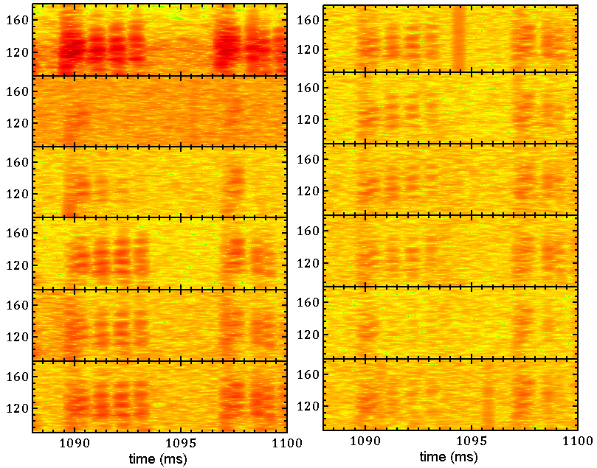
Localized position of TAE (details)
mpol | 16
18 | 26
20 | 28
10 | 38
12 | 40
14 | 46

Slide 17
TAEs
f_{lab}=(100+3*10)=130kHz

Slide 18

Explosive instability
  The amplitude evolution equations （3-wave mixing） are given by
B. Coppi, et al, Annals of Physics, 55 (1969), 207
with m, n, l = {1, 2, 3} and by assumption m, n and l are all different.
if {δ₁, δ₂, δ₃} all have the same sign, then A₁,A₂,A₃ can all blow up at the same time, everywhere in space. This is called the explosive instability, appropriately describing the waves blowing up everywhere to infinity in finite time (as (τ − τ₀)⁻¹).
The general solution of the equation can be written:
where {τ₀, θ₁, θ₂, β₁, β₂, γ} are 6 free real-valued constants, and β₁ +β₂ +β₃ = 0. Note how every nontrivial solution of the ODEs near τ = τ₀ blows up at τ = τ₀. Due to 4-wave mixing, an explosive instability can also exist.
Harvey Segur, Analysis and Applications, Vol. 6, No. 4 (2008) 413.

Slide 19
Physical interpretation of blow-up
In finite-time blow-up, both of these model assumptions break down as τ → τ₀, and strongly nonlinear interactions must be taken into account. The outcome of the explosive instability can be wave breaking or structure formation. The additional information can be obtained from the model before it breaks down completely. For example, it can reveal that significant energy is transferred into the wave modes from a background source (pump wave, shear flows, etc.).
Harvey Segur, Analysis and Applications, Vol. 6, No. 4 (2008) 413.
EXPLOSIVE INSTABILITY DUE TO 3-WAVE OR 4-WAVE MIXING, WITH OR WITHOUT DISSIPATION

Slide 20

Explosive solution from of BB model
Its solution can exhibit self-similar behavior with a blowup in a finite time. When blowup occurs, the mode saturates due to plateau formation arising from particle trapping in the wave.
H. L. Berk, B. N. Breizman, and M. Pekker, PRL, 76, 1256, (1996)
M. K. Lilley, B. N. Breizman, and S. E. Sharapov, PRL 102, 195003 (2009)
B. N. Breizman, et al, PoP 4, 1559, (1997)

Slide 21
Explosive solution from of BB model
While the diffusion or collision decreasing, or friction(drag) increasing, the mode moves from steady-state to explosive regime.

Slide 22
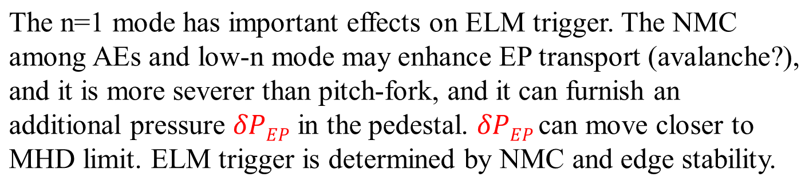
Possible interpretation of ELM trigger & pedestal collapse
P=P_{th}+δP_{th}+δP_{EP}
Toroidal coupling:
m/n->m±1/n =>m/n=1/1, 2/1, 3/1, 4/1=>core-edge coupling;
long-distance ballistic transport;
Nonlinear mode coupling:
Low-frequency n=1 mode+High-frequency AE=>Explosive instability/avalanche transport=>ELM trigger & pedestal collapse.

Slide 23
Summary
The nonlinear dynamics of TAEs, including nonlinear wave-particle and wave-wave interactions, have been observed in HL-2A NBI H-mode plasmas. It is found and identified firstly that the TAE nonlinear dynamics triggers the onset of ELMs and pedestal collapse within several hundred Alfvén times, and they are correlated to the irregular ELM features.
These findings can help to understand the triggering mechanism of an ELM event. Moreover, following the continuous appearances of rich nonlinear dynamics phenomena, more attentions should be paid to understand the underlying mechanisms, as experimental verification of numerical simulations and analytical theory, that are developed for the predictive ability for future burning plasma scenarios.

Slide 24
Thank you for your attention!
Your advice and criticism are welcome.
Email: chenw@swip.ac.cn

Slide 25
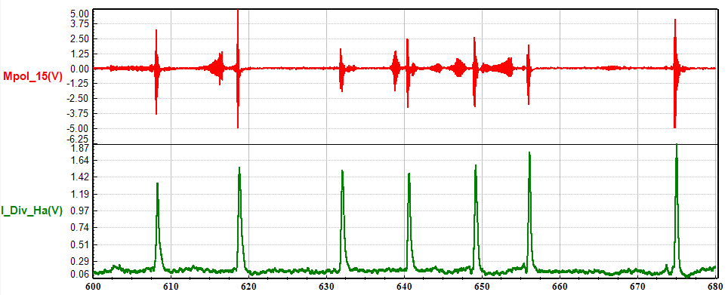
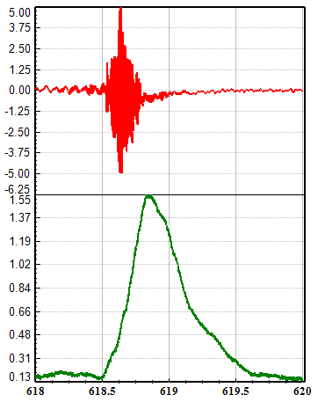
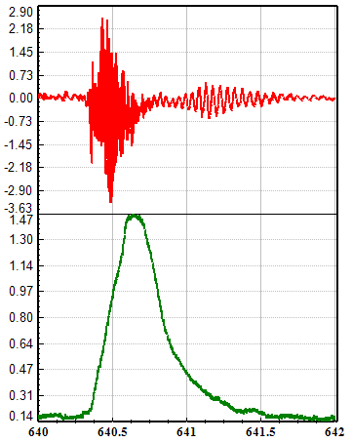
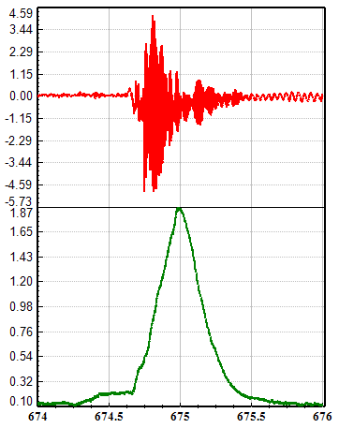

Slide 26
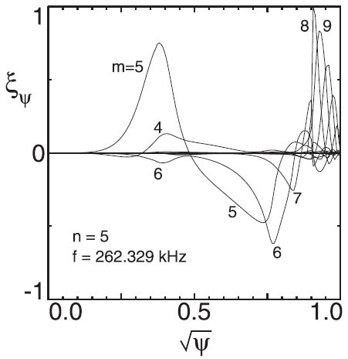
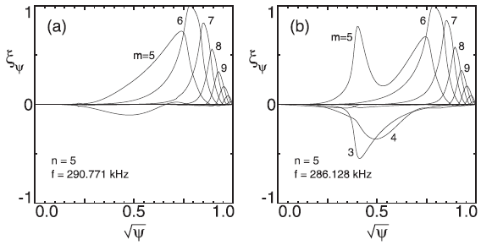
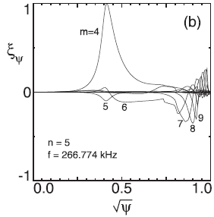
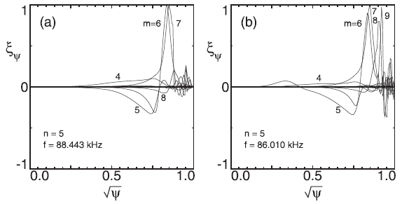
AEs in the outer region
ASEs in the outer region
C. Z. Cheng, Phys. Plasmas 26, 082508 (2019);

Slide 27
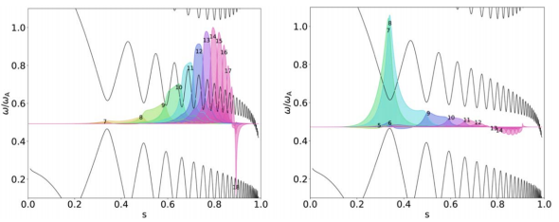
AEs in the outer region
n=8, CASTOR-K code
F Nabais et al 2019 Plasma Phys. Control. Fusion 61 084008

