Slide 1
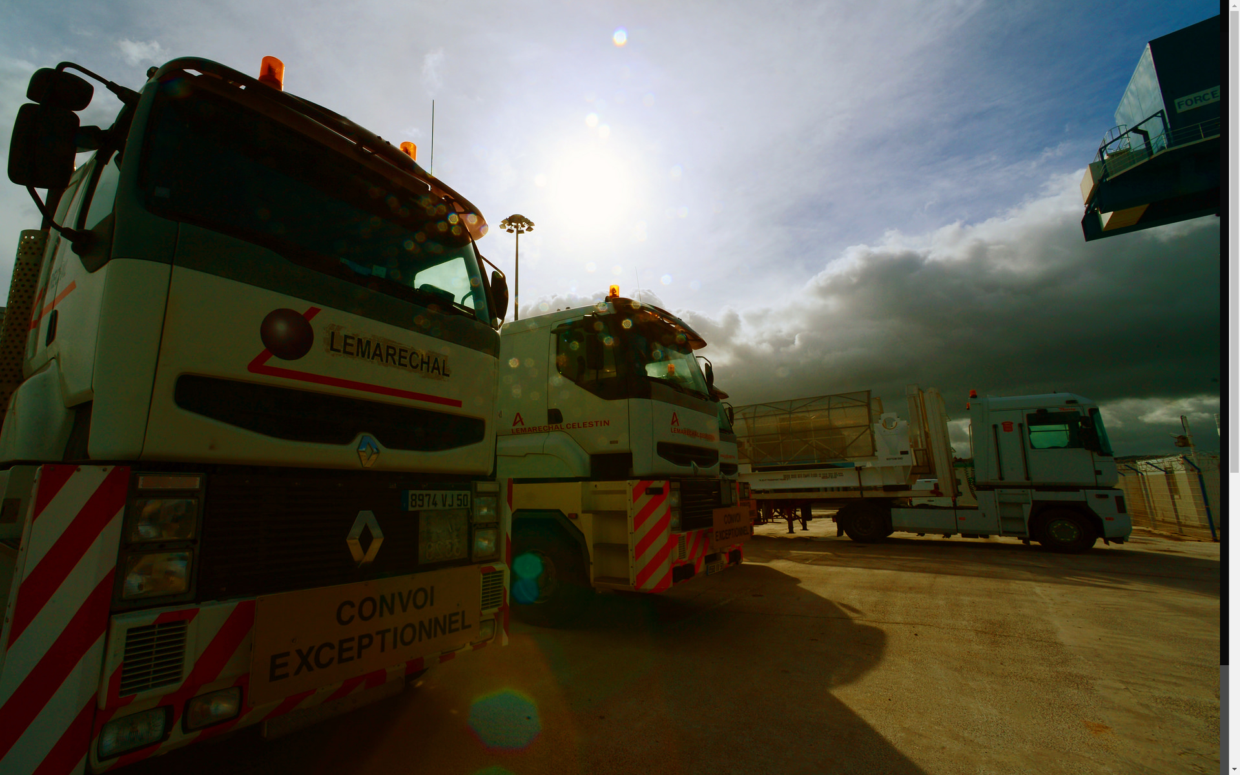
Interactive Content Presentation
for the
International Conference on Nuclear Security 2020
IAEA-NSNS (ICONS2020@iaea.org)
The aim of this guide is to provide an example to ICP presenters who are not familiar with this format. This is to be taken as an example and the structure is not mandatory for CN278
The Conference Team is available for further advice upon request at ICONS2020@iaea.org
1/3
Starting Point
Presenting in more detail
Zooming in
Navigation

Slide 2
Interactive Content Presentation
for the
International Conference on Nuclear Security 2020
IAEA-NSNS (ICONS2020@iaea.org)
An ICP is an Interactive Content Presentation and combines the advantages of both oral and poster presentations. You are less restricted in putting information beyond your presentation time-slot on your presentation slides, have the chance to provide a wider variety of content (video, links, graphs, etc.), and can interact with your audience in a less formal setting.
2/3
Starting Point
Presenting in more detail
Zooming in
Navigation

Slide 3
Interactive Content Presentation
for the
International Conference on Nuclear Security 2020
IAEA-NSNS (ICONS2020@iaea.org)
The ICPs are planned to be presented as part of related sessions during the Conference. They will take place outside the Session rooms on several touch screens. Participants will gather around the screen while the author presents. This is hoped to provide participants with the opportunity to interact with each other over commonly interested topics in a less formal setting.
3/3
Starting Point
Presenting in more detail
Zooming in
Navigation

Slide 4
Interactive Content Presentation
for the
International Conference on Nuclear Security 2020
IAEA-NSNS (ICONS2020@iaea.org)
The great advantage of the ICP is that a user does not have to go through your presentation from beginning to end, but can focus on the parts that he or she finds more interesting. This is especially applicable when it is made available on the Conference Website or Conference app. Properly organizing your ICP is therefore of prime importance. Please click the boxes below to see suggestions for creating an ICP.
Please click on the highlighted boxes.
Starting Point
Presenting in more detail
Zooming in
Navigation

Slide 5
Interactive Content Presentation
for the
International Conference on Nuclear Security 2020
IAEA-NSNS (ICONS2020@iaea.org)
You can start with a simple main page, containing the title, authors, an introductory text, and an overview of the presentation, like this ICP.
Starting Point
Presenting in more detail
Zooming in
Navigation

Slide 6
Interactive Content Presentation
for the
International Conference on Nuclear Security 2020
IAEA-NSNS (ICONS2020@iaea.org)
Clicking on links shows more information on a particular subject.
Within each subject, there is the possibility to go further into depth, in this case by going through the results of the different iterations of the modelling.
Starting Point
Presenting in more detail
Zooming in
Navigation

Slide 7
Interactive Content Presentation
for the
International Conference on Nuclear Security 2020
IAEA-NSNS (ICONS2020@iaea.org)
Individual Figures can be enlarged by Selecting the figure
Click on the boxes inside the red outlines
to discover more information
Starting Point
Presenting in more detail
Zooming in
Navigation

Slide 8
Interactive Content Presentation
for the
International Conference on Nuclear Security 2020
IAEA-NSNS (ICONS2020@iaea.org)
You can continue to add more links to further explore a specific subject.
Click within the red box
Starting Point
Presenting in more detail
Zooming in
Navigation

Slide 9
Interactive Content Presentation
for the
International Conference on Nuclear Security 2020
IAEA-NSNS (ICONS2020@iaea.org)
You can continue to add more links to further explore a specific subject.
Starting Point
Presenting in more detail
Zooming in
Navigation

Slide 10
Interactive Content Presentation
for the
International Conference on Nuclear Security 2020
IAEA-NSNS (ICONS2020@iaea.org)
Nuclear medicine techniques create images of functional processes by using radioactive tracers and photon detectors. An increasing number of systems are being installed by Member States, thus making capacity building a learning priority for many nuclear medicine and imaging departments
Starting Point
Presenting in more detail
Zooming in
Navigation

Slide 11
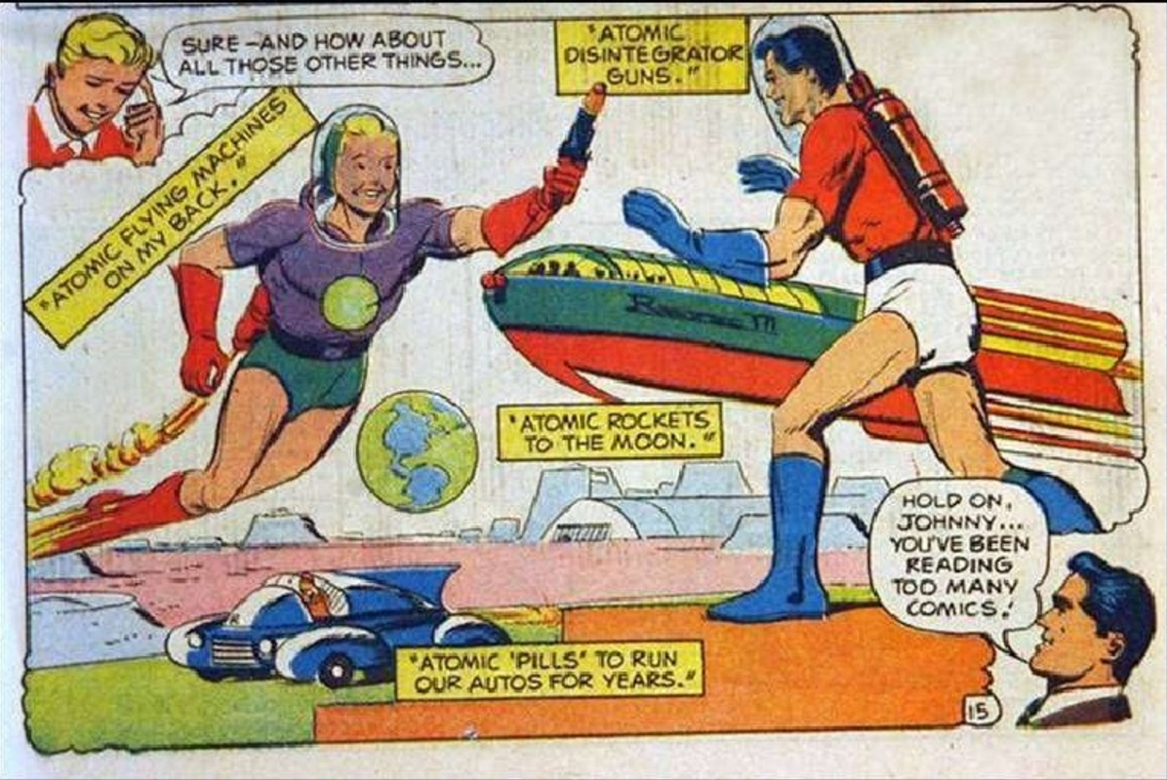
Interactive Content Presentation
for the
International Conference on Nuclear Security 2020
IAEA-NSNS (ICONS2020@iaea.org)
The future of nuclear power will be greatly impacted by technological innovation - the development of new reactor and fuel cycle technologies. As might be expected, current nuclear R&D projects are focused on enhancing nuclear safety, reducing proliferation risks, minimizing waste generation and improving economic performance.
Starting Point
Presenting in more detail
Zooming in
Navigation

Slide 12
Interactive Content Presentation
for the
International Conference on Nuclear Security 2020
IAEA-NSNS (ICONS2020@iaea.org)
Pop-ups can contain links of their own. And can link to more detailed information or even websites
More Information
Starting Point
Presenting in more detail
Zooming in
Navigation

Slide 13
International Conference on the Security of Radioactive Material: The Way Forward for Prevention and Detection
Pop-ups can contain links of their own, and can link to documents,
videos or even websites
More Information
Starting Point
Presenting in more detail
Zooming in
Navigation

Slide 14
Navigating in your presentation
Consider using ‘X’ buttons to close windows, or Home buttons to take you back to the start. These should be obvious, easy to reach and clearly visible.
These options allow you to navigate through the whole presentation in any order and with as much detail as you like.
Starting Point
Presenting in more detail
Zooming in
Navigation

