Slide 1
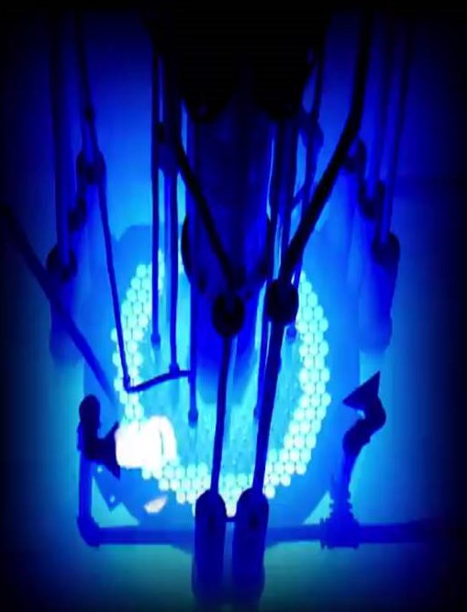
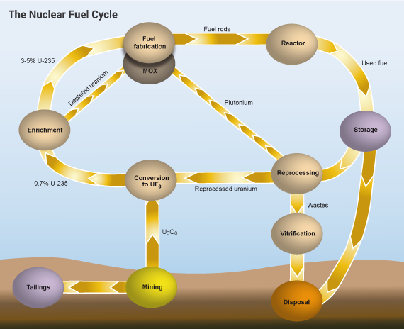
SAFEGUARDS APPROACHES OF THE SPENT NUCLEAR FUEL: THE ROUTE TO DETECT PARTIAL AND GROSS DEFECTS
S.E. Shaban ^{a*}, R.A. EL-Tayebany ª, M.H. Hazzaa ª
ª Nuclear Safeguards and Physical Protection Department, Nuclear and Radiological Regulatory Authority, P. O. Box 11762, Cairo, Egypt
*Email: smh_elsaid@yahoo.com
ID: IAEA-CN272-121
ABSTRACT
A characteristic blue Cherenkov light is emitted in the water surrounding the fuel assembly when spent nuclear fuel is stored in water. Gamma radiation that outcomes from fission products interact with electrons in the water leading to the creation of Cherenkov light as electromagnetic shock fronts from the electrons moving faster than light through the water. The amount of Cherenkov light can be estimated to characterize the fuel in a storage pool.
Spent Nuclear Fuel (SNF) has signatures such as physical signature, gamma radiation, Cherenkov radiation, neutron radiation, and combined radiation.
Nuclear Material Accountancy (NMA) verification objectives are to detect gross defects like missing a spent fuel assembly also to verify the identity of SNF to ensure that a spent fuel assembly is the assembly that declared by the facility operator another verification objective is to detect partial defects like verification of the integrity of SNF object.
The Containment and surveillance (C/S) verification objectives are to verify continuity of knowledge over SNF assemblies and to verify no use or production of undeclared nuclear material.
Design Verification objectives are to verify facility design (no new unsafeguarded SNF transfer paths).
Eventually, nuclear abuse scenarios are suggested and the role of any robust accounting system in safeguarding SNF was discussed to stand up to these concealment tricks.
OUTCOME
Digital Cherenkov Viewing Device (DCVD) is a valid tool approved by the Agency to verify the nuclear fuel within case of gross and partial defects.
NMA verification objectives, (C/S) verification objectives and Design Verification objectives are essential to counter abuse in NM and activities within facilities.
BACKGROUND
Nuclear Fuel Cycle (NFC) consists of two ultimate parts the first part is called "front end" while the other is named "back end". The back end of the NFC involves managing the spent fuel after irradiation.
IAEA executes safeguards system on sates under the non-proliferation umbrella. This system ensures not only nuclear material (NM) but also the activities within facilities are subject to supervised criteria.
The characteristics of NSF are two types: physical and operational characteristics. Physical characteristics such as fuel material, initial enrichment, cladding material, cladding diameter, cladding thickness, pellet diameter, pellet height, and assembly array. Irradiation history, burn up, initial enrichment and cooling time are the main parameters that give us a view on the reactor operations.
The SSAC has national and international objectives. SSAC has a vital role in detecting and responding to any trial to misuse or divert nuclear materials or facility.
FIG. 2. View of blue Cherenkov light
CONCLUSION
Safeguards tools are effective to counter any misuse of material or activities involving nuclear material within facilities.
The state system responsible for accounting and controlling nuclear material is the technical tool for the practical execution of nuclear safeguards.
Spent fuel is a strategic component of the back end nuclear fuel cycle.
SNF characteristics and signatures give the most effective information on NMA.
Proposing scenarios for misuse and diversion by SSAC lead to well established and robust safeguards system.
ACKNOWLEDGEMENTS / REFERENCES
[1] GREGORY, C., CHRISTIAN, E., Radiochemistry and Nuclear Chemistry, Fourth Edition. (2013).
[2] BYUNG, N., ENRICO S., Organization for economic cooperation and development/Nuclear Energy Agency international benchmark on the VENUS-2 MOX core measurements. Nuclear science and engineering 142.1 (2002) 37-47.
[3] BODANSKY, D., Nuclear Fuel Cycle. Nuclear Energy: Principles, Practices, and Prospects. (2005) 193-229.
[4] WORLD NUCLEAR ASSOCIATION, Nuclear Fuel Cycle,
http://www.world-nuclear.org/information-library/nuclear-fuel-cycle/introduction/nuclear-fuel-cycle-overview.aspx
[5] U.S. Department of Energy, Nuclear Power Generation and Fuel Cycle Report, Energy Information Administration Report DOE/EIA-0436(97) (Washington, DC: U.S. DOE), 1997.
[6] BLACK, J., FLECK, D., Nuclear Non-proliferation in International Law. Asser Press, (2016).
[7] The structure and content of agreements between the Agency and states required in connection with the Treaty on the Non-Proliferation of nuclear weapons, INFCIRC153., IAEA, Vienna (1972).
[8] Treaty on The Non-proliferation of Nuclear Weapons, INFCIRC 140., IAEA, Vienna (1970).
[9] JAEA, Japan Atomic Energy Agency,
https://www.jaea.go.jp/english/.
[10] IAEA, Guidance for States Implementing Comprehensive Safeguards Agreements and Additional Protocols. service series 21 (updated).(2014).
[11] IAEA, Nuclear Material Accounting. services series 15.(2008).
[12] GAVRON, A., Non destructive assay techniques applied to nuclear materials. (2001).
[13] IAEA, Safeguards Techniques and Equipment. (2011).
[14] ERIK, B., Studies of Cherenkov Light Production in Irradiated Nuclear Fuel Assemblies, Uppsala University. (2016).
[15] KARL J., Characteristics of spent nuclear fuel. Oak Ridge National Laboratory, April (1988).
[16] TEXAS University, The Nuclear Security & Safeguards Education Portal (NSSEP),
https://nsspi.tamu.edu/nssep/
[17] TARVAINEN, M., NDA techniques for spent fuel verification and radiation monitoring, Report on activities 6a and 6b of Task JNT C799 (SAGOR), Finnish support programme to the IAEA safeguards, Finnish Centre for Radiation and Nuclear Safety, 1997.‏
[18] IAEA, Guidelines for States' Systems of Accounting for and Control of Nuclear Materials. SG/INF/2,(1980).‏
FIG. 1.The stages of nuclear fuel cycle.
CHALLENGES / METHODS / IMPLEMENTATION
Nuclear material consists of two fundamental categories: one is called "bulk material" and the other named "item material". Bulk material can exist in different shapes such as powders, solutions…etc. whereas the second type may be fuel rods. Nuclear materials include special fissile materials and source materials.
Verification of nuclear materials is a fundamental principle of the safeguards regime. Safeguards inspections are performed by international inspectorates.
NDA is to conduct measurements on nuclear materials without prejudice to their physical or chemical state. This type of measurement depends on the measurement of emission from the sample to be measured. An example of NDA is gamma ray measurements.
Destructive analysis is measurements in which the physical form of the sample is normally destructed. UV spectrophotometer, Inductively coupled plasma optical emission spectrometer, mass spectrometer, auto titrator…et. are examples of DA techniques.

