Slide 1
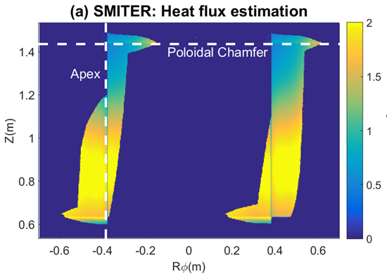
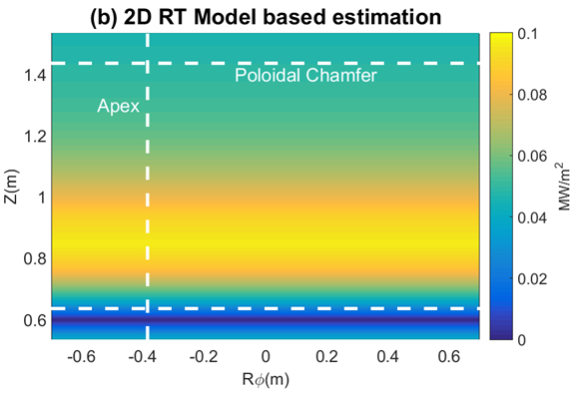
ITER FIRST WALL HEAT FLUX CONTROL DEVELOPMENT
Steady state heat flux on the ITER first wall panels are limited by the heat removal capacity of the water cooling system.
Real-time heat load control mandatory early in plasma operations.
Algorithm combining off-line 3D field line tracing and 2D real-time power flux estimation for the heat load control system.
SMITER incorporated in IMAS
ITER Start-up
Heat Loads
Cross-calibration
using SMITER
Real-time power flux estimation for ITER Plasma Control System
H. Anand et al., Fusion Engineering and Design 137 (2018) 143
H. Anand et al., IAEA FEC Conference (2018) EX/P7-24

