Slide 1
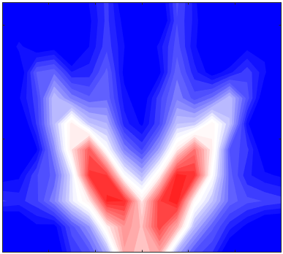
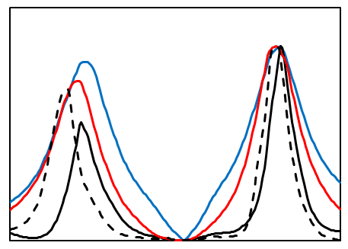
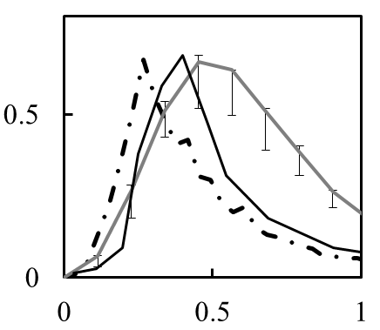
TH/P1-2, N. Kasuya, et al.,
“Numerical Diagnostic to Investigate Poloidal Asymmetry in Three-Dimensional Magnetic Configurations”
Numerical diagnostics to capture turbulence properties in helical plasmas
Synthetic diagnostic
2-D k spectrum of (line-integrated spectrum)
Kasuya, NF 2018
1.0
0.5
0
[A.U.]
(log)
ITG peak:
k ρ_{i} ~ 0.4
f L_{n} / v_{ti} ~ 0.05
Combination of simulations for turbulence (Gyrokinetic model) and diagnostic (Phase contrast imaging), and application of statistical signal processing techniques
effect of 3-D configuration
evaluation of up-down asymmetry
k_{y} ρ_{i}
0.7
-0.4
x: toroidal
y: poloidal
-0.3 0 0.3
k_{x} ρ_{i}
reconstruction by using the pitch angle of the magnetic shear
comparison of vertical profile
comparison of wavenumber spectrum
Exp
ρ ＝ 0.65
1
original
S
exp LS
sPCI
fluctuation amp. [A.U.]
exp LS + MEM
Quantitative comparison of fluctuation spectra with limited spatial resolutions is possible
0.5
MEM
0
-0.8
0
0.8
vertical position [m]
k ρ_{i}
Notes:
Complicated configurations make it difficult to capture the entire structures of fluctuations in helical plasmas, so 3-D turbulence simulations are necessary for understanding the characteristic features. In this research, the numerical diagnostics in LHD ahs been carried out by combining the gyrokinetic simulation in the real 3-D geometry with the GKV-X code and synthetic diagnostic of PCI with application of statistical signal processing techniques to give numerical observation signals.
Three factors to induce the poloidal asymmetry have been evaluated; 3-D magnetic configuration with the realistic line of sight, effect of signal processing techniques, and inherent inhomogeneity of the turbulence itself. The up-down asymmetry is rather weak for the ITG simulation as in the high-T_{i} regime in the experiments, when the ITG instabilities are dominant.
The quantitative evaluations represent a guideline for comparison of observed signals from experiments and simulations.

