Slide 1
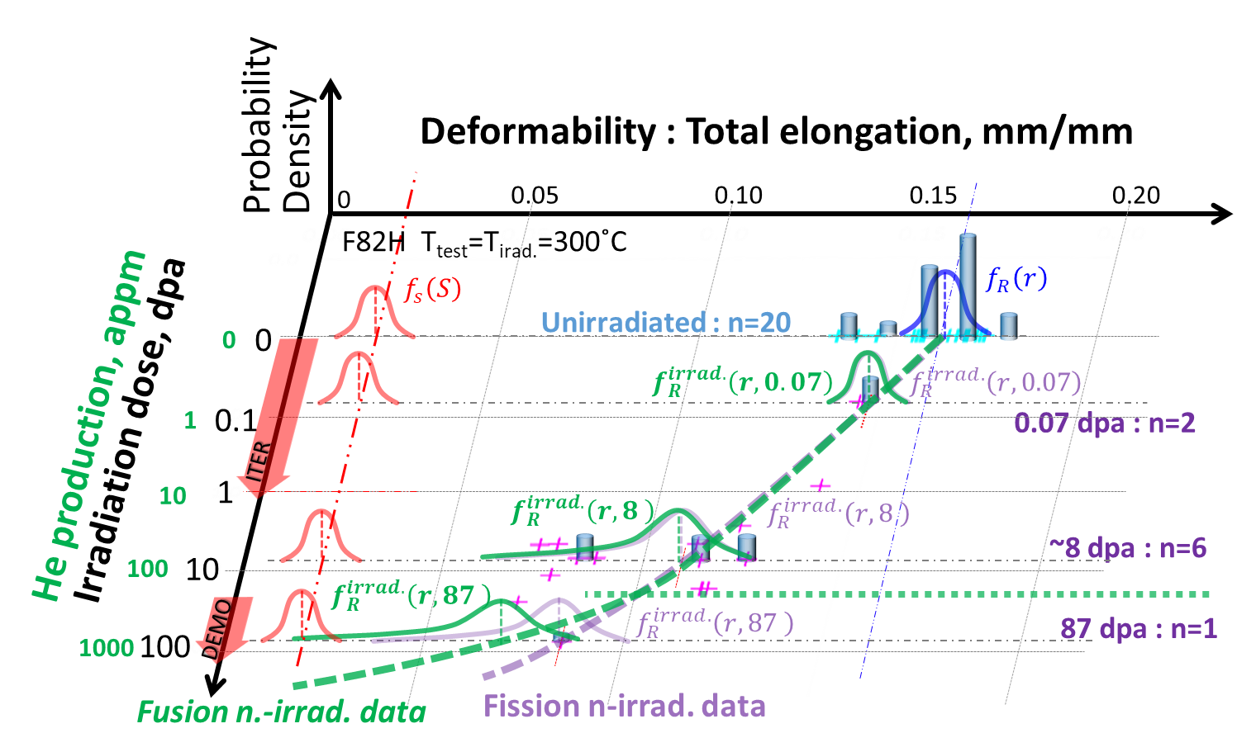
OV/3-4
The Strategy of Fusion DEMO In-vessel Structural Material Development
Hiroyasu TANIGAWA,
E. DIEGELE, Y. KATOH, T. NOZAWA, T. HIROSE, M. GORLEY,H. SAKASEGAWA, E. GAGANIDZE, J. AKTAA, G. PINTSUK
A new strategy based on probability based design method was proposed to mitigate the difficulty to define the allowable limit for irradiation induced degradation without enough "empirical” evidence.
Probability of fracture after irradiation up to D dpa can be calculated by integrating probability functions,
$$P^{irrad.}\left(D\right)=\int_{0}^{∞}{f_{S}\left(s\right)\left[\int_{0}^{s}{f_{R}^{irrad.}\left(r,D\right)dr}\right]ds}$$
Fusion n irrad. data distribution could be estimated by updating fission n irrad. based probability function by Bayesian inference, which compromise the limitation of data size.
the critical condition
${Fusion f}_{R}^{irrad.}\left(r,D\right)$
$∝f_{R}^{irrad.}\left(r^{new},D\right)∙{Fission f}_{R}^{irrad.}\left(r,D\right)$
It is essential to accumulate a reasonable amount of fission n irradiation data to estimate the probability density function.

