Slide 1
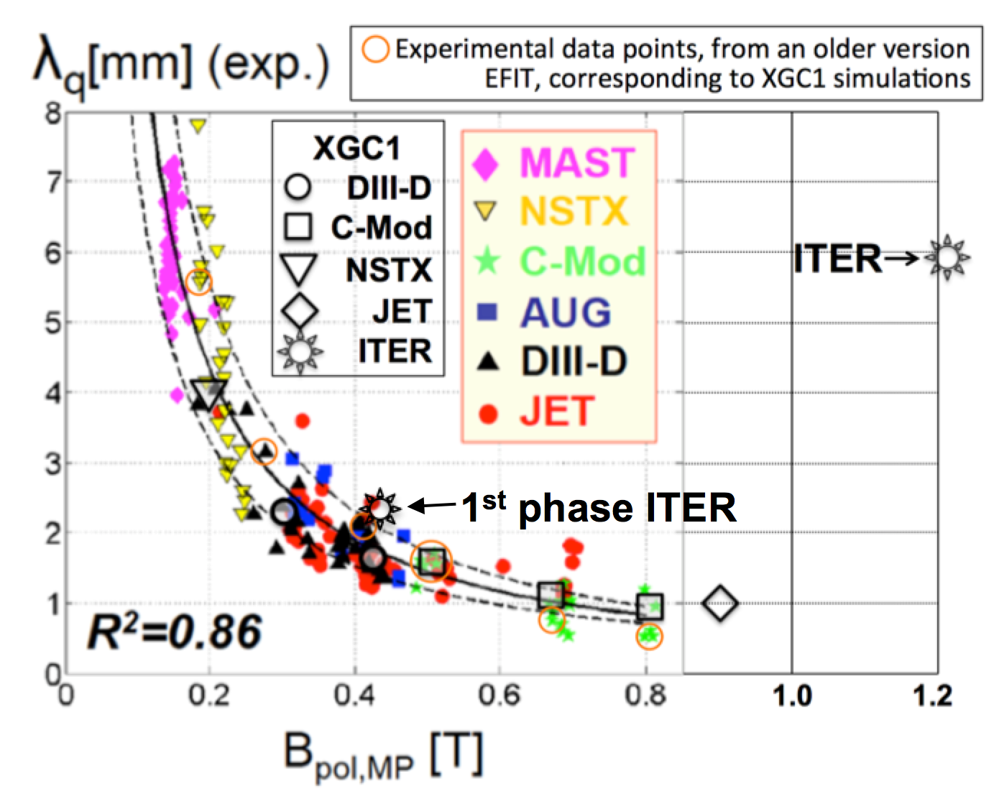
TH/P7-22
Wide divertor heat-flux width λ_{q} in ITER from turbulence bifurcation across separatrix C-S Chang et al.
XGC predictions for λ_{q} has been well-validated against representative DIII-D, C-Mod, NSTX, and JET data: neoclassical effect is dominant
The same XGC predicts 6X greater λ_{q} in full-current (15MA) ITER than extrapolation (λ_{q}^{Eich}) from present tokamaks:
turbulence effect is dominant in 15MA ITER
λ_{q} on 1st phase ITER at 5MA agrees with λ_{q}^{Eich}
→ Wider λ_{q}^{ITER}(15MA) is not a pure size effect, but a ρ_{i}/a effect.
Turbulence across separatrix bifurcates from JET(4.5MA) to ITER(15MA)
from “blobs” to “streamers,” and
from high to low ExB shearing rate.
Strong “streamer transport” is seen across separatrix in ITER(15MA) → wider λ_{q}
Full I_{P}
Bifurcation
JET high I_{P}

