Slide 1
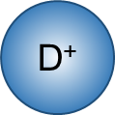
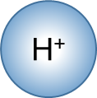
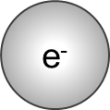
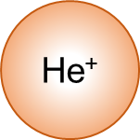
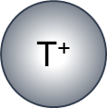
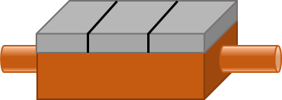
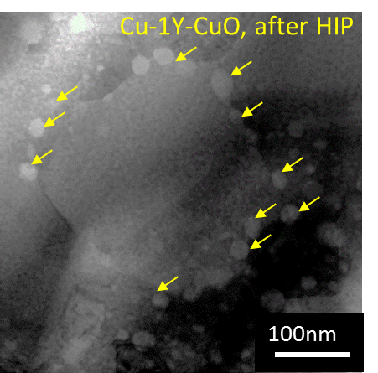
Improvement of Cu Alloys as Divertor Heat Sink Material
Example Design for Divortor
(Oxide) Dispersion Strengthening method
Armor Materials
Dislocation
Stable Nano-oxide particles in matrix
Suppression of dislocation motion
Improvement of the strength and resistance to irradiation
Pipe
Dispersed
particles
Matrix
(Cu)
Heat Sink Materials
μm
Application of Dispersion Strengthening by Mechanical Alloying (MA) and Hot Isostatic Press (HIP) to Copper Alloys
1.Effect of oxygen concentration for Cu-Al and Cu-Zr
2.n-situ fabrication of Cu-Y₂O₃ alloy
The increase in oxygen concentration improved mechanical properties
A new process, addition of oxidant(CuO) during the MA, increased the density of oxide particles.

