Slide 1


Pitch Angle Dynamics and Synchrotron Emission of Runaway Electrons in
Quiescent and Disrupted DIII-D Plasmas
D. del-Castillo-Negrete, L. Carbajal, M. Cianciosa¹
C. Paz-Soldan²
E. Hollmann, R.A. Moyer³
C. J. Lasnier⁴
1 Oak Ridge National Laboratory
^{2 General Atomics}
3 University of California, San Diego
4 Lawrence Livermore National Laboratory
Presented at
IAEA Fusion Energy Conference
Ahmedabad, India
October 25th, 2018

Slide 2
Introduction
There is a pressing need to develop modeling and simulation tools with predictive capabilities for the avoidance, mitigation, and dissipation of runaway electrons (RE).
Synchrotron emission (SE) measurements and simulations play a key role in model validation.
We present a numerical study of SE in DIII-D plasmas with emphasis on pitch-angle dynamics and RE energy distributions that significantly depart from current Fokker-Planck models.
We focus on visible SE of quiescent RE, and visible and infrared SE in mid-plateau RE in disrupted plasmas.

Slide 3
There are significant discrepancies between experimentally inferred runaway electron (RE) distribution functions and current theoretical & computational models
[Hollmann, et al. (2015)]
[Paz-Soldan, et al (2017)]
Understanding this is key for the development of a predictive
simulation capability of RE generation, avoidance, and mitigation

Slide 4
Synchrotron emission (SE) is a key diagnostic that can be used to understand these discrepancies.
Different levels of description
Orbit dynamics:
  - Single particle (0D) - Phase space (2D)
  - Guiding center - Full-orbit (6D)
Radiation: curvature and pitch angle dependence
  - Single particle - Drift orbit correction
  - Exact curvature
Synthetic camera: direction and symmetry of emission
  - Cone models - Full-angular dependence
  - 2D (Axisymmetric B fields ) - 3D (islands & stochastic B)

Slide 5
Kinetic Orbit Runaway electron Code (KORC)
KORC computes the full-orbit dynamics of large ensembles of particles in prescribed 3D magnetic and electric fields including radiation damping and collisions.
Synchrotron emission synthetic diagnostic incorporates exact curvature, and direction of emission and camera geometry.
Applicable to non-axisymmetric (3D) B field configurations (islands and stochasticity)
[Carbajal, et al, (2017),
del-Castillo-Negrete et al, (2018) ]
SE synthetic camera

Slide 6
Approximations can compromise the accuracy of SE and lead to underestimate or overestimate RE parameters
P(λ)=Radiation power per particle per wavelength
Trapped-orbit effects
Full-orbit:
3D B fields with islands
trapped
Full-orbit
P(λ)
passing
Approximation
P(λ)
λ
Measured by the camera
“Cone” model
P(λ)
Approximation
Full angular
dependence
λ
[Carbajal, et al, (2017),
del-Castillo-Negrete et al, (2018) ]
λ

Slide 7
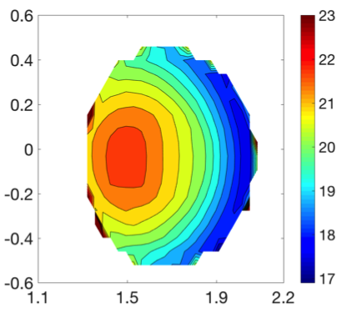
Orbit induced (“collisionless”) pitch angle dispersion
The pitch angle is not a constant of motion and an initial distribution will evolve due to orbit-effects even without pitch angle collisional scattering
RE cross section
An initial mono-pitch distribution
will spread around θ_{o}
An initial spatially uniform pitch distribution with < θ >=20º will “segregate” and become spatially dependent
Z
f(θ)
θ
R
mono-pitch angle and spatially-independent pitch angle distributions
are idealizations inconsistent with orbit dynamics
This collisionless dispersion effect [Carbajal, et al, (2017)] is different
to the colissionless scattering discussed in [Jian et al, (2016)].
,

Slide 8

Modeling of synchrotron emission of quiescent RE (QRE)
Measured SE in DIII-D
Focus on DIII-D quiescent flattop discharge shot # 165826
Our goal is to apply KORC synthetic diagnostic to reproduce the SE in DIII-D
Z
Previous studies [Hoppe et al (2018)] have shown that using the energy distribution from the Fokker-Planck model does not reproduce the observed SE
R
Here we use the energy distribution from a direct fit of the hard-x-ray emission measurements
$f_{ℰ}\left(ℰ\right)= \frac{ℰ^{α−1}}{Γ\left(α\right)β^{α}} exp\left(−\frac{ℰ}{β}\right)$

Slide 9

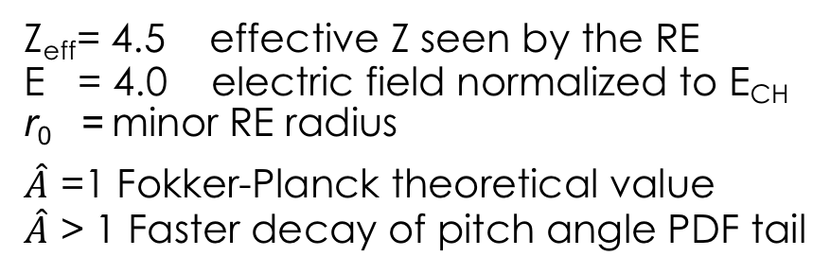


Initial spatial and pitch angle distributions
For the pitch angle distribution we use the model in [Hollmann et al (2015)]
We assume an initial spatially homogeneous toroidal
distribution of RE
$f_{θ}\left(θ;ℰ\right)= \frac{A}{2\sinh{A}} exp\left(A\cos{θ}\right)$
$A=\hat{A}C\left(γ^{2}−1\right)/γ$
$C=2E/(Z_{eff}+1)$.
The model assumes a steady-state equilibration of pitch angle scattering and E field acceleration
Model parameters
Z_{eff}= 4.5 effective Z seen by the RE
E = 4.0 electric field normalized to E_{CH}
r₀ = minor RE radius
$\hat{A}$ =1 Fokker-Planck theoretical value
$\hat{A}$ > 1 Faster decay of pitch angle PDF tail
As expected, the radial drifts
shift the distribution to the low
field side

Slide 10
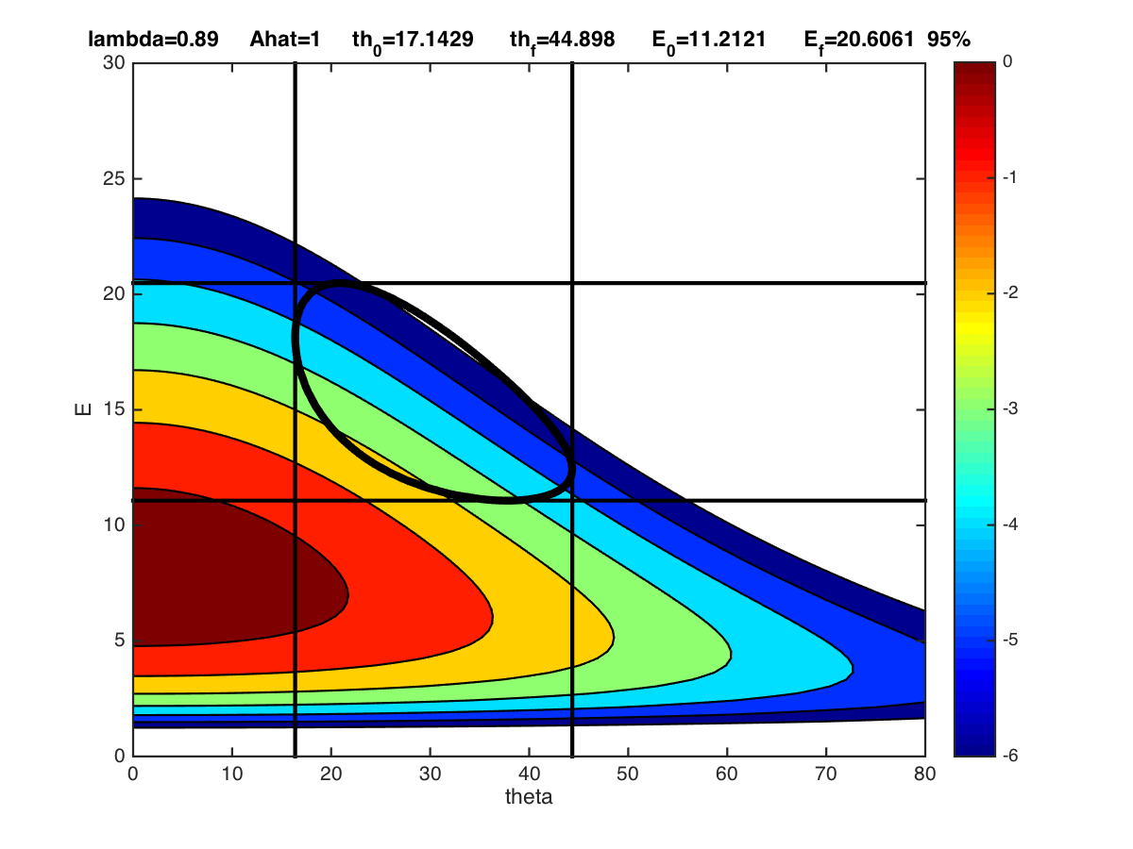
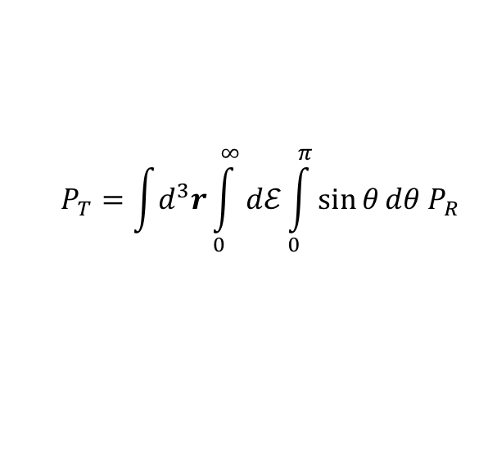

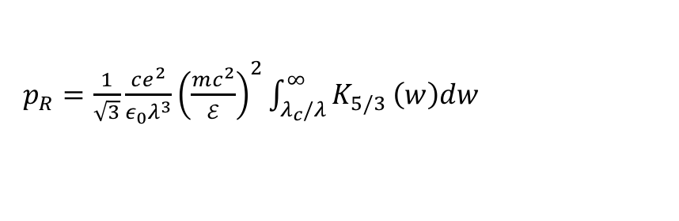
For numerical efficiency limit sampling of RE to region contributing to 95% of the radiation observed by the camera at a given wavelength
.
Total radiation power
0
-1
-2
-3
-4
-5
-6
$$P_{T}=\int{d^{3}r}\int_{0}^{∞}{dℰ}\int_{0}^{π}{\sin{θ}}dθ P_{R}$$
95% of SE at λ=890 nm
Comes from this region
Energy [MeV]
Radiation density
0 5 10 15 20 25 30
${P_{R}=n_{RE}(r,t)f}_{Rℰ}\left(θ,ℰ,t\right) p_{R}\left(θ,ℰ,λ,B_{0}\right)$
RE pdf
$${ f}_{Rℰ}\left(θ,ℰ,t\right)$$
Radiation per particle
$p_{R}=\frac{1}{\sqrt{3}}\frac{ce^{2}}{ε_{0}λ^{3}}{\left(\frac{mc^{2}}{ℰ}\right)}^{2}\int_{λ_{c}/λ}^{∞}{K_{5/3}}\left(w\right)dw$
0º 20º 40º 60º
θ

Slide 11
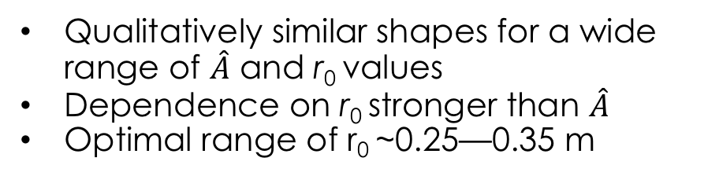
There is agreement between the computed and the measured SE shape for quiescent runaways
Z
Experiment
Z
Simulation
Qualitatively similar shapes for a wide range of $\hat{A}$ and r₀ values
Dependence on r₀ stronger than $\hat{A}$
Optimal range of r₀ ~0.25—0.35 m
R
del-Castillo-Negrete et al, (2018)

Slide 12
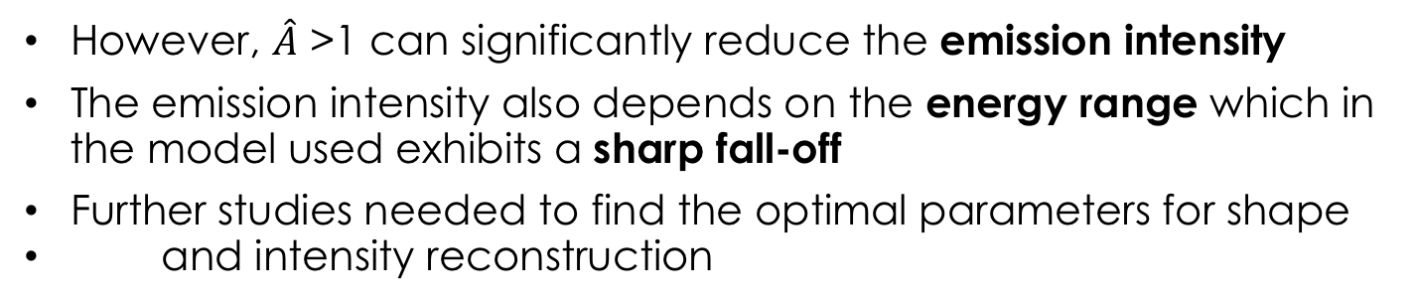
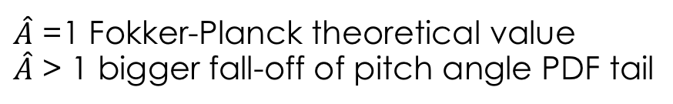

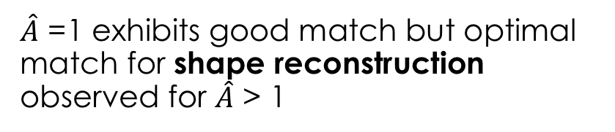


Dependence on pitch angle and energy fall-off
Reconstruction error Δ
large Δ
Fokker-Planck model for pitch angle PDF
$f_{θ}= \frac{A}{2\sinh{A}} exp\left(A\cos{θ}\right)$
$A=\hat{A}C\left(γ^{2}−1\right)/γ$
$\hat{A}$
$\hat{A}$ =1 Fokker-Planck theoretical value
$\hat{A}$ > 1 bigger fall-off of pitch angle PDF tail
$\hat{A}$ =1 exhibits good match but optimal match for shape reconstruction observed for $\hat{A}$ > 1
small Δ
r₀= minor RE radius
However, $\hat{A}$ >1 can significantly reduce the emission intensity
The emission intensity also depends on the energy range which in
the model used exhibits a sharp fall-off
Further studies needed to find the optimal parameters for shape
and intensity reconstruction

Slide 13
Modeling of synchrotron emission of RE in disrupted plasmas (DRE)
Our study of SE of RE in disrupted plasmas
involves comparisons with visible and infrared
cameras as well as visible spectrometers.
Standard RE mid-plateau in DIII-D, I_{P}=270 kA with ~1/3 Ar and ~2/3 D.
This provides a unique opportunity to to test
different ranges of the energy distribution.
Similar to the QRE case, our methodology is
to run KORC simulations using as initial conditions ensembles of RE sampled from the experimentally inferred energy distributions.
For the pitch angle distribution we use the standard Fokker-Planck model.
Layout of diagnostics used in disruptions experiments

Slide 14
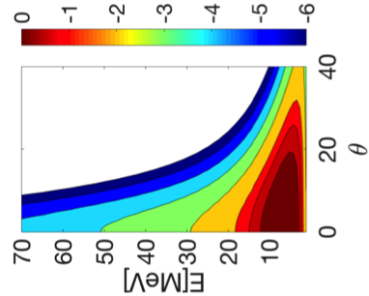
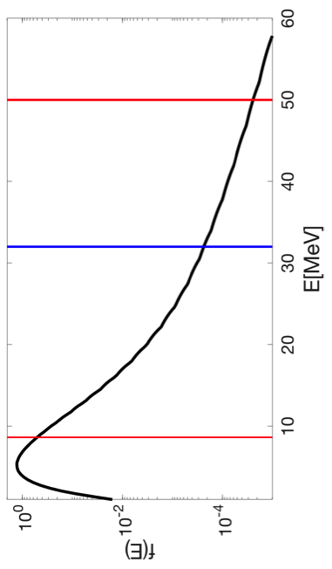



RE distribution function models and sampling box
For the pitch angle distribution we use
$f_{θ}\left(θ;ℰ\right)= \frac{A}{2\sinh{A}} exp\left(A\cos{θ}\right)$
$A=C\left(γ^{2}−1\right)/γ$
$C=2E/(Z_{eff}+1)$.
E=11 E_{CH} Z_{eff} = 5
n_{RE}=4.5 x 10¹⁶ m⁻³
For the energy we use the reconstructed model in [Hollmann et al (2015)]
Visible
λ=890 nm
Infrared
λ=4 μ m
Maximum energy in simulations for VIS = 50 MeV
Maximum energy in simulations for IR = 35 MeV

Slide 15
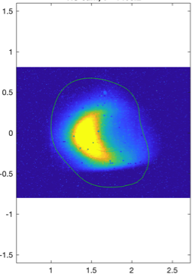
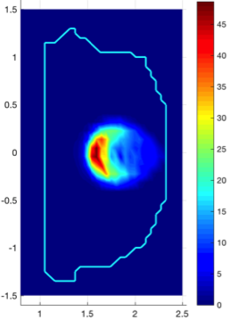
Simulation of Visible (λ=790 nm) Synchrotron Emission
Brightness [10¹³ photons/cm²/s/ster/nm]
Visible spectrum in DIII-D
45
λ=790 nm
100
35
Measured
90
Z
Z
25
70
10¹³ photons/cm²/s/ster/nm
50
15
30
Measured
Simulation
Simulated
5
10
600
700
800
900
R
R
Wavelength [nm]
Maximum RE energy in simulation=50 MeV

Slide 16
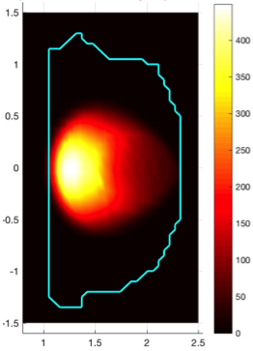
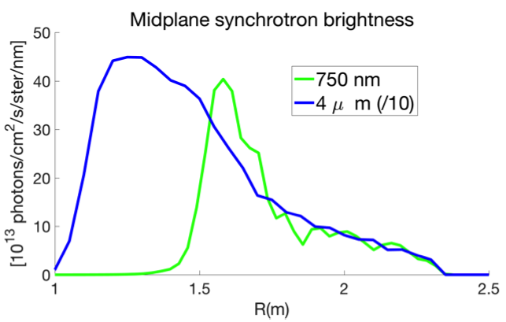
Simulation of Infrared (λ=4 μm) Synchrotron Emission
Brightness (10¹³ photons/cm²/s/ster/nm)
400
Measured
λ=4 μm
1/10
300
Z
Z
200
Blind spot
100
Measured
Simulation
Simulation
R
R
1/10
Maximum RE energy in simulation=35 MeV

Slide 17
Conclusions
We have applied the Kinetic Orbit Runaway electron Code (KORC) to model synchrotron emission (SE) of RE in quiescent (QRE) and disrupted plasmas (DRE) in DIII-D.
KORC SE synthetic diagnostic incorporates the RE full-orbit, emission and camera geometry.
Orbit-induced (collisionless) pitch angle dispersion plays a key role.
For both, QRE and DRE, agreement has been found between measurements and simulations when using RE energy distributions that significantly depart from current Fokker-Planck models.
QRE with pitch angle distributions with faster fall-off rate than Fokker-Planck model also reproduce the radiation shape but underestimate the intensity.

