Slide 1
PPPL Notable 2018:
Reduced energetic particle transport models enable comprehensive
time-dependent tokamak simulations
M. Podestà¹, N.N. Gorelenkov¹, C.S. Collins², W.W. Heidbrink³, L. Bardóczi^{2,4},
V. Duarte¹, G.J. Kramer¹, E.D. Fredrickson¹, M. Gorelenkova¹,
D. Kim¹, D. Liu³, F.M. Poli¹, M.A. Van Zeeland², R.B. White¹
and NSTX-U and DIII-D Teams
¹Princeton Plasma Physics Laboratory, Princeton University, Princeton, NJ USA ²General Atomics, P. O. Box 85608, San Diego, CA USA
³Department of Physics and Astronomy, University of California Irvine, Irvine CA USA ⁴Oak Ridge Associated Universities, Oak Ridge, TN USA
2018 IAEA Fusion Energy Conference
Ahmedabad, Gujarat, India
October 22 – 27, 2018
Work supported by the U.S. Department of Energy, Office of Science, Office of Fusion Energy Sciences under contract numbers DE-AC02-09CH11466 and DE-FC02-04ER54698.
NSTX-U at Princeton Plasma Physics Laboratory and DIII-D at General Atomics are DOE Office of Science User Facilities

Slide 2
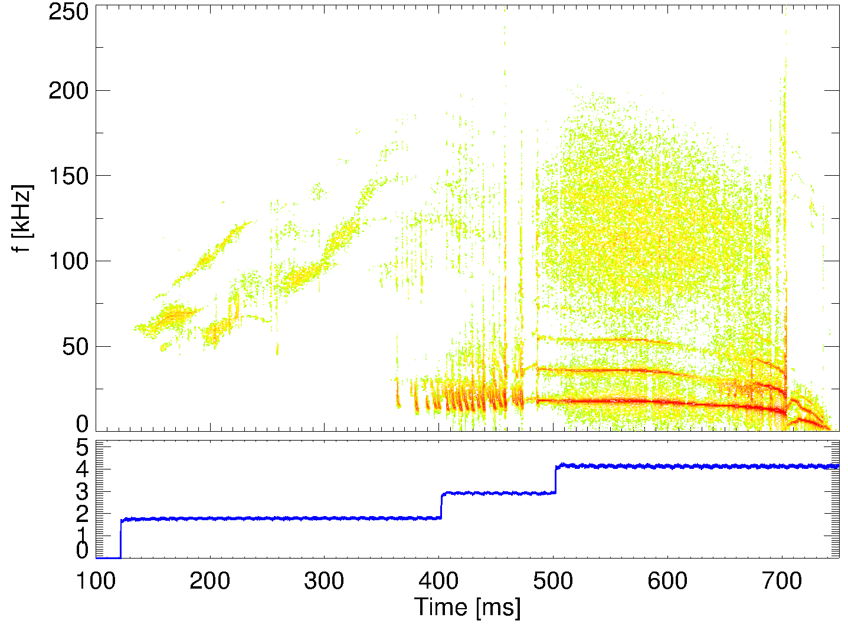
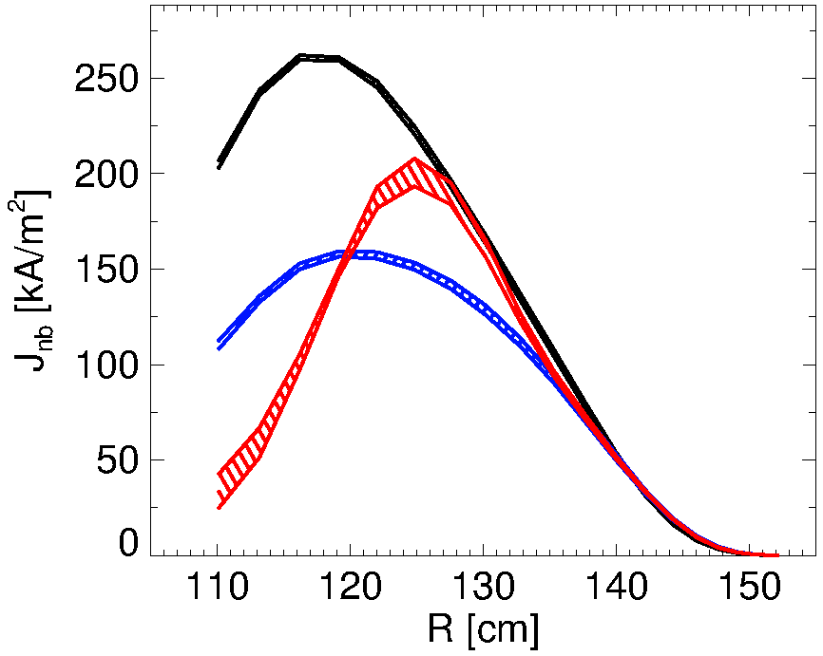
Verified, validated energetic particle (EP) models are required in integrated tokamak simulations
EPs (alphas, NB ions, RF tails) provide main source of heating, momentum, current drive in burning plasmas
But: EPs drive instabilities, instabilities affect EPs
This work: reduced EP transport models being developed, validated for time-dependent predictive simulations
NSTX-U #204202
*AE: Alfvén Eigenmode
Modeled NB driven current
classical
RSAEs
TAEs
model A
TAEs
model B
frequency [kHz]
[kA/m²]
fishbones
kink
NB power [MW]

Slide 3
Layout
Overview of main modeling tools
Summary of results
Future work & conclusions

Slide 4
Layout
Overview of main modeling tools
Summary of results
Future work & conclusions

Slide 5
TRANSP code is the main platform for Integrated Simulations
NUBEAM module accounts for (neo)classical EP physics
Includes scattering, slowing down, atomic physics
TRANSP (main)
NUBEAM step k
TRANSP (main)
Classical EP physics:
apply scattering, slowing down; update sources
May be inaccurate if EP transport is enhanced by instabilities

Slide 6
With instabilities, additional physics is required for quantitative simulations
NUBEAM module accounts for (neo)classical EP physics
Includes scattering, slowing down, atomic physics
TRANSP (main)
NUBEAM step k
TRANSP (main)
Classical EP physics:
apply scattering, slowing down; update sources
Ad-hoc EP diffusivity:
e.g. adjusted to match neutron rate
Ad-hoc transport models: often unphysical -> no predictive capabilities!

Slide 7
Kick and RBQ-1D reduced models address EP transport in time-dependent integrated simulations
NUBEAM module accounts for (neo)classical EP physics
Includes scattering, slowing down, atomic physics
TRANSP (main)
NUBEAM step k
TRANSP (main)
Classical EP physics:
apply scattering, slowing down; update sources
Phase-space resolved reduced EP models:
‘kick’, RBQ-1D
New physics-based models enable predictive capabilities
Podestà PPCF 2014, PPCF 2017; Gorelenkov NF 2018

Slide 8
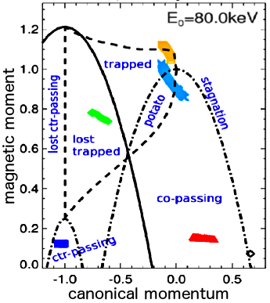
Constants of Motion variables are used to describe resonant wave-particle interaction
Each orbit characterized by:
Wave stability (drive):
E, energy
P_{ζ}∼mRv_{par}-qΨ, canonical momentum
μ∼v_{perp}²/B, magnetic moment
Complex orbits in real space translate in simple trajectories in phase space
Resonant interactions obey simple rule:
ω=2πf : mode frequency
n : toroidal mode number
R. B. White, Theory of toroidally confined plasmas, Imperial College Press (2001)

Slide 9
Constants of Motion variables are used to describe resonant wave-particle interaction
Each orbit characterized by:
Wave stability (drive):
E, energy
P_{ζ}∼mRv_{par}-qΨ, canonical momentum
μ∼v_{perp}²/B, magnetic moment
Complex orbits in real space translate in simple trajectories in phase space
Resonant interactions obey simple rule:
ω=2πf : mode frequency
n : toroidal mode number
Define transport matrix(es) for NUBEAM:
p(ΔE,ΔP_{ζ} |E,P_{ζ},μ)
“Conditional probability that a particle at (E,P_{ζ},μ) receives kicks ΔE, ΔP_{ζ} from wave-particle interaction”
Podestà PPCF 2014, PPCF 2017

Slide 10
RBQ-1D and kick models distill physics of wave-particle interaction for its inclusion in p(ΔE,ΔP_{ζ})
Both models use mode structure, damping rate from MHD codes, e.g. NOVA/NOVA-K
Input: thermal profiles, equilibrium
RBQ-1D based on resonance-broadened quasi-linear theory for wave-particle interaction:
Use “diffusive transport” approximation -> gaussian p(ΔP_{ζ} | E,P_{ζ},μ)
1D: transport along canonical momentum P_{ζ} dominates
Computationally efficient
Gorelenkov NF 2018

Slide 11
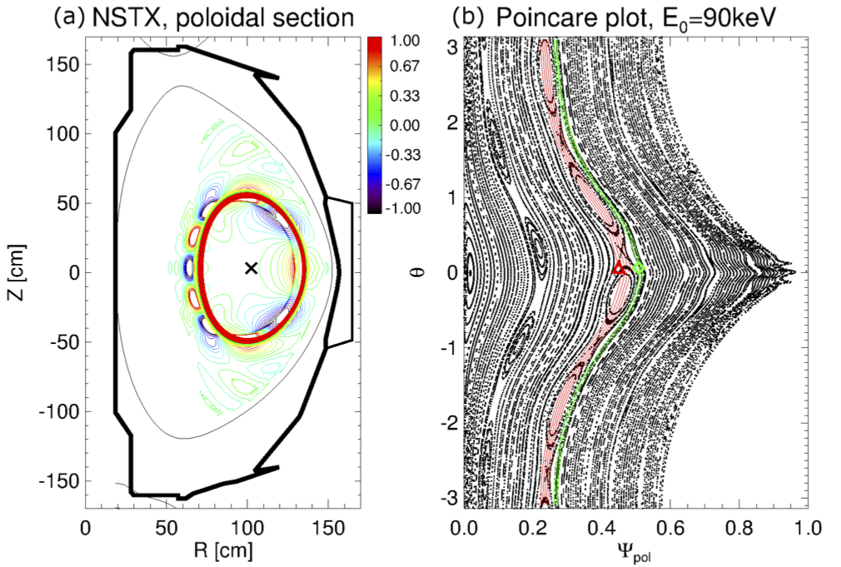
Kick model: particle-following ORBIT code used to infer transport matrix numerically
Initialize test particles uniformly in phase space
Perturbation from NOVA code
Podestà PPCF 2017

Slide 12
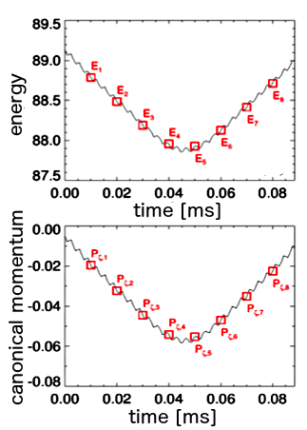
Kick model: particle-following ORBIT code used to infer transport matrix numerically
Initialize test particles uniformly in phase space
Track energy, momentum variations (kicks) at fixed time intervals
Perturbation from NOVA code
Podestà PPCF 2017

Slide 13
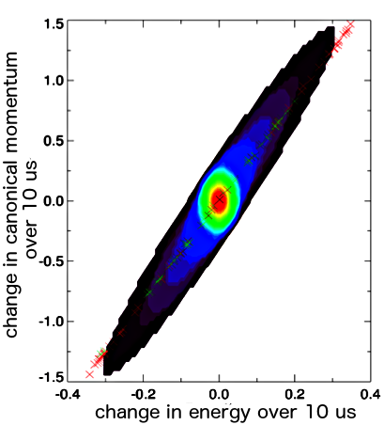
Kick model: particle-following ORBIT code used to infer transport matrix numerically
Initialize test particles uniformly in phase space
Combine ΔE, ΔP_{ζ} from same (E,P_{ζ},μ) phase space bin into p(ΔE,ΔP_{ζ} )
Track energy, momentum variations (kicks) at fixed time intervals
p(ΔE,ΔP_{ζ} )
Perturbation from NOVA code
Podestà PPCF 2017

Slide 14
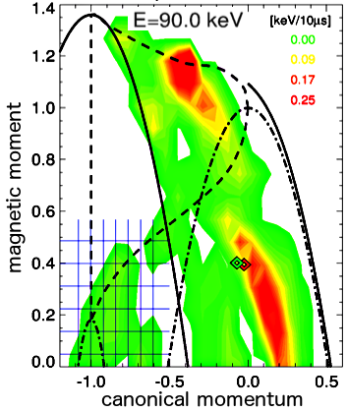
Kick model: particle-following ORBIT code used to infer transport matrix numerically
Initialize test particles uniformly in phase space
Combine ΔE, ΔP_{ζ} from same (E,P_{ζ},μ) phase space bin into p(ΔE,ΔP_{ζ} )
Repeat for all (E,P_{ζ},μ) bins to infer 5D matrix
-> input for NUBEAM:
p(ΔE,ΔP_{ζ} |E,P_{ζ},μ)
Track energy, momentum variations (kicks) at fixed time intervals
rms energy change
p(ΔE,ΔP_{ζ} )
localized
resonances
Perturbation from NOVA code
Podestà PPCF 2017

Slide 15
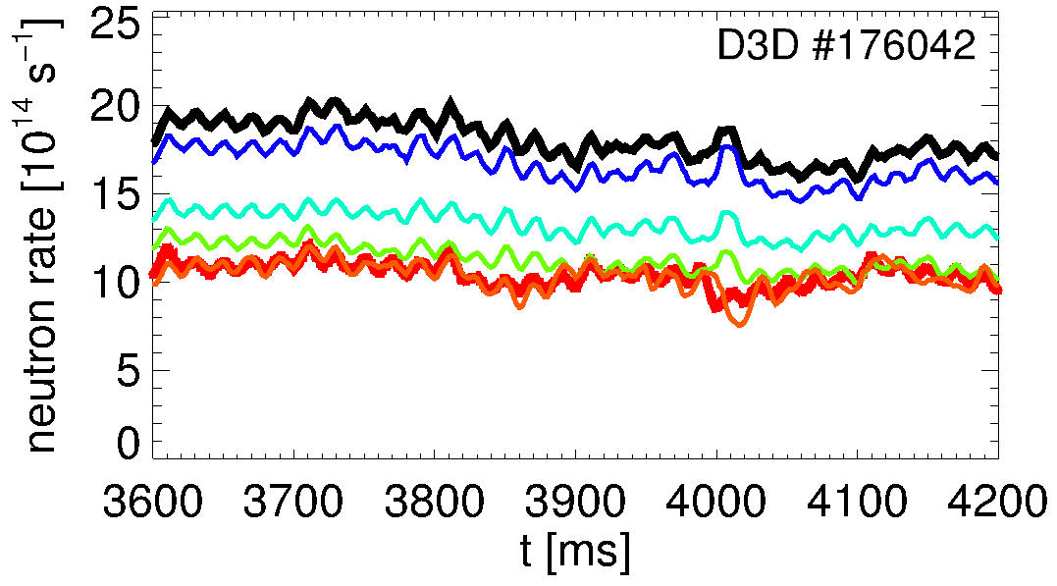
Models can be used for both interpretive and predictive simulations
Interpretive runs:
To validate EP models, analyze actual discharges
Use experimental info to set ΔE, ΔP_{ζ}
E.g. based on neutron rate, internal measurements of mode amplitude
classical TRANSP run
increase
kicks
measured
Podestà PPCF 2017

Slide 16
Models can be used for both interpretive and predictive simulations
reduced input from experiment
Interpretive runs:
To validate EP models, analyze actual discharges
Use experimental info to set ΔE, ΔP_{ζ}
E.g. based on neutron rate, internal measurements of mode amplitude
Predictive runs:
To optimize/explore new scenarios
Use saturation condition to set ΔE, ΔP_{ζ}
Impose drive = damping vs time
classical TRANSP run
increase
kicks
drive from NUBEAM or RBQ-1D
damping from NOVA-K
measured
Main limitation:
Can be only as good as damping rate estimates!
Many practical cases lie in between ‘fully interpretive’ & ‘fully predictive’
Podestà PPCF 2017

Slide 17
Layout
Overview of main modeling tools
Summary of results: from validation/analysis to predictions
Single-mode scenarios
NTM only: single dominant mode, few resonances in EP phase space
AEs only: many modes of same type, many resonances
Multi-mode scenarios
AEs + fishbones + kinks: multiple types of modes, many resonances
Example of predictive capabilities
Future work & conclusions
complexity

Slide 18
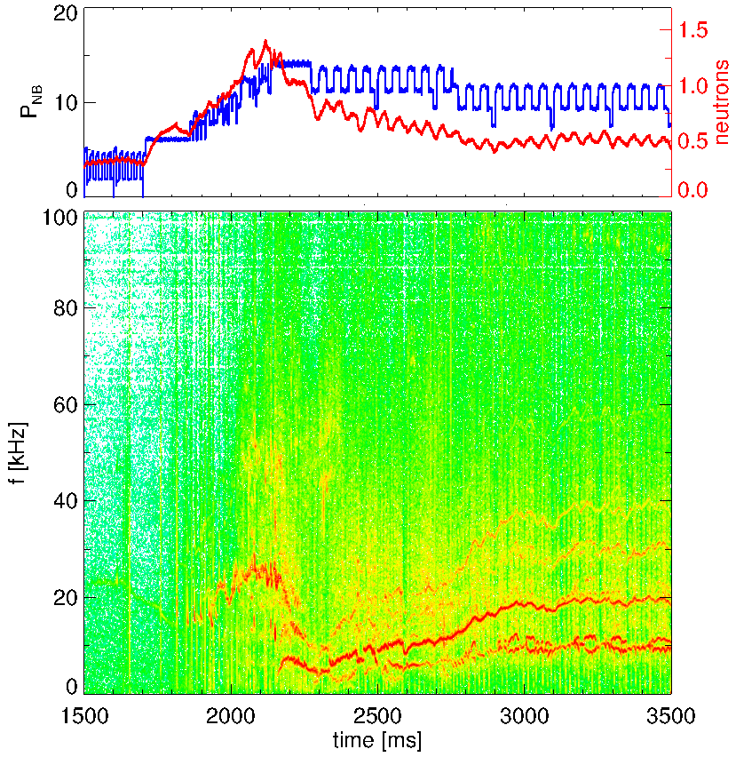
DIII-D discharge with large NTM provides a good test bed for EP transport models
NTMs destabilized by step-up in NB power
Dominant 2/1 in this case
Large NTM amplitude causes EP confinement degradation
Clear drop in neutron rate
DIII-D #170247
NB power [MW]
neutron rate [au]
magnetic fluctuations
frequency [kHz]
NTMs
2/1
Heidbrink NF 2018 Bardóczi PoP 2017 Poli NF 2017 Bardóczi PPCF 2018 (submitted)
time [ms]

Slide 19
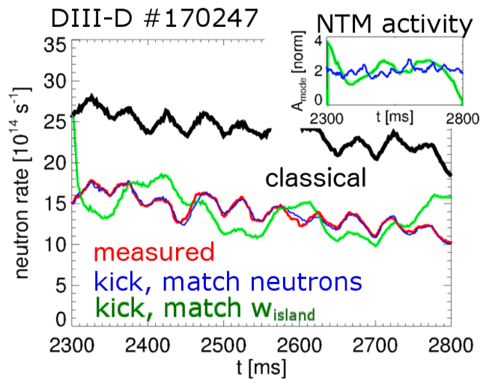
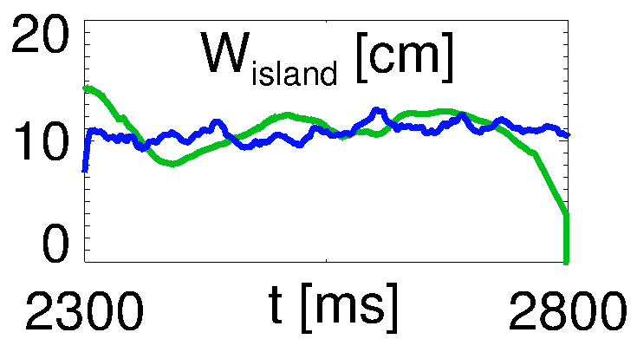
Interpretive analysis reproduces experiment, matches direct measurements of NTM island width
Kick “interpretive” run:
Scale kicks to match measured neutrons
Mode amplitude related to w_{island}
Inferred NTM island width agrees with measured w_{island} from ECE
a posteriori check, validation
Path towards ‘predictive’ simulations with w_{island} from Modified Rutherford Equation
Heidbrink NF 2018 Bardóczi PPCF 2018 (submitted)

Slide 20
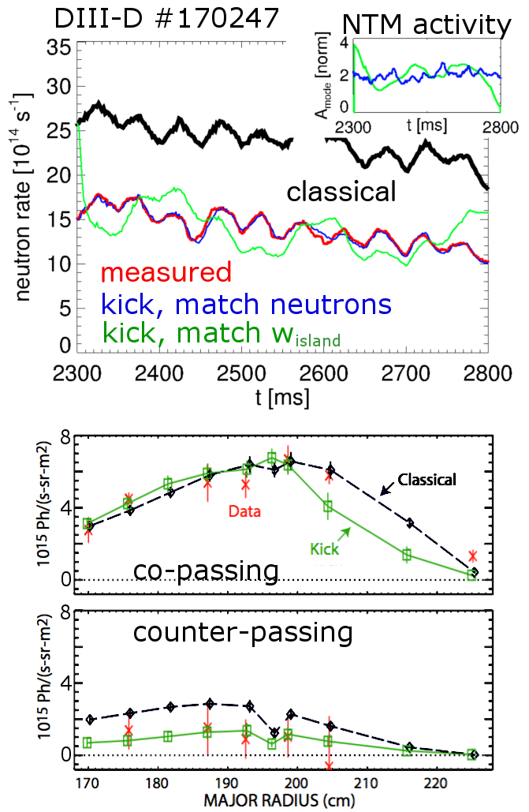
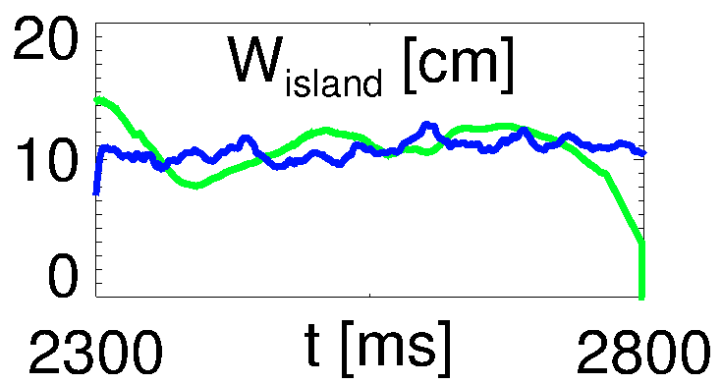
Analysis gives reasonable agreement with phase-space resolved diagnostics
Kick “interpretive” run:
Scale kicks to match measured neutrons
Mode amplitude related to w_{island}
Inferred NTM island width agrees with measured w_{island} from ECE
a posteriori check, validation
Path towards ‘predictive’ simulations with w_{island} from Modified Rutherford Equation
Favorable comparison with phase-space resolved data (FIDA)
Acceptable for co-passing, good for counter-passing
Key exercise for model validation
Ad-hoc diffusion would give same drop for co/cntr
Heidbrink NF 2018 Bardóczi PPCF 2018 (submitted)
FIDA brightness

Slide 21
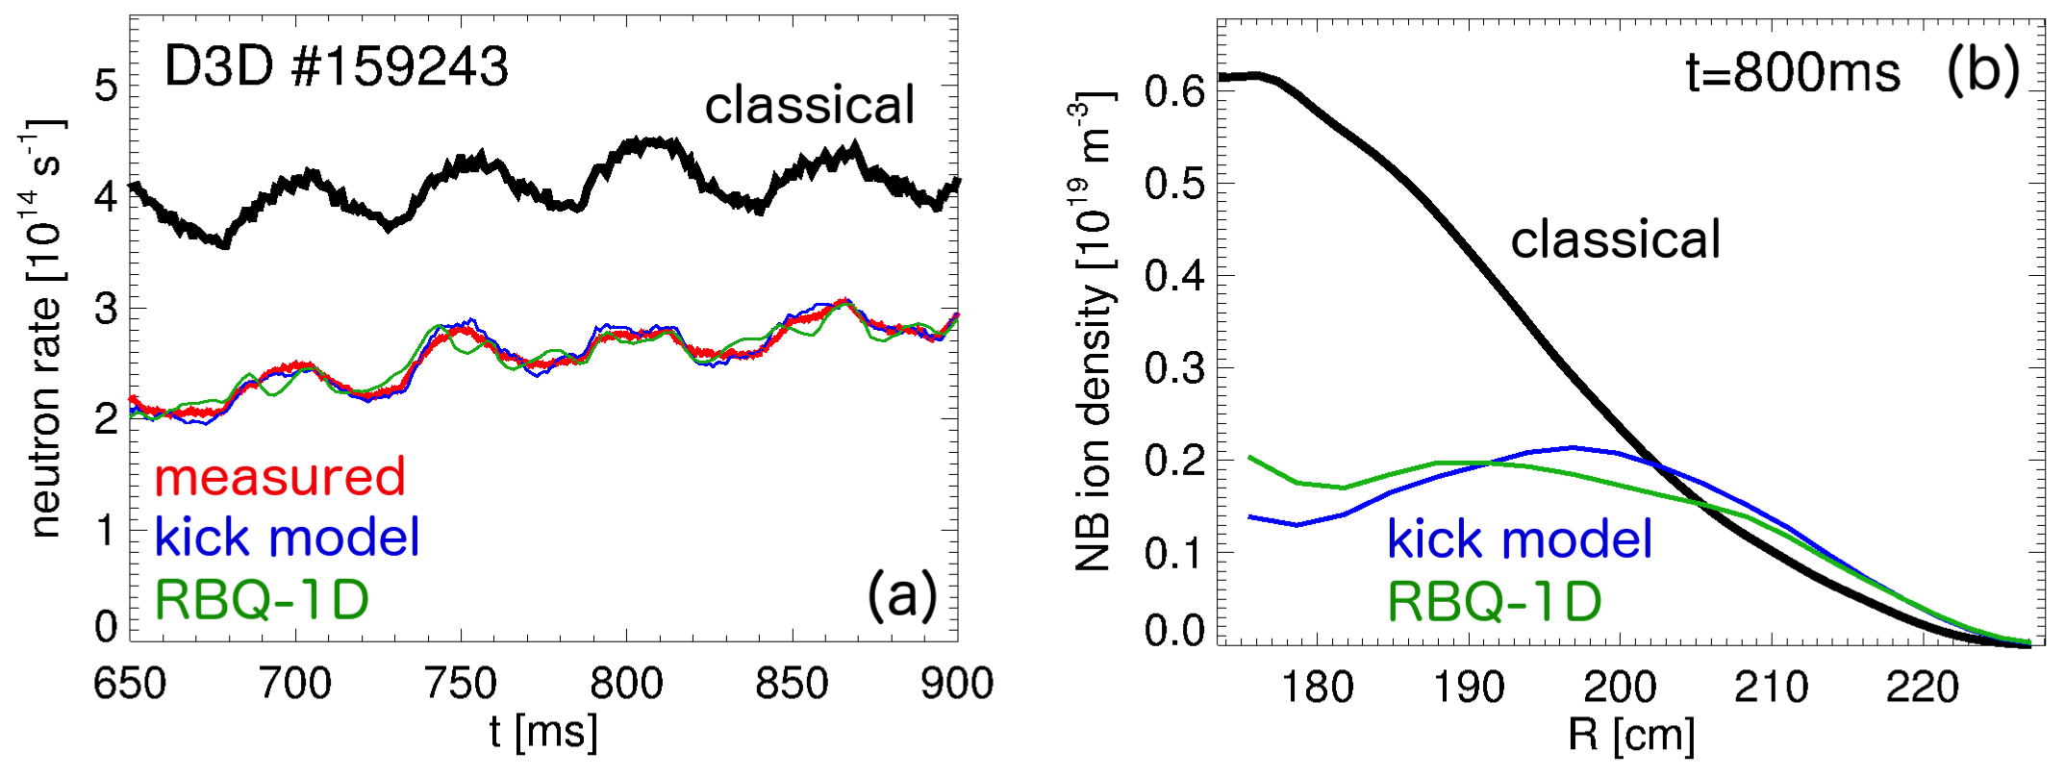
Kick & RBQ-1D successfully benchmarked for scenario with multiple unstable AEs
AEs selected based on experimental data from ECE, Mirnov coils
Amplitudes inferred around t=800ms
Adjusted vs time to match measured neutron rate
Gorelenkov NF 2018

Slide 22
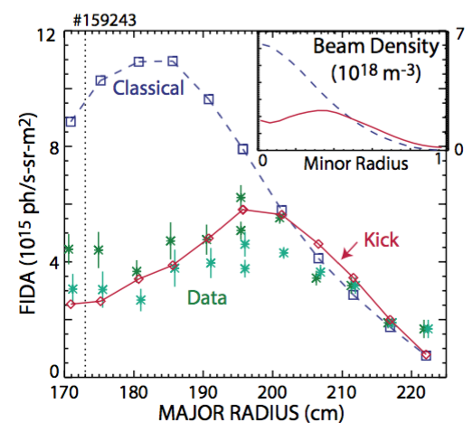
Successful comparison with phase-space resolved data (FIDA, NPA) validates models
Simulation can also reproduce dynamic response to NB modulation
Less favorable comparison with FIDA using updated calibration
Need to work closely with experimentalists
Retaining phase space resolution is critical for validation
Heidbrink PoP 2016

Slide 23
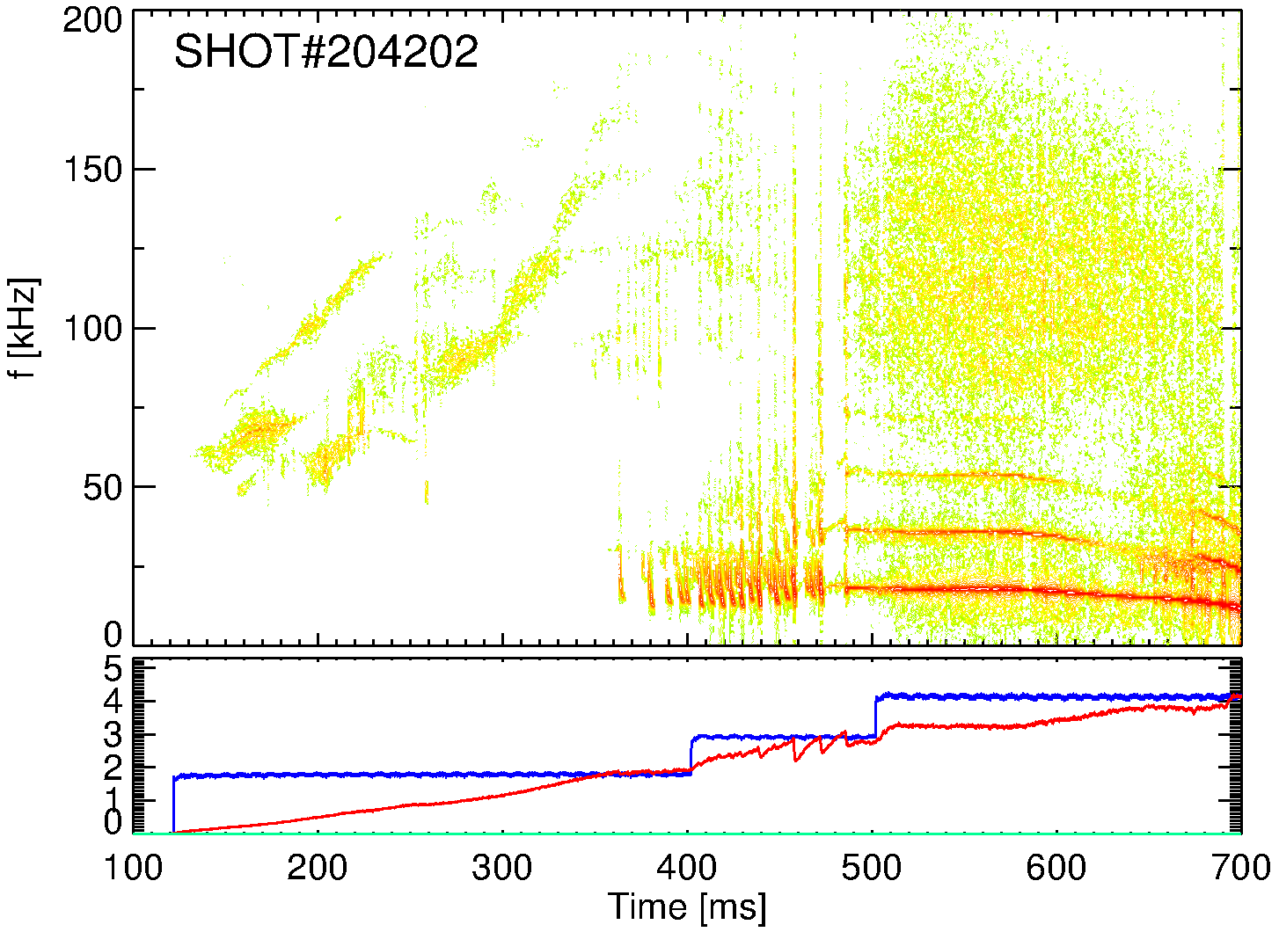
Towards predictive simulations: need estimate of unstable spectrum, saturated amplitudes
NSTX-U #204202
Need estimate for relative AE amplitudes:
Use saturation condition (drive=damping) to infer AE amplitudes vs time
Then, rescale fishbone & kink amplitudes to match measured neutron rate
No damping available (yet)
TAEs
RSAEs
TAEs
fishbones
kink
NB power [MW]
neutron rate [au]

Slide 24
Analysis provides assessment of role of different instabilities on EP transport, NB driven current
NSTX-U #204202
NB density
AEs and fishbones/kinks cause comparable drop in neutrons
Fishbones, kinks are mostly responsible for NB ion density depletion
AEs have larger effect on NB ion energy redistribution
Synergy between modes is observed, e.g. in total EP losses

Slide 25
Layout
Overview of main modeling tools
Summary of results
Future work & conclusions

Slide 26
Reduced-physics EP transport models enable quantitative, time-dependent tokamak simulations
Verification & Validation being extended for kick & RBQ-1D
Extend RBQ to 2D (canonical momentum & energy)
Reduced models enable efficient simulations retaining (most of) the relevant EP physics
Including predictive capabilities (ITER & beyond)
Phase-space resolution is required to move beyond ad-hoc models
Critical for heating, current drive, thermal transport
Goal: develop framework to streamline TRANSP analysis including effects of instabilities on EPs

Slide 27
Backup

Slide 28
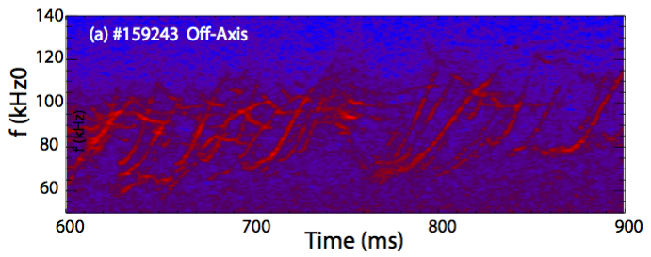
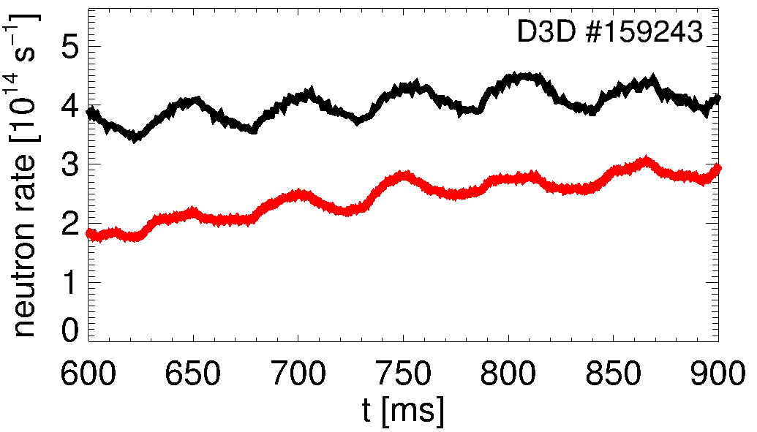
Reasonable agreement also found for scenario with multiple unstable Alfvén Eigenmodes
TAEs
frequency [kHz]
Heidbrink PoP 2016
Collins PRL 2016
Collins NF 2017
RSAEs
classical
Mix of Toroidal and Reversed-shear AEs observed
Large neutron deficit indicates substantial fast ion transport
measured

Slide 29
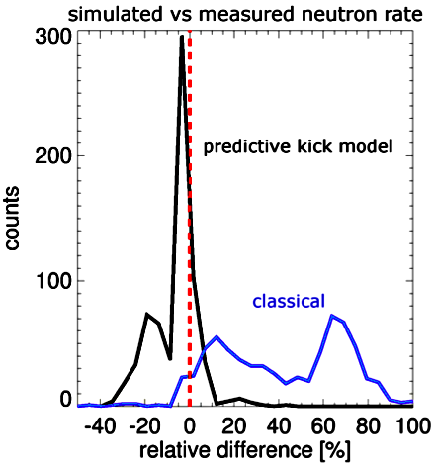
Predictive analysis (AEs) results generally agree within +/-15% with interpretive simulations
Relative difference from interpretive simulations: NSTX, NSTX-U and DIII-D database
However: in some cases, predictive runs fail to reproduce experiments!
Predicted AE spectrum differs from experiment
Key role of damping rate from MHD codes
Affects inferred AE saturation amplitude
More validation is required to assess model limitations, missing physics
interpretive kick model

Slide 30
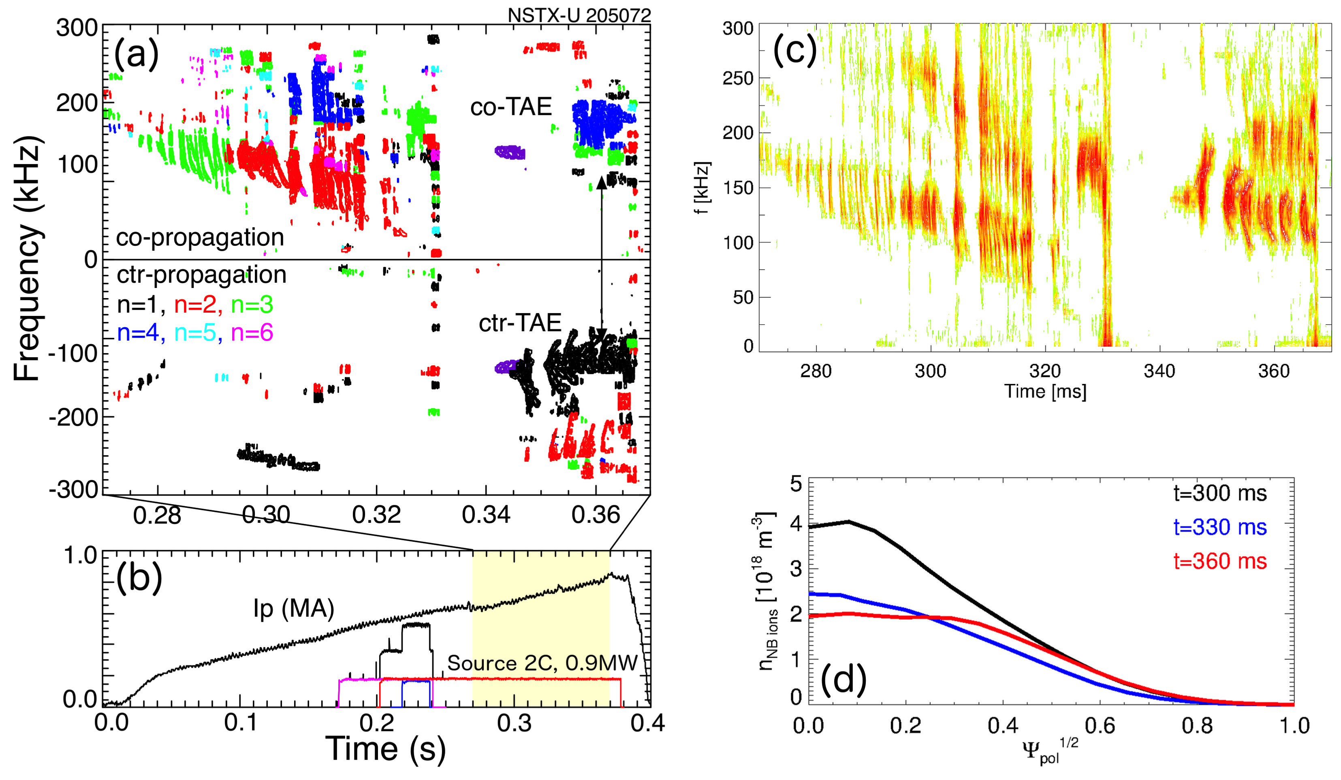
Predictive analysis: test kick model on challenging NSTX-U discharge
Examples from NSTX-U scenario
Transition from co- to counter-TAEs as NB ion density profile becomes flat or hollow
Complex scenario, simulations are challenging
Most quantities evolve in time, not suitable for “single-time-slice” analysis
Podestà NF 2018

Slide 31
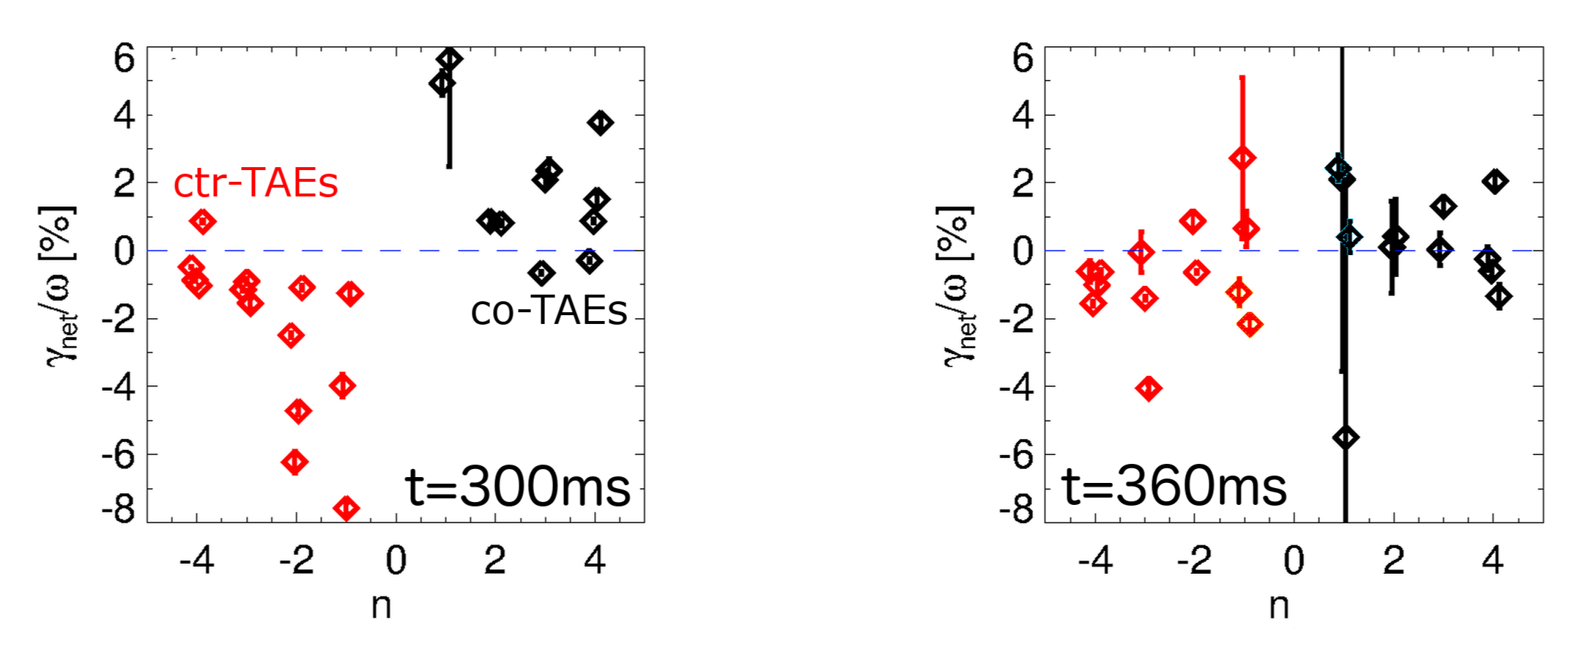
Predictive analysis recovers overall properties of measured instabilities
Reproduces main features of the experiment
Reproduces transition co- to counter-TAEs
Capture time evolution of unstable modes, spectrum, …
co-TAEs only
co- and cntr-TAEs

Slide 32
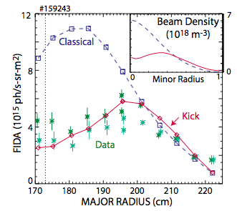
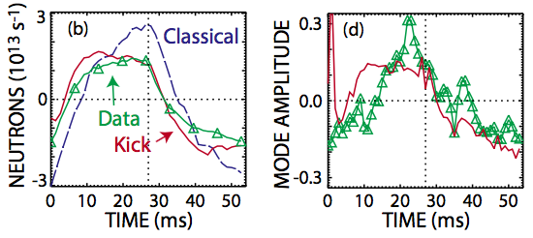
Successful comparison with phase-space resolved data (FIDA, NPA)
Retaining phase space resolution is important
Localized resonances result in “fine structures” in fast ion distribution, profiles
Comparison with FIDA: phase space resolution crucial for validation
Agreement extends to response to NB modulation

