Slide 1
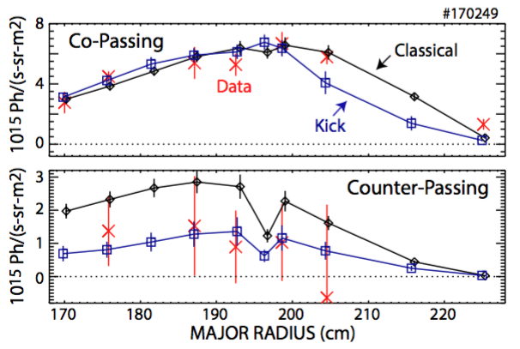
EX-1/2: Reduced-Physics Energetic Particle (EP) transport models greatly improve fidelity of integrated tokamak simulations
Kick and RBQ-1D models included in the TRANSP tokamak transport code
Models enable integrated simulations including effects of MHD instabilities on EP confinement
TRANSP replicates measured neutron rate reduction caused by enhanced EP transport
Similar results running kick model in either predictive or interpretive mode
Phase space resolution implemented in kick and RBQ-1D models is critical
Crucial for model validation against measurements (e.g. FIDA, NPA)
Crucial to enable predictive simulations including mode drive, damping
Example - kick model in TRANSP replicates:
measured relation between NTM magnetic island width and neutron rate reduction
modification of profiles as measured by FIDA
FIDA brightness DIII-D #170249
Podestà EX/1-2
Petty OV/1-4

