Slide 1
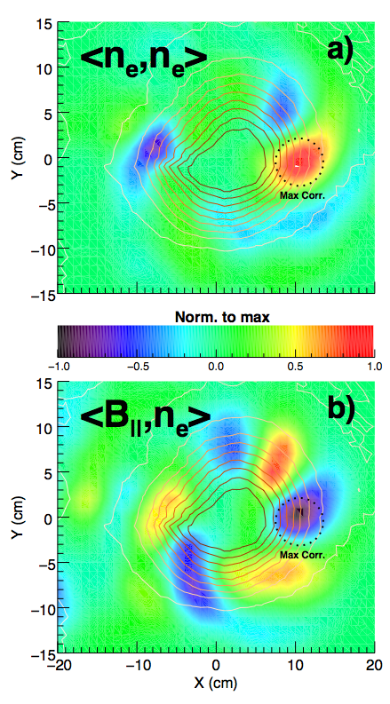
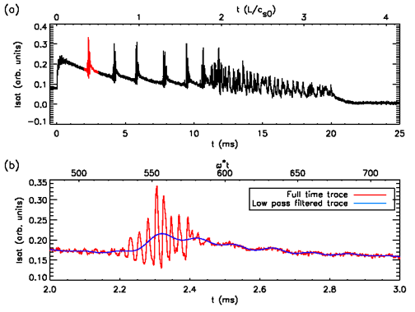
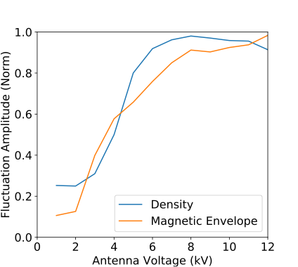
Advances in Fusion Relevant Physics using the Large Plasma Device
Studies of the dynamics of avalanche transport events [Van Compernolle, et al. PoP 24, 112302 (2017)]
Electromagnetic turbulence and transport in increased beta plasmas [Pueschel, et al., PPCF 59, 024006 (2017)]
High power ICRF experiments [Martin, et al. PRL 119, 205002 (2017)]: interaction between drift waves and ICRF
Basic Plasma Science Facility is US DOE/NSF User facility; provides LAPD experimental platform to users to make important contributions to fusion-relevant turbulence and transport physics

