Slide 1
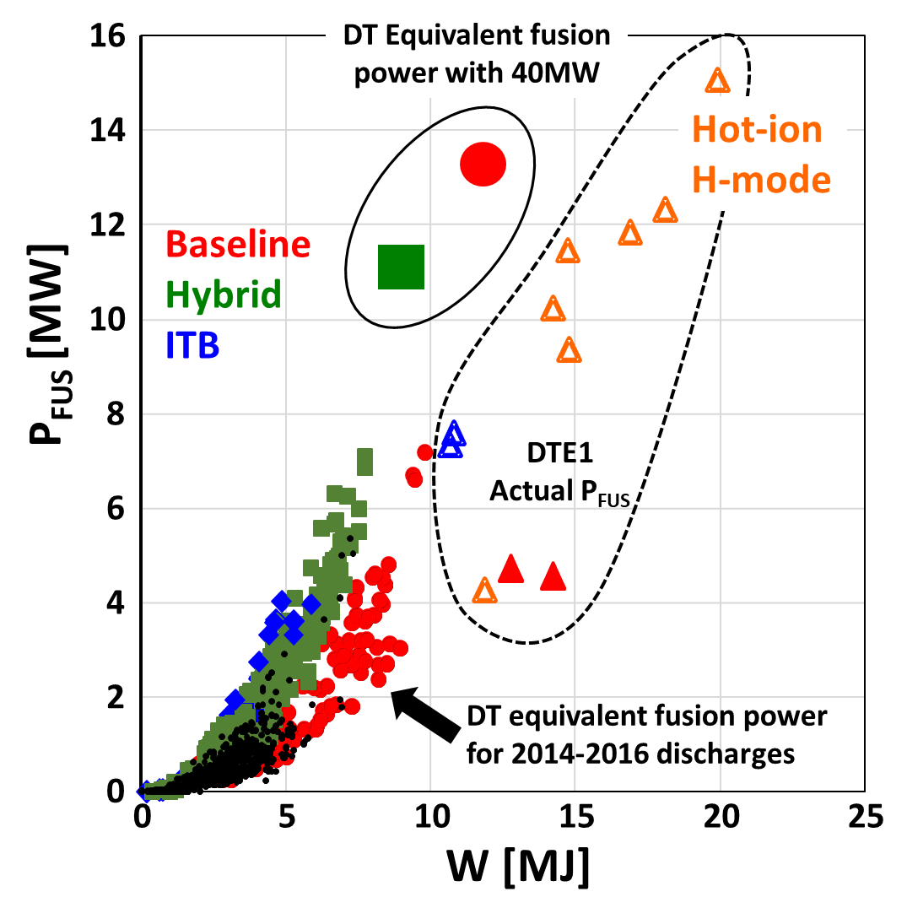
JET-ILW is heading towards the DT campaign
Fusion power is predicted to reach similar level than in the 1998 DT campaign (DTE1) but in steady state with two scenario: baseline and hybrid.
In support of the DT scenarios development, the impact of isotope physics is being studied in advance of the DT phase in dedicated in H, D and T campaigns together with the impact of mixed species plasmas.
Studying alpha physics is a central part of the outcome of the DT campaign and specific ITB scenario are developed for studying e. g. α-driven instabilities (TAEs), and dedicated ICRH schemes.

