Slide 1
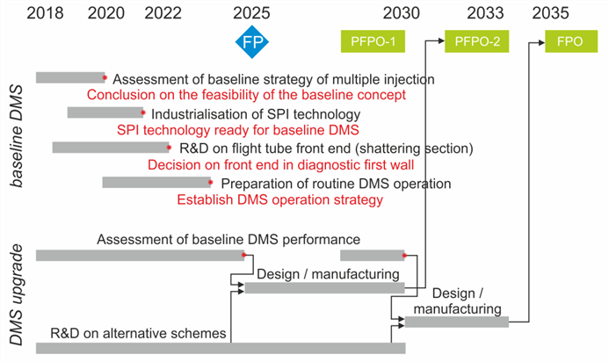
EX/P7-12, R&D for reliable disruption mitigation in ITER, M. Lehnen et al.
The Disruption Mitigation System (DMS) is a key plant system of ITER
The baseline concept is based on dissipating thermal and magnetic energy through line radiation and to prevent runaway electron formation by increasing the density
The baseline technique is the injection of Ne, Ar and D2 through Shattered Pellet Injection
An R&D plan has been established to address the gaps in the physics basis and to adapt the technology to the ITER needs; an upgrade of the ITER DMS would be possible if required; R&D on alternate technology and concepts is needed for this
The ITER Disruption Mitigation Task Force will implement the required R&D
ITER is planning to expand the injection capabilities to up to 32 injectors in three equatorial ports together with one injector each in three upper ports
Most urgent issues to be addressed:
Timeline for R&D activities
Confirm concept of multiple injection (e.g. up to 10 pellets for thermal load mitigation and disruption avoidance in ITER) (baseline concept)
Identify the most effective fragment sizes for ITER (baseline concept)
Assess the concept of runaway electron avoidance and runaway energy dissipation (upgrade needs)

