Slide 1





Test of the ITER-like RMP Configurations
for ELM-crash-suppression on KSTAR
Yongkyoon In^{1,2}, A. Loarte³, H.H. Lee², K. Kim², J.W. Ahn⁴,
Y.M. Jeon², J.K. Park⁵, G.Y. Park², M.W. Kim^{1,2}, H. Park^{1,2},
and the 3D Physics Task Force in KSTAR
¹ Ulsan National Institute of Science and Technology (UNIST), Ulsan, Korea
² National Fusion Research Institute (NFRI), Daejeon, Korea
³ ITER Organization
⁴ Oak Ridge National Laboratory, Oak Ridge, U.S.
⁵ Princeton Plasma Physics Ridge Laboratory, Princeton, U.S.
In acknowledgement of the supports by Ministry of Science and ICT for the KSTAR project and by the Research Funds (180056 & 180245) of UNIST(Ulsan National Institute of Science & Technology)
“ITER is the Nuclear Facility INB no. 174. The views and opinions expressed herein do not necessarily reflect those of the ITER Organization.”
IAEA-FEC, October 22 - 27, 2018, Gandhinagar, India

Slide 2
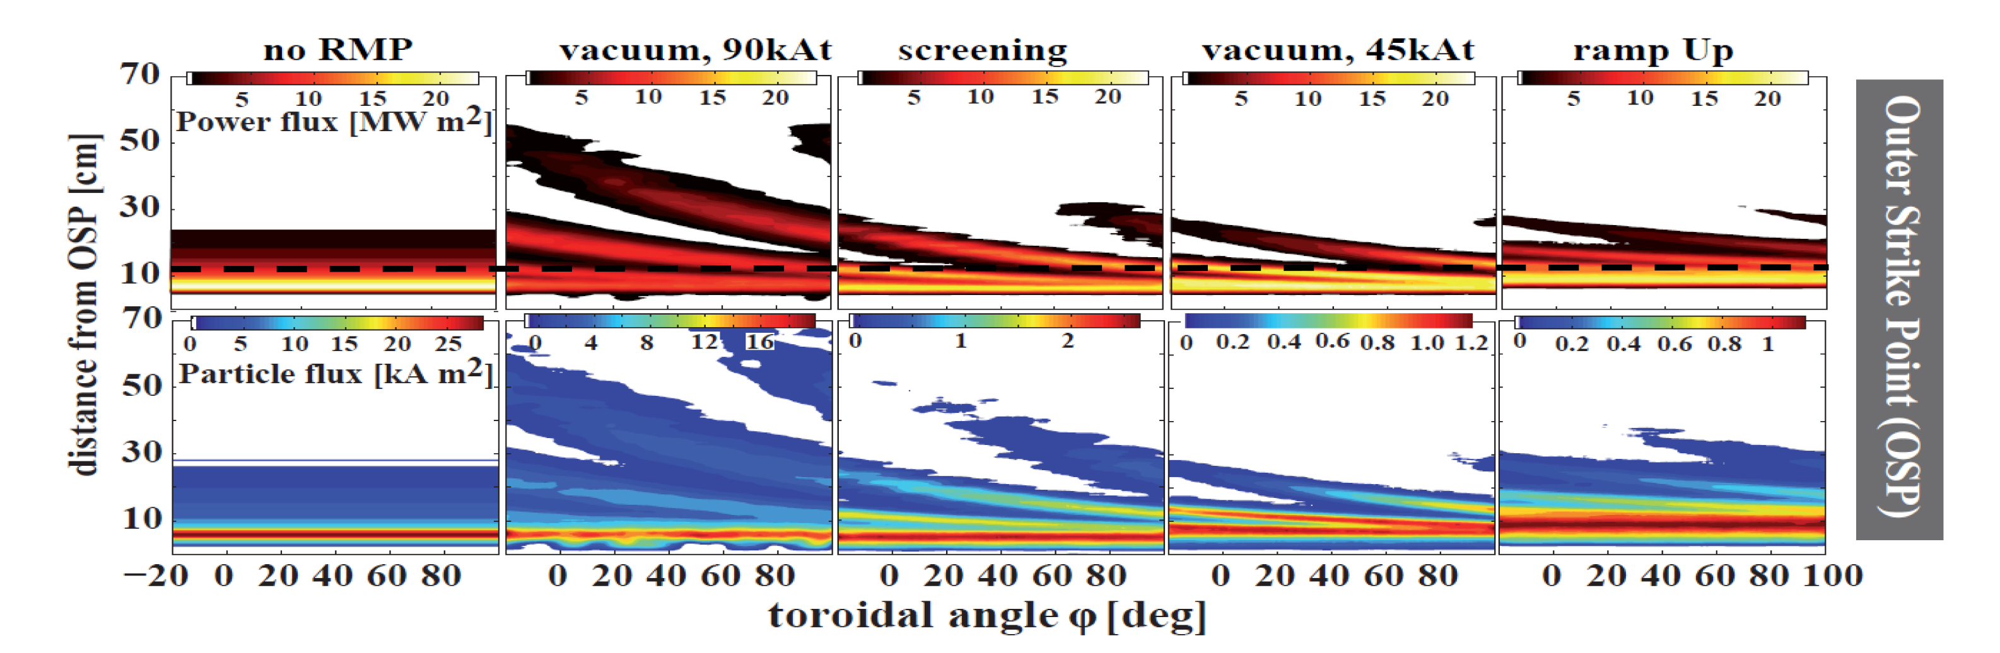

ITER requires a scheme to spread the divertor heat fluxes with minimum electromagnetic cycling of coils, while sustaining the RMP-driven, ELM-crash-suppression
Application of ELM control coils leads to localized power fluxes at divertor and main wall by thermal plasma and by fast particles (NBI + α’s)
Loarte (2014) “Rigid rotation of the perturbation solves the problem but causes large EM cycling of the control coils”
Excerpted from O. Schmitz et al, NF (2016)

Slide 3
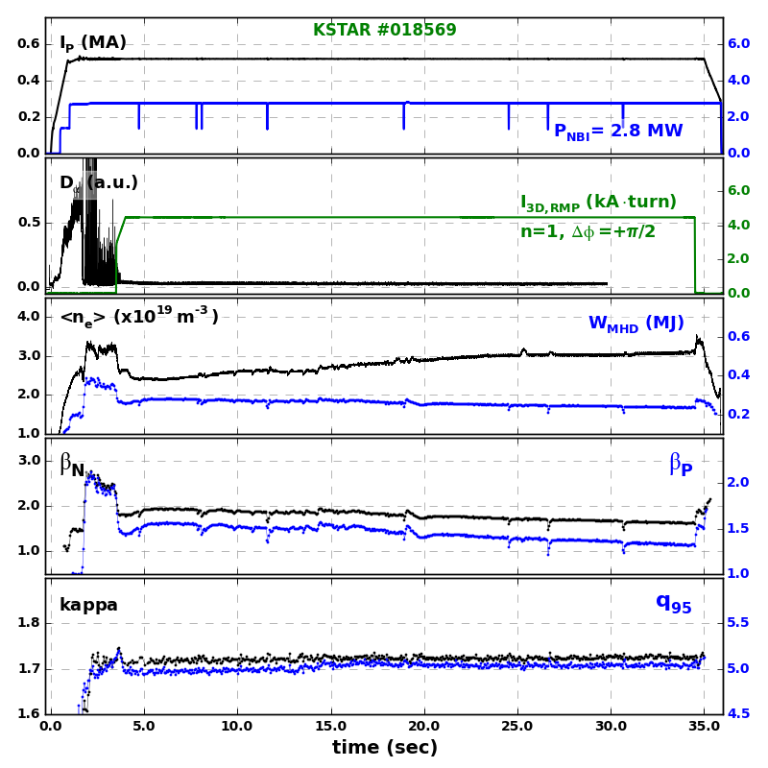
KSTAR has secured robust RMP-driven ELM-crash-suppression, equipped with the capability to measure the divertor heat fluxes
As of 2017, KSTAR accomplished the longest sustainment of RMP-driven ELM-crash-suppression !
Ultimately, the RMP-driven ELM-crash-suppression would be one of the critical tools to warrant the divertor lifetime with a minimal cost of confinement
Toroidally varying striation pattern needs to be diagnosed even during RMP-driven ELM-crash-suppression
Above 30 sec ≥ τ_{wall}
q₉₅~5.0

Slide 4
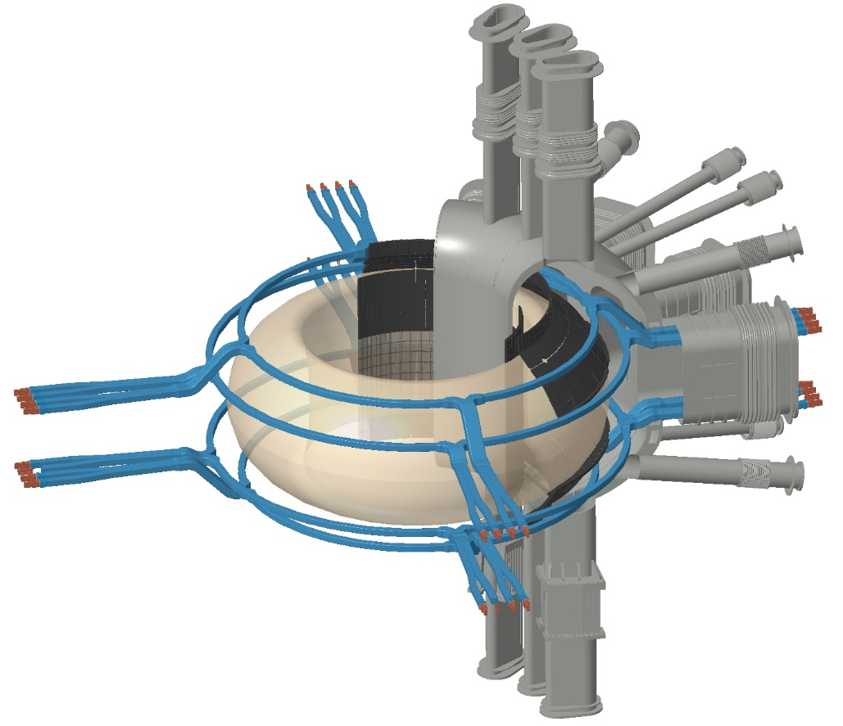
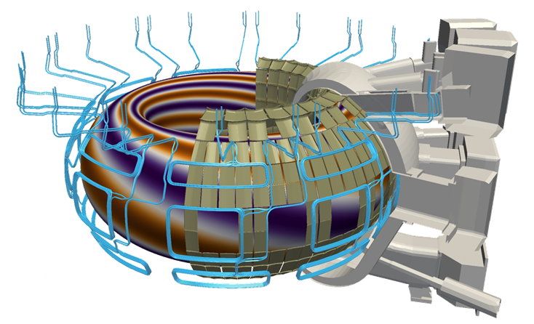
The 3-row in-vessel coils in KSTAR can accommodate various 3-D configurations in ITER-RMP, including “intentionally misaligned configurations (IMC)”
KSTAR In-vessel Control Coils (IVCC): Top/Mid/Bot
ITER RMP coils
Up to n=2 with 4 coils in each row
Up to n=4 with 9 coils in each row
Courtesy of K.S. Lee
Courtesy of G.T.A. Huijsmans
Uniquely equipped with in-vessel mid-RMP coils

Slide 5
Outline
Introduction
  Divertor heat flux measurement diagnostic
  Intentionally misaligned 3-D configurations (IMC)
Impact of 3-D field configurations on divertor heat flux profiles
  3-rows vs 2-rows (Upper/Lower RMPs)
Simple-model comparison (preliminary)
Progress in the compatibility study of RMP-driven, ELM-crash-suppression with detached plasmas
Discussion and Summary

Slide 6

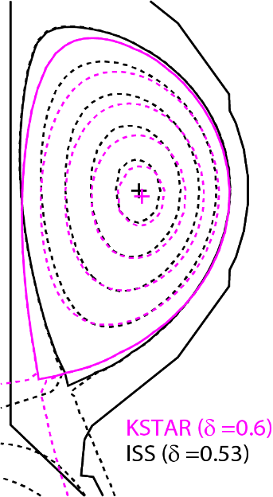
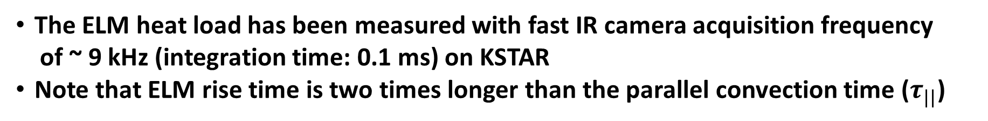
Time-resolved ELMy burst has been diagnosed
to be peaked up to 50 MW/m² near divertor
H.H. Lee et al, FEC (2016)
The ELM heat load has been measured with fast IR camera acquisition frequency
of ~ 9 kHz (integration time: 0.1 ms) on KSTAR
Note that ELM rise time is two times longer than the parallel convection time ($τ_{||}$)

Slide 7
Divertor heat flux striation pattern during rotating n=1 RMP is consistent with the field line tracing calculation, including plasma response
† K. Kim PoP 24 052506 (2017)
Vacuum (before phase rotating)
Ideal plasma response (before phase rotating)
H.H. Lee et al, IAEA-TM (2017)
Also, refer to K. Kim et al, PoP (2017)

Slide 8
Intentionally misaligned configurations, with minimal EM loads, have been proposed to reduce EM loading on coils, while effectively diffusing the divertor heat fluxes
Phasing (= phase difference between rows)
[e.g. φ_{UM} = φ_{M} − φ_{U} = 0⁰ – (-90 ⁰ ) = 90 ⁰ ]
Reference phasing (φ_{UM} = φ_{ML}= 90 deg):
default n=1 RMP
Misaligned configurations: 3 types
“distorted” (φ_{UM} ≠ φ_{ML} )
II. “away” (φ_{UM} = φ_{ML}> 90 ⁰): kink-aligned
III. “toward” (φ_{UM} = φ_{ML}< 90 ⁰)
IV. 2-row (without mid-row):
Upper/Lower rows: nearly orthogonal to
the 3-D configuration of 90 deg phasing in vacuum
Δφ =+90 ⁰
U
M
L
+ | + | − | −
− | + | + | −
− | − | + - | +
θ
−180º
0º
180º
φ

Slide 9
Intentionally misaligned configurations, with minimal EM loads, have been proposed to reduce EM loading on coils, while effectively diffusing the divertor heat fluxes
Phasing (= phase difference between rows)
[e.g. φ_{UM} = φ_{M} − φ_{U} = 0⁰ – (-90 ⁰ ) = 90 ⁰ ]
Reference phasing (φ_{UM} = φ_{ML}= 90 deg):
default n=1 RMP
Misaligned configurations: 3 types
“distorted” (φ_{UM} ≠ φ_{ML} )
II. “away” (φ_{UM} = φ_{ML}> 90 ⁰): kink-aligned
III. “toward” (φ_{UM} = φ_{ML}< 90 ⁰)
IV. 2-row (without mid-row):
Upper/Lower rows: nearly orthogonal to
the 3-D configuration of 90 deg phasing in vacuum
Δφ =+90 ⁰
U
M
L
+ | + | − | −
− | + | + | −
− | − | + - | +
θ
Y. In et al, APS-DPP (2017); submitted for publication (2018)
−180º
0º
180º
φ

Slide 10
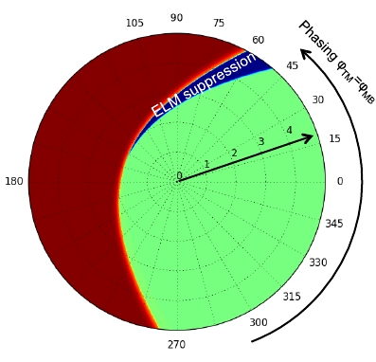
“Away” phasing might have been greatly influenced by kink-associated contributions, but what about “toward” phasing?
3-D phase space mapping has been successfully benchmarked for RMP-driven, ELM-crash-suppression
[J.K. Park et al, Nature Physics (2018)]
Divertor heat flux broadening has been observed in the “away” phasing
“Away Phasing”
“Toward Phasing”
Coil current (kA) I_{T}=I_{M}=I_{B}
Locking
Dominantly
non-resonant
Y. In et al, APS-DPP (2017);
submitted for publication (2018)

Slide 11
“Away” phasing might have been greatly influenced by kink-associated contributions, but what about “toward” phasing?
3-D phase space mapping has been successfully benchmarked for RMP-driven, ELM-crash-suppression
[J.K. Park et al, Nature Physics (2018)]
Divertor heat flux broadening has been observed in the “away” phasing
“Away Phasing”
“Toward Phasing”
Coil current (kA) I_{T}=I_{M}=I_{B}
Locking
Dominantly
non-resonant
Y. In et al, APS-DPP (2017);
submitted for publication (2018)

Slide 12
Outline
Introduction
  Divertor heat flux measurement diagnostic
  Intentionally misaligned 3-D configurations (IMC)
Impact of 3-D field configurations on divertor heat flux profiles
  3-rows vs 2-rows (Upper/Lower RMPs)
Simple-model comparison (preliminary)
Progress in the compatibility study of RMP-driven, ELM-crash-suppression with detached plasmas
Discussion and Summary

Slide 13
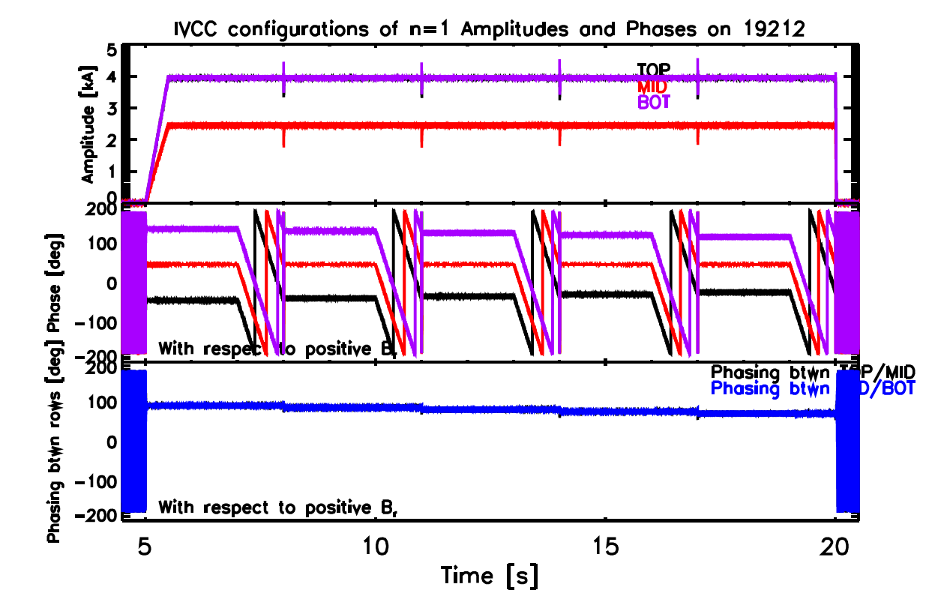
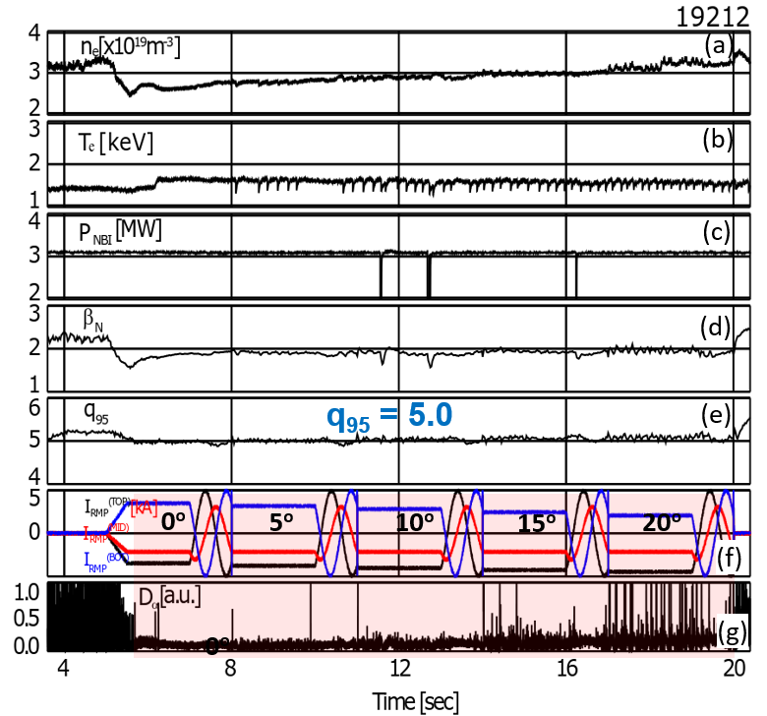
“Toward” Phasing in n=1 RMP appears as equally effective as “Away” phasing in terms of ELM-crash-suppression, suggesting a broad optimal phasing
“Toward” each other at Upper/Lower rows
3-rows
Rotating RMP
(φ_{UM}, φ_{ML})= (-90,90); (-85,85);(-80,80);(-75,75);(-70,70)
w.r.t. φ_{M} =0 deg [e.g. +90deg phasing (-90,90)]
No
RMP
U
M
L
+ | + | - | -
- | + | + | -
- | - | + | +
−180º
0º
180º

Slide 14
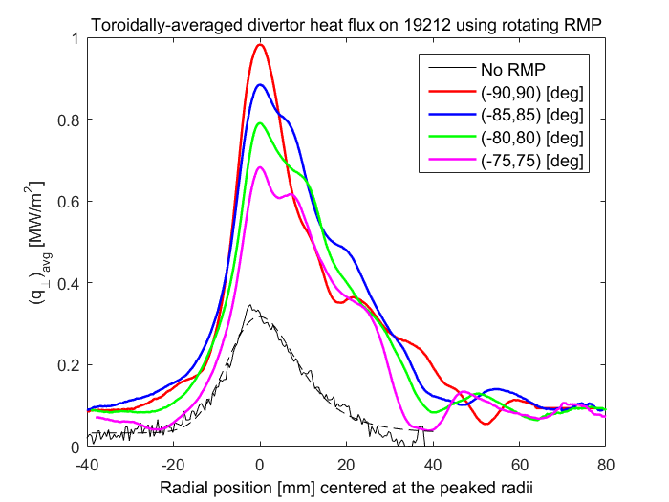
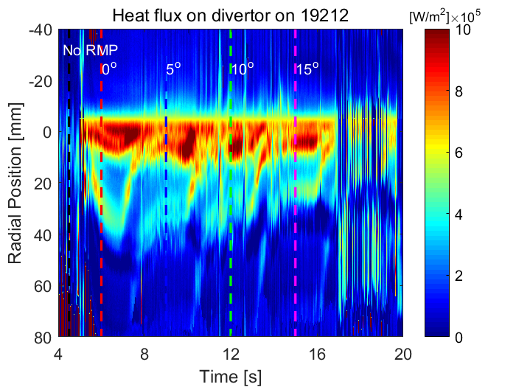
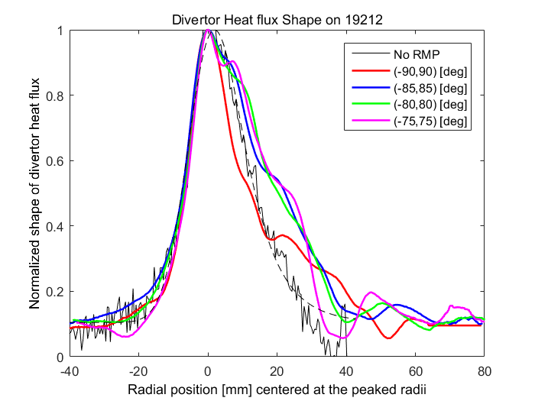
“Toward” phasing in n=1 RMP appears as equally effective in dispersing divertor heat flux as found in “Away” phasing (kink-aligned)
3-rows
Realigned divertor heat flux (19212)
Rotating RMP
λ_{q} =1.9 mm
Radial position at the maximum [mm]
Normalized
“Toward” dephasing benefits are clearly observed in
terms of divertor heat flux dispersal, prior to the loss of ELM-crash-suppression, avoiding mode-locking!
Radial position at the maximum [mm]

Slide 15
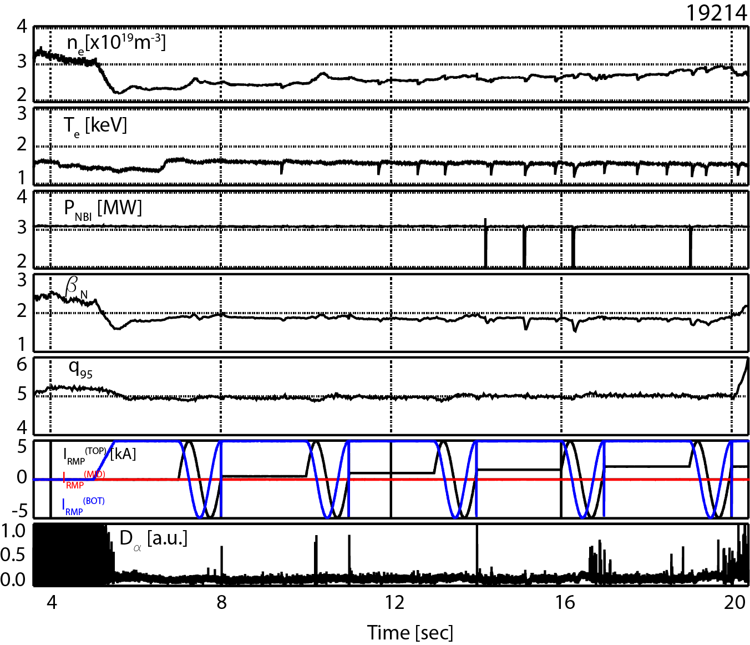
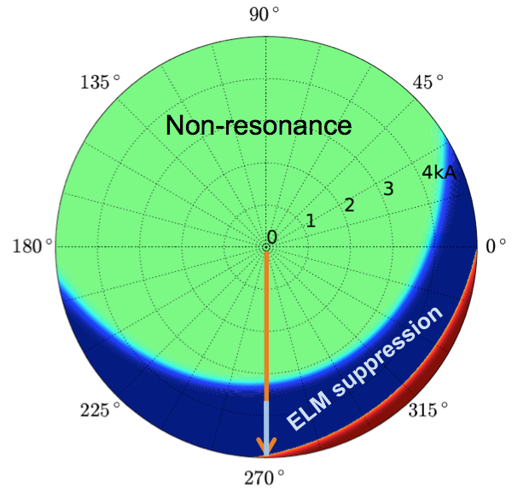
Newly achieved RMP ELM-crash-suppression using n=1 off-midplane coils has been configured to be operationally perpendicular to conventional RMP configuration
2-rows
Upper/Lower rows (without mid-row):
: nearly orthogonal to the configuration of
3-row 90 deg phasing in vacuum
Δ_{UL}φ =+180 ⁰
Δ_{UL}φ =-90 ⁰
U
M
L
+ | + | − | −
− | − | + - | +
θ
q₉₅ ~ 5.0
−180º
0º
180º
Δφ_{TB} = -90° -85 °
-80° -75 ° -70 °
ELM suppression has been demonstrated with a range of phasings of Δφ_{UL} = -70° ~ -90 °, and sustained during rigid rotation

Slide 16
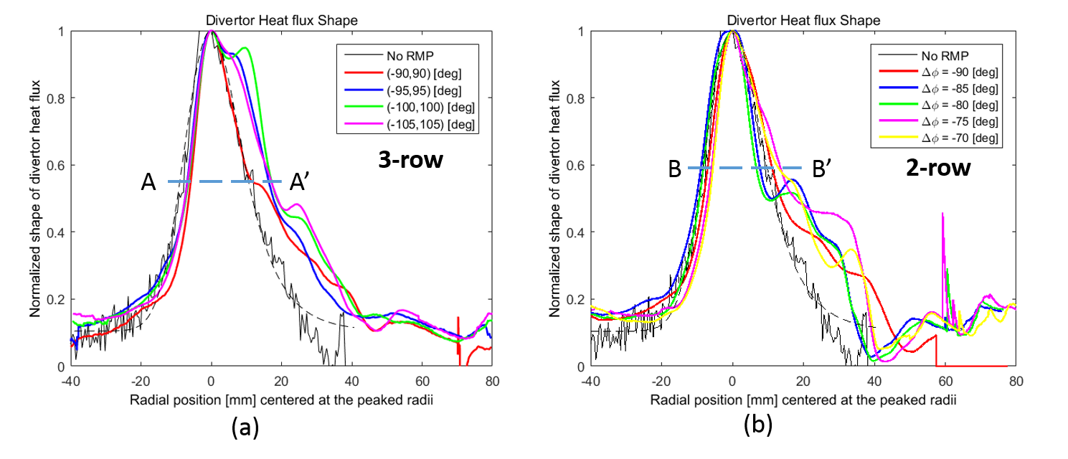
ITER-like 3-row RMPs have broadened the divertor heat flux during
ELM-crash-suppression at the near SOL, which cannot be seen with 2-rows
19212
19214
3-row
A
A’
3-rows
2-rows
Radial position at the maximum [mm]
Radial position at the maximum [mm]
Additional degree of freedom in 3-rows in RMPs, beyond usual 2-rows, appears responsible for the broadening of the heat flux near SOL, favorable to the ITER system

Slide 17
Outline
Introduction
  Divertor heat flux measurement diagnostic
  Intentionally misaligned 3-D configurations (IMC)
Impact of 3-D field configurations on divertor heat flux profiles
  3-rows vs 2-rows (Upper/Lower RMPs)
Simple-model comparison (preliminary)
Progress in the compatibility study of RMP-driven, ELM-crash-suppression with detached plasmas
Discussion and Summary

Slide 18
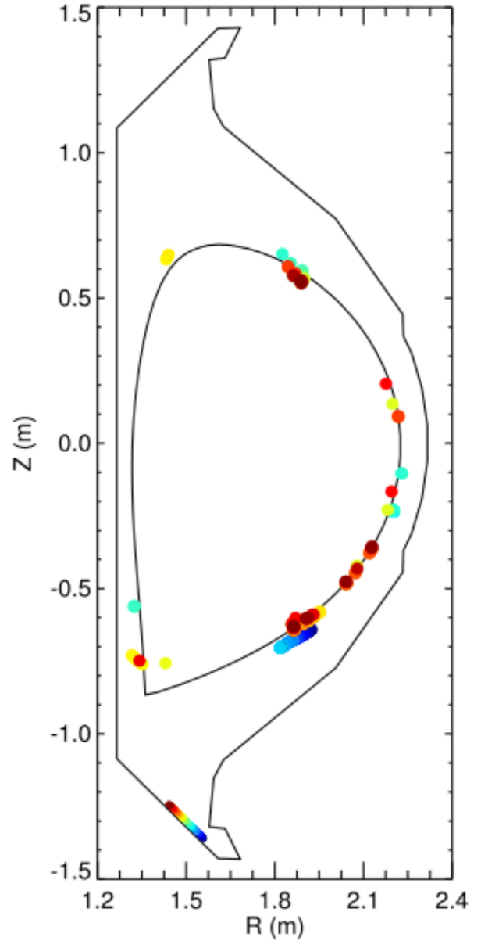
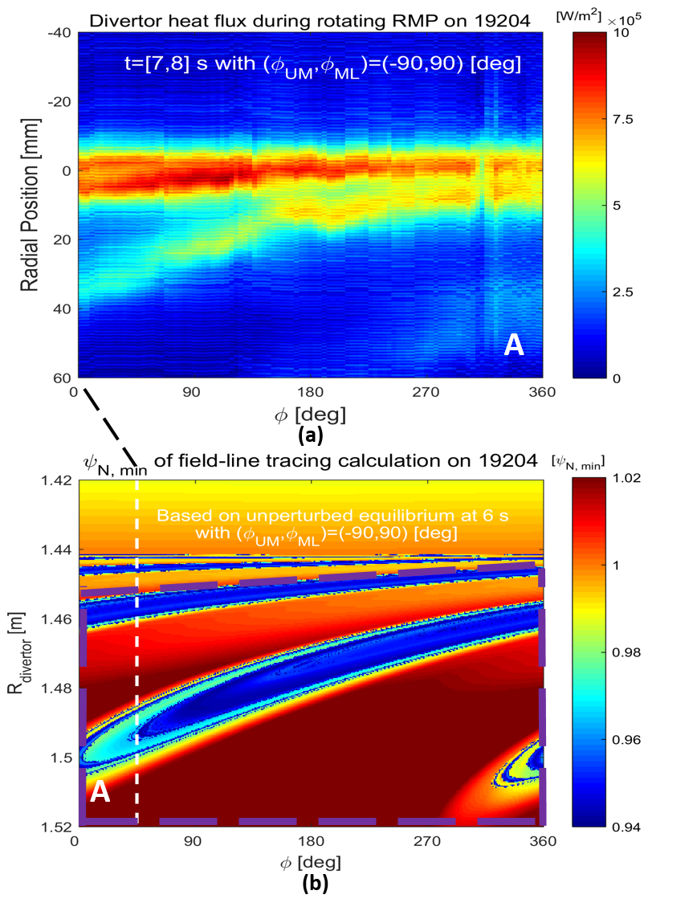
Field-line-tracing suggests minimum ψ_{n} surface, possibly corresponding to the vicinity of the outer striking point
No effect on power loads in narrow regions of long connection lengths, attributable to a ‘smearing’ effect due to perpendicular transport
[Kobayashi et al, NF (2007);
Stangeby & Mitteau,
JNM (2009)]
Refer to K. Kim et al, PoP (2017)

Slide 19
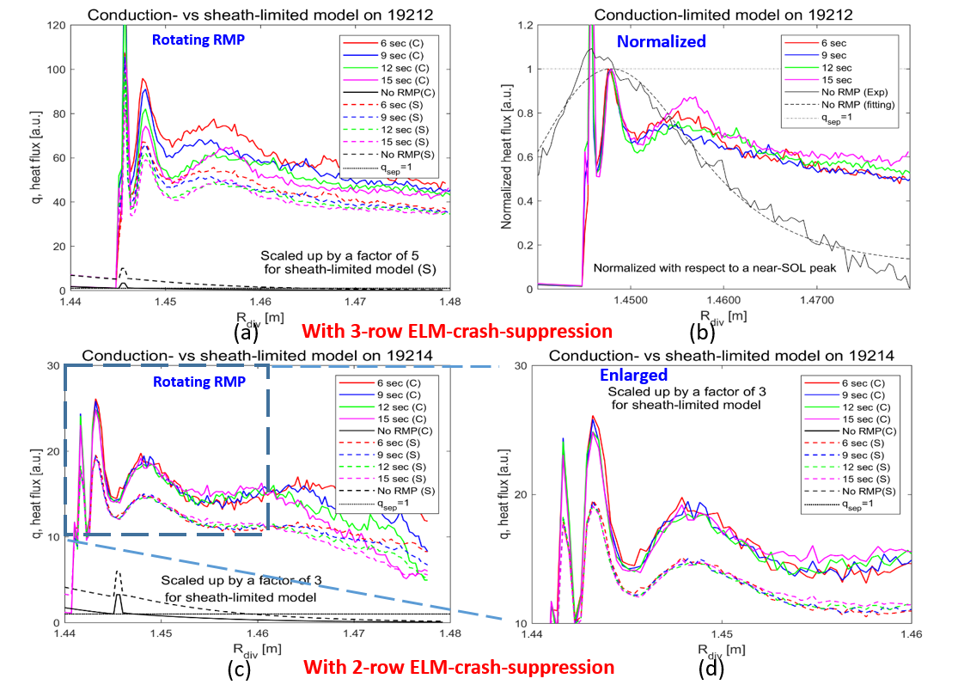
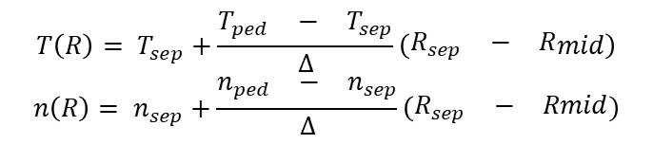

Although a simple modeling with 3 rows predicts heat flux reduction based on field-line-tracing, the broadened profiles have not been numerically confirmed yet
Simple models
- Sheath-limited heat flux
$q_{div}(R)= \frac{\begin{matrix}n(R) & {T(R)}^{3/2}\end{matrix}}{\begin{matrix}n_{sep} & T_{sep}^{3/2}\end{matrix}}$
- Conduction-limited heat flux
$q_{div}(R)= \frac{{T(R)}^{7/2}}{T_{sep}^{7/2}}$
where
No spike observed in experiment
e-folding length ~ 15mm (unperturbed)
$${T\left(R\right)= T}_{sep}+\frac{\begin{matrix}T_{ped} & − & T_{sep}\end{matrix}}{∆}\left(\begin{matrix}R_{sep} & − & R\end{matrix}mid\right)$$
$${n\left(R\right)= n}_{sep}+\frac{\begin{matrix}n_{ped} & − & n_{sep}\end{matrix}}{∆}\left(\begin{matrix}R_{sep} & − & Rmid\end{matrix}\right)$$
➔ Need more sophisticated modelling (e.g. EMC3-EIRENE) and nonlinear approaches, as well as perpendicular transport

Slide 20
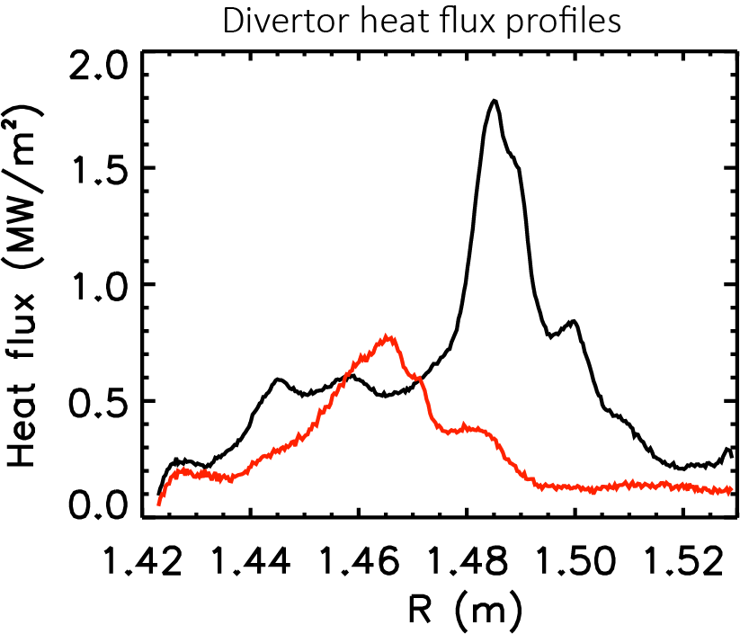
High density ELM-crash-suppression has been achieved for n=2 RMP with substantial reduction of divertor heat flux, despite no detachment yet
RMP
RMP
19261 19279
6.0
4.0
2.0
q_{peak} = 1.8 MW/m² (19261): typical density
vs
0.8 MW/m² (19279): high density
[10¹⁹m⁻³]
2
1
0
D_{α} (arb.)
Measured during the outer strike point sweep
at t=9.0 sec (19261)
7.5 sec (19279)
4.0
3.5
3.0
q₉₅
q₉₅ = 3.4
2.5
2.0
1.5
β _{N}
1.0
0.5
0
V_{div} (V)
3 4 5 6 7 8 9
Time (sec)
J.W. Ahn et al, APS-DPP (2017)

Slide 21
Simple linear and parallel transport analysis is not sufficient to explain the divertor heat flux broadening mechanism, requiring more sophisticated modeling
Although the 3-row RMP appears effective in broadening the divertor heat flux, it is possible that the mid-row might have played a bigger role than the other off-mid rows (scheduled for experiments in 2018)
Further study needs to demonstrate the RMP-driven, ELM-crash-suppression even with
i) low-rotation, ii) ITER-similar-shape (ISS), iii) partially detached plasmas
At the same time, the physics mechanism responsible for the broadening of near-SOL heat flux needs to be answered (in need of more detailed simulations (e.g. EMC3-EIRENE) and nonlinear approach)
➔ Pure 3-D field effect or plasma response (e.g. kink or peeling (?))

Slide 22
Intentionally misaligned configurations are not only compatible with ELM-crash-suppression, but also effective in dispersing the divertor heat flux, while minimizing EM loads on RMP coils
Demonstrated a divertor heat flux broadening by dephasing
during RMP-driven, ELM-crash-suppression without driving mode-locking
3-row RMPs appeared more effective in broadening divertor heat fluxes than 2-row RMPs
Simple linear and parallel transport analysis is not sufficient to explain the divertor heat flux broadening mechanism, possibly requiring more sophisticated modelling (e.g. EMC3-EIRENE) and nonlinear approaches
ITER-like 3-row RMPs could be judiciously configured to broaden divertor heat fluxes with minimal EM loads on coils using IMC

Slide 23
Back-up

Slide 24
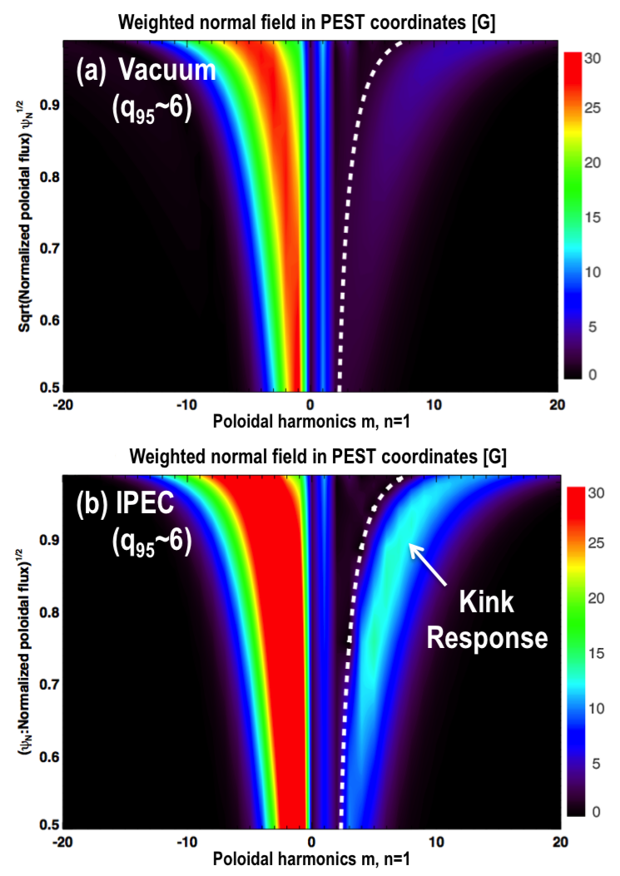
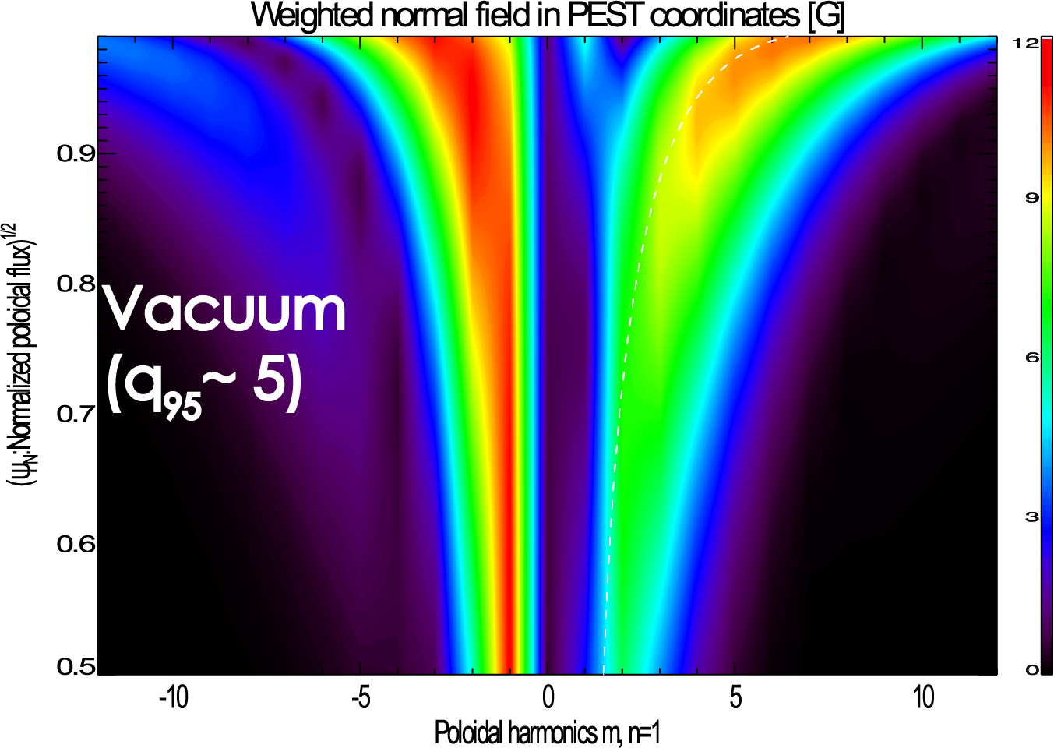
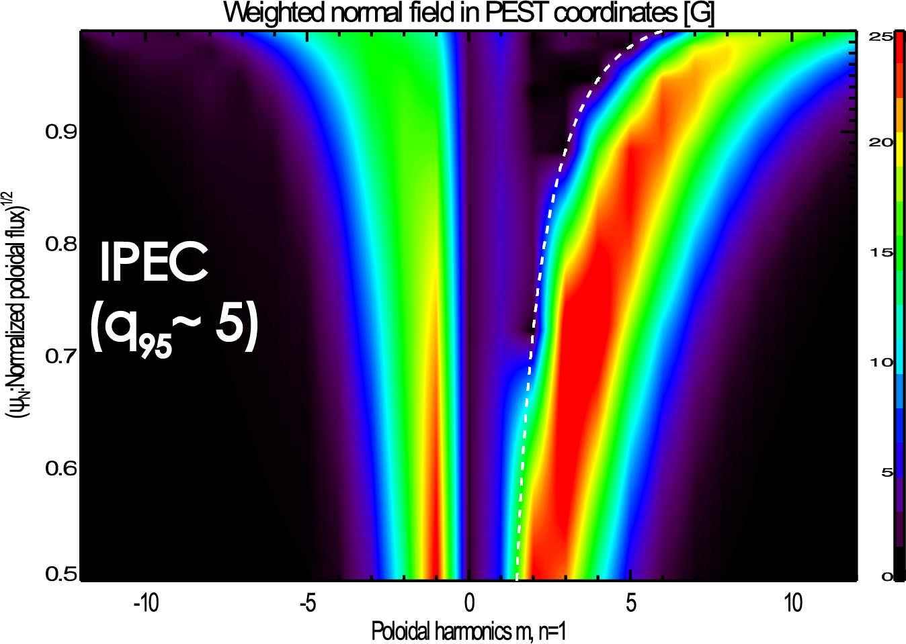
Seemingly dominantly non-resonant configuration in vacuum may turn out to be dominantly resonant configuration in plasma response
- | - | + | +
- | + | + | -
I_{M}=0kA subspace
(off-midplane only)
Seemingly ‘Kink-orthogonal’ in vacuum
appears dominantly
‘kink-aligned’ in plasma response (Δφ = 270°)
(Δφ = -90°)
K. Kim et al, NF (2017)
Ideal plasma response calculation “predicted first” the ELM-crash-suppression of n=1 ‘off-midplane’ RMPs

Slide 25
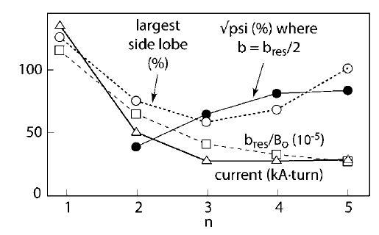
Slowly decaying nature of n=1 field could be potentially a merit, rather than an obstacle in RMP ELM control in future reactors
Previously, ITER RMP control has discarded the option of n=1 RMP due to
1) wide spacing between adjacent islands
  high field strength required to meet σ_{Chirikov} > 1
2) hardly decaying into the core plasma, susceptible to mode-locking
➔ correct, but not a major hindrance in KSTAR due to low-intrinsic EF !
Likely, KSTAR would be the most suitable device to address the validity of n=1 RMP ELM-control
Y. In et al, KSTAR conference (2015)
KSTAR specializes in low-n RMP ELM control challenges !!!
[Schaffer et al, NF (2008)]

Slide 26
Intentionally misaligned configurations
II. “away” from each row (φ_{UM} = φ_{ML}> 90 ⁰): kink-aligned
Δφ =+90 ⁰
U
M
L
+ | + | − | −
− | + | + | −
− | − | + - | +
θ
−180º
0º
180º
φ

Slide 27
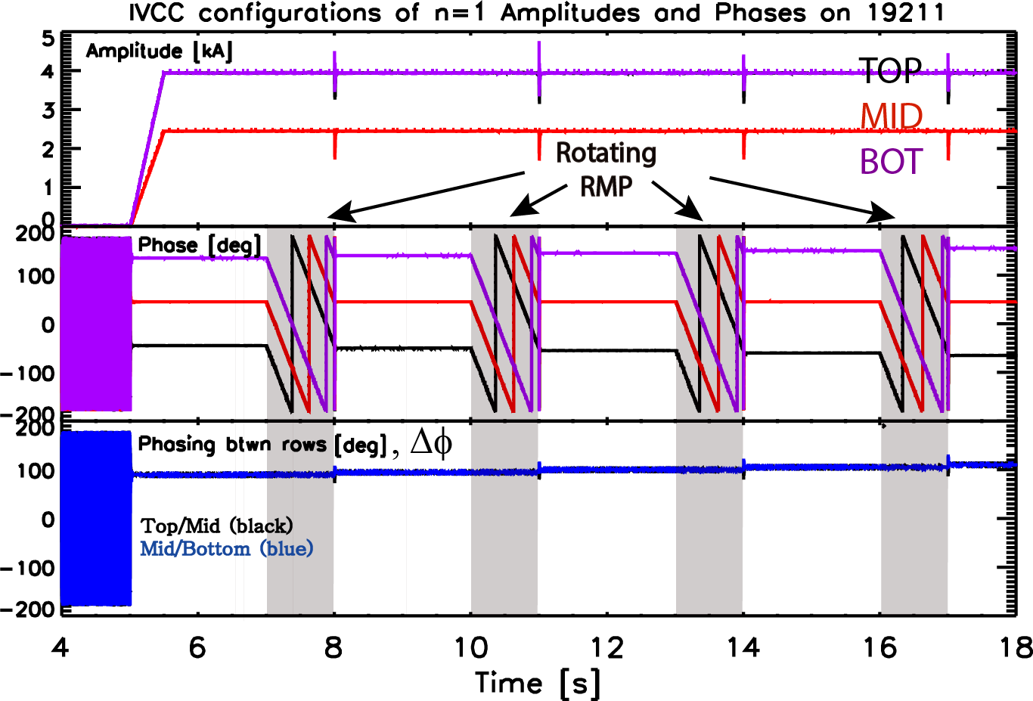
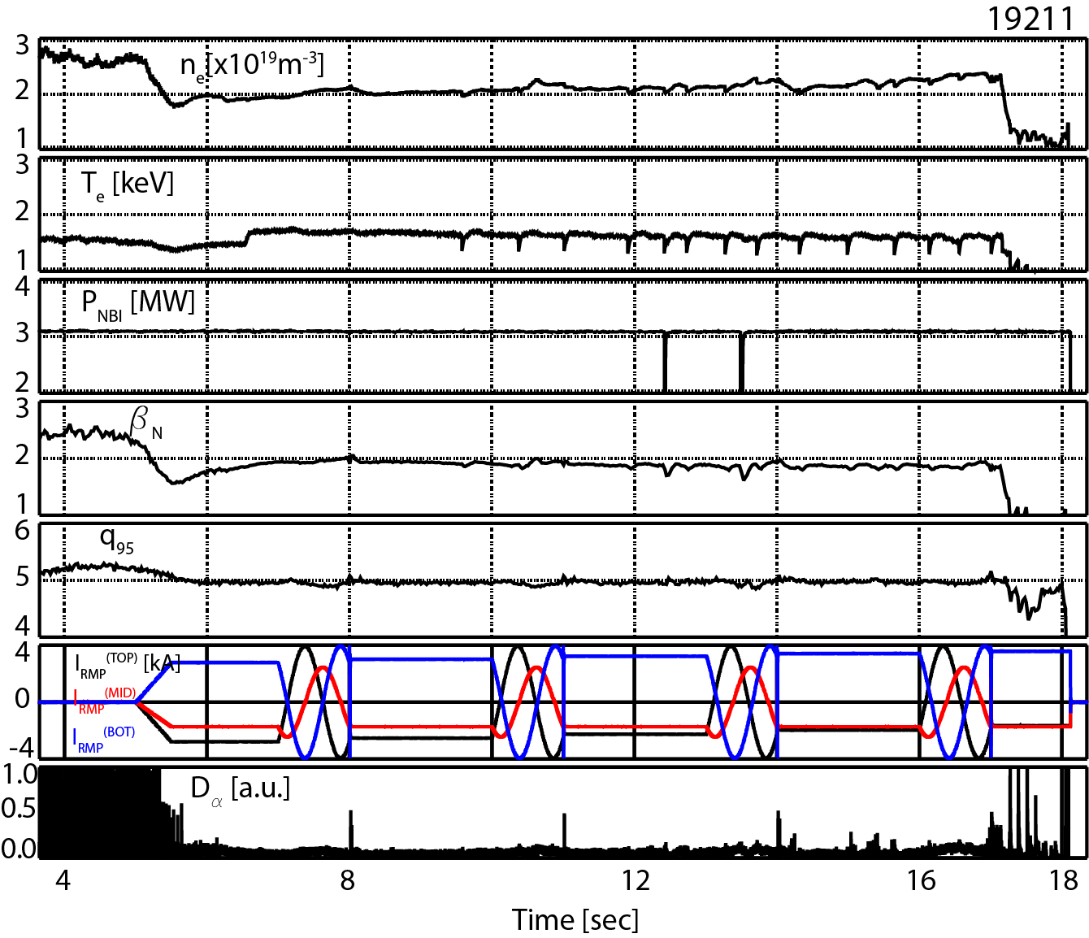
Phasing increase toward kink-resonance in n=1 RMP configurations appears quite effective in sustaining the RMP ELM suppression
Away from each other (Top/Bot) (19211)
(φ_{UM}, φ_{ML})= (-90,90);(-95,95);(-100,100);(-105,105)
w.r.t. φ_{M} =0 deg [e.g. +90deg phasing (-90,90)]
U
M
L
+ | + | - | -
- | + | + | -
- | - | + | +
Y. In et al, APS-DPP (2017); submitted for publication (2018)
−180º
0º
180º

Slide 28
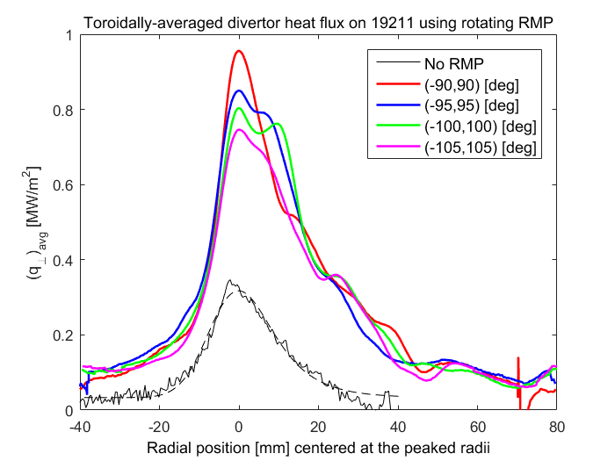
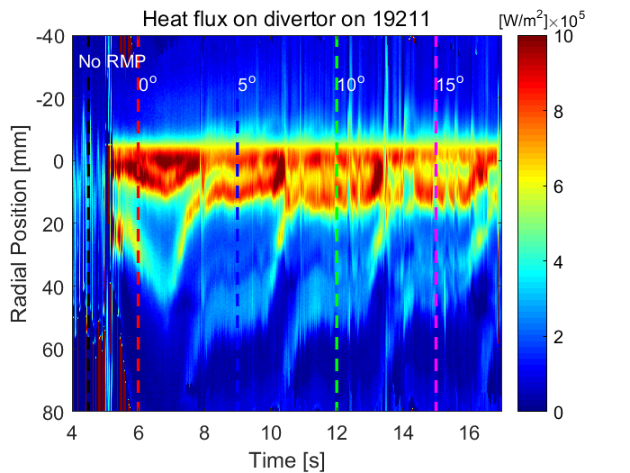
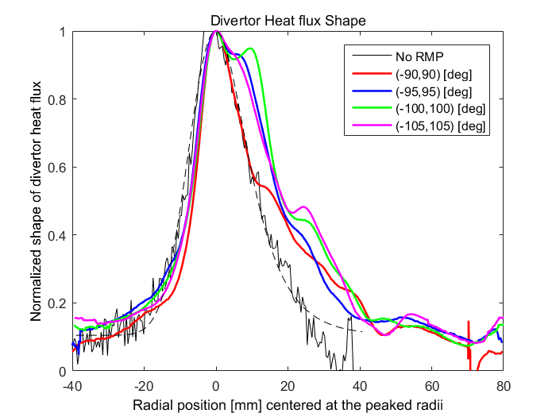
As long as mode-locking is avoided, the kink-aligned configuration has been observed to be effective in broadening the divertor heat flux
Realigned divertor heat flux contour (19211)
Rotating RMP
λ_{q} =1.9 mm
Normalized
Reduced peak of heat flux, along with broadened
shape, during RMP-driven, ELM suppression is quite favorable to ITER, similarly observed during RMP-driven, ELM mitigation [Y. In et al, NF (2017)]
Y. In et al, APS-DPP (2017); submitted for publication (2018)

Slide 29
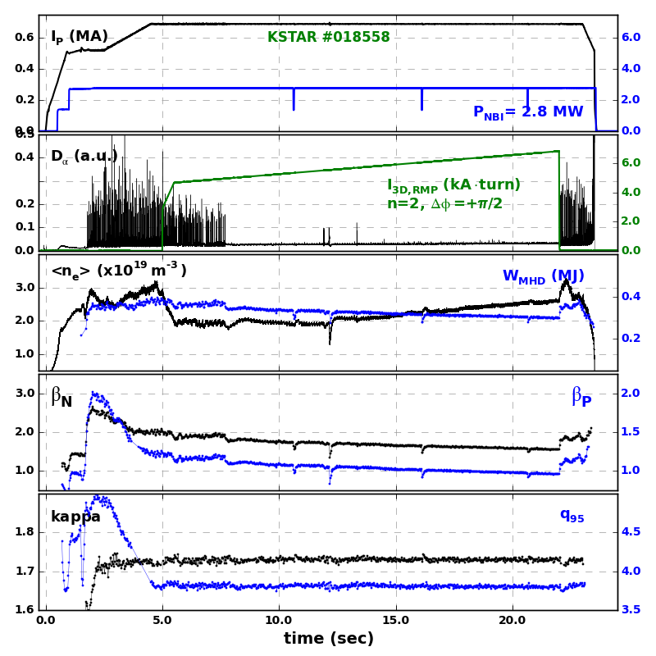
Robust ELM-crash-suppression has been successfully developed using either n=1 or n=2 RMPs
∼ 30 sec ≥ τ_{wall}
∼ 15 sec
n=1, Δφ = +90°
n=2, Δφ = +90°
q₉₅ ~ 5.0
q₉₅ ~ 3.8
+ | + | - | -
- | + | + | -
- | - | + | +
+ | - | + | -
- | + | - | +
+ | - | + | -
Y.M. Jeon et al, APS-DPP (2017)

Slide 30
Intentionally misaligned configurations
I. “distorted” (φ_{UM} ≠ φ_{ML} )
Δφ =+90 ⁰
U
M
L
+ | + | − | −
− | + | + | −
− | − | + - | +
ELM-crash-suppression
Y. In et al, APS-DPP (2017)
ELM-crash-mitigation
Y. In et al, FEC (2016); NF (2017)
θ
−180º
0º
180º
φ

Slide 31
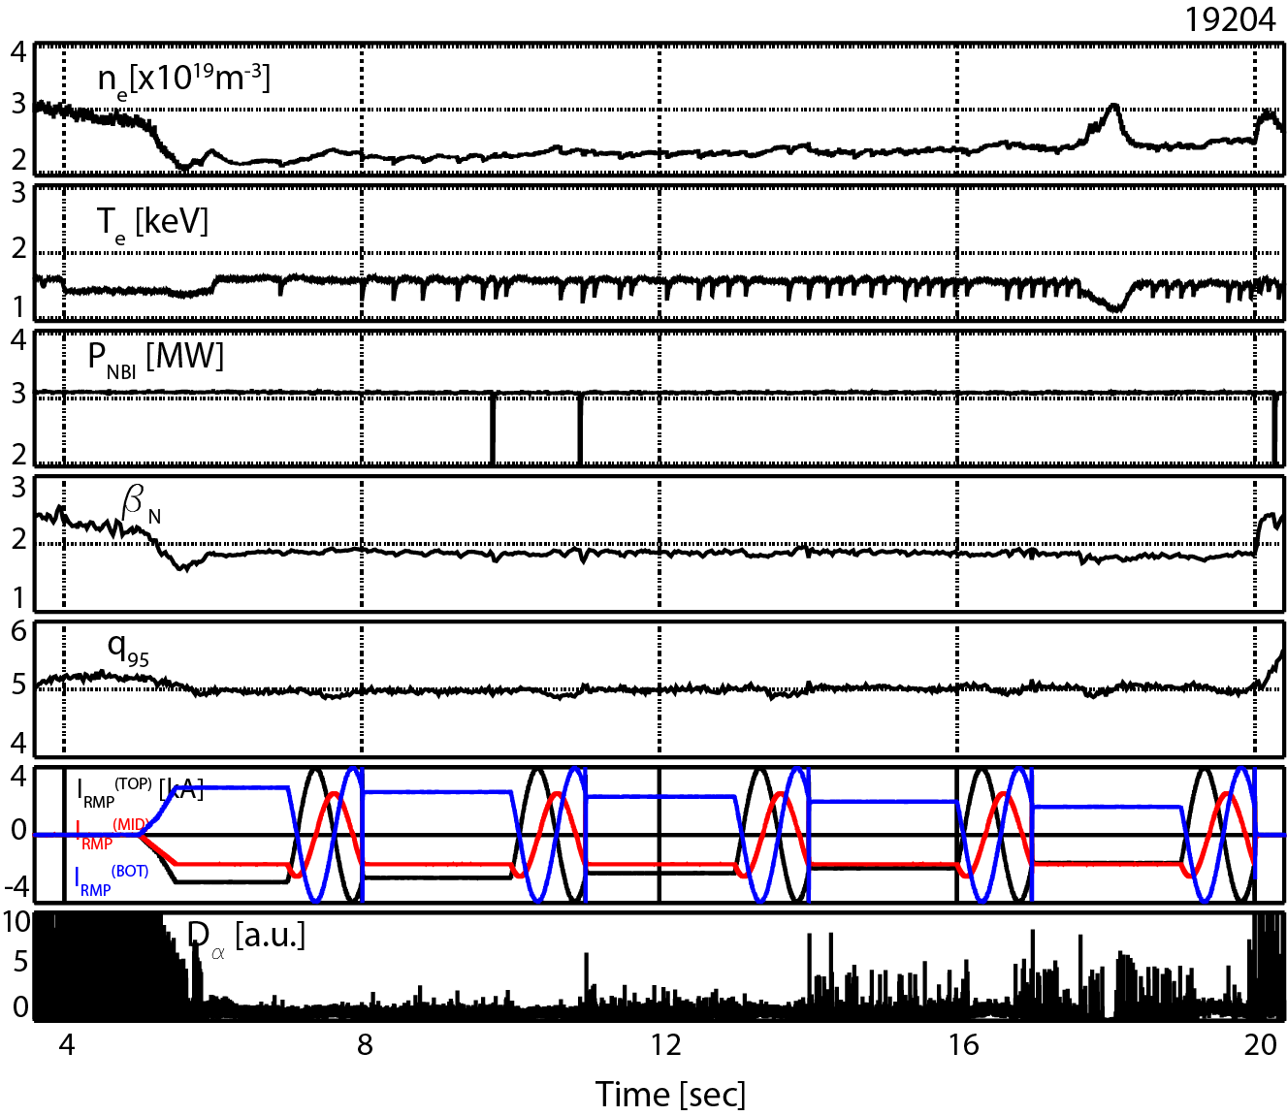
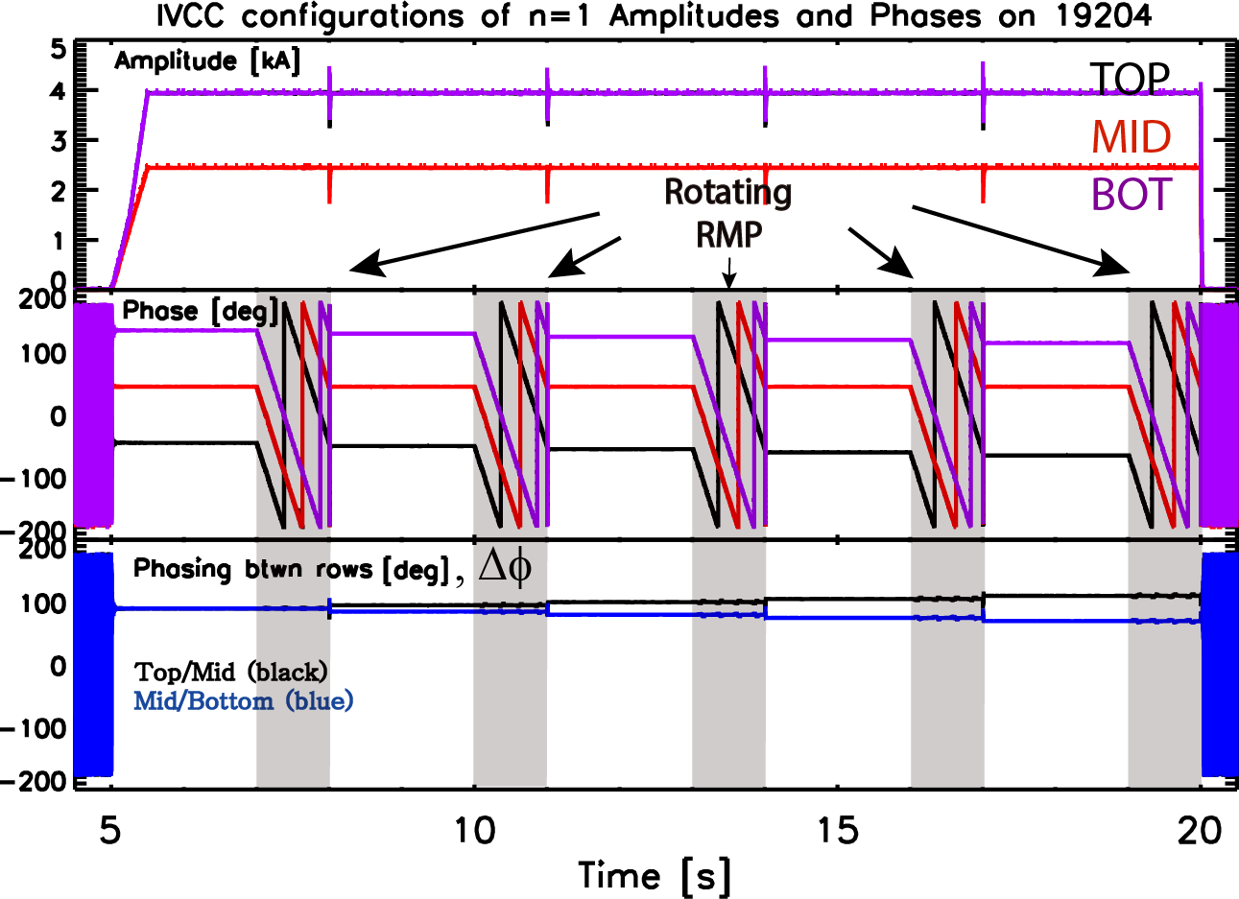
Intentionally misaligned n=1 RMP configurations have been confirmed to be effective in suppressing ELM-crashes
(φ_{UM}, φ_{ML})= (-90,90);(-95,85);(-100,80);(-105,75);(-110,70)
w.r.t. φ_{M} =0 deg [e.g. +90deg phasing (-90,90)]
U
M
L
+ | + | - | -
- | + | + | -
- | - | + | +
Y. In et al,
APS-DPP (2017)
Fully sustained ELM-crash-suppression during rotating n=1 RMP is attributable to the low intrinsic EF in KSTAR
−180º
0º
180º

Slide 32
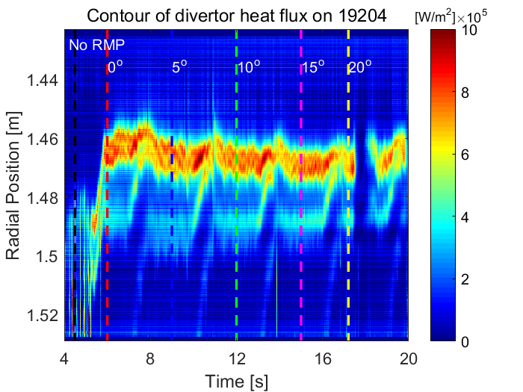
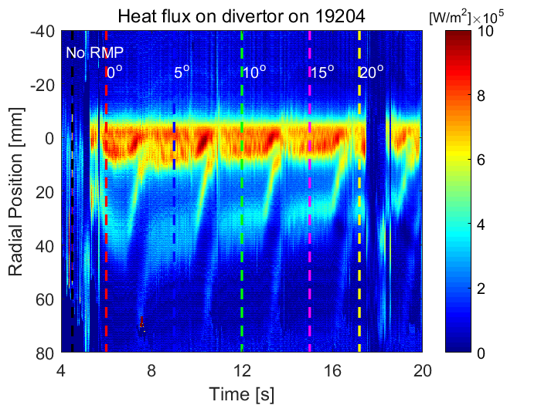
Given various uncertainties in fixing the outer strike point, the realigned heat flux patterns would help us assess the most stringent conditions on divertor
IR camera
Hitting the same spot with the peaked heat flux throughout the discharge would be the most severe conditions, which could be regarded as the maximal heat flux on divertor

Slide 33
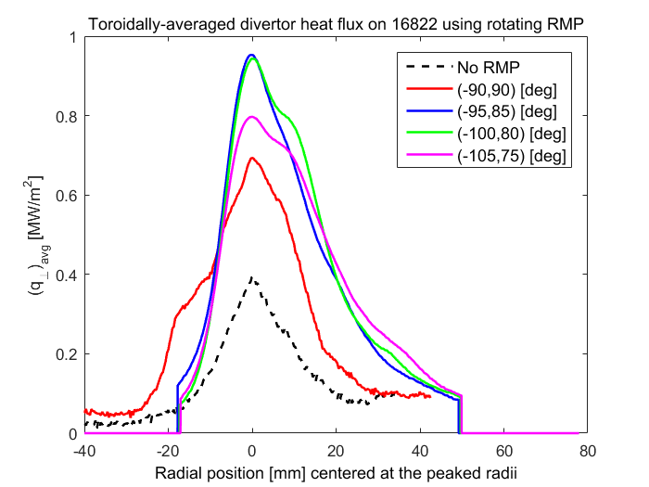
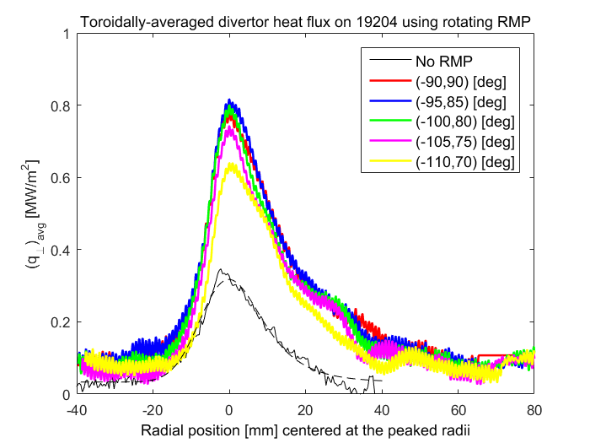
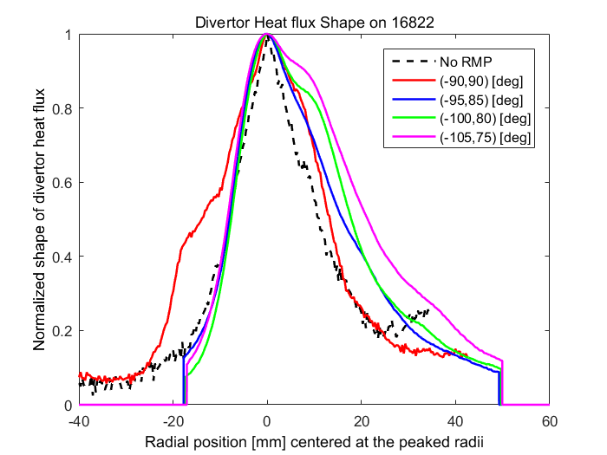
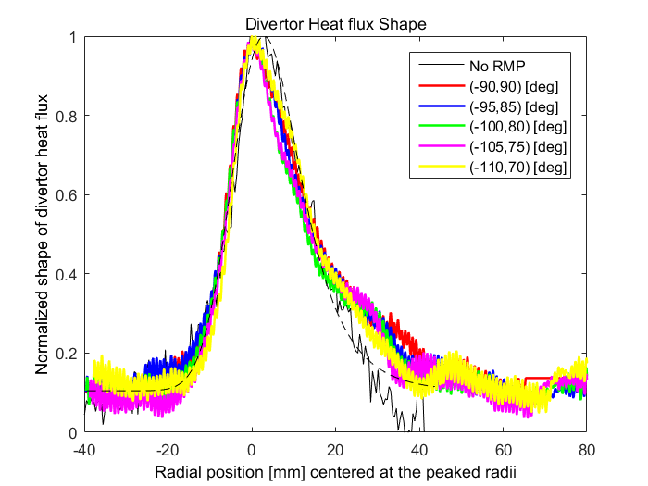
During RMP ELM suppression, the misaligned configurations has reduced the peaks, but no broadening was seen in both static and rotating RMPs
NOTE that the exactly same 3-D configuration during ELM mitigation led to a lowered peak, along with broadened heat flux
Divertor heat flux
dispersal cannot be extrapolated
from ELM mitigation
to ELM suppression
Attributable to
bifurcated state of ELM suppression
Rotating RMP
λ_{q} =1.9 mm
During ELM mitigation
During ELM suppression
Normalized
Excerpted from
Y. In et al, NF (2017)

Slide 34
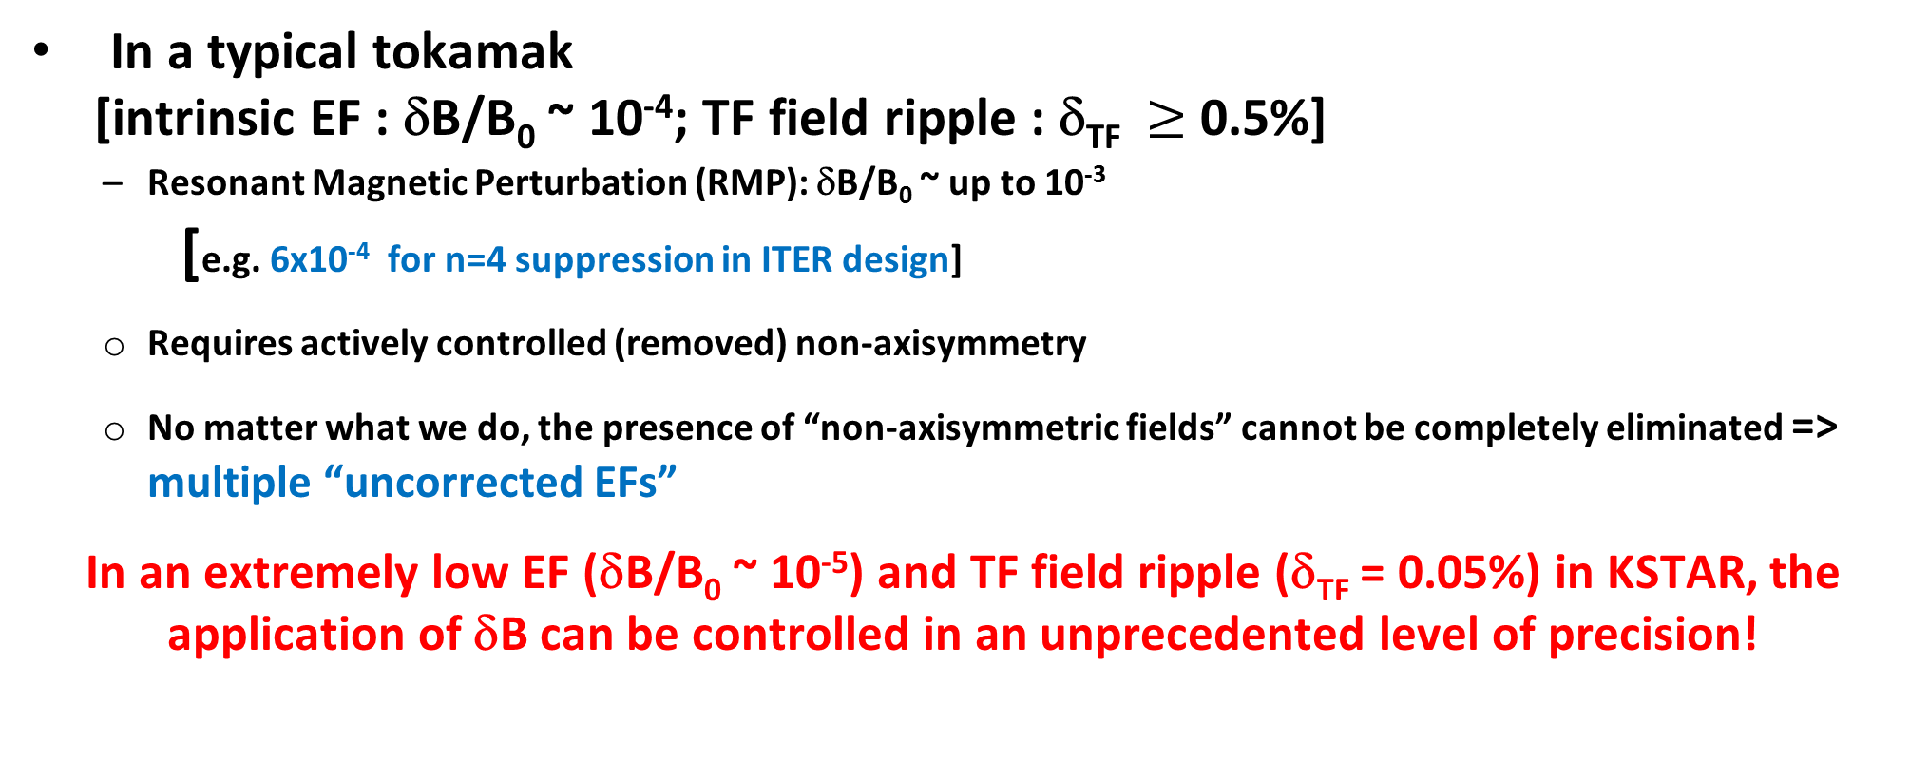
An order of magnitude lower level of intrinsic non-axisymmetry enables us to address 3D field physics and its uncertainties more rigorously
In a typical tokamak
[intrinsic EF : δB/B₀ ~ 10⁻⁴; TF field ripple : δ_{TF} $≥$0.5%]
  Resonant Magnetic Perturbation (RMP): δB/B₀ ~ up to 10⁻³
  [e.g. 6x10⁻⁴ for n=4 suppression in ITER design]
  Requires actively controlled (removed) non-axisymmetry
  No matter what we do, the presence of “non-axisymmetric fields” cannot be completely eliminated => multiple “uncorrected EFs”
In an extremely low EF (δB/B₀ ~ 10⁻⁵) and TF field ripple (δ_{TF} = 0.05%) in KSTAR, the application of δB can be controlled in an unprecedented level of precision!
δB/B₀
10⁻⁵
10⁻⁴
10⁻³
10⁻²
Conv. Tokamaks
Stellerator
Y. In et al, NF (2015)
KSTAR
What about ITER or future reactors ?

Slide 35
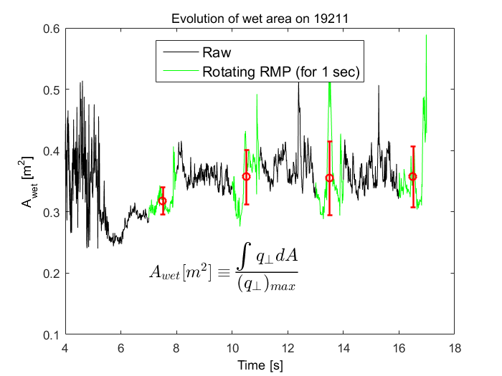
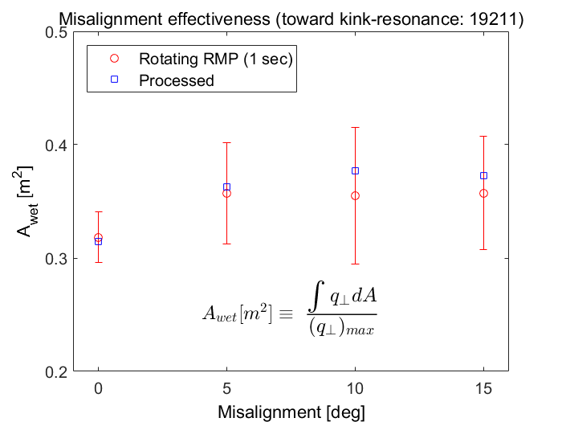
The effectiveness of misalignment is easily understood in the comparison of “wet areas”, leading up to ~20% increase
Using “intentionally misaligned” RMP configurations, the merit of dephasing is shown in reducing the peak, as well as dispersing heat flux on a wider area

Slide 36
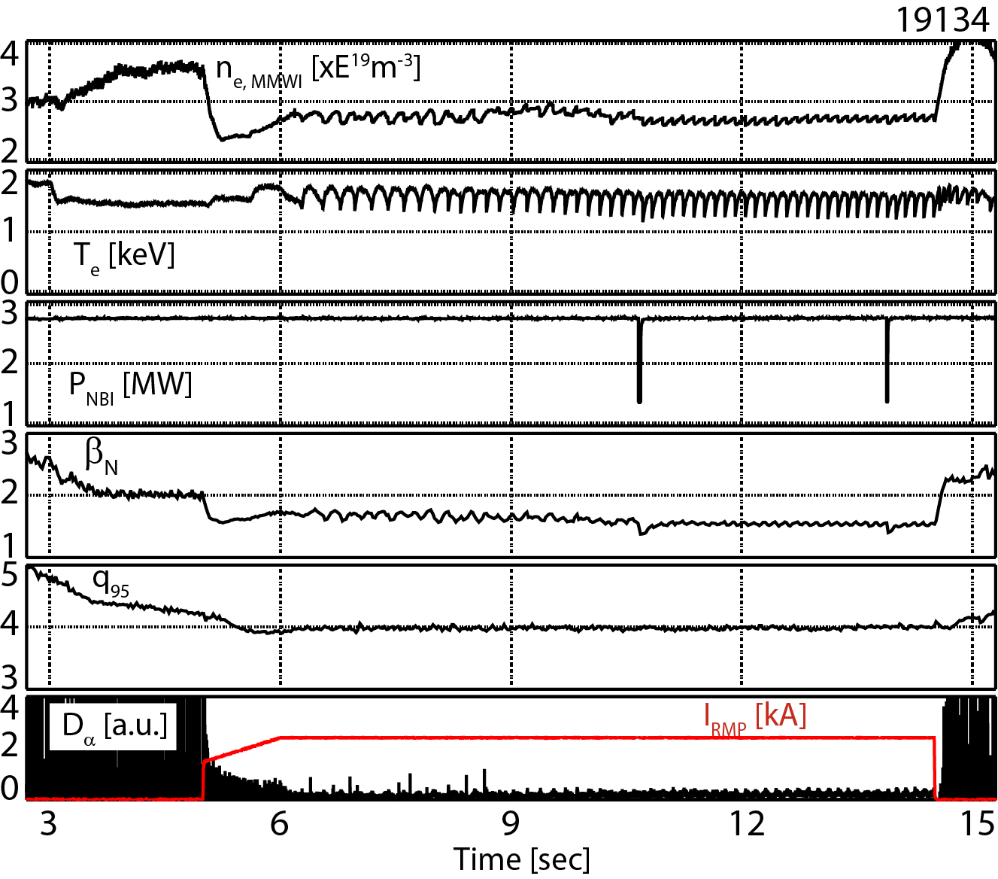
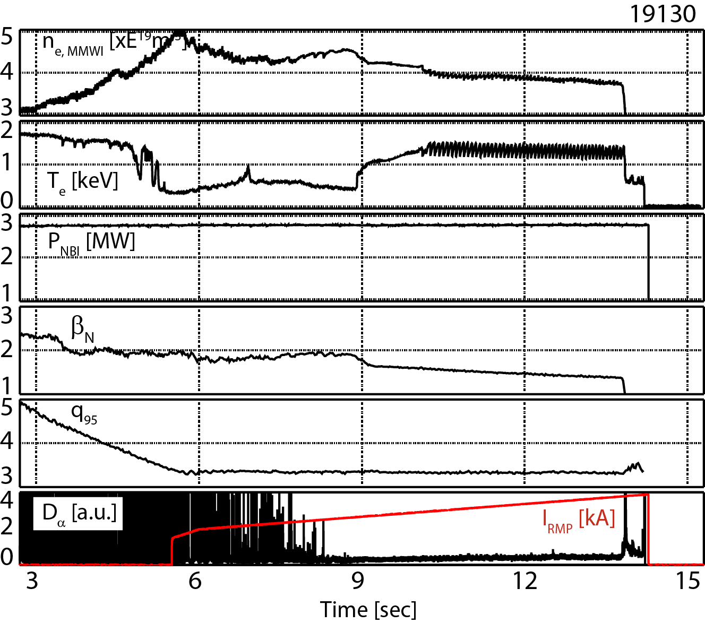
Lower q₉₅ ELM-crash-suppressions, close to ITER (q₉₅~3.1) have been newly established in KSTAR using low-n RMPs
ECE density cutoff
q₉₅ = 4.0
q₉₅ = 3.4
n=1, Δφ = +90°
n=2, Δφ = +90°
+ | + | - | -
- | + | + | -
- | - | + | +
+ | - | + | -
- | + | - | +
+ | - | + | -
Demonstrated the established methodology of low-n RMP-driven, ELM-crash-suppression would be applicable to ITER-relevant low-q₉₅ regime

Slide 37
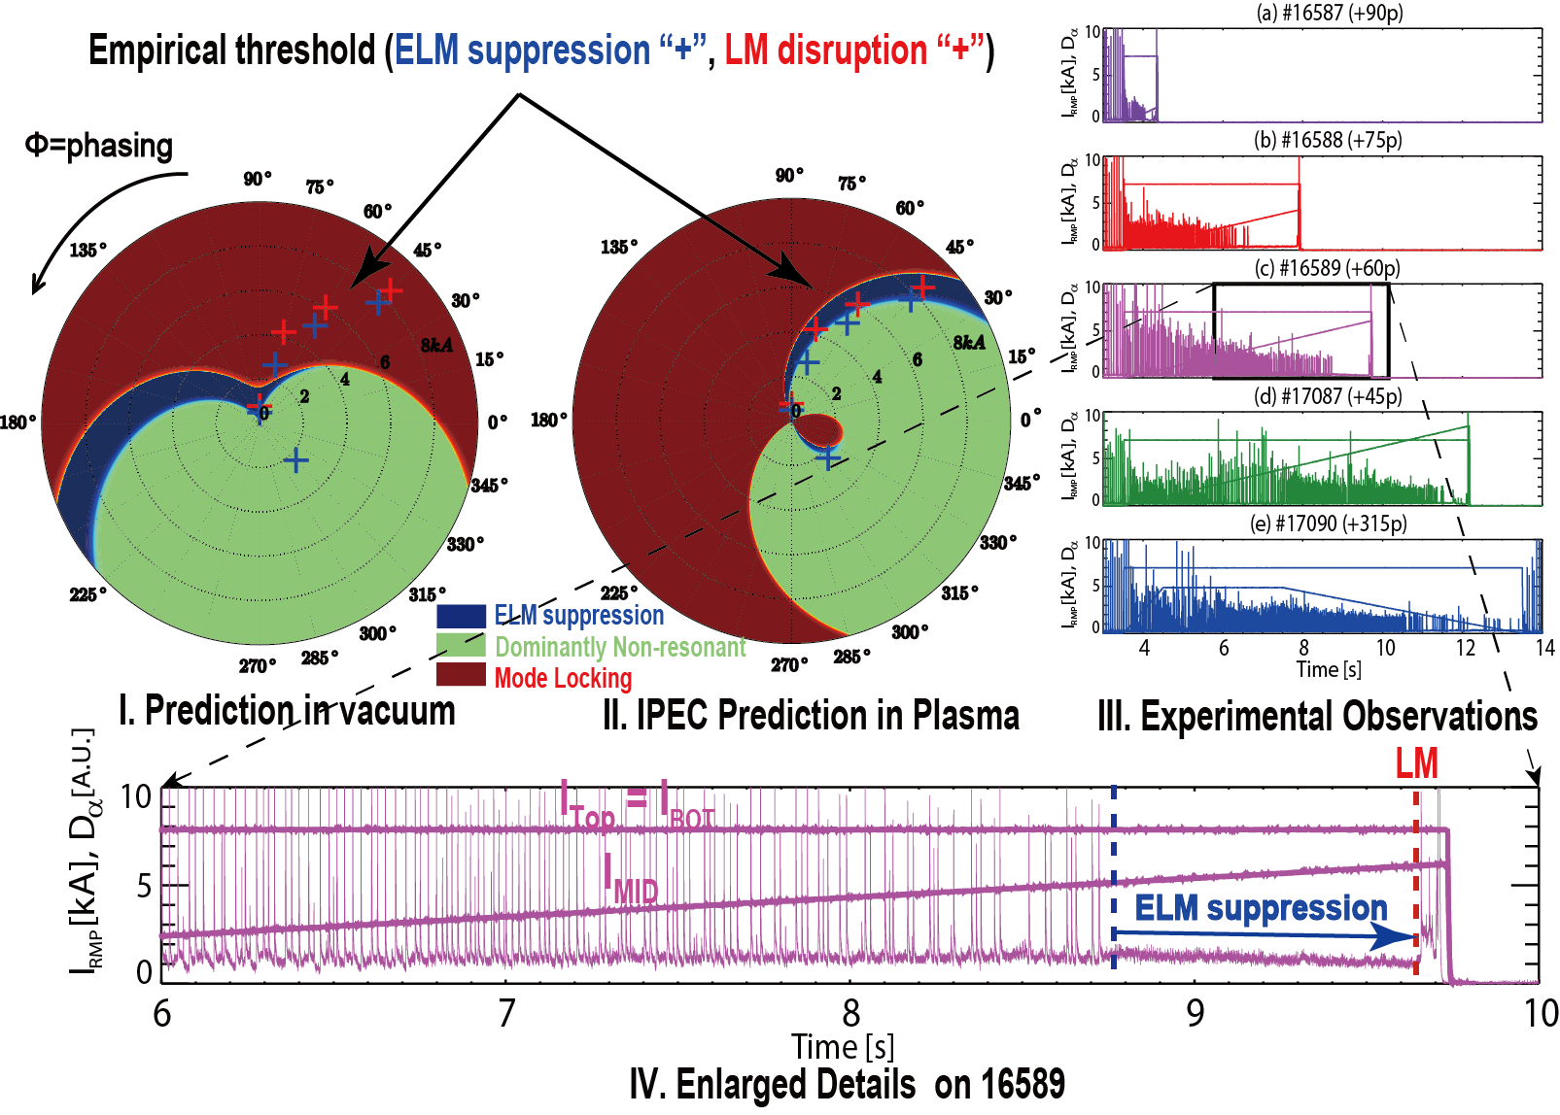
Edge resonant components decoupled from core counterparts allow us to predict an optimal window for n=1 RMP-driven ELM-crash suppression, while avoiding mode-locking
Polar plot of (I_{MID}, ϕ)
with I_{U}=I_{L}=5kA and ϕ=ϕ_{UM}=ϕ_{ML}
n=1, Δφ = +90°
+ | + | - | -
- | + | + | -
- | - | + | +
Minimize resonant
δB impacts in core,
while maximizing
RMP at edge
Y. In et al, NF (2017); J.K. Park et al, to appear in Nature physics (2018)

