Slide 1
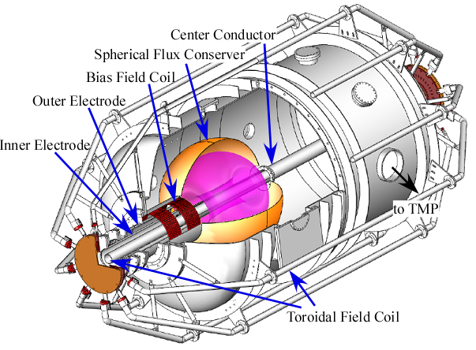
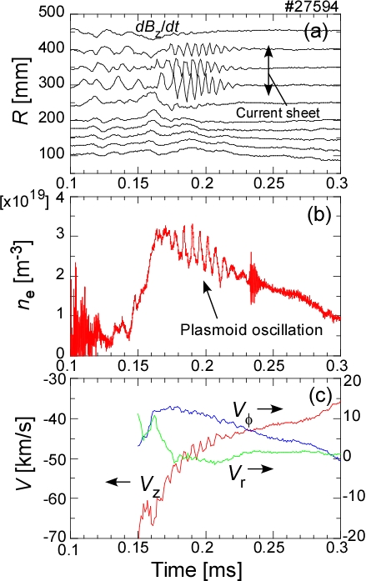
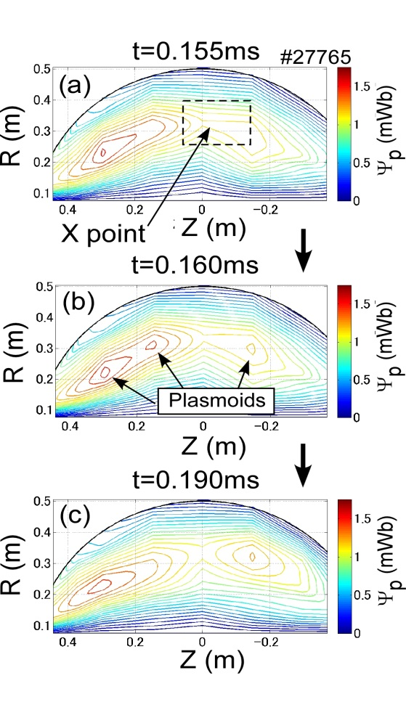
Experimental Studies of Plasmoid Reconnection for Closed Flux Current Generated by Coaxial Helicity Injection on HIST
M. Nagata et al. (Univ. of Hyogo) EX/P3-17
HIST
Fig.1
The flux closure due to the fast plasmoid reconnection has been demonstrated in the transient coaxial helicity injection (T-CHI) start-up plasma on HIST.
Fig.2
Fig.3
The observation of the regular oscillations of B_{z}, n_{e} and V_{z} in the elongated current sheet provides a strong evidence of the plasmoid reconnection.(Fig.2)
In the He discharges, the two discrete closed flux surfaces (doublet-type ST configuration) have been established after the mini-plasmoid develops to the large-size plasmoid by the reconnection with slower compared to H₂. (Fig.3)

