Slide 1
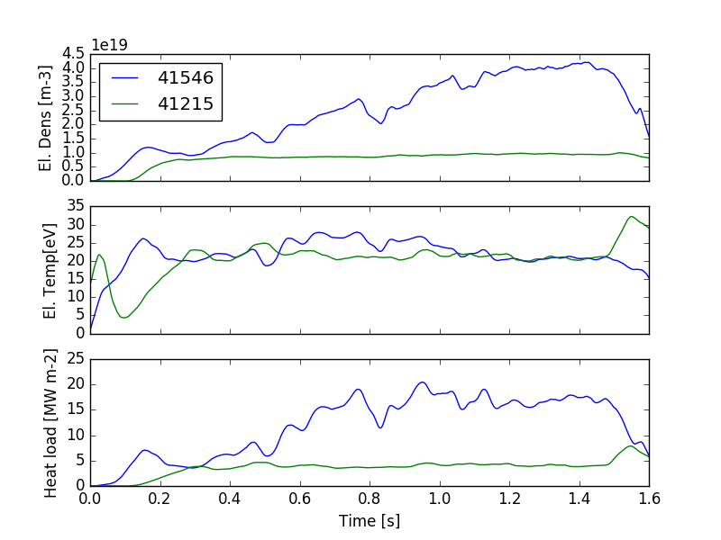
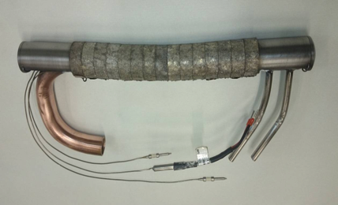
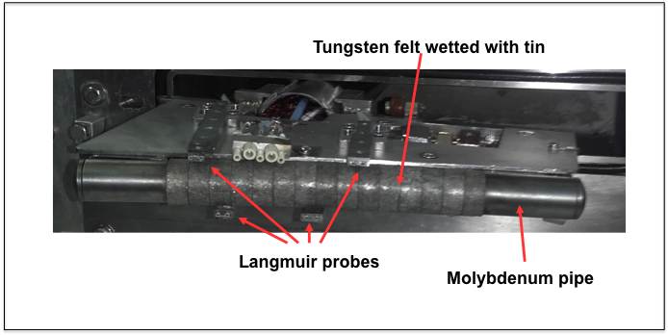
Experiments on FTU with a liquid tin limiter
For the first time a tin limiter has been tested on a tokamak device
Capillary Porous system based tin experiments are promising and indicate high heat exhaust capability.
Up to 18 MW/m² were measured on the liquid tin limiter during FTU pulse for more than 0.5 s
Low plasma contamination and no plasma degradation have been observed with tin also in the case of strong evaporation n_{Tin}/n_{e}≈1x10⁻⁴
Liquid metal seems a viable solution to the power exhaust problem
From the top, the electron density n_{e,LP,} the electron temperature T_{e,LP} and the heat loads q_{LP} versus time are shown for two pulses.
Increased density -→Increased heat load
The Tin limiter
Paper FIP/3-5Rb

