Slide 1
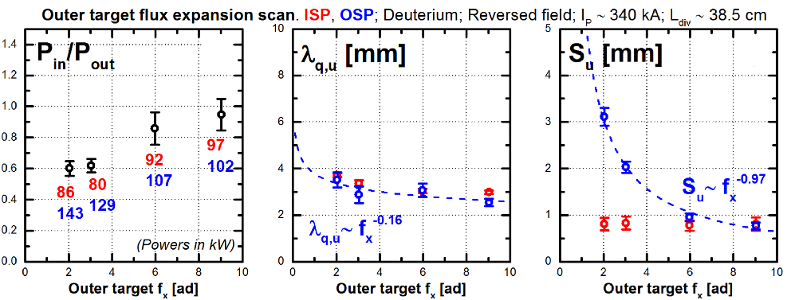
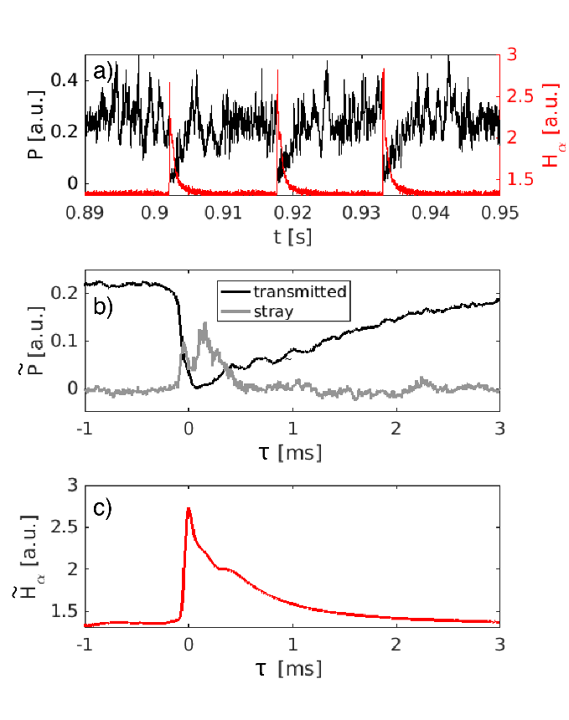
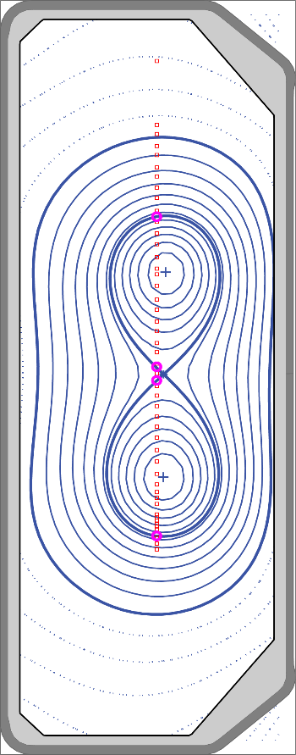
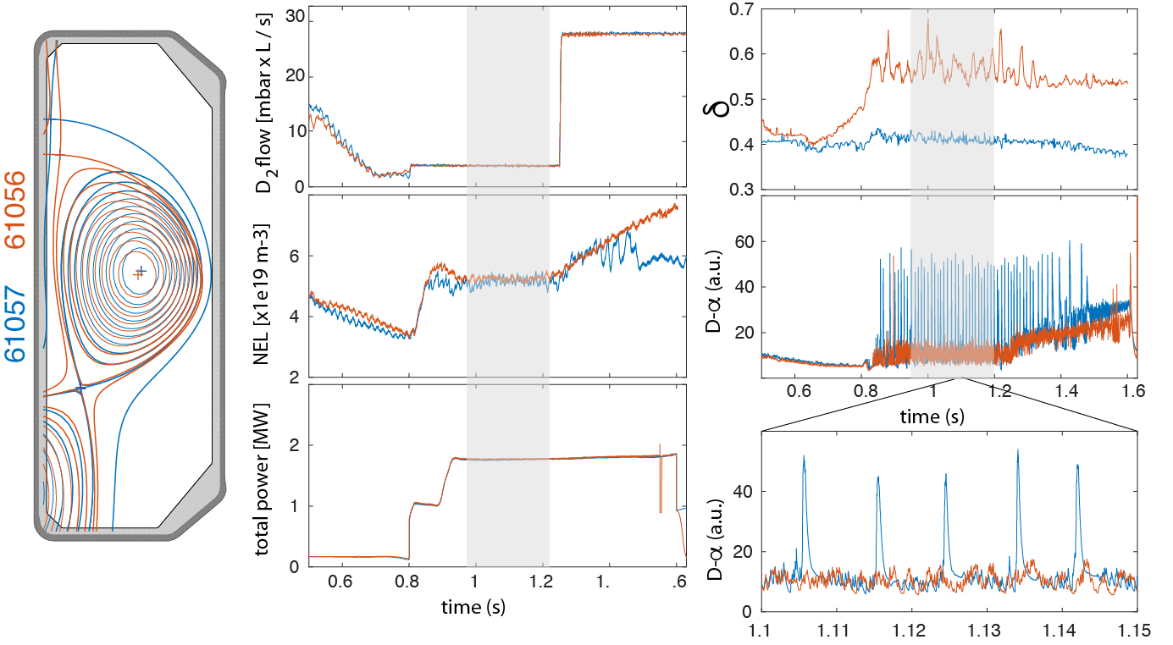
Flux expansion has little effect on SOL decay length, reduces in-out heat-flux asymmetry
Disruption avoidance with ECRH
Runaway electron beam control
Nearly non-inductive H-mode with ECRH+NBI
Transport improvement, ELM mitigation at negative triangularity
Detachment in H-mode
Upcoming vessel upgrade with variable closed divertor
ELMs modulate EC power
First doublet
Higher triangularity changes ELMs from type-I to type-II

