Slide 1

Min Xu on behalf of HL-2A team & collaborators
Southwestern Institute of Physics, Chengdu , China
27th IAEA FEC, October 22-27, 2018, Ahmedabad, India
Overview of HL-2A Recent Experiments
In collaboration with
IRFM/CEA, Cadarache, France
University of California, San Diego, USA
University of Wisconsin – Madison, Wisconsin, USA
CCFE, Culham Science Centre, UK
NIFS, Japan
PPPL, USA
MIT, USA
Kyushu University, Kyoto University, Japan
ASIPP, China
USTC, HUST, Dalian UT, Beijing U, Tsinghua U, HIT, Sichuan U, China

Slide 2
Outline
Present status of the HL-2A Tokamak
Progress of physics study in H-mode plasma
  Techniques and physics of ELM control
  Pedestal dynamics & L-H transitions
  ITB in H-mode plasma
Energetic particle physics and modulation of turbulence by MHD
  Control of fishbone by ECRH
  Fishbone-like mode destabilized by fast ions
  Interaction between TM and turbulence
Summary & Outlook

Slide 3
Outline
Present status of the HL-2A Tokamak
Progress of physics study in H-mode plasma
  Techniques and physics of ELM control
  Pedestal dynamics & L-H transitions
  ITB in H-mode plasma
Energetic particle physics and modulation of turbulence by MHD
  Control of fishbone by ECRH
  Fishbone-like mode destabilized by fast ions
  Interaction between TM and turbulence
Summary & Outlook

Slide 4
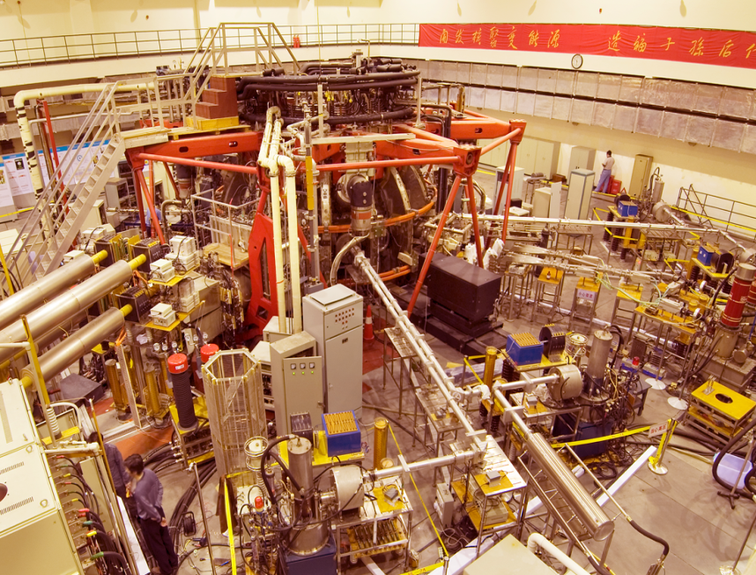
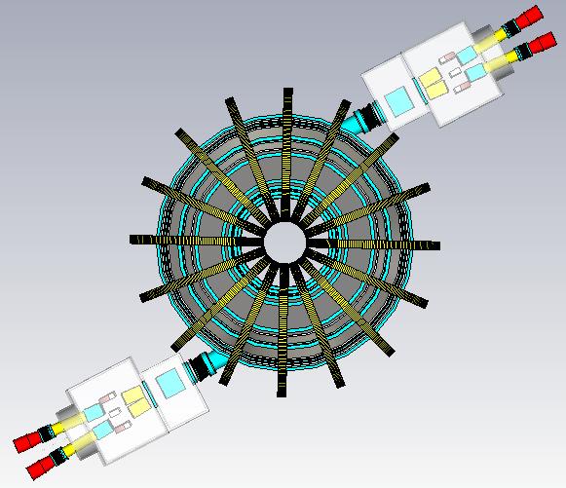
Present Status of HL-2A Tokamak
R: 1.65 m
a: 0.40 m
B_{t}: 1.2~2.7 T
I_{p}: 150 ~ 480 kA
n_{e}: 1.0 ~ 6.0 x 10¹⁹ m⁻³
T_{e}: 1.5 ~ 5.0 keV
T_{i}: 0.5 ~ 3.5 keV
Heating systems:
ECRH/ECCD: 5 MW
NBI (tangential): 3 MW
LHCD: 2 MW (PAM, 2 s)
Plan view
NORTH
Newly developed diagnostics
Beam Emission Spectroscopy (BES)
Phase Contrast Imaging (PCI)
He Gas-Puss-Imaging (He-GPI)
Coherence Imaging Spectroscopy (CIS)
CO2 laser collective Thomson scattering system
NBI2
NBI1
SOUTH

Slide 5
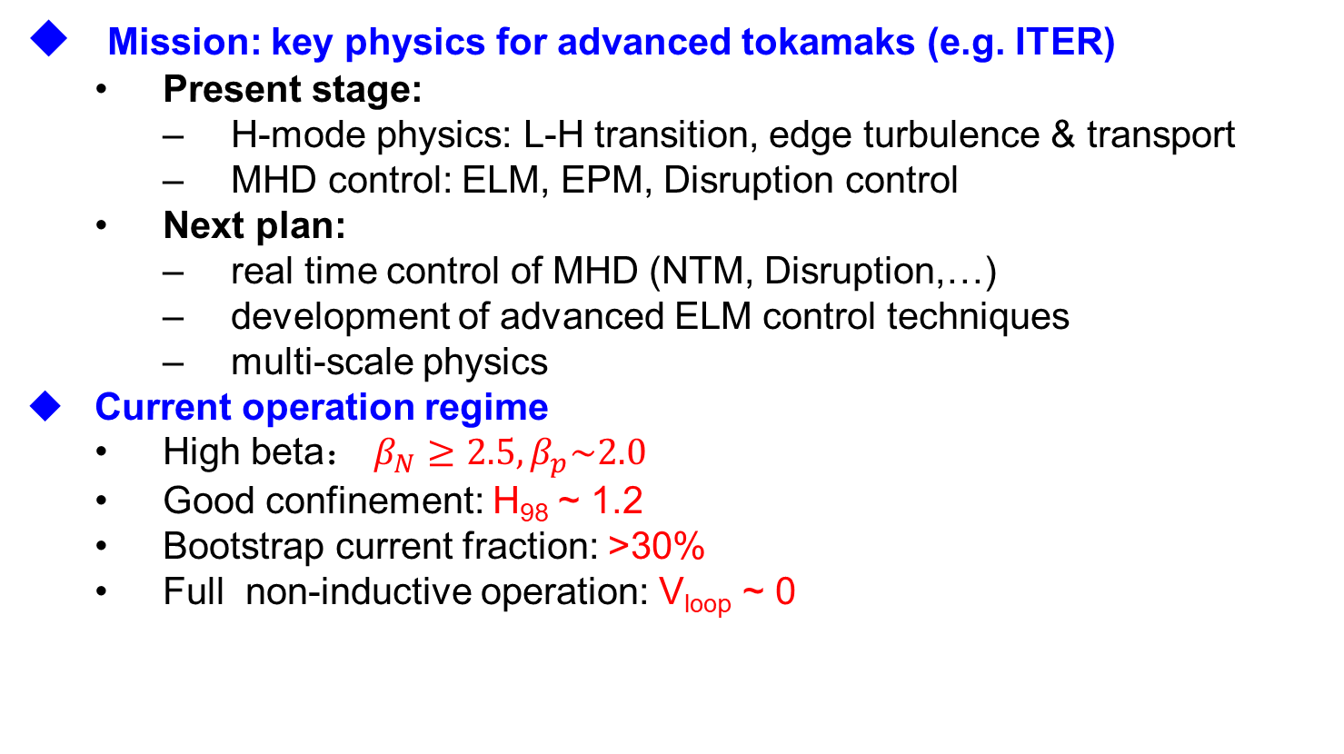
Mission of the HL-2A
Mission: key physics for advanced tokamaks (e.g. ITER)
  Present stage:
    H-mode physics: L-H transition, edge turbulence & transport
    MHD control: ELM, EPM, Disruption control
  Next plan:
    real time control of MHD (NTM, Disruption,…)
    development of advanced ELM control techniques
    multi-scale physics
Current operation regime
  High beta： $β_{N}≥2.5, β_{p}\sim 2.0$
  Good confinement: H₉₈ ~ 1.2
  Bootstrap current fraction: >30%
  Full non-inductive operation: V_{loop} ~ 0
Notes:
Beta_N, Beta_p：shot34340@908ms；beta_p from MARS-F estimation.
Bootstrap cuttent: shot34185, based on Aiping’s modelling result
H98： Wulv’s extimation

Slide 6
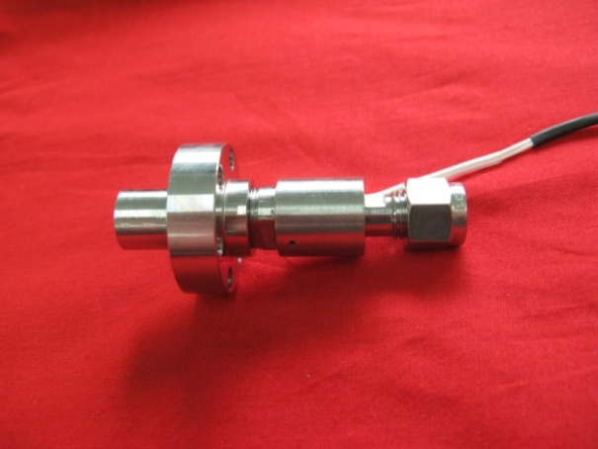
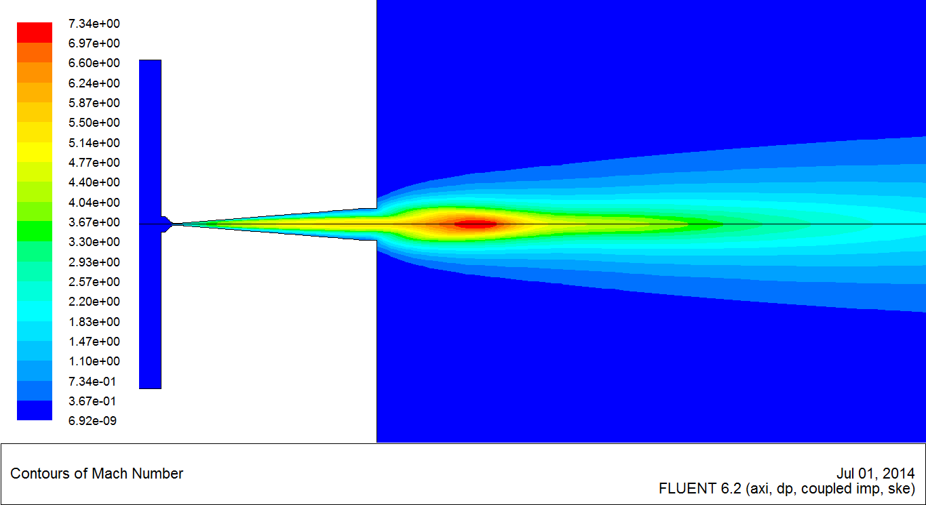
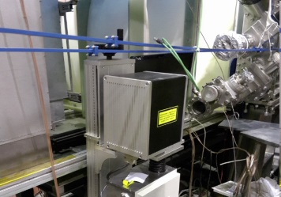
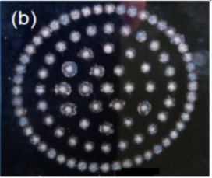
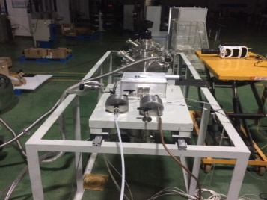
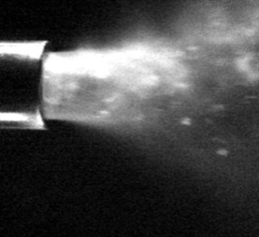
Fuelling and MHD Control Systems
Supersonic molecular beam injection (SMBI):
  new skimmer, 1kHz,Max throughput :10²²
  H₂,D₂, He,Ar…,with pressure: 0.1-5 MPa
Laser blow-off (LBO):
  Al, Fe, Ti, W,…
  multi-pulses frequency: 30 Hz
Shattered pellet injection(SPI)：
  diameter: 3.5 mm, length: ~4.5 mm
  Velocity: 0.2 to 0.5 km/s
Pellet injection:
  diameter: 1-1.2 mm; 0.1-0.5 km/s
Gas Puffing: ~0.18 MPa
Massive gas injection (MGI): max throughput :10²³
SMBI injector with higher fueling efficiency
LBO system
SPI system
Notes:
(a) Schematic diagram of the LBO system in HL-2A; (b) LBO target with footprints of laser ablation

Slide 7
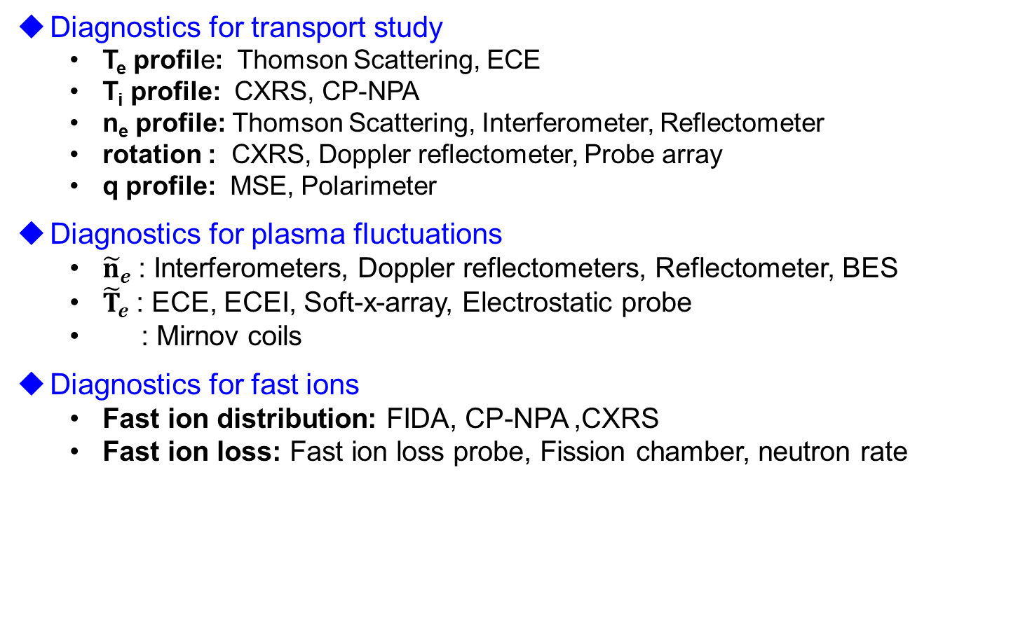
Main diagnostics on the HL-2A
Diagnostics for transport study
  T_{e} profile: Thomson Scattering, ECE
  T_{i} profile: CXRS, CP-NPA
  n_{e} profile: Thomson Scattering, Interferometer, Reflectometer
  rotation : CXRS, Doppler reflectometer, Probe array
  q profile: MSE, Polarimeter
Diagnostics for plasma fluctuations
  ${\tilde{n}}_{e}$: Interferometers, Doppler reflectometers, Reflectometer, BES
  ${\tilde{T}}_{e}$: ECE, ECEI, Soft-x-array, Electrostatic probe
  : Mirnov coils
Diagnostics for fast ions
  Fast ion distribution: FIDA, CP-NPA ,CXRS
  Fast ion loss: Fast ion loss probe, Fission chamber, neutron rate

Slide 8
Outline
Present status of the HL-2A Tokamak
Progress of physics study in H-mode plasma
  Techniques and physics of ELM control
  Pedestal dynamics & L-H transitions
  ITB in H-mode plasma
Energetic particle physics and modulation of turbulence by MHD
  Control of fishbone by ECRH
  Fishbone-like mode destabilized by fast ions
  Interaction between TM and turbulence
Summary & Outlook

Slide 9
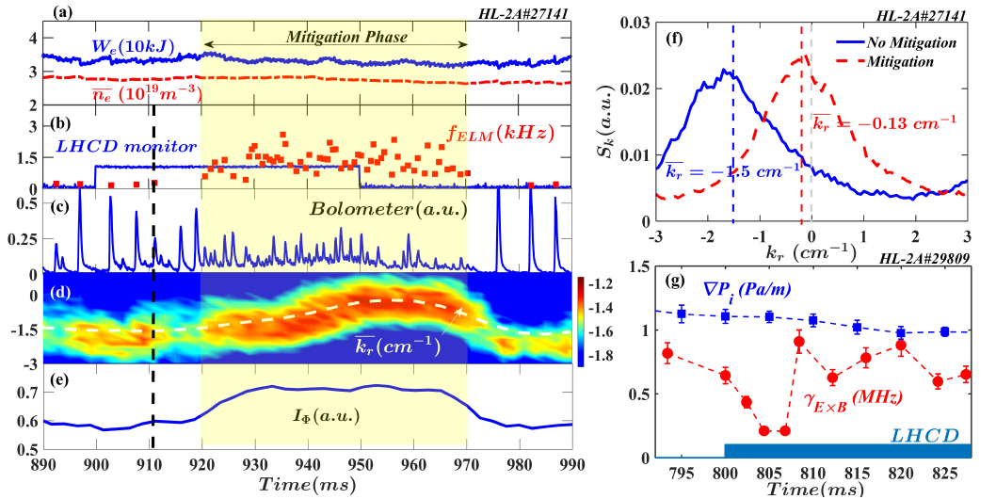
ELM Mitigation by LHCD
Mechanism: LHCD → ExB shear decrease → $k_{r}$ shift → ${\tilde{n}}_{e}$increase → ELM mitigation
Pedestal turbulence intensity
Xiao(SWIP), Zou(CEA), et al., EX/7-4
ELM mitigation with LHCD and significantly reduction of the divertor heat load.
A plausible mechanism : LHCD → Edge velocity shear decrease → Turbulence radial spectral shift → Turbulence amplitude → ELM mitigation
Notes:
Some theory results shown below will support the conclusion about the mechanism of ELM mitigation
LHCD – change the E -- change ExB
我们的猜测是LHCD影响电流电厂

Slide 10
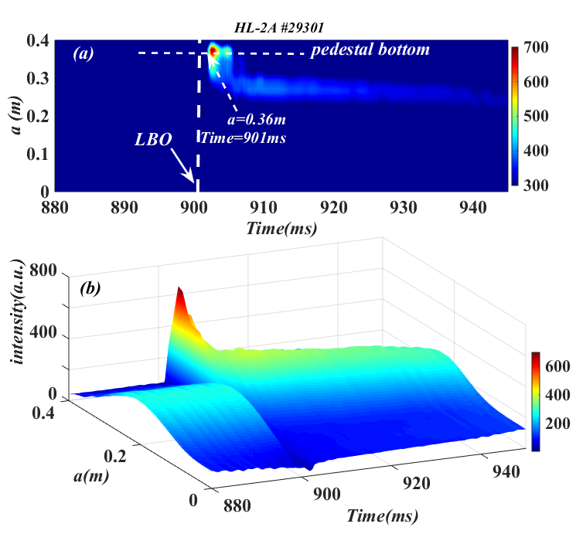
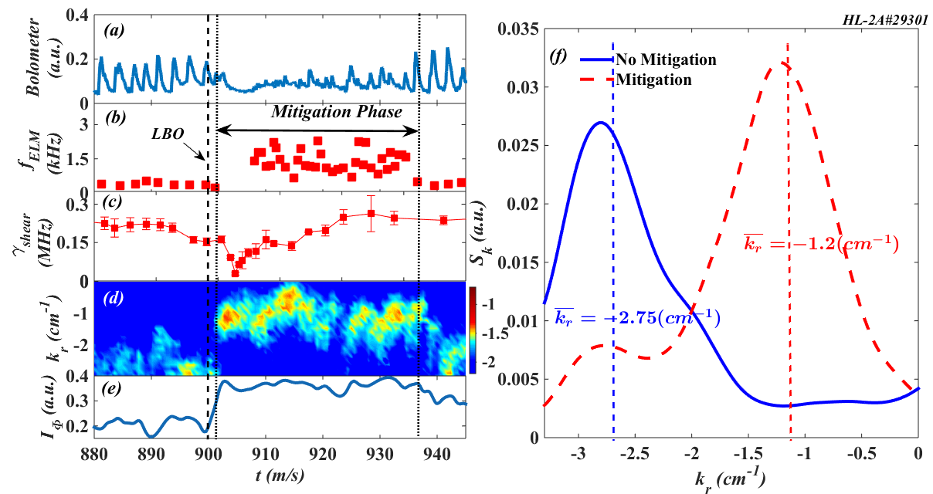
ELM Mitigation by LBO Fe impurity seeding
$\text{E}\text{×}\text{B}$ Velocity shear: severe reduction after LBO.
Pedestal turbulence: Intensity enhanced.
radial wavenumber spectral shift.
ELM Mitigation
Xiao(SWIP), Zou(CEA), et al., EX/7-4
Notes:
而impurity seeding主要是导致局部温度下降，碰撞增加
形成剪切阻尼
所以二者都导致shear变化

Slide 11
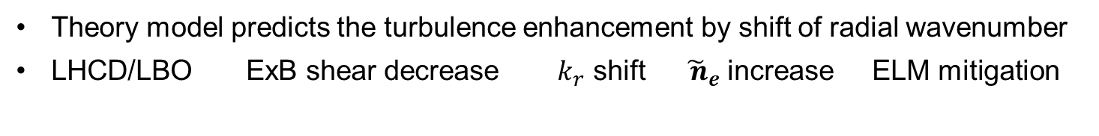
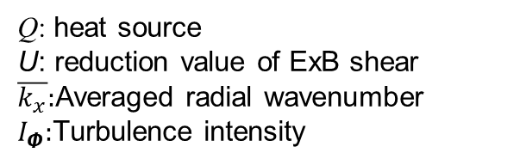
Mechanism of ELM Mitigation by LHCD/LBO
Theoretical results confirm enhancement of turbulence by shift of radial wavenumber
Theoretical results
Q: heat source
U: reduction value of ExB shear
$\overline{k_{x}}:$Averaged radial wavenumber
$I_{Φ}:$Turbulence intensity
Theory model predicts the turbulence enhancement by shift of radial wavenumber
LHCD/LBO ExB shear decrease ${ k}_{r}$ shift ${\tilde{ n}}_{e}$increase ELM mitigation
Xiao(SWIP), Zou(CEA), et al., EX/7-4
Notes:
这个case 我之前初步算了下，没看到。附近的炮都没看到，也不知道是物理不一样了，还是那段时间测量有问题。目前还在分析更多的数据。但是纯D2 发现了。

Slide 12
ELM mitigation with D₂+Ne SMBI
  D₂ +Ne(30% ) SMBI strongly mitigates ELMs
Zhong et al., EX/P5-3
Mitigate ELMs
ELM frequency ratio
Divertor heat flux near the striking point
Improve confinement
  Mixture SMBI mitigates ELMs & significantly reduce divertor heat flux
  Impurity ions and change of pedestal profiles lead to ELMs mitigation

Slide 13
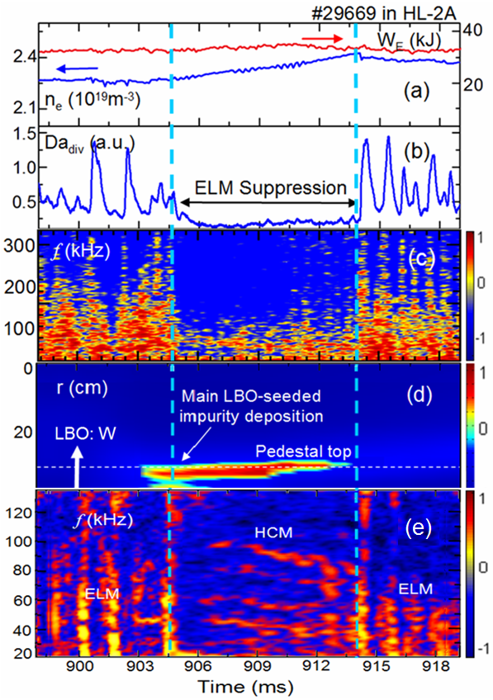
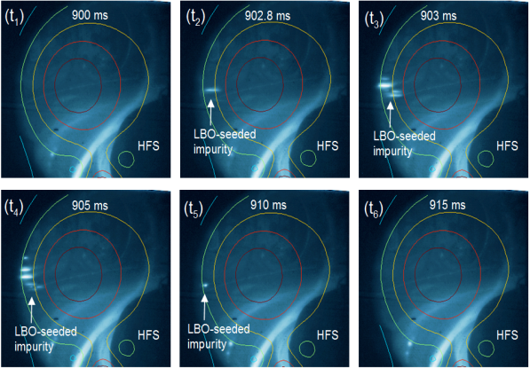
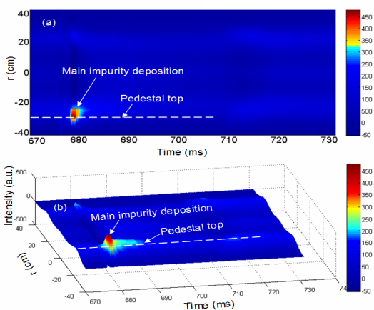
ELM control by LBO W impurity seeding
A new ELM suppression technique: LBO-seeded impurity
LBO-seeded impurity measured by camera and bolometer
ELM suppressed by LBO seeded impurity (W)
In suppression phase, a new mode (Harmonic Coherent Mode, HCM) was found.
ELM suppressed by LBO-seeded impurity
Zhang, Mazon, et al., NF (2018)
Notes:
HCM: EM mode, too weak to identify the mode number and structure

Slide 14
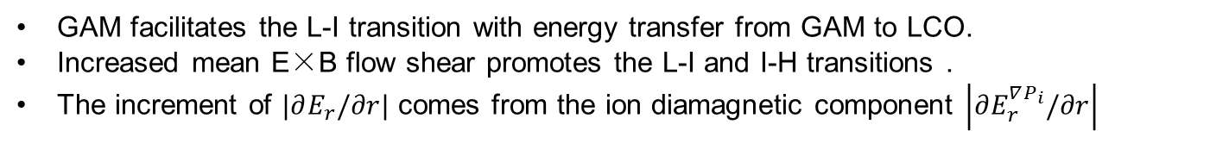
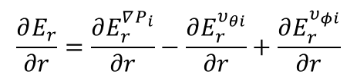
Interaction between plasma flows and turbulence
Pressure gradient → E×B flow shear increase → L-I&I-H transition
$$\frac{∂E_{r}}{∂r}=\frac{∂E_{r}^{∇P_{i}}}{∂r}−\frac{∂E_{r}^{υ_{θi}}}{∂r}+\frac{∂E_{r}^{υ_{φi}}}{∂r}$$
Liang et al., PoP 2017
GAM facilitates the L-I transition with energy transfer from GAM to LCO.
Increased mean E×B flow shear promotes the L-I and I-H transitions .
The increment of $|∂E_{r}/∂r|$ comes from the ion diamagnetic component $\left|∂E_{r}^{∇P_{i}}/∂r\right|$

Slide 15
Nonlinear coupling in pedestal turbulence
Coherent mode (f=30-70 kHz, EM) plays a key role in inward particle flux
CM
CM: f=30-70 kHz, m=20-24,localized in pedestal (2~3cm)
Inward particle flux induced by the coherent mode
CM generation mechanism: nonlinear coupling of small scale turbulence
Cheng et al., AAPPS-DPP, 2017
Notes:
h中的红线和蓝线分别代表的是悬浮电位扰动和密度梯度扰动; 采用条件平均方法计算; 表明了电位扰动超前密度梯度; 局部梯度扰动是因为模发展而引起;
CM基本特性: 电磁结构, 模数m=20-24, Localized 台基区域 (通常宽度2-3cm); 但在接近ELM的过程中, 模结构会发生变化.

Slide 16

First observation of streamer in H mode
In ELM phase: streamer induces a transport channel from core to edge within a few microsecond
Time increases
ECEI
Δt= 0 us
(ECEI)
Time increases
Transition to streamer
Δt=+26 us
Nonlinear coupling of turbulence → localized mode → streamer
Streamer: life time 10 ~ 20 us, size: ~10 cm * 5 cm
Streamer provides a fast transport channel connected the edge to core plasmas
16
Cheng, EX/P5-6
Notes:
The first observation of radially elongated streamer in pedestal during inter-ELM phase, which provides a transport channel connected the edge to core plasmas within a few microsecond. 形成机制: 湍流通过非线性耦合而形成; Streamer 径向空间尺度10-15 cm (占装置小半径尺寸的20-30%),

Slide 17
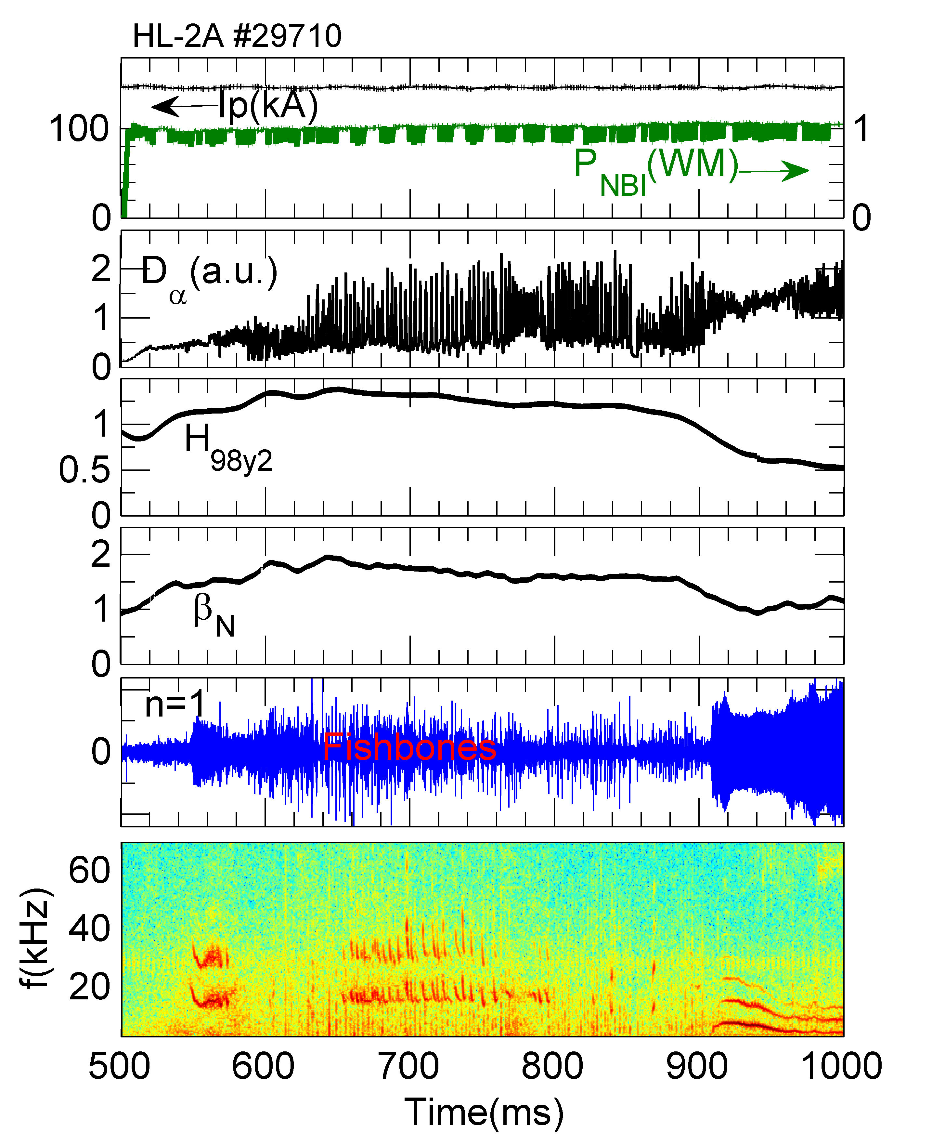
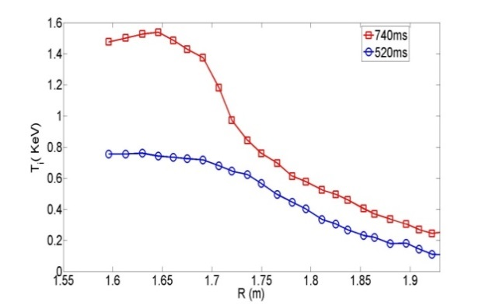
ITB in H-mode plasma
Fishbone → fast ion redistribution→ change of q shear → affect transport → ITB formation
ITB
ELMy
HL-2A # 29710
(1/1) fishbone plays an important role in the formation and sustainment of ITB at low central shear;
Formation of ITB in H mode plasma
Turbulence suppressed during ITB sustainment
Liu et al., EX/P5-28

Slide 18
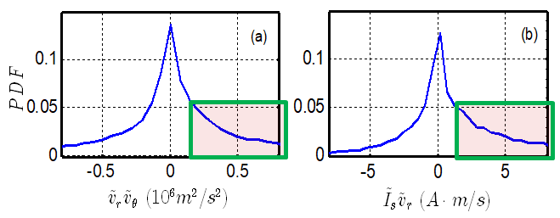
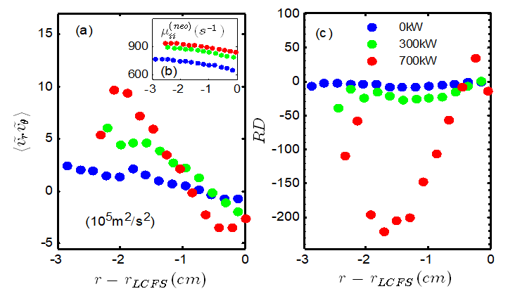
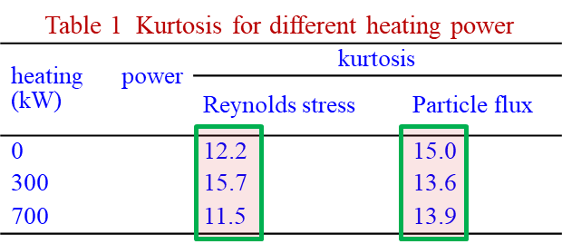
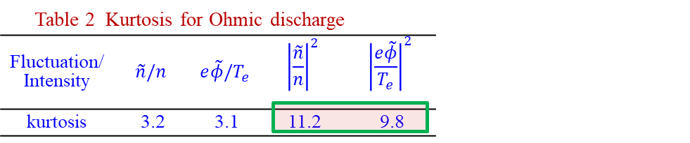
RS and Turbulent Generation of Edge Poloidal Flows
Significant deviation of mean poloidal flow from neoclassical due to turbulent stresses. Shift ↑ with power.
Reynold stress and particle flux PDF at 1cm inside LCFS show elevated kurtosis, which indicates fat tails;
Deviation from Gaussian suggests the consideration of:
1. Validity of quasilinear models of edge turbulence transport
2. Phase correlations and dynamics
T. Long, P.H. Diamond et al. EX/P5-5

Slide 19
Outline
Present status of the HL-2A Tokamak
Progress of physics study in H-mode plasma
  Techniques and physics of ELM control
  Pedestal dynamics & L-H transitions
  ITB in H-mode plasma
Energetic particle physics and modulation of turbulence by MHD
  Control of fishbone by ECRH
  Fishbone-like mode destabilized by fast ions
  Interaction between TM and turbulence
Summary & Outlook

Slide 20
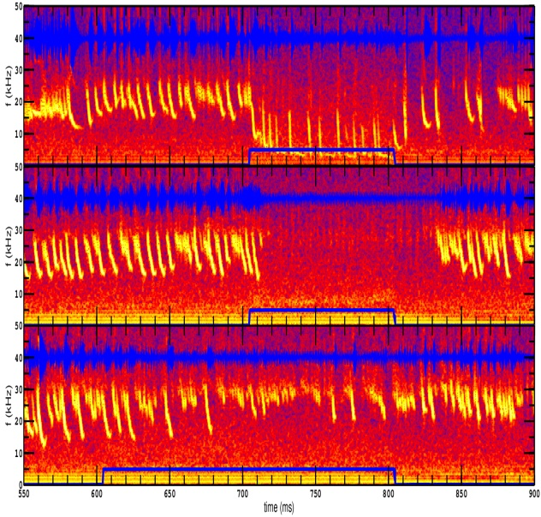
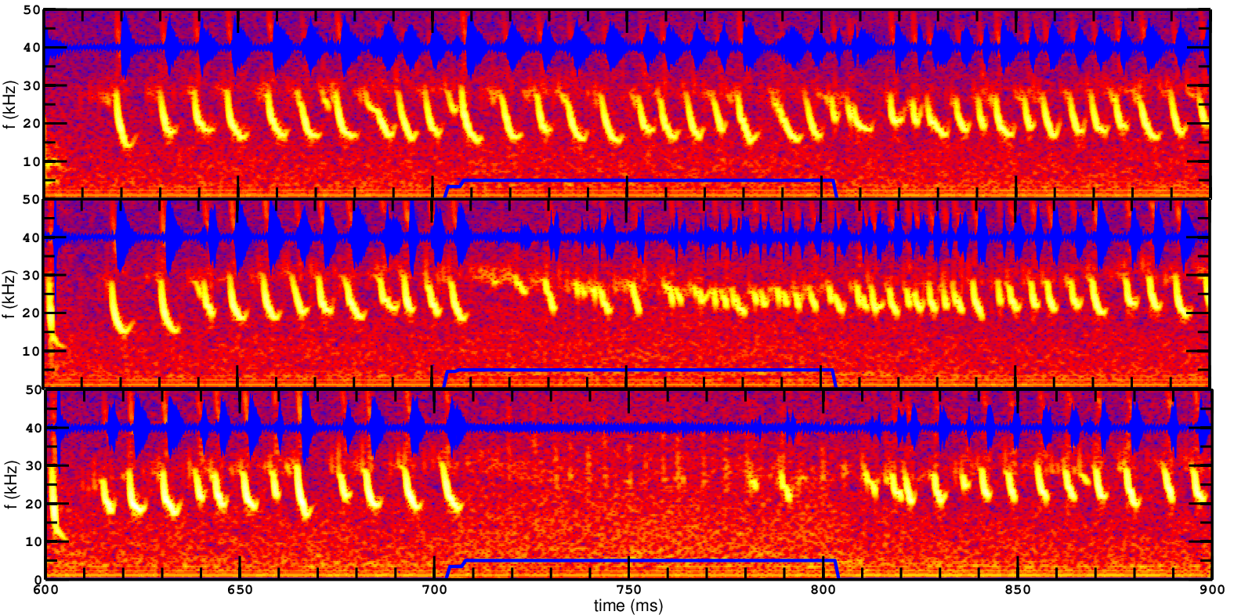
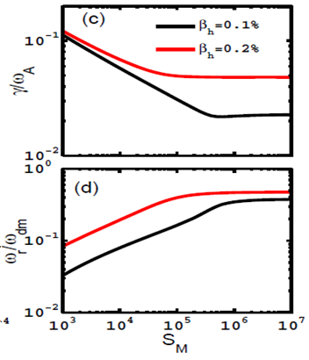





Stabilization of m/n=1/1 fishbone by ECRH
Mechanism: ECRH → Te increase → resistivity decrease → resistive fishbone stabilized
Scan $ρd$, fixed P_{ECRH}=1 MW
Scan P_{ECRH} ,$\text{fixed} ρd$ = 0.42
Theoretical result
$ρ_{d}$ = 0.02
P_{ECRH} = 0.37 MW
$$dB_{θ}/dt+40$$
ECRH
$ρ_{d}$ = 0.42
P_{ECRH} = 0.55 MW
growth rate
fishbone
$ρ_{d}$ = 0.66
P_{ECRH} = 0.60 MW
Mode frequency
Reynolds number
Mode stability depends on both the P_{ECRH} and deposition location ($ρ_{d}$)
Fishbone suppressed when P_{ECRH} exceeds a threshold.
Chen et al., EX/P5-20&NF, 2018

Slide 21
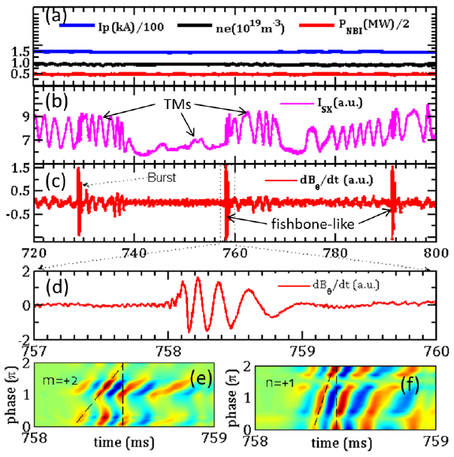
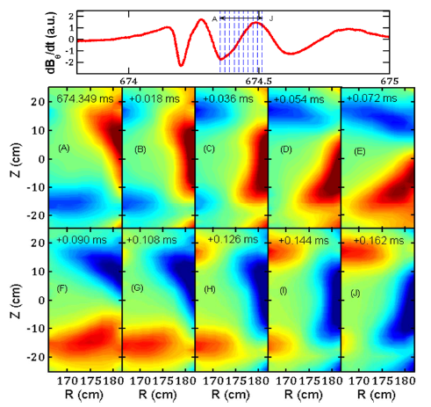
Excitation of m/n=2/1 fishbone by fast ions
Resonant interactions between fast ions and m/n=2/1 TM were observed
ECEI
Wave-particle resonance converts unstable TM to fishbone-like mode with frequency chirping and amplitude bursting
Chen et al., EX/P5-20

Slide 22
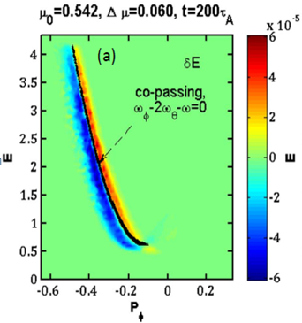
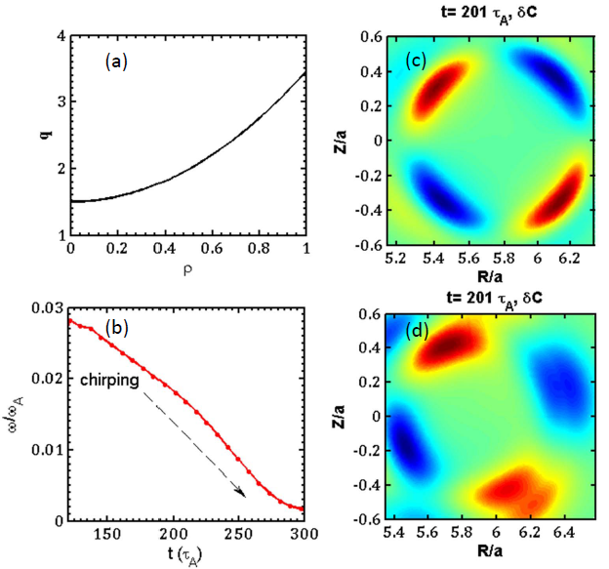
Co-passing energetic-ions drive the m/n=2/1 fishbone-like mode
Co-passing energetic-ions play a key role in the fishbone-like mode drive
Resonance condition
Mode structure
without EP
Simulated mode structure and mode frequency chirping consistent with the measurements
Resonance condition: ω_{φ}−2ω_{θ}−ω = 0, and co-passing energetic-ions are responsible for the mode drive
with EP
M3D-K modelling collaborates with Zhu (DLUT)

Slide 23
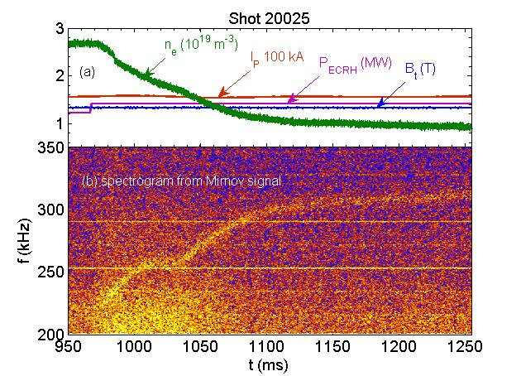
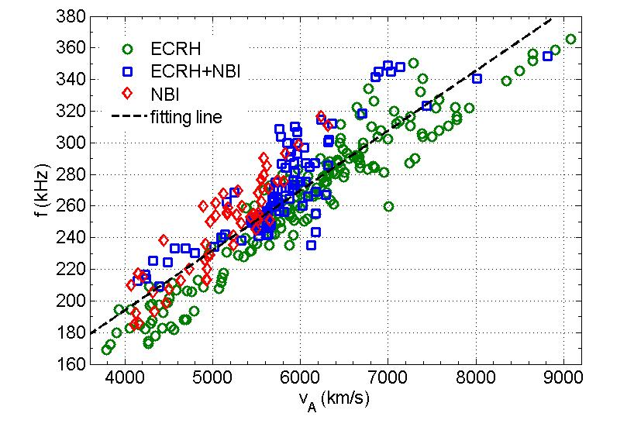
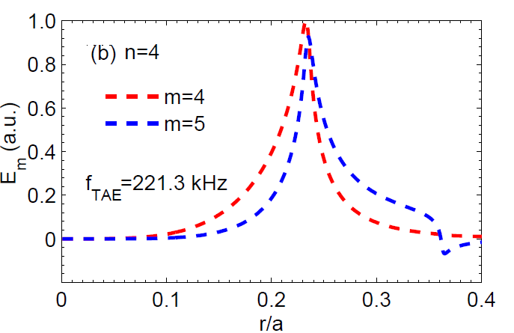
TAEs driven by energetic electrons
High-frequency TAE driven by energetic electrons was observed
Theory predicted
mode structure
Mode propagates in electron diamagnetic drift directions
TAE locates in the core(ρ=0.35), with n=4, m=4 and 5
f_{TAE}=224 kHz by theory close to experimental results (235 kHz);
Yu et al., PoP, 2018

Slide 24
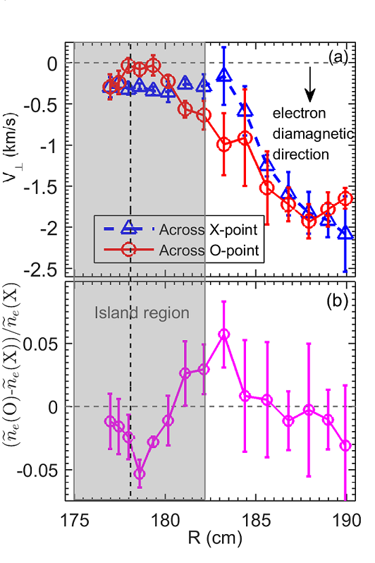
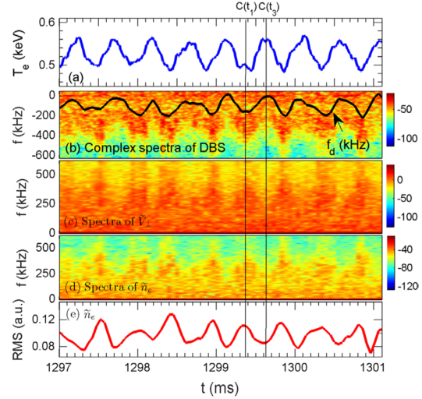
Interaction among island, flow and turbulence
Pressure gradient plays a key role in modulation of turbulence by TM
(@ outer bdry of island)
flow
Island width
turbulence
Turbulence reduced inside island while elevated at island boundary, consistent with gradient-driven turbulence
Perpendicular flow, flow fluctuation and density fluctuation were modulated by island rotation.
Jiang et al., NF, 2018
Notes:
Shear increase at outer bdry of island
While turbulence increase, which implies that that pressure have a key role on affecting turbulence

Slide 25
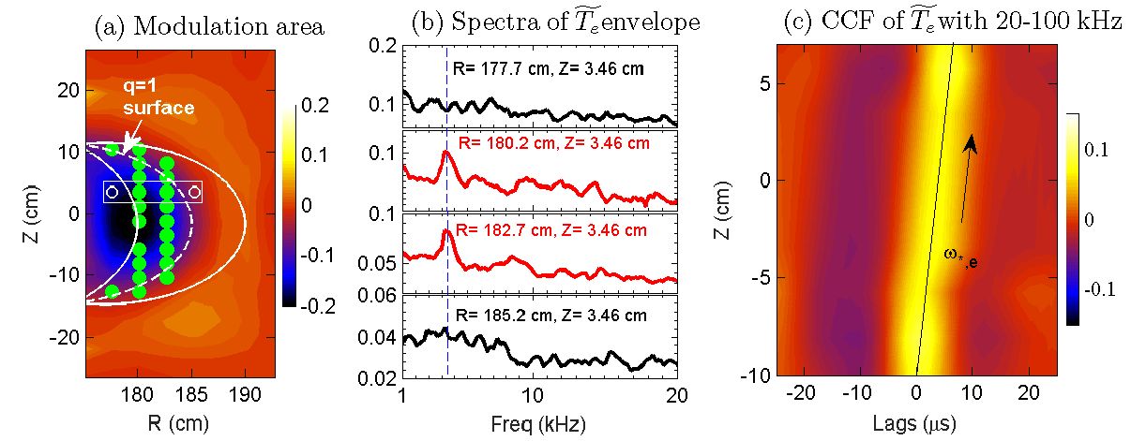
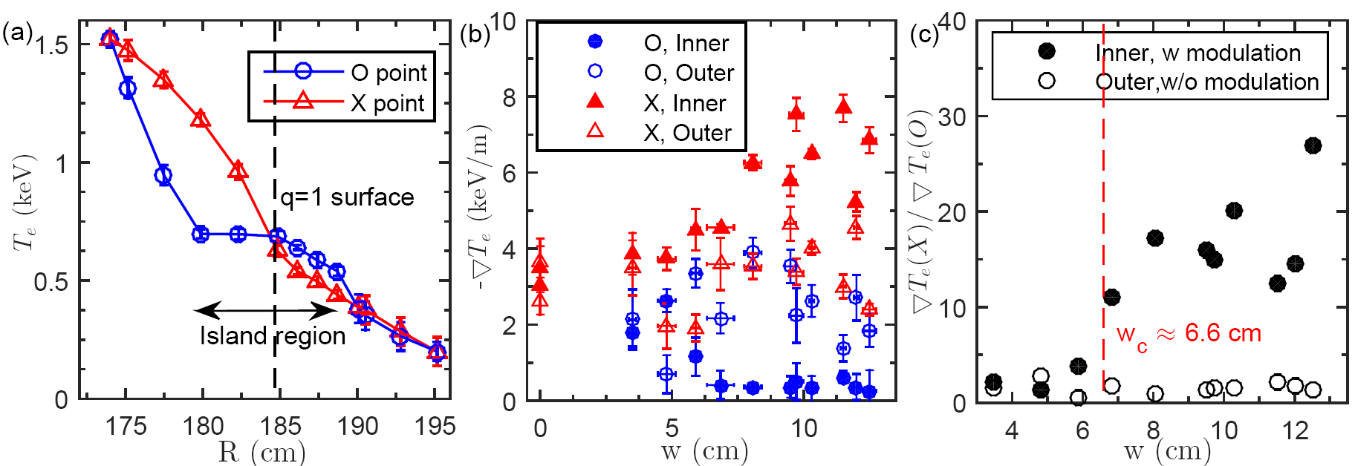
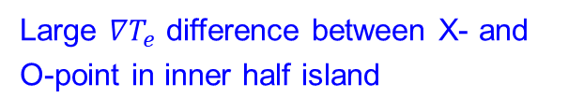
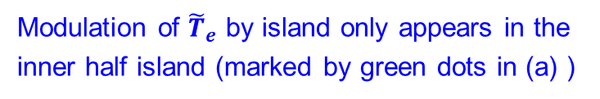
Localized modulation of ${\tilde{T}}_{e}$ by large island
Large $∇T_{e}$ difference between X- and O-point in inner half island
Modulation of ${\tilde{T}}_{e}$ by island only appears in the inner half island (marked by green dots in (a) )
An island-width threshold (6.6 cm) was found in the turbulence modulation.
Jiang et al., EX/P5-4

Slide 26
Outline
Present status of the HL-2A Tokamak
Progress of physics study in H-mode plasma
  Techniques and physics of ELM control
  Pedestal dynamics & L-H transitions
  ITB in H-mode plasma
Energetic particle physics and modulation of turbulence by MHD
  Control of fishbone by ECRH
  Fishbone-like mode destabilized by fast ions
  Interaction between TM and turbulence
Summary & Outlook

Slide 27
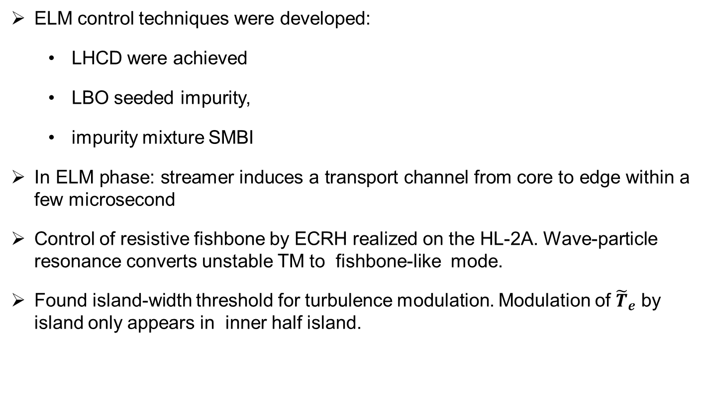
Summary of research highlights
ELM control techniques were developed:
  LHCD were achieved
  LBO seeded impurity,
  impurity mixture SMBI
In ELM phase: streamer induces a transport channel from core to edge within a few microsecond
Control of resistive fishbone by ECRH realized on the HL-2A. Wave-particle resonance converts unstable TM to fishbone-like mode.
Found island-width threshold for turbulence modulation. Modulation of ${\tilde{T}}_{e}$ by island only appears in inner half island.

Slide 28
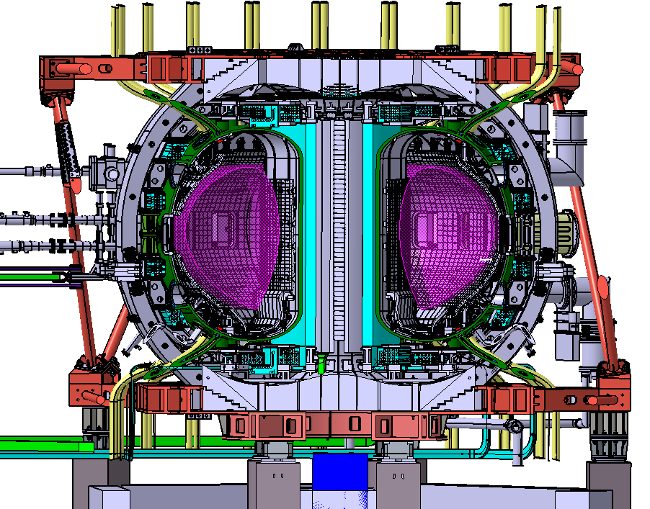
Outlook
HL-2M
  Mission: In support of ITER & CFETR: high performance, high beta, and high bootstrap current plasma; advanced divertor configuration (snowflake, tripod), PWI at high heat flux, etc.
  Parameters: R=1.78 m, a=0.65 m, B_{t}=2.2 T, I_{p}=2.5 MA, Heating~ 25 MW, triangularity=0.5, elongation=1.8-2.0
  Status: Start the assembling before the end of this year.
HL-2M tokamak

Slide 29
List of HL-2A Contributions
OV/5-1 Xu: Overview of HL-2A recent experiment
EX/P5-20 Chen: Suppression and destabilization of ion fishbone activities on HL-2A
EX/P5-28 Liu: Development of the q=1 Advanced tokamak Scenarios in HL-2A
EX/P5-6 Cheng: Pedestal dynamics in inter-ELM phase on HL-2A tokamak
EX/P5-4 Jiang: Localized modulation of turbulence by magnetic islands on HL-2A tokamak
EX/P5-19 Shi: Energetic-ion Driven Toroidal and Global Alfvén Eigenmodes on HL-2A
EX/P5-3 Zhong: Plasma confinement and pedestal dynamics responses to impurity seeding in HL-2A H-mode plasmas
EX/P5-8 Zhang: Effect of LBO-seeded Impurity on ELMs in the HL-2A tokamak
EX/P5-12 Xu: Experimental evaluation of electron energy probility function and sheath potential coefficient of HL-2A
EX/7-4 Xiao: ELM Control Physics with Impurity Seeding and LHCD in the HL-2A Tokamak
Welcome to the poster session for further discussions!

Slide 30
List of SWIP Contributions
OV/5-1 M.Xu : Overview of HL-2A recent experiments
FIP/2-1 J. Chen:Progress in Developing ITER and DEMO First Wall Technologies at SWIP
FIP/1-6 X. Wang: Current Design and R&D Progress of CN HCCB TBS
EX/7-4 G. L. Xiao: ELM Control Physics with Impurity Seeding and LHCD in the HL-2A Tokamak
EX/P5-20 W. Chen: Suppression and destabilization of ion fishbone activities on HL-2A
EX/P5-28 Y. Liu: Development of the q=1 Advanced tokamak Scenarios in HL-2A
EX/P5-6 J. Cheng: Pedestal dynamics in inter-ELM phase on HL-2A tokamak
EX/P5-4 M. Jiang: Localized modulation of turbulence by magnetic islands on HL-2A tokamak
EX/P5-19 P. W. Shi: Energetic-ion Driven Toroidal and Global Alfvén Eigenmodes on HL-2A
EX/P5-3 W. Z. Zhong: Plasma confinement and pedestal dynamics responses to impurity seeding in HL-2A H-mode plasmas
EX/P5-8 Y. P. Zhang: Effect of LBO-seeded Impurity on ELMs in the HL-2A tokamak
EX/P5-12 M. Xu: Experimental evaluation of electron energy probility function and sheath potential coefficient of HL-2A
FIP/P1-38 L. Cai: Preliminary development on a conceptual first wall for DEMO
TH/P2-3 H. He: Simulation of Toroidicity-Induced Alfven Eignenmode Excited by Energetic Ions in HL-2A Tokamak Plasmas
FIP/P3-22 H. Liao: Recent progress of R&D activities on Chinese reduced activation ferritic/martensitic steel (CLF-1)
FIP/P3-11 Z. Xu: Splashing Effect of Liquid Metal Divertor Due to ELMs Crashing
EX/P5-15 X. Q. Ji: Nonlinear evolution of multi-helicity neoclassical tearing modes in HL-2A low rotation plasmas
EX/P5-29 Y. B. Dong: Study of disruption and runaway electrons mitigation using multipulse supersonic molecular beam injection on HL-2A
EX/P5-30 X. M. Song: First Plasma Scenario Development for HL-2M
EX/P5-27 L. W. Yan: Real-time control system of neoclassical tearing modes in the HL-2A tokamak
TH/P5-13 G. Z. Hao: Centrifugal force driven low frequency modes in spherical tokamak
TH/P6-22 Z. H. Wang: Physics of fast component of deuterium gas jet injection in magnetized plasmas
TH/P8-13 Y. Li: Nonlinear turbulent parallel momentum transport due to blobs
FIP/P8-13 P. Y. Li: Recent Progress of ITER Magnet Supports Package in SWIP

Slide 31
Thanks for your attentions!
HL-2A
HL-2M (under construction)

Slide 32
Back-up slides
Highlights of recently upgraded/developed diagnostics on the HL-2A
Introduction of HL-2M

Slide 33
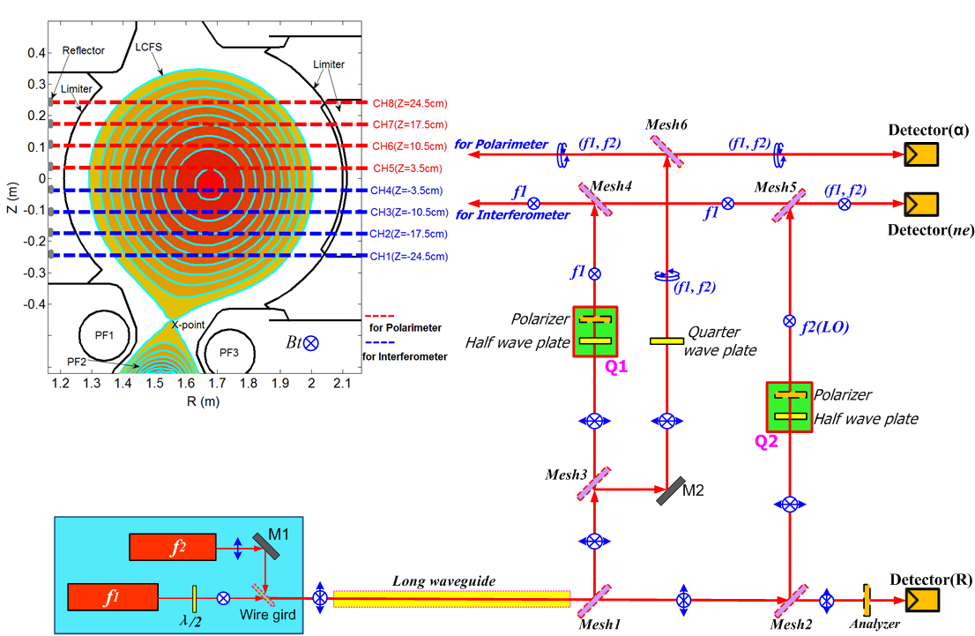
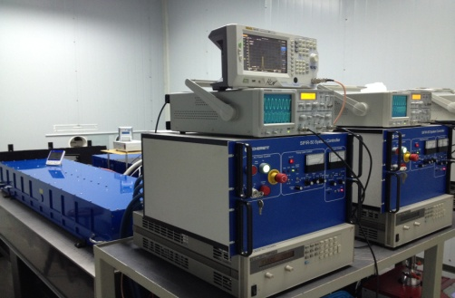
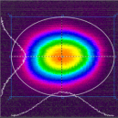
FIR laser Interferometer and Polarimter on the HL-2A
Multi-channel FIR laser Polarimeter-Interferometer has been commissioned on HL-2A for electron density and Faraday rotation angle measurements.
Laser source: HCOOH laser (λ=432.5um)
Composition: 4-chord Polarimeter + 4-chord Interferometer
Time resolution: 1.0us, spatial resolution: 7.0cm
Figure:
Schematic layout of HL-2A Polarimeter and Interferometer.
HCOOH laser
1). Y.G. Li, et al., RSI. 88, 083508 (2017)
2). Y.G. Li, et al., JINST. 12, C11004 (2017)
3). Y.G. Li, et al., FED 137, 137 (2018)

Slide 34
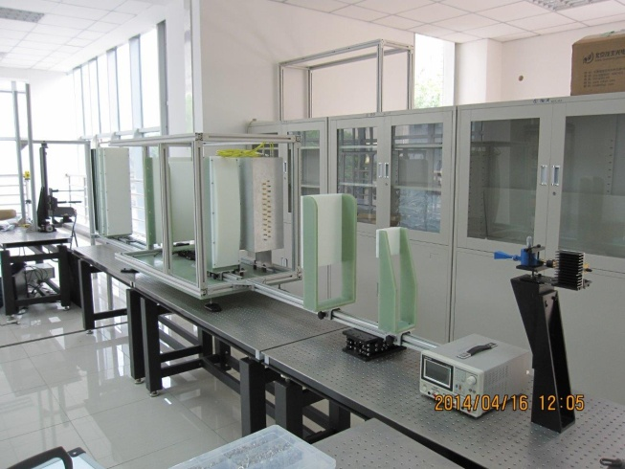
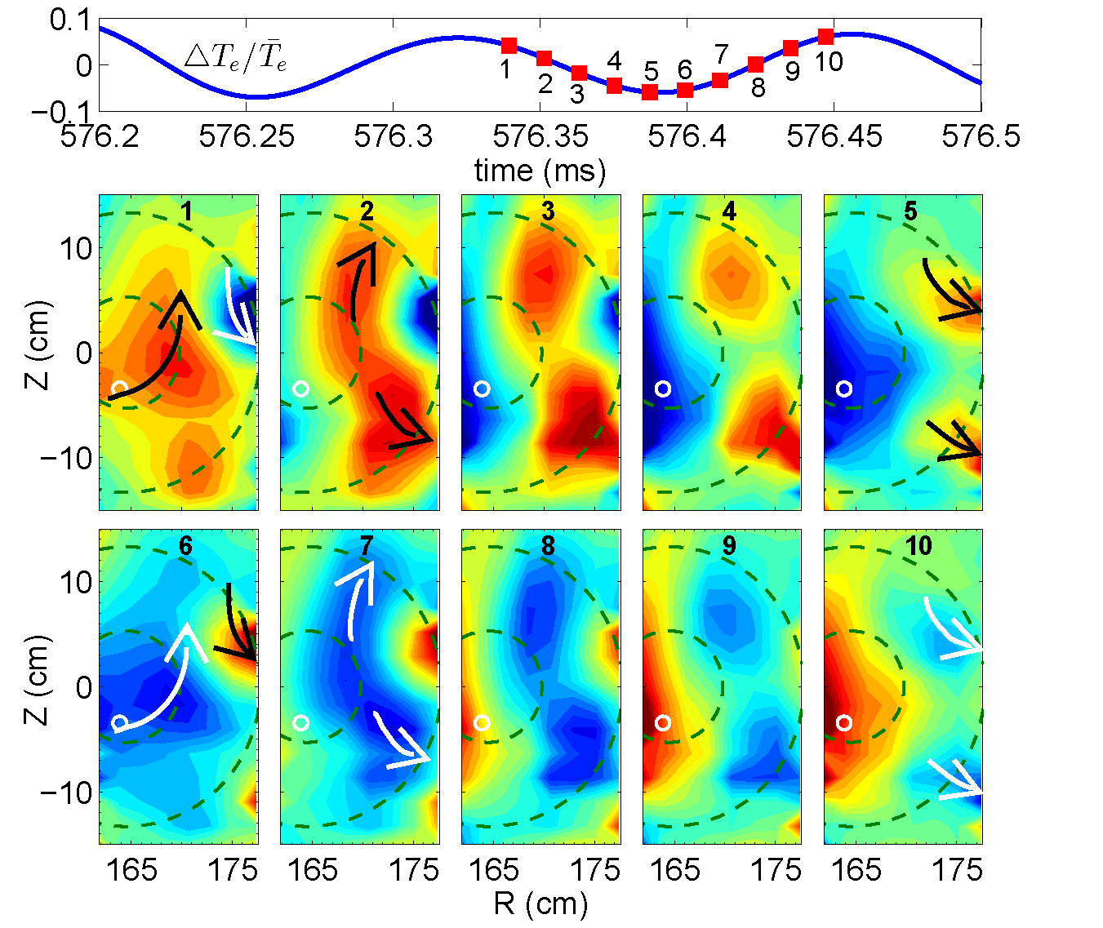
24×16 Electron Cyclotron Emission Imaging (ECEI) on the HL-2A
Optics of ECEI system
Tearing mode images
Double e-fishbone images
24(vertical)× 16(radial)=384 channel, with a coverage of 53 cm (vertical) × 30 cm (radial).
Tempo-spatial resolution: 2μs, 1-3 cm.
Abundant physics have been captured, such as TM, fishbone, ELM crash and multi-scale physics.
M. Jiang, NF 2018; PoP 2017; RSI 2013&2015;
Z. B. Shi, RSI 2014; PST2018
P.W. Shi, POP2017&2018. W. Chen, NF2018;

Slide 35
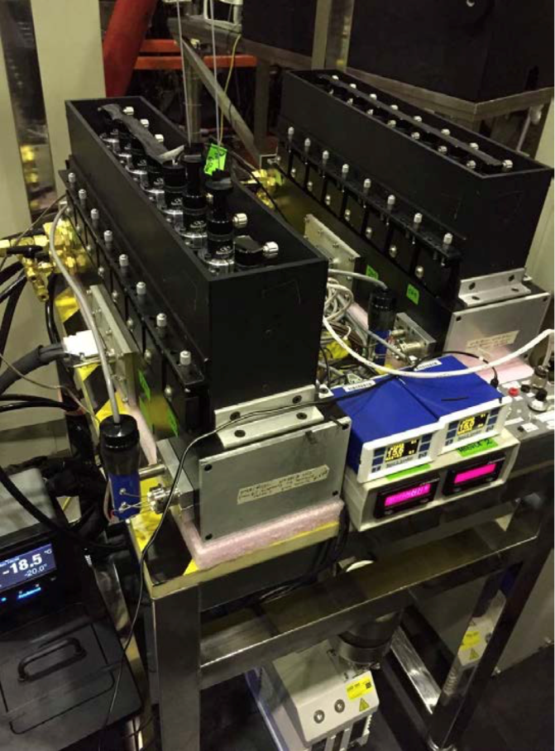
Recent process of BES on the HL-2A
32-channel BES array has been installed on the outer mid-plane of HL-2A tokamak, focusing on the edge and SOL region.
Spatial resolution: Δr ≈ 0.8 cm； ΔZ ≈ 1.2 cm, covering r = 34.5 ~ 40.5 cm.
  High SNR has been achieved in the experiments last year.
shot # 33103, 640 ms

Slide 36

BES applied on turbulence studies
Turbulence density spectrum is broadened when ECRH is applied.
Poloidal velocity and shear increased with ECRH.
HL-2A # 33103
Density spectrum
Poloidal velocity profiles

Slide 37




Preliminary results from Phase Contrast Imaging: $\int{{\tilde{n}}_{e}dl}$
Experimental Setup
System design
Expanding platform
Imaging platform
Systematic Parameters
Time resolution: 1 us
Spatial resolution: ~1mm
Detector array: 32 channels
Wavenumber: 2~15cm⁻¹
The consistent experimental results obtained from magnetic probe and PCI data confirm the reliability of this diagnostic.
Calibration by Sound Wave
Observation of MHD instabilities

Slide 38
Introduction of HL-2M
Mission: In support of ITER & CFETR: high performance, high beta, and high bootstrap current plasma; advanced divertor configuration (snowflake, tripod), PWI at high heat flux,etc.
Main parameters
Plasma current I_{p} = 2.5 (3) MA
Major radius R = 1.78 m
Minor radius a = 0.65 m
Aspect ratio R/a = 2.8
Elongation Κ = 1.8-2
Triangularity δ > 0.5
Toroidal field B_{T} = 2.2 (3) T
Flux swing ΔΦ= 14Vs
Heating power 25 MW

