Slide 1
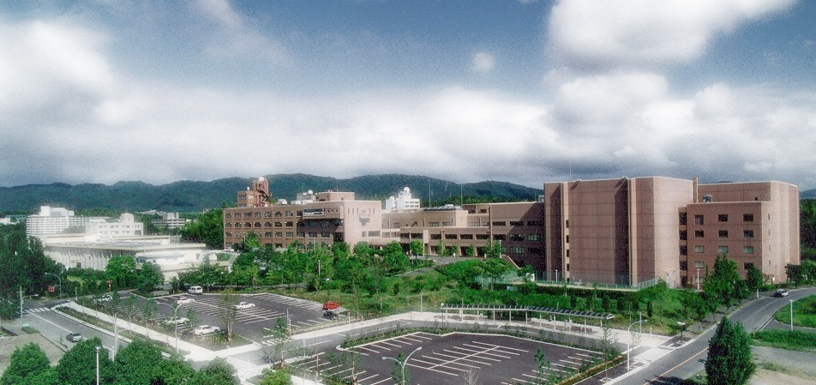



Production of keV-Temperature Plasma Core
with Magnetized Fast Isochoric Heating
Shinsuke FUJIOKA (Institute of Laser Engineering, Osaka Univ.)
This work was supported by the Collaboration Research Program between the NIFS and ILE at Osaka University, the ILE Collaboration Research Program, and by the Japanese MEXT through Grants-in-Aid for Scientific Research (KAKENHI).

Slide 2
Summary
Short-pulse energetic electron beam accelerated by an intense laser pulse is used to heat instantaneously a compressed fuel core in the MFI.
The laser accelerated electron beam has a large divergence relative to a fuel core radius.
The diverging electron beam is guided to a small fuel core along the externally applied kilo-tesla magnetic field.
An over-solid-density core was heated up to > 2 keV with > 8% of the energy coupling by the MFI scheme.
We are trying to increase the heating laser energy to achieve the ignition temperature with the MFI scheme.

Slide 3
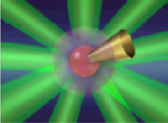


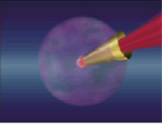


Critical problems in FI
Laser-accelerated relativistic electron beam (REB) has large divergence.
Only a small portion of REB collides with the small core.
Fuel compression by
multiple ns beams
S. Fujioka et al., Phys. Plasma (2016).
Heating of a plasma core with the diverging REB
Only a small portion of the REB collides with the small core.
Electron beam
Heating laser
Heating by ps beams
Core
Cone
Ignition & burn

Slide 4
Critical problems in FI
Demonstration of I_{REB, abs} > 10²⁰ W/cm² is one of the milestones
toward the fusion ignition with the fast isochoric heating.
Scaling of REB mean energy
Mean energy depends strongly on laser intensity. ~3 x 10¹⁹ W/cm² is an adequate intensity for efficient heating.
Absorbed REB intensity
> 10 of the REB focusing factor is requested to produced > 1 x 10²⁰ W/cm² of the absorbed intensity.
I_{REB,abs} ~ η_{Le} I_{L} (πr_{L}²/πr_{REB}²) (ρR/0.6T_{REB})
=
=
=
REB intensity
@generation point
> 1 x 10¹⁹ W/cm²
= (= 0.3 x 3 x 10¹⁹ W/cm²)
Absorption
~ 1
for 3 x 10¹⁹ W/cm²
REB Mean energy (MeV)
~ 3 x 10¹⁹ W/cm²
REB focusing factor
> 10
Normalized laser intensity (a₀)

Slide 5
Guiding of REB with strong B-field
Application of kilo-tesla B-field is a possible scheme
for guiding the diverging laser-accelerated REB to a small core.
T. Johzaki et al., Nucl. Fusion (2017).
REB focusing with externally applied magnetic field
Kilo-tesla magnetic field is required for 1 MeV REB.
Gyro-radius of electron
Gyro-radius of electron must be smaller than fuel core radius.
Electron
generation
point
Transport region
1 MeV
10 MeV
Heating laser
Gyro motion
Plasma core
Magnetic field lines
10 kT
1 kT
Relativistic electrons
Cone

Slide 6
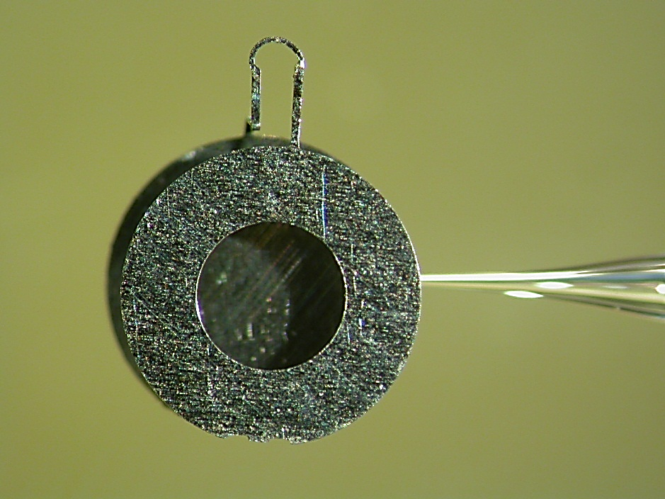
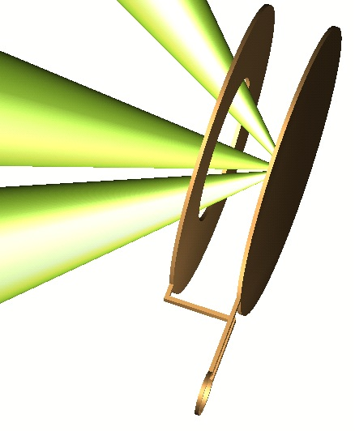
Guiding of REB with strong B-field
Laser-produced magnetic field was developed to produce kT-field
for guiding the diverging REB to a fuel core.
#H. Daido et al., PRL (1985), C. Courtois et al., JAP (2005).
*S. Fujioka et al., Sci. Rep. (2013), K. Law et al., APL (2016).
B-feild generation with capacitor-coil target
Laser driven current produce kT-level B-field
Temporal history of B-field measured with B-dot probe
600 T of the peak magnitude and 2 ns of the duration
MA current
= “Thunder”
kJ-ns pulses
B-field
kJ-ns laser
1 mm

Slide 7
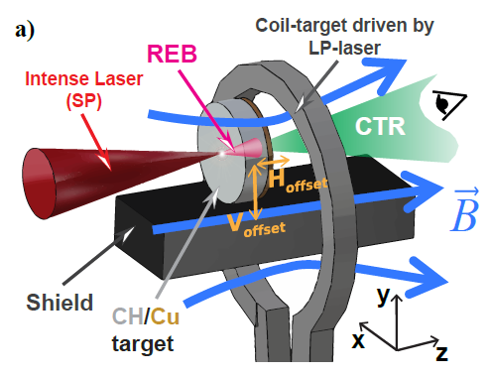
Guiding of REB with strong B-field
Collimation of REB has been demonstrated
with the laser-driven kT-magnetic field in a planer geometry.
Diverged electron beam
M. Bailly-Grandvaux et al., Nat. Comm. 2018.
Plasma core
Heating laser
Experimental results
w/o B_{ext}
w/ B_{ext}
Guided electron beam
10 µm
Plasma core
Magnetic field lines
Heating laser

Slide 8
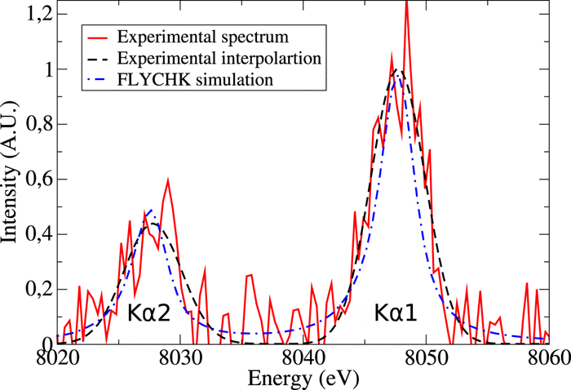
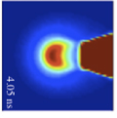

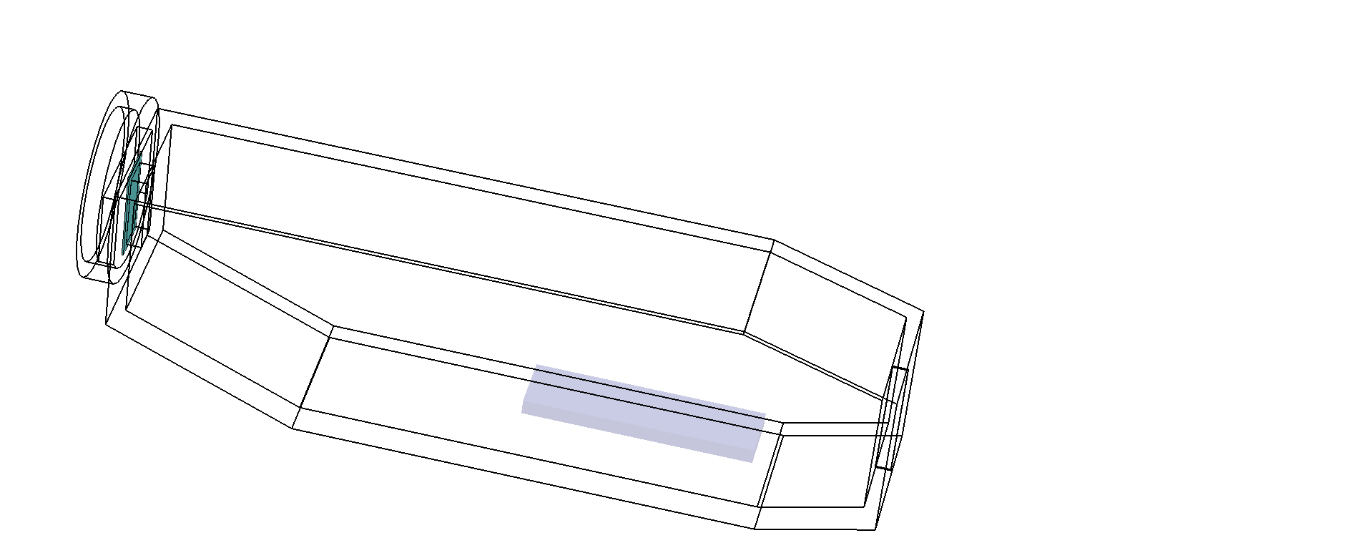
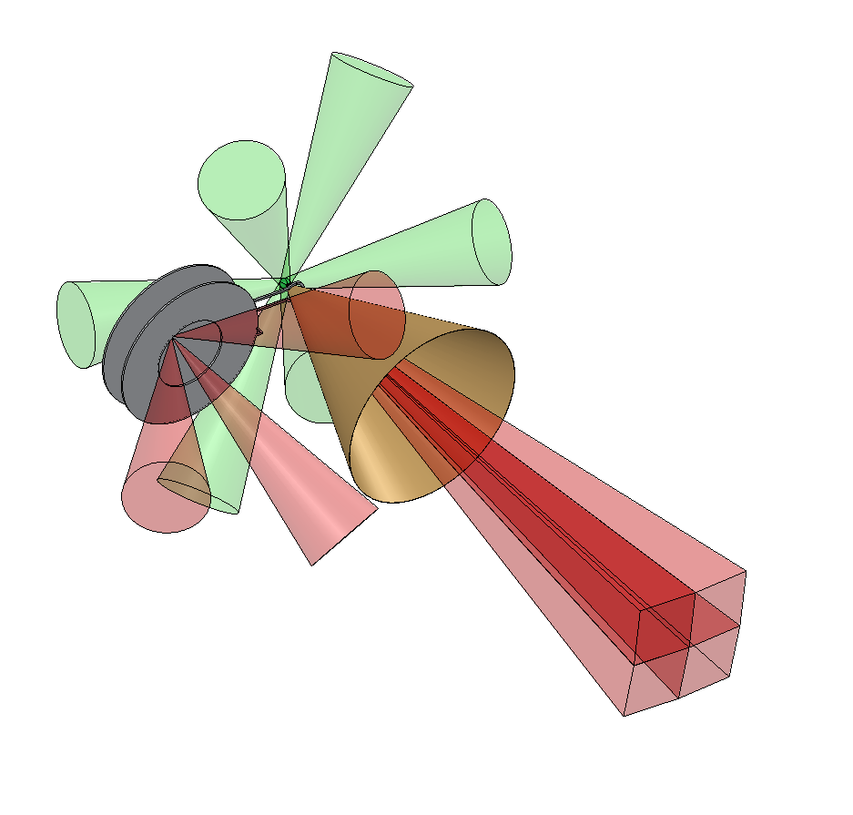
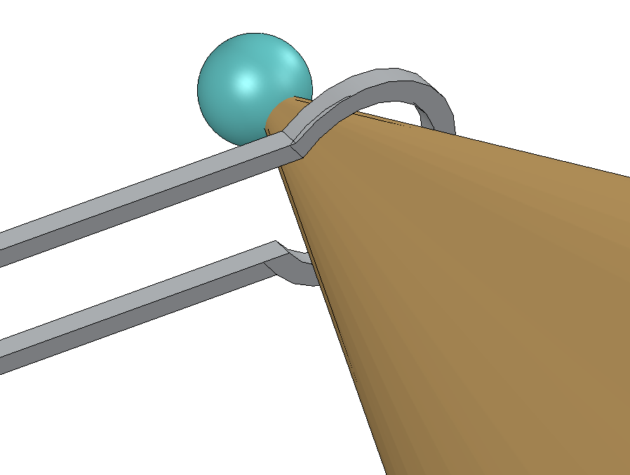
Integrated experiments of MFI scheme
Laser-driven kT-magnetic field was applied to an integrated experiment
for increasing heating efficiency by guiding the REB to the plasma core.
Experimental set-up
S. Sakata et al., Nature Communications (2018).
Cu-Kα spectroscopy
Cu-Kα imaging
Spherical crystal
GEKKO-XII (2ω)
for implosion
Flat crystal
Cu-doped CH solid ball
(250 μmφ)
GEKKO-XII (1ω)
for B-field
Current
Gold cone
(45 deg. full angle)

Slide 9
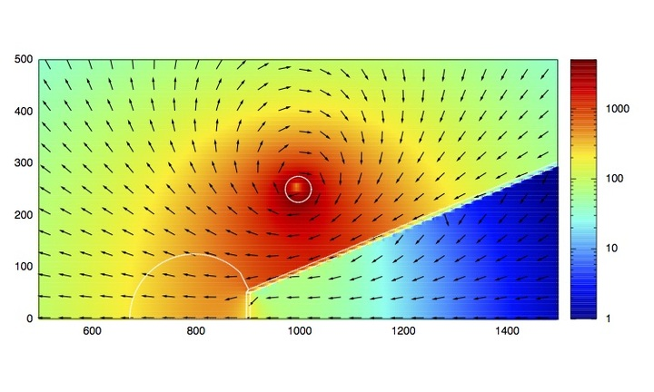
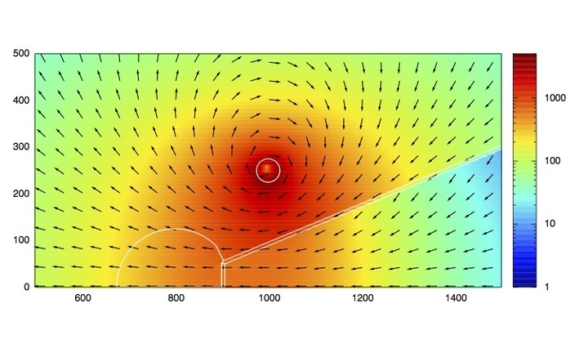
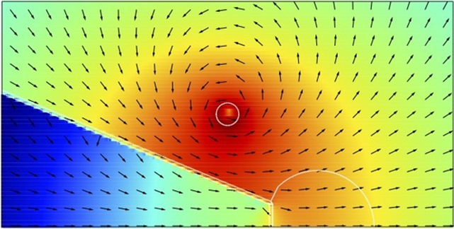
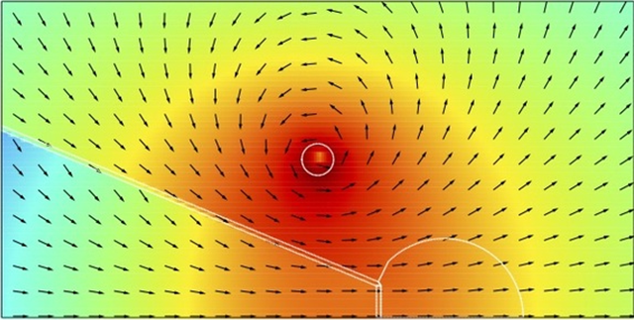
Integrated experiments of MFI scheme
Magnetic field diffusion into the gold cone is
essential for the success of the MFI scheme.
* M. Dharma-wardana et al., Phys. Rev. E (2006).
Calculated 2D magnetic field profile (430 kA)
B-field strength (T)
B-field strength (T)
σ = 10⁷ S/m
σ = 10⁶ S/m
r-distance (μm)
r-distance (μm)
Z-distance (μm)
Z-distance (μm)
t_{diff} = 1/2 μ₀ σ r L
Diffusion time scale
860 ps
Electrical conductivity
2 x 10⁶ S/m (0.1 eV-gold)*
Cylinder radius
50 µm
Diffusion spatial scale
7 µm cone wall

Slide 10
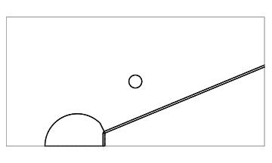
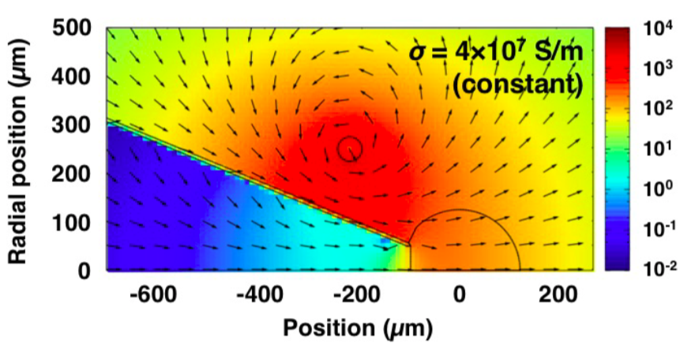
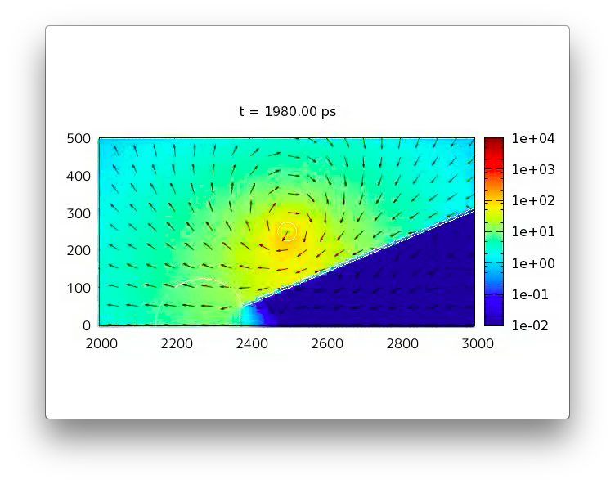
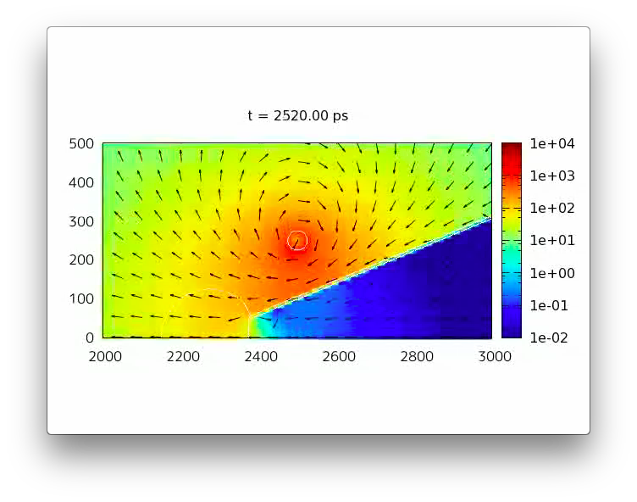
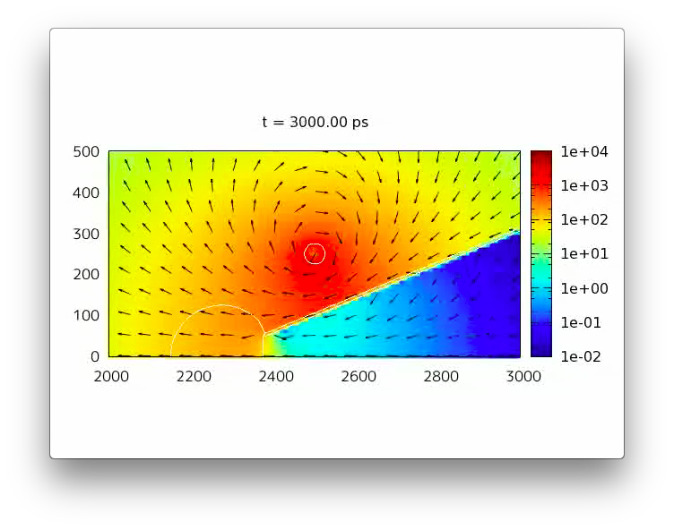
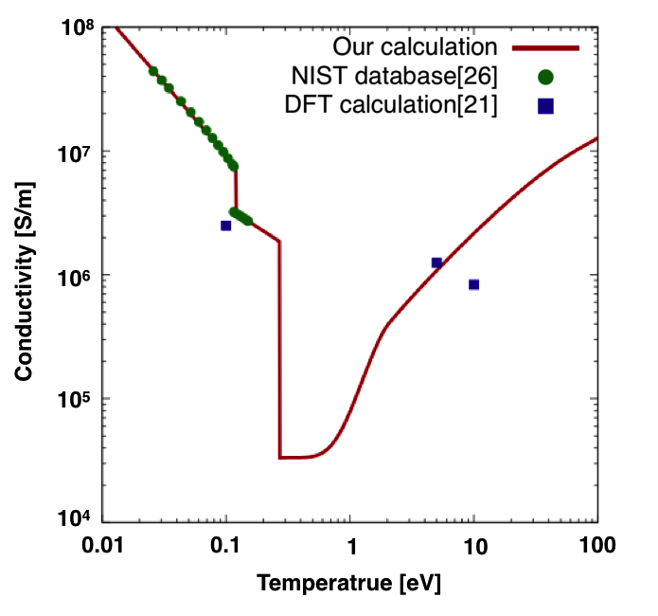
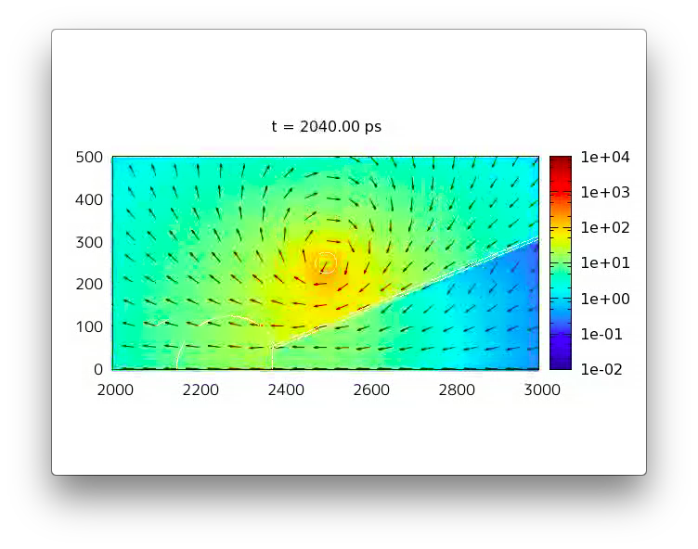
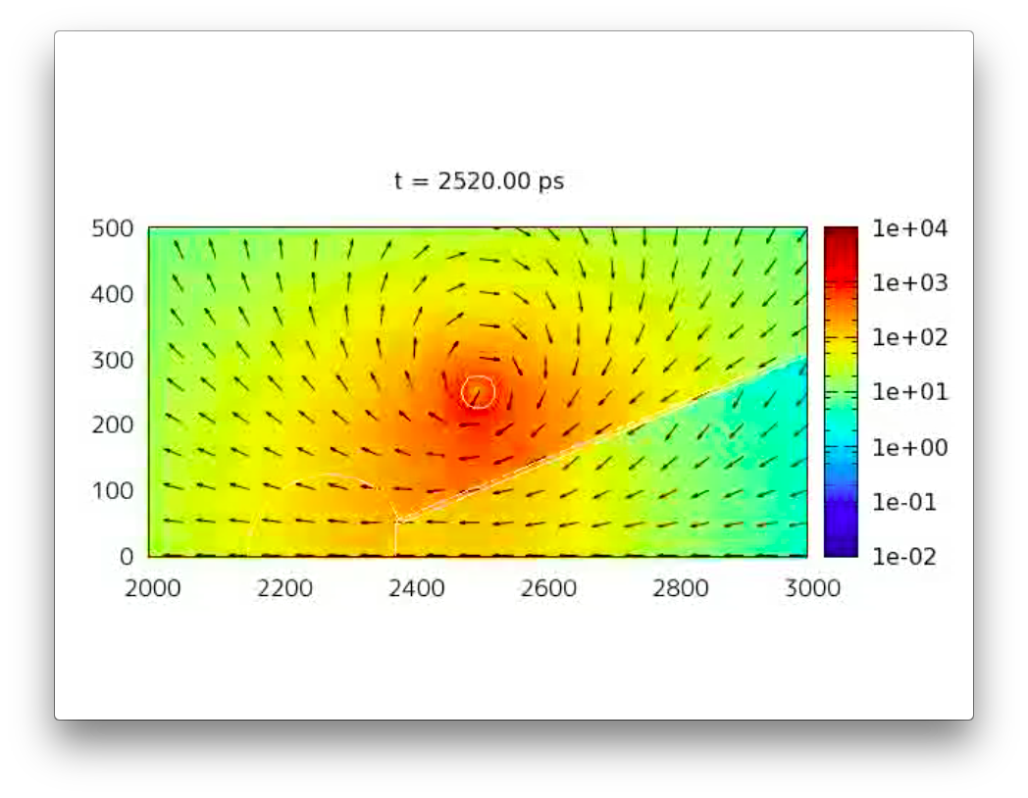
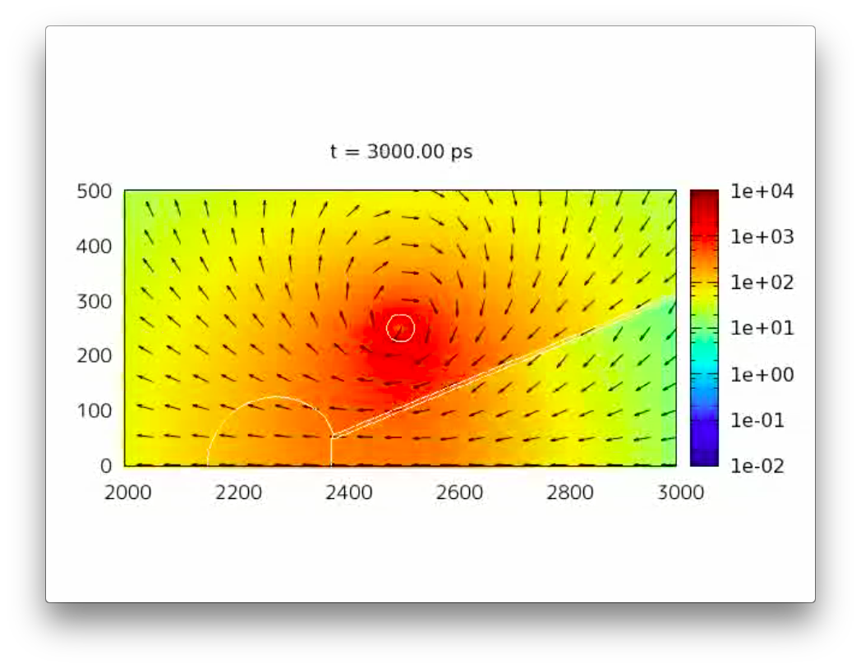
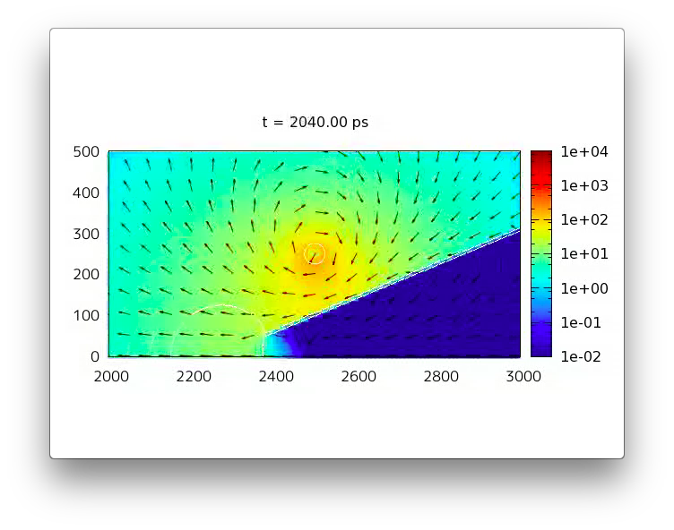
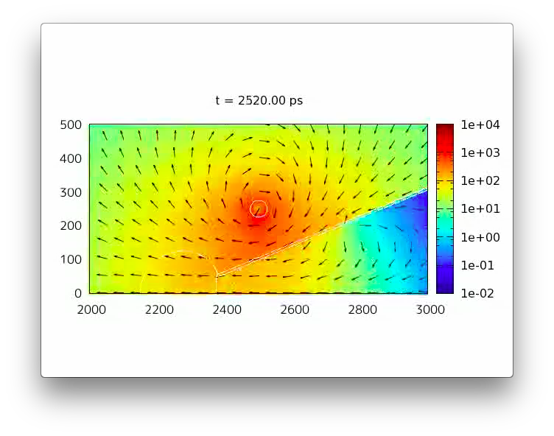
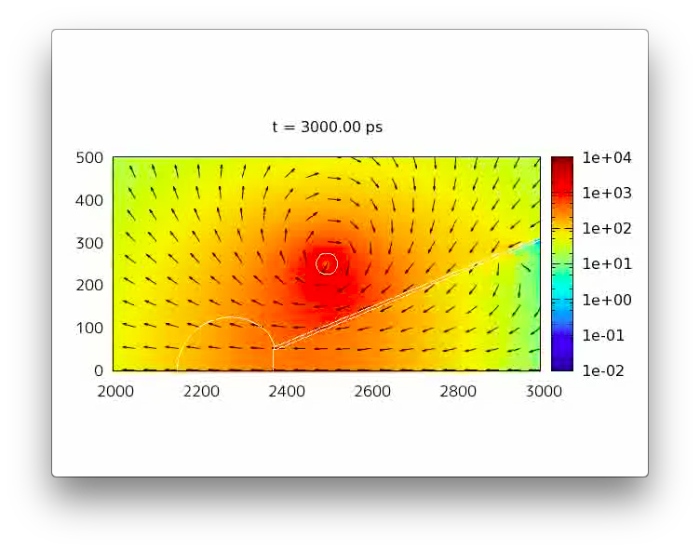
Integrated experiments of MFI scheme
Magnetic field diffusion was calculated with considerations of
inductive heating and dependence of conductivity on temperature.
Temperature dependence Au conductivity
* H. Morita et al., Phys. Plasmas (2018).
-1 ns
-0.5 ns
@ peak
σ = 4×10⁷ S/m
(constant)
|B|
Bloch-Gruneisen model
σ = 2×10⁶ S/m
(constant)
|B|
Modified
Spitzer model
Temperature
dependent σ
|B|

Slide 11

Integrated experiments of MFI scheme
X-ray spectra emitted from heated cores indicate
production of 1.5 – 2.1 keV plasmas with the MFI scheme.
E_{L} = 670 J
E_{L} = 1100 J
E_{L} = 1500 J
Log₁₀( $χ^{2}$)
1400 – 1600 eV
1800 – 2000 eV
2000 – 2200 eV

Slide 12
Integrated experiments of MFI scheme
Quasi-monochromatic X-ray images show
the extension of the heated region along the heating laser axis.
Ti-Ka quasi-monochromatic image
= corresponding to a cold region
Ti-Heα quasi-monochromatic image
= corresponding to a heated region
Position (µm)
LASER
Position (µm)
LASER
PSL
#41392
#41394
Position (µm)
Position (µm)

Slide 13
Integrated experiments of MFI scheme
Efficient laser-to-core coupling (~8%) was achieved even with
a relatively small ρR core (~ 0.1 g/cm²) by application of external B-field.
Cu-Kα spectra
Dependence of laser-to-core coupling
Solid marks t = 0.61 – 0.72 ns
Open marks t = 0.37 – 0.42 ns

Slide 14



Y. Arikawa, S. Sakata, H. Lee, K. Law, K. Matsuo, Y. Ochiai, C. Liu, H. Li, J. Nishibata, M. Hata, N. Iwata, Y. Abe, Y. Hironaka, T. Jitsuno, A. Morace, K. Mima, M. Murakami, N. Miyanaga, H. Nagatomo, M. Nakai, Y. Nakata, K. Nishihara, H. Nishimura, T. Norimatsu, T. Sano, Y. Sakawa, K. Shigemori, T. Shirato, K. Tsubakimoto, A. Yogo, H. Shiraga, H. Azechi, Y. Sentoku, R. Kodama
Institute of Laser Engineering, Osaka University, Japan
S. Kojima
Institute for Chemical Research, Kyoto University, Japan
T. Johzaki
Hiroshima University, Japan
A. Iwamoto, T. Ozaki, T. Watanabe, H. Sakagami
National Institute for Fusion Science, Japan
T. Taguchi
Setsunan University, Japan
H. Sawada
University of Nevada, Reno, USA
Z. Zhang
Institute of Physics, China
J. Santos, M. Bailly-Grandvaux, D. Batani, Ph. Nicolaï, V. Tikhonchuk
CELIA, Univ. Bordeaux, France
B. Pollock, J. Moody
Lawrence Livermore National Laboratory, USA
A. Sunahara
Perdue University, USA

Slide 15
Summary
Short-pulse energetic electron beam accelerated by an intense laser pulse is used to heat instantaneously a compressed fuel core in the MFI.
The laser accelerated electron beam has a large divergence relative to a fuel core radius.
The diverging electron beam is guided to a small fuel core along the externally applied kilo-tesla magnetic field.
An over-solid-density core was heated up to > 2 keV with > 8% of the energy coupling by the MFI scheme.
We are trying to increase the heating laser energy to achieve the ignition temperature with the MFI scheme.

