Slide 1
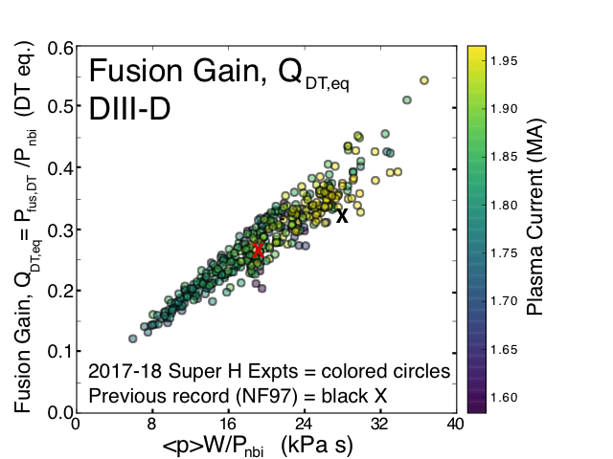
Super H-Mode Experiments on Alcator C-Mod and DIII-D Achieve High Fusion Performance, Record Pedestal Pressure
P.B. Snyder EX/2-4
C-Mod SH expts p_{ped}= 40-81 kPa
Super H-mode (SH) predicted in strongly shaped plasmas: high p_{ped}, increases with n_{e} [Snyder NF15]
Record pedestal pressures (~81 kPa) achieved in C-Mod SH experiments [Hughes NF18]
Successful tests of EPED model up to ~90% of predicted ITER p_{ped}
Record DIII-D fusion gain (Q_{DT,eq}~ 0.5). Q_{DT,eq}/IaB and Q_{DT,eq}/(RB)² highest reported on any tokamak
High performance sustained w/ 3D magnetic perturbations to control n_{e} and impurity accumulation
High p_{ped} and τ_{E} sustained with high rates of D₂ and N₂ puffing, strong reduction of divertor T_{e}
Super H-mode compatible with both high fusion performance and high separatrix density for divertor solutions

