Slide 1
Increasing the density in Wendelstein 7-X: Benefits and limitations
G. Fuchert¹, K.J. Brunner¹, K. Rahbarnia¹, T. Stange¹, D. Zhang¹, J. Baldzuhn¹, M.N.A. Beurskens¹, S.A. Bozhenkov¹, C.D. Beidler¹, S. Brezinsek², R. Burhenn¹, H. Damm¹, A. Dinklage¹, M. Hirsch¹, Y. Kazakov³, J. Knauer¹, Y. Feng¹, A. Langenberg¹, H.P. Laqua¹, S. Lazerson⁴, N. Pablant⁴, E. Pasch¹, T. Sunn Pedersen¹, E.R. Scott¹, F. Warmer¹, V. Winters⁵, R.C. Wolf^{1,6} and W7-X team
¹Max Planck Institute for Plasma Physics, Greifswald, Germany, ²Forschungszentrum Jülich, Jülich, Germany, ³Royal Military Academy, Brussels, Belgium, ⁴Princeton Plasma Physics Laboratory, Princeton NJ, USA, ⁵University of Wisconsin-Madison, Madison WI, USA, ⁶Technische Universität Berlin, Berlin, Germany

Slide 2
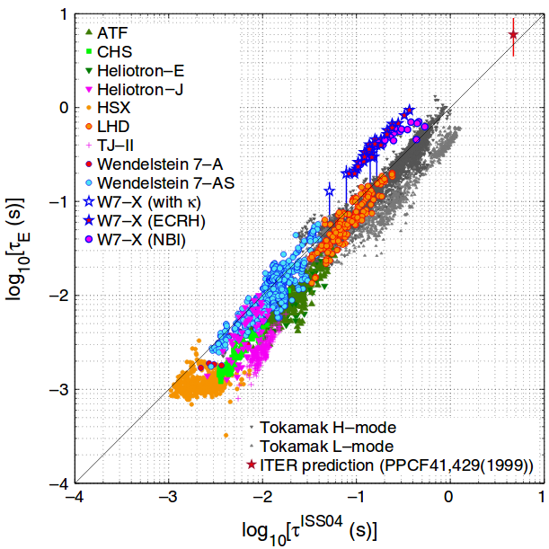
Motivation: Density scaling of the energy confinement
Empirical scaling ISS04
Positive density scaling and negative power scaling („power degradation“).
Triple product benefits from increasing the density.
Power and density scaling agree with neoclassical plateau regime. [Dinklage , NF 47, (2007)]
ISS04 close to a gyro-Bohm scaling: turbulent transport?
[Dinklage, NF 47, (2007)]

Slide 3
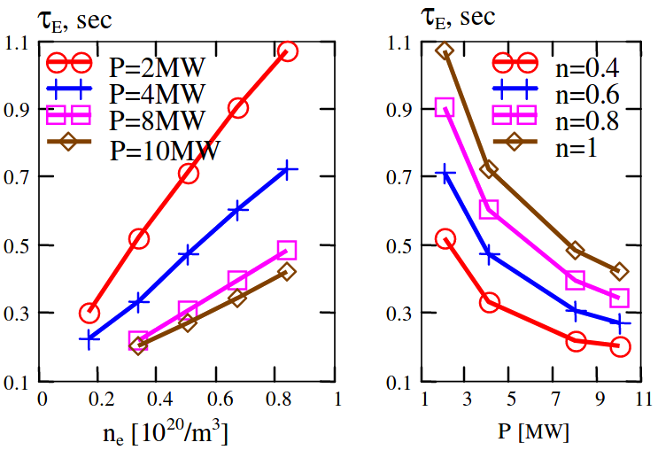
Motivation: Density scaling of the energy confinement
Neoclassical prediction for W7-X
Neoclassical transport modeling suggests a negative power scaling close to ISS04 and a stronger positive density scaling. [Turkin, PoP 18, (2011)]
Increase the density!
Limitations? Empirical τ_{E} scaling?
[Turkin 2007 (EPS)]

Slide 4
Outline
Energy confinement time before boronization
Scaling close to ISS04
Density limited by radiative collapses
Critical density
Comparison of analytical models with experimental observations
Critical density before and after boronizatoin
Energy confinement time after boronization
Scaling after boronization
Energy confinement time at higher densities
Summary and conclusion

Slide 5
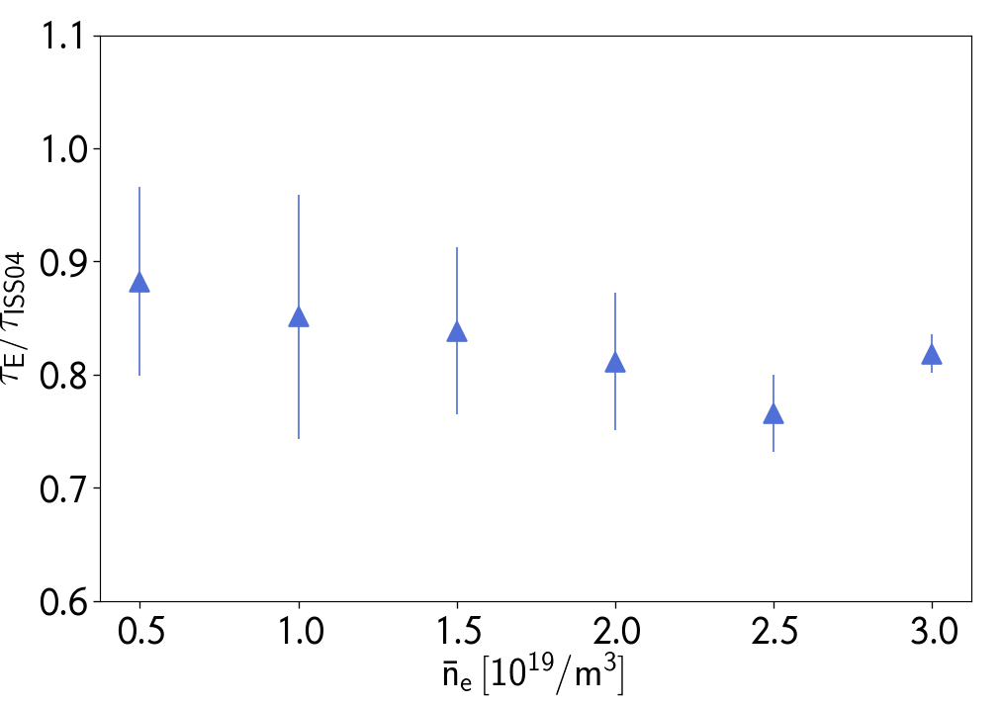
Energy confinement before boronization
Before boronization, τ_{E} showed a scaling close to ISS04 in hydrogen.
Densities above ~ 4∙10¹⁹ /m³ were only accessible transiently with pellet fuelling due to radiative collapses.
Spread of experimental data, not error
τ_{E} ~ a₀n^{α}P^{β}
Scenario | a₀ | α | β
Standard divertor | 0.16 | 0.56 | -0.78
Limiter (OP1.1) | 0.13 | 0.75 | -0.64
ISS04 | - | 0.54 | -0.61

Slide 6
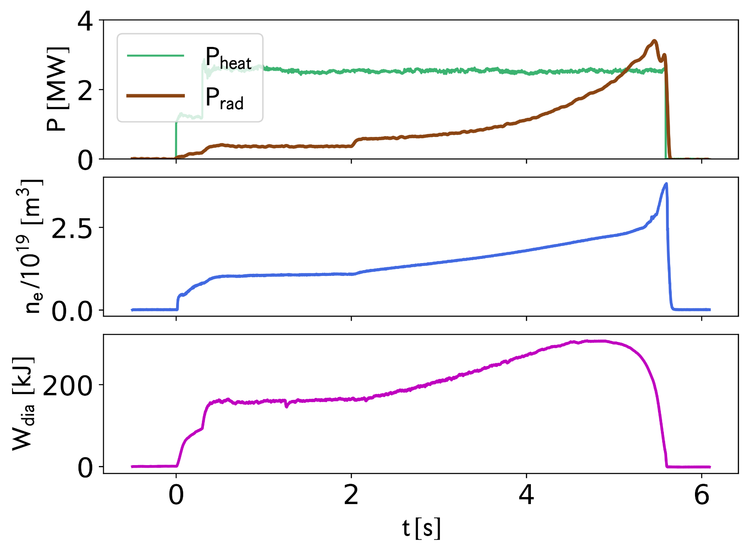
Density scaling of the energy confinement

Slide 7
Density scaling of the energy confinement

Slide 8
Density scaling of the energy confinement
Common phenomenon in stellarators, e.g. in
LHD: [J. Miyazawa et al., Fusion Sci. Technol. 58 (2010)]
TJ-II: [M.A. Ochando, 41st EPS Conference on Plasma Physics (2014)]
W7-AS: [L. Giannone et al., Plasma Phys. Control. Fusion 45 (2003)]
W7-A: [G. Cannici et al., Proc. 7th Int. Conf. on Plasma Phys. And Control. Nucl. Fusion (1978)]

Slide 9
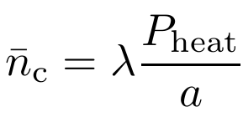
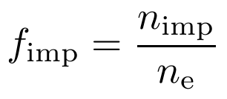
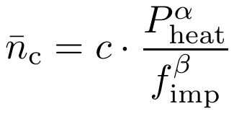
Predicting the critical density for strong edge radiation
Critical density from the detachment model by Itoh [K. Itoh and S. Itoh, J. Phs. Soc. Jpn. 57 (1988)]
Sudo density limit [S. Sudo et al., Nucl. Fusion 30 (1990)]
Limits with different transport and radiation models [H. Wobig, Plasma Phys. Control. Fusion 42 (2000)]
Modified Itoh model for W7-AS [L. Giannone et al., Plasma Phys. Control. Fusion 45 (2003)]
Implicit dependences on transport and edge impurities (low Z) have to be made explicit [Zanca et al., Nucl. Fusion 57 (2017)]

Slide 10
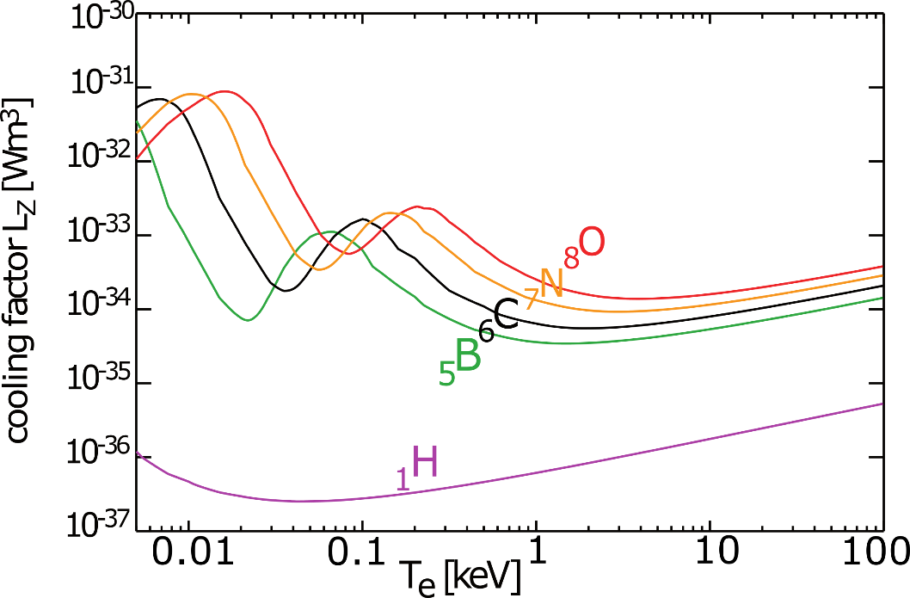
Predicting the critical density for strong edge radiation
Image courtesy by T. Pütterich
Critical density from the detachment model by Itoh [K. Itoh and S. Itoh, J. Phs. Soc. Jpn. 57 (1988)]
Sudo density limit [S. Sudo et al., Nucl. Fusion 30 (1990)]
Limits with different transport and radiation models [H. Wobig, Plasma Phys. Control. Fusion 42 (2000)]
Modified Itoh model for W7-AS [L. Giannone et al., Plasma Phys. Control. Fusion 45 (2003)]
Implicit dependences on transport and edge impurities (low Z) have to be made explicit [Zanca et al., Nucl. Fusion 57 (2017)]

Slide 11
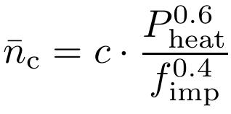
Predicting the critical density for strong edge radiation
Critical density from the detachment model by Itoh [K. Itoh and S. Itoh, J. Phs. Soc. Jpn. 57 (1988)]
Sudo density limit [S. Sudo et al., Nucl. Fusion 30 (1990)]
Limits with different transport and radiation models [H. Wobig, Plasma Phys. Control. Fusion 42 (2000)]
Modified Itoh model for W7-AS [L. Giannone et al., Plasma Phys. Control. Fusion 45 (2003)]
Implicit dependences on transport and edge impurities (low Z) have to be made explicit [Zanca et al., Nucl. Fusion 57 (2017)]
W7-X
Configuration | c
Standard | 0.56
High-iota | 0.59
High-mirror | 0.57
Details on the magnetic configurations:
[J. Geiger et al., Plasma Phys. Control. Fusion 57 (2015)]

Slide 12
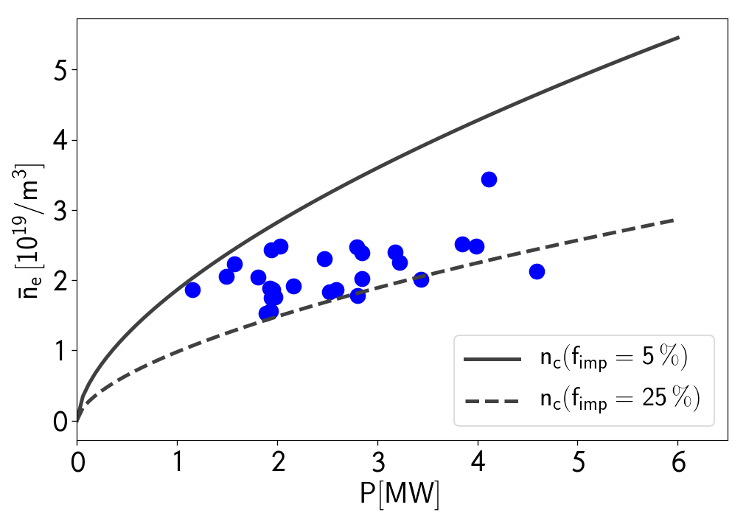
Critical density before boronization
Hydrogen plasmas with central X2-heating
Large scatter in n_{c}
Weaker power scaling than predicted (if any…)
Possible reasons:
Changing impurity content (depending on heating power?)
Profile effects, importance of edge density (δ)
Model not applicable (local effects, changing main radiator,…)

Slide 13
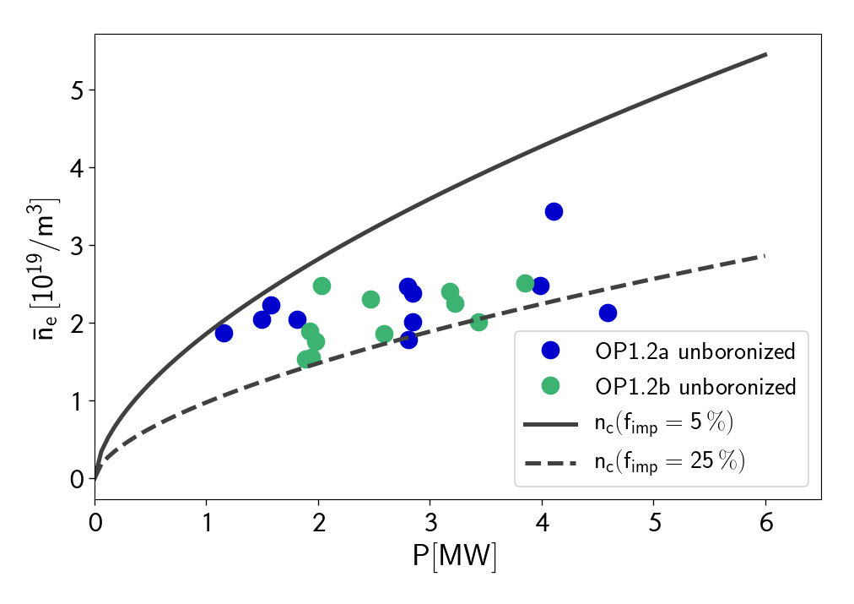
Critical density before boronization
Large scatter in n_{c}
Weaker power scaling than predicted (if any…)
Possible reasons:
Changing impurity content → under investigation
Profile effects, importance of edge density (δ)
Model not applicable → local effects exist (e.g. Marfe [U. Wenzel, NF 58 (2018)]), but their importance is unclear
Common mitigation strategies:
Pellet fueling (decouple core and edge density)
Wall conditioning by e.g. boronization [->R. Brakel, EX/P8-17]
[G. Kocsis, T. Szepesi]

Slide 14
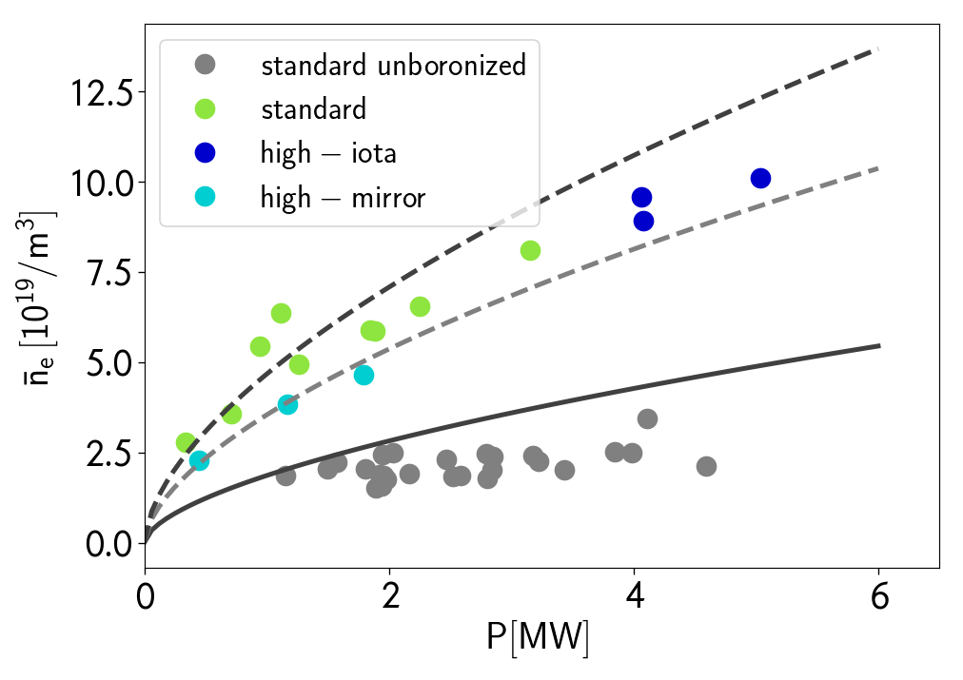
Critical density after boronization
f_{imp}=0.5%
After boronization, radiation from oxygen and carbon lines went down significantly
Reduced by a factor of 5 to 10
Only moderate additional boron lines
[-> Pedersen et al., EX/9-1]
At the same time, n_{c} increased by a factor of ~3
In the scaling law this would correspond to a reduction of f_{imp} by a factor of 5 to 10
Configurational effects are either absent or subtle
f_{imp}=1%
f_{imp}=5%

Slide 15
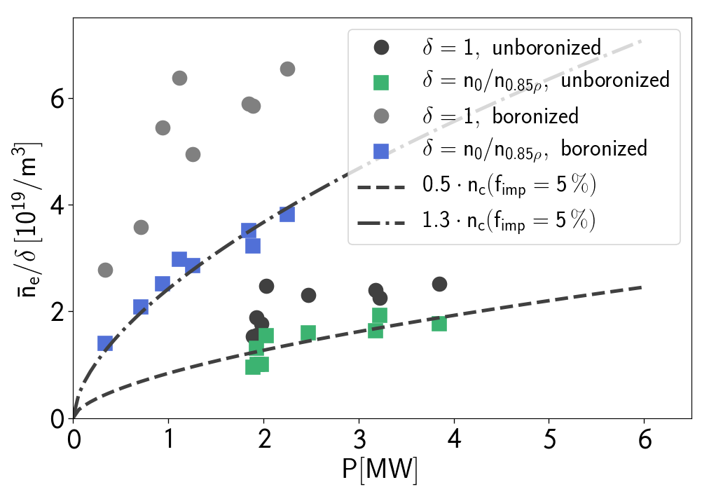
Profile effects
Estimate edge density by δ=n₀/n_{0.85ρ}
Significantly improved agreement with scaling for n_{e}/δ
→ Profile effects are a major source for the scatter in n_{c}

Slide 16
Profile effects
Estimate edge density by δ=n₀/n_{0.85ρ}
Significantly improved agreement with scaling for n_{e}/δ
→ Profile effects are a major source for the scatter in n_{c}
τ_{E}?

Slide 17
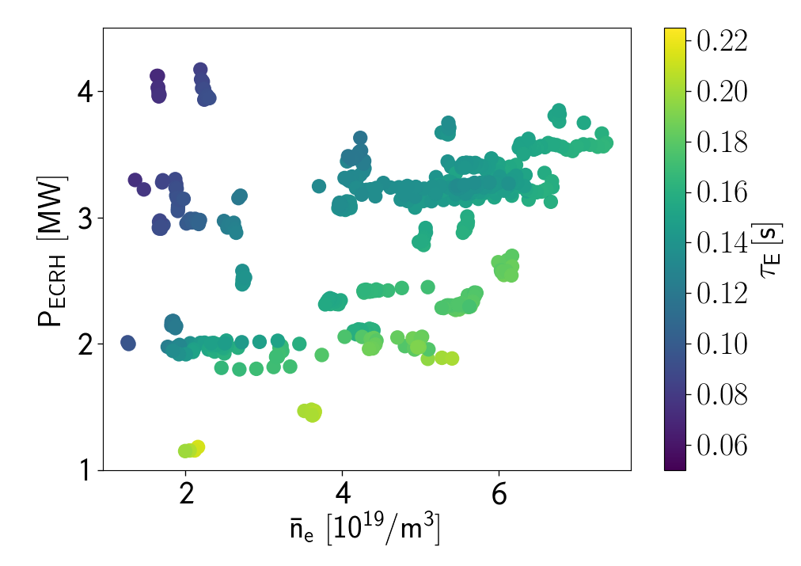
Energy confinement at higher densities
Scenario | a₀ | α | β
After boronization | 0.16 | 0.38 | -0.59
ISS04 | - | 0.54 | -0.61
Energy confinement after boronization
For simplicity, only X2-heated plasmas are shown
In O2 similar observations, but P_{absorbed} < P_{heat}.
Also in these experiments a positive density scaling of τ_{E} is found.
This trend can be observed even in single experiments.
Density scaling gets weaker at high f_{rad}=P_{rad}/P_{ECRH} or densities close to n_{c}.

Slide 18
Energy confinement at higher densities
Scenario | a₀ | α | β
After boronization | 0.16 | 0.38 | -0.59
ISS04 | - | 0.54 | -0.61
Energy confinement after boronization
For simplicity, only X2-heated plasmas are shown
In O2 similar observations, but P_{absorbed} < P_{heat}.
Also in these experiments a positive density scaling of τ_{E} is found.
This trend can be observed even in single experiments.
Density scaling gets weaker at high f_{rad}=P_{rad}/P_{ECRH} or densities close to n_{c}.
Only accessible after boronization

Slide 19
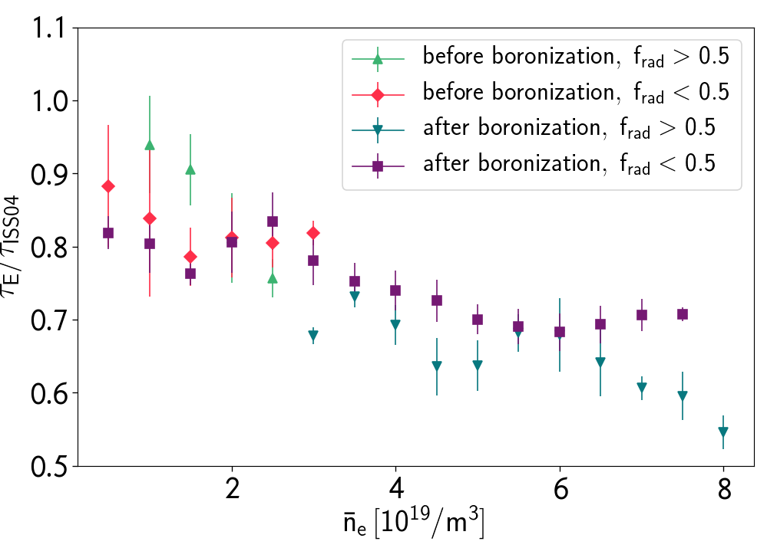
Energy confinement at higher densities
Scenario | a₀ | α | β
After boronization | 0.16 | 0.38 | -0.59
… n_{e} > 4∙10¹⁹ /m³ | 0.11 | 0.62 | -0.64
ISS04 | - | 0.54 | -0.61
Energy confinement after boronization
For simplicity, only X2-heated plasmas are shown
In O2 similar observations, but P_{absorbed} < P_{heat}.
Also in these experiments a positive density scaling of τ_{E} is found.
This trend can be observed even in single experiments.
Density scaling gets weaker at high f_{rad}=P_{rad}/P_{ECRH} or densities close to n_{c}.

Slide 20
Energy confinement at higher densities
Scenario | a₀ | α | β
After boronization | 0.16 | 0.38 | -0.59
… n_{e} > 4∙10¹⁹ /m³ | 0.11 | 0.62 | -0.64
ISS04 | - | 0.54 | -0.61
Energy confinement after boronization
For simplicity, only X2-heated plasmas are shown
In O2 similar observations, but P_{absorbed} < P_{heat}.
Also in these experiments a positive density scaling of τ_{E} is found.
This trend can be observed even in single experiments.
Density scaling gets weaker at high f_{rad}=P_{rad}/P_{ECRH} or densities close to n_{c}.
?

Slide 21
Energy confinement close to n_{c}
Before boronization, the density scaling becomes weaker above ~0.5·n_{c,5%}
After boronization, the density scaling becomes weaker above ~1.0·n_{c,5%}
f_{rad} increases with n_{e}/n_{c}
As it was shown before, high densities as such are not an issue

Slide 22
Summary and conclusion
Energy confinement time in W7-X
Improves with density, roughly in-line with ISS04 (τ_{E}~n^{0.54}).
Improvement obviously limited by radiative collapses.
Critical density can be estimated from analytical models.
Boronization crucial to achieve relevant densities.

Slide 23
Summary and conclusion
Energy confinement time in W7-X
Not one single scaling law for the entire parameter range.
Unravelling the main transport/loss channels has only started.
Plasmas with pellet-fueling [-> Bozhenkov et al., EX/P8-8] or O2 and NBI-heating are not even included in the analysis yet.
τ_{E}–scalings need to take different regimes and operational limits into account. This is well established for tokamaks, but not yet for stellarators.

