Slide 1
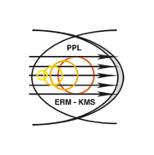
Advances in predictive thermo-mechanical modelling for the JET divertor experimental interpretation, improved protection, and reliable operation
D. Iglesias, W. Arter, I. Balboa, P. Bunting, C. Challis, J.W. Coenen, Y. Corre, S. Esquembri, S. Jachmich, K. Krieger, G. F. Matthews, R. A. Pitts, V. Riccardo, M. L. Richiusa, M. Porton, F. Rimini, S. Silburn, V. Thompson, R. Otin, D. Valcarcel, L. Vitton-mea, Z. Vizvary, J. Williams

Slide 2
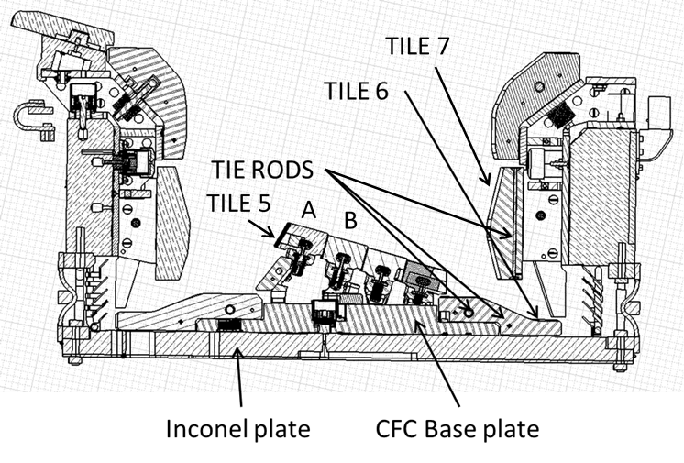
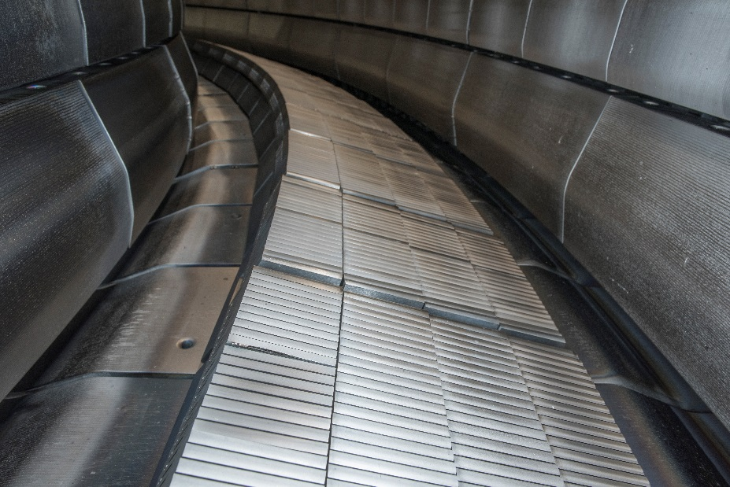
Overview
ITER-like (Be) wall and (W) divertor
Motivation
Modelling advances
Parallel heat flux (amplitude)
Engineering footprint (width)
Divertor integrity predictive analysis
Validation activities
Application to engineering assessments
Conclusions
W-coated CFC
W-coated CFC
Bulk-W

Slide 3
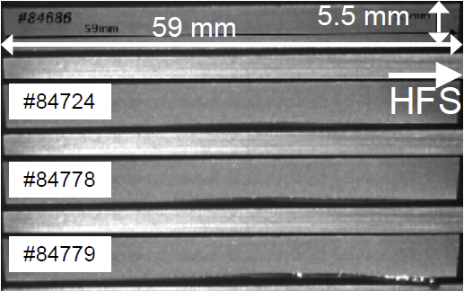
Motivation
Modelling needs
Operational risks:
JET divertor is protected by a set of operating instructions, limiting maximum tile temperature and energy
Several tiles where found damaged with cracks and broken tie-rods during the last two shutdowns
Last high-power campaign has exposed weaknesses in divertor design requiring additional protection measures
In support to ITER, experiments at JET studied the impact of melting an exposed tungsten edge

Slide 4
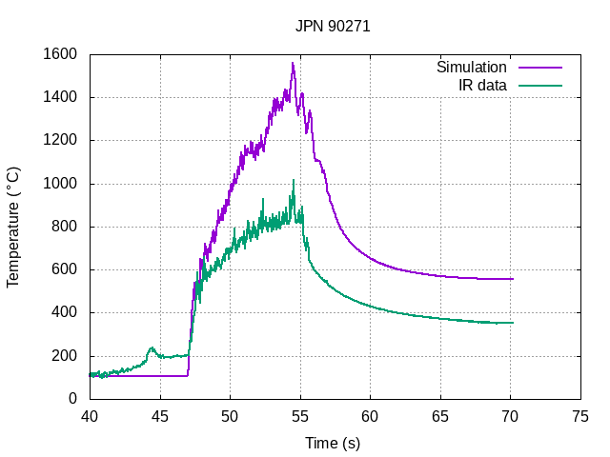
Motivation
JPN 84779 [1]
Simulation issues
Reconstruction of parallel heat flux for 2013 melting experiments was only possible reducing the IR derived q// by a factor of 5 for L-mode and 2.5 for H-mode [1]
Assuming that λ_{q} from the inter-ELM scaling laws [2] applies for the heat flux on all components leads to:
An overestimation of the peak temperature, and
An underestimation of the maximum stress
Operational
limit
[1] ARNOUX G. et al, Thermal analysis of an exposed tungsten edge in the JET divertor, J. Nucl. Mat. 463 (2015) 415–419.
[2] EICH T. et al, Scaling of the tokamak near the scrape-off layer H-mode power width and implications for ITER, Nucl. Fusion 53 (2013) 093031.

Slide 5
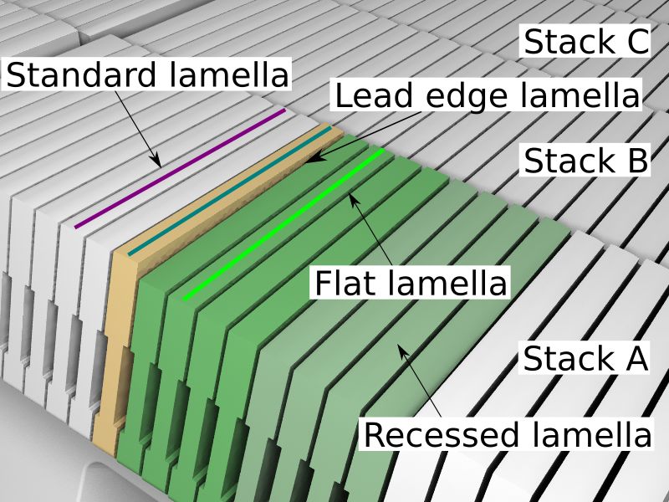
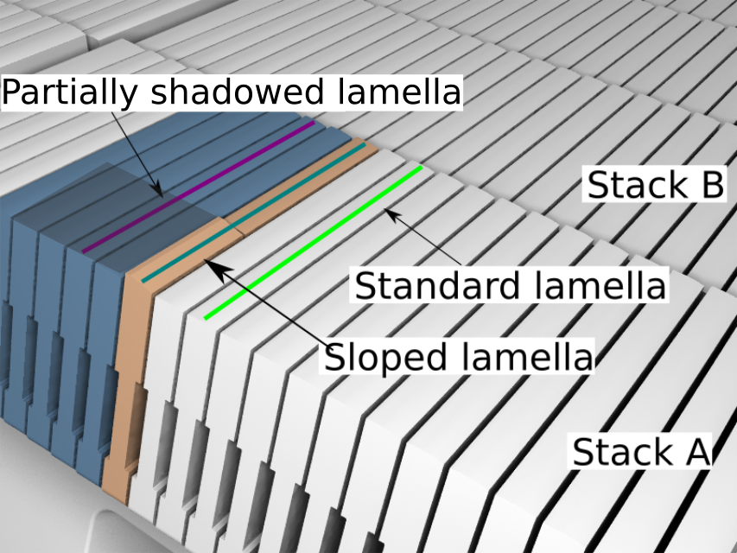
Modelling advances
Parallel heat flux
2013 Experiment
2015-16 Experiment
Characterized using results from 2013 and 2015-16 melting experiments
Three geometries compared, with 2˚, 15˚, and 90˚ angles
New inverse code ALICIA [3] for increased IR derived heat flux calculation
Geometrical and surface loading effects considered
Power measured at shadowed region used as cross-check
[3] IGLESIAS D. et al, Digital twin applications for the JET divertor, Fusion Eng. Des. 145 (2017) 71–76.

Slide 6
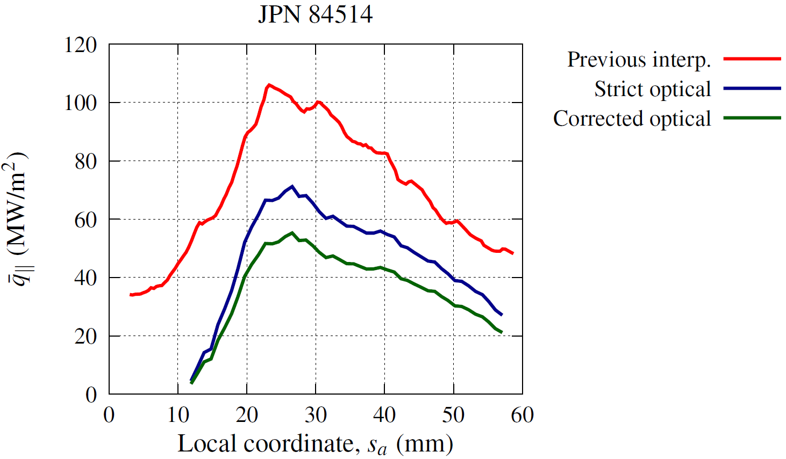
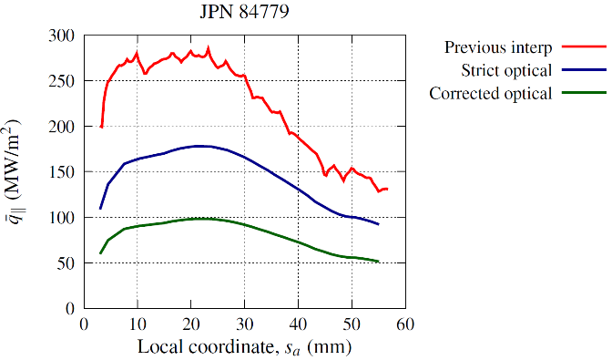
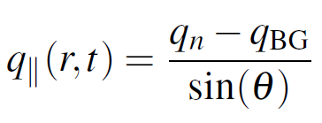
Modelling advances
Parallel heat flux
Background measured with strike point away
Mismatch between q// measured by typical approach:
Measurements at three different angles match when adding an additional term [4]:
[4] IGLESIAS D. et al, An improved model for the accurate calculation of parallel heat fluxes at the JET bulk tungsten outer divertor, Nucl. Fusion 58 (2018) 106034

Slide 7
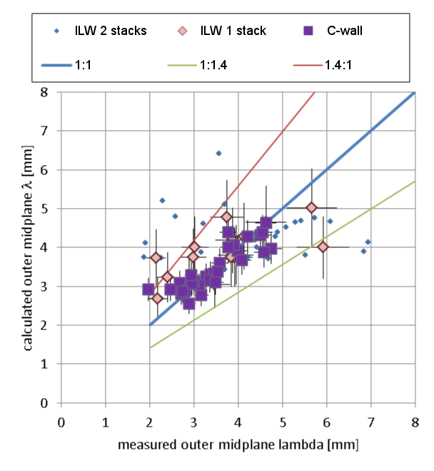
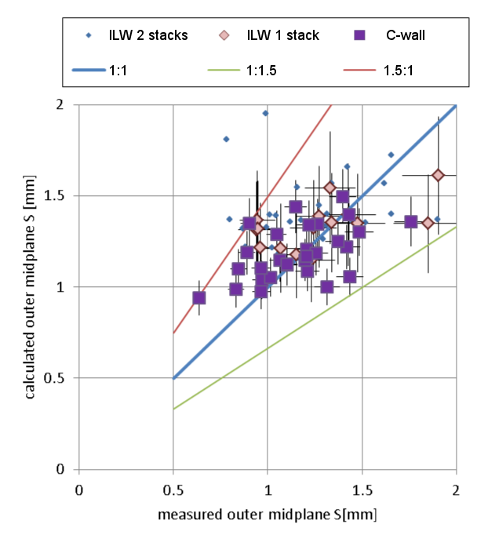
Modelling advances
$$midplane λ_{q}\left[mm\right]=1.6⋅I_{p}^{−0.24}B_{t}^{0.52}n_{e}^{c_{λ}}P_{SOL}^{d_{λ}}f_{ELM}^{e_{λ}}+0.006σ_{RF}$$
$midplane S\left[mm\right]=$ $1.6{⋅I}_{p}^{0.74}B_{t}^{−0.83}n_{e}^{c_{S}}P_{SOL}^{d_{S}}f_{ELM}^{e_{S}}+0.002σ_{RF}$
Engineering footprint [5]
Fit averaging ELM and inter-ELM contributions
Includes natural movements of the strike point due to EM and control system transients
Tile 5 analysed for C and ILW-wall with no major differences between materials
[5] RICCARDO V. et al, “Power footprint definition for JET divertor protection”, 22nd PSI, Roma, Italy (2016).

Slide 8
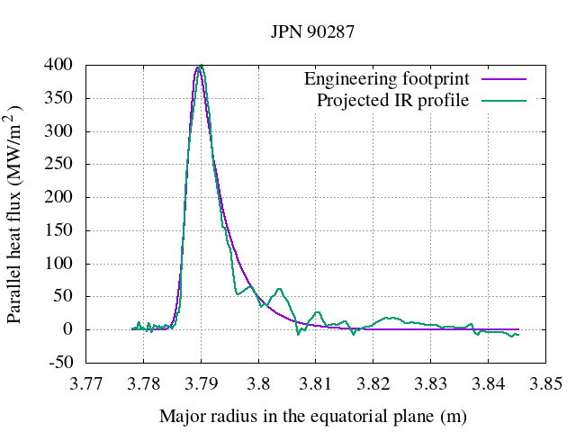
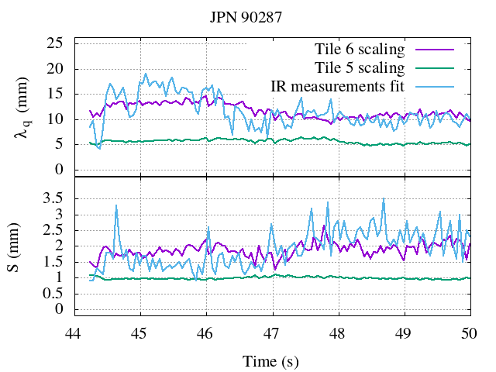
Modelling advances
Engineering footprint
Tile 6 has different equilibrium, with longer connection length
Footprint fit found is broader than tile 5
Compared to inter-ELM scaling, engineering footprint for tile 6 is 5-10 times larger
shot | λ_{q} inter-ELM (mm) | λ_{footprint} T5 (mm) | λ_{footprint} T6 (mm)
90271 | 2.1 | 2.2-3.5 | 9-17
92025 | 2.1 | 2.1-3.0 | 11-19
92436 | 2.1 | 2.1-2.5 | 10-19
92398 | 2.5 | 2.0-3.2 | 13-16

Slide 9
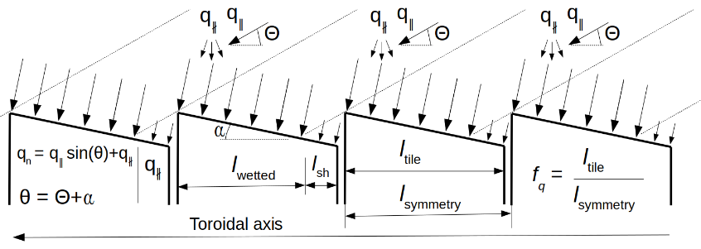
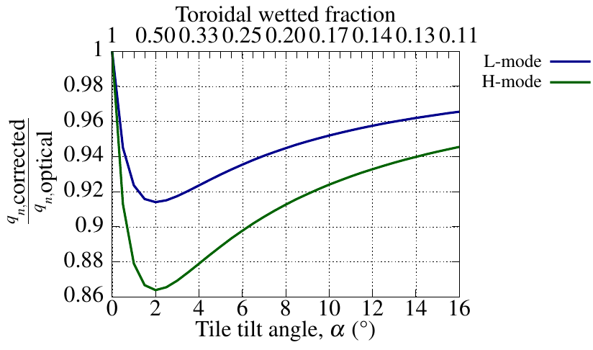
Divertor integrity predictive analysis
Forward model
Tile surface heat flux density calculated at equatorial plane using the engineering footprint
Projected using Flush (2D) or SMARDDA/PFC (3D), and
Taking into account the corrected optical projection

Slide 10
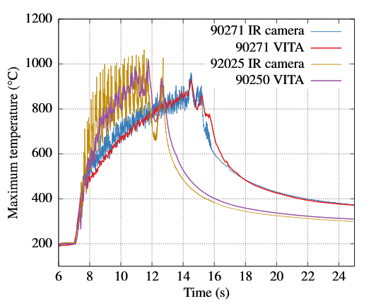
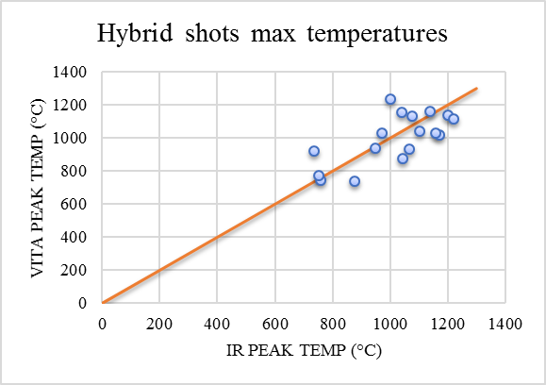
Divertor integrity predictive analysis
Validation
Temperature evolution captured during flat-top and ramp-down
Energy consistent predictive model with 15% error in temperatures and energy

Slide 11
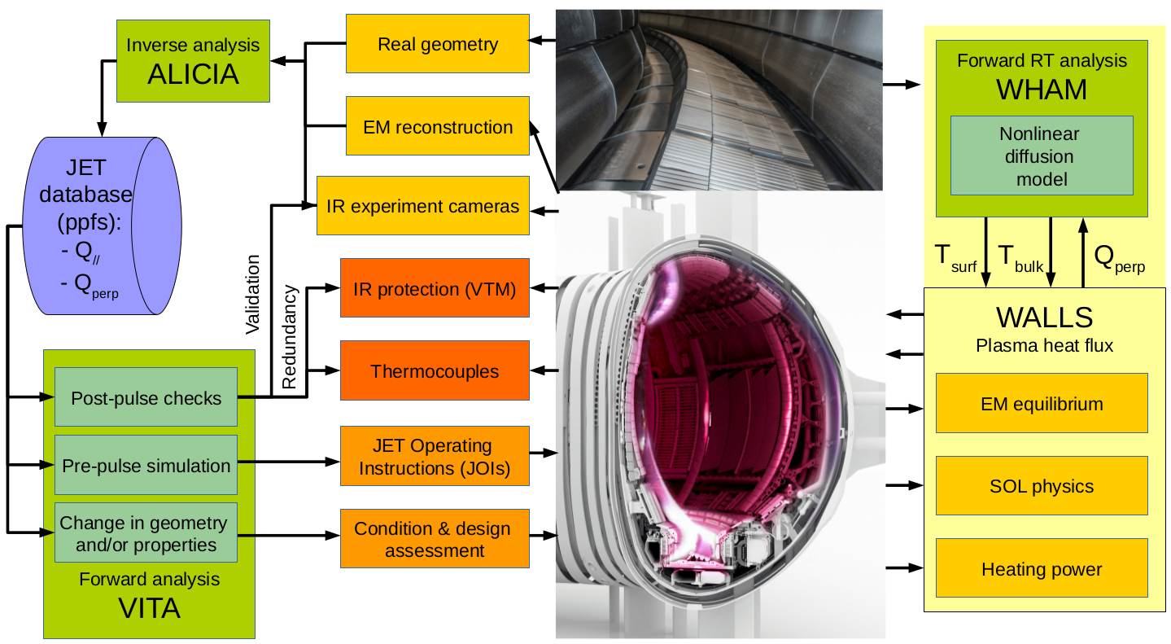
Divertor integrity predictive analysis
Workflows
Preparation: JET Operating Instructions checks running synthetic shots in the integrated modelling tool VITA

Slide 12
Divertor integrity predictive analysis
Workflows
Protection: Real-time protection using WALLS with the engineering footprint and fast FE 2D RT models

Slide 13
Divertor integrity predictive analysis
Workflows
Post-pulse integrity assessment: possible even if camera signals are not available for the shot. The surface load is calculated at the equatorial plane, projected to the divertor and then linked to 3D FE codes, such as ANSYS

Slide 14
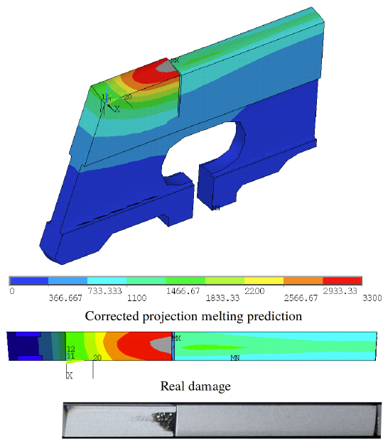
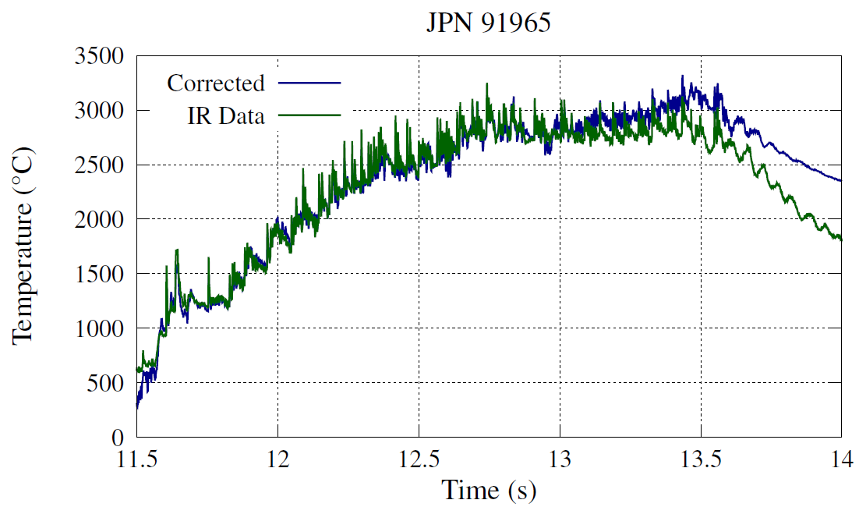
Divertor integrity predictive analysis
Integrity assessments
Damage prediction:
Melting experiments simulation with IR derived heat flux and corrected optical projection [4]
Melting onset
changes emissivity
[4] IGLESIAS D. et al, An improved model for the accurate calculation of parallel heat fluxes at the JET bulk tungsten outer divertor, Nucl. Fusion 58 (2018) 106034

Slide 15
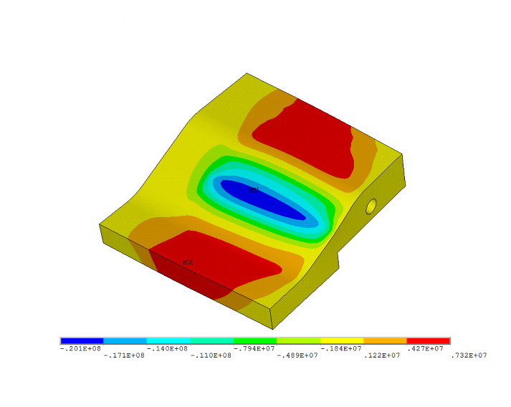
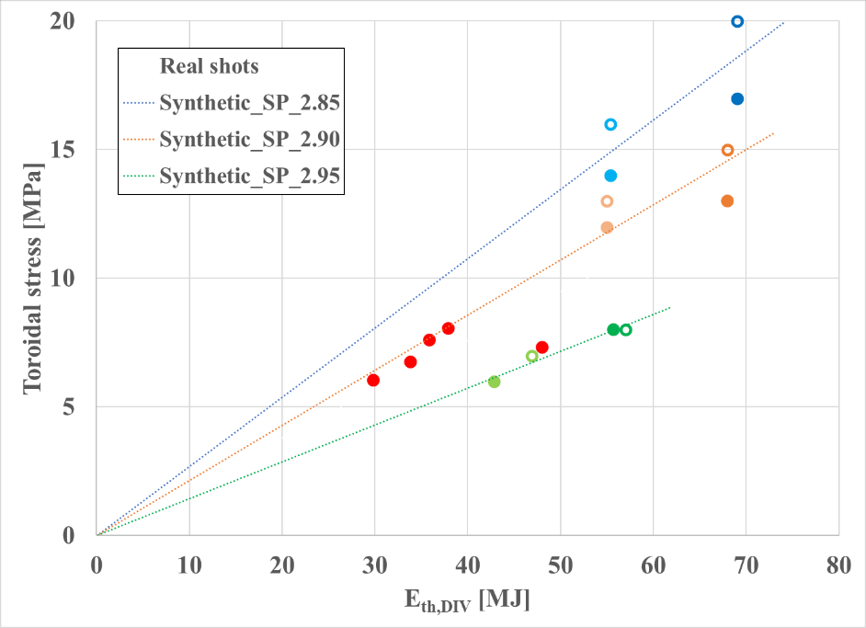
Divertor integrity predictive analysis
Integrity assessments
Failure mode investigation:
Tile radial cracks due to poloidal temperature gradient
Tie-rod failure due to fatigue produced by repeated tile extension and bending
Cracks
Risk assessment:
Cracks risk is high [6] for toroidal stress > 6 Mpa
Fatigue failure avoided by managing energy accumulated through life
Tie-rod fatigue
[6] RICHIUSA M. L. et al, Maximizing JET divertor mechanical performance for the upcoming Deuterium-Tritium experiments, Fusion Eng. Des. (2018) Submitted.

Slide 16
Conclusions (I)
The corrected optical projection for the parallel heat flux is 40% of that inferred when geometrical and loading corrections are not taken into account
The non-parallel heat flux component is characterized by direct measurements and needed in JET for consistency, although its origin is uncertain and more analysis is required to separate any diagnostic error from understood physics
Future experiments and dedicated modelling should assess what the implications of the corrected projection are for the steady loads on ITER
The engineering footprint averages ELM and inter-ELM contributions leading up to 5-10 times broader profiles when compared to the inter-ELM scaling laws

Slide 17
Conclusions (II)
Modelling improvements have been integrated in predictive analysis tools, with a maximum 15% error in temperatures and energy estimations
Melting, cracks and tie-rod failures at the divertor tiles can now be reproduced and prevented in the upcoming high power D-T campaign
The thermal behaviour is calculated in a matter of seconds while a 3D thermo-mechanical assessment can be automatically performed in less than 10 minutes.
This development extends the operational envelope for JET high power and high energy shots and is also transferable to ITER

Slide 18
Advances in predictive thermo-mechanical modelling for the JET divertor experimental interpretation, improved protection, and reliable operation
Thank you for your attention!
D. Iglesias, W. Arter, I. Balboa, P. Bunting, C. Challis, J.W. Coenen, Y. Corre, S. Esquembri, S. Jachmich, K. Krieger, G. F. Matthews, R. A. Pitts, V. Riccardo, M. L. Richiusa, M. Porton, F. Rimini, S. Silburn, V. Thompson, R. Otin, D. Valcarcel, L. Vitton-mea, Z. Vizvary, J. Williams

