Slide 1
Gyrokinetic XGC1 Simulation of Magnetic Island Effects on Neoclassical and Turbulence Physics in a KSTAR Plasma
Jae-Min Kwonª in collaboration with
S. Ku^{b}, C.S. Chang^{b}, M.J. Choiª, R. Hager^{b},
E.S. Yoon^{c}, H.H. Leeª, and H.S. Kimª
ªNational Fusion Research Institute, Korea
^{b}Princeton Plasma Physics Laboratory, USA
^{c}Ulsan National Institute of Science and Technology, Korea
27th IAEA Fusion Energy Conference
Oct. 22~27. 2018, Gandhinagar, India

Slide 2
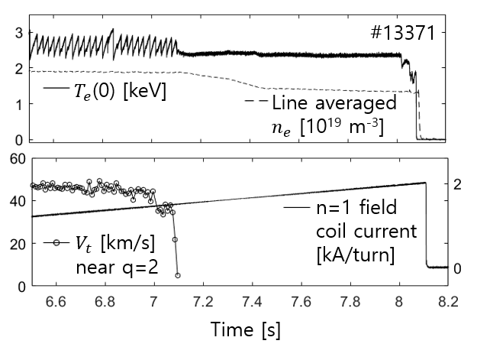
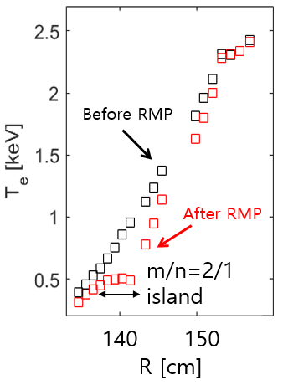
Motivation - KSTAR Experiment
M.J. Choi, EX/11-2
Dedicated experiments employing RMP and fluctuation diagnostics(ECEI) on KSTAR (M.J. Choi et al, NF 57, 126058 (2017)) → Impact of 3D magnetic island on plasma flow and fluctuation
$T_{e}$ profile flattening by m/n=2/1 island, little change in central $T_{e}$ due to steep $∇T_{e}$ gradient region → physics of sustained $T_{e}$ confinement?

Slide 3
Motivation - KSTAR Experiment
$$r_{si}$$
$$r_{so}$$
$$r_{si}$$
M.J. Choi, EX/11-2
20
Anisotropic distribution of electron temperature fluctuations around magnetic island
$T_{e}$ fluctuation is strong near the X-point (slightly shifted).
Very weak (or no) $T_{e}$ fluctuation is observed around the O-point and inside of magnetic island.
Summed
coherence
10
10
z [cm]
8
X-point
O-point
0
6
4
-10
2
0
-20
200 205
R [cm]

Slide 4
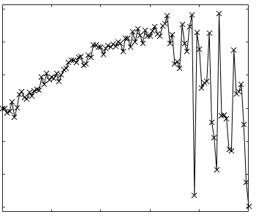
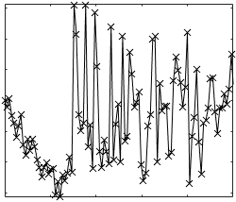
Motivation - KSTAR Experiment
M.J. Choi, EX/11-2
Poloidal flow distribution shows an opposite trend from $T_{e}$ fluctuation
Weaker flow is observed near the X-point
Stronger flow is observed near the O-point
$$π$$
15
$v_{pt}$ [km/s]
0
10
6
Cross phase
Electron
direction
4
$$−π$$
5
0 20 40 60 80 100
2
Frequency [kHz]
0
Z [cm]
0
Physical mechanisms behind the observed flow and turbulence patterns?
Sustained electron thermal confinement in the inner region?
$$π$$
-5
Ion
direction
-2
Cross phase
-10
0
-2
-15
-6
$$−π$$
0 20 40 60 80 100
Frequency [kHz]
205
210
R [cm]

Slide 5
Contents
Perturbed neoclassical equilibrium by magnetic island
Modified equilibrium profiles, equilibrium potential, and $E×B$ flow by magnetic island
Global XGC1* total-f electrostatic neoclassical simulation with magnetic island and KSTAR data
Global linear instabilities of perturbed profiles by magnetic island
Detailed properties of micro-instabilities such as growth rate, frequency
Global gKPSP** $δf$ linear stability analysis using perturbed profiles from XGC1 simulation
Global nonlinear turbulence simulation with self-consistent neoclassical physics and magnetic island
Nonlinear evolution of turbulence and zonal flow around magnetic island
Global XGC1* total-f electrostatic turbulence simulation with magnetic island
* S. Ku et al, JCP 315, 467(2016); S. Ku et al, PoP 25, 056107(2018)
** L. Qi et al, PoP 23, 062513(2016); J.-M. Kwon et al, CPC 215, 81(2017)

Slide 6
Perturbed 3D neoclassical equilibrium by magnetic island

Slide 7
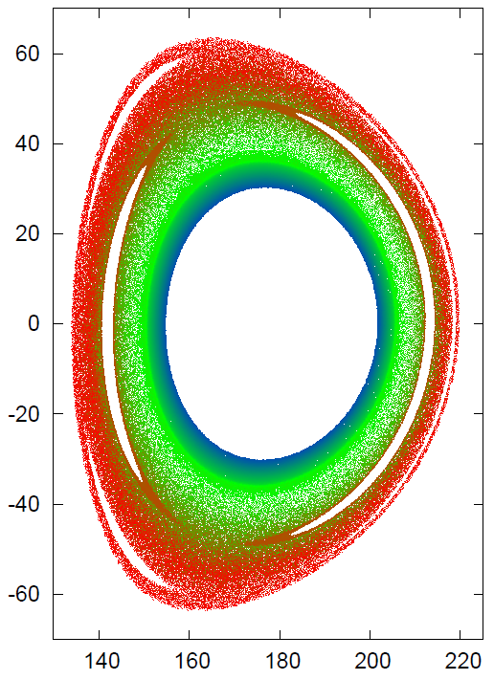
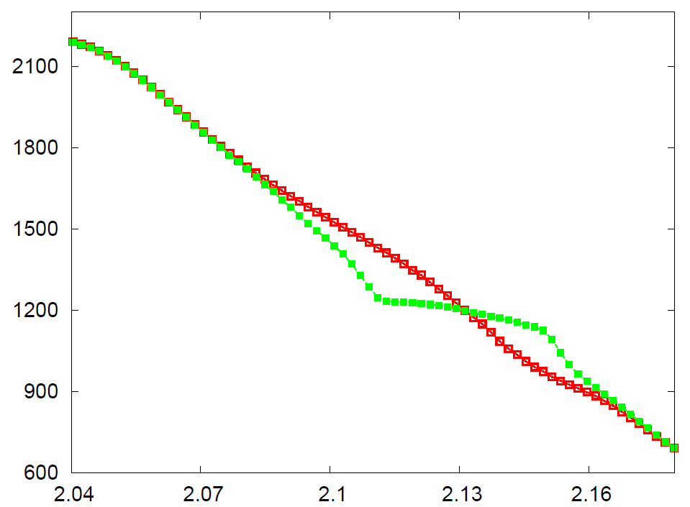
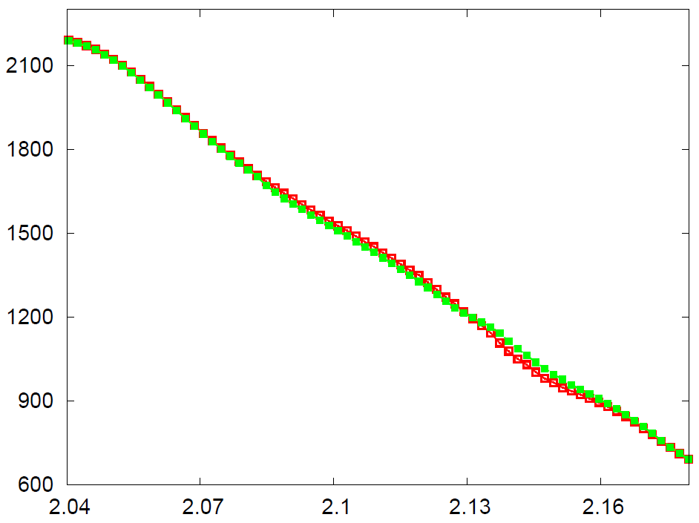
$T_{e}$ Profile Change by Magnetic Island
Poincare plot of field lines
$T_{e}$(eV) across O-point
$T_{e}$(eV) across X-point
W/O Island
W/ Island
Magnetic Island
W/O Island
W/ Island
Magnetic Island
$$R (m)$$
$$R (m)$$
(2,1) magnetic island is modelled by $δA_{∥}=A_{0}\left(ψ\right)\cos\left(2θ−φ\right)$
$T_{e}$ profile immediately responds to magnetic island, and enters into quasi-steady state after $t∼0.5 τ_{ii}$.
Across O-point, magnetic island width is $w_{sim}∼4 cm$ with steepened-$∇T_{e}$ in inner region.
Across X-point, $T_{e}$ profile shows little change with finite $∇T_{e}$.

Slide 8
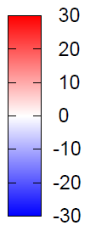
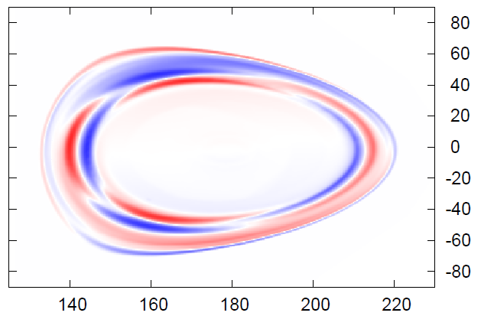
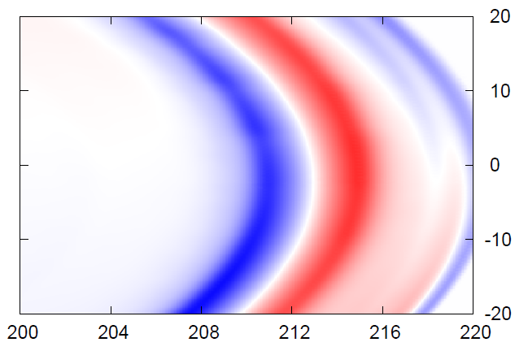
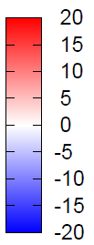
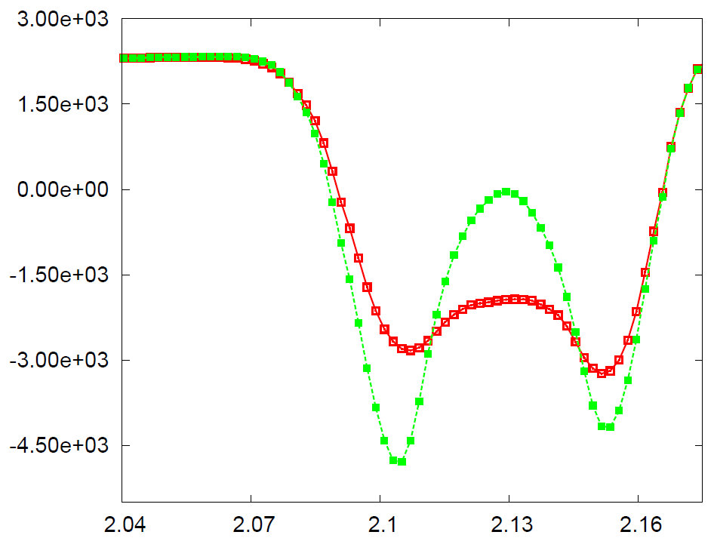
Perturbed Potential Structure
$$δΦ$$
$$V_{E×B} (m/s)$$
Across X-point of $Φ$
Across O-point of $Φ$
Electron
Direction
Ion
Direction
Magnetic Island
$$R (m)$$
Magnetic island induces non-axisymmetric electrostatic potential perturbation $δΦ$, which has (2,1) structure with tearing parity.
Finite phase difference in poloidal angle between magnetic island and $δΦ$ ($∼0.1π$) ➔ $δΦ$ is not flux function (non-ideal effects)
$E×B$ flow and shear are maximum and minimum across potential O, X-point, respectively → Stronger suppression of micro-instability is expected in the region neighboring O-point of magnetic island with the phase shift $∼0.1π$.

Slide 9
Global linear instabilities
of perturbed profiles
by magnetic island

Slide 10
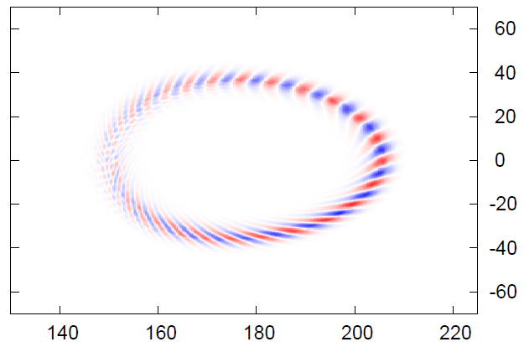
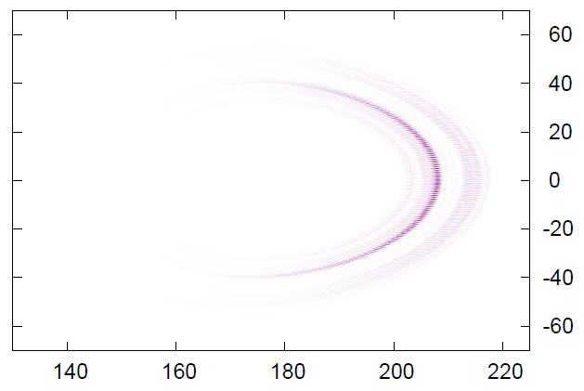
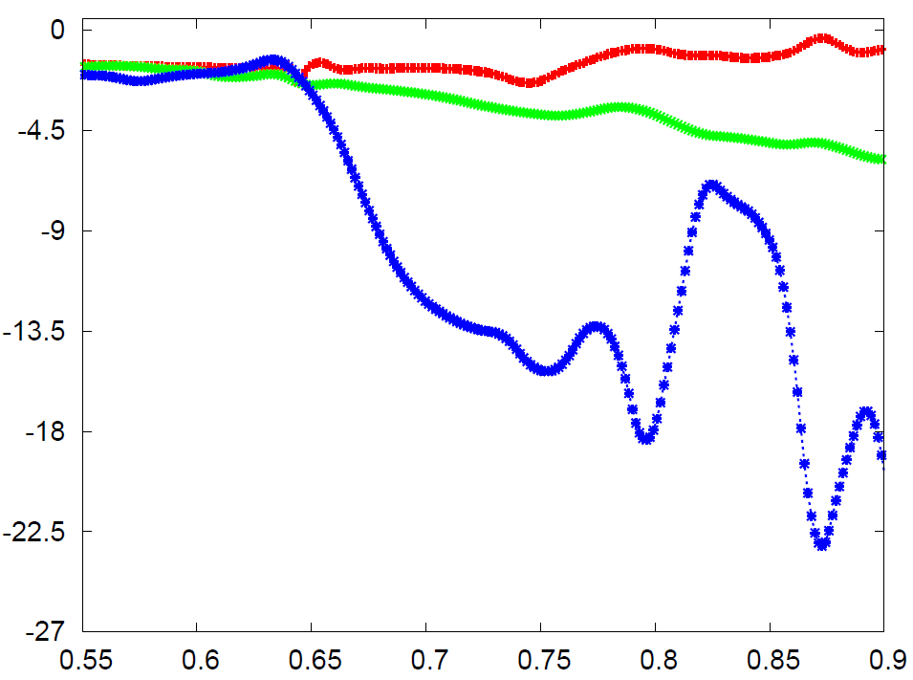
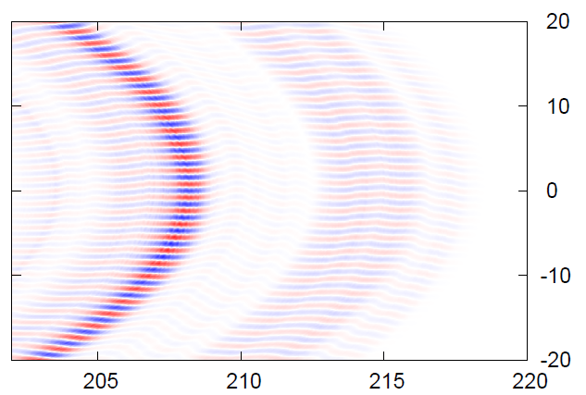
Global Linear Analysis
$$k_{θ}ρ_{i}=0.12$$
$$n_{φ}=20$$
TEM
$$k_{θ}ρ_{i}=0.8$$
$$n_{φ}=140$$
TEM/ITG
$$L_{n_{e}}^{−1}$$
$$L_{T_{i}}^{−1}$$
$$L_{T_{e}}^{−1}$$
$$\sqrt{ψ/ψ_{X}}$$
Perturbed equilibrium profiles from XGC1 neoclassical simulation are used for global linear stability analysis.
$∇T_{e}−$driven TEM is dominant in the inner region neighboring magnetic island.
TEM→ITG in outer region as $∇T_{i}$ and collisionality increase.

Slide 11
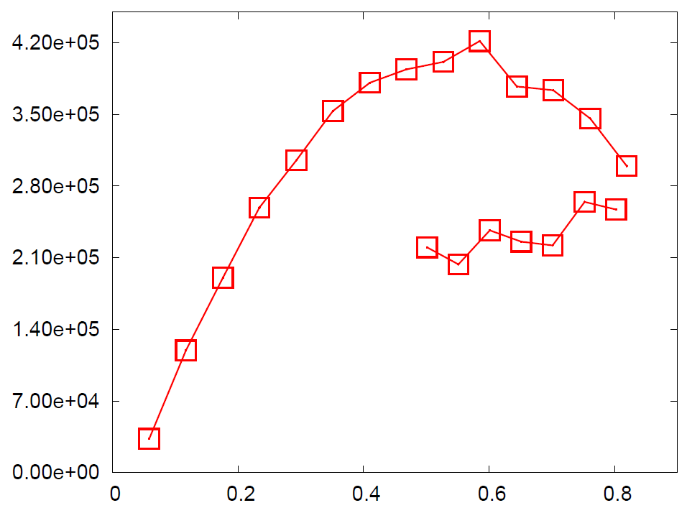
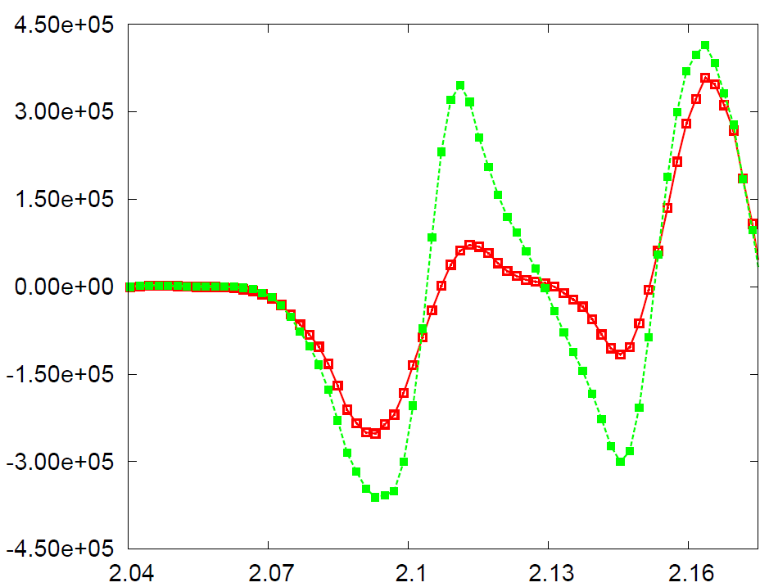
Flow Shearing vs $γ_{TEM/ITG}$
$$γ (s^{−1})$$
$$ω_{E×B} (s^{−1})$$
Across X-point of $Φ$
Across O-point of $Φ$
$$\left|ω_{E×B}^{O}\right|$$
TEM
$$\left|ω_{E×B}^{X}\right|$$
ITG
Magnetic Island
$$k_{θ}ρ_{i}$$
$$R (m)$$
Around the O-point, $E×B$ flow shear is strong enough to suppress a significant portion of micro-instabilities.
Around the X-point, TEM with $k_{θ}ρ_{i}=0.2 \sim 0.8$ can still exist.
Due to the phase difference between magnetic island and potential, the region with maximum and minimum fluctuation will appear poloidally shifted regions from magnetic X, O-point → consistent with ECEI observation

Slide 12
Global nonlinear turbulence simulation with magnetic island and self-consistent neoclassical physics

Slide 13
Turbulence Evolution near O-point
time
Nonlinear turbulence simulation starts from the established 3D neoclassical equilibrium with magnetic island
Instabilities are found to be excited outside of magnetic island.
Turbulence spreads into the island. But the island blocks turbulence spreading across the separatrix.

Slide 14
Turbulence Evolution near X-point
time
Very different turbulence evolution patterns are found in the X-point region.
Instabilities are excited both inside and outside of magnetic island (finite $∇T_{e}$ near X-point).
Turbulences spread into the island and pass through to the other side.

Slide 15
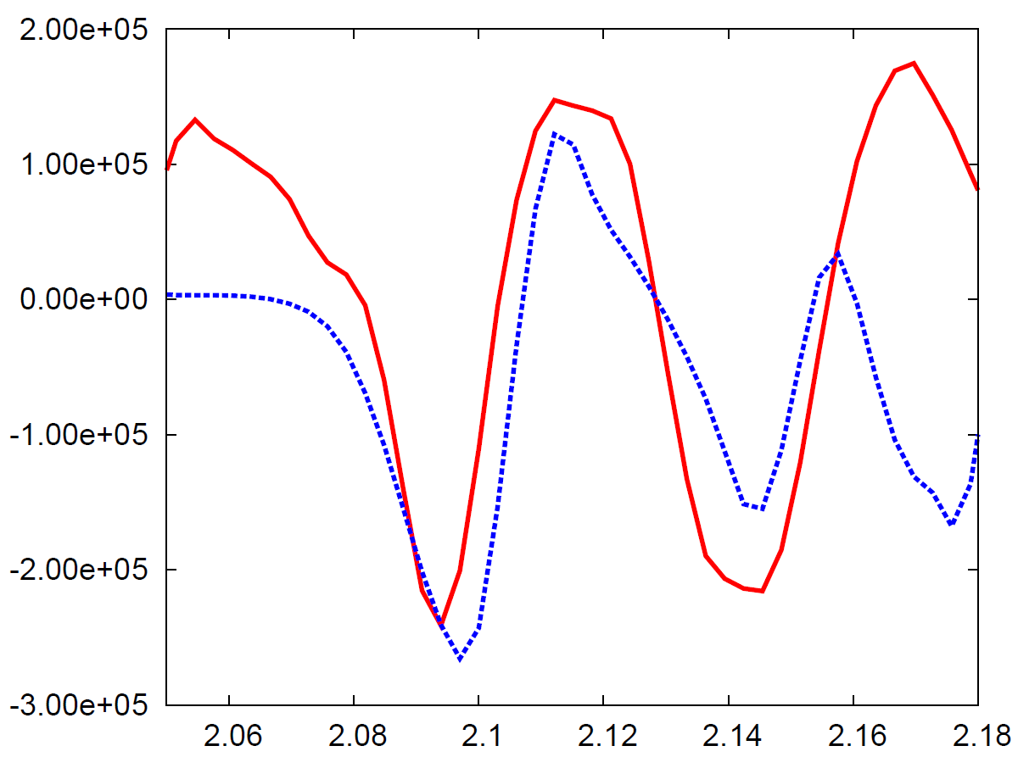
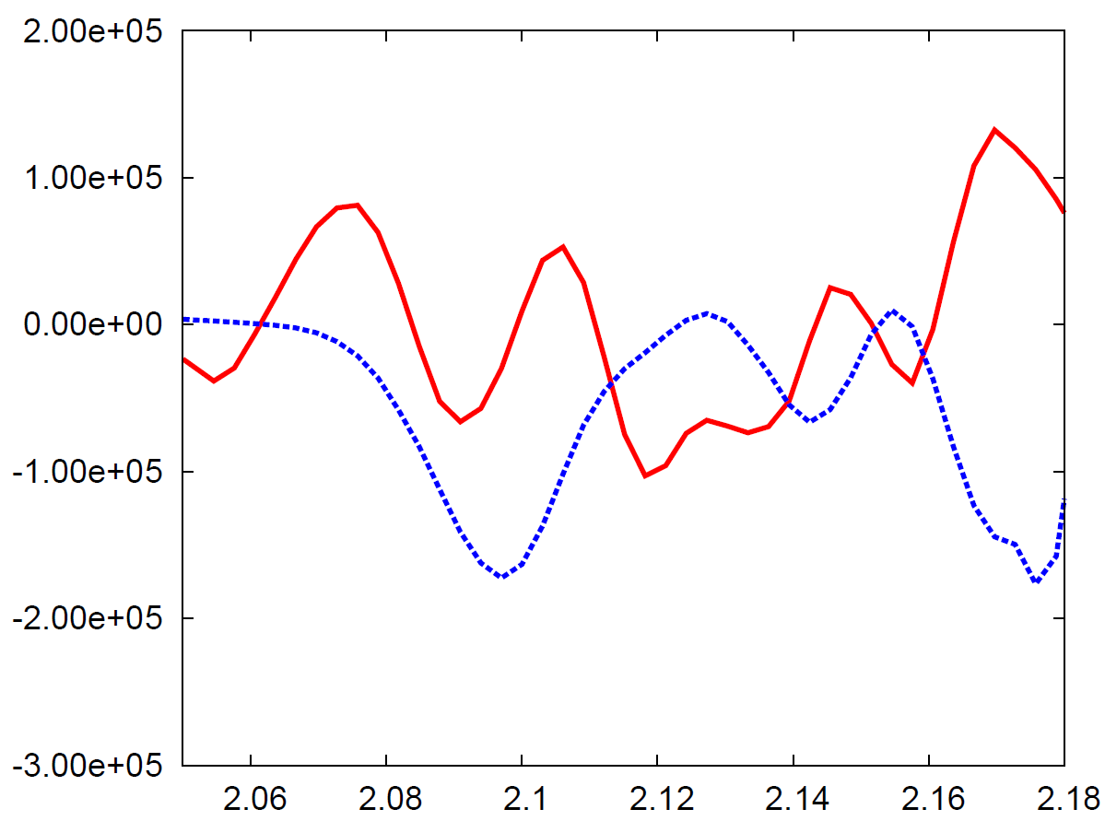
$ω_{E×B}$ profiles across O, X-point
$ω_{E×B}$ profile across O-point
$ω_{E×B}$ profile across X-point
Magnetic
Island
Magnetic
Island
before turbulence onset
before turbulence onset
after turbulence onset (time averaged)
after turbulence onset (time averaged)
R [m]
R [m]
Around the O-point, $E×B$ shearing structure is similar with the neoclassical equilibrium
→ turbulence generated zonal flow is relatively weak.
Around the X-point, $E×B$ shearing is dominated by time varying zonal flow driven by turbulence

Slide 16
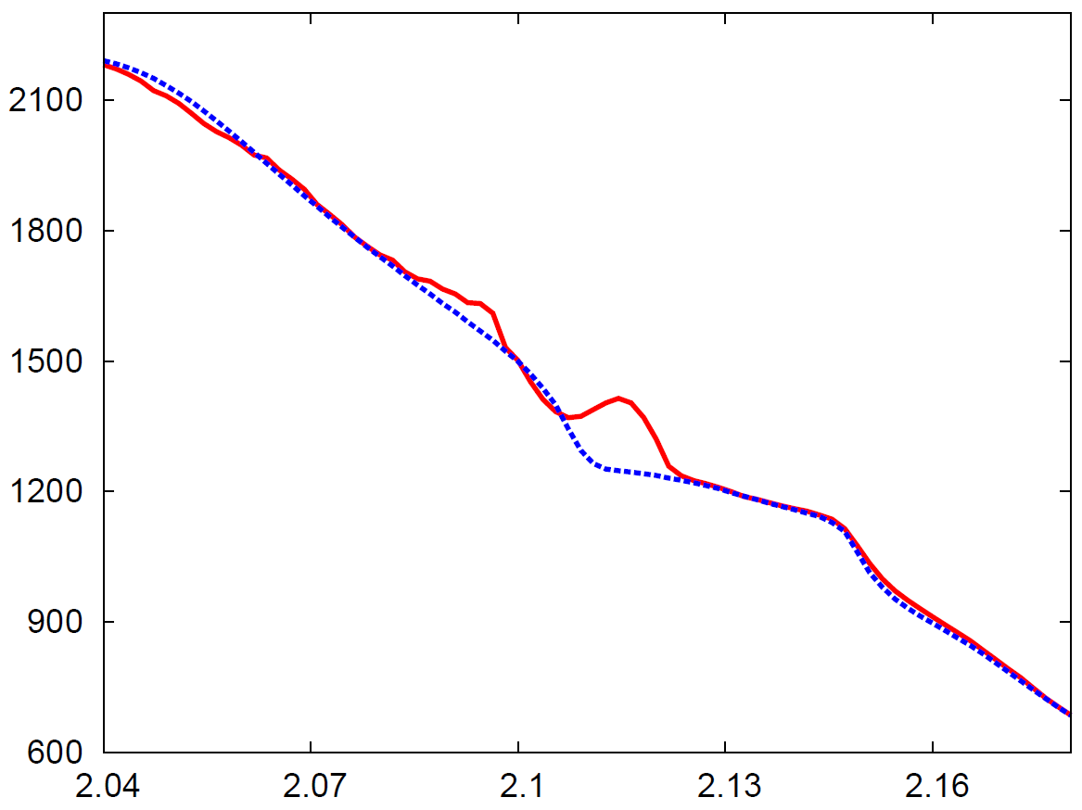
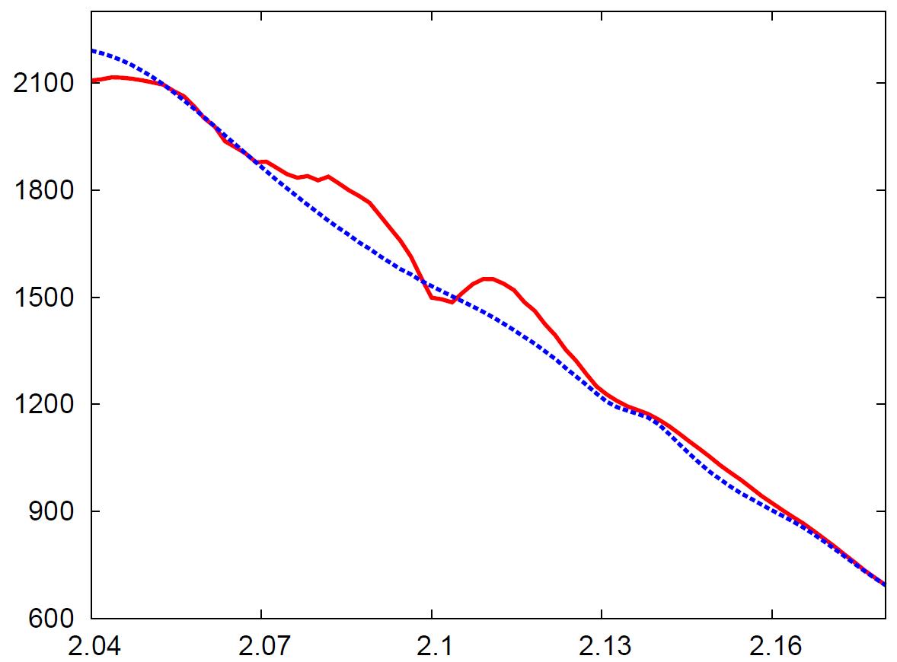
$T_{e}$ profiles across O, X-point
$T_{e}$ profile across O-point
$T_{e}$ profile across X-point
Magnetic
Island
Magnetic
Island
$T_{e}$ before turbulence onset
$T_{e}$ before turbulence onset
$T_{e}$ after turbulence onset
$T_{e}$ after turbulence onset
R [m]
R [m]
“Leakage” of electron thermal energy in both cases: stronger penetration into the X-point ➔ consistent with the turbulence evolution patterns.
“Leakage” is not enough to degrade the central confinement inside the island radii.
Island size estimated by flat-$T_{e}$ is smaller than the real island size.

Slide 17
Conclusion (1/2)
Potential
Perturbation
Magnetic island induces perturbed equilibrium $E×B$ flow
In O-point region, flow shear is strong enough to suppress ambient TEMs and good electron thermal confinement is sustained.
In X-point region, flow shear becomes weaker and stronger instabilities are excited.
However, magnetic O,X-point do not coincide with maximum/minimum $E×B$ shearing region due to phase difference between $δT_{e}$ and $δΦ \left(\sim δn_{e}\right)$ → separate fluctuation measurement
Strong
Flow
Weak
Turb
Weak
Flow
Strong
Turb
Phase difference
in poloidal angle$≈0.1π$
Magnetic
Island
Jae-Min Kwon et al, Phys. Plasmas 25, 052506 (2018)

Slide 18
Conclusion (2/2)
“Shallow penetration
by turbulence spreading”
“Shallow penetration
by turbulence spreading”
“Transport through X-point”
Nonlinear turbulence evolution pattern is different in O- and X-point. (L. Bardoczi et al, PoP 24, 122503(2017); K. Ida et al, PRL 120, 245001(2018))
Due to turbulence spreading, fluctuation penetrates into magnetic island, and flat-$T_{e}$ region becomes smaller than island region → separate measurement of magnetic perturbation

Slide 19
Thanks for your attention!

