Slide 1
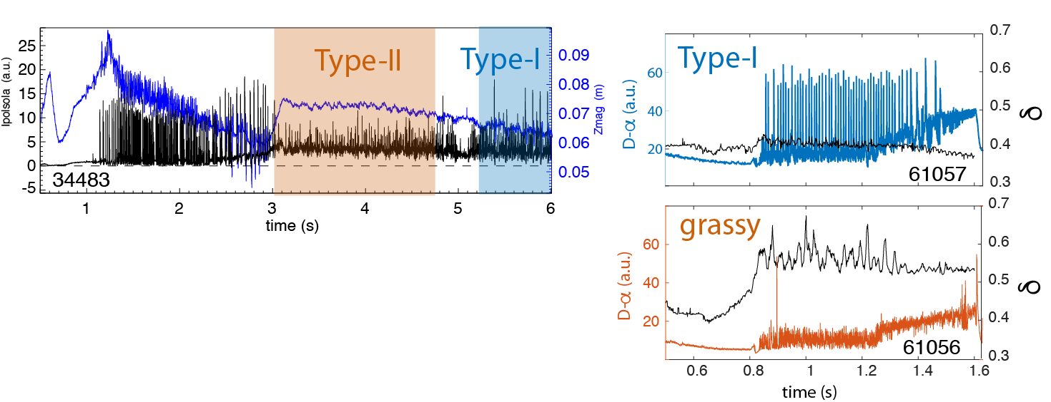
EX/2-5: Plasma shape and fueling dependence on the small ELMs regime in TCV and AUG B. Labit et al.
AUG
TCV
A transition from Type-I to Type-II/grassy ELMs is obtained either by approaching a DN (AUG) or by increasing the upper triangularity (TCV)
Current understanding:
Close to DN and/or at high δ :
ballooning modes at the separatrix are unstable
pressure profile flattens
pedestal width shrinks
Type-I partially stabilized
AUG and TCV parameters for small ELM regimes and comparison with ITER BL
 | q₉₅ | δ | β_{pol} | ν*_{ped} | f_{GW,ped} | n_{e,sep}/n_{e,ped} | Δ_{sep}
AUG (type-II) | 4.5 | 0.37 | 1.2 | 1.39 | 0.82 | 0.4 | <5λ_{q}
TCV (grassy) | 4.5 | 0.54 | 1.3 | 1.95 | 0.32 | 0.2 | <5λ_{q}
ITER | 3 | 0.4 | 0.6 | 0.1 | 0.6-0.8 | - | ~50λ_{q}

