Slide 1
ORGANIZATIONAL LEARNING, BUILDING AND SUSTAINING CORE COMPETENCIES:
Knowledge Management Initiatives on Inspection and Regulatory Enforcement in BAPETEN Indonesia
By:
W.P. Daeng Beta
Yusri Heni
Asep S.H.
Syaifulloh
Third International Conference on Nuclear Knowledge Management: Challenges and Approaches, IAEA , Vienna, Austria, 7-11 November 2016

Slide 2
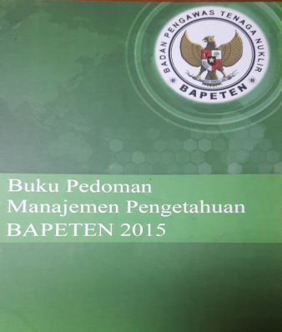
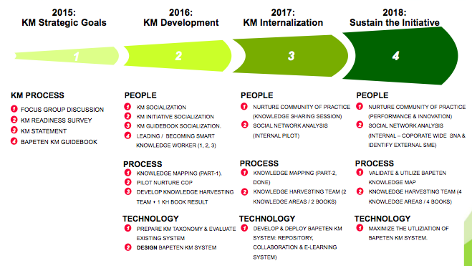
INTRODUCTION
All of the KM activities in BAPETEN refer from the BAPETEN KM Guidebook which content of KM Blueprint & KM Road Map for 5 year 2015 – 2019, develop from the result of KM Readiness survey of BAPETEN.

Slide 3
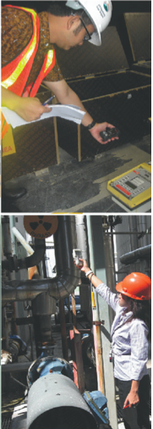
OBJECTIVES
To overview on knowledge management initiatives of regulatory inspection and law enforcement on radiation facilities and radiation sources in BAPETEN Indonesia. analyse the innovation products in regulatory inspection and law enforcement activities

Slide 4

DESCRIPTION OF THE KM INITIATIVES
Direction of Policy
and Strategic
The architecture and perfomance information of program and activities
in inspection and regulatory enforcement are as follow:
  to conduct risk graded approach based inspection for medical, industrial, and research facilities;
  to enhance planning, monitoring and evaluation of efective inspection, developing procedures and working instructions;
  to utilize human resources inspectors for safety and security of radiation sources optimally along with coordination to related stakeholders;
  enforcing in place, the safety and security facilities report toward all users;
  to utilize reliable data communication, processing and information technology (B@LIS);
  to perform regulatory enforcement along coordination with other related stakeholders, such as police departments, attorney office and justice office.

Slide 5
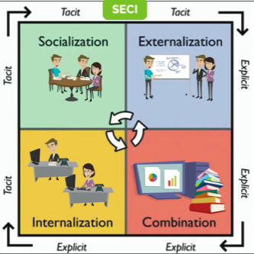
DIALOG
LINKING
EXPICIT
KNOWLEDGE
FIELD (TEAM) BUILDING
LEARNING BY DOING
Extraordinary inovation = A simple idea + creative process
Inovation is a result of the process. Simple method of inovation through Observe, Imitate, Modify (OIM) or enhance previous model to create value added. Systematic process of innovations usually through:
Preparation and problem identification;
Establish objectives of innovation, identify the problems and challenges to achieve goals;
Finding as many as ideas (divergence), then incubate them;
Produce innovations and implement them.

Slide 6
3.3. KM Tools:
KM portal & knowledge are shared in BAPETEN intranet & website
Table 1.Identification of KM Initiatives based on Activities and Outputs
No | Activity | Output/Target/ Performance Indicator | KM Initiatives, Task, Event
1. | a.To conduct risk graded approach based inspection for medical, industrial, and research facilities | Coverage of inspection to 1100 users across the country in 2016; 3300 users in 2017-2019 | Guidelines of performing inspection for medical, industrial, and research facilities Standard Operational Procedure for preparation, conduct and monitoring of inspection follow-up. Electronic filing system (ELFIS) Inspection information system for medical, industrial, and research facilities, integrated with lisencing information system e-Inspection (online users self-assessment, which they can input data in BAPETEN website)
 | b.Tacit knowledge transfer from senior to junior inspectors to do inspection and enforcement c.Composition of team building | To enhance competence of 39 junior inspectors and 22 trainee inspectors | Conducting inspection together among seniors, juniors and trainee inspectors Organizing event for Inspector Coordination Meeting for sharing knowledge and experience (twice a year) To supervise junior and trainee inspectors for regeneration issue.
6

Slide 7
No | Activity | Output/Target/ Performance Indicator | KM Initiatives, Task, Event
2. 3. | Development of Inspection System | Evaluating and monitoring the inspection follow-up. (Inspection follow-up documents evaluated 100%) | Guidelines for evaluating and monitoring the inspection follow-up Information system for evaluating and monitoring the inspection follow-up e-Valuation of BAPETEN Safety & Security Awards e-Users Radiation Safety Report
 |  | SOP and Inspector Valuation Team | Finalize and enforce the SOP/Guidelines for Inspector Valuation Team
 | Regulatory enforcement in medical, industrial, and research facilities. | Regulatory enforcement documents and reports. 18 facilities had been brought to justice in 2012-2015 8 facilities being brought to justice in 2015-2016. To enhance / refresh 74 Inspectors’ understanding regarding regulation of radiation facilities and activities | Guidelines / SOP for regulatory enforcement in medical, industrial, and research facilities. Story telling and online regulatory enforcement report for sharing knowledge. Information system for regulatory enforcement in medical, industrial, and research facilities integrated to licensing information system Focus Group Discussion of Nuclear Regulation in BAPETEN

Slide 8

4. Major challenges and achievements:
On the first stage, KM initiatives need a tremendous effort, not only internally, but also externally. We should address them carefully, especially in a matter of coordination for collaboration. We believe that impacts of the KM activity or process, can be perceived as positive or negative by stakeholders.
5. Lesson Learned:
KM is something that BAPETEN should consider to be done for maintaining and enhancing the level of performance of regulatory body, in Indonesia. In this case, BAPETEN should take the role to be the main agent and proactively takes part of knowledge management activities.

Slide 9
^{THANK YOU}
Nuclear Energy Regulatory Agency of Indonesia

