Slide 1
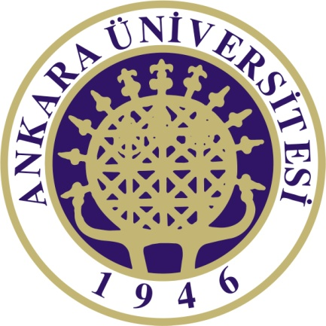
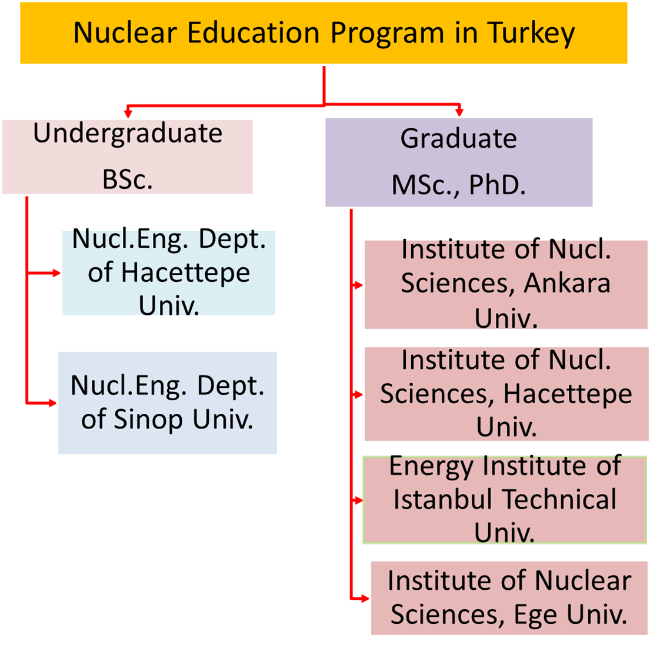
Status of Nuclear Science Education and Needs to Competency Based Education at the Beginning of Nuclear Power Programme in Turkey
Haluk Yücel
Institute of Nuclear Sciences, Ankara University, Tandogan Campus, 06100 Ankara, Turkey
haluk.yucel@ankara.edu.tr
Abstract
In Turkey, in recent years, the public opinion is mostly positive to the establishment of nuclear power plants(NPP) because the electricity demand is ever-increasing with a growing population and fast developing economy. For peaceful nuclear energy use, Turkey ratified the Non-proliferation treaty (NPT) in 1979 and has had a safeguards agreement, and its Additional Protocol since 2001. However, Turkey has not accumulated the essential nuclear knowledge and experience until now. The present nuclear higher education and training programs are not focused on nuclear power technology. Since NPP was not operated in past, the interests of Universities to the nuclear sciences and technology education have been quite limited. In general, this can be attributed to the decreased student’s interest, decreased course numbers, aging faculty members and insufficient or aging facilities. From practical point of view, the key question is that how the competency based education programs should be organized to produce the well-educated workforce. It is worth noting the present nuclear education should also have the curriculum covering nuclear safety culture and nuclear security culture to instil the Younger generations. For a safe operation of any facility, nuclear safety and security are key requirements especially for newcomers embarked on utilizing nuclear technology. In this paper, the present status of nuclear science education and training programs in Turkey is discussed briefly and the fundamental arguments are dealt to focused on competency based nuclear education.
Introduction
For peaceful nuclear energy use, Turkey has started Nuclear Power Program since 2012, but it is a fact that there needs to develop its nuclear capacity building(NCB). The level of NCB processes indicate the gained professionalism, scientific skills and expertise, which might lead to solve the problems to be encountered in NPP installations. According to NCB strategy, the nuclear education and training infrastructures and processes should also be well established because nuclear education and training programs provide a structured knowledge base for individuals involved in the utilization or control of nuclear technologies. The present paper will give brief information about status of nuclear science education structure in Turkey and but it also highlights on some fundamental arguments concerning with competency based nuclear education in future.
Nuclear energy is a viable energy option for electric production in Turkey
Turkey imports much of its energy, including 98% of its natural gas and 92% of its oil, and this amounts to more than US$70 billion per annual(EUAS, 2016). In the coming decades, it is evident that use of nuclear energy will play a vital role for the electricity demand of Turkey.
Currently, primary energy demand is met by natural gas (35%), coal (28.5%), oil (27%), hydro (7%), and other renewable (2.5%). This requires new investments estimated to around 100-150 billion $US and the present installed plant capacity of 74 GWe have to increase 96 GWe by 2023. Electricity production in Turkey by fuel is dependent mainly on the imported natural gas (EUAS,2016). In order to meet Turkey’s growing energy needs, the present energy supply’s plans are revised by the energy policy-makers. As a result, NPP projects are now underway in Turkey and the first NPP with four reactor units (Russian VVER-1200 PWR type design, 4800MWe capacity) has already started to build in Akkuyu reactor site at Mediterranean coast.
In addition, Turkey's second NPP will construct at Sinop on its Black Sea coast, which was proposed to feature four Atmea 1 reactors supplied by Areva and MHI. Construction of the plant is expected to start in 2017, once Sinop site is licensed and an environmental impact assessment has been approved An intergovernmental agreement was ratified by Turkish parliament in March 2015 (WWN, 2016).
Turkey’s economy needs ever-increasing amounts of energy to sustain economic growth, raise living standards, and reduce poverty. But today’s trends in energy supply are not seen to be sustainable. Hence, the energy issue has always the first priority for the Country’s development.
Nuclear education and training programs in Turkey
As shown in Fig.1, there is only two undergraduate programs related to nuclear engineering education, which service is given to the limited number of BSc students of about 20-30 in a year. It is worth noting that most of the higher-graded nuclear engineering scholars generally prefer to go abroad for the post-graduate education. After completing their post-graduate education, they usually work in abroad and hardly ever return to Turkey.
Fig.1 . Presently implemented nuclear education programs in Turkey
Currently, graduate programs in nuclear science education are actively conducted at four Nuclear Institutes. These MSc and PhD programs are servicing to approximately 80-100 students in each year. Istanbul Technical University(ITU) has also a 250 kW TRIGA Mark II research reactor for education and research purposes.
Other Public Institutions related to Nuclear Training, Research and Development Activities
In Turkey, Turkish Atomic Energy Authority(TAEK) establishes all legislative regulations concerned with radiation protection and nuclear safety, and gives also licenses to the facilities in medicine and industry. Additionally, nuclear material safety and security, illicit trafficking of nuclear materials, environmental issues are also dealt with and conducted at the same time. There are two nuclear research and training Centres. The one is called as ÇNAEM in Istanbul and the other is SANAEM in Ankara. Both are the governmental organisations managed by TAEK. These Centers conduct some radiation protection training courses, accomplish nuclear research activities such as radiation applications in medicine and industry. TAEK can sometimes ask for technical and scientific support from IAEA to fill the gaps in achieving the highest possible levels of safety and security for nuclear reactors, waste management, radiation protection and its applications.
Discussion
IAEA suggests a nuclear capacity building(NCB) strategy to the Member States. It is based on four elements as shown in Fig.2, and therefore NCB concept can be applicable at three levels in any State that are: (a) Governmental, (b) Organizational and (c) Individual (IAEA, 2016).
Fig.2. IAEA Strategy of Nuclear Capacity Building
These components are very closely related with each other. For instance, graduate education programs have a great importance to gain the competence within nuclear field consistent with International and EU standards to produce the educated workforce that is able to meet the future need of nuclear power programme within framework of economic and social needs. In Turkey, it is a fact that there is a serious lack of competency and well-educated workforce capacity in the nuclear field. Hence it is an important point that how the interest of the young scientists and engineers can be attracted to graduate and post-graduate programs concerning nuclear science and technology, given by National Nuclear Institutes.
The second issue is that how these education programs should be well-organized for human resource development and further improved nuclear infrastructure by replenishing modern equipments. For example, even if the nuclear technology transfer agreements are to be made between Turkey and NPPs vendors, it seems that there are still open question marks on knowing and absorbing fully nuclear safety, security and technology aspects because of insufficient number of the well-educated workforce and infrastructure. For instance, Russia has suspended the nuclear education and training activities and cancelled unilaterally mutual collaborations among the Universities whereas Turkey trusted this agreements. Now, Turkey has to find smart solutions to obtain valuable knowledge from international nuclear community to eliminate the shortage of qualified professionals. At first sight, first two NPPs should be operated or supervised to ensure reactor safety by foreign nuclear experts. However, in near future, there needs to find alternative methods to start competency bas education by taking the supports of NPP vendors and other related Nuclear Countries.
New challenges for nuclear training and education
The present National Nuclear Institutes and Faculties might be re-organized to focus on competency based nuclear education by developing bilateral and/or multilateral collaborations and joint initiatives. In NCB, Turkey has to estimate the human resources needs for future NPP programmes, assess their existing capability, identify competences gaps, plan and implement the required activities to meet the needs. In this context, it is anticipated that the Department (NEPUD) of Ministry of Energy and Natural Sources identify the gaps since 2011. This new governmental organization might also play an important role in preserving nuclear knowledge, making knowledge networks and managing for NPP project implementations. It is clear that high quality nuclear education and training is essential to maintain the high level of nuclear safety and nuclear security matters in a nuclear facility. But, this is not only the task of academic institutions in the Country but also of regulatory bodies and other research Centres.
This can be achieved by collaboration with leading universities and educational institutions in other Countries. For instance, there is a plan to establish Turkish-Japan Nuclear Technology University in Sinop. Turkey can also make a collaboration with EU Joint Research Center (JRC) because the JRC can actively contributes to consolidating and improving educational tracks, by providing its knowledge and expertise in fields of nuclear security and safety, nuclear materials, nuclear data exchange, etc. Thus, the nuclear education activities can be organized in four pillars:
The higher education pillar concerns academic education which comprises academic courses, and special educational activities for students (workshops, summer schools and inter-semester courses).
The vocational training pillar focuses on the training of young professionals in the nuclear sector. They have no specific expertise in the nuclear field. This pillar can be developed with opening new nuclear Vocational Higher Schools and Vocational Intermediate Schools with the directives of Higher Education Council and Ministry of Education, together with the partners from the European and with other educational institutions in Europe.
The user access programme organized by the JRC can also serve to Turkish researchers to make research opportunities. Applicants can perform dedicated experiments on nuclear materials, or materials relevant to nuclear technology, that cannot be performed in their laboratories of the applicants in Turkey.
At least two nuclear information centres can be established in Mersin and Sinop cities near to NPPs sites. This pillar can provide independent information about nuclear science and technology to the general public.
In coming decades, nuclear energy will become a vital option for supplying of Turkey’s electricity demand This pressure comes from the decreasing stocks of domestic fossil fuels, with increasing reliance upon politically volatile nations for the provision of oil gas and from the increasing prices of domestic and imported fuels. Finally, the pressures are thus resulted in emerging new concern in taking of advantage of future nuclear industries. Therefore, the need for nuclear competence is greater now than earlier anticipated.
Conclusions
Turkey must set up a comprehensive program that seeks to develop human resources and harmonise nuclear skills and competencies with national recognition, and contribute to nuclear education, training and knowledge management (KM). The most urgent need is to give a priority to the competency based education programs in which utilization of nuclear technology should inspired confidence to the Younger generations. The curriculums of nuclear higher education programs should also include the training courses to enhance both nuclear safety culture and nuclear security culture. This must be a key requirement for newcomers to nuclear technology in order to protect human, environment and to secure radioactive materials associated with facilities against malicious acts from insiders or outsiders.
Modern methods and techniques/tools can be used for the preservation and dissemination of the vital importance nuclear knowledge and information. This approach can also contribute to enhance the nuclear safety and security culture and competitiveness of energy supply from NPP programs by following new trends and developments in nuclear energy sector. Knowing that education and training provides the basis for human resource development, it is underlined other pillars that are knowledge management and knowledge networking mechanisms. These can be established to promote the pooling, analysis and sharing of nuclear safety, security and other technical knowledge and experiences at national levels. It will be stressed that Turkey can strive for collaborations within international community, and can be considered the new challenges to tackle with the present difficulties in higher nuclear education programs.
References
[1]. IAEA, 2016. Nuclear Safety and Security.http://www-ns.iaea.org/coordination/capacity-building.asp?s=110&l=111 (access date:17.09.2016)
[2] EUAS, 2016. Turkish Electricity Generation Corporation(EUAS), Annual Electric Sector Report 2015.http://www.euas.gov.tr/Documents/sektor_raporlari/EUAS-Sektor_Raporu2015.pdf (access date:23.07.2016)
[3] OECD Data: https://data.oecd.org/turkey.htm (access date:23.07.2016)
[4] TEDAS, 2015. Republic of Turkey Prime Ministry Privatization Administration (OIB in Turkish). Privatization of Turkey’s Electricity Distribution Industry, Ankara, Turkey. www.oib.gov.tr/tedas/teaser.
[5]. WWN, 2016. World Nuclear News. < http://www.world-nuclear-news.org >(access date:18.09.2016)
Nuclear Capacity Building (NCB) Strategy
Education and training
Human resource development
Knowledge networks
Knowledge management

