Slide 1
OPERATIONAL APPROACH ON AGEING MANAGEMENT AT THE GHANA RESEARCH REACTOR-1(GHARR-1) FACILITY BY
Obeng Henry, Amponsah-Abu E.O, Gbadago J.K,K. Gyamfi,p.d.gasu,a.g ampong

Slide 2
OUTLINE OF PRESENTATION
DESCRIPTION OF GHARR-1
AGEING MANAGEMENT PROGRAMME OF GHARR-1
OPERATIONAL SAFETY APPROACH AND MITIGATION PRACTICES
AGEING AND SAFETY OF RESEARCH REACTORS
MINIMIZATION OF AGEING DEGRADATION
PERIODIC SAFETY REVIEW FOR GHARR-1
MODERNIZATION, REFURBISHMENT AND UPGRADING ACTIVITIES
SECURITY
AGEING OF STAFF / SUCCESSION PLAN
CONCLUSION

Slide 3
Brief Description of GHARR-1Facility
Ghana Research Reactor-1 is an MNSR
Tank-In-Pool
Power = 30kW
Core excess reactivity =4.0mk
Max. neutron flux = 1x10¹²n/cm².s
HEU (90.2%) fuel (U-Al)
Cooling is by natural convection
Reflection is by metal Be alloy
Uses: Research, NAA, HRD in nuclear technology

Slide 4
Brief Description of GHARR-1 Facility
Attained Criticality on December 17, 1994
Commissioned in March 1995
Control Rod is Stainless Steel Clad, Cadmium Absorber
It has an average operational hours of 3.5 hrs/day and 4 days/week

Slide 5
FIG 1. GHARR-1 FACILITY

Slide 6
Ageing Management Programme of GHARR-1
Management Responsibility and Structure
GOVERNMENT RESPONSIBILITY
An effective legal and governmental framework for safety, including an independent regulatory body, has been established by the Government of Ghana for the facility. ACT 588, 2000 established the GAEC to advise the Government on Nuclear Science & Technology.
The Radiation Protection Board (RPB) of GAEC, established by Legislative Instrument, LI 1559 of PNDCL 308, 1993 of the Republic of Ghana is the Regulatory Body.
The Regulatory Body inspect, review and assess safety documents of the facility and issue licenses for operation and experiments.

Slide 7
AGEING MANAGEMENT PROGRAMME OF GHARR-1 Leadership and Management for Safety
The Director of NNRI appoints responsible officers to constitute the Reactor Safety Committee (RSC) and Radiation Safety Committee (Rad.SC) to review and make recommendations on reactor and radiological safety of the facility to the Reactor Manager (RM).
Reactor Safety Committee (RSC) :
This Committee is established by the Director of NNRI to advise him on the safe and secured operation of the reactor.
The RSC has the responsibility to review:
- experiments - reportable occurrences
- modifications - personnel qualification
- procedures
The RSC is part of auditing team
Radiation Safety Committee (RadSC) :
This Committee advises the Director on all matters concerning radiological safety at facilities under the Institute.
The Committee is to control the movement and use of all radioisotopes and radiation producing machines at the institute. The distribution and use of any radionuclides are reviewed and approved by the Committee.
The Reactor Manager, the Reactor Safety Committee and the Radiation Safety Committee report to the Director of the Institute.
Reactor Manager (RM):
The Reactor Manager is the operational administrator of the facility and is responsible for all aspects of the operation of the reactor and the reactor facility. He is answerable to the Director of NNRI.

Slide 8
AGEING MANAGEMENT PROGRAMME OF GHARR-1 Leadership and Management for Safety
The Reactor Manager enforces administrative rules and operating procedures for all planning, schedules and reviews for the reactor.
He classifies all proposed experiments and modifications to the reactor and submit them to the RSC for review and recommendations to him for action before submitting to RPB for approval.

Slide 9
AGEING MANAGEMENT PROGRAMME OF GHARR-1 Scope of Ageing Management
The ageing programme for GHARR-1 ageing management focuses on the management of physical and non-physical ageing of structures, systems and components (SSCs.)
Ageing is a general process in which the characteristics of SSCs gradually change with time as the reactor is being use. Research reactors experience two kinds of time dependent changes:
(1) Degradation of SSCs (physical ageing), i.e. gradual deterioration in their
physical characteristics;
(2) Obsolescence of SSCs (non-physical ageing), i.e. their becoming out of date in comparison with current knowledge, standards and technology.

Slide 10
AGEING MANAGEMENT PROGRAMME OF GHARR-1 Scope of Ageing Management
Major components of ageing management programme :
i. Operational Procedures
ii. Maintenance Procedures
iii. Periodic Testing and Inspection Procedures
iv. Radiation Protection Procedures
v. Utilization and Modification Procedures
vi. Administrative Procedures

Slide 11
AGEING MANAGEMENT PROGRAMME OF GHARR-1 6/6 Detection, monitoring and trending of ageing degradation
Evaluation of Structures, Systems and Components (SSCs’) which is important to safety have been listed and examine as to whether their ageing have the potential to cause failure to the structure or component.
Below are methods for examination:
• Inspections
• Monitoring
• Performance tests
• Periodic testing and
• Visual examination.

Slide 12
OPERATIONAL SAFETY APPROACH AND MITIGATION PRACTICES
Maintenance Program of GHARR-1
The maintenance structure adopted for GHARR-1 is PROACTIVE and REACTIVE based.
The proactive component is based on preventive and predictive maintenance, while the reactive component is executed by corrective maintenance activities.
The maintenance program developed for the reactor is hence divided into two:
Routine maintenance, during which preventive and predictive maintenance are carried out; and corrective maintenance.
Maintenance logbooks for routine and corrective maintenance activities are kept to keep track of maintenance records of systems and components.

Slide 13
OPERATIONAL SAFETY APPROACH AND MITIGATION PRACTICES
The maintenance team conduct daily inspection of operating systems, weekly, quarterly and annual general maintenance.
Maintenance check list has been prepared for various schedule.
Maintenance include, measurements, test run, oiling & greasing, replacement, purification and repairs.
All the active components of the control instrumentation are tested on a bread board quarterly to access their functionability.
Methods for testing have been developed by the maintenance team.

Slide 14
Screening for ageing management of the SSCs of GHARR-1
Important to safety | Ease of replacement | Ageing mechanism
Y: Yes N: No M: Maybe | A: Very difficult B: Difficult technically or costly C: Normal D: Readily | Changes of properties due to neutron irradiation. Changes of properties due to temperature service condition. Stress or creep ( due to pressure and temperature service condition) Motion, fatigue or wear (resulting from cycling of temperature flow and or load, or flow induced vibrations) Corrosion Chemical processes Erosion Changes of technology Changes of regulation Obsolescence of documentation
A table list of SSCs that indicates their importance to safety, their ease of replacement, as well as the relevant ageing mechanism has been prepared.
Abbreviations used in Table

Slide 15
Components and their equivalents
A table list of semiconductor (active) components for replacement in case of failure due to temperature, over voltage, short circuit or ageing has been prepared to ensure continuous operation.

Slide 16
Safety Features of GHARR-1
The reactor is inherently safe with a very strong capability of power self-limitation.
The total cold excess reactivity is 4.0 mk and it is control by one central control rod of worth 7 mk, which ensures a shutdown margin of about 3 mk. This is sufficient to maintain the reactor in safe shutdown condition.
A scram is provided such that the reactor power will not exceed 120% nominal power and the temperature difference between the core outlet and inlet must not exceed 120% of the nominal limit.
The reactor can be shut-down by inserting cadmium rabbits into the core using the pneumatic transfer system. Four (4) cadmium capsules of 4 mk worth is provided for shutting down the reactor in the event of a failure of the control system. Auxiliary shutdown is accomplished by the manual insertion of cadmium capsules into the inner irradiation sites. To ensure deep subcritical reactivity of the reactor, additional string of cadmium capsules of three (3) pieces knotted together at the worth of 3 mk is available to replace the control rod when failure occurs.

Slide 17
MINIMIZATION OF AGEING DEGRADATION
Reactor Core Management
The top reflector of GHARR-1 core is of variable thickness and assembled by stacking semi-circular plates within an aluminium tray. It is composed of a group of semi-circular beryllium shims with internal diameter of 243 mm. Four different thickness sizes are available, namely 10 pieces of 1.5 mm, 20 pieces of 3.0 mm, 8 pieces of 6.0 mm and 8 pieces of 12.0 mm
Long-term reactivity control is exercised by periodically increasing the thickness of this reflector to compensate for reactivity loss caused by fuel burn up and samarium poison. Under normal operating conditions of the reactor, the top shims need to be added less frequently than once every one and half years. The maximum thickness of top shims is 109.5 mm for a cold, clean reactor, which is equivalent to 18 mk. In addition to the initial excess reactivity of the core, the presence of the shims ensures that the core life of the reactor fuel elements shall be longer than 10 years

Slide 18
MINIMIZATION OF AGEING DEGRADATION
Provisions has been made for the necessary monitoring, testing, sampling and inspection for the detection, assessment, prevention and mitigation of ageing effects.
The GHARR-1 reactor and pool water measurement are carried out every Monday in order to detect clad failure as early as possible. It is expected that fission products such as 131-135I, 90Sr, 95Zr, 95Nb, 137Cs, 140Ba, 140La, 85Kr, 133Xe and 135Xe will be transferred through the failed clad to the reactor. According to the Safety Analysis Report (SAR), 3.4 x 105Bq/L of 137Cs in the reactor and pool water respectively present minimum hazard.
If water quality is not good enough, it will result in curd deposits on fuel cladding which will affect the heat conduction properties of the fuel elements. The reactor and the pool water purification is therefore carried out on Mondays and the water quality is monitored. The monthly average resistivity values measured are converted to conductivity using equation 1
C = 1/ρ (µS) 1
Where C = Conductance in cm/Ω or (µS)
ρ = Resistivity in Ω or (MΩ)
The permissible conductivity ranges for both reactor and pool water are 0.5 – 1.0 µS and 1.0 – 2.0 µS respectively according to the SAR.

Slide 19
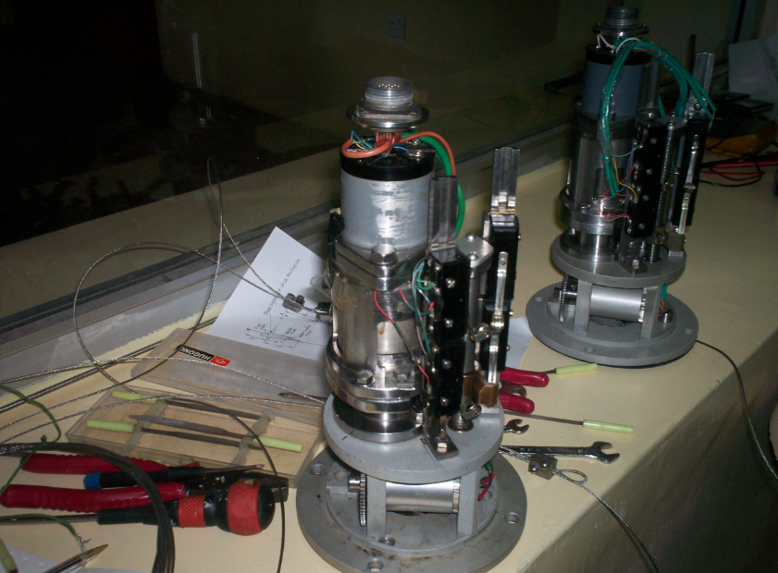
MODERNIZATION, REFURBISHMENT AND UPGRADING ACTIVITIES
Control Rod Drive Mechanism
The control rod drive mechanism was
replaced in August 2009.
The installation was performed by the staff
of GHARR-1.
The installation was done by
following procedures approved
by the regulatory authority.
NEW
OLD

Slide 20
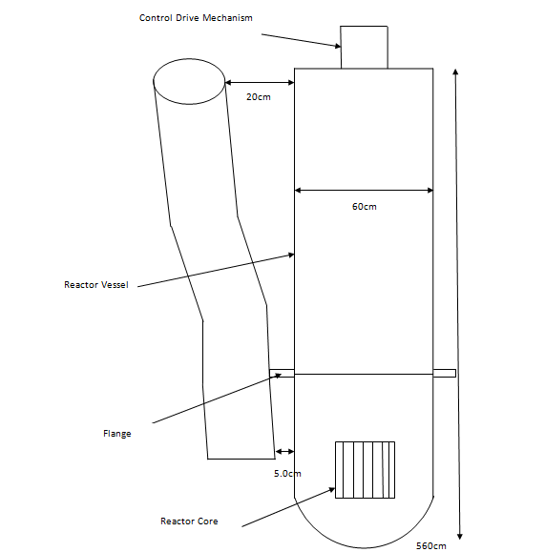
MODERNIZATION, REFURBISHMENT AND UPGRADING ACTIVITIES
Construction of Slant Tube
The existing irradiation sites accommodate
only small samples.
A new larger slant tube (irradiation site) was
constructed and installed on the reactor vessel.
The slant tube enables larger samples
to be irradiated and also carry out some experiments
owing to its volume efficiency.
The slant tube was constructed
using aluminium sheet and moulded
into a cylindrical tube and joined together
by an electrical welding.

Slide 21
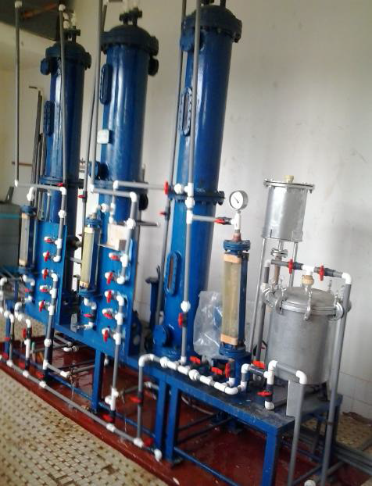
MODERNIZATION, REFURBISHMENT AND UPGRADING ACTIVITIES
Deionized Water Plant
The facility is designed for the production of
deionized water to top up the reactor
and the pool water respectively.
The resins in the plant columns
were replaced in December 2012.
The pipes and the valves were also
replaced in November 2012 as a result
of brittleness due to ageing.

Slide 22
MODERNIZATION, REFURBISHMENT AND UPGRADING ACTIVITIES
Micro computer closed loop system
In GHARR-1, two independent control systems are used to operate the reactor; control console (CC) and micro-computer closed loop system (MCCLS).
Several parts and components of the MCCLS have been replaced, as a result of ageing and obsolescence.
The MCCLS was replaced with a new one in 2008 with the operating system changed from Disk Operating System (DOS) to Windows “eXPerience” (Win XP).
The interface board sockets have been changed from Industrial Standard Architecture (ISA) to Peripheral Component Interconnect (PCI) making the system user friendly.
The new system has been improved based on the original system.

Slide 23
MODERNIZATION, REFURBISHMENT AND UPGRADING ACTIVITIES
Core Conversion Project
Using proposed parameters , an LEU core has been designed with similar operational capabilities as the original HEU core and with acceptable safety margins under both normal and accident conditions.
Some of the analytical tools that were used for the analysis included but not limited to MCNP, MCNP5/X, PLTEMP/ANL V4.1, PARET.
The project has continued steadily. Phase one to phase three have been completed. The project is now at phase four - preparation of documentations for shipping and receiving spent HEU core and fresh LEU core.

Slide 24
MODERNIZATION, REFURBISHMENT AND UPGRADING ACTIVITIES

Slide 25
SECURITY
Security activities have been implemented in the GHARR-1 Facility in order prevent possible access to the controlled areas by unauthorized persons.
These improvements in reactor security were performed by the IAEA and the regulatory agency in 2012.
The frame of this project included
fabrication and installation of a reinforced steel door at the reactor hall and vault
installation of closed circuit television in reactor hall and main corridor to the control room and reactor hall.
Installation of reinforced steel window over windows to the reactor from the control room
infrared and microwave sensors, installation of a balanced magnetic switch on doors to the control room and turnstile to the main corridor.

Slide 26
PERIODIC SAFETY REVIEW FOR GHARR-1
Review of safety documents are conducted every two (2) years prior to the safety analysis report (SAR) which is reviewed every five (5) years.
Feedback from previous safety review mission and operational experience, expert missions’ recommendation and documents developed by the reactor manager and team assist in the review for onward submission to the regulatory agency for approval.
Modifications and experiments having significance effect on safety are reviewed by the reactor safety committee and recommendations made to the reactor manager for review before submission to the regulatory body for further review and approval.

Slide 27
AGEING OF STAFF / SUCCESSION PLAN
In accordance with Article 3 of Act (2000) which mandates the Commission to collaborate with the Universities in training and teaching in the field of nuclear energy, Ghana Atomic Energy commission (GAEC) with the University of Ghana and IAEA has established a Postgraduate School of Nuclear and Allied Sciences (SNAS) to train personnel for Ghana’s nuclear practice and the Africa Region. The objectives are to preserve and enhance knowledge in nuclear technology and to develop human and institutional capacity in the field of nuclear and allied sciences. The following M.Phil. and Ph.D Courses are offered: Nuclear Engineering, Applied Nuclear Physics, Nuclear and Environmental Protection, Radiation Protection, Nuclear Agriculture, Medical Physics, Nuclear and Radiochemistry among others. Hence, with these arrangements in place, Sustainable Human Resource Development (HRD) is assured.

Slide 28
Conclusion
It is challenging to do research on
how to manage ageing effectively , but It has yielded in enhancing the safety of reactor operation, extend the life of the reactor and improve the quality of operation, making this work very relevant .

Slide 29
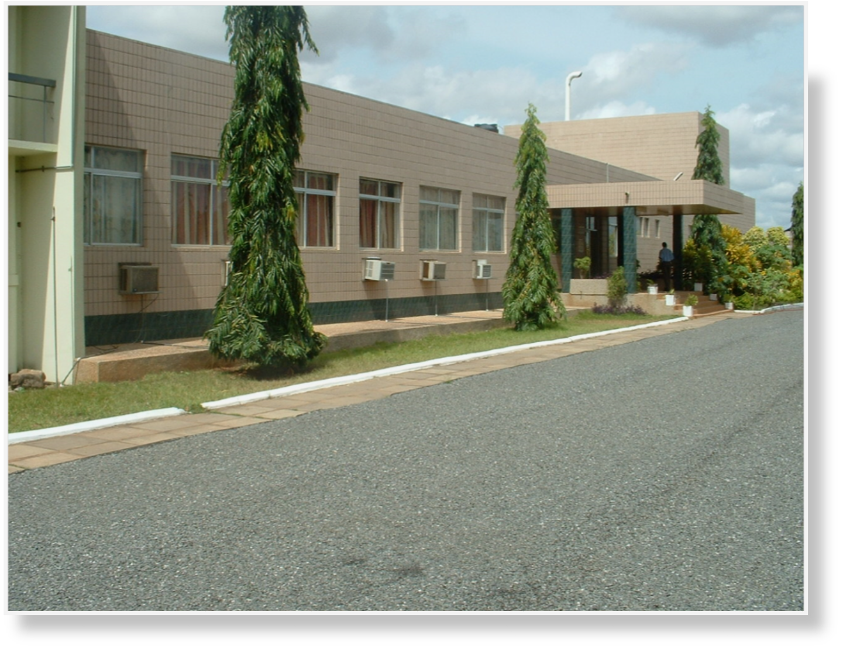
GHARR-1 BUILDING

Slide 30
THANK YOU FOR YOUR ATTENTION

