Slide 1
Risk Based Approach for Security Management
Dave Ek, USA
Notes:
The subject of Nuclear Security receives significant attention in today’s world
International Bodies,
Member States,
NGOs
Several International Instruments developed
Significant funding for strengthening from several Members States
Establishment of IAEA Department of Nuclear Security
guidance
workshops
missions
Governments at the highest levels meet every other year for several days to specifically address nuclear security at the Nuclear Security Summit!

Slide 2
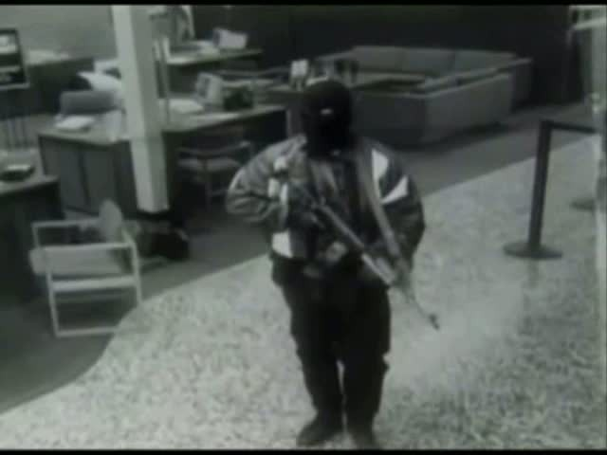
Why is so much attention being given to Nuclear Security?
1997, North Hollywood Shootout
Two bank robbers in North Hollywood and the Los Angeles Police Department fired some 2,000 rounds in a shootout. Both robbers were killed, 11 police officers and 7 civilians were injured and numerous vehicles and other property was damaged. [Source: Wikipedia]
Notes:
The subject of Nuclear Security receives significant attention in today’s world
International Bodies,
Member States,
NGOs
Several International Instruments developed
Significant funding for strengthening from several Members States
Establishment of IAEA Department of Nuclear Security
guidance
workshops
missions

Slide 3
Objective
Describe the historical growth of interest in nuclear security and the corresponding developments in nuclear security as a technical discipline.
OBJECTIVE
HISTORY
WHAT IS
NUCLEAR
SECURITY
FEATURES OF
EFFECTIVE
SECURITY
SYSTEM
BALANCED
SECURITY
THREAT
BASED
CRITERIA
PERFORMANCE
BASED
SECURITY
INTEGRATED/
EFFECTIVE
SECURITY
MANAGEMENT
NUCLEAR
SECURITY
RISK
MANAGEMENT
SUMMARY
Notes:
This presentation will describe the historical growth of interest in nuclear security and
the corresponding developments in nuclear security as a technical discipline
Foundation for succeeding presentations

Slide 4
History: Pre-security
Euphoria of Atoms for Peace overwhelmed any considerations for security
Lack of any nuclear security event history
Security concerns seem to have grown slowly, first recognized in the late 1960’s/early 70’s.
Concerns evolved due to:
Growing fears of potential nuclear consequences
Plethora of regional criminal and terrorist groups
Nuclear Bomb Threat
Security concerns were facilitated by a growing sophistication of media communication
These issues combined to grow concerns for security of nuclear material
OBJECTIVE
HISTORY
WHAT IS
NUCLEAR
SECURITY
FEATURES OF
EFFECTIVE
SECURITY
SYSTEM
BALANCED
SECURITY
THREAT
BASED
CRITERIA
PERFORMANCE
BASED
SECURITY
INTEGRATED/
EFFECTIVE
SECURITY
MANAGEMENT
NUCLEAR
SECURITY
RISK
MANAGEMENT
SUMMARY
Notes:
Next 4 slides try to show basis for the steady rise in interest in nuclear security
July 23, 1968 Hijack of El Al flight - is seen by many as the initiation of modern terrorism—deploying tactics to utilize the modern press
Fears
cold war public planning/exercises and revealed hazards
radioactive fallout from atmospheric nuclear testing (U.S., U.K, USSR)
the China Syndrome – core melt—bigger reactors = more latent heat without corresponding increase in containment
reports of the ease with which a bomb could be built
All that is needed for a bomb is knowledge and material, and knowledge
Encyclopedia details available in early 70’s
Terror groups:
FARC --Peru
ETA--Basque
Weathermen--US
Japan Red Army
Red Army Faction --Germany
Black September --Palestine
Red Brigade, Italy
Irish Republican Army

Slide 5
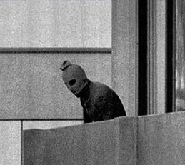
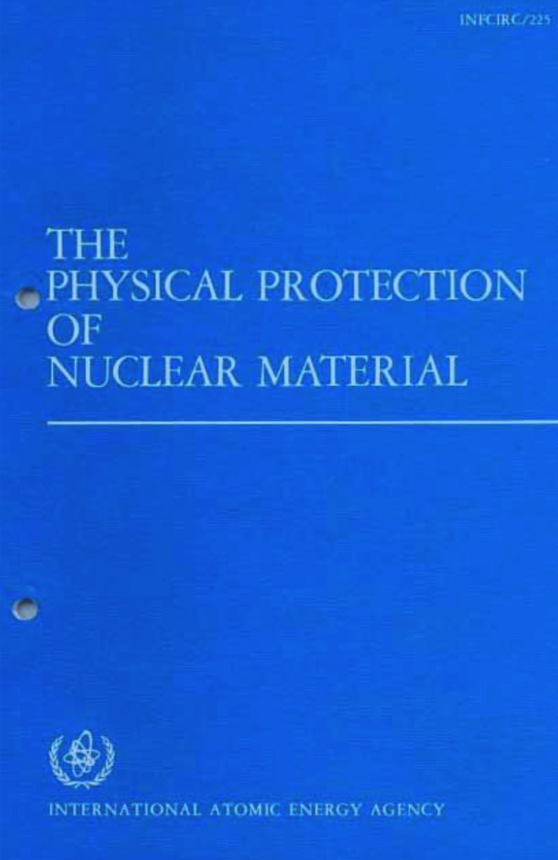
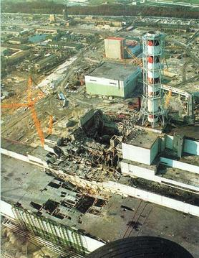
History
Sources: Wikipedia
1972 Munich Olympics
1975 First INFCIRC/225
(1972 First Guidance by IAEA DG)
1986 Chernobyl
OBJECTIVE
HISTORY
WHAT IS
NUCLEAR
SECURITY
FEATURES OF
EFFECTIVE
SECURITY
SYSTEM
BALANCED
SECURITY
THREAT
BASED
CRITERIA
PERFORMANCE
BASED
SECURITY
INTEGRATED/
EFFECTIVE
SECURITY
MANAGEMENT
NUCLEAR
SECURITY
RISK
MANAGEMENT
SUMMARY
Notes:
These concerns led to the initial security steps
Security always existed: Gates, Guns, Guards
Physical Protection of Nuclear Materials, 1972
Only shared upon Member State request
“Complement to Safeguards”
Munich Olympics (Black September)
INFCIRC 225 in 1975
Includes categorization of Nuclear Material for theft (including irradiated fuel)
Sabotage mentioned as concern but no security recommended
The Convention of the Physical Protection of Nuclear Materials in 1980
3 mile island & Chernobyl
Sabotage Concerns increased
INFCIRC225/Rev2 (1989) first includes concept of Vital Areas
INFCIRC 225/Rev4 (1999) title includes “…Nuclear Materials and Facilities”
includes chapter on security against sabotage
includes concept of Design Basis Threat
Includes first mention of insider
IAEA Office of Nuclear Security (1996?)
Under Safeguards Department

Slide 6
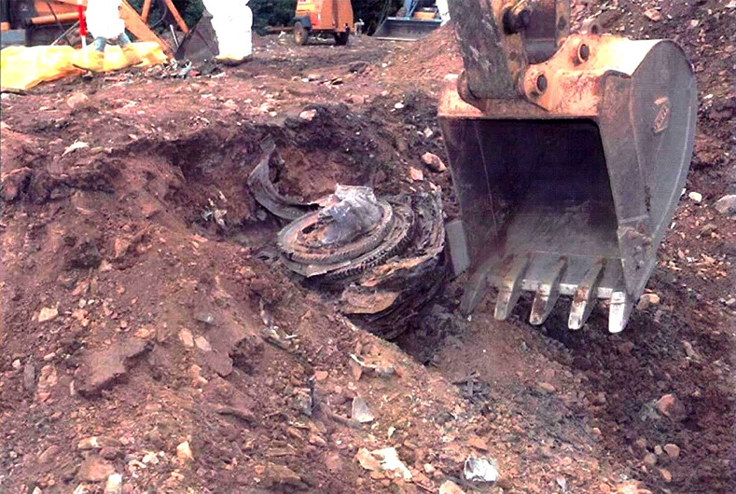
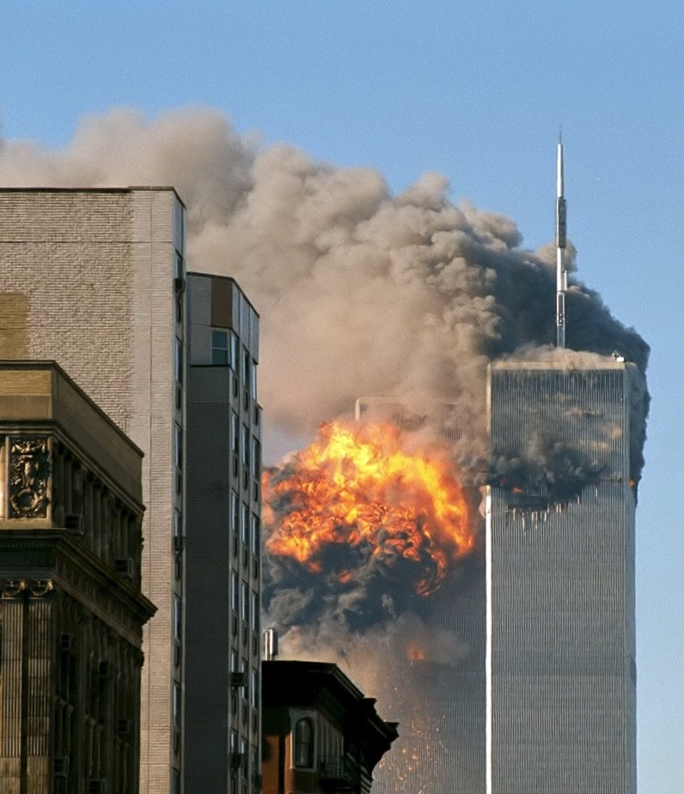
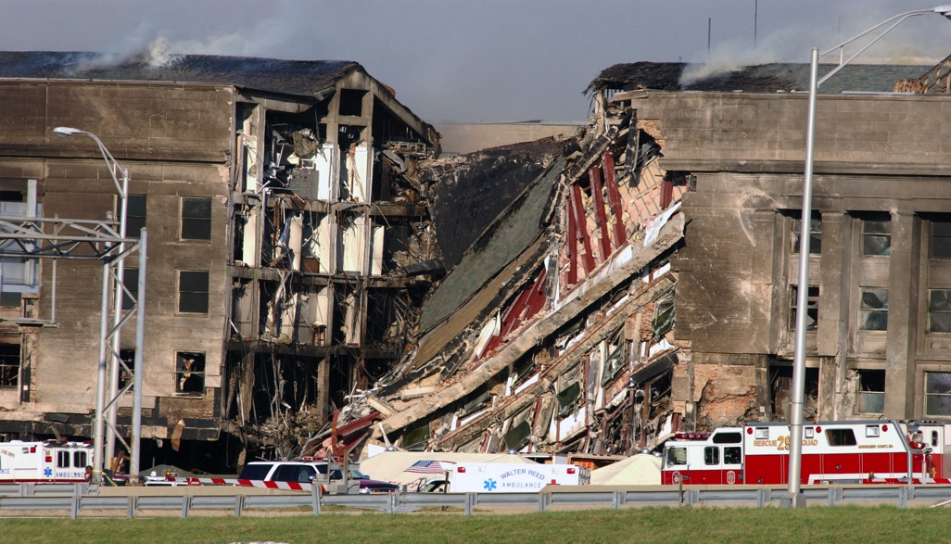
History
9/11 Events
WTCs hit with 2 hijacked planes - 2759 killed, 8700 injured
Pentagon hit with a hijacked plane - 189 killed, 200 injured
Pennsylvania field where a hijacked plane was crashed - 45 killed
WTC
Flight 93
Sources: Wikipedia
Pentagon
OBJECTIVE
HISTORY
WHAT IS
NUCLEAR
SECURITY
FEATURES OF
EFFECTIVE
SECURITY
SYSTEM
BALANCED
SECURITY
THREAT
BASED
CRITERIA
PERFORMANCE
BASED
SECURITY
INTEGRATED/
EFFECTIVE
SECURITY
MANAGEMENT
NUCLEAR
SECURITY
RISK
MANAGEMENT
SUMMARY
Notes:
Watershed event for terrorism
Sabotage emphasized as much as theft
Security and Safety relationship strengthened
Sabotage INFCIRC225/Rev5 (2011) expands the chapter on Sabotage measures
Addresses risk management
Addresses prevention of vehicle bombs
Mentions airborne threat
Terrorism focus strengthened:
The Amendment to the Convention on Nuclear Security and Nuclear Facilities ‘05
Nuclear Security Fundamental Principles
International Instruments on Nuclear Security
UNSCR 1373
UNSCR 1540
Convention on the Suppression of Acts of Nuclear Terrorism
At IAEA:
Initiates concerns about Beyond Design Basis Threat events
Initiates concerns for security of radioactive materials
Code of Conduct on the Safety and Security of Radioactive Sources ’04
Office of Nuclear Security expands from 5 staff to…
IAEA Nuclear Security Series Guidance
Nuclear Security Summit (2004+)

Slide 7
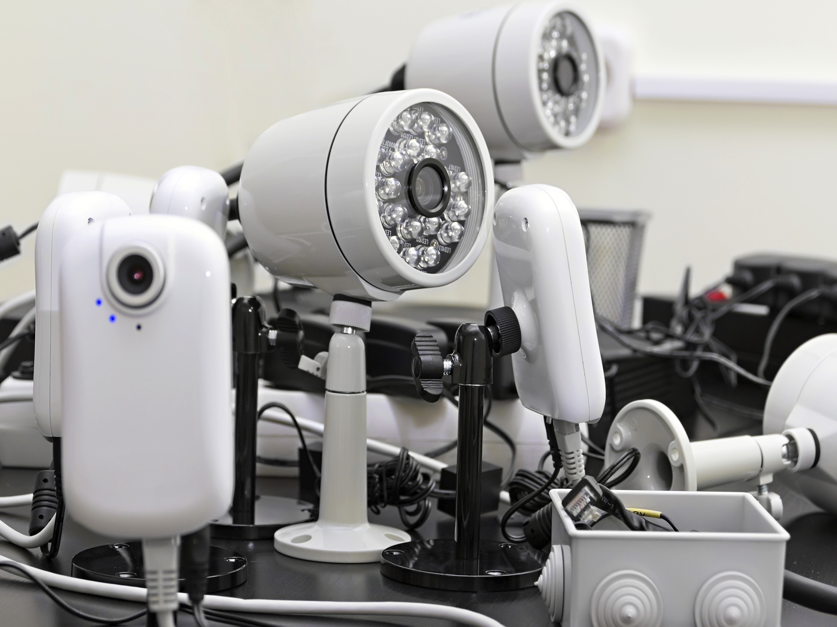
History
and
Approach
Systematic
Integrated
Technology
Security guards
Towers
Locks
Gates
Guns
Guards
Gates
Guns
Guards
IMPROVED SECURITY
From “Gates, Guns, Guards” to a systematic, integrated approach
OBJECTIVE
HISTORY
WHAT IS
NUCLEAR
SECURITY
FEATURES OF
EFFECTIVE
SECURITY
SYSTEM
BALANCED
SECURITY
THREAT
BASED
CRITERIA
PERFORMANCE
BASED
SECURITY
INTEGRATED/
EFFECTIVE
SECURITY
MANAGEMENT
NUCLEAR
SECURITY
RISK
MANAGEMENT
SUMMARY
Notes:
Detection, Delay, Response
Along with these developments, nuclear security evolved into a more sophisticated discipline
From “Gates, Guns, Guards” to a systematic, integrated approach
Paralleling in many ways safety advances
Performance approach
Timely detection, measuring system effectiveness
Design basis threat
Sabotage Analysis
Vital areas
Risk-based security

Slide 8
What is Nuclear Security?
International Nuclear Security objective:
“prevent, detect and respond to … theft, sabotage … and
other malicious acts involving nuclear materials,
radioactive materials, and their associated facilities”
SAFETY
Radiological release
due to systems failure,
human error, or
natural disaster.
SECURITY
Radiological release
caused by sabotage,
external attack,
malicious act.
Prevent proliferation
by non-state actors.
SAFEGUARDS
Prevent proliferation
of nuclear weapons.
Nuclear Security provides a vital complement to both Nuclear Safety and Nuclear Safeguards.
OBJECTIVE
HISTORY
WHAT IS
NUCLEAR
SECURITY
FEATURES OF
EFFECTIVE
SECURITY
SYSTEM
BALANCED
SECURITY
THREAT
BASED
CRITERIA
PERFORMANCE
BASED
SECURITY
INTEGRATED/
EFFECTIVE
SECURITY
MANAGEMENT
NUCLEAR
SECURITY
RISK
MANAGEMENT
SUMMARY
Notes:
What is Nuclear Security. Nuclear security includes protection of nuclear and radioactive materials under regulatory control, and detection and response to malicious acts involving nuclear material out of regulatory control.
Prior to sept 11, 2001
Nuclear Security was part of Safeguards organization at IAEA
Necessary complement to Safeguards
After Sept 11, 2001
Nuclear Security was part of Nuclear Safety at IAEA
Nuclear Security is relevant and necessary to the goals of both disciplines

Slide 9
What is Nuclear Security?
OBJECTIVE
HISTORY
WHAT IS
NUCLEAR
SECURITY
FEATURES OF
EFFECTIVE
SECURITY
SYSTEM
BALANCED
SECURITY
THREAT
BASED
CRITERIA
PERFORMANCE
BASED
SECURITY
INTEGRATED/
EFFECTIVE
SECURITY
MANAGEMENT
NUCLEAR
SECURITY
RISK
MANAGEMENT
SUMMARY
Notes:
Nuclear Security under regulatory control achieves its objective of preventing theft and sabotage primarily by:
Separating adversaries from areas where targets are located and therefore where malicious acts can be undertaken
Targets are materials, equipment or systems that if accessed or disabled could lead to unacceptable consequences
Safety analysis can assist in identifying targets of sabotage; however, due to intentional nature of sabotage, and the possible introduction of external energy:
some sabotage targets may not be identified in a safety analysis;
consequences of sabotage can exceed those identified in safety analysis

Slide 10
What is Nuclear Security?
OBJECTIVE
HISTORY
WHAT IS
NUCLEAR
SECURITY
FEATURES OF
EFFECTIVE
SECURITY
SYSTEM
BALANCED
SECURITY
THREAT
BASED
CRITERIA
PERFORMANCE
BASED
SECURITY
INTEGRATED/
EFFECTIVE
SECURITY
MANAGEMENT
NUCLEAR
SECURITY
RISK
MANAGEMENT
SUMMARY
Notes:
Nuclear Security achieves its objective of preventing theft and sabotage primarily by:
Separating adversaries from areas where targets are located and therefore where malicious acts can be undertaken
Targets are materials, equipment or systems that if accessed or disabled could lead to unacceptable consequences
Safety analysis can assist in identifying targets of sabotage; however, due to intentional nature of sabotage, and the possible introduction of external energy:
some sabotage targets may not be identified in a safety analysis;
consequences of sabotage can exceed those identified in safety analysis
In practice it separates by surrounding targets in security layers

Slide 11
What is Nuclear Security?
OBJECTIVE
HISTORY
WHAT IS
NUCLEAR
SECURITY
FEATURES OF
EFFECTIVE
SECURITY
SYSTEM
BALANCED
SECURITY
THREAT
BASED
CRITERIA
PERFORMANCE
BASED
SECURITY
INTEGRATED/
EFFECTIVE
SECURITY
MANAGEMENT
NUCLEAR
SECURITY
RISK
MANAGEMENT
SUMMARY
Notes:
Nuclear Security achieves its objective of preventing theft and sabotage primarily by:
Separating adversaries from areas where targets are located and therefore where malicious acts can be undertaken
Targets are materials, equipment or systems that if accessed or disabled could lead to unacceptable consequences
Safety analysis can assist in identifying targets of sabotage; however, due to intentional nature of sabotage, and the possible introduction of external energy:
some sabotage targets may not be identified in a safety analysis;
consequences of sabotage can exceed those identified in safety analysis
In practice it separates by surrounding targets in security layers
So that there are no gaps

Slide 12
What is Nuclear Security?
PERIMETER
EXTERIOR
INTERIOR
RESTRICTED
DETECTION
DELAY
RESTRICTED
INTERIOR
EXTERIOR
PERIMETER
OBJECTIVE
HISTORY
WHAT IS
NUCLEAR
SECURITY
FEATURES OF
EFFECTIVE
SECURITY
SYSTEM
BALANCED
SECURITY
THREAT
BASED
CRITERIA
PERFORMANCE
BASED
SECURITY
INTEGRATED/
EFFECTIVE
SECURITY
MANAGEMENT
NUCLEAR
SECURITY
RISK
MANAGEMENT
SUMMARY
Notes:
These layers can be multiple
This envelopment is done in concentric layers
A protection system may include several layers for each target (defense in depth)
Security measures in each layer strive to:
Detect undesirable activities
Delay undesirable activities to permit response to undesirable activities
The suite of layers of security comprises a physical protection system

Slide 13
Features of Effective Security System
Balanced
Security
No weak areas
Threat-Based
Criteria
Design criteria describing adversary capabilities
Performance
Based Security
Robustness of security measures
Integration of Detection, Delay, and Response
Integrated and
Effective
Security
Management
Entire security effort
OBJECTIVE
HISTORY
WHAT IS
NUCLEAR
SECURITY
FEATURES OF
EFFECTIVE
SECURITY
SYSTEM
BALANCED
SECURITY
THREAT
BASED
CRITERIA
PERFORMANCE
BASED
SECURITY
INTEGRATED/
EFFECTIVE
SECURITY
MANAGEMENT
NUCLEAR
SECURITY
RISK
MANAGEMENT
SUMMARY
Notes:
Objective is to outline some features of effectiveness that will be discussed in succeeding slides
All of these together permit risk management of nuclear security

Slide 14
Balanced Security
DETECTION • DELAY • RESPONSE
DETECTION & DELAY
PERIMETER
PROTECTED AREA
INNER AREA
STRONG ROOM
DETECTION & DELAY
DETECTION & DELAY
STRONG ROOM
INNER AREA
PROTECTED AREA
PERIMETER
DETECTION & DELAY
Access Control is the the most difficult to achieve in a Balanced Security.
OBJECTIVE
HISTORY
WHAT IS
NUCLEAR
SECURITY
FEATURES OF
EFFECTIVE
SECURITY
SYSTEM
BALANCED
SECURITY
THREAT
BASED
CRITERIA
PERFORMANCE
BASED
SECURITY
INTEGRATED/
EFFECTIVE
SECURITY
MANAGEMENT
NUCLEAR
SECURITY
RISK
MANAGEMENT
SUMMARY
Notes:
An adversary can select how, when and where to attempt a malicious act
security system must be designed to ensure that detection, delay and response is effective regardless of where the adversary breaches the security layer, and when this occurs
A balanced security system implies layers of security that provide uniform detection and delay across the layer regardless of time of attack
Biggest challenge for balance is detection and delay at access points in the security layer (doors, gates, etc.)
This difficulty with balance at entry/egress points is why security desires to minimize access points to restricted areas
SAFETY SECURITY CONFLICT IS EMX

Slide 15
Threat Based Criteria
What is the criteria used for security design?
What is the ability of a sensor to detect an intrusion, or the access delay time of a barrier?
Sensor or barrier effectiveness depends on the capabilities and scenario of the adversary.
What alarms reliably for one adversary, may NOT alarm for another
A security component is designed for
specific adversary capabilities.
OBJECTIVE
HISTORY
WHAT IS
NUCLEAR
SECURITY
FEATURES OF
EFFECTIVE
SECURITY
SYSTEM
BALANCED
SECURITY
THREAT
BASED
CRITERIA
PERFORMANCE
BASED
SECURITY
INTEGRATED/
EFFECTIVE
SECURITY
MANAGEMENT
NUCLEAR
SECURITY
RISK
MANAGEMENT
SUMMARY
Notes:
Objective: Highlight that design criteria is characteristics of people
As adversary capabilities vary
From one to the next
With time
A hypothetical adversary description is used for security design and evaluation
A particular type of hypothetical adversary description is called Design Basis Threat (DBT)

Slide 16
Performance Based Security
Effectiveness of a detection or delay security measure relates to…
its functionality in the expected environment
its success against the defined adversary
its installation and maintenance quality
OBJECTIVE
HISTORY
WHAT IS
NUCLEAR
SECURITY
FEATURES OF
EFFECTIVE
SECURITY
SYSTEM
BALANCED
SECURITY
THREAT
BASED
CRITERIA
PERFORMANCE
BASED
SECURITY
INTEGRATED/
EFFECTIVE
SECURITY
MANAGEMENT
NUCLEAR
SECURITY
RISK
MANAGEMENT
SUMMARY
Notes:
A robust security measure will provide reliable detection or adequate delay of the defined adversary
Robustness of specific measures can only be assessed though analysis and testing of actual installed measure against adversary capabilities in actual environment

Slide 17
Performance Based Security
INTEGRATION OF MEASURES
Integration
Timeline
Comparing to response time
Container
Fence
Building
Access
Room
Access
SENSITIVE MATERIAL
TIME
OBJECTIVE
HISTORY
WHAT IS
NUCLEAR
SECURITY
FEATURES OF
EFFECTIVE
SECURITY
SYSTEM
BALANCED
SECURITY
THREAT
BASED
CRITERIA
PERFORMANCE
BASED
SECURITY
INTEGRATED/
EFFECTIVE
SECURITY
MANAGEMENT
NUCLEAR
SECURITY
RISK
MANAGEMENT
SUMMARY
Notes:
Objective: Overall security system effectiveness is based on the ability of the security system to prevent unacceptable consequence. This is achieved by reliable:
Detection of any malicious action
Delay progress of the malicious action after detection
Respond to and stop the malicious action prior to the initiation of unacceptable consequences
This requires effective integration of detection, delay and response measures
Detection must occur early enough to alert responders
Delay must occur after detection and be adequate to slow the malicious act while responders prepare, deploy and interrupt the malicious action
Response must be fast and prepared enough to respond in a timely manner; and be adequately equipped, trained, and capable to stop the adversary
Overall holistic security effectiveness is not easy to measure, but we can measure the effectiveness of detection, delay and response integration against specific scenarios against specific adversaries
{Now describe diagram}

Slide 18
Performance Based Security
TIMELINE REPRESENTATION
Integration
Timeline
Comparing to response time
Adversary
Begins Task
Sensing Opportunities
Adversary
Completes Task
Adversary Task Time
Adversary Task Time Remaining After First Sensing
PPS Response Time
First
Sensing
Detection
Time
Response
Force Time
Time
Remaining
After
Interruption
Adversary
Detected
Adversary
Interrupted
T₀
T_{D}
T_{I}
T_{C}
TIME
OBJECTIVE
HISTORY
WHAT IS
NUCLEAR
SECURITY
FEATURES OF
EFFECTIVE
SECURITY
SYSTEM
BALANCED
SECURITY
THREAT
BASED
CRITERIA
PERFORMANCE
BASED
SECURITY
INTEGRATED/
EFFECTIVE
SECURITY
MANAGEMENT
NUCLEAR
SECURITY
RISK
MANAGEMENT
SUMMARY
Notes:
Overall system effectiveness is estimated by specific effectiveness of certain, worst-case scenarios using conservative estimates of security measure robustness
This timeline representation of the example scenario in previous slide
Security Effectiveness for scenario = is simply the cumulative sensing likelihood of first 3 sensing opportunities
If effectiveness too low (=timely detection too low), you can:
Increase early detection, or
extend delay/accelerate response (to make previously non-timely detection measures become timely)

Slide 19
Integrated/Effective Security Management
Security management includes all of the activities and efforts to implement a security regime
Developing policies, programs, and plans
Overseeing security operations
Security training
Security system evaluation and maintenance
Quality assurance
Coordination with site and offsite stakeholders
Integration with Information Management System
OBJECTIVE
HISTORY
WHAT IS
NUCLEAR
SECURITY
FEATURES OF
EFFECTIVE
SECURITY
SYSTEM
BALANCED
SECURITY
THREAT
BASED
CRITERIA
PERFORMANCE
BASED
SECURITY
INTEGRATED/
EFFECTIVE
SECURITY
MANAGEMENT
NUCLEAR
SECURITY
RISK
MANAGEMENT
SUMMARY
Notes:
Objective: Security Management is the entire security system

Slide 20
Nuclear Security Risk Management
All adverse consequences are not unacceptable
Unacceptable consequences require security resources
All unacceptable consequences are not equal
Graded approach
Likelihood of unacceptable consequences cannot be reduced to zero
Acceptable risk
RISKS
COSTS
OBJECTIVE
HISTORY
WHAT IS
NUCLEAR
SECURITY
FEATURES OF
EFFECTIVE
SECURITY
SYSTEM
BALANCED
SECURITY
THREAT
BASED
CRITERIA
PERFORMANCE
BASED
SECURITY
INTEGRATED/
EFFECTIVE
SECURITY
MANAGEMENT
NUCLEAR
SECURITY
RISK
MANAGEMENT
SUMMARY
Notes:
Objective: Some consequences acceptable. Those that are not must have security applied to reduce risk to acceptable level

Slide 21
Nuclear Security Risk Management
Risk = Consequence Severity * Consequence Likelihood
OBJECTIVE
HISTORY
WHAT IS
NUCLEAR
SECURITY
FEATURES OF
EFFECTIVE
SECURITY
SYSTEM
BALANCED
SECURITY
THREAT
BASED
CRITERIA
PERFORMANCE
BASED
SECURITY
INTEGRATED/
EFFECTIVE
SECURITY
MANAGEMENT
NUCLEAR
SECURITY
RISK
MANAGEMENT
SUMMARY
Notes:
Likelihood of Consequence for Security Event
Likelihood adversary makes attempt
Cannot confidently quantify nor qualify
Likelihood adversary succeeds (security system fails)
adversary capabilities, security system effectiveness
Security regulations define levels of security to appropriately reduce likelihood of adverse consequences (balance risk)
Greater consequence severity are appropriated more robust security measures
Increased threat capabilities increase risk
Increased threat likelihood of attempt increase risk
(Increased security effectiveness offsets increased threat capabilities and decreases threat likelihood of attempt)

Slide 22
Nuclear Security Risk Management
Risk = Consequence Severity * *
Likelihood of Attempt
Likelihood of Success
OBJECTIVE
HISTORY
WHAT IS
NUCLEAR
SECURITY
FEATURES OF
EFFECTIVE
SECURITY
SYSTEM
BALANCED
SECURITY
THREAT
BASED
CRITERIA
PERFORMANCE
BASED
SECURITY
INTEGRATED/
EFFECTIVE
SECURITY
MANAGEMENT
NUCLEAR
SECURITY
RISK
MANAGEMENT
SUMMARY
Notes:
Likelihood of Consequence for Security Event
Likelihood adversary makes attempt
Cannot confidently quantify nor qualify
Likelihood adversary succeeds (security system fails)
adversary capabilities, security system effectiveness
Security regulations define levels of security to appropriately reduce likelihood of adverse consequences (balance risk)
Greater consequence severity are appropriated more robust security measures
Increased threat capabilities increase risk
Increased threat likelihood of attempt increase risk
(Increased security effectiveness offsets increased threat capabilities and decreases threat likelihood of attempt)

Slide 23
Nuclear Security Risk Management
Risk = Consequence Severity * *
Can control success
Likelihood of Attempt
Likelihood of Success
Can’t control attempt
OBJECTIVE
HISTORY
WHAT IS
NUCLEAR
SECURITY
FEATURES OF
EFFECTIVE
SECURITY
SYSTEM
BALANCED
SECURITY
THREAT
BASED
CRITERIA
PERFORMANCE
BASED
SECURITY
INTEGRATED/
EFFECTIVE
SECURITY
MANAGEMENT
NUCLEAR
SECURITY
RISK
MANAGEMENT
SUMMARY
Notes:
Likelihood of Consequence for Security Event
Likelihood adversary makes attempt
Cannot confidently quantify nor qualify
Likelihood adversary succeeds (security system fails)
adversary capabilities, security system effectiveness
Security regulations define levels of security to appropriately reduce likelihood of adverse consequences (balance risk)
Greater consequence severity are appropriated more robust security measures
Increased threat capabilities increase risk
Increased threat likelihood of attempt increase risk
(Increased security effectiveness offsets increased threat capabilities and decreases threat likelihood of attempt)

Slide 24
Nuclear Security Risk Management
Risk = Consequence Severity * *
Can control success
Likelihood of Attempt
Likelihood of Success
Can’t control attempt
Increasing
security
reduces success
likelihood
=
RISK
REDUCTION
OBJECTIVE
HISTORY
WHAT IS
NUCLEAR
SECURITY
FEATURES OF
EFFECTIVE
SECURITY
SYSTEM
BALANCED
SECURITY
THREAT
BASED
CRITERIA
PERFORMANCE
BASED
SECURITY
INTEGRATED/
EFFECTIVE
SECURITY
MANAGEMENT
NUCLEAR
SECURITY
RISK
MANAGEMENT
SUMMARY
Notes:
Likelihood of Consequence for Security Event
Likelihood adversary makes attempt
Cannot confidently quantify nor qualify
Likelihood adversary succeeds (security system fails)
adversary capabilities, security system effectiveness
Security regulations define levels of security to appropriately reduce likelihood of adverse consequences (balance risk)
Greater consequence severity are appropriated more robust security measures
Increased threat capabilities increase risk
Increased threat likelihood of attempt increase risk
(Increased security effectiveness offsets increased threat capabilities and decreases threat likelihood of attempt)

Slide 25
Summary
Nuclear Security has objectives in common with Nuclear Safety and with Nuclear Safeguards
Nuclear Security has evolved over the past 45 years
and
Approach
Systematic
Integrated
Technology
Gates
Guns
Guards
Gates
Guns
Guards
IMPROVED SECURITY
OBJECTIVE
HISTORY
WHAT IS
NUCLEAR
SECURITY
FEATURES OF
EFFECTIVE
SECURITY
SYSTEM
BALANCED
SECURITY
THREAT
BASED
CRITERIA
PERFORMANCE
BASED
SECURITY
INTEGRATED/
EFFECTIVE
SECURITY
MANAGEMENT
NUCLEAR
SECURITY
RISK
MANAGEMENT
SUMMARY

