Slide 1
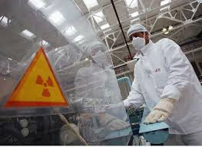
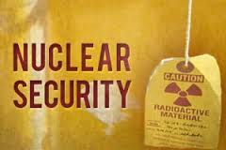
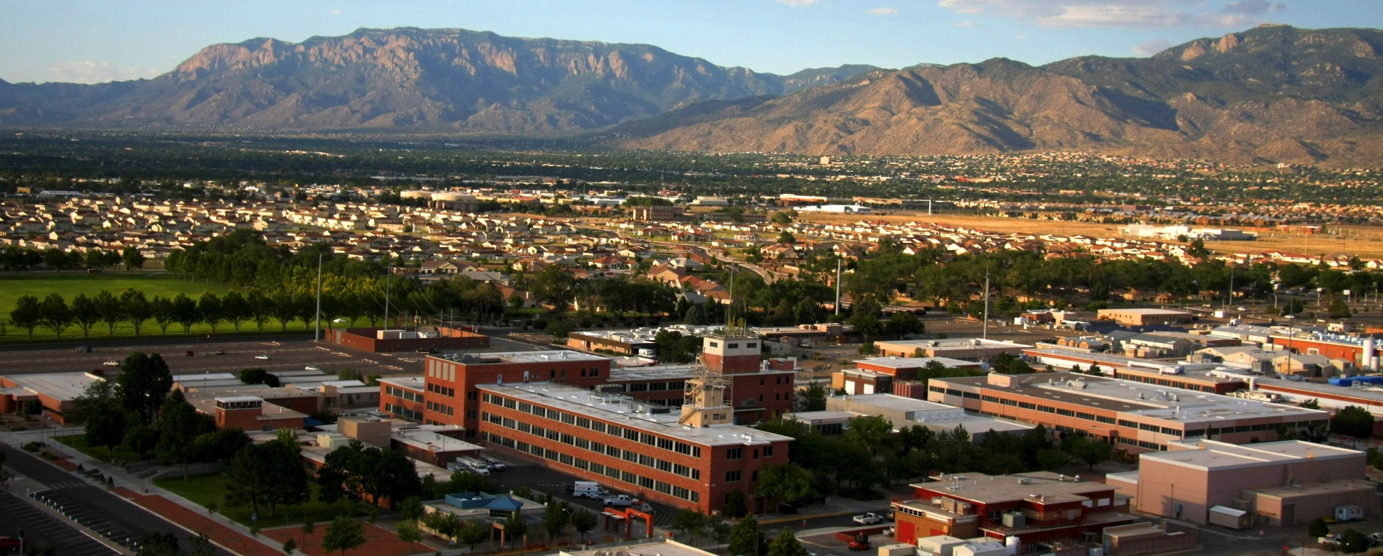
Leveraging Safety Programs to Improve and Support Security Programs J. Leach, M. Snell, R. Pratt, and S. Sandoval OCTOBER 2015 SAND2015-9023 R

Slide 2
Overview
Safety programmes have several inherent advantages over security programmes:
Safety, as a field, is comparatively more mature and has very detailed processes;
Safety processes and techniques can be shared nationally and internationally without security concerns; and
Nuclear facilities tend to have more extensive and comprehensive safety programmes than security programme.
Safety may already support capabilities that security organizations could leverage so as to be more effective within resource constraints

Slide 3
Holistic Approach to Safety & Security
Three programmes exist that, if implemented, result in a more holistic approach to safety and security:
Integrated management systems;
Formality of operations and maintenance of an organizational culture; and
Exercise programmes
There are some aspects of security programmes that do not have direct parallels with safety.

Slide 4
Five Principles of an Integrated Management System
Plan the work – Ensure safety missions are uniformly translated into objectives, expectations established, tasks are defined and prioritized, and resources equally allocated.
Analyze the risks – Identify, categorize, and communicate risks to life and asset(s).
Develop controls – Establish administrative and engineering controls and allocate resources to address safety considerations.
Perform the work –Worker competence shall be commensurate with responsibilities and personnel shall possess the experience, knowledge, skills, and abilities necessary to carry out their responsibilities.
Feedback and improvement – Feedback information on the adequacy of controls, identify opportunities for improving the planning or execution of work.

Slide 5
Integrated Management System – Continual Improvement Cycle
PLAN
Collect & Analyze
Requirements
Evaluate Risks & Implement Controls
Roles & Responsibilities
Staff Competencies
Design Basis Threat
Insider/Outsider
Security Strategy
Denial, Containment,
Recapture, Recovery
ACT
DO
Process/System
Improvement
System Sustainability
Authorize Work
↓
Perform Work
Safely / Securely
CHECK
Management
Review
Measure
Performance
Performance
Testing

Slide 6
IMS at SNL Annular Research Reactor Facility
Materials Management
Applied Nuclear Technologies
External Nuclear Technologies
Mission
Operations, Engineering, & Maintenance
Integrated Nuclear Security
Operations
Training
Information
Nuclear Safety
Environment, Health & Safety
Requirements
Integrated Work
Assurance
Business
Operations
Engineering
Maintenance

Slide 7
Use of Formality of Operations to Develop Organizational Culture
Four key principles of a formality of operations result in desired organizational culture
Conduct of operations
Maintenance and surveillance
Training and qualifications, and
Configuration Management

Slide 8
Measuring the Effectiveness of an IMS
Training exercises are perhaps one of the simplest measures to exam the effectiveness of an IMS.
Training exercises:
Identify underlying cause of issues
Aide in the development of corrective actions
Areas of examination must have an objective and should be prioritized by facility management

Slide 9
Unique Security Considerations
Security programmes include several aspects that do not have direct parallels with safety:
Unique PPS functions that need to be performed: detection (including access control and intrusion detection), delay, and response;
Compliance requirements and, where applicable, performance-based security requirements (to include performance testing) as addressed in security plans;
Use of policy threat statements about security threats, as opposed to more readily observable safety hazards; and
Confidentiality requirements for information about the threat as well as physical security measures (in terms of personnel, procedures and equipment) that constitute a PPS.

Slide 10
Conclusion
There is a distinct difference between safety and security
An integrated management system takes a holistic approach for facility operations from initial planning, execution, evaluation, and corrective actions.
Each step in the cyclical process can easily incorporate safety, security, and safeguard activities.
Thank you!

