Slide 1
Integrated Management System, Configuration and Document Control for Research Reactors
Benji Steynberg
Koos du Bruyn
SAFARI-1, Necsa
4th International Conference on Research Reactors:
Safe Management and Effective Utilization
16 to 20 November 2015, IAEA, Vienna

Slide 2
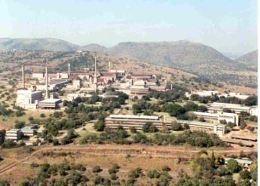
The Geographical Location of SAFARI-1, Necsa
Pretoria
Pelindaba
JHB. Int. Airport
Johannesburg

Slide 3
SAFARI-1 Overview
20 MW Tank-in-Pool MTR reactor of ORR design – light water moderated & cooled, Be reflected.
Operational since March 1965 (~3 697 211 MWh)
SAFARI-1 was on 18th March 2015, 50 years in operation
Primary activities: Isotope production, Si doping, neutron activation analysis, beam port research
Converted to LEU fuel (U₃Si₂) in June 2009

Slide 4
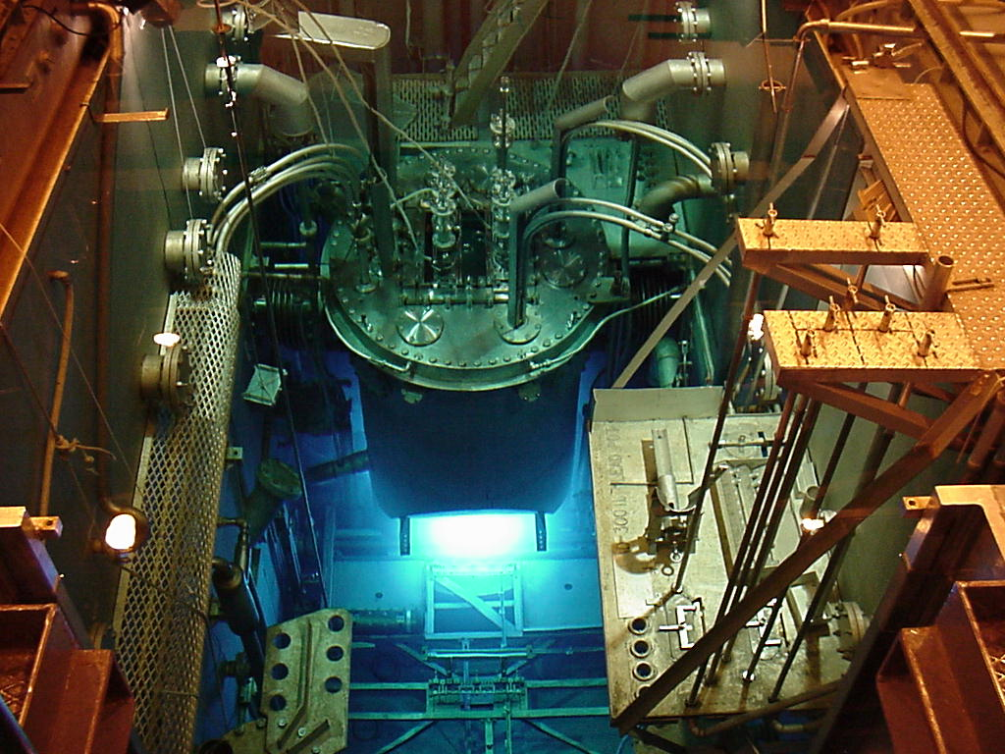

Slide 5
Contents
Introduction
Integrated Management System (IMS)
Main Elements of an IMS
Graded Approach to the IMS
Benefits of an IMS
Safety Culture
PDCA Cycle – Framework for Continual Improvement
Example of an IMS
Configuration Management (CM)
What is CM?
The Objectives of CM
Example of a CM Structure
Document Control
What is Document Control?
The Purpose of Document Control
Document Control Procedures
A Practical Approach to Document Control
Conclusion

Slide 6
Integrated Management System
Goals and objectives should include:
economic,
environmental,
health,
operational,
quality,
supplier management,
information management,
equipment management,
safeguards,
safety,
security,
resources, and
social considerations

Slide 7
Main Elements of an IMS
Policy
Planning
Management responsibility and authority
Implementation and operation
Compliance management
Resource management
Process implementation
Change control
Performance assessment
Continuous improvement
Documented information
Management review
Transition to an IMS

Slide 8
Graded Approach to the IMS
Consider the following during the graded approach:
Extent of integration
Political and cultural situation
Levels of competence necessary
Legal and other regulatory requirements
Organisational identified risks and opportunities
Clear objectives for the integration

Slide 9
System Flowchart of a Generic IMS

Slide 10
Benefits of an IMS
Reducing unnecessary duplication
Reducing paperwork
Reducing administrative costs
Providing a user friendly interface to the management systems
Identify risks and reduce risks to increase utilisation and profitability
Identify conflicting objectives and assist in balancing these conflicts
Identify conflicting responsibilities and relationships and assist in eliminating these conflicts
Clearly stated responsibilities and authorities
Turn the focus onto business goals and objectives
Gain a structured balance of authority/power
Create a formalisation of informal systems
Harmonise and optimise practices and thus creating consistency
Improve internal and external communication
Facilitate training and development of staff
Enabling environment for a health safety culture

Slide 11
PDCA Cycle – Continual Improvement

Slide 12
Example of an IMS Model
RADIOLOGICAL SAFETY
National legislation:
Nuclear energy Act 46 of 1999
Regulatory Act (47/1999)
QUALITY MANAGEMENT SYSTEM
ISO 9001: 2008
Necsa/guidelines
IAEA SS/Techdocs
SECURITY SYSTEM
INFCIRC/225/Rev 4/5
INTEGRATED
MANAGEMENT SYSTEM
(QHSE)
CONVENTIONAL SAFETY
ISO 18001
OHSA; Act 85 of 1993
Haz.Sub. act No.: 15 of 1973
NUCLEAR SAFETY FOR
THE DESIGN AND OPERATION
PARAMETERS OF THE REACTOR
(IAEA SAFETY SERIES 35-G1)
Organizational
Resources and services
ENVIRONMENTAL MANAGEMENT
ISO 14001: 2004
NEMA Act 107 of 1998
Env. Con. Act, 1989
APPA Act 45 of 1965

Slide 13
Safety Culture
The IMS enables a healthy safety culture by:
The high priority given to safety is shown in documentation, communications and decision making, illustrating leadership’s clear commitment to safety.
Safety is a primary consideration in the allocation of resources (“If we can’t do it safely, we won’t do it at all”).
The strategic importance of safety is reflected in all the business planning processes and outcomes.
Individuals are convinced that the safe operation of the research reactor is the top priority and nothing is more important.
A proactive and long term approach to safety issues is shown in decision making so as to ensure sustainability of the organisation and of the research reactor.
Safety conscious behaviour is not only socially accepted and supported (both formally and informally), but it is actively encouraged as the desired behaviour

Slide 14
Configuration Management
What is CM?
Technical discipline
Supporting discipline
Controlling discipline
Integrating discipline

Slide 15
The Objectives of CM
Preserving the CM equilibrium
Building up a sufficient technical description
Initiating and supporting design reconstitution
Supporting safety
Consistency

Slide 16
The CM Equilibrium

Slide 17
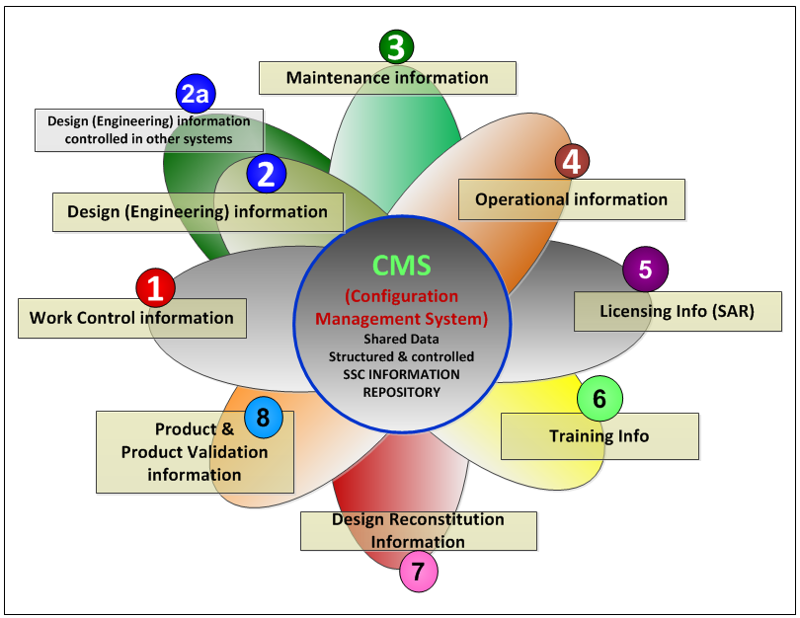
The Purpose of CM

Slide 18
Example of a CM Structure

Slide 19
Document Control
What is Document Control?
Basis for any IMS to define the hierarchy structure for document groups
Management of documents through the document life cycle to a high degree of reliability for security, version control, review cycle, visibility, availability and, most importantly, for a controlled reliable audit trail.
Technological approach to governing document quality and mitigating risk stemming from human error in document preparation.
Best achieved through process automation and electronic documentation control systems are commonly used by many organisations that produce complex, rule-based documents on a repetitive basis

Slide 20
The Purpose of Document Control
To ensure:
Documents fulfil a useful purpose and resources are not wasted on the distribution of unimportant or useless information
Only valid information is published and information is kept up to date
Information is provided in a form that can be used by the audience
Classified, confidential, or proprietary information is restricted to the people who have a real need to access it
Information is retained that could help solve a problem, improve opportunities, avoid costly errors, or deflect potential litigation

Slide 21
Document Control Procedures
The document control process put in place to support the policy should include procedures that define the development of documents
While these procedures should not be cumbersome, they should be explicit and detailed enough to provide clear direction as to how documents should be prepared, reviewed, changed, controlled, distributed, stored and archived

Slide 22
Practical Approach to Document Control
Requires an underlying philosophy and strategy
Tailored to the needs of the organisation
Should be practical
Should be explicitly documented
Have document management policy
Implement document management process

Slide 23
Conclusion
There are multiple benefits in having an IMS with CM and documentation control integrated into this system.
Configuration management and document control within an integrated management system are essential requirements for the safe operation, utilisation and modification as well as up-to-date information of any research reactor.

Slide 24
