Slide 1
Methodology on
Cyber Security for Digital I&C System in Research Reactors
ICRR 2015
Vienna, Austria
Jinsoo Shin¹, Gyunyoung Heo¹*,
Hanseong Son²
1: Kyung Hee University / 2: Joongbu University
+82-31-201-3835
* gheo@khu.ac.kr
Date
2015. 11. 16 ～ 2015. 11. 20
1

Slide 2
Layout
Methodology on Cyber Security for Digital I&C System in Research Reactors
2015.11.18
Introduction
Methodology on Cyber Security
  Event Tree Analysis
  Cyber Security Evaluation Model using Bayesian Belief Network
Conclusions
2

Slide 3
Goal
Methodology on Cyber Security
for Digital I&C System in Research Reactors
Research Goal
Proposing the methodology for cyber security risk evaluation
with Event Tree (ET) and Bayesian Belief Network (BBN) model
▶ ET model
Systematic analysis for hazard scenarios under cyber-attack
Deduction of critical digital asset (CDA) for research reactors
▶ BBN model
I&C architecture modeling (ex. Reactor Protection System) to be merged with ET models
Quantification from Qualitative values
3

Slide 4
Introduction
Methodology on Cyber Security
for Digital I&C System in Research Reactors
Introduction
Cyber Security
Insufficiency of Activity-Quality
Attack to
vulnerability of
architecture
4

Slide 5
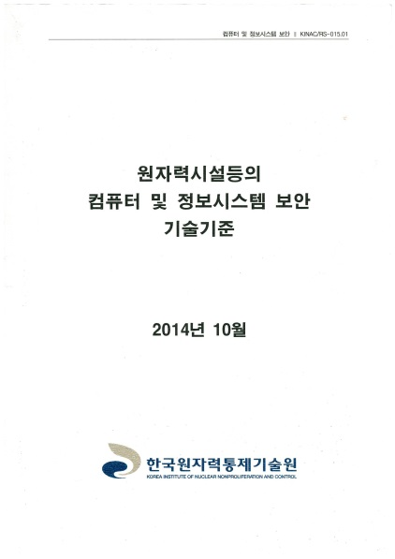
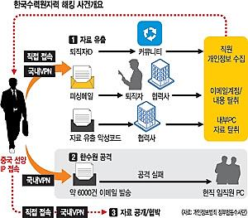
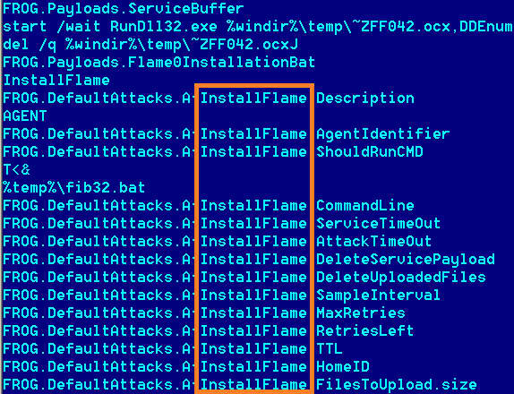
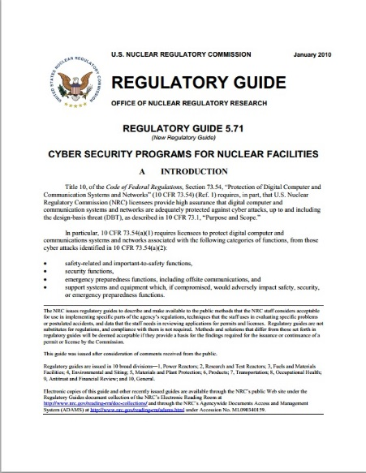
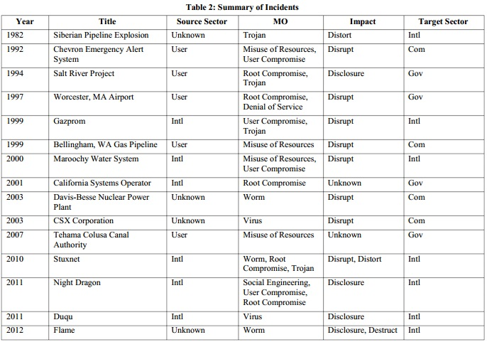
Introduction
Methodology on Cyber Security
for Digital I&C System in Research Reactors
Issues
Cyber Security
  Cyber Security
Insufficiency of Activity-Quality
Attack to
vulnerability of
architecture
5

Slide 6
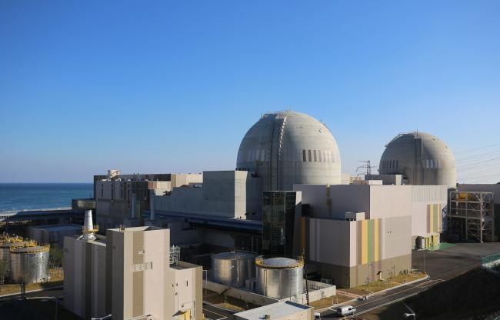

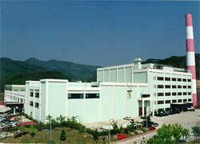

Introduction
Methodology on Cyber Security
for Digital I&C System in Research Reactors
Cyber Security for Research Reactors
Cyber Security
  I&C
  One Goal : Power Production
  Access
  User (Operator)
  Multi-Goals : Neutron Beam, Irradiation Test…
  Access
  Users
6

Slide 7
Introduction
Methodology on Cyber Security
for Digital I&C System in Research Reactors
Cyber Security for Research Reactors
Cyber Security
  I&C
  One Goal : Power Production
  Access
  User (Operator)
  Multi-Goals : Neutron Beam, Irradiation Test…
  Threat
  Access
  Threat
  Threat
  Users
6

Slide 8
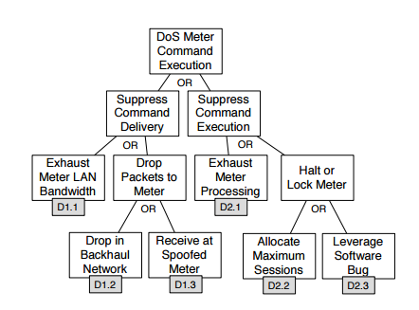
Methodology on Cyber Security
Methodology on Cyber Security
for Digital I&C System in Research Reactors
Event Tree Analysis for Research Reactors
Definition of Cyber Threat for Digital I&C System in Research Reactors
  Attack-Tree
  Test-Bed example
7

Slide 9
Methodology on Cyber Security
Methodology on Cyber Security
for Digital I&C System in Research Reactors
Event Tree Analysis for Research Reactors
Definition of Cyber Threat for Digital I&C System in Research Reactors
  Attack-Tree
  Test-Bed example
  Systematic?
  Scope?
7

Slide 10
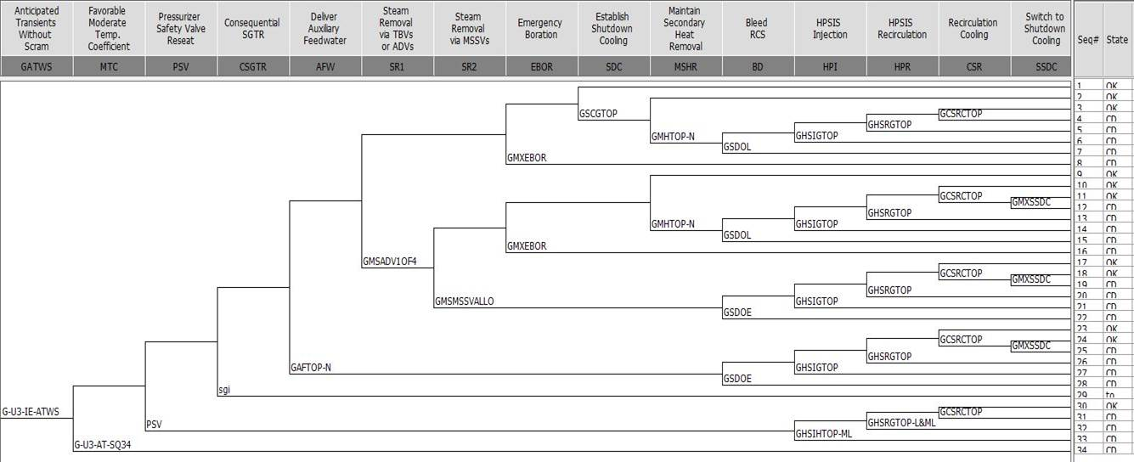
Methodology on Cyber Security
Methodology on Cyber Security
for Digital I&C System in Research Reactors
Event Tree Analysis for Research Reactors
Event Tree Analysis to identify Design Basis Accident (DBA) for cyber security
8

Slide 11
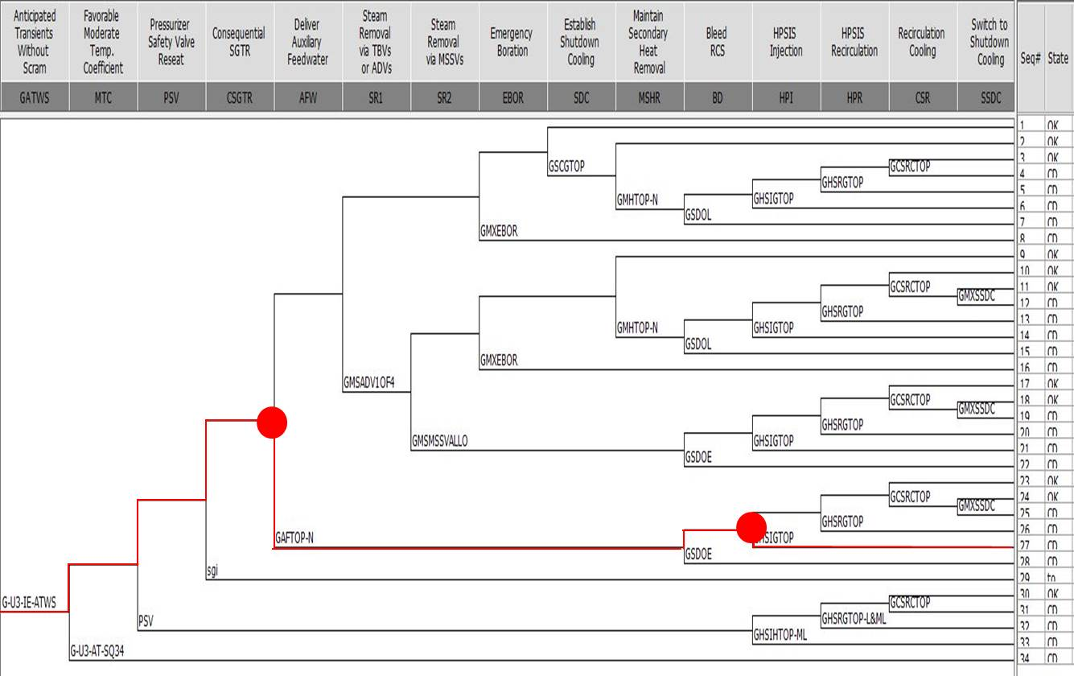
Methodology on Cyber Security
Methodology on Cyber Security
for Digital I&C System in Research Reactors
Event Tree Analysis for Research Reactors
Event Tree Analysis to identify Design Basis Accident (DBA) for cyber security
8

Slide 12
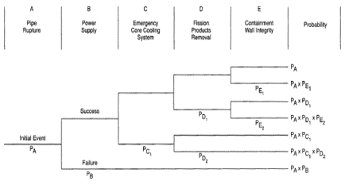
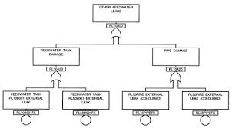
Methodology on Cyber Security
Methodology on Cyber Security
for Digital I&C System in Research Reactors
Existing Safety Assessment Methodologies
Probabilistic Safety Assessment (PSA)
Event Tree
Fault Tree
9

Slide 13
Methodology on Cyber Security
Methodology on Cyber Security
for Digital I&C System in Research Reactors
Existing Safety Assessment Methodologies
Probabilistic Safety Assessment (PSA)
Event Tree
Fault Tree
9

Slide 14
Methodology on Cyber Security
Methodology on Cyber Security
for Digital I&C System in Research Reactors
BBN Cyber Security Evaluation Model
Flowchart of BBN Model for Research Reactors
Activity-quality
Architecture
Check list
Mitigation Measure
Vulnerability
Qualitative Analysis
Vulnerability risk
  Reasons for using BBN
  → Modeling complex dependencies with ease
  → Use of prior & posterior information
  → Use of both quantitative
  & qualitative information
Architecture
Final Risk
Quantitative Analysis
10

Slide 15
Methodology on Cyber Security
Methodology on Cyber Security
for Digital I&C System in Research Reactors
BBN Cyber Security Evaluation Model
Qualitative and Quantitative Analysis
Check list
Mitigation Measure
Qualitative Analysis
Quantitative Analysis
Evaluating the quantitative analysis of mitigation measure through the evaluation of the check list
Need to convert from qualitative analysis to quantitative analysis
  Words of estimative probability
  Assignment of node probability table value according to connection strength between node and node (using KAERI/TR-2668/2004 )
11

Slide 16
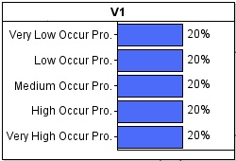
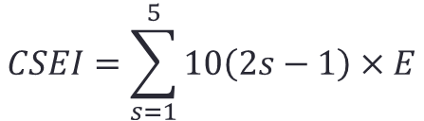
Methodology on Cyber Security
Methodology on Cyber Security
for Digital I&C System in Research Reactors
BBN Cyber Security Evaluation Model
Cyber Security Evaluation Index (CSEI)
How compliant with regulatory guides (From 10 to 90)
Goodness of cyber-attack occurrences or the completeness of mitigation measures
Where,
- s is a numeric value of each node
- E is a percentage ratio of evaluation for each node
$$CSEI=\sum_{s=1}^{5}{10\left(2s−1\right)×E}$$
Activity-quality model
Architecture model
Numeric value of Stage | Mean (Compliance)
5 | Very Well
4 | Well
3 | So so
2 | Bad
1 | Very Bad
Numeric value of Stage | Mean (Attack Occurrence)
5 | Very Low
4 | Low
3 | Medium
2 | High
1 | Very High
12

Slide 17
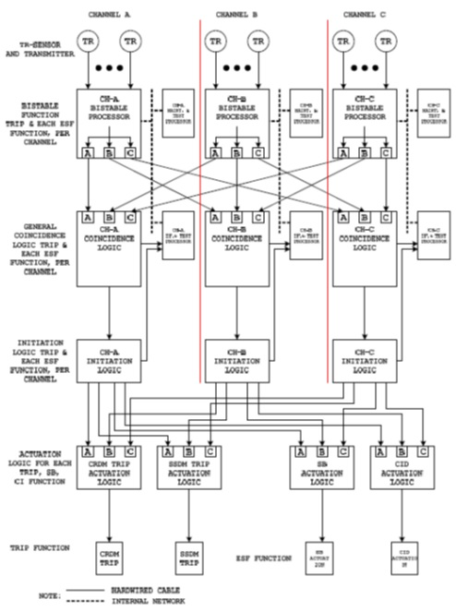
Methodology on Cyber Security
Methodology on Cyber Security
for Digital I&C System in Research Reactors
BBN Cyber Security Evaluation Model
BBN Model for Reactor Protection System in Research Reactors
13

Slide 18
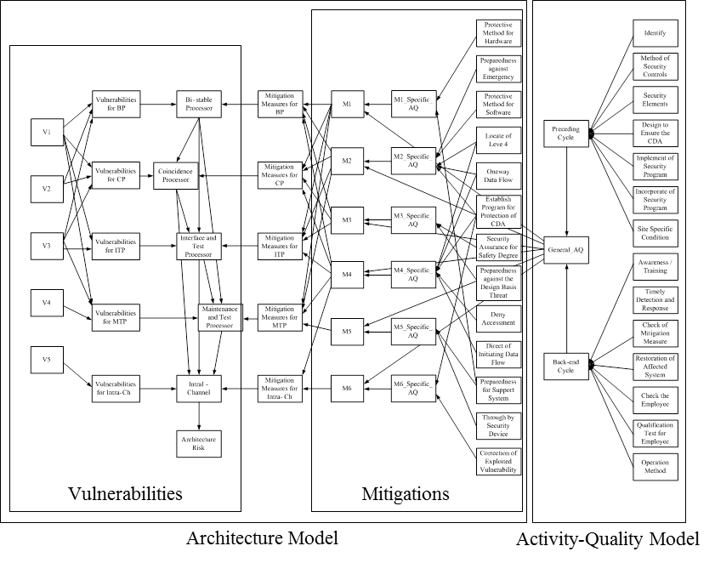
Methodology on Cyber Security
Methodology on Cyber Security
for Digital I&C System in Research Reactors
BBN Cyber Security Evaluation Model
BBN Model for Reactor Protection System in Research Reactors
13

Slide 19
Methodology on Cyber Security
Methodology on Cyber Security
for Digital I&C System in Research Reactors
BBN Cyber Security Evaluation Model
Analysis Process with the BBN Model
Model Buildup
Model Applications
14

Slide 20
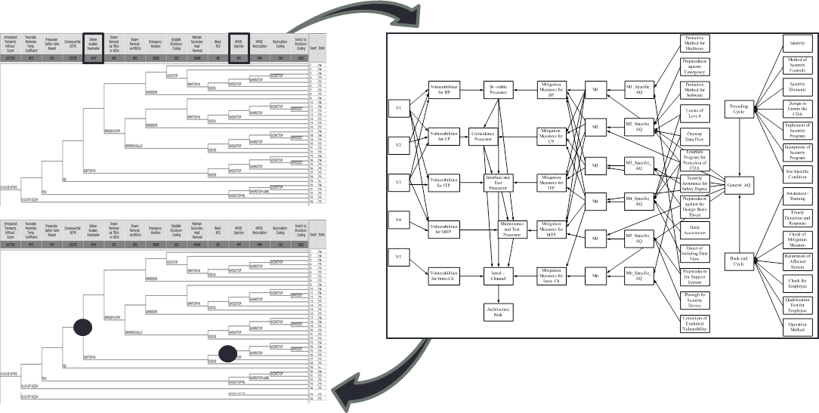
Methodology on Cyber Security
Methodology on Cyber Security
for Digital I&C System in Research Reactors
Methodology on Cyber Security for Research Reactors
Cyber Security Evaluation with ET and BBN model
15

Slide 21
▶▶ Cyber Security Risk Evaluation for Research Reactors
→ It is difficult to quantify and standardize all potential situations
→ We proposed the methodology with ET and BBN models
→ ET model can help to identify the issues (point of interests) for cyber security
→ BBN model can facilitate to develop activity-quality as well as architecture of RPS from the viewpoint of cyber security
Conclusions
Methodology on Cyber Security
for Digital I&C System in Research Reactors
Conclusions
16

