Slide 1
IAEA International Conference
16-20 November 2015
Neutron Imaging in Science and Technology
Nikolay Kardjilov, André Hilger, Ingo Manke, John Banhart

Slide 2
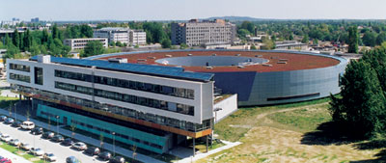
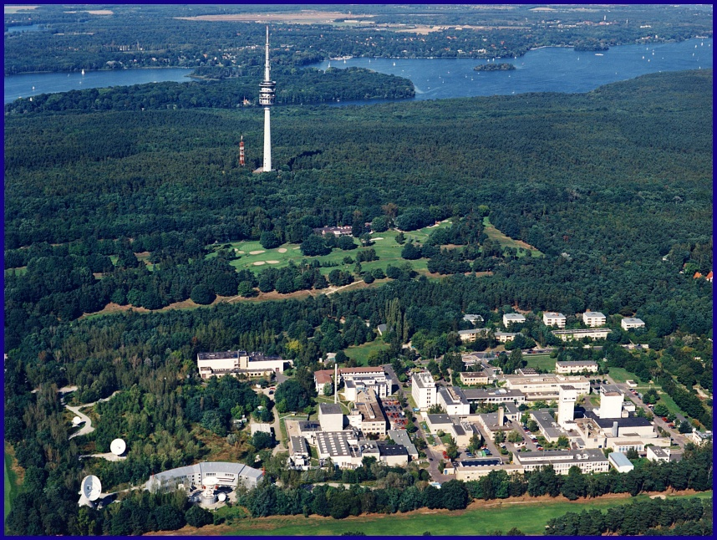

Introduction
BESSY II
20 km
BER II
2

Slide 3
User service at HZB
The continued development of unique instruments is a major focus of the HZB.
Every year, HZB’s user service enables some 2,500 external scientists (from 35 countries to date) to access measuring methods, which in some cases are quite unique.
The aim is to further the complementary use of neutrons and photons to gain a more complete picture of matter.

Slide 4
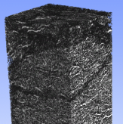
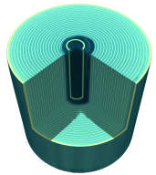
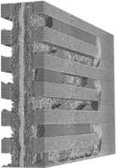
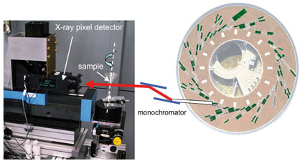
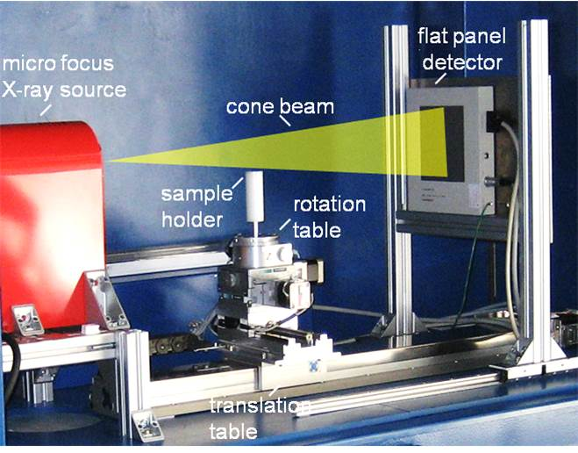

Introduction
Institute of Applied Materials
BAM-Line @ BESSY
Synchrotron tomography
Neutron
Imaging
Micro CT Synchrotron
n
x
CONRAD-2
neutron tomography
MicroCT Lab
X-ray tomography
3D-Analytics Lab

Slide 5
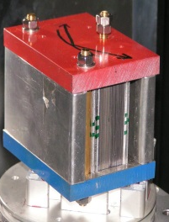
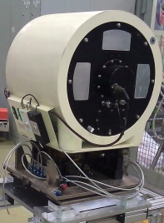
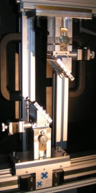
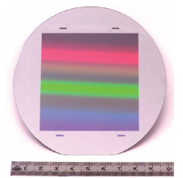
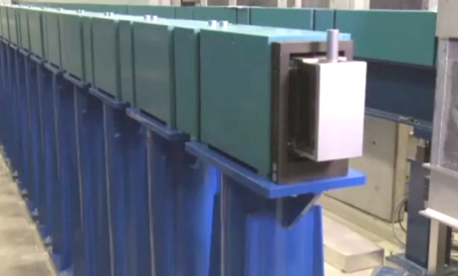
CONRAD-2
Cold neutrons
Labs
Micro-CT Lab
3D Data Analytics Lab
Wavelength range: 1.5 Å – 10 Å
Large beam
Beam size: 20 cm x 20 cm
Instrumentation
High flux
Neutron polarizers
Velocity selector
Double-crystal monochromator
Grating interferometry
Flux (guide end): 2.7x10⁹ n/cm²s

Slide 6
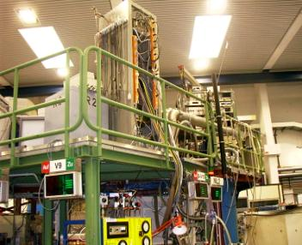
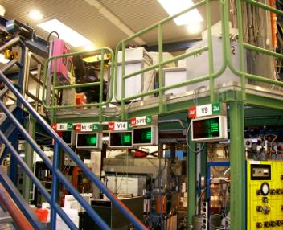
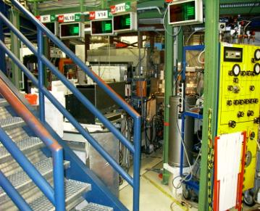
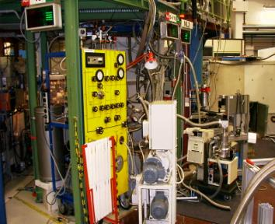
History
2003

Slide 7
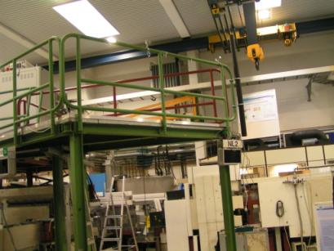
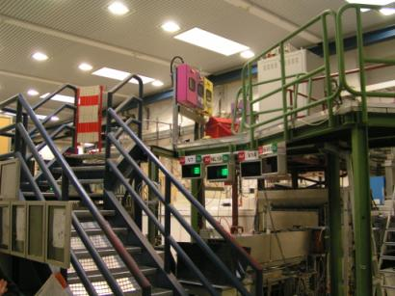
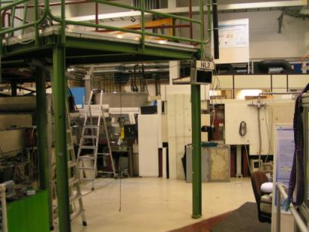
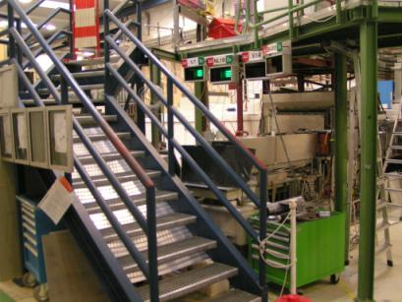
History
2005

Slide 8
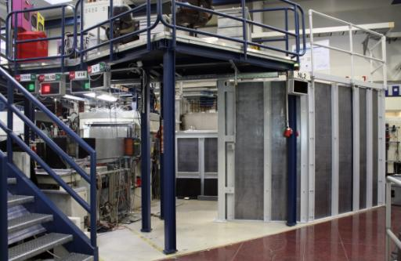
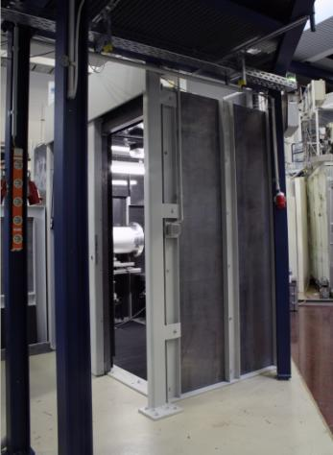
History
CONRAD at HZB
Design phase: 2003 – 2004
Construction phase: 2004 – 2005
Operation: July 2005 – Nov. 2010
Total investment: 250 k€
(shielding + equipment)

Slide 9
Upgrade
V7 CONRAD
Beam size: 10 cm x 10 cm
Neutron flux: 10⁷ n/cm²s
Maximal sample size: 20 cm
V7 CONRAD (Upgrade program)
longer beam path
better neutron guide
larger curvature of the neutron guide
Gain
Beam size: 20 cm x 20 cm (x4.0)
Neutron flux: 2x10⁷ n/cm²s (x2.0)
Maximal sample size: 50 cm (x2.5)

Slide 10
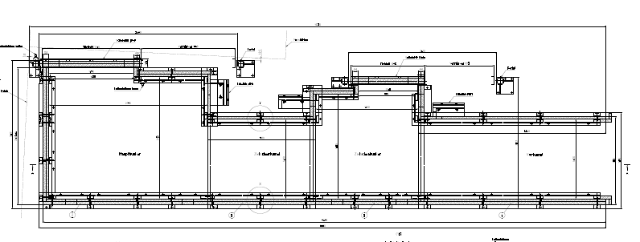
Design
Top view
2.6 m
10 m
Sandwich type shielding based on 5 mm B₄C and 5-10 cm Pb.

Slide 11
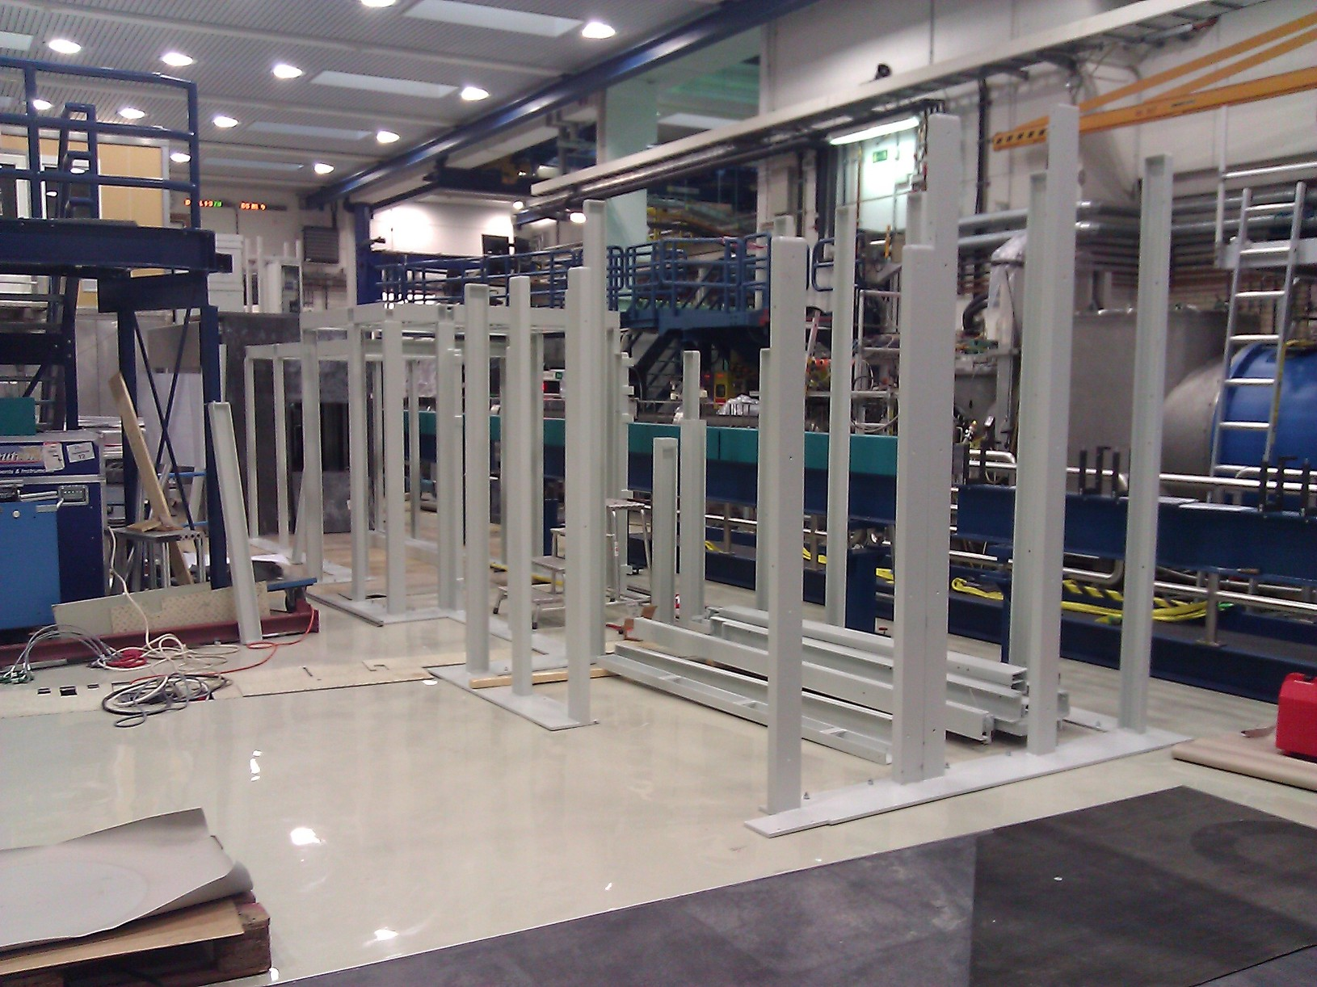
Construction

Slide 12
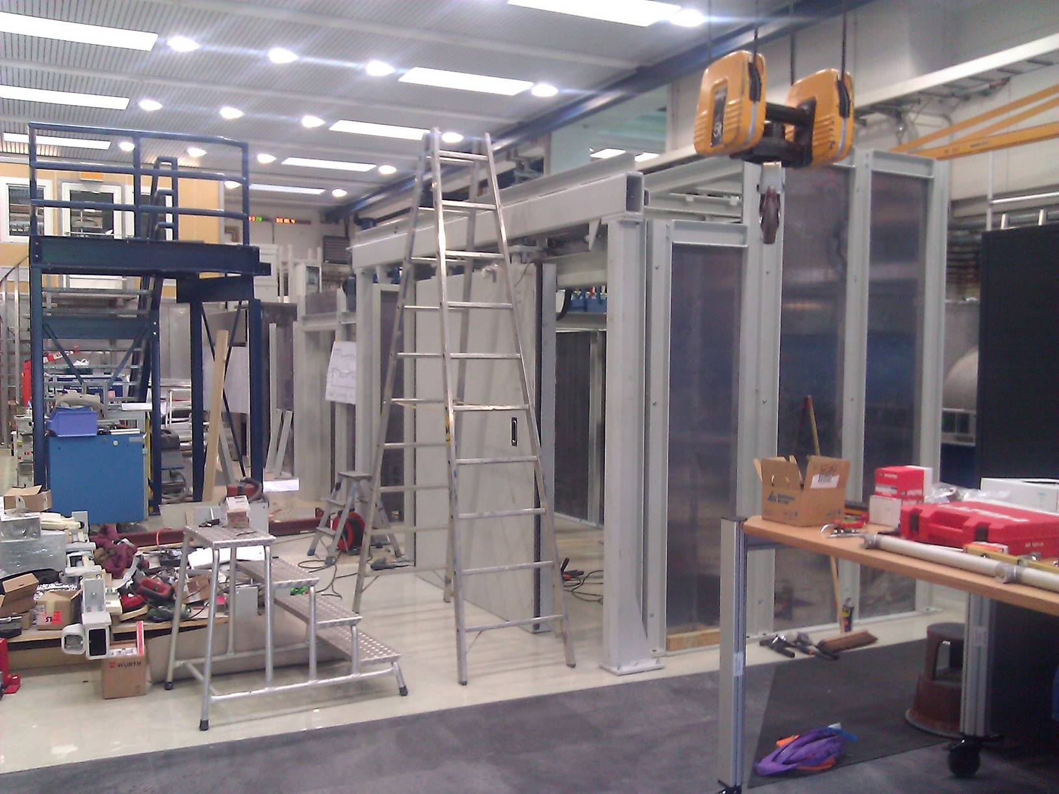
Construction

Slide 13
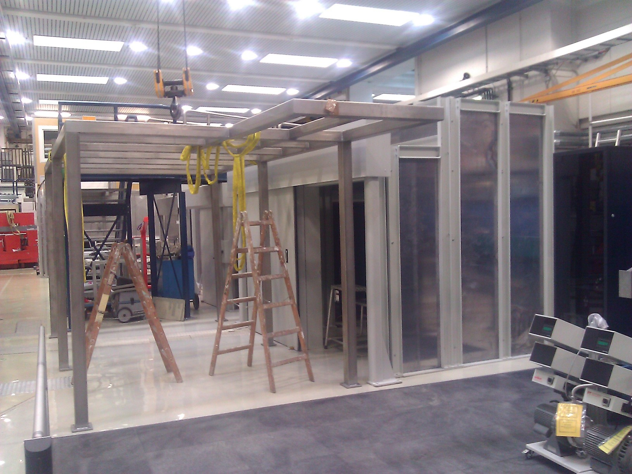
Construction

Slide 14
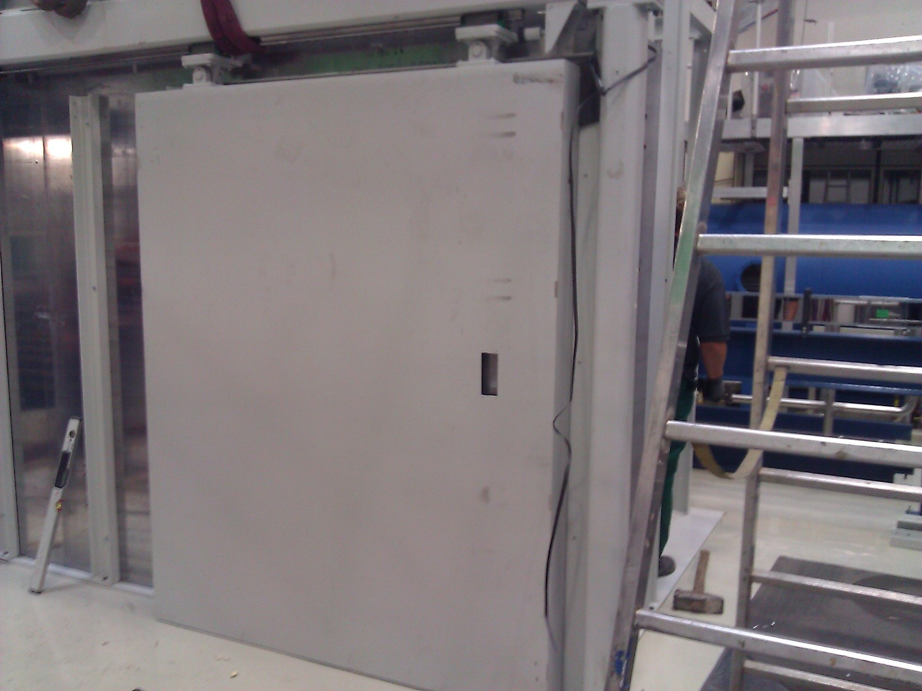
Construction

Slide 15
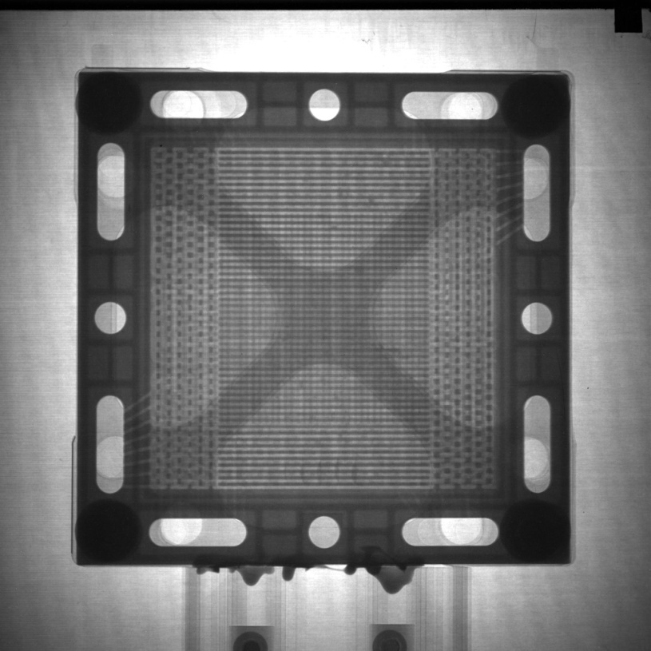
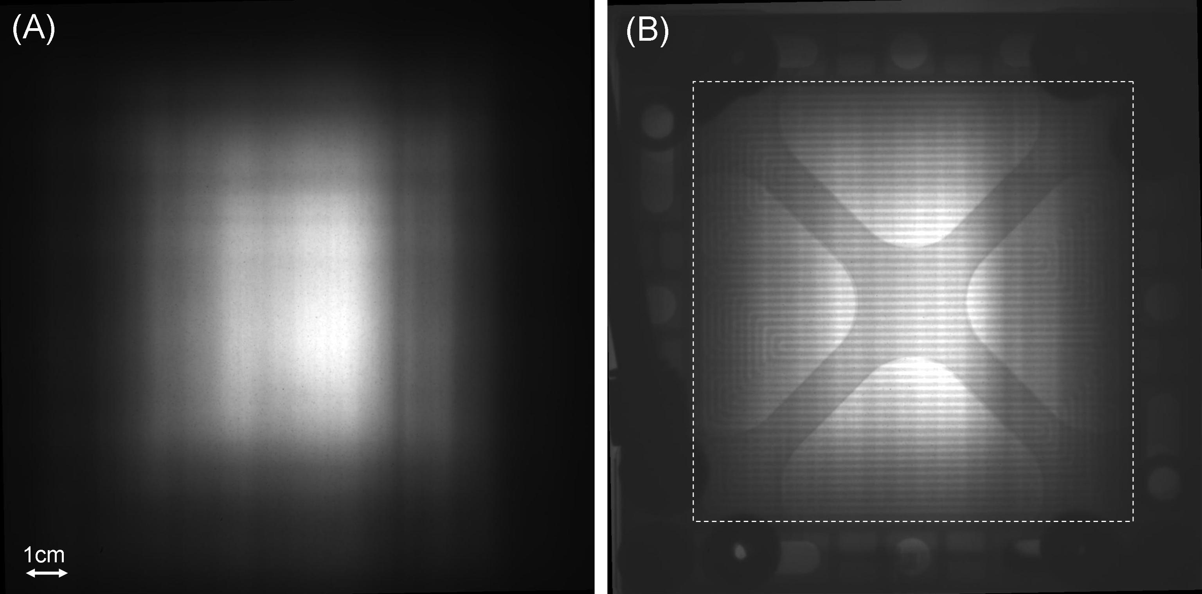
Larger beam
Before
After Upgrade
Intensity at the end of the guide:
Before upgrade: 2.0x10⁸ n/cm²s
After upgrade: 2.7x10⁹ n/cm²s

Slide 16
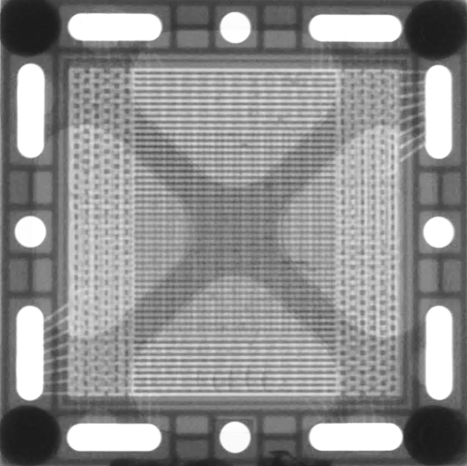
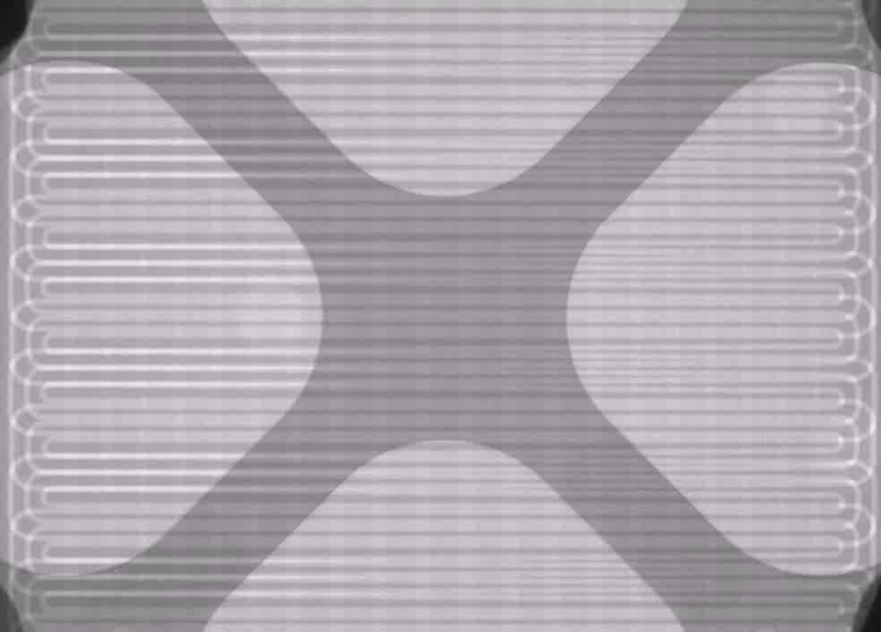
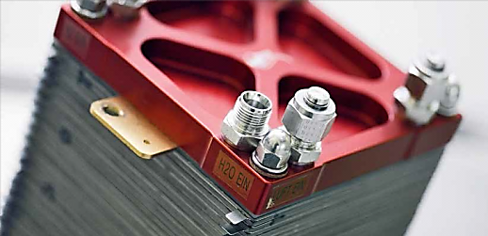

Attenuation Contrast
Fuel cells
  How to optimize water management in a PEM fuel cell?
Neutron Imaging @ V7(CONRAD-2)
In-operando visualization of water distribution
Quantification of water amount
Diffusion dynamics revealed with
D-H contrast
10 mm
1 mm
  Diffusion dynamics revealed with D-H contrast
  Understanding of ageing mechanisms
  M. Klages Journal of Power Sources 239 (2013) 596

Slide 17


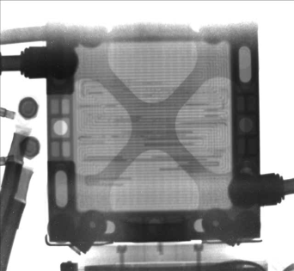
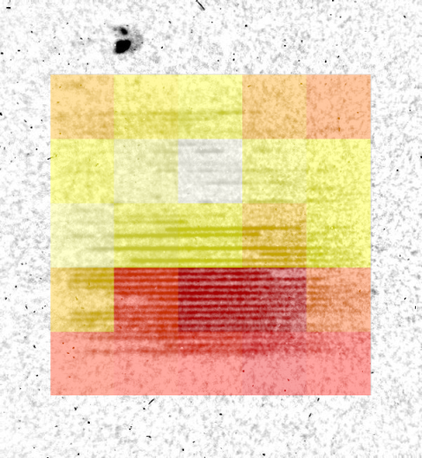
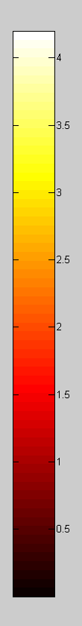
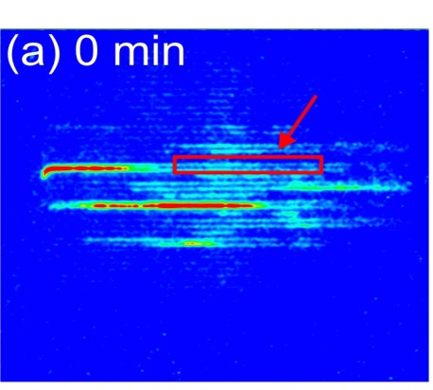


Attenuation Contrast
Fuel cells
Current density
(A/cm²)
H₂/D₂ contrast radiography
water thickness
1.0
0.5
0.0
1 cm
15 cm
I. Manke et al, APL 92,
(2008)
A.Schröder et al, Electrochem Commun (2009)
A. Schröder et al, J Power Sources 195 (2010)
C. Tötzke et al, J Power Sources 196 (2011),
A. Lange et al, J Power Sources 196 (2011)
R. Kuhn et al, Int J Hydrogen Energy 37 (2012)
H. Markötter et al, J Power Sources 219 (2012)

Slide 18
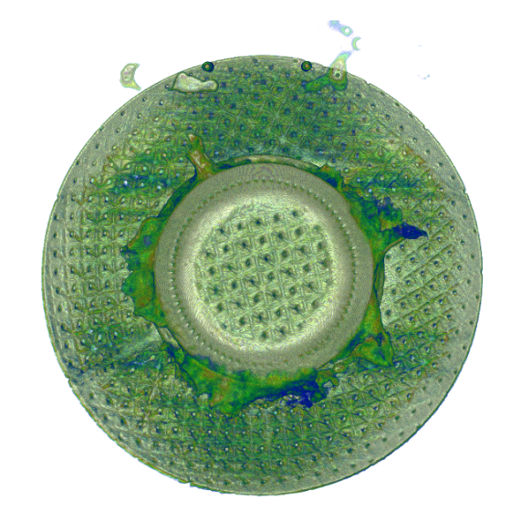
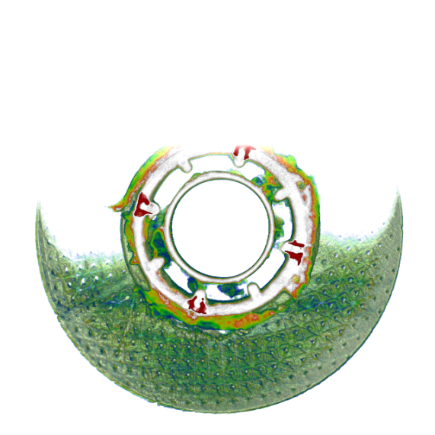
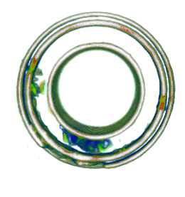
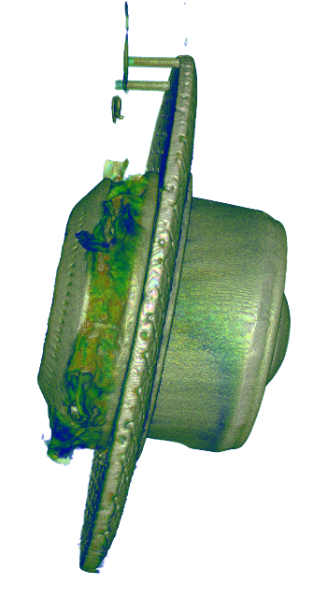
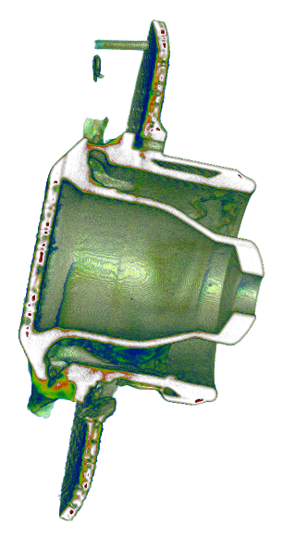
Attenuation Contrast
Combustion chamber
Time scale
1 – old sediments
3 – fresh sediments
2
2
2
2+3
1+2
1
volume histogram
low
absorption
medium
absorption
(metal)
high
abs.
1
2
3
2+3
1+2

Slide 19
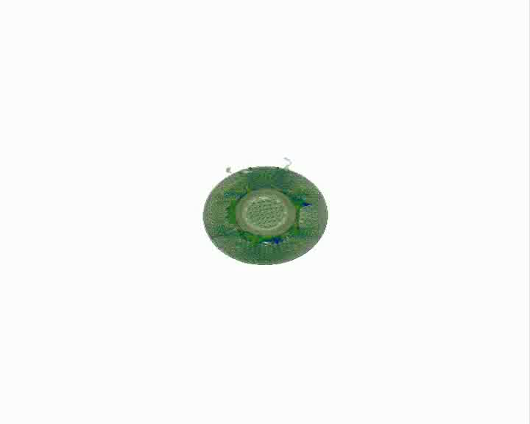

Slide 20
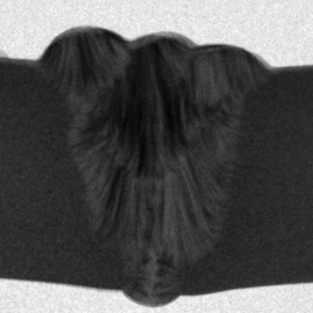
Diffraction Contrast
λ = 4.0 Å
1 cm

Slide 21
Bragg edges
Diffraction Contrast
Bragg‘s law
polychromatic
neutron beam
polycrystalline
material
2d_{hkl}sinθ=λ
λ
d_{hkl}
DCM

Slide 22
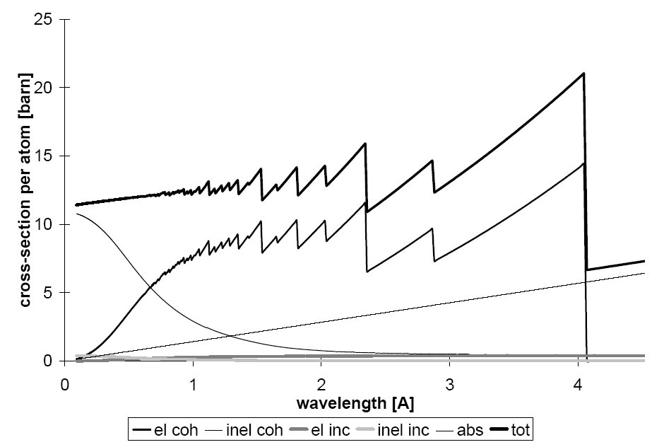
Diffraction Contrast
Bragg edges
Bragg‘s law
polychromatic
neutron beam
polycrystalline
material
2d_{hkl}sin90°=λ
λ
d_{hkl}
DCM
Cross-sections of iron per atom
2d_{hkl}=λ
(110)

Slide 23

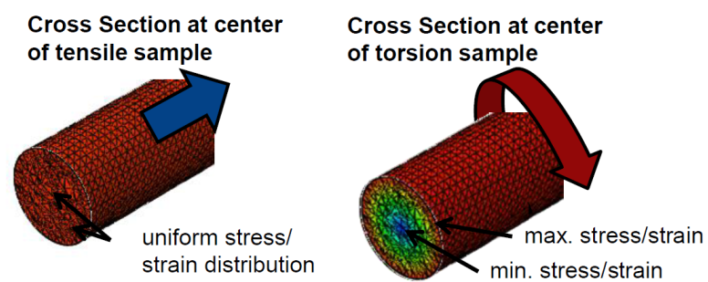
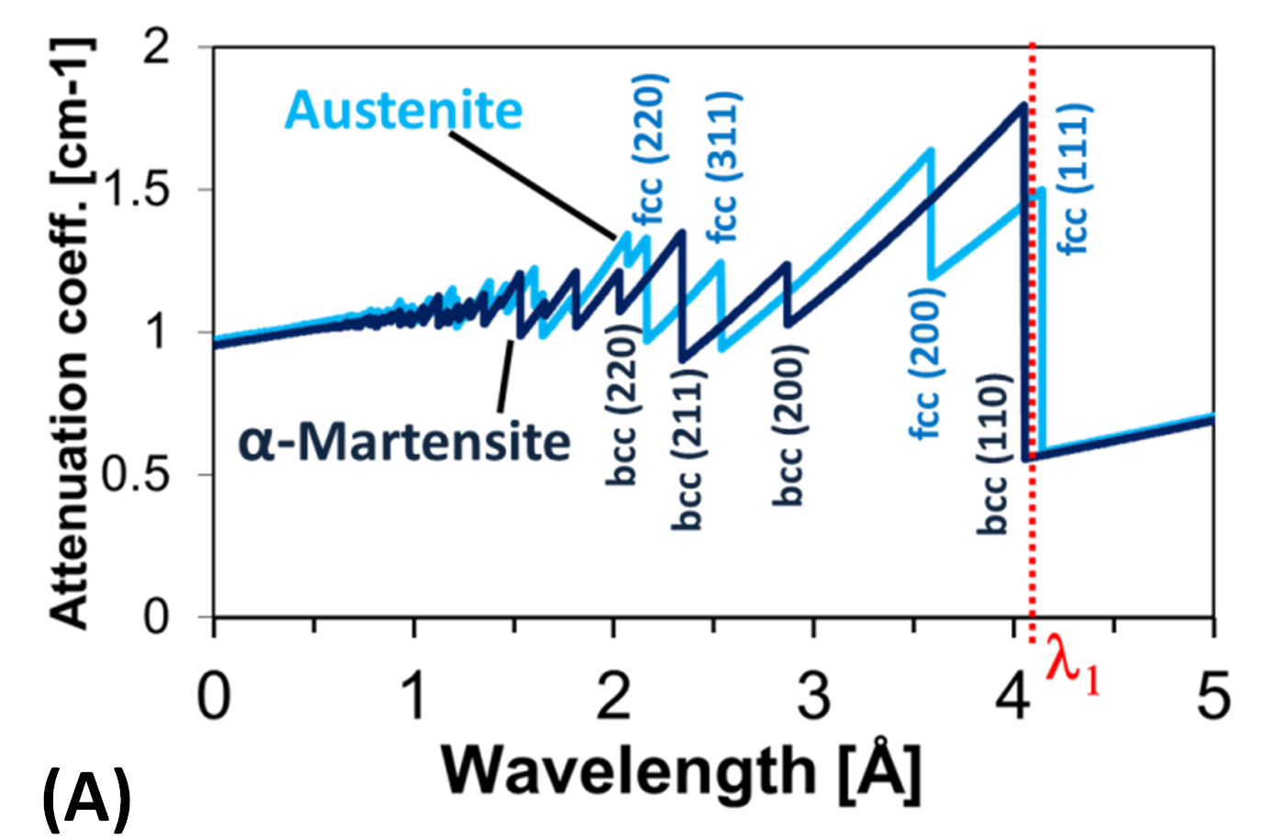
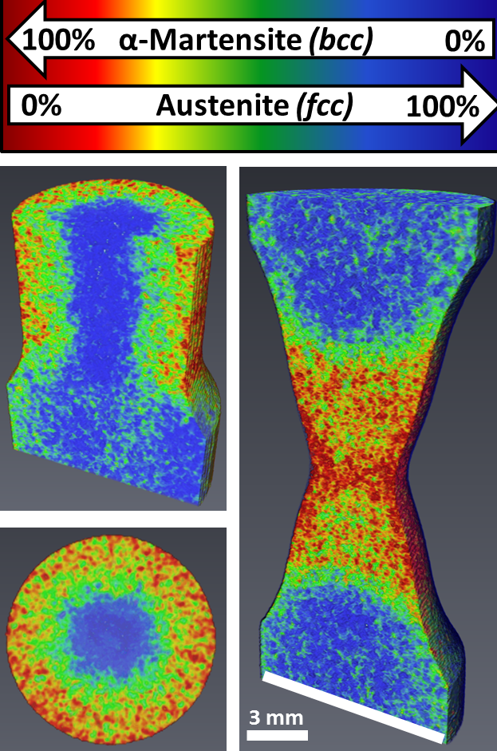
3D Phase mapping in metals
Energy-selective neutron tomography of TRIP-steel
R. Woracek et al., Advanced Materials 26 (2014)

Slide 24
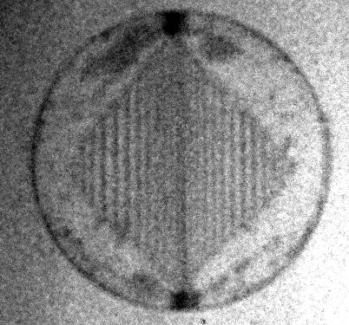
Phase/Dark-field Contrast
2 mm

Slide 25
Phase/Dark-field Contrast
The spatially resolved analysis of the interference pattern (phase, amplitude and offset) reveal information about phase effects, small angle scattering and attenuation introduced by the sample.
C. Grünzweig et al, PRL (2008)

Slide 26
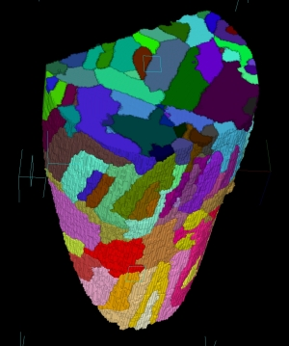
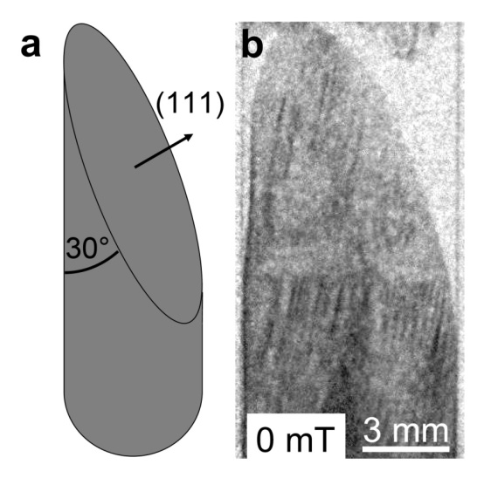


Phase/Dark-field Contrast
Source
grating
Phase
grating
Analyser
grating
Detector
Multiple refractions at the domain walls results in local degradation of the beam coherence (decrease of the amplitude in the interference pattern).
Sample
Neutrons
G₀
G₁ G₂
x_{G}
Magnetic domains in a bulky FeSi single crystal
3D domain distribution
Magnetic domain structure can be visualized in 3D by applying tomographic reconstruction from 2D angular projections
I. Manke et al, Nature Communications (2010)

Slide 27

Magnetic Contrast
1 cm

Slide 28
Magnetic Contrast
Principle
Experimental parameters
Solid state polarazing benders
Beam size (WxH): 20 x 4 cm²
Exposure times: ~10 min / image
1 cm
N. Kardjilov, et al, Nature Physics (2008)

Slide 29





Magnetic Contrast
Flux pinning in superconductors
Pb cylinder
(polycrystalline)
T
7.2 K
7.196 K (T_{c})
7.0 K
7.0 K
6.9 K
6.8 K
1 cm
trapped flux
Flux pinning at cooling down below Tc while applying a homogenous magnetic field of 10 mT perpendicular to the beam.
The images were recorded after switching off the magnetic field.

Slide 30

Magnetic Contrast
Flux pinning in superconductors
Pb cylinder
(polycrystalline)
T
7.2 K
7.196 K (T_{c})
7.0 K
7.0 K
6.9 K
6.8 K
1 cm
trapped flux
Flux pinning at cooling down below Tc while applying a homogenous magnetic field of 10 mT perpendicular to the beam.
The images were recorded after switching off the magnetic field.

Slide 31

Spatial Resolution

Slide 32

Spatial Resolution
Introduction
Standard setup (2006)
Detector system
Scintillator: 200 µm 6LiF
Lens system: 50 mm
Pixel size: 100 µm
Exposure time: 20 s
500
400
300
200
100
µm

Slide 33

Spatial Resolution
Camera: Andor DW436
Lens system: Magnification
Pixelsize = 3.375 µm
Szintillator: 5 µm Gadox
Resolution: 7.9 µm (63.2 lp/mm)
2 mm
S. H. Williams et al,
Journal of Instrumentation (2012)

Slide 34



Spatial Resolution
Neutron tomography
Hydrogen storage (MHGC Ti-Mn)
(L. Röntzsch, IFAM, Dresden, Germany)
50 µm
1 mm
Resolution: 15 µm (pixel size: 6.5 µm), FOV: 13 x 13 mm², Exp. Time: 20 s

Slide 35

Spatial Resolution
Hydrogen loading of duplex stainless steel
(A. Griesche, BAM, Berlin, Germany)
H₂ (~ 100 ppm)
5 mm
Electrochemically loading
A. Griesche et al., Acta Materialia 78 (2014)

Slide 36
Conclusions
Over the last 10 years, significant developmental work has been performed to expand the radiographic and tomographic capabilities of the neutron imaging facility at HZB.
New techniques have been implemented, including imaging with polarized neutrons, Bragg-edge mapping, high-resolution neutron imaging and grating interferometry.
These methods have been provided to the user community as tools to help addressing scientific problems over a broad range of topics such as superconductivity, materials research, life sciences, cultural heritage, paleontology and various others.

Slide 37
Thank you!

