Slide 1
The Application of a Graded Approach in the Regulation of Research Reactors at the U.S. Nuclear Regulatory Commission
November 19, 2015
Alexander Adams, Jr.
Chief
Research and Test Reactors Licensing Branch

Slide 2
Overview
Introduction
Reactor categorization
Atomic Energy Act
Graded approach in the licensing process
Graded approach in technical requirements
Graded approach in security
Graded approach in inspection
Graded approach in other aspects of regulation

Slide 3
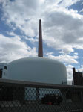
Graded Approach
Equate degree of scrutiny in the
regulatory process to the safety
significance of the reactor design
As risk increases the regulatory process
becomes more stringent
IAEA SSG-22, “Use of a Graded Approach in the
Application of the Safety Requirements for
Research Reactors” contains specific details

Slide 4
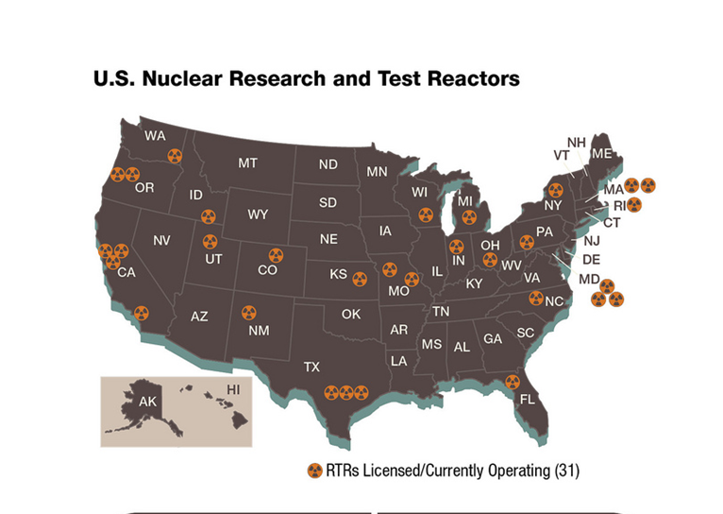
U.S. Research and Test Reactors
31 operating reactors
- Power range 5 watts to
20 MW
- Five are 2 MW or greater
- Reactor types
16 TRIGA
9 plate-type fuel
3 AGNs
3 one-of-a-kind (PULSTAR, Argonaut,
critical assembly)

Slide 5
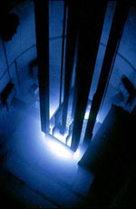
Reactor Categorization
Reactor type
- Research reactor
- Test reactor
- Power reactor
Reactor power
- Low-power research reactor
- High-power research reactor
- Test reactor
Reactor purpose
- Research and development
- Commercial activities

Slide 6
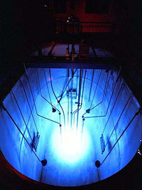
Reactor Categorization
Low-power research reactor
- Less than 2 MW(t)
- Low decay heat generation
- Core can be air-cooled in case
of loss of coolant accident
- Limited fission product inventory

Slide 7
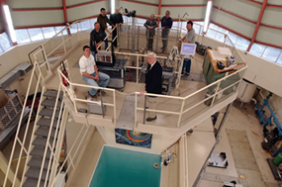
Reactor Categorization
High-power research reactor
- 2 MW(t) to 10 MW(t)
- Decay heat removal may need
emergency core cooling system
- Increase in fission product inventory over low-
power research reactors
- Accidents consider fuel plate melt

Slide 8
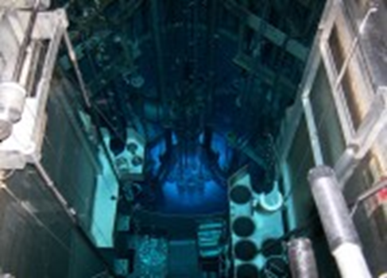
Reactor Categorization
Test reactor
- Greater than 10 MW(t)
- Greater than 1 MW(t) with:
Circulating loop through core for fuel
experiments
Liquid fuel loading
In-core experimental facility in excess of
16 in² in cross section

Slide 9
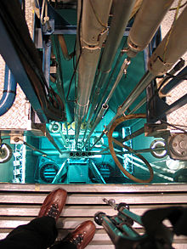
Reactor Categorization
Reactors used for research and
development
- Theoretical analysis, exploration,
or experimentation
- Extension of investigative findings and
theories of a scientific or technical nature
into practical application for experimental
and demonstration purposes

Slide 10
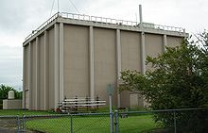
Reactor Categorization
Commercial research reactor
- More than 50 percent of the
annual cost of owning and operating
the facility is devoted to items for sale or
commercial distribution or service other than
research and development or education or
training

Slide 11
Atomic Energy Act
Commission is directed to impose only such minimum amount of regulation of the licensee as the Commission finds will permit the Commission to fulfill its obligations under this Act to promote the common defense and security and to protect the health and safety of the public and will permit the conduct of widespread and diverse research and development

Slide 12
Graded Approach in the Licensing Process
The licensing process gets more complex as the risk of a facility increases
- Mandatory hearings for test reactor and
commercial facility construction permits
- Advisory Committee on Reactor Safeguards
review for construction permits and
operating licenses for test reactor and
commercial facilities

Slide 13
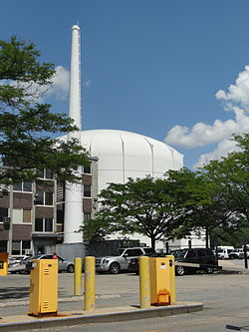
Graded Approach in the Licensing Process
License renewal process gets more
rigorous as facility risk increases
- 2 MW and greater or facilities seeking a
power increase undergo full review using
NUREG-1537
- Less than 2 MW undergo streamlined review
than focuses on reactor, radiation protection,
accidents and technical specifications

Slide 14
Graded Approach in the Licensing Process
Future license renewal proposed rule
- Non-expiring license for non-commercial
research reactors (SAR update every five
years)
- Streamlined review for commercial facilities
and test reactors (review of changes to
facility)

Slide 15
Graded Approach in Technical Requirements
Technical requirements increase as the risk of a
facility increases
- Design criteria
- Bounding fission product release
- Emergency planning
- Reactor siting
- Environmental requirements

Slide 16
Graded Approach in Technical Requirements
Design requirements
- Power reactors – General Design
Requirements for Nuclear Power Plants
- Research and test reactors – Maintaining
radiation doses within acceptable limits
- Guidance in NUREG-1537 – Guidelines for
Preparing and Reviewing Applications for
the Licensing of Non-Power Reactors

Slide 17
Graded Approach in Technical Requirements
Bounding fission product release – maximum
hypothetical accident
- low-power plate reactors – strip plate from
specified fraction of fuel plates
- high-power plate reactors – melt a specified
fraction of fuel plates
- TRIGA – loss of clad in air of maximum fission
inventory fuel pin

Slide 18
Graded Approach in Technical Requirements
Emergency planning regulations – potential
radiological hazards associated with research reactors
different than power reactors
- Emergency planning zone power level dependent
- Categorization by power level - up to 100 W, 100 W to
less than 100 kW, 100 kW to less than 2 MW, greater
than 2 MW
- 100 W reactors do not need emergency organization
that can operate around the clock for a long time

Slide 19
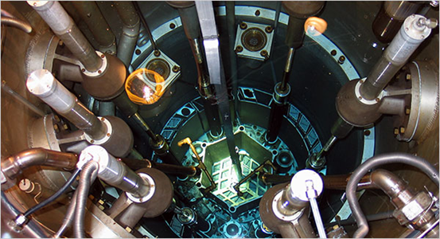
Graded Approach in Technical Requirements
Reactor siting
- Power reactors and test reactors -
10 CFR Part 100 – specific siting regulations
- Research reactors – no specific siting
regulations – currently no accident release
limits, doses limited to 10 CFR Part 20

Slide 20
Graded Approach in Technical Requirements
Environmental regulations
- Test reactors – environmental impact
statement for construction permit,
operating license, or renewal
- Research reactors – environmental
assessment

Slide 21
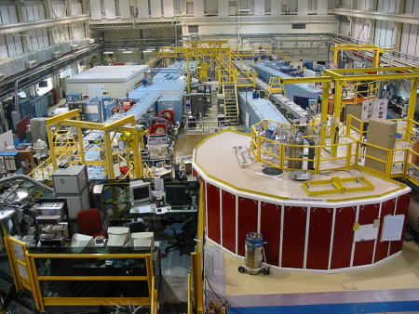
Graded Approach in Security
Regulatory approach based
on type and amount of
material possessed
- Formula quantity, 5000
grams or more high enriched uranium (HEU)
- Moderate strategic significance, more than 1000
grams HEU up to 5000 grams
- Low strategic significance, more than 15 grams
HEU up to 1000 grams

Slide 22
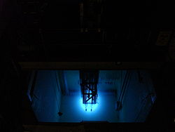
Graded Approach in Inspection
Inspection effort increases
with increasing risk
- Reactors are divided into 3
classes for inspections:
Class 1 – 2 MW and greater
Class 2 – less then 2 MW
Class 3 – permanently shut down

Slide 23
Graded Approach in Inspection
Scope of inspection similar
for class 1 and 2
Depth of inspection increases
with power
Class 1 reactors 2 week on site per year
Class 2 reactors 1 week on site per year
Class 3 reactors on site in response to
activities or 1 week every 3 years

Slide 24
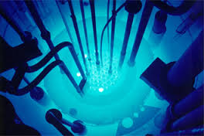
Other Applications of a Graded Approach
Financial protection
- 10 kW or less, $1 M
- 10 kW to 1 MW, $1.5 M
- More than 1 MW to 10 MW (research
reactors only), $2.5 M

Slide 25
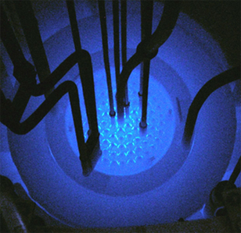
Other Applications of a Graded Approach
Base civil penalties
- Research reactor, $7000
- Test reactor, $14,000
- Power reactor, $140,000
Fees for 2015
- Research and test reactors, $83,500
- Power reactor, $5,030,000

Slide 26
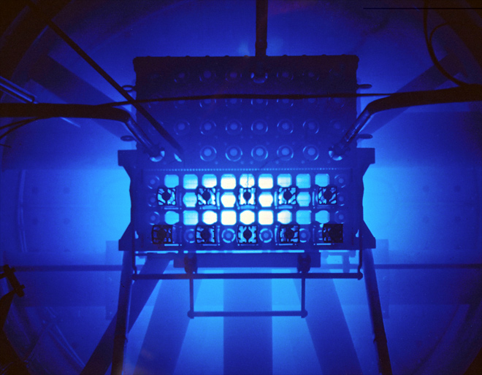
Conclusions
Graded approach starts with
the Atomic Energy Act
Graded approach has been
used from the earliest days of reactor
regulation
A graded approach is used in all aspects of NRC
regulation

