Slide 1
Safety Assessment and Up-grades at Dhruva Reactor Following Accident at Fukushima Daiichi
C.G. Karhadkar
Reactor Superintendent Dhruva
Reactor Operations Division
Reactor Group
Bhabha Atomic Research Centre
INDIA

Slide 2
Outline of Presentation
Introduction.
Review Methodology for aassessment of external events, Results & consequences.
Guide lines for Beyond Design Basis Events.
Present configuration of safety/safety related systems of Dhruva.
Review of system configuration and changes.

Slide 3
Introduction
Fukushima Daiichi was an extreme event.
Common cause resulted in three extreme conditions occurring simultaneously.
Prolonged Station Blackout.
BDB Seismic Event.
BDB Flood.
This has forced all the nuclear reactor operators to review their reactor system configuration for adequacy.

Slide 4
Introduction
A comprehensive review of system configuration of Dhruva was undertaken.
Safety up-grades have been proposed /implemented.
Improving safety margins against DBEs
Managing BDBEs.

Slide 5
Review --External Events for Coastal Site
External Flooding
Tsunami
Storm Wave/ Surge
Seismic Events

Slide 6
External Flooding
Grade level for new nuclear facilities, is based on combinations of phenomena that gives maximize water level at the facility.
For inland sites Safety Guide AERB/SG/S-6A
For Costal Sites Safety Guide AERB/SG/S-6B
For older plants it is part of Periodic Safety Reviews (PSR).
If site cannot be graded to this level, suitable engineering measures are designed so that the water level does not jeopardize the safety of the facility.
For Dhruva PSR was concluded in 2014 for its relicensing.

Slide 7
External Flooding-Coastal Site
Tsunami / Storm Surge: maximum water level is summation of:
Astronomical high tide
Wave height either due to storm or tsunami
Their respective wave run-up

Slide 8
Tsunami -Assessment-General
Submarine faults capable of generating tsunami are >800 km from the Indian coast.
Simultaneous earthquake & tsunami unlikely.
National Centre for Ocean Information Services (INCOIS) was established in Hyderabad.
Tsunami early warning system made operational.
Sumatra earthquake with magnitude 8.5 on April 11, 2012, INCOIS issued bulletin within eight minutes.

Slide 9
Tsunami –Western Coast-General
Makran subduction in southern Pakistan is seismically active.
Historical tsunamigenic earthquakes have occurred in 1765, 24th Jan 1851 and 27th Nov 1945.
Earth quake of 8.2 magnitude had occurred in 1945.
Computer codes developed & validated against observed data for assessment of threat.
National round robin exercise for evaluation of flood levels.

Slide 10
Tsunami –Western Coast-Assessment
Maximum height predicted 1.05 meters including wave run up.
Tsunami, at Mumbai after a delay of 270 minutes.
It is concluded that, extent of flooding due to tsunami is well below the present Design Basis Flood Level (DBFL).

Slide 11
Storm Wave/Surge-Assessment
Central Water & Power Research Station (CWPRS), Pune.
Storm tracks and synoptic charts for 115 years (1891-2005) referred for hind casting of Wave /Surge for Mumbai coast.
Extreme value analysis storm wave.
Extreme value analysis storm surge.
Greater of two with return period of 1000 years was adopted.
Predicted storm surge 2.3 m.
Higher than tsunami, adopted as DBFL for Dhruva.

Slide 12
Estimation Design Basis SSE
As per AERB guide AERB/SG/S-11 (1990).
Deterministic evaluation.
Distance of the site with respect to the seismic faults.
Maximum seismicity attributed to each fault.
Probabilistic evaluation.
Maximum potential vibratory ground motion that can be expected for the region with Mean Return Interval (MRI) ≥ 10,000 years and OBE, with MRI ~100 years.
Higher of the two (i.e. deterministic and probabilistic value) is adopted for a site.
SSE value for a design basis seismic event is set at 0.2 g OBE at 0.1g for Dhruva .

Slide 13
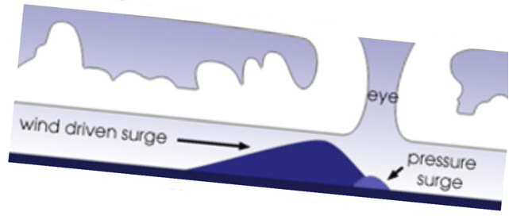
Guide lines BDBF-Storm Surge-AERB
Upper bound value for postulated BDB basis cyclonic storm.
A pressure drop of 100 mbar, associated wind speed of 300 kmph for east coast and 240 kmph for west coast and a radius of 50 km
The translational speed of storm is suggested as 40 kmph.
CWPRS suggested the BDBF level to be 3.5 meters above the maximum high tide.
Significantly higher than the grade level for Dhruva reactor and beyond a level of cliff edge effect

Slide 14
Guide lines BDBF-Tsunami-AERB
All physically possible combinations and variations of tsunamigenic source parameters and accurate near shore data including the effect of built environment around the site, were to be accounted.
Sensitivity analysis was carried out up to a an earthquake of 9.0 magnitude for the Makrana fault.
It was concluded that it is not likely to affect the tsaunami wave height significantly.

Slide 15
Guide line for BDB Earthquake-AERB
AERB suggested to evaluate the capability of the nuclear facilities to withstand ground motion utilizing as-built information.
Re-evaluation is being carried out following the methodologies as suggested in the IAEA Safety Series-28 for assessing the margins.

Slide 16
Review of SSCs BDB Earthquake
Walk down of reactor structures, by civil and seismic experts.
Health assessment structure using NDT techniques in progress.
Preliminary, assessment indicates no signs of distress.
Assessment of Seismic margins beyond DBE with Trombay site (site specific) spectrum and soil characteristics is in progress.
Results of the analysis completed so far have indicated that adequate margins (at least two times) are available for the SSCs.
In case safety margins are observed to be less necessary retrofitting will be considered.

Slide 17
Additional Provisions Tripping of Reactor on a Seismic Event
As per the guidelines issued by the regulatory bodies.
Seismic trip on the reactor is being provided on two out of three logic using three free field sensors, if ground motion approaches ~80% of OBE value.
Additional four sensors will be provided for recording the time history and response spectrum at:
Reactor building/Service foundation
Top of pile block
Top of service building.

Slide 18
Configuration Safety/Safety related systems-Dhruva
Dhruva reactor systems reviewed for their sustainability and functionality in event of BDBEs.
Shut down capability and guaranteed shutdown.
Containment integrity and controlled venting of containment.
Cooling and submergence of stored irradiated fuel assemblies in storage bays.
Decay heat removal and power supply system.

Slide 19
Primary Shut Down System
Fast acting shut-down system
Nine air-cooled cadmium shut-off rods
In two banks.
Spring accelerated gravity driven (fail safe)
fast acting 80% drop in 2 sec and 100% drop in 5 sec.
They provide a minimum sub-criticality of 90 mK.

Slide 20
Shut Down System-Moderator Dump
6 number of spring to open (fail safe) dump valves.
Gravity assisted dumping.
Provides long-term shut-down safety.
Provide a minimum sub-criticality of 50 mK.
Typically takes 160 seconds for complete dumping.
Initial Dump rate of 10,000 lpm.

Slide 21
Containment System
All active facilities housed in RCC containment building.
Automatic (fail safe) isolation.
Controlled depressurization through HEPA and charcoal filters to stack, through fail safe /manual dampers.
Hence controlled venting of reactor building through stack in any of the BDBEs is possible.

Slide 22
Spent Fuel Storage Bay (SFSB)
Storage pool of 1000 m³ capacity, SS lined with tell-tale device for identifying leakage.
Evaporative cooling from the pool is adequate.
Emergency core un-loading, maximum heat load 300 kW.
Without external cooling, temperature stabilizes at 70ᵒC after 15 days, fuel remains submerged for 2 months.
Make up facility, is available from OHST or Service water and Recently added fire hydrant.
Hence for the worst scenario safety of fuel in SFSB is assured.

Slide 23
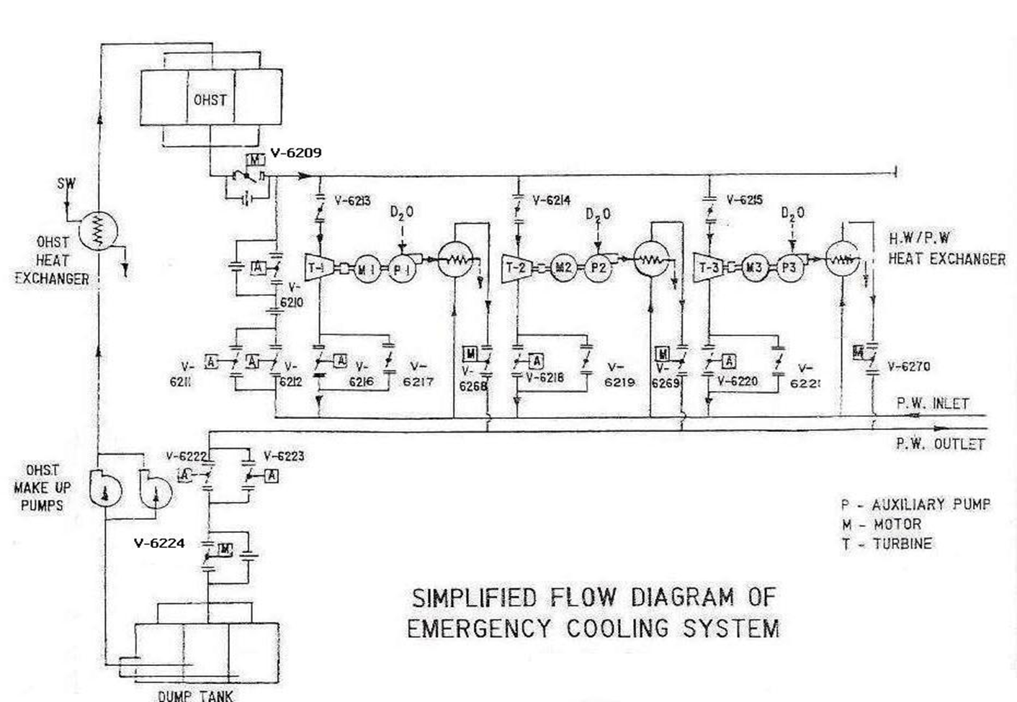
Decay Heat Removal System
1800 M³ Capacity
OHST & UGDT put to gather act as ultimate heat sink
Without make up can provide cooling for 8 Hrs.
Fail safe valves for auto operation of the system
Make up pumps can directly drive turbines.

Slide 24
Power Supply-Class IV
Power to Dhruva, is fed from 110 kV substation.
Two physically separated redundant underground 22 kV feeders.
Reactor trip is provided on Class IV power under voltage condition, persisting for more than 200 milliseconds.
Electrical Power supply to site from the grid is provided through 4 feeders.
Two of these feeders are overhead transmission line of 110 kV.
Two are underground feeders of 22 kV.

Slide 25
Power Supply-Class III
3 DG sets of 500 kVA capacity.
Diesel inventory Two tanks 40,000 lit. (Minimum 23,000 liters)
3 DG sets for 2 days and one sets for another 5 days.
Another two Station Black Out (SBO) DG sets exclusively for OHST makeup pumps.
These DG kept isolated from class -III system and connected manually.
Additionally, two portable diesel engine driven pumps for makeup of OHST from UGDT.

Slide 26
Class-II supply
Class II 415 V AC uninterrupted supply is provided by two numbers of 250 kVA Motor Alternator Sets.
Two numbers of 20 kVA inverter sets driven by Class I power supply.

Slide 27
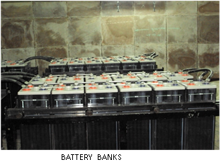
Class-I Supply
240 V DC and 48 V DC supply from ACVRs driven by Class-III and backed up by battery banks (two each) of 1200 Amp-hour capacity and of 300 Amp-hour capacity.
One battery bank in each category can last up to 10 hours.

Slide 28
Review BDB Flood Storm Surge
Safety of Dhruva reactor has been demonstrated up to DBFL.
For BDBF there will be a cliff edge effect and many of the systems will get affected viz.
Class IV power supply.
Class-III power sources (main and SBO),
Class-II power sources and switch gear,
OHST make up pumps,
Equipment controls,
Instrumentation,
Communication,
Lighting etc.

Slide 29
Review BDB Flood Storm Surge
Equipment located at higher elevation and those inside reactor building will remain available viz.
OHST,
Class-III switch gear,
All the battery banks and class-I switchgear and their chargers,
Shut down cooling pump motor/turbine sets,
Facility for venting of reactor building,
Portable engine mounted pumps for making up OHST,
Supplementary Control Room (SCR) etc.

Slide 30
Review BDB Flood Storm Surge-Stages
Three stages of mitigation
Stage-I Preparatory Stage: As per the metrological expertise pre-warning of 72 hrs is possible. Hence, response time of two days (48 hrs) assumed for preparations.
Stage-II Fighting Stage: Typical storm surge can last up to 24 hours with peak duration of 6 hour. Hence conservative mission time two days (48 hrs).
Stage-III Restoration Stage: It was felt that a time of about seven days would be adequate for minimal class IV power supply and makeup pump restoration.

Slide 31
Review BDB Flood -EOP
With these inputs a detailed event sequence was created and deficiencies observed in meeting the safety functions were noted.
After detailed deliberations system configuration changes were proposed to fill the gap areas taking into account the available resources.
Many temporary provisions were made and kept poised for their quick deployment during the preparatory stage.
Care was taken to see that these configuration changes have a very minimal impact on the normal day to day operation.
An EOP was created to manage the all the safety functions.

Slide 32
Additional Provisions –Rationale Provision of Emergency Power supply and distribution
All class-III buses and switchgear will be used to provide power.
Distribution by laying temporary cables (kept ready) to emergency equipment in reactor building.
Plan for upgrading the existing 500 kVA DG sets with new 625 kVA DG sets was on the anvil.
It was decided to construct a new seismically qualified building and provide two 625 kVA air cooled DG set in this building at higher elevation with adequate diesel storage facility.
For interim period a 200 kW portable DG set maintained by fire services station has been identified and ear marked for this purpose.

Slide 33
Additional Provisions –Rationale Provision of Emergency Power supply and distribution
Battery banks #1, 2, 3 and 4 can provide uninterrupted power to vital services.
Lighting loads,
Communication facility for few of the identified control stations,
Control and instrumentation in SCR.
It is proposed to transfer one inverter at higher elevation for making available uninterrupted AC power for operating one shut down cooling pump through class-III switch gear.

Slide 34
Additional Provisions –Rationale Provision of Power water and OHST makeup
New pump house, with two pumps and independent make up line, was built and made external flood proof, up to BDBFL.
Overflow line modified to provide an hookup point for make up.
Additional hookup point to provide high pressure water source, for directly driving the turbines and providing secondary cooling, external to the reactor building has been made.
Modifications proposed to provide direct hookup points in loop#1 turbine inlet and outlet lines and primary heat exchanger for driving one turbine and providing secondary cooling, using any water source (like fire hydrant water).
Additional Down comer from OHST proposed for improving redundancy.

Slide 35
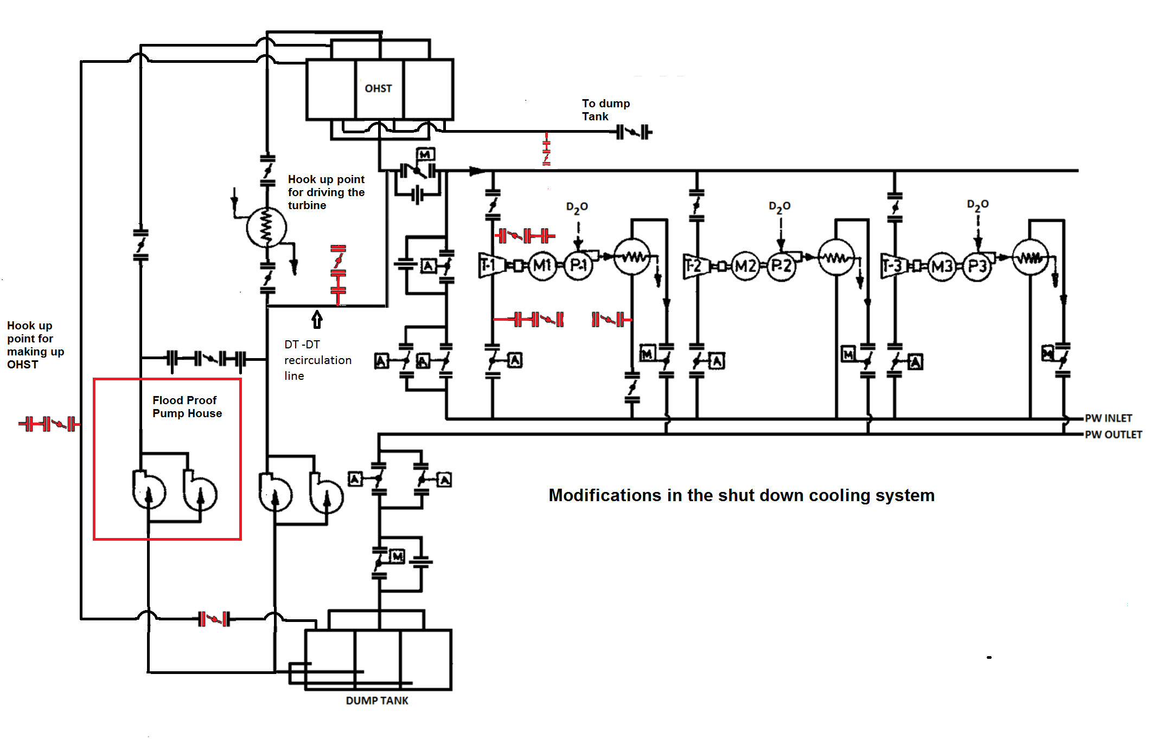

Slide 36
Additional Assessment –Rationale Estimation of time to initiate secondary cooling
Time available with primary circulation on, without secondary cooling was evaluated giving credit to stagnant water inventory in Vault and primary heat exchangers.
It is noted that after 48 hours, of reactor shut down, time available before reactor coolant temperature reaches 70ᵒC (with in the design limits), will be about 16.0 hours.

Slide 37
Additional Provisions –Rationale Monitoring of important parameters
Supplementary Control Room (SCR) has been provided, it will remain available during BDBF for Monitoring of plant parameters, including necessary information pertaining to following:
Neutronic power,
Status of shut-down devices (shut-off rods, dump valves & control valves),
Moderator level,
Shut down cooling pump status, core gross flow, each loop flow,
Primary coolant inlet temperature,
Reactor building pressure & ventilation gamma
SCP is also provided with some limited controls.

Slide 38
Conclusion
Considering various improvements made/ proposed in the system configuration, it is felt that it will be possible to cope with an overwhelming beyond design basis natural events as described above.

Slide 39
Thank You

