Slide 1
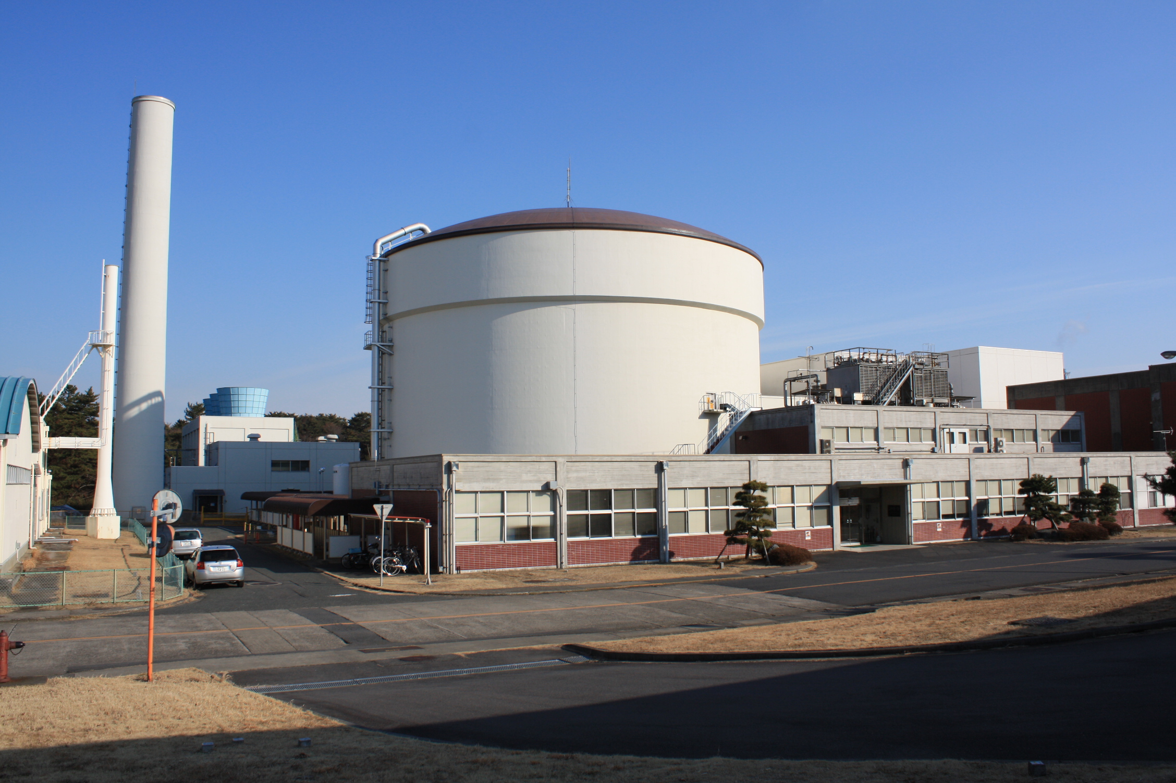

Current Status of JRR-3
Tomoaki KATO
Department of Research Reactor and Tandem Accelerator
Japan Atomic Energy Agency
1

Slide 2
1. Introduction
2. Impact of the Great East Japan earthquake
2.1 Post-quake situation
2.2 Recovery works
3. Work for Re-operation
3.1 New Regulatory Requirements
3.2 Verify Conformity to
New Regulatory Requirements

Slide 3
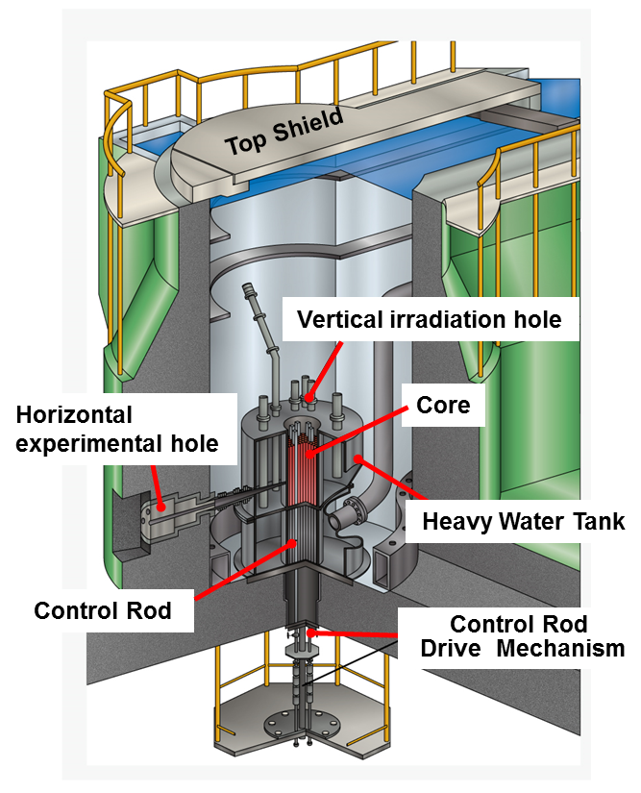
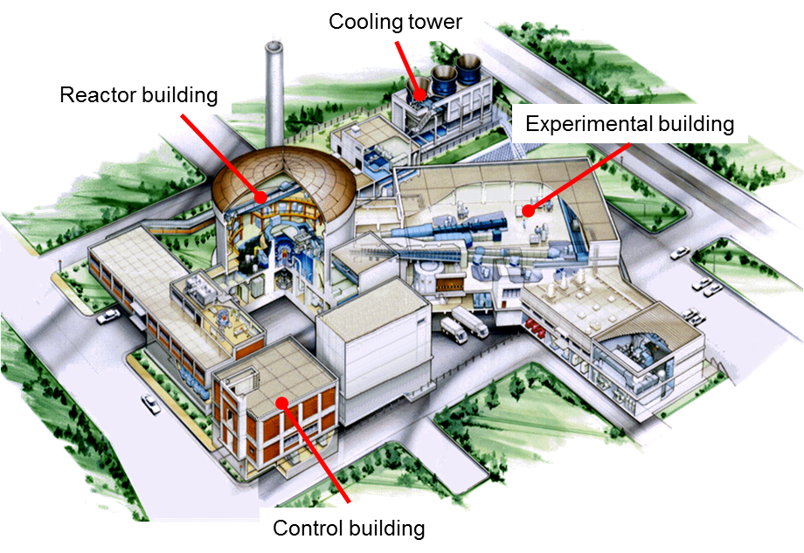
1.1 JRR-3 (Japan R.R. No.3)
Reactor Type： Swimming pool type
Thermal Power： 20MW
1st criticality： March 22nd,1990

Slide 4
1.2 Safety Characteristics of JRR-3
The thermal power of JRR-3 is 1/100 of power rector.
Cooling water is under ordinary temperature and normal pressure.
The safety protection systems are designed with redundancy.
The reactor is shut down automatically without power supply in case of accidents.
The fission product decay heat can be removed by natural circulation of the cooling water.
JRR-3 has a successful accessibility .

Slide 5
2.1 Post-quake situation of JRR-3
【March 11, 2011 (Fri.) 14:46 】
Strong earthquake with the seismic energy of magnitude 9.0
JRR-3 was not operated for periodic inspection.
Nuclear fuels and reactor containment system were checked.
  Fuels stayed in normal position. No damaged.
  No release of radioactive materials to environment
Reactor building and equipment important for safety survived without getting serious damage.
Notes:
5

Slide 6
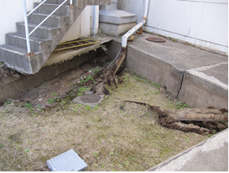
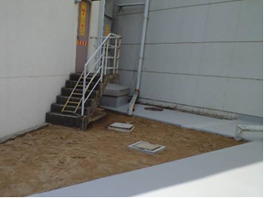
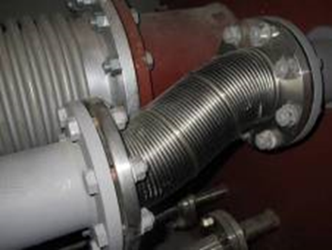
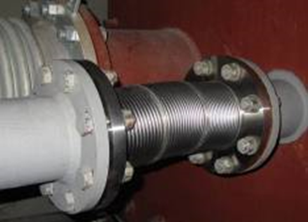
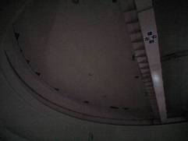
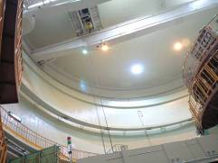
2.2 Recovery works (1/2)
 | Before | After
Ground sinking
Emergency exhaust piping system
Ceiling panel in reactor building

Slide 7
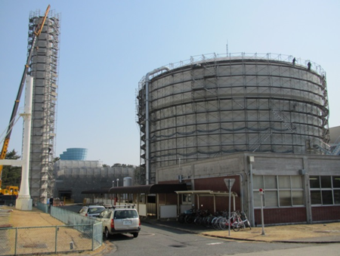
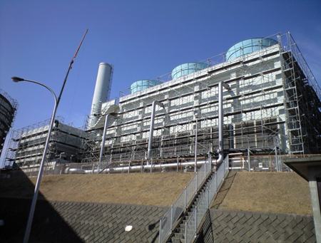
2.2 Recovery works (2/2)
Cracks of reinforced concrete structure were investigated .
  The cracks were mostly less than 1mm in width.
  Exfoliation or falling was not found.
Reactor building
Cooling tower
All recovery works have already been completed.

Slide 8
3.1 New Regulatory Requirements
New regulatory requirements for research reactors
（enforced on December 18, 2013）
Item |  | Requirement
Seismic design |  | Reevaluation of standard seismic motions with latest findings
Tsunami |  | Establishment of design basis tsunami
External Events | Natural Phenomena | Consideration of natural disasters such as volcanic eruptions, tornados, and forest fires, etc.
 | Man-Induced Events | Consideration of airplane crash, explosion, fires in neighboring factories, electromagnetic interferences, etc.
Fire Protection |  | Consideration of protective measure for preventing, detecting and extinguishing of fire
Internal Flooding |  | Consideration of protective measure for internal flooding
Communication Systems |  | Enhancement of communication system for the person inside and outside the facilities
Loss of External Power Supply |  | Preparation of power supply for parameter monitoring in case of the station blackout
Prevention of Spread of Accidents |  | The evaluation against accidents beyond design basis (BDBA)

Slide 9
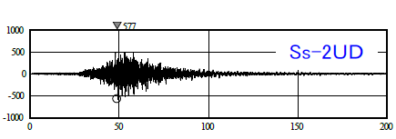
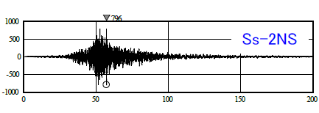
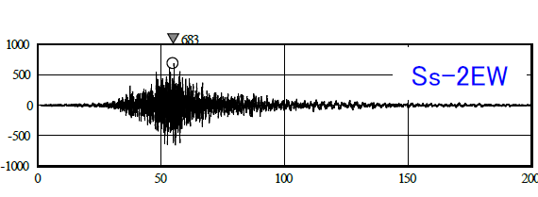
3.2.1 Reevaluation of standard seismic motion
We have conducted an evaluation of seismic ground motion in relation to the Great East Japan Earthquake that registered 9.0 on the Richter scale and have established standard seismic motion.
【Standard Seismic motion】
Horizontal: 796 cm/s²
Vertical : 577 cm/s²
Up-Down
acceleration (cm/s²)
time (s)
North-South
East-West
acceleration (cm/s²)
acceleration (cm/s²)
time (s)
time (s)
Time history waveform of standard seismic motion
Each component has enough strength, because they are designed with margin.

Slide 10
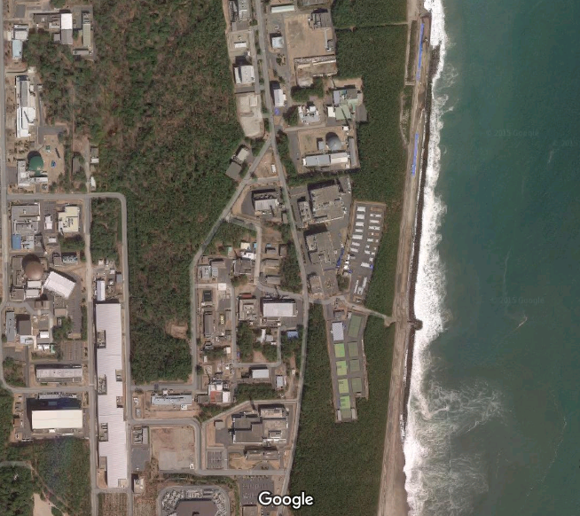
3.2.2 Establishment of Design Basis Tsunami
We have established a design basis tsunami by the surveys and studies on factor causing huge tsunami, regarding inter-plate earthquake and submarine landslides.
The maximum water reaching level by design basis tsunami is level with T.P. +13 m at on the site.
JRR-3 located at the altitude of 19 m prevents basis tsunami from directly reaching and intruding into them through land area.
maximum water reaching level
T.P. +13 m
JRR-3 T.P. +19 m
There is no need to take particular countermeasures.

Slide 11
3.2.3 Evaluation of tornados
and volcanic eruptions
○ Tornados
A design basis tornado has been defined based on the maximum wind speed 92 m/s of tornados previously occurring in Japan.
The reactor building of JRR-3 would not be ruined by the tornado or flying objects.
○ Volcanic eruptions
The nearest volcano is located 88km away from JRR-3.
Safety functions would not be lost by the falling tephra (volcanic ash).

Slide 12
3.2.4 Fire Protection and Internal Flooding
【Fire Protection】
Important cable (signal cable, power supply cable and communication cable) are flame resistant as a fire prevention.
【Internal Flooding】
The safety function of shutdown system and cooling system will not be impaired by the internal flooding.
(Internal flooding may be caused by failure of equipment or piping, the operation of the fire protection system, or sloshing in the spent fuel pool.)

Slide 13
3.2.5 Communication Systems and
Loss of External Power Supply
【Communication Systems】
Communication systems can convey necessary information (instruction on operation, information of accident) to the people inside and outside of JRR-3.
The communication systems have dedicated and diversified communication lines. (specific cable/wireless lines and satellite telephone, etc)
【Loss of External Power Supply】
When the power supply from off-site is lost, the reactor can safety be shut down automatically and the cooling after shutdown can be achievable by emergency AC power and natural circulation.

Slide 14
3.2.6 Evaluation of Beyond
Design Basis Accidents (BDBA)
Conceivable event |  | Countermeasure
Loss of shutdown function | 2 control rods insert failed | If 2 control rods are not inserted, JRR-3 can be shut down with 4 other control rods.
Loss of cooling function | Loss of commercial and emergency power supply (BLACKOUT) | JRR-3 is shutdown automatically and removes its decay heat by the natural cooling circulation.
 | Primary cooling water leakage (LOCA) | We can supply the reactor pool with alternative water by using mobile injection pumps, water injection lines or buckets.
Loss of containment function | Loss of emergency exhaust function in case of fuel failure accident | All ventilation equipment is stopped, radioactive materials are kept in the reactor building by the isolation valves.

Slide 15
Conclusions
Damages by the Great East Japan Earthquake have not diminished the safety of the JRR-3.
We had confirmed that JRR-3 conforms to new regulatory requirements.
(Regulatory body review it. )
We submitted an application document for re-operation to the regulatory body on September 26, 2014.
The over 10 review meetings were held by the regulatory body, and that is ongoing.

Slide 16
Thank you for your attention!

