Slide 1
IAEA Sub-programme on Safety Enhancement of Research Reactors
A. M. Shokr
Research Reactor Safety Section
Division of Nuclear Installation Safety
Department of Nuclear Safety and Security
International Conference on Research Reactors: Safe Management and Effective Utilization, 16 – 20 November 2015, IAEA, Vienna

Slide 2
Contents
Introduction: Overview of research reactors
Research reactor safety issues and trends
IAEA activities on research reactor safety
Feedback from the IAEA survey on safety reassessments following the accident at the Fukushima Daiichi NPP
Concluding remarks

Slide 3
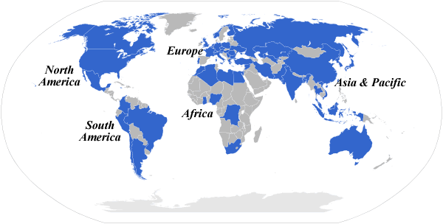
Introduction: Overview of Research Reactors (RRDB)
Built to date: about 700
Operational 234
Temp. shutdown 13
Shutdown 142
Decommissioned 298
Under construction/planned:
Argentina, Azerbaijan, Bolivia, Brazil, France, Indonesia, Jordan, Korea, Mongolia, Netherlands, Nigeria, Saudi Arabia, Sudan, Tanzania, Tunisia, USA, Vietnam.
Number: ~234 operational
Region | Operational Research Reactors
Africa | 10
Americas | 66
Asia/Pacific | 52
Europe | 106

Slide 4
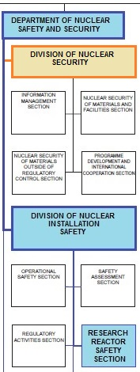
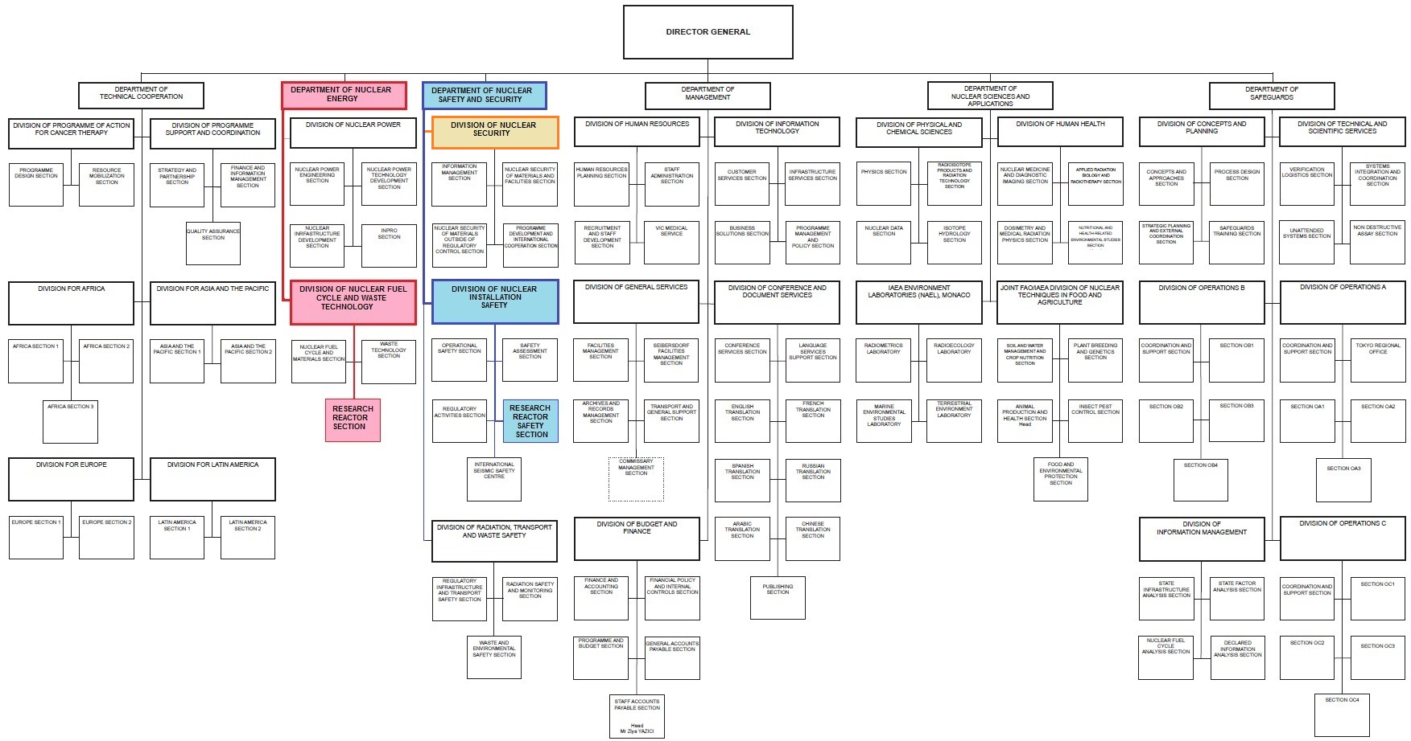
Introduction: Research Reactor Safety Section (RRSS) - Department of Nuclear Safety and Security

Slide 5
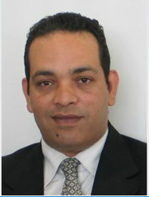


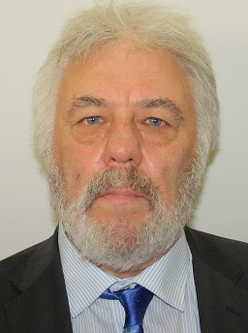

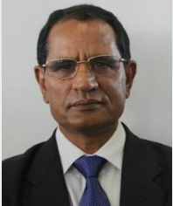
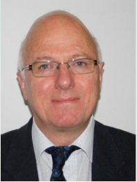

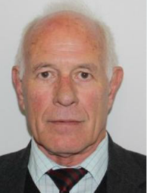

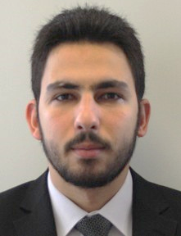
RRSS - Department of Nuclear Safety and Security

Slide 6
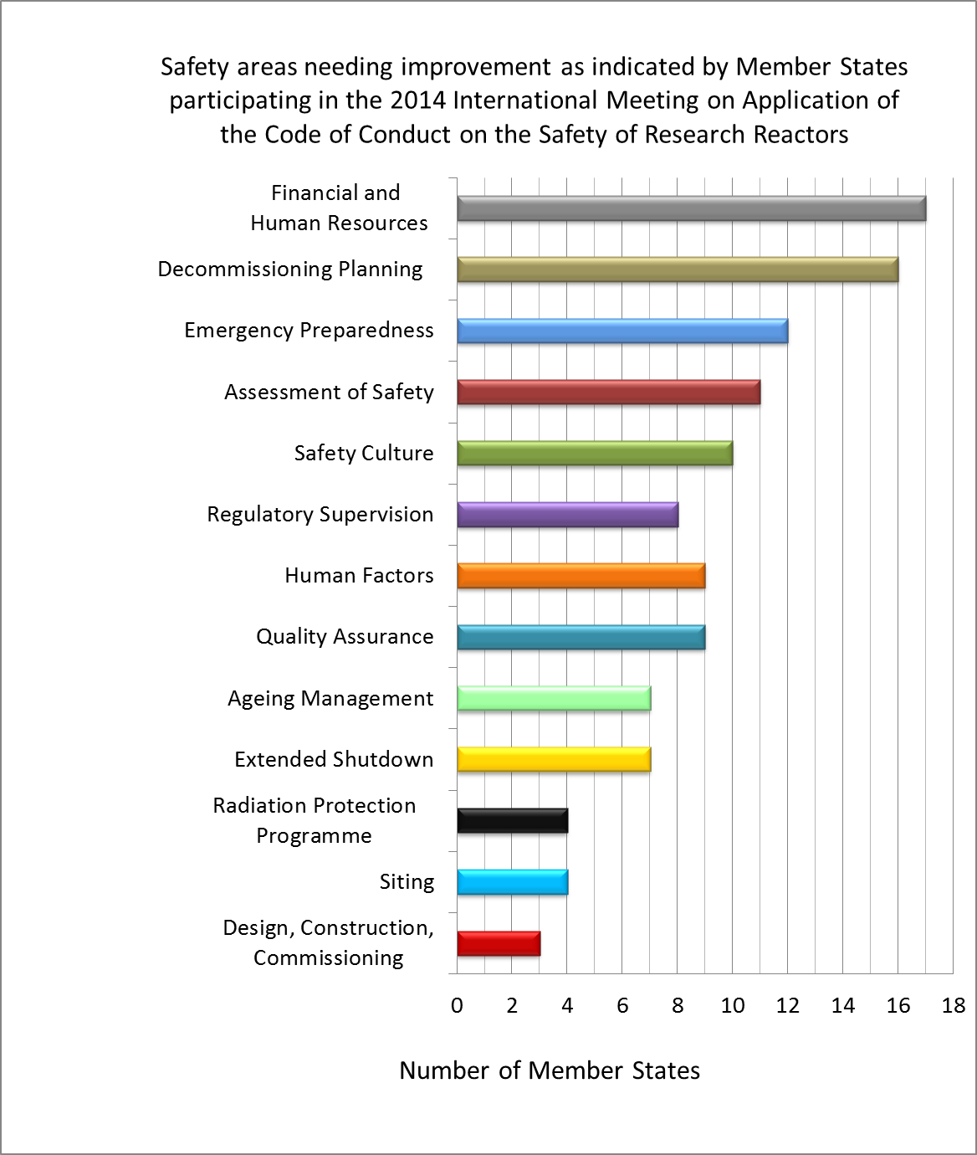
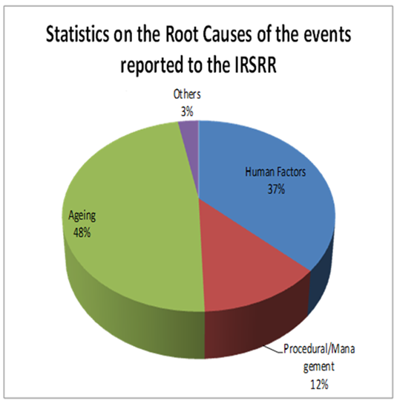
Safety Issues and Trends - Updating the IAEA activities on research reactor safety
Safety issues and trends are identified. Programme and activities are updated accordingly: Feedback from Code of Conduct meetings, IRSRR, and safety reviews.

Slide 7
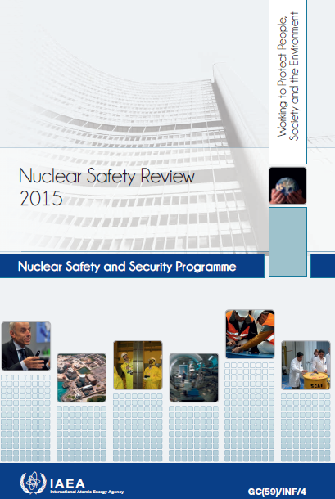
Safety Issues and Trends - Updating the IAEA activities on research reactor safety
Feedback from the activities shows attention need to be paid to the:
  Regulatory effectiveness;
  Ageing of facilities and continued safe operation;
  Ability to perform safety assessment;
  Operational radiation protection, emergency preparedness, and decommissioning plans;
  Infrastructure for establishment of the first research reactor;
  Interface between safety and security.

Slide 8
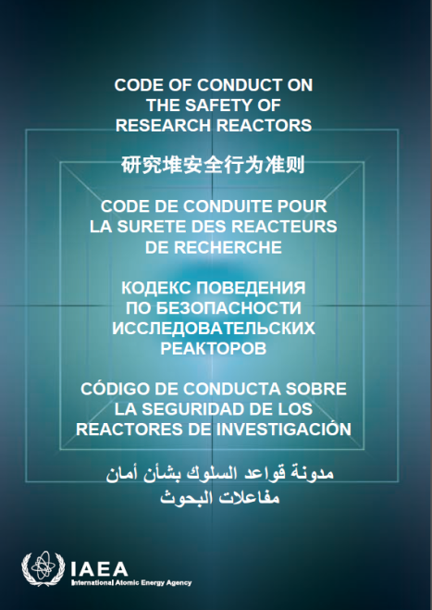
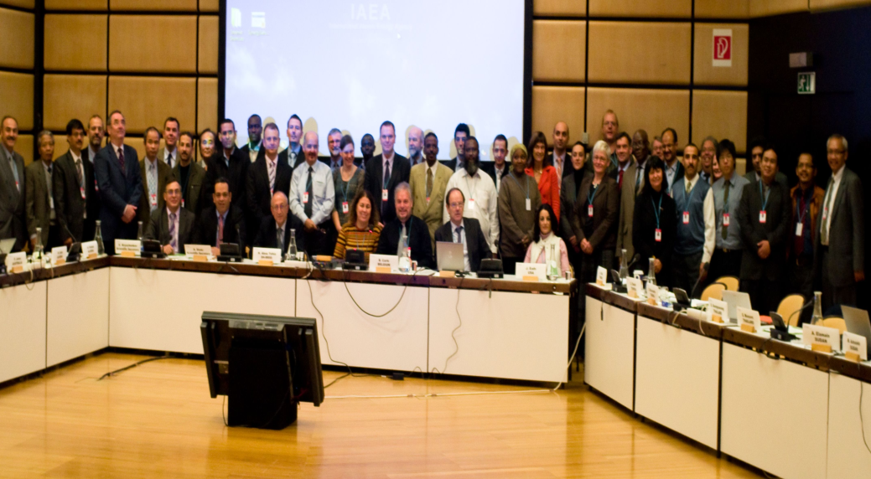
RRSS activities – Supporting application of the Code of Conduct
Regional meetings focusing on areas of common concern;
Triennial International Meetings:
  Self assessments - identification of areas needing improvements.

Slide 9
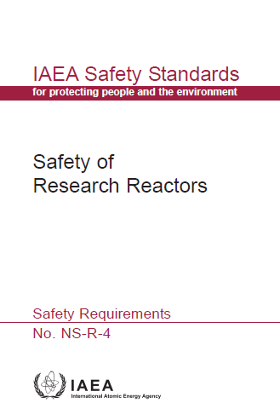
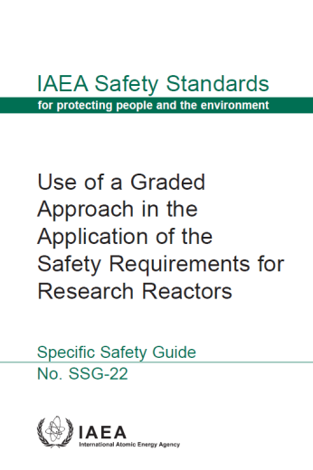
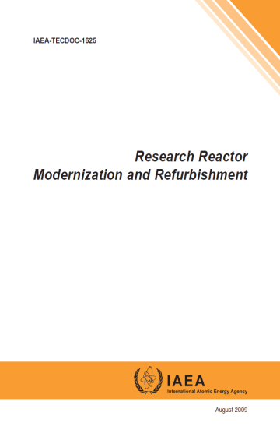
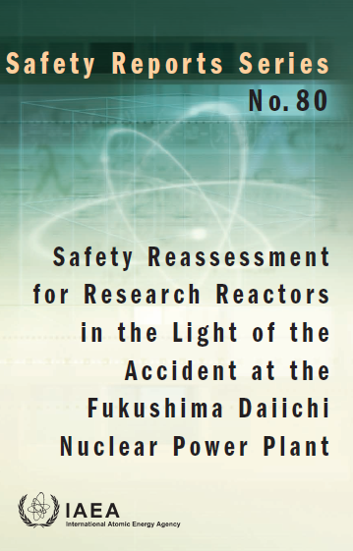
RRSS activities – Safety Standards and supporting documents
Development of safety standards and supporting documents and assist Member Sates in their application.
During the last 6 years: 11 Safety Guides; 9 TECDOCs and Safety Reports covering all safety topics.
  Safety Standards: http://www- ns.iaea.org/standards/documents/default.asp?s=11&l=90&sub=20&vw=9#sf
  TECDOCs: http://www-pub.iaea.org/books/IAEABooks/Series/34/Technical-Documents
  Safety Reports: http://www-pub.iaea.org/books/IAEABooks/Series/73/Safety-Reports-Series

Slide 10
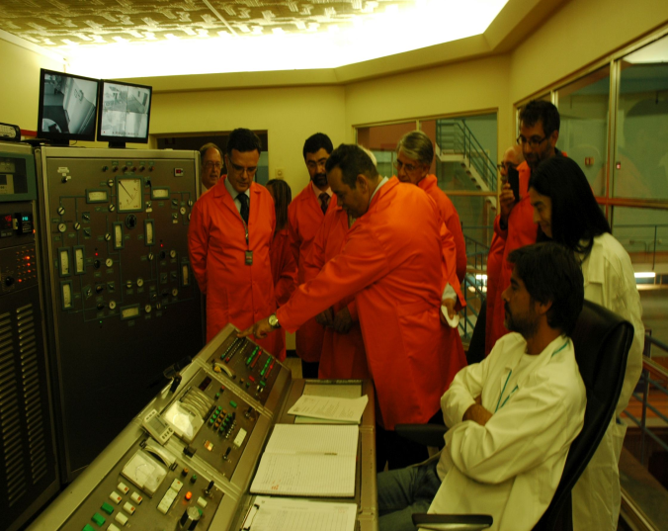
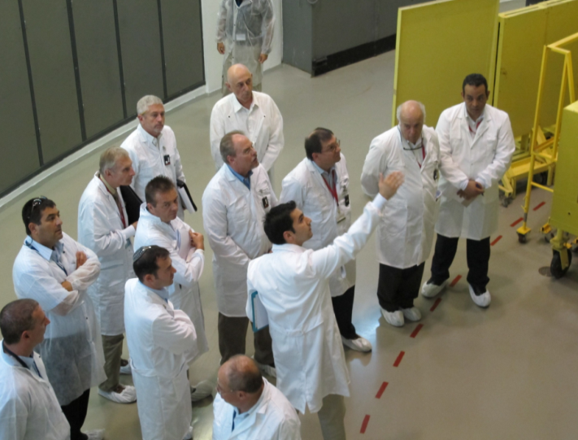
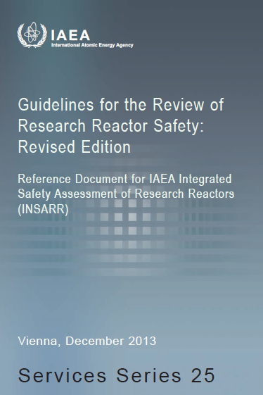
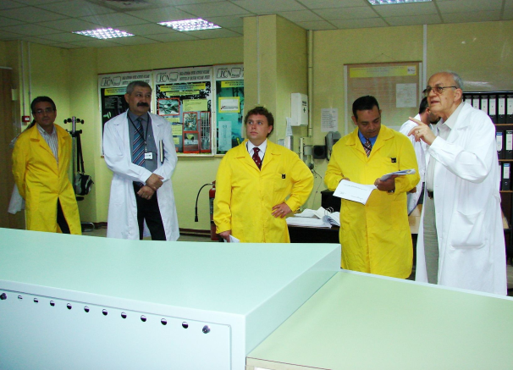
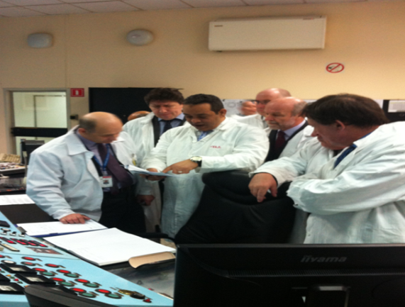
RRSS activities – Safety reviews and advisory services
Conducting INSARR review services - 15 INSARR/Expert Missions, on average per year.

Slide 11
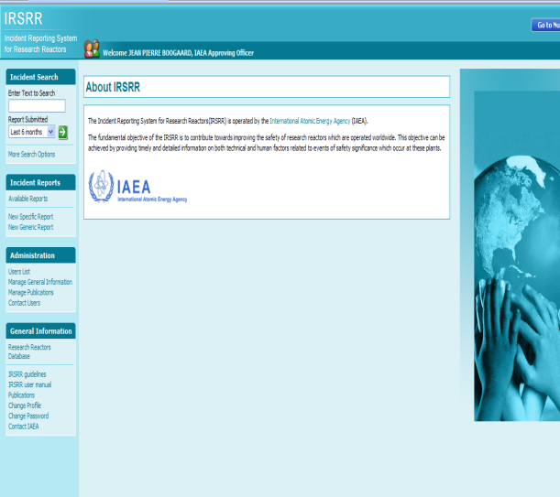
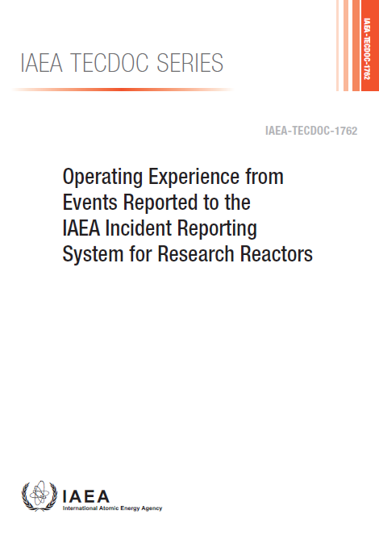
RRSS activities – Dissemination of operating experience
Operating the IRSRR and organizing regular meetings for exchange of operating experience – the meetings include training sessions on event investigation techniques.
The IRSRR currently joined by 57 Member States (more than 95 % of the facilities are covered).
Operating experience from the events reported to IRSRR was published in 2015.

Slide 12
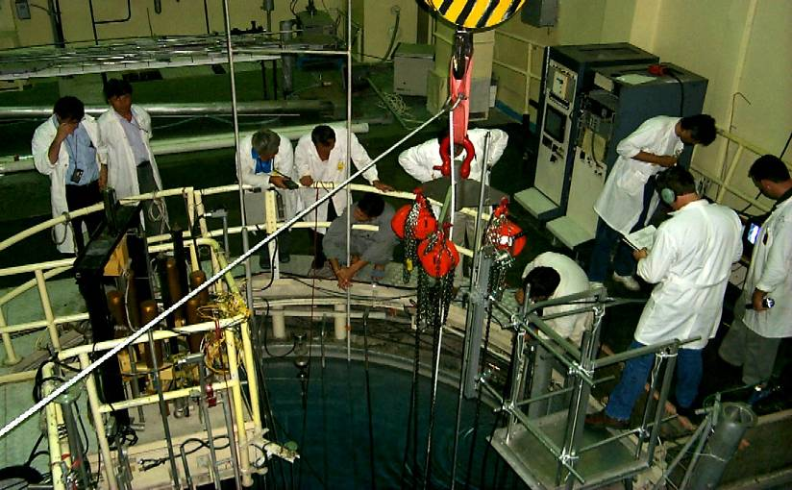
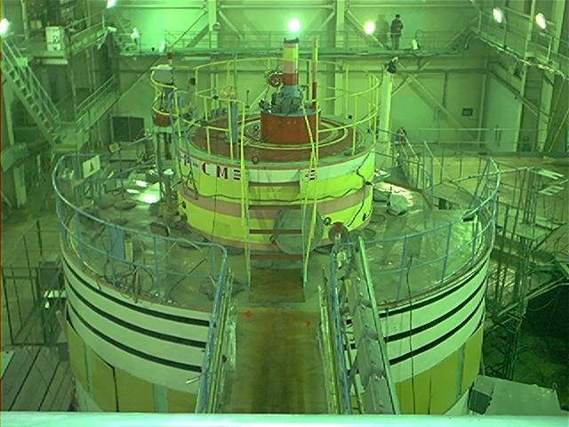
RRSS activities – Monitoring safety of Research Reactors under Project and Supply Agreements
27 research reactors in 23 countries are under Project and Supply Agreements with the IAEA.
Collecting, analysing, and disseminating the results of Safety Performance Indicators (SPIs);
Regular meetings on the safety of the research reactors under agreements and review of the SPIs of these facilities.

Slide 13

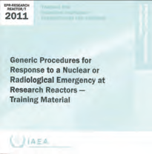
RRSS activities – Capacity building – E&T
Training workshops and technical meetings – more than 40 since 2010;
Group Fellowship Training Course (NA, NE, NS, and TC);
Online video presentations on safety standards and key technical areas for Research Reactors;
Publication of training material;
Coordinated Research Projects.

Slide 14
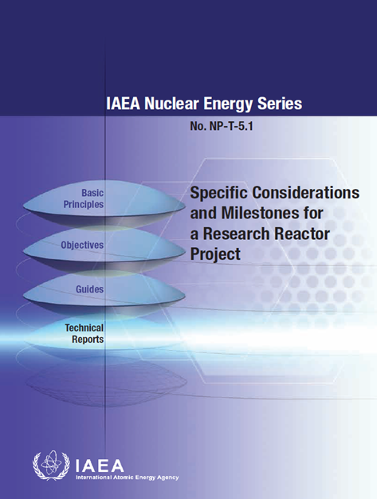
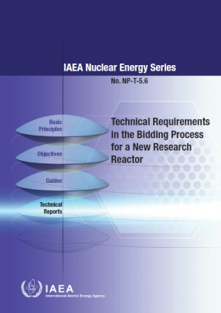
RRSS activities - Infrastructure for first/new research reactor programmes (with NE, NA, and TC)
Publications;
Conduct of advisory services and expert missions;
Training workshops and meetings.

Slide 15
RRSS activities – Support TC programme and information networks
Supporting the implementation of more than 25 national/regional technical cooperation projects;
Supporting the functioning of regional Advisory Safety Committees for Research Reactors in Europe, Africa and the Asia and the Pacific;
Supporting safe implementation of research reactor core fuel conversion from HEU to LEU;
Supporting the functioning of information networks (ANSN, FNRBA, ANNuR, etc.)

Slide 16
Feedback from the survey on safety reassessment in light of the accident at the
Fukushima-Daiichi nuclear power plant
A. M. Shokr, A. D’Arcy, W. Kennedy, and A. Abdelaty

Slide 17
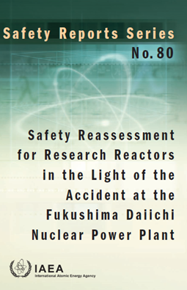
Feedback from the Survey: General
Feedback from the survey on safety reassessment of research reactors in light of the accident at the Fukushima Daiichi NPP:
About 50% of communicated MSs responded;
25 responses from operating organizations;
2 from regulatory bodies;
18 reassessments;
13 following IAEA SRS No. 80;
Many safety enhancements.

Slide 18
Feedback from the Survey: Modifications of the Facility
Did the reassessment include analysis of loss of electrical power supply, combinations of events and consequential events?
Almost all responses indicated reassessment of DBAs and consideration of additional single external/ internal events, with emphasis on the loss of electrical power supply.
Many reassessments included consequential events (e.g. earthquake with LOCA, loss of power supply).
Some considered combined earthquake and flooding events and implemented related modifications (e.g. improvements on site accessibility and emergency prepardness).

Slide 19
Feedback from the Survey: Modifications of the Facility
Has the reassessment verified that the existing design provisions ensure that the basic safety functions will be fulfilled in the case of extreme external events?
a. Implementation of seismic monitoring and automatic protective actions, as well as increased protection of control rod drives.
Modifications to strengthen protection against LOCA with loss of offsite electrical power.
c. Enhanced seismic resistance of the reactor building, and some facilities installed emergency ventilation systems.
Implementation of additional measures to protect existing electric power supplies (spare cabling, redundant and separate external source lines, seismic resistance of UPS), and added mobile/portable generators.

Slide 20
Feedback from the Survey: Safety Organization
Has the reassessment resulted in changes in the reactor organizational aspects (e.g., reactor organizational chart, human factors, etc.) and/or relevant regulatory practices (e.g., licensing conditions, inspection programmes, etc.)?
The majority of facilities did not change organizational aspects;
Some facilities increased technical support and training for emergency response and strengthened the functioning of the reactor safety committee;
Regulatory bodies reported that guidance on safety reassessments was developed consistent with SRS No. 80.

Slide 21
Feedback from the Survey- Emergency Preparedness
Have the existing emergency arrangements and procedures been reviewed, particularly for an accident initiated by an extreme external event affecting several facilities simultaneously?
Most facilities reported that the existing arrangements were generally adequate, but many made enhancements such as:
Improving communication systems, increasing response forces and increasing emphasis on training of responders;
Redesigning off-site access points and routes and upgrading roads within the facility site;
Installing additional fire protection equipment and relocation of equipment into seismically qualified buildings;
Performing exercises of BDBAs response, incorporating human factors training and increasing the frequency of emergency exercises that include offsite organizations.

Slide 22
Feedback from the Survey: Safety Documentation
Has the reassessment resulted in changes in the safety analysis and conclusions presented in the SAR?
Has the reassessment resulted in changes in the operating programme, including operating, maintenance and periodic testing procedures?
Most facilities did not identify a need to update the SAR based on the reassessment.
The SAR for other facilities is currently under revision or regulatory review and assessment.
Changes made to:
  Cover new emergency response equipment (mostly reported);
  Increase the frequency of preventive maintenance;
  Establish procedures for abnormal conditions.

Slide 23
Feedback from the Survey – Summary
Most organizations who responded to the survey have performed reassessments following the guidance in SRS No. 80, or a similar national process.
The majority have implemented modifications to SSCs, procedures, and emergency plans to strengthen robustness of the facility.
Efforts are still needed in many facilities to complete the reassessment (or to implement its results).
(More detailed feedback from the Survey will be communicated with those who provided responses).

Slide 24
Concluding remarks
Improved application by MSs of the Code of Conduct on the Safety of Research Reactors. However, there is a need for further improvements in some areas, including regulatory supervision, human factors, emergency preparedness, and decommissioning.
The set of IAEA safety standards for research reactors is now complete – efforts should continue to ensure their effective application.
The quality of the IAEA peer review services to research reactors continues to be enhanced. Increased requests from MSs of these services is observed.

Slide 25
Concluding remarks- Future focus (2016-2017)
Maintaining and expanding worldwide application of the Code of Conduct and the IAEA safety standards;
Maintaining adequate safety levels of ageing research reactors;
Regulatory effectiveness, including infrastructure for country’s first research reactor project;
Dissemination of the relevant lessons learned from the accident at the Fukushima Daiichi nuclear power plant;
Improving managing the interface between safety and security;
Improving exchange of operating experience and networking.

Slide 26
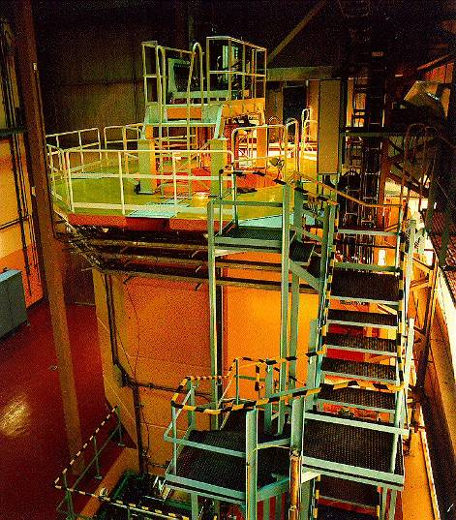
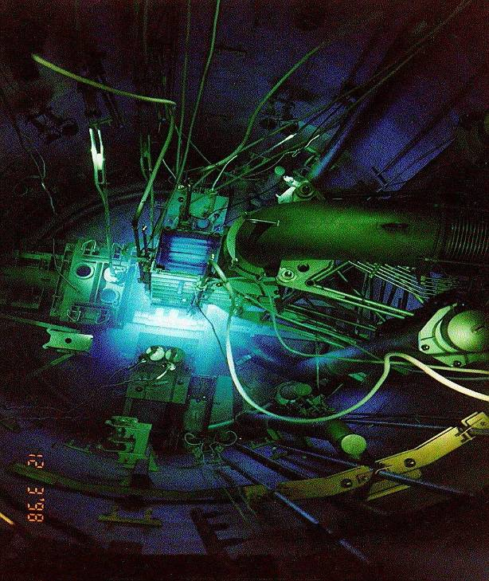
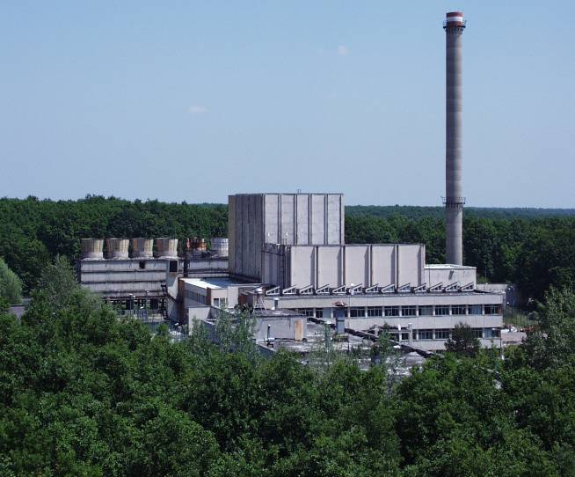
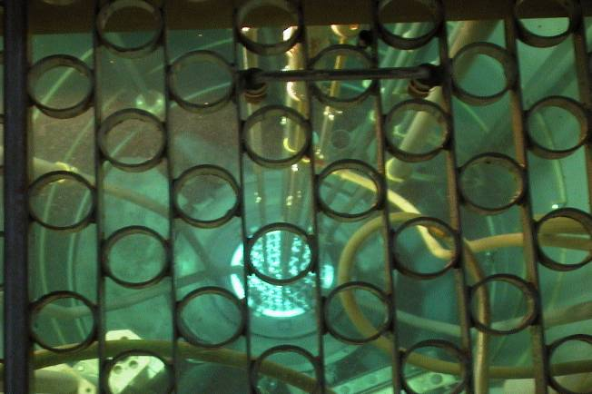
Research Reactor Safety Section (RRSS/NSNI)
To support Member States in achieving and maintaining a high level of safety of research reactors …

