Slide 1
COATINGS FOR SAFE LONG TERM WET STORAGE OF SPENT AL-CLAD RESEARCH REACTOR FUELS
S.M.C.FERNANDES, O.V.CORREA, J.A.DE SOUZA,
R. A. ANTUNES, M.C.L. DE OLIVEIRA, L.V.RAMANATHAN.
IPEN, UFABC and CIETEC, Brazil.
International Conference on Research Reactors:
Safe Management and Effective Utilization
November 16-20, 2015
Vienna, Austria

Slide 2
Outline
Motivation
Constraints and options
Coatings.
Laboratory and field tests - results
Conclusions
Scale-up

Slide 3

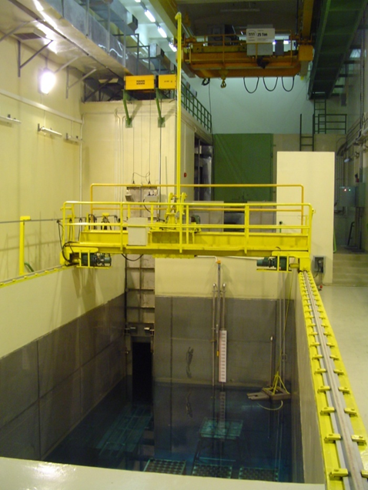
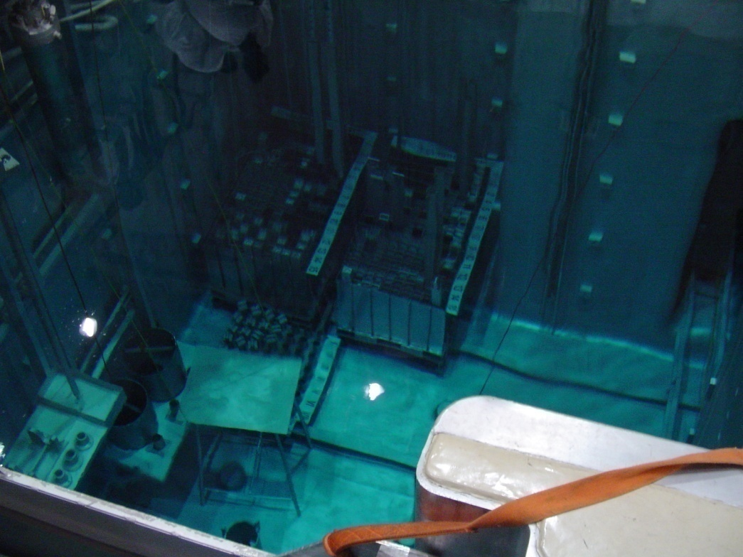

In-reactor storage

Slide 4
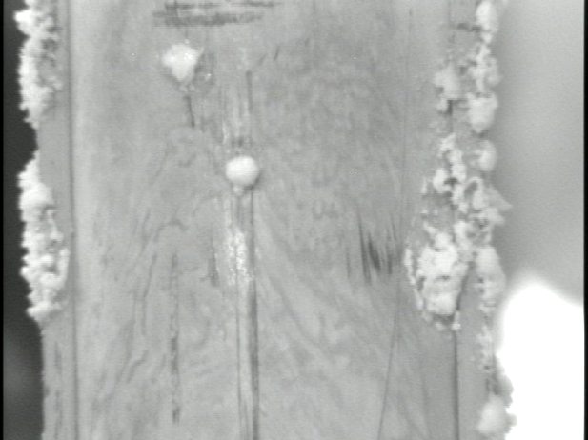
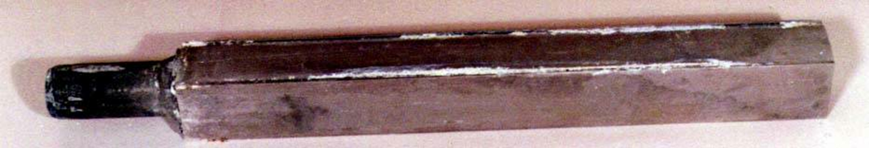
Motivation
2. Over 90% of the spent RR fuels stored in wet basins are clad with aluminium or aluminium alloys and pitting corrosion is the main form of degradation.
This could lead to breach of cladding and contamination of the storage facilities.

Slide 5
Motivation
3. Many countries manufacture Al-clad fuels for their RR without any plans for reprocessing.
Includes: Brazil, Argentina, Chile, Indonesia .........
In Brazil:
Foreseen annual long term wet storage of 60 – 70 SFA.
5 MW - IEA-R1: 8 - 12 SFA
30 MW – RBM : 50 - 60 SFA

Slide 6
Problem: Corrosion of Al alloys
This is influenced by
      Alloy composition,
      Galvanic effects (Al alloy/stainless steel),
      Crevices,
      Settled solids,
      Alloy grain orientation and
      Water parameters

Slide 7
The main water parameters are:
Conductivity and aggressive ions (chlorides)
Hence
Use of low conductivity water in spent fuel storage basins is recommended.
Nevertheless, many incidences of pitting corrosion have been reported even in high quality water.

Slide 8
The solution: Protect the spent fuel elements
How: Separate the metal from its environment.
Only option : COATING
CONSTRAINTS
Fuel is `hot` - hence remote handling
Fuel geometry – cannot disassemble
Coating process capable of scale-up.
Thus only option: A chemical coating
4. Surface could be scratched during handling
Further - only option: A chemical coating with an inhibitor.

Slide 9
Advantages
A corrosion protected spent RR fuel can be stored for extended periods in waters of less than optimum quality.
This would also reduce cost of maintaining water quality.

Slide 10
Conversion coatings have been widely used in many industries.
Rare earth compounds have been used to develop corrosion protection systems for aluminium alloys, mainly as an alternative to chromates, which are being phased out, due to its toxicity.
Hence the use of conversion coatings, to protect spent research reactor fuel assemblies, was proposed in 2007 and we carried out preliminary laboratory and field tests.
The results revealed that pitting corrosion resistance of aluminium alloys AA 1100 and AA 6061, used as cladding of RR fuel plates, increased when coated with lanthanide-based compounds.

Slide 11
These investigations were extended to include boehmite and hydrotalcite coatings on Al alloy surfaces.
Inclusion of boehmite was motivated by the fact that a thick layer of boehmite forms on spent fuel surfaces.
Hydrotalcite (HTC) is lithium aluminium-nitrate-hydroxide hydrate (a form of talc) and it forms on Al alloys immersed in an appropriate alkaline Li salt solutions.

Slide 12
We present
HTC coating preparation from different aqueous solutions and its characterization.
Laboratory corrosion tests and results.
Field tests and results.

Slide 13
Solutions and conditions used to prepare coatings on Al 6061 alloys.
Solution | Purpose | Composition of solution and conditions
1 | Degrease | 25 g/L Na₂SiO₃; 25 g/L Na₂CO₃; 65 °C; 2 min.
2 | Deoxidize | 10% HNO₃; 3% NaBrO₃; 55 °C; 3 min.
3 | Form boehmite | Deionized water; 97-100 °C; 5 min.
4 | Incorporate Ce in boehmite | 0.1% CeCl₃; 97 °C; pH 4; 5 min.
5 | Form HT - HTC | 6.9g/L LiNO₃; 28.3 g/L KNO₃; 2.4 g/L LiOH; 0.06 g/L NaAlO₂; 98 °C; pH 12; 10 min.
6 | Form LT – HTC | 0.1M Li₂CO₃; LiOH; Al; pH 12; 15 min; R.T.
7 | Incorporate Ce in HTC | 10 g/L Ce (NO₃)_{3;} 30% H₂O_{2;} R.T.; 5 min.
8 | Sealing | MgC₄H₆O₄; 82 °C; 15 min.

Slide 14
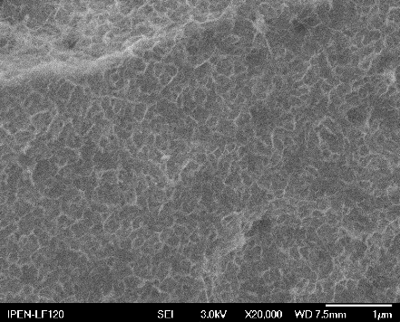
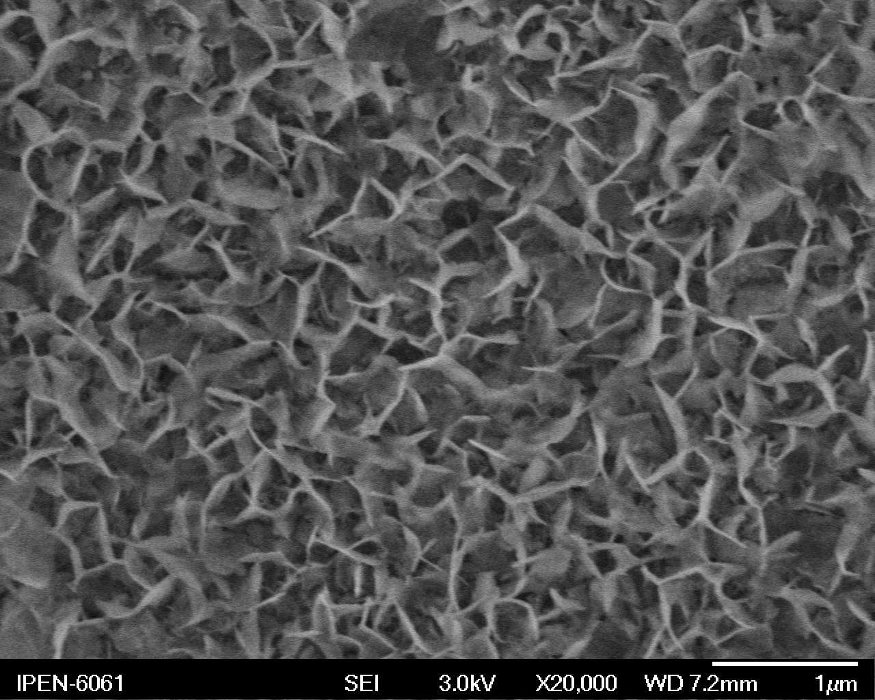
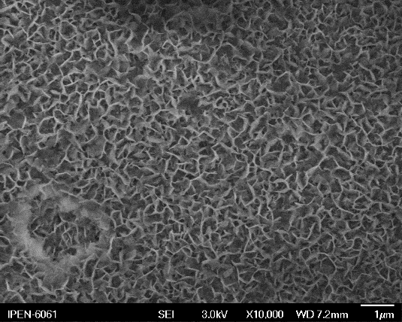
Scanning electron micrographs of:
(a) LT - HTC
(b) HT-HTC
(c) HT-HTC forming inside pits
a
c
b
Below the outer layer a dense layer of nanocrystaline lithium aluminate forms.
The coating thickness varies with substrate, bath (composition, age, immersion time.
Typical coating thickness after 10 minutes of immersion was ~2 µm.

Slide 15
Scanning electron micrographs of HTC coatings formed from solution 3 at room temperature:
(a) without additions; (b) with H₂O₂; (c) with K₂S₂O₈; (c) with H₂O₂ and K₂S₂O₈.

Slide 16
a
b
X-ray diffraction spectra: HTC (Li₂[Al₂(OH)₆]₂CO₃ 3H₂O) formation from
(a) nitrate bath and (b) carbonate bath.

Slide 17
Laboratory electrochemical tests
Potentiodynamic polarization curves of uncoated and coated AA 6061 specimens in 0.01 M NaCl at room temperature and at scan rate of 0.1 mV/s.

Slide 18
The corrosion potential E_{corr}, corrosion current I_{corr} and breakdown potentials E_{b}, as determined from the electrochemical polarization measurements.
Specimen | I_{corr} (μA.cm⁻²) | E_{corr} (V) | E_{b} (V)
Uncoated | 6.120 | -1.23 | -0.59
Boehmite coated | 0.327 | -0.54 | -
Boehmite + Ce (S4) | 1.749 | -0.59 | -
Boehmite + Ce (S7) | 1.694 | -0.58 | -
HT-HTC | 0.972 | -0.90 | -0.59
HT-HTC + Ce (S7) | 0.085 | -0.69 | -0.56
LT-HTC | 0.141 | -0.62 | -
LT-HTC + Ce (S 7) | 0.284 | -0.60 | -
HT-HTC + sealed | 0.134 | -0.63 | -
LT-HTC + sealed | 0.998 | -0.61 | -

Slide 19
THE CORROSION POTENTIAL E_{corr} AND CORROSION CURRENT i_{corr} DETERMINED FROM THE ELECTROCHEMICAL POLARIZATION CURVES.
Specimen | i_{corr} (μA.cm⁻²) | E_{corr} (V)
Uncoated | 1.56 | -1.23
HT-HTC | 0.35 | -0.90
HT-HTC + Ce | 0.26 | -0.69
LT-HTC | 0.77 | -0.62
LT-HTC + Ce | 0.71 | -0.60
HT-HTC + sealed | 0.13 | -0.63
LT-HTC + sealed | 0.99 | -0.61
EFFECT OF DURATION OF HT-HTC FORMATION ON ELECTROCHEMICAL PARAMETERS OF UNCOATED AND COATED AA 6061 IN 0.01 M NaCl.
Specimen condition | i_{corr} (μA.cm⁻²) | E_{corr} (V)
Untreated | 1.56 | -0.79
HT-HTC (20’) | 0.35 | -0.58
HT-HTC (30’) | 0.78 | -0.57
HT-HTC (60’) | 0.93 | -0.58

Slide 20
EFFECT OF DURATION OF LT-HTC FORMATION ON ELECTROCHEMICAL PARAMETERS OF UNCOATED AND COATED AA 6061 IN 0.01 M NaCl.
Specimen condition | i_{corr} (μA.cm⁻²) | E_{corr} (V)
Untreated | 1.56 | -0.79
LT-HTC (20’) | 0.77 | -0.59
LT-HTC (30’) | 0.46 | -0.59
LT-HTC (60’) | 0.72 | -0.60
EFFECT OF DUARTION OF CERIUM TREATMENT ON ELECTROCHEMICAL PARAMETERS OF HTC COATED SPECIMENS.
Surface condition | i_{corr} (μA.cm⁻²) | E_{corr} (V)
HT-HTC + Ce (5 min.) | 0.26 | -0.60
HT-HTC + Ce (10 min) | 0.12 | -0.59
HT-HTC + Ce (15 min) | 0.37 | -0.59
LT-HTC + Ce (5 min ) | 0.96 | -0.58
LT-HTC + Ce (10 min) | 0.78 | -0.56
LT-HTC + Ce (15 min) | 0.71 | -0.58

Slide 21
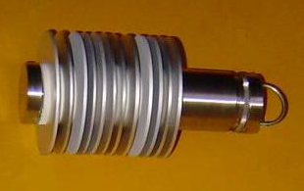
FIELD TESTS
Coupons (10 cm in diameter).
Uncoated and coated coupons were stacked in racks.
Racks were suspended in the spent fuel section of the IEA-R1 research reactor in IPEN, Brazil,
The coupons were exposed to the IEA-R1 reactor spent fuel section water for 3 and 5 months

Slide 22
Surface features compared to those observed on AA 6061 coupons prior to exposure to the IEA-R1 research reactor spent fuel section
Coating | Surface features after exposure for
 | 3 months | 5 months
None | Many pits | Stained and one pit
Boehmite | No difference | Many tiny pits
Boehmite + Ce | No difference | Few pits
HTC – HT | No difference | No difference
HTC – HT + Ce | No difference | No difference
HTC – HT + sealed | No difference | No difference
HTC – HT + Ce + sealed | No difference | No difference
HTC – LT | No difference | Dark and some pits
HTC – LT + Ce | No difference | Dark and some pits
HTC – LT + sealed | No difference | Very dark and one pit
HTC – LT + Ce + sealed | No difference | Very dark + two pits

Slide 23
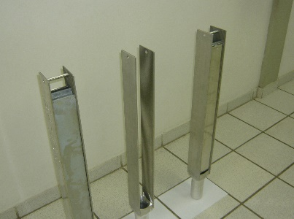
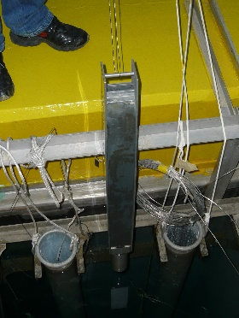
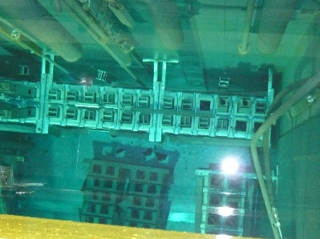
Uncoated and coated plates assembled to form dummy fuels
A dummy fuel being withdrawn after 8 months
In spent fuel section

Slide 24
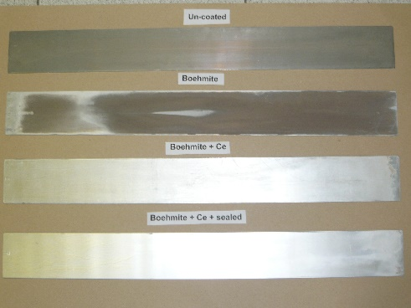
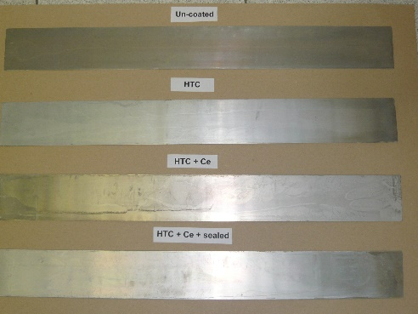
Uncoated and coated plates after 8 months of exposure to the IEA-R1 spent fuel section

Slide 25
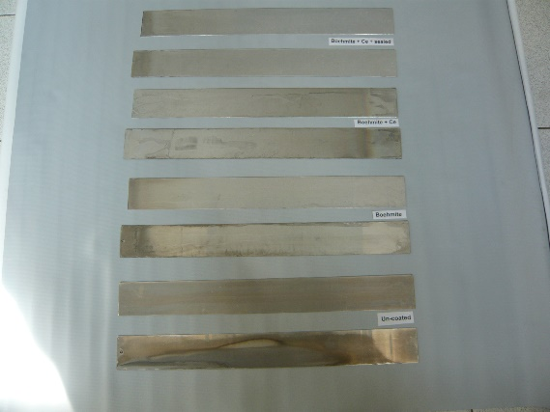
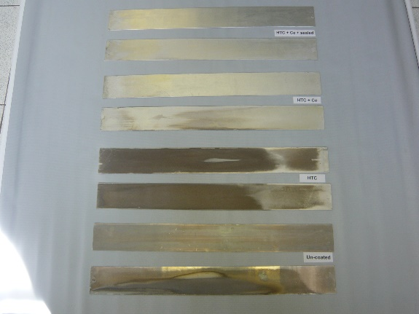
a
b
Photographs of full-size plate surfaces. (a) Boehmite coated and (b) HTC coated. The plates above the identification mark were exposed for 8 months and the plates below, for 14 months.

Slide 26
Surface features on untreated and treated AA 6061 plates exposed to the IEA-R1 reactor’s spent fuel section for 8 and 14 months.
Surface treatment | Plate surface features
 | After 8 months |  | After 14 months
 | Side - A | Side - B | Side - A | Side - B
Untreated | 11 pits surface dark. | 5 pits, surface dark. | 10 pits, surface dark. | No pits, surface dark.
Boehmite | No pits, surface very dark. | 1 pit, surface very dark. | 4 pits, stained. | 6 pits, stained.
Boehmite + Ce | No pits, surface white. | 7 pits, dark stain in center. | No pits, Grey stain. | No pits, stained.
Boehmite + Ce + sealed | No pits, surface oxide layer. | 5 pits, dark stain in center | 1 pit, surface stained. | 4 pits, surface stained.
HTC | No pits, dark surface. | No pits, dark surface. | No pits, very dark surface. | No pits, dark surface.
HTC + Ce | 8 pits at lower end. | 8 pits at lower end. | No pits, stained. | No pits, stained.
HTC + Ce + sealed | No pits. | No pits. | No pits. | No pits.

Slide 27
The mechanism by which HTC imparts pitting corrosion protection is refered to as ‘passive corrosion protection’.
The HTC acts as a physical barrier between the solution and the surface.
The mechanism by which the cerium modified HTC imparts protection is considered to be ‘active corrosion protection’, analogous to that in chromium coatings.

Slide 28
Active corrosion protection
This involves release of Ce ions from the coating, transport through the solution and its action at defect sites to stifle corrosion.
It has been speculated that if a Ce⁴⁺ bearing inorganic coating contacts a solution, soluble Ce⁴⁺ is released into the solution. When these ions encounter reducing conditions, like those associated with exposed bare metal at coating defects, it reduces to Ce³⁺, which forms an insoluble hydroxide and precipitates.
The precipitated cerium hydroxide at the defect then stifles further corrosion.

Slide 29
Conclusions
Hydrotalcite (HTC) coatings on AA 6061 alloy were prepared from nitrate baths at 98 °C and carbonate baths at room temperature.
HT-HTC coating increased pitting resistance of the alloy more than LT-HTC coating
Cerium incorporation in the HT-HTC and boehmite coating increased pitting resistance of the alloy.

Slide 30
Conclusions (contd)
Sealing of LT-HTC coatings increased pitting corrosion resistance of the alloy.
Coupons and `dummy` fuel elements with full-size plates coated with HT-HTC and exposed to the IEA-R1 reactor spent fuel section for 5 and 14 months respectively did not reveal any pits, indicating marked potential for use of HT-HTC as a protective coating on spent RR fuel during long term wet storage.

Slide 31
A process involving simple immersion in several solutions to form cerium containing HTC coating on Al alloys increases significantly the pitting corrosion resistance of the alloy.
This process can be scaled-up to increase the corrosion resistance of Al-clad spent RR fuel assemblies during long term wet storage.

Slide 32
Process to coat Al-clad spent fuels with cerium modified hydrotalcite

Slide 34
Degrease
Acetone
2 min.

Slide 35
Degrease
Acetone
2 min.

Slide 36
Degrease
Acetone
2 min.
Rinse
Water
2 min.

Slide 37
Degrease
Acetone
2 min.
Rinse
Water
2 min.

Slide 38
Degrease
Acetone
2 min.
Rinse
Water
2 min.
Form
HTC
LiNO₃
15min.

Slide 39
Degrease
Acetone
2 min.
Rinse
Water
2 min.
Form
HTC
LiNO₃
15min.

Slide 40
Degrease
Acetone
2 min.
Rinse
Water
2 min.
Form
HTC
Li₂CO₃
15min.
Rinse
Water
2 min.

Slide 41
Degrease
Acetone
2 min.
Rinse
Water
2 min.
Form
HTC
Li₂CO₃
15min.
Rinse
Water
2 min.

Slide 42
Degrease
Acetone
2 min.
Rinse
Water
2 min.
Form
HTC
LiNO₃
15min.
Rinse
Water
2 min.
Incorporate
Cerium
Ce(NO₃)₂
5 min.

Slide 43
Degrease
Acetone
2 min.
Rinse
Water
2 min.
Form
HTC
LiNO₃
15min.
Rinse
Water
2 min.
Incorporate
Cerium
Ce(NO₃)₂
5 min.

Slide 44
Degrease
Acetone
2 min.
Rinse
Water
2 min.
Form
HTC
LiNO₃
15min.
Rinse
Water
2 min.
Incorporate
Cerium
Ce(NO₃)₂
5 min.
Rinse
Water
2 min.

Slide 45
Degrease
Acetone
2 min.
Rinse
Water
2 min.
Form
HTC
LiNO₃
15min.
Rinse
Water
2 min.
Incorporate
Cerium
Ce(NO₃)₂
5 min.
Rinse
Water
2 min.

Slide 46
Degrease
Acetone
2 min.
Rinse
Water
2 min.
Form
HTC
LiNO₃
15min.
Rinse
Water
2 min.
Incorporate
Cerium
Ce(NO₃)₂
5 min.
Rinse
Water
2 min.
Air flow
Dry

Slide 47
THANK YOU

