Slide 1
The study and analyze the operation of the Bandung TRIGA research reactor using plate-type fuel elements.
Ketut Kamajaya
National Nuclear Energy Agency
Bandung - Indonesia
Vienna, 16-20 november 2015

Slide 2
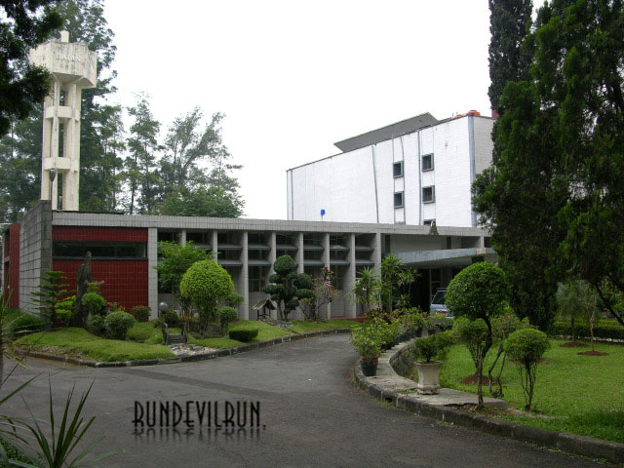
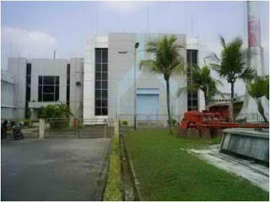
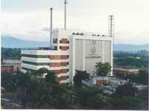
Serpong reactor 30 MW
1964
1979
Bandung reactor
2000 kW
1987
Yogya reactor
100 kW
Fig. 1. Three research reactors
in Indonesia

Slide 3
Brief history of Bandung TRIGA reactor
Bandung TRIGA Mark II Reactor was first critical on October 10, 1964 and since then it was operated at power level of 250 kW
In 1971, the reactor was upgraded from 250 kW to 1000 kW
In 2000, the reactor was upgraded from 1000 kW to 2000 kW

Slide 4
Reactor was critical at 2000 kW in May 2000.
In 2001, Bandung TRIGA reactor received an operating license for nominal power 2000 kW, valid until December 2016.
In 2006, the license was limited to 1250 kW as a result of excessive bubbles in the reactor core.
In 2007 - 2010 has been done on-line sipping test for investigation of the fuel leakage, by performing on-line gamma analysis of the fission product

Slide 5
Since September 2011, the reactor operating license has been suspended by the Indonesian Regulatory Body because of technical issues related to fuel burn-up (FFCR) and seismic hazard.
In addition, 3 of 5 FFCRs have burn-up up to 50% and the reactor building need to be strengthened (reinforced)
In 2014 the reactor building has been reinforced
In 2015 a control rod without fuel has been designed, until now has been made one control rod and is being tested.

Slide 6
If the test results were good, it will make two additional control rods
Expected early 2016 Bandung TRIGA reactor has been able to operate normally, using existing fuel elements
Until currently, the Bandung TRIGA reactor still has 125 fuel elements, seven of them are fresh fuel elements

Slide 7
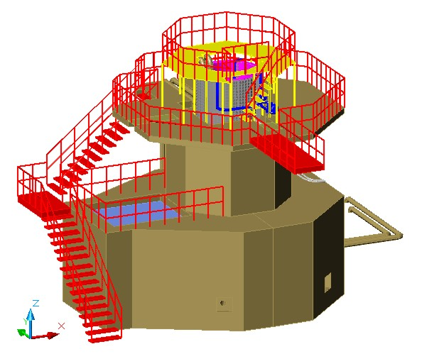
Fig. 2. Bandung TRIGA Reactor

Slide 8
Reactor critical 250 kW
Journey of time
Reactor began Upgrading
Regulatory body permits
reactor operation
Study of thermal-hydraulics plate-type fuel
License limited
to 1250 kW
1964
1996
2006
2014
2016
1971
2000
2011
2015
2017
?
License
suspended
Reactor critical 1000 kW
Reactor critical 2000 kW
Study of neutronic plate-type fuel
The reactor is expected
to be operated

Slide 9
To convert Bandung TRIGA reactor standard fuel elements into plate-type fuel elements

Slide 10
Purpose of this study
This technical study is intended to provide assurance that it is technically the Bandung TRIGA reactor fuel can be converted into a plate-type fuel elements

Slide 11
The scope of activities to prepare operate the reactor using a plate-type fuel elements

Slide 12
This study will only discuss the feasibility and safety aspects of the operation Bandung TRIGA reactor converted, which uses plate-type fuel element, from the viewpoint of the neutronic.
This study will be conducted for one year, until the end of 2015.
If the neutronic aspect is feasible, then in the second year (2016) will be followed by a thermo-hydraulic study

Slide 13
Results of Study (General criteria)
Using all reactor systems available today: reactors tank, thermal-thermalizing column, beam-ports, reflector, rotary specimen rack, primary and secondary cooling system.

Slide 14
Using of the technology that has been well known and tested: manufacture of plate-type fuel elements U₃Si₂-Al, and control elements Ag-In-Cd
Each fuel element is composed of 21 plates
Using full symmetry core configuration: symmetry power distribution and neutron flux, and ease to manage of fuel elements

Slide 15
Have been analyzed several different variations of the reactor core configuration

Slide 16
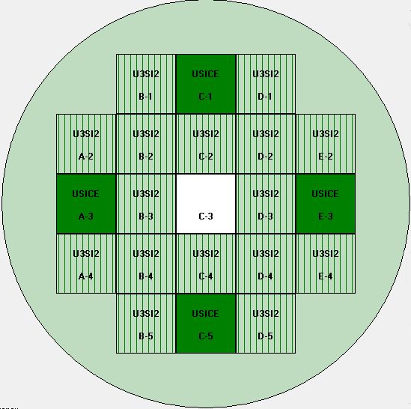
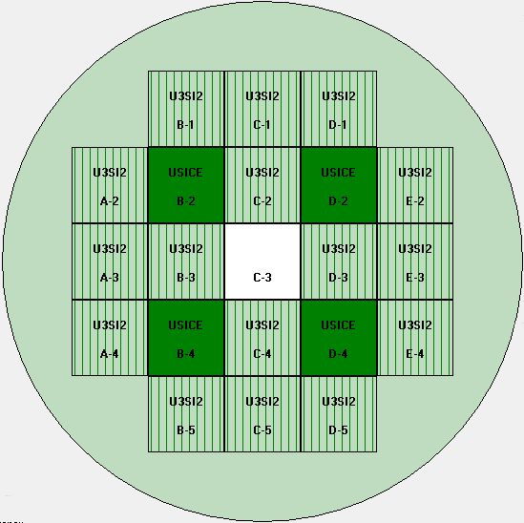
Fig. 3. TRIGA reactor core with plat-type fuel elements

Slide 17
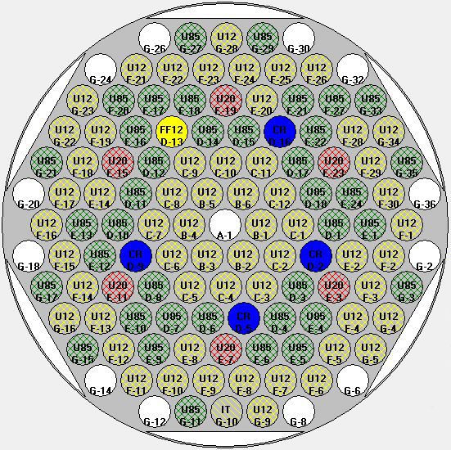
The reactor core configuration chosen
Fig. 4. TRIGA reactor core with standard fuel elements
Fig. 5. TRIGA reactor core with plat-type fuel elements

Slide 18
Core lattice size is 5 x 5, and five positions irradiation facility, A-1, A-5, C-3, E-1 and E-5
Loaded a maximum of 20 fuel elements, including control elements (16 fuel elements, 4 control elements)
The alternative control element position at the B-2, D-2, B-4, and D-4.

Slide 19
One center irradiation position (CIP) at C-3, and four irradiation positions (IP) at A-1, A-5, E-1, and E-5.
Material control elements are Ag-In-Cd (85 : 10 : 5) w-%
U₃Si₂-Al fuel elements, 178.6 g, with 19.75% enrichment and a density of 2.96 g.cc⁻¹

Slide 20
By using MCNP5 and ORIGEN program for the reactor power 2000 kW obtained:
Thermal neutron flux 2.89 x 10¹³ cm⁻².sec⁻¹ at the CIP and 1.55 x 10¹³ cm⁻².sec⁻¹ at the IP
TRIGA reactor can be operated continuously for a minimum of 800 days in 1000 kW power

Slide 21
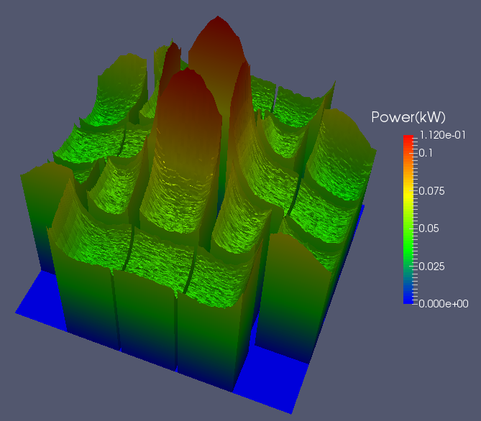
Fig. 6. Power distribution of each
fuel element
Fig. 7. Power distribution per plate
of fuel elements

Slide 22
Examples of the calculation result of burn-up on some of the fuel elements at some position

Slide 23
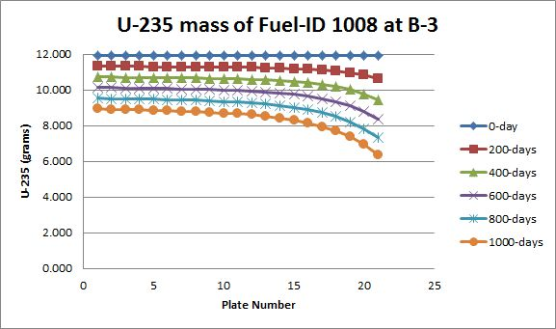

Slide 24
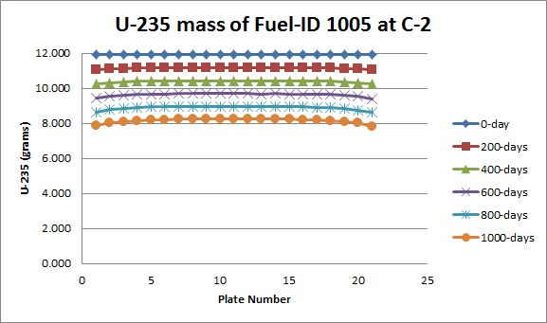

Slide 25
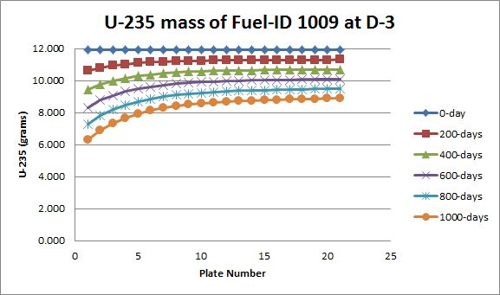

Slide 26
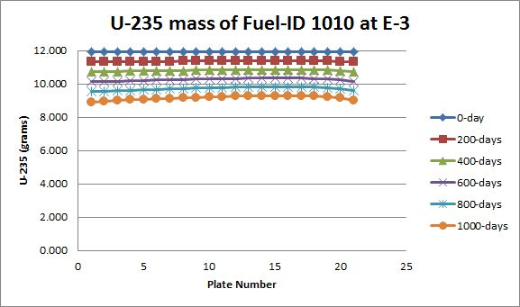

Slide 27
Conclusion of Study
The results of study and analysis from the viewpoint of neutronic that the Bandung TRIGA reactors can be designed and be operated by using plate-type fuel elements.
The fuel elements to be used, such as those used in the Serpong reactor - Indonesia.

Slide 28
Neutronic analysis will be used as a reference in the design of thermo-hydraulic system and the reactor coolant system.
Expected at the end of the second year (2016), the design of the neutronic and thermo-hydraulic reactor can be resolved.

Slide 29
Thank you

