Slide 1
International Policies and Tools for Protecting Against Radiological Sabotage
Rosalyn Leitch, Dennis Stanford, Robert Brigantic
Pacific Northwest National Laboratory
PNNL-SA-112586

Slide 2
Overview
The Threat of Nuclear Terrorism and the International Response
International Policies and Guidance
Physical Protection of Nuclear Facilities against Sabotage
Tools for Analyzing Radiological Release and Consequences of Sabotage
PNNL-SA-112586

Slide 3
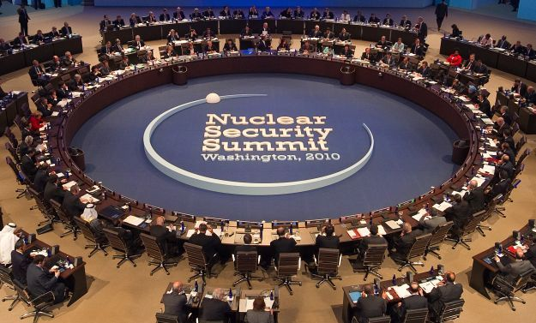
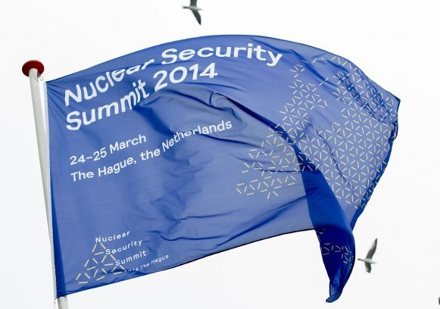
The Threat of Nuclear Terrorism and the International Response
“The tragic terrorist attacks on the United States were a wakeup call to us all. We cannot be complacent. We have to and will increase our efforts on all fronts - from combating illicit trafficking to ensuring the protection of nuclear materials – from nuclear installation design to withstand attacks to improving how we respond to nuclear emergencies.”
IAEA Director General Mohamed El Baredei (2001)
Nuclear Security Summit Process
Global Initiative to Combat Nuclear Terrorism (GICNT)
https://iwearthetruth.files.wordpress.com/2010/05/nss2-jpeg-scaled1000.jpg
http://en.aectourismthai.com/images/blog/content1/20140430194319.jpg
PNNL-SA-112586

Slide 4
International Policies and Guidance: INFCIRC 225, Revision 5¹
5.1 An objective of the State’s physical protection regime is to protect against sabotage….
5.4 For each nuclear facility, an analysis, validated by the competent authority, should be performed to determine whether the radioactive inventory has the potential to result in unacceptable radiological consequences as determined by the State, assuming that the sabotage acts will be successfully completed while ignoring the impact of the physical protection or mitigation measures.
5.8 If the potential radiological consequences of sabotage exceed the State’s unacceptable radiological consequences, then the operator should identify equipment, systems or devices, or nuclear material, the sabotage of which could directly or indirectly lead to this condition as potential sabotage targets and protect them in accordance with the following design and protection requirements.
¹ International Atomic Energy Agency. 2013. Nuclear Security Recommendations on Physical Protection of Nuclear Material and Nuclear Facilities. INFCIRC/225/Revision 5, IAEA Nuclear Security Series No. 13, Vienna, Austria.
PNNL-SA-112586

Slide 5
International Policies and Guidance: Other Policies and Guidance Documents
IAEA NSS-16, Identification of Vital Areas at Nuclear Facilities
IAEA NSS-4, Engineering Safety Aspects of the Protection of Nuclear Power Against Sabotage
Convention on the Physical Protection of Nuclear Material (CPPNM), Amended
International Convention on the Suppression of Acts of Nuclear Terrorism (ICSANT)
http://www-pub.iaea.org/MTCD/Publications/PDF/Pub1505_web.pdf
http://www-pub.iaea.org/MTCD/Publications/PDF/Pub1271_web.pdf
PNNL-SA-112586

Slide 6
Radiological Sabotage
Radiological sabotage is any deliberate act directed against a nuclear facility or nuclear material in use, storage, or transport which could directly or indirectly endanger the health and safety of personnel, the public, or the environment by exposure to radiation or release of radioactive substances.
Potential consequences include radiological release, environmental contamination, injury to persons, loss of use of a facility, and potentially negative economic and political consequences.
High risk facilities: nuclear power plants, spent fuel pools, research reactors, transport shipment of nuclear and radioactive material, waste storage facilities
Two categories of sabotage: direct access attack and indirect/standoff attack
State determines its own threshold for unacceptable radiological consequences based on a variety of factors including dose level, radioactive material release level, or plant state
PNNL-SA-112586

Slide 7
Threat Assessment
Threat Assessment
Design Basis Threat (DBT) defines the threat characteristics against which the operator should provide protection (Category I facilities)
Category II and III facilities can have either a threat assessment or a formal DBT
Obtain an inventory of nuclear and radiological material on site, specifically noting the form, activity level, and location on site for each inventory item
Identify critical safety functions and potential sabotage targets for the nuclear facility
PNNL-SA-112586

Slide 8
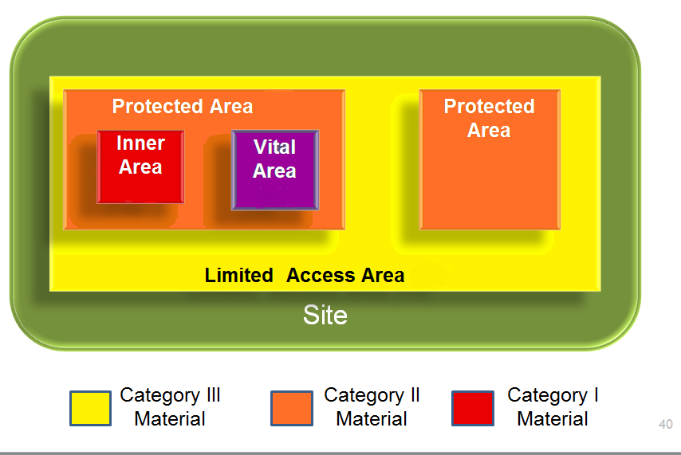
Vital Area Identification
Vital Area Identification: the process of identifying the areas in a nuclear facility around which protection will be provided in order to prevent or reduce the likelihood of sabotage.
Identify possible initiating events of malicious origin (IEMOs) that could lead to unacceptable radiological consequences and identify IEMOs that exceed the capability of existing mitigation systems
Identify specific systems, structures, and components needed to mitigate negative consequences for each IEMO
Figure 1: Location and Boundaries for Protected, Inner, and Vital Areas
PNNL-SA-112586

Slide 9
Sabotage Analysis Tools
Radiological Assessment System for Consequence Analysis (RASCAL)
Developed for the U.S. Nuclear Regulatory Commission
Designed for use in the independent assessment of dose projections during response to radiological emergencies
Turbo Federal Radiological Monitoring and Assessment Center (FRMAC)
Developed by Sandia National Laboratory’s Nuclear Incident Response Program (NIRP)
Uses values generated by field samples, instrument readings, or computer dispersion models to generate and assess values that are meaningful and useful for decision makers for a radiological emergency.
RASCAL model of potential release pathways during containment leakage/failure
http://pbadupws.nrc.gov/docs/ML1328/ML13281A701.pdf
PNNL-SA-112586

Slide 10
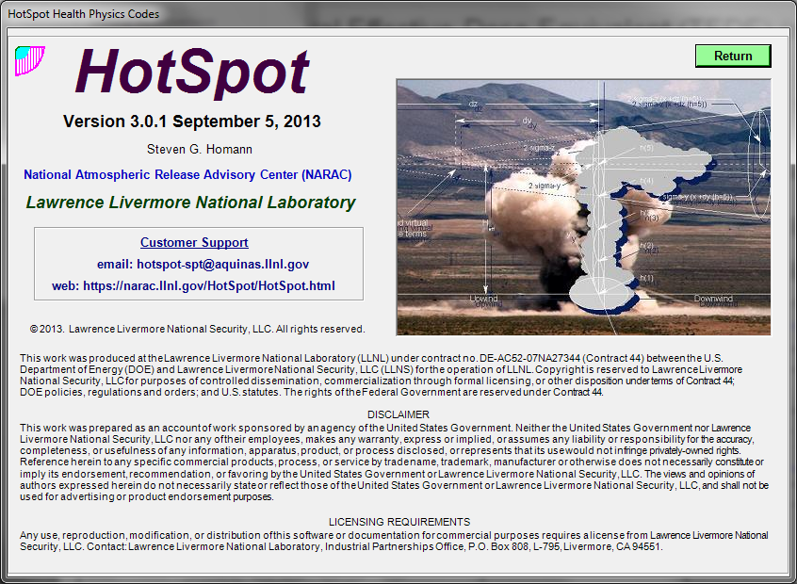
Sabotage Analysis Tools
HotSpot ® Health Physics Code*
A computer code to provide fast, field-portable set of software tools for evaluating incidents involving radioactive material
For current purposes, user enters isotope, activity level, and explosive mass
HotSpot returns total effective dose equivalent (TEDE) as a function of distance
ENSEMBLE
Allows the rapid exchange, display and analysis of atmospheric dispersion forecasts produced by 22 models operational in 18 countries in Europe, US and Canada
Based on server-side technology and does not require any specific software installation
* HotSpot ® was developed by Lawrence Livermore National Laboratory
PNNL-SA-112586

Slide 11
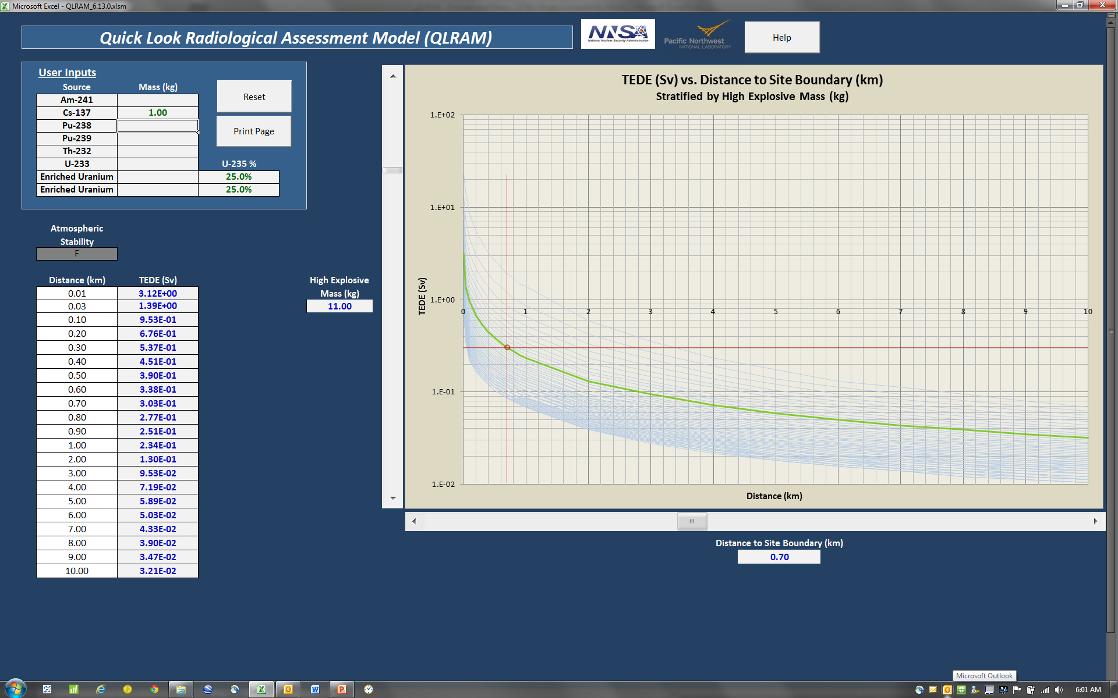
Quick Look Radiological Assessment Model (QLRAM) Development
PNNL developed a web-based tool that performs the analysis of a sabotage threat based on isotope, mass, and explosive weight
The tool does not require the user to perform complex calculations or to determine the values for variables, and it is flexible to allow for different URC thresholds
Produces a table and graph output that show TEDE over a range of distances
PNNL-SA-112586

