Slide 1
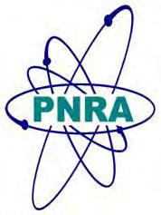
PNRA Role for Ensuring Safety of Research Reactors
International Conference on Research Reactors: Safe Management and Effective Utilization
Vienna, Austria, 16-20 November, 2015
Farhana Naseer
Pakistan Nuclear Regulatory Authority (PNRA)

Slide 2
Contents
Research Reactors and their Use in Pakistan
History of Regulatory Control of Research Reactors
PNRA Activities for ensuring Safety of Research Reactors
Conclusion

Slide 3
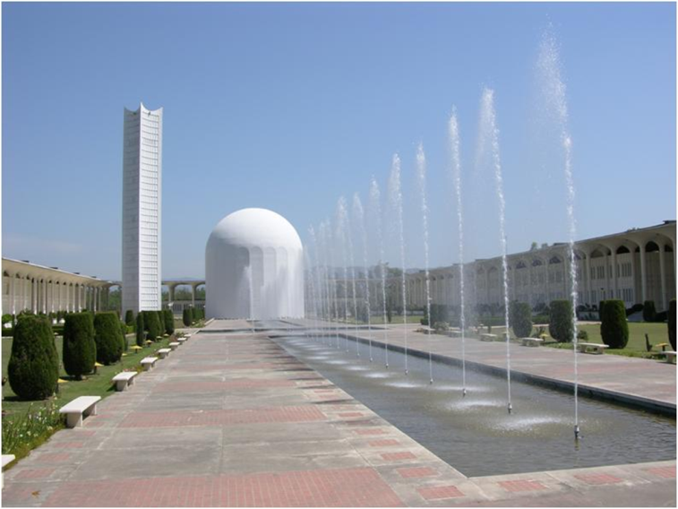
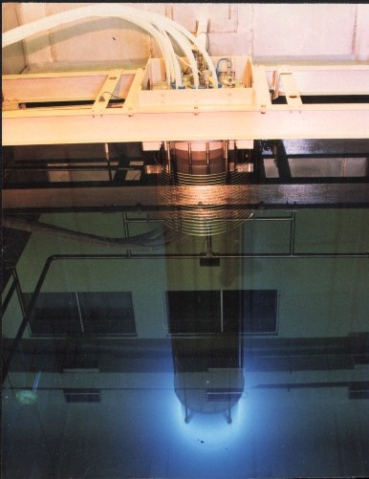
Research Reactors and their Use in Pakistan
PARR-1
Pool type reactor with 10 MW power and used for radioisotope production & training of personnel
PARR-2
Tank in a pool type reactor of 27KW and used for training of personnel

Slide 4
History of Regulatory Control of Research Reactors
1964 Review of PARR-1 SAR by Pakistan Nuclear Safety Committee
1984 Review of up-gradation of PARR-1 (5MW to 10 MW)
1993 License was granted to PARR-2
1988 PARR-2 SAR was reviewed
2001 Pakistan Nuclear Regulatory Authority
2000 Formal operating license was granted to PARR-1

Slide 5
PNRA Activities for ensuring Safety of Research Reactors
Development & maintenance of Regulatory Framework
Licensing
Regulatory Oversight
Operator Licensing
Coordination with Licensee
Application of Graded Approach

Slide 6
Development of Regulatory Framework
Ordinance
Regulations
Regulatory Guides
Codes and Standards

Slide 7
Development & Maintenance of Regulatory Framework
Regulations
Regulations for Licensing of Nuclear Installations (PAK/909)
Regulations on the Safety of Research Reactor(s) Operation (PAK/923)
Regulations on the Safety of Nuclear Installations- Site Evaluation (PAK/910)
Regulations on Radiation Protection (PAK/904)
Regulations on the Safety of NPP Quality Assurance (PAK/912)
Regulations on Management of a Nuclear or Radiological Emergency (PAK/914 )
Regulations on Radioactive Waste Management (PAK/915)
PNRA Enforcement Regulations (PAK/950)

Slide 8
Licensing Process
Site Registration
Construction Licence
Permission for Commissioning
Permission to Introduce Nuclear Material
Operating
Licence
Licence Revalidation
Licensing beyond Design Life
Licensing for Decommissioning or closure
Removal from Regulatory Control

Slide 9
Regulatory Oversight
Mainly based on
Review & assessment of routine/non routine submissions
Regulatory inspection
Enforcement
Regional Directorates responsible for performing regulatory inspections
Planned/unplanned inspections
In case of non-compliance, enforcement actions are taken under PAK/950

Slide 10
Operator Licensing
PNRA licenses :
Shift supervisor
Reactor operator
Elements of Operator licensing process:
written examinations,
Oral examinations
Operating tests
Oversight of requalification training and examination programs

Slide 11
Co-ordination with Licensee
Formal Coordination Meetings
Periodicity of the meetings
Recording of decisions / actions made during meetings
Follow-ups

Slide 12
Application of Graded Approach
Hazards and risks associated with facility
Examples of graded approach
Allocated resources
Level of regulatory control, frequency of inspection
Emergency preparedness & planning

Slide 13
Conclusion
Regulatory infrastructure is developed and in place for ensuring safety of research reactors in Pakistan
Regulatory processes are defined
Strong regulatory oversight is one of the significant factors in safe operation of research reactors for almost five decades

Slide 14
Thank You

