Slide 1
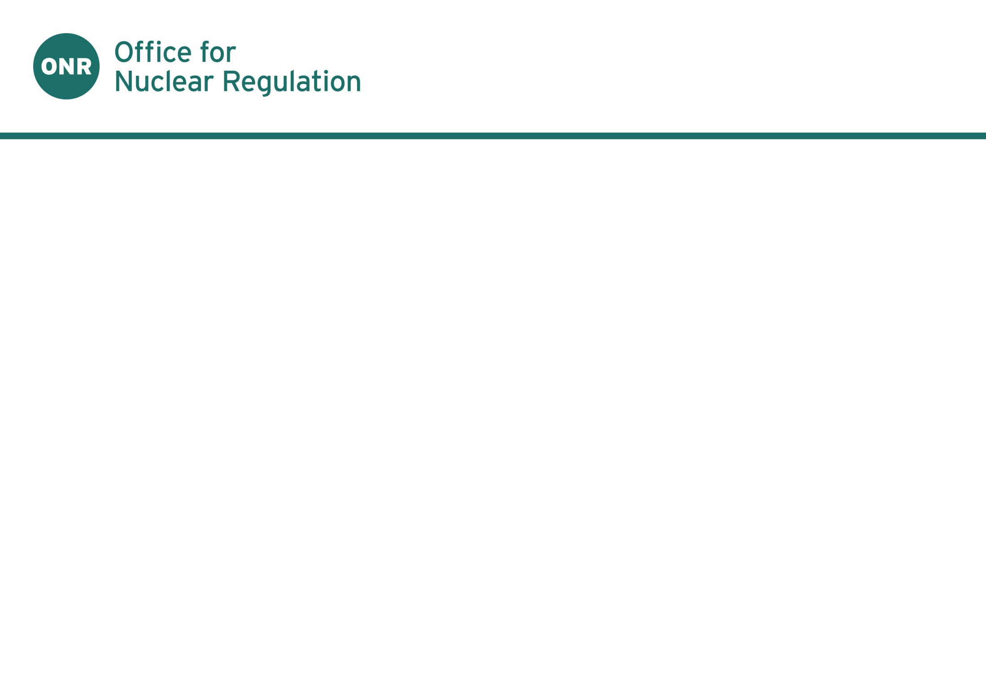
The UK Response to Fukushima
Dr Andy Hall
Chief Nuclear Inspector

Slide 2
Contents
UK Response to Fukushima
EC Stress Tests
Benefits of Goal Setting Regulation
Application of Modern Standards to Older Plant
“Intelligent Customer” Arrangements and their application to Technical Support

Slide 3
ONR Response to Fukushima
17000 UK nationals in Japan - securing the protection of people and society
Incident Suite set up providing advice to Highest levels of UK Government
Prompt assurance of UK fleet
Chief Inspector’s Interim Report to Secretary of State – May 2011
Chief Inspector’s Final Report to Secretary of State – September 2011

Slide 4
Chief Inspector’s Final Report
ONR’s review of the information available did not reveal any vulnerabilities with UK nuclear facilities or shortcomings in safety methodology that would require operations to be curtailed
Approach to design basis is sound.
No gaps were revealed in ONR’s safety assessment principles.
Periodic safety reviews robustly identify necessary improvements to facilities in the UK.
Notes:
Included all UK nuclear facilities
Total of 17 conclusions and 38 recommendations

Slide 5
Recommendations
General: need for good comms, seek lessons for emergency preparedness & enhance openness
For regulators: review standards/guidance and emergency preparedness, particularly for severe accidents
For industry: review aspects of accident for implications, e.g. resilience, natural hazards, AC supplies, cooling, site/plant layout, human performance, emergency preparedness, data comms.

Slide 6
EC Stress Tests
European Council 24/25 March – safety of all EU nuclear plants should be reviewed
WENRA developed, and ENSREG agreed a consistent approach applied across the EU
Stress Tests applied to EU countries operating NPPs.
Publication of National Action Plans delivering transparency of implementation programmes
Notes:
In the wake of events at Fukushima, every nuclear power generating country in Europe agreed to carry out safety 'stress tests'. The tests [completed in the UK, by licensees] involve a targeted reassessment of each NPP’s safety margins in light of extreme natural events, such as earthquake and tsunami.
The stress test can be summarised as the licensed nuclear installations targeted reassessment of the relevant safety margins in light of the events which occurred at Fukushima: Extreme natural events challenging the plant safety functions and leading to a severe accident.
The 'stress tests' were a three step process:
Operator Assessment - all operators to perform an assessment and make proposals for safety improvements, following the ENSREG specifications.
Regulatory Review - national regulators performed an independent review of the operators assessments and issue requirements where appropriate.
a European peer review of all the national reports submitted by regulators.
The stress tests were followed up by publication of National Action plans explaining the programme for implementation of actions identified from application of the stress tests.
ENSREG will host a National Action Plan Workshop to review progress against National Action Plans in April 2015.

Slide 7
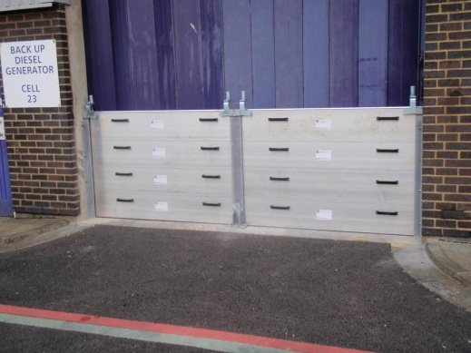
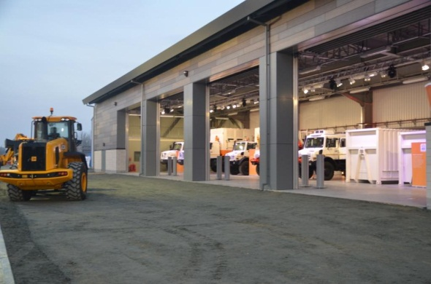
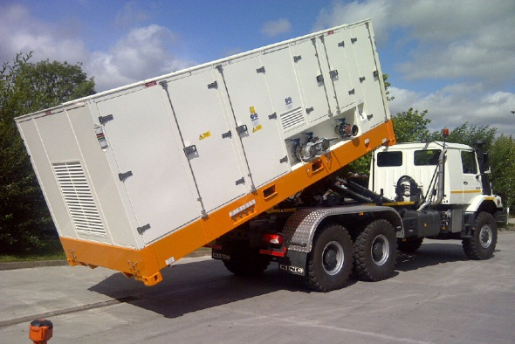
UK Approach to Stress Tests
Each UK licensee produced stress test reports. NPP reports published - October 2011
ONR issued “European Council Stress Tests for UK Nuclear Power Plants – National Final Report”, December 2011
Raised 19 Stress Test Findings (STFs)
Notes:
The tests, completed by licensees, involve a targeted reassessment of each stations safety margins in light of extreme natural events, such as earthquake and tsunami.
The UK National Final Report, published in December built on the Chief Inspector’s Reports and reported on licensees’ progress in implementing recommendations from these earlier reports.
Given that the European Council stress tests only focus on NPPs, ONR decided to extend the stress test process to all other licensed nuclear installations within the UK.

Slide 8
Approaches to Safety Regulation
Many regulators set out rules telling operators how to ensure safety – a ‘prescriptive’ approach
UK instead has a ‘goal-setting’ approach, which makes it a legal duty to meet the safety goals, but does not set out in detail how operators should meet this duty.
Requirement to “reduce the risk to workers and the public so far as is reasonably practicable,” places legal requirement to seek continuous improvement.
Notes:
When considering lessons learnt from Fukushima (particularly as regulators or TSOs) it is interesting to compare differing approaches to regulation and their relative benefits.
Many countries have adopted a rule-based approach in which the regulator prescribes the measures that designers and operators must take to assure safety.
The UK is different as it has a goal-setting approach to all aspects of safety regulation
Fundamental UK safety law is the HSWA 1974, which applies to all work activities
Enacted as a reaction to the ever growing number of prescriptive safety regulations from the time of the industrial revolution, which attempted to control hazards in the light of experience of incidents and accidents.
I am fully committed to (indeed my entire organization is fully committed to) the principle of “continuous improvement.” I believe that this commitment is key to achieving high standards of nuclear safety.
The principle of continuous improvement is embedded in UK law, where there is a requirement for nuclear designers and operators to reduced risks so far as is reasonably practicable. This means that, no matter how high the standards of nuclear design and subsequent operation are, the quest for improvement should never stop. Seeking to learn from events, new knowledge and experience, both nationally and internationally, is a fundamental feature of the safety culture in the UK nuclear industry.

Slide 9
UK Approach to Design Basis
No prescribed lists of accidents to be considered in the design basis
Probabilistic identification of the faults must be combined with deterministic analyses of representative faults to demonstrate that the protection would be effective
Operator has initially to identify all events that could potentially lead to either a person receiving a significant radiation dose or a significant escape of radioactive material
Notes:
This difference is illustrated by the UK approach to identifying the design basis
In the UK, the operator rather than the nuclear safety regulator is required to demonstrate the safety of plant
We ask “why do you think it will operate safely?” If the answer is because it is designed to be robust against a list of anticipated events specified by X, we would then ask “why do you think that is sufficient?”
The approach the operator has to adopt is to start by identifying all possible events that could possibly lead to an accident – SAP FA.2

Slide 10
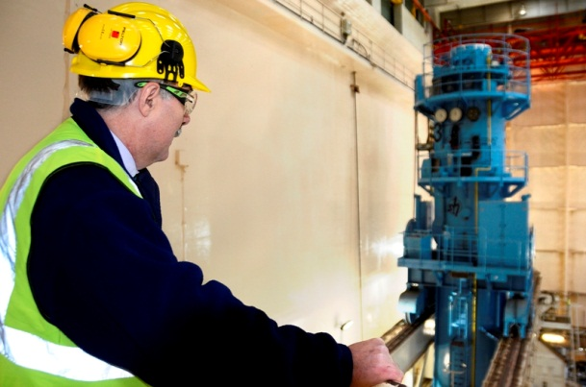
Application of standards to older plant
Fukushima Daiichi reactors entered service between 1971 and 1979
UK also has old nuclear facilities
National and International standards evolve over time.
How can regulators ensure that the safety standards achieved at older facilities move with the times?
Notes:
Over the years there have been significant development in standards which apply to nuclear plant. Consider developments in seismic design, consideration of internal and non-seismic external hazards, severe accident management following [TMI].
These standards continue to evolve – only last month, WENRA issued its latest safety reference levels - incorporating learning from Fukushima. Many of the all of the UK’s reactors entered service many years before these developments. The oldest currently operating reactor, Wylfa, entered service in 1971
How can we ensure that older facilities benefit from these developments?

Slide 11
Periodic Safety Reviews
UK operators must perform Periodic Safety Reviews (PSRs) every 10 years. They must:
demonstrate that the facility still meets its original design standards
identify any issues that might limit the future life of the facility or its components and explain how they will be managed
review the safety case against modern standards and identify any emerging gaps
Notes:
The answer is by requiring operators to perform periodic safety reviews and implement any reasonably practicable improvements.
PSRs are a legal requirement under LC 15 in the UK and underpin our commitment to “Continuous Improvement.”

Slide 12
Plant Improvements
Operators have a legal duty to identify and make plant improvements if “reasonably practicable”
ONR assesses the PSRs and does not allow operation to continue beyond the anniversary if not satisfied that this is being done
Magnox improvements included improving shutdown reliability, installation of additional cooling systems, and improving their seismic resistance

Slide 13
Use of new information
UK approach: if new information might undermine a safety case, the regulator may immediately require the operator to show that risk is still reduced “so far as is reasonably practicable” and to take action if it is not
Prescriptive regimes: time lag as operators are not required to take action until the regulators have developed and enacted new decrees or rules tailored to the specific findings

Slide 14
Regulatory Independence
Significant topic post-Fukushima
Japanese regulator was criticised and government has made major changes
Managing risk to regulatory independence from use of technical support organisations
Notes:
I would like to briefly say a few words about the importance of Regulatory Independence.
Whenever a major accident occurs there are, not unreasonably, questions and comments directed to the regulatory body in relation to its role overseeing the safety of facilities. Often questions arise over the independence of the regulator, and the approach taken for individual regulatory decisions.
We have all heard about how the Japanese regulator was criticised following the accident, for its lack of independence from those parts of government promoting nuclear energy. Changes have been made to address this issue with the formation of the NRA and further steps are being taken to make changes in this regard.
Given the audience here today, I would like to talk about something different:
I would like to talk about how regulators maintain their independence when employing technical support organisations and contracts.

Slide 15
Regulatory Independence & Intelligent Customer Arrangements
In the UK the concept of “Intelligent Customer” has developed.
Ensures nuclear licensees are able to meet legal reasonability for managing safety, even when commissioning work undertaken by external organisations.
ONR’s Guide to “Licensee Core and Intelligent Customer Capabilities” outlines the concept (http://www.onr.org.uk/operational/tech_asst_guides/ns-tast-gd-049.pdf).
Notes:
Whenever a major accident occurs there are, not unreasonably, questions and comments directed to the regulatory body in relation to its role overseeing the safety of facilities. Often questions arise over the independence of the regulator, and the approach taken for individual regulatory decisions.
The concept of “intelligent customer” has developed in UK to ensure that organisations account for their legal duties for any work commissioned externally.
This builds on the prinicple that the prime responsibility for safety must rest with the person or organization responsible for the facilities that give rise to radiation.
The term intelligent customer is defined by the IAEA as follows:
‘As an intelligent customer, in the context of nuclear safety, the management of the facility should know what is required, should fully understand the need for a contractor's services, should specify requirements, should supervise the work and should technically review the output before, during and after implementation. The concept of intelligent customer relates to the attributes of an organisation rather than the capabilities of individual post holders’.

Slide 16
Regulatory Independence & Intelligent Customer Arrangements
Regulators should have to have sufficient technically competent resource to:
Target areas for Assessment
Specify and communicate work let to TSO’s
Supervise the work
Evaluate and interpret findings
Regulatory decisions must be made by warranted inspectors to safeguard regulatory independence.
Notes:
In the UK we do not have an standalone technical support organisation which we can call to undertake technical assessment. We employ experienced nuclear professional scientists, engineering, organisational safety specialists – undertaking a majority of assessment work ourselves. However, it some areas we rely on support provided by our Technical Support Contract framework to
The ONR applies the “intelligent customer” approach to its technical support.
This requires ONR to have sufficient numbers of technically and managerially competent staff to retain control and oversight of work carried out on its behalf.
An intelligent customer, ensures that it only lets contracts for assessment support, to organisations with sufficient competence, standards management systems, safety culture and resources.
The intelligent customer, ensures that TSO staff are familiar with the nuclear safety implications of the work and interact in a well coordinated manor.
Arrangements are in place to prevent any conflict of interest which may arise between the TSO’s commercial interests and the work they are undertaking for the Regulator.

Slide 17
Overall Conclusion
No fundamental weaknesses in UK nuclear facilities or systems
But…
No matter how high the standards, continuous challenge and questioning of standards is vital and all must seek to improve
This demands a vibrant and active safety culture

