Slide 1
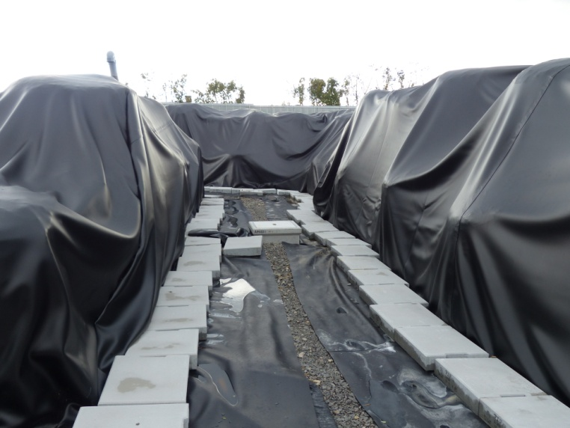
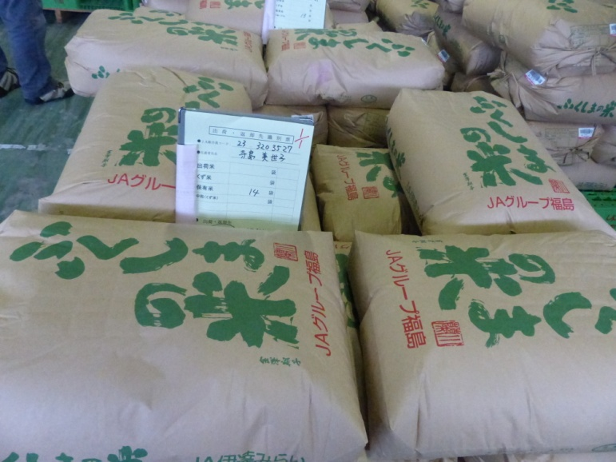
Off-site post-accident recovery after the Fukushima Daiichi accident: challenges and solutions
B.J Howard

Slide 2
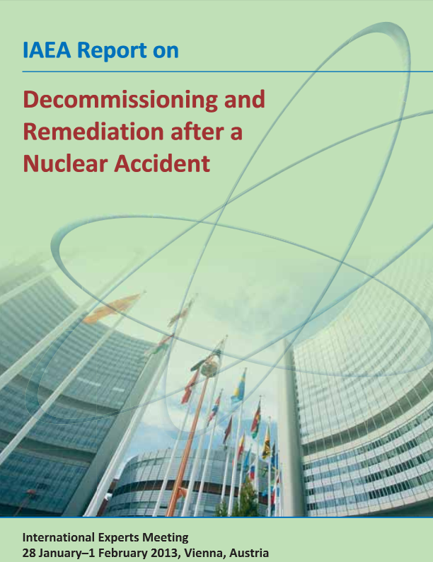
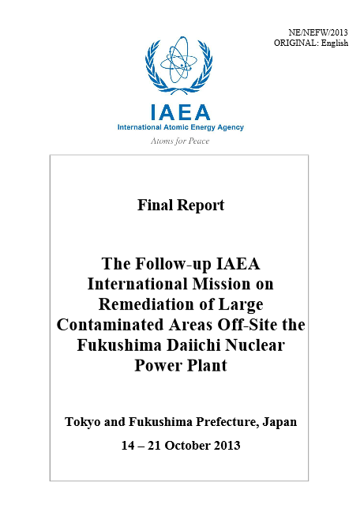
Outline
Remediation
Remediation after the Fukushima accident
Estimation of doses
Setting derived reference levels
Waste generation and management
Summary

Slide 3
What is remediation
IAEA Safety Glossary:
“.. any measures that may be carried out to reduce the radiation exposure from existing contamination of land areas through actions applied to the contamination itself (the source) or to the exposure pathways to humans”.
World Health Organization defines health as
“… a state of physical, mental and social well-being”.

Slide 4
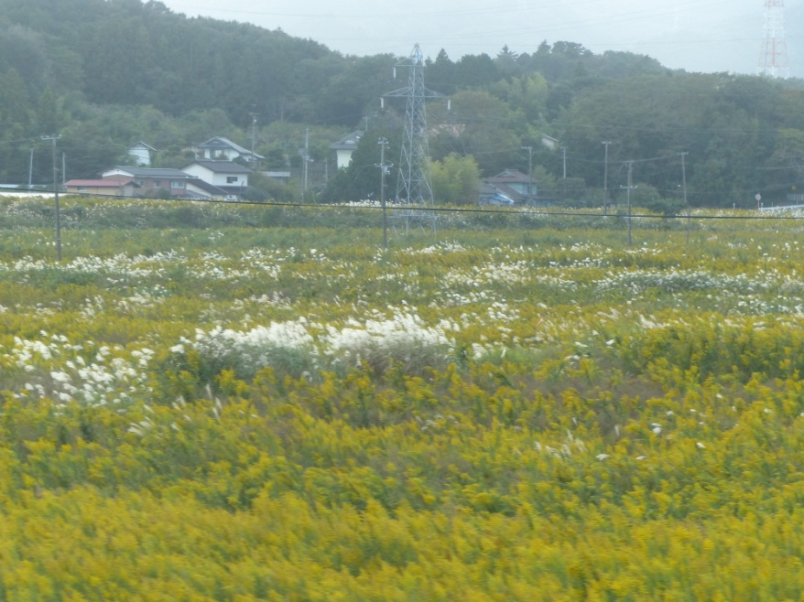
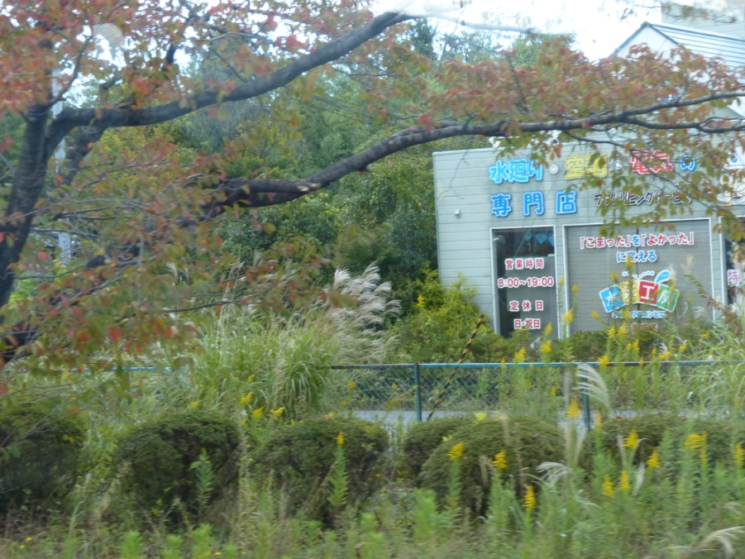
Remediation and recovery objectives
Reduction of dose
A return to normal life and livelihoods

Slide 5
Principles For Remediation
Justification for undertaking remediation
Optimisation of protection through application of remedial actions
Limitation of radiation doses
Providing appropriate protection of both humans and the environment
Targeting use of resources efficiently
Ensuring open and transparent communication with stakeholders

Slide 6
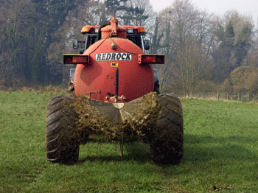
Remediation Strategy
Sets out the means for achieving the principles and requirements set out in the national policy
Normally established by the relevant remediation implementer or by government

Slide 7
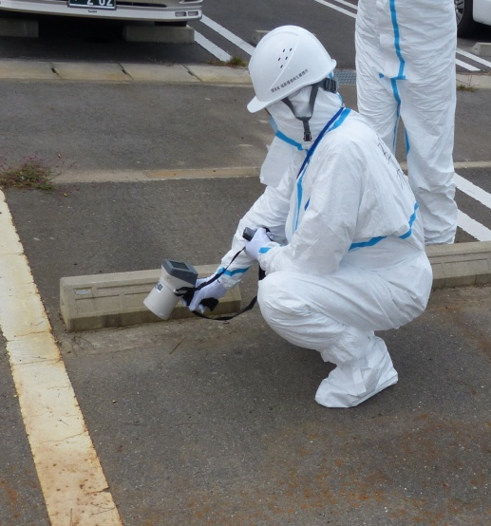
Remediation After The Fukushima Accident
Strategy applied in Japan includes the ICRP and IAEA dose criterion [reference level of annual additional effective dose 1-20 mSv]
stepwise and rapid reduction in total doses in residential areas and farmland
Long term goal - additional annual effective dose shall be 1 mSv or less
Most of the dose from external dose pathways from 2012 onwards

Slide 8
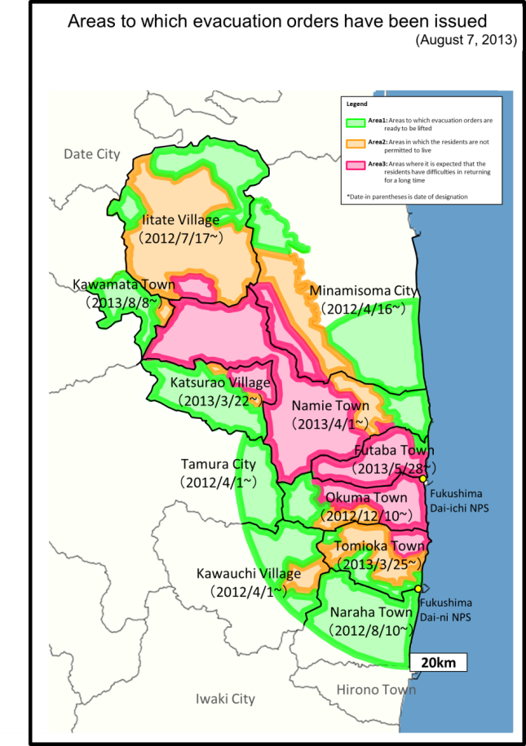
Special Decontamination Area (SDA)
previously restricted areas
deliberate evacuation areas
additional annual effective dose for individuals anticipated >20 mSv during the first year
National government

Slide 9
Intensive Contamination Survey Area (ICSA)
additional annual effective dose between 1 -20 mSv estimated in some parts of the municipality
areas where air dose rate > 0.23 µSv/h designated “Decontamination Implementation Areas”.
Municipalities

Slide 10
Estimation Of Doses
Estimation of additional annual effective dose to individuals used to define the designated areas for remediation were deliberately conservative and based on the concept of the critical group
an air dose rate of 0.23 µSv/h assumed to correspond to an additional annual effective dose of 1 mSv.

Slide 11
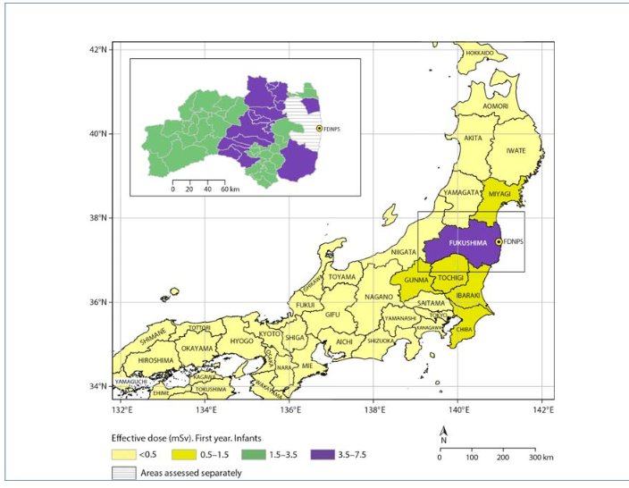
Estimation Of Doses
ICRP /IAEA quantitatively defined the representative person as a virtual person receiving an average dose from the upper 10% of the population dose distribution
large areas of land (especially ICSA) designated for remediation where average additional annual effective doses are < 1 mSv from 2012
Total effective doses (mSv) to infants in first year UNSCEAR 2014

Slide 12
Challenge - Solution
Reference levels often set in emergency phase
Large uncertainty when initially estimating doses and insufficient site-specific info
HIGHLY CONSERVATIVE
Develop models for the estimation of internal and external dose using country-specific data as part of emergency preparedness.
Derivation of reference levels such as air dose rates before an accident

Slide 13
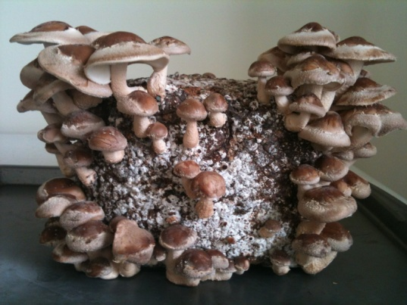
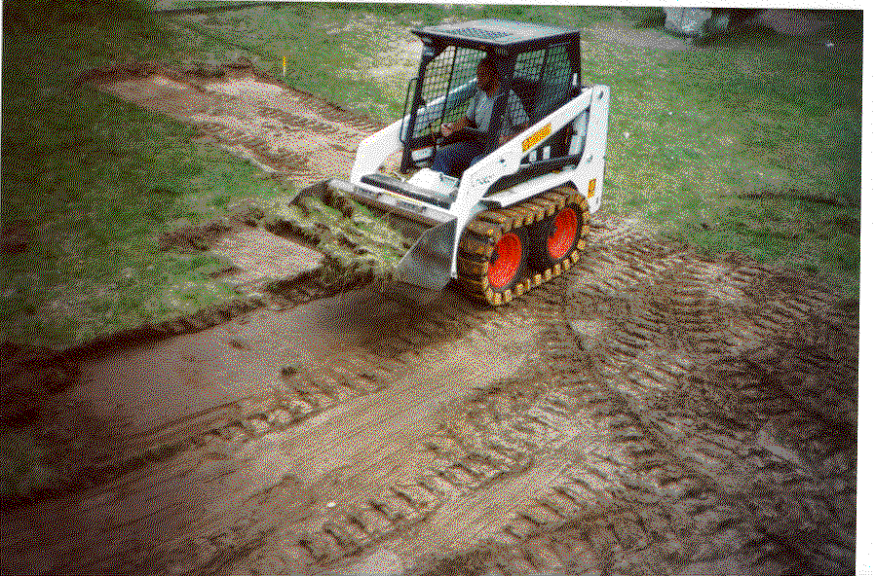
Setting Derived Reference Levels
Many factors affect effective dose received - RADIONUCLIDE, ENVIRONMENT, LAND USE, LIVING HABITS – and are site specific
Derived reference levels are a practical solution which should be site-specific and transparently derived

Slide 14
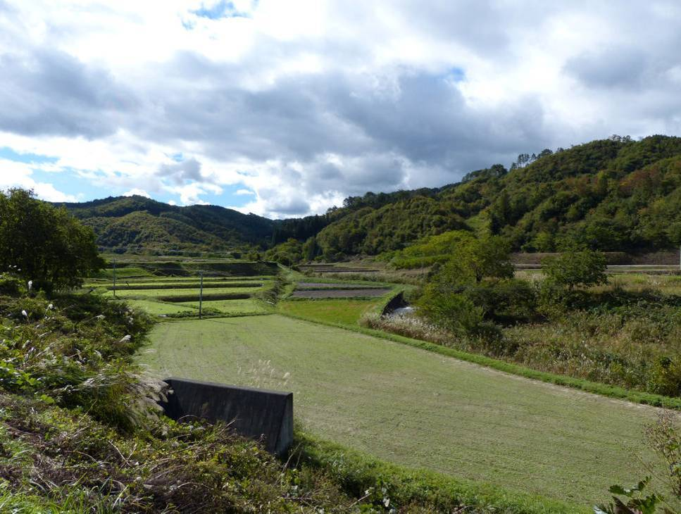
Identifying Key Pathways
Measurement and characterisation
In post accident phase BOTH deposition density and environmental characteristics important
Most key exposure routes and areas giving higher doses will be identified quickly BUT not all
LOSS OF TRUST

Slide 15
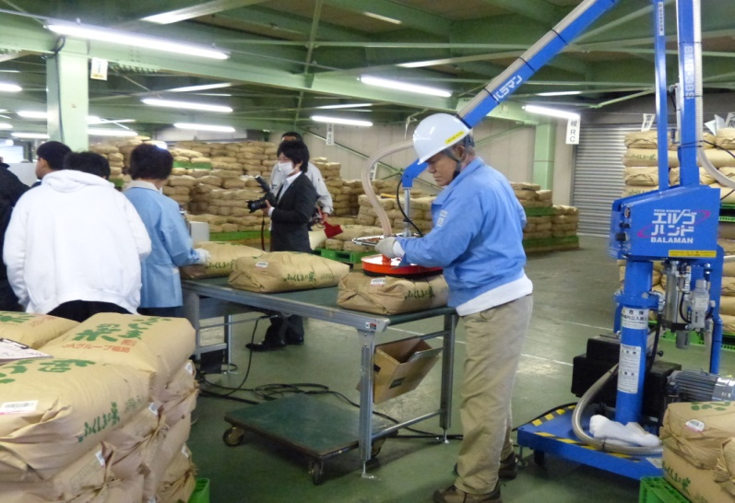

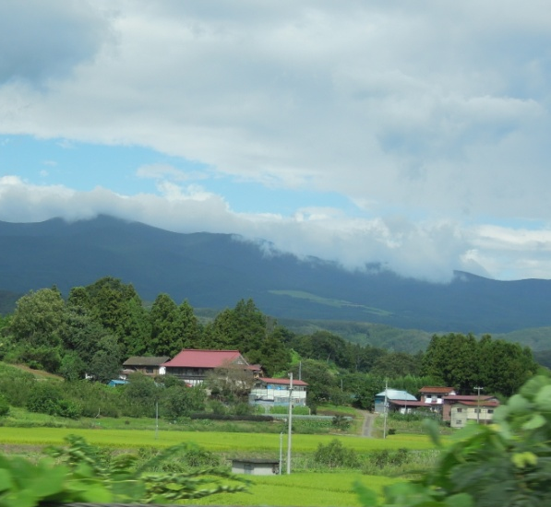
Preparedness
Availability / use of measurement devices critical for implementing policy and strategy
Koshiabura
Identify radioecologically sensitive pathways / regions BEFORE an accident
Steep forested catchments

Slide 16


Identifying, evaluating, implementing Remediation
Remedial measures need to be considered for:
Effectiveness
Feasibility
Practicality
Costs
Wastes
Side effects
Social aspects
Experience

Slide 17
TEMPLATE
Name of measure
Objective | Specifying the aims of the action, e.g., reassurance, dose reduction
Other Benefits | Secondary objectives e.g. social implications
Countermeasure description | Short description of what the countermeasure is.
Target | On or to what target do you apply this countermeasure?
Targeted radionuclides | Caesium, strontium, mixed deposit, Plutonium, Americium
Scale of application | Large? Small? Generally applicable?
Contamination pathway | root uptake, contaminated feed/standing water, re-suspension, plant- animal, irrigation
Exposure pathway | Ingestion? Inhalation? External?
Time of application | Time after deposition (early – up to 6 weeks, medium – up to 2 years, late – more than two years), season, need for repetition

Slide 18
Constraints:
Legal constraints
Social constraints
Environmental constraints
Communication constraints
Effectiveness:
Countermeasure effectiveness
Factors influencing effectiveness of procedure (Technical)
Factors influencing effectiveness of procedure (social)
Feasibility:
Required specific equipment
Required ancillary equipment
Required utilities and infrastructure
Required consumables
Required skills
Required safety precautions
Other limitations
Waste:
Amount and type
Possible transport, treatment and storage routes.
Factors influencing waste issues
Doses:
Averted dose
Factors influencing averted dose
Additional dose
Intervention costs:
Equipment
Consumables
Operator time
Factors influencing costs
Communication costs
Compensation costs
Waste cost
Assumptions
Cost-effectiveness:
Side-effect evaluation:
Ethical considerations
Environmental impact
Agricultural impact
Social impact
Other side effects, pos. or neg.
Stakeholder opinion
Practical experience
Key references
Comments

Slide 19
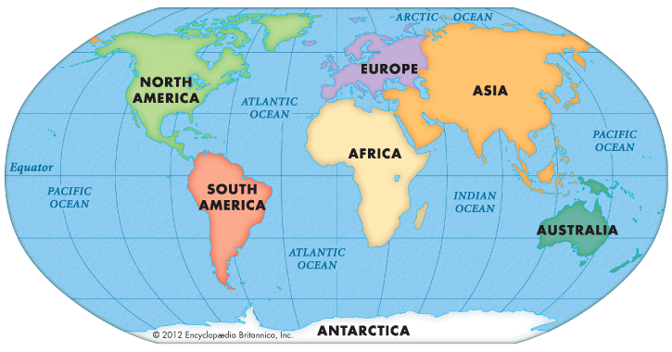
Relevance?

Slide 20
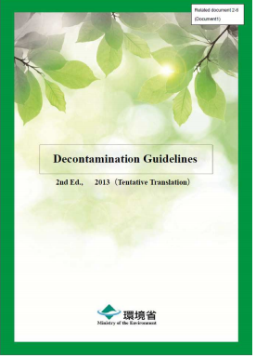
Pilot demonstration projects
MOE Decontamination Model Evaluation Project in six SDA 3 sites

Slide 21
Relevance?

Slide 22

Waste Generation and Management
Decontamination of surfaces and topsoil
reduces external exposure
High acceptability and feasibility
Protects economic value of residences and land
Well received by residents
High logistical needs
Large generation of waste
High cost
Averted dose less than air dose reduction at 1 m
Averted dose can be small

Slide 23
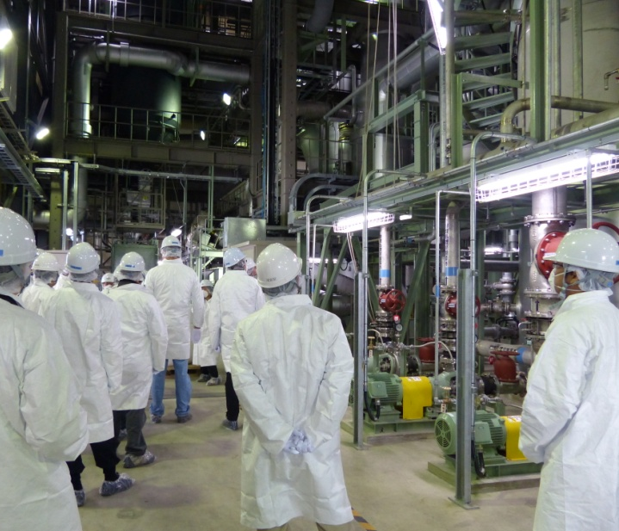
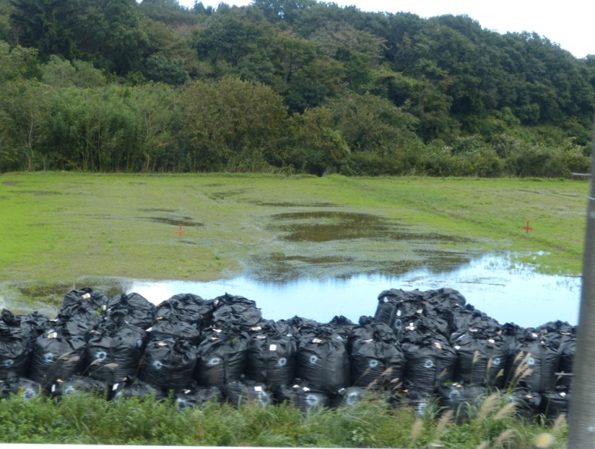
Waste generation and management
Prior thought to regulatory, management and practical application issues relevant to waste
Generation
Minimisation
Incineration
Disposal
Cost

Slide 24
Summary
Broad objectives of remediation need to be addressed
Site specific
Emergency preparedness needs to include the post accident phase / remediation
Need to retain knowledge and expertise, and promote knowledge transfer from countries with practical experience
Revise international guidance

