Slide 1
Role of the Technical Experts in the ConvEx 3
Itimad SOUFI
National Center for Nuclear Energy, Sciences and Techniques
Morocco

Slide 2
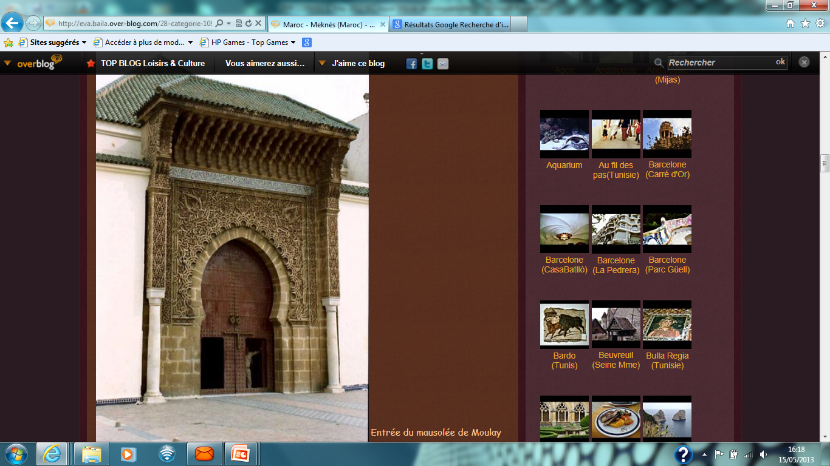
OUTLINE
Context
Exercise Purpose
Exercise Objectives
Exercise Players
Exercise Scenario
Exercise Preparation
Exercise Response
Role of the TSO
Lessons Learned

Slide 3
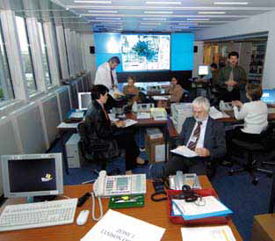
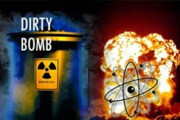
Context
IAEA Conventions
Prepared by IACRNE (AIEA, International Organizations)
Exercise organized every 3 -5 years (France, Romania, Mexico)
2013 ConVex 3 based on a national exercise hosted by Morocco
Scenario based on a serious radiological emergency triggered by a criminal act
ConvEx-3, Rabat les 20 et 21 Novembre 2013
Notes:
3

Slide 4
Exercise Purpose
Large scale joint international exercise covering the early phase of a severe radiation emergency, based on a national exercise.
Evaluate response to a major radiation emergency, in particular:
  Exchange of information,
  Provision of the international assistance
  Coordination of public information.
Notes:
Morocco hosted on 20-21 November 2013 a ConvEx 3 Exercise, co named Bab Al Maghrib, the fourth of the series initiated by the International Atomic Energy Agency (IAEA) and the relevant International Organizations under the Conventions of Early Notification and Assistance. The purpose of the ConvEx-3 exercises is to evaluate response to a major radiation emergency and in particular the exchange of information, provision of the international assistance and coordination of public information.

Slide 5
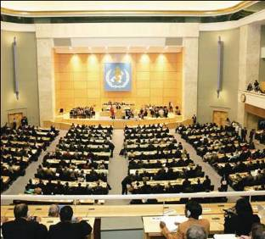
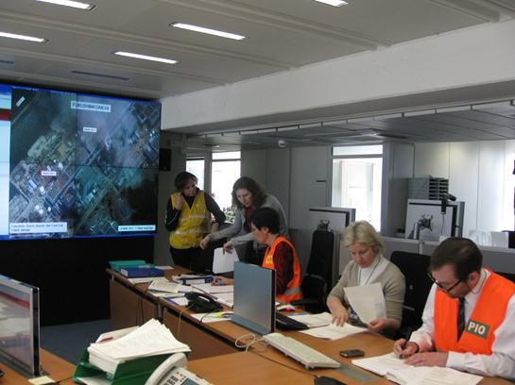
Exercise Objectives
Allow Member States and International Organizations to assess the response to a serious radiological emergency triggered by a criminal act
Assess the international system to respond to radiological emergencies ( arrangements) and the bilateral and multilateral communications between States
Identify good practices and improvements needed
ConvEx-3, Rabat les 20 et 21 Novembre 2013
Notes:
5

Slide 6
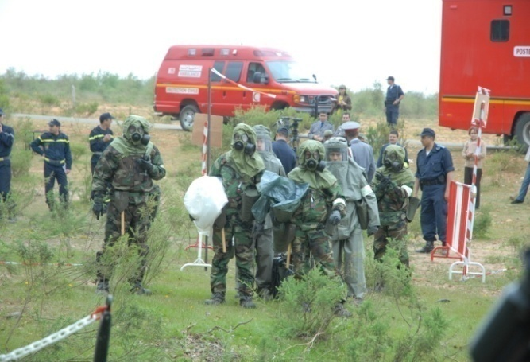
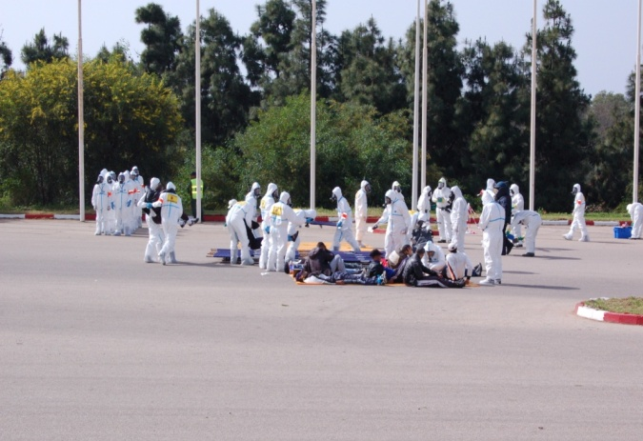
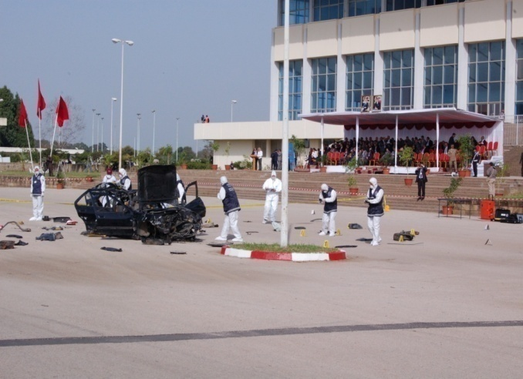
Objectives of Morocco
Assess the efficiency of the ORSEC Plan to respond to a serious radiological emergency triggered by a criminal act
Test the notification and activation mechanisms
Assess the coordination between involved parties and emergency centers activated
Test the control command system
Test the arrangements for requesting assistance
ConvEx-3, Rabat les 20 et 21 Novembre 2013
Notes:
6

Slide 7










Participants to the Exercise
International Organisations
58 Member States
At the national level
DGPC, CNESTEN, TMPA, MAEC, GR, DGSN, FAR, DGED, DGST, MI, MJ, MEF, MET, MS, MEMEE, MCE,CNRP, DMN.
ConvEx-3, Rabat les 20 et 21 Novembre 2013
Notes:
The players were Morocco as a host Accident State, other States and international organizations. 59 Member States and 10 International Organizations participate to the exercise (either with level A or level B participation).Bab Al Maghrib exercise allowed Member States and relevant International Organizations to evaluate the response in a severe radiological emergency triggered by a nuclear security event; and to identify good practices as well areas requiring improvement that cannot be identified in national exercises.
7

Slide 8
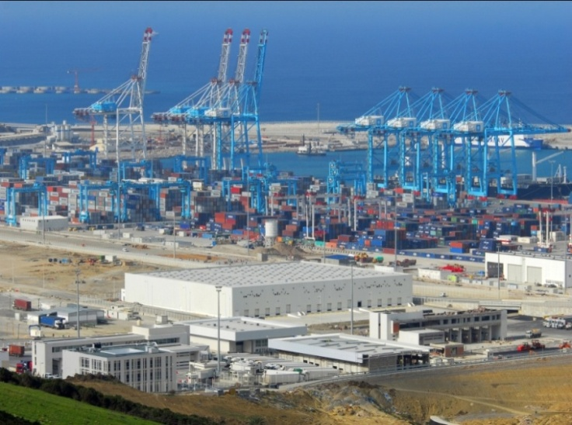
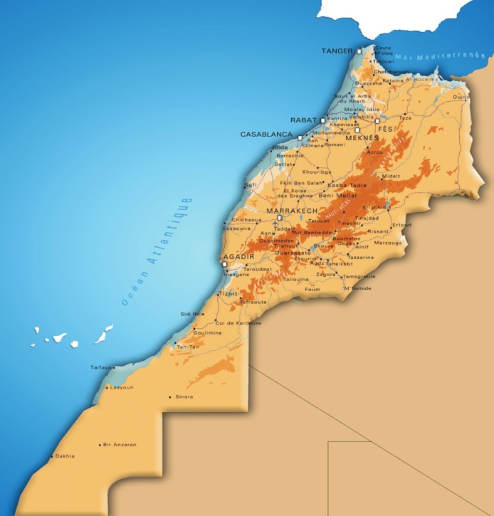


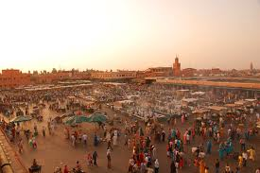
Exercise Scenario
Port
Tanger Med
20 November , 1° explosion at port Tangier Med.
Dirty Bomb
Many victims Moroccan § foreigners
Social, economic, psychological Impacts
  Maritime and aerial traffics, agriculture, tourism
Strong pressure from the Media
New Threats
2nd Explosion on Marrakech
Assistance Requests
Place
Djamaa al Fnaa
ConvEx-3, Rabat les 20 et 21 Novembre 2013
Notes:
On 20 November 2013, a large explosion took place in the biggest port of Morocco, Tangier Med Port. At the time of the explosion, there was a large traffic of ships, including ferry boats and boats for goods and an important number of people in the harbor complex (around 3000 people, including staff, boat crews and passengers, among them a significant number of foreigners). The deployment of first responders near the area of detonation revealed important damage to the buildings and vehicles, dozens of dead bodies and more than one hundred injured among the passengers, tourists and employees. In addition, many people not injured, but in shock, were wandering around the scene and some left the port immediately. Many ships and boats, that were waiting to be served, sailed away. The alarm of a radiation pager of one of the first responders triggered a suspicion that the explosion might have had a radiological component.
International media delivered ‘breaking news’ to the world about the event shortly after the explosion, including photos and videos from the scene.
Moroccan authorities promptly responded to the explosion according to the national emergency response plan. The exchange of information at the international level and the preliminary results from the ongoing criminal investigation supported a suspicion of an exploded RDD.
The assessment of the credibility of new threats targeting other populated areas identified few other big cities in Morocco as likely future targets. Consequently, a large radiological search, investigations, preventive and protective actions were launched targeting, mainly, strategic locations in these cities. During an aerial survey, abnormal radiation levels were detected over the medina of Marrakech. Security forces and monitoring teams were deployed immediately, but all intended protective actions were thwarted by a new explosion.
Following these events, Moroccan authorities received numerous requests for information from possibly affected States, businesses, media as well as from citizens.
Both events caused consequences that exceeded Moroccan response capabilities and led Moroccan authorities to request international assistance through the IAEA.
8

Slide 9
Exercise Preparation
EADRCC, EC, EUEOPOL, FAO, ICAO, IMO, INTERPOL, WHO, WMO
IACRNE
Exercise Director Exercise Dep. Director
Chief Controller
Dep. Chief Controller
Chief Evaluator en DEP. Chief Evaluator
Controller / Evaluator (TMPA)
Controller / Evaluator (NEC)
Controller / Evaluator (TCC)
ConvEx-3, Rabat les 20 et 21 Novembre 2013
Notes:
The Exercise Direction Committee led the exercise preparation, conduct and evaluation of the exercise. The Exercise Direction Committee was composed of the staff from various national stakeholders from the Ministries of Interior, Defence, Health, Energy, Foreign Affairs and Port Authority of Tangier Med. It was tasked to develop basic exercise elements (exercise scenario, list of events, injects, exercise control and exercise evaluation).
9

Slide 10
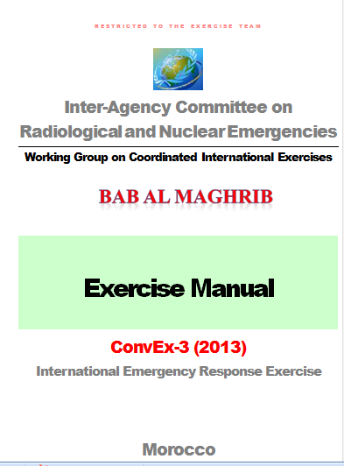
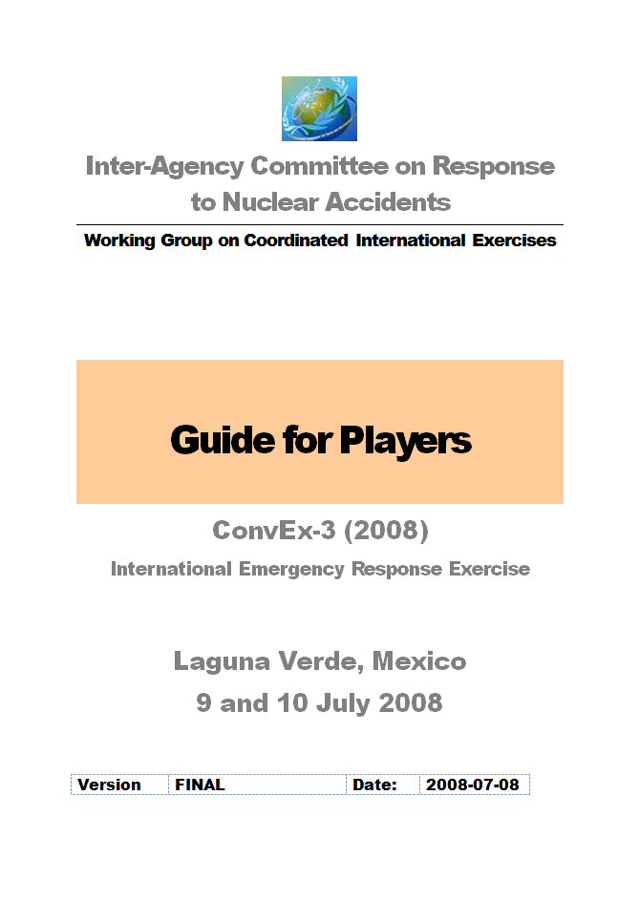
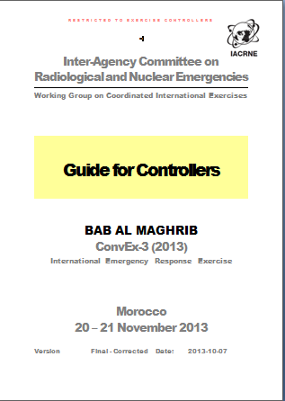
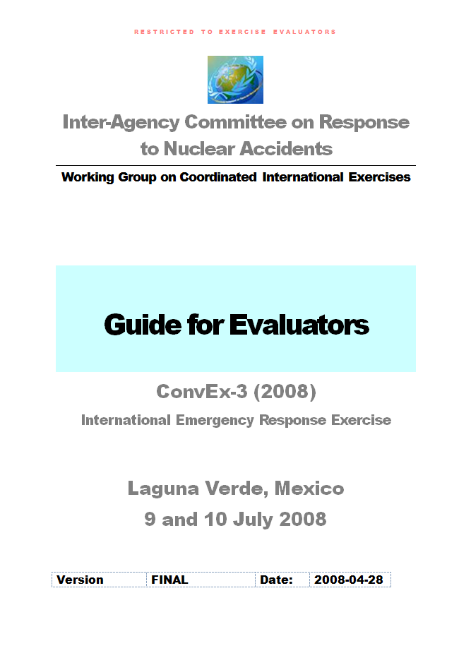
Preparation: Documents
Manuel de l’Exercice
Guide des Joueurs
Guide des Contrôleurs
ConvEx-3, Rabat les 20 et 21 Novembre 2013
Guide des Evaluateurs
Notes:
10

Slide 11
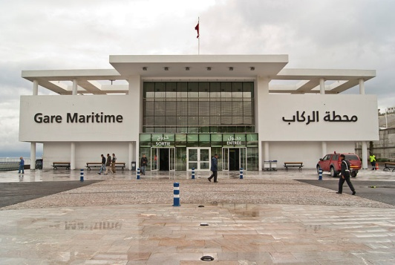
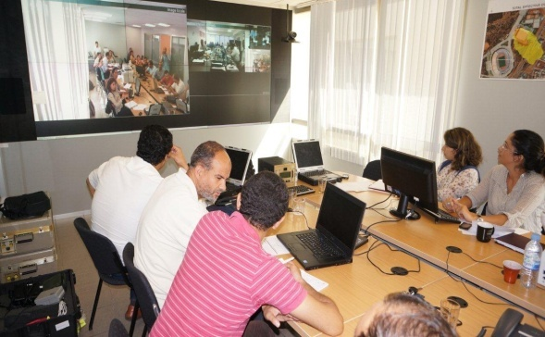
Response Organization
IAEA
Operational Command Post (Tanger Med Port Authority TMPA)
Technical Crisis Center (TCC)
National Emergency Center (NEC)
Notes:
The exercise was conducted for 25 hours on real time, with the activation of 3 emergency centers at the national level, managing the response from different but complementary perspectives: The National Emergency Center (national level), Tanger Med Port Authorities ( on scene level) and the Technical Crisis Center ( technical level).
During the exercise, the Tangier Med Port Authority (TMPA) acted at the local level, deploying first responders and managing the situation at the scene (Port Tangier Med). The TMPA’s main functions were: (1) assessment of the situation on the scene; (2) activation of emergency response plans based on the situation assessment; (3) first response (security, medical, radiological safety, communication, etc.); (4) decisions on port activities; (5) mobilization of necessary resources; and (6) informing and coordinating with the NEC.
11

Slide 12
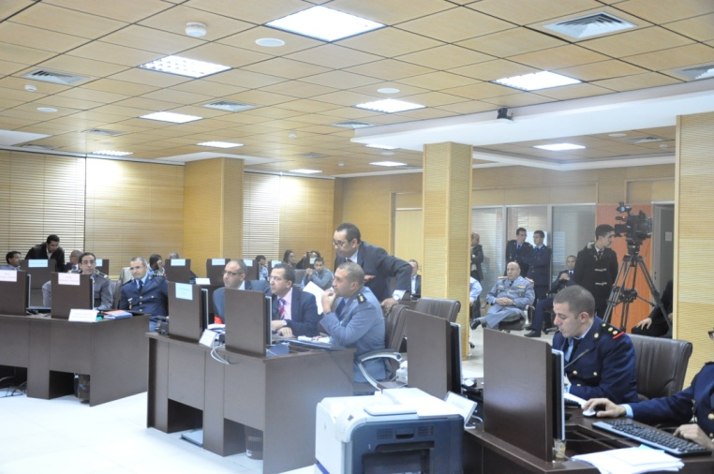
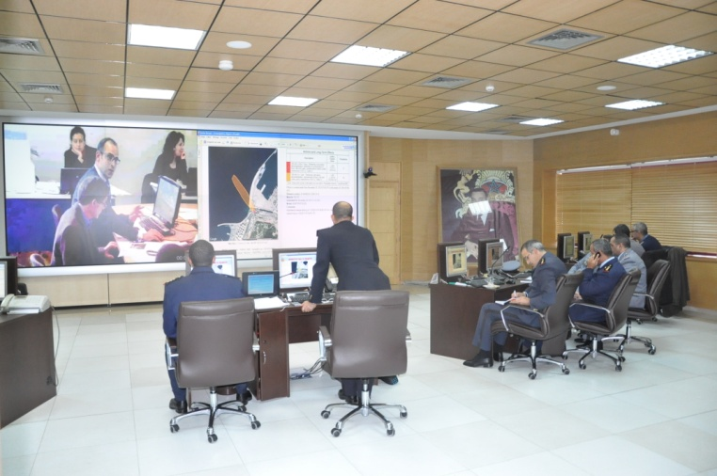
NEC Organization
National Emergency Center (NEC)
International Communication Cell
Support Cell
Technical Cell
Life Saving and Protection Cell
Security Cell
Notes:
The response to the exercise events was led by the National Emergency Centre (NEC), under the coordination of the General Direction of Civil Protection (Ministry of Interior). NEC is tasked with the following functions: (1) decision making, coordination and resources provision at the national level; (2) coordination, assessment and follow up of the situation at the national level (national security and investigation, public health and protection, environment protection and logistical issues); (3) communication with the public and with the media; (4) international notification and coordination of the international assistance; and (5) returning to normal situation.
12

Slide 13
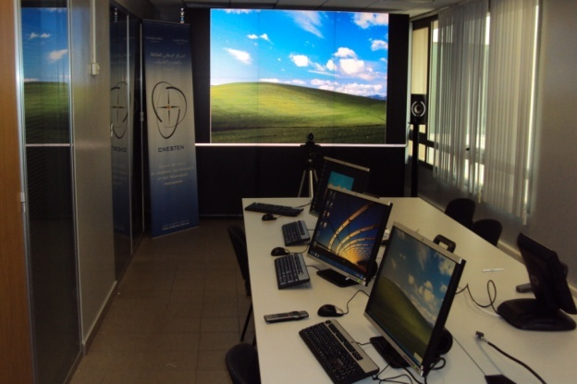
Technical Crisis Center (TCC)
Located at Maamora Nuclear Center;
Missions:
    Assessment of radiological consequences in case of emergency,
    Recommendations of protective actions,
    National Warning Point
Organization: 4 units
Coordination
Assessment
Technique
NWP
Support
Notes:
The Technical Crisis Centre (TCC) is an entity based at the National Center for Nuclear Energy, Sciences and Techniques (CNESTEN), acting as Technical Support Organization. The TCC is in charge of the radiological risk assessment during radiation incident or emergency and recommends protective actions (public, emergency workers) to the NEC, based on the IAEA standards and guidelines. The TCC mainly performs: (1) plume modelling of radioactive material dispersion (IXP model, Hotspot, etc); (2) radiological risk assessment based on dose rates, contamination levels, radioactive source identification, etc; (3) radiological search and survey (aerial, on-route, pedestrian); (4) radiological environmental monitoring; and (5) radioactive waste management.
The TCC has arrangements with the US DOE for support if needed (IXP, triage, etc.).
13

Slide 14
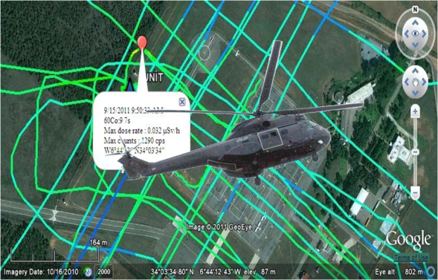
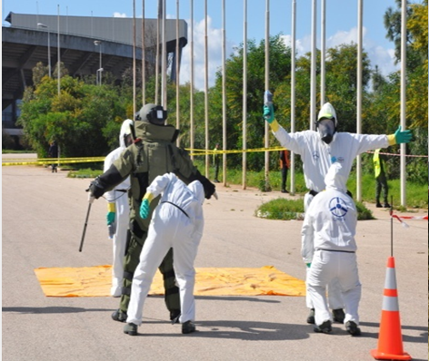
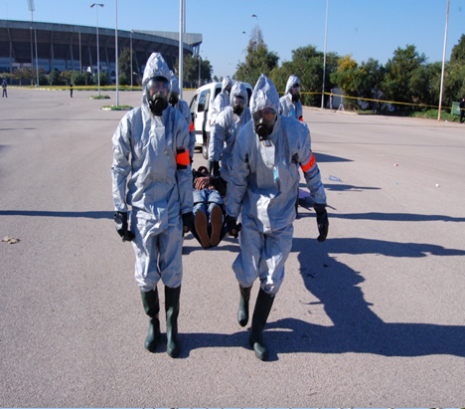
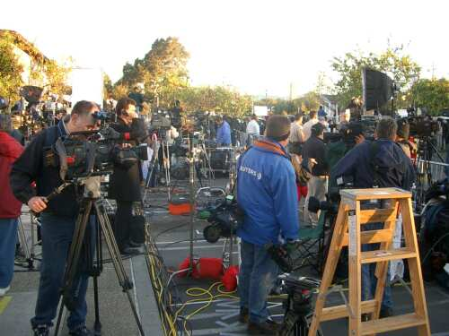
Response Components
Duration : 25 hours minimum
Real time
In addition of information exchange at the national and international levels, other considerations :
    1- Radioactive releases in the atmosphere
    2- Safety/ Security Interface
    3- Medical end Health
    4- Commerce, industry , agriculture, tourism and aerial and maritime transport,
    5- Contamination of products, of vehicles , ships, and infrastructure
    6- Public Information
ConvEx-3, Rabat les 20 et 21 Novembre 2013
Notes:
14

Slide 15
Rôle of the TSO
Protecting the public, the responders and mitigating the consequences require a clear view and understanding of the situation, the risks and the potential consequences.
Beside the national agencies in charge of lifesaving, security, etc, several technical organizations played an important role in assisting national authorities responsible for decision making and the protection of the public
Specialized organizations with knowledge and expertise in nuclear and radiological safety: Regulatory Bodies and the Technical Support Organization (TSO).
Other agencies, such as (such as meteorology, aviation, maritime, health provide specialized support as necessary.
Notes:
Protecting the public, the responders and mitigating the consequences require a clear view and understanding of the situation, the risks and the potential consequences. With this regard, beside the national organizations and authorities in charge of lifesaving, security, public protection, control command and coordination, several technical organizations (such as meteorology, aviation, maritime, health, regulatory body and TSO organizations) played an important role in assisting national authorities responsible for decision making and the protection of the public to have a better understanding of the risks and their potential consequences.
For radiological emergencies, the main organizations having knowledge and expertise in nuclear and radiological safety are the Regulatory Bodies ( Ministry of Energy and Ministry of Health / National Radiation Protection Center ) and the National Center for Nuclear Energy, Sciences and techniques (CNESTEN), acting as Technical Support Organization (TSO). Other ministries or agencies, such as National Meteorological Directorate (DMN), provide specialized support as necessary.

Slide 16
Role of TSO:Prepation Phase
The technical experts provide a substantial support, in particular in terms of suggesting elements of the scenario, technical injects and expected response actions
In particular, CNESTEN as TSO:
  support to the exercise preparation, conduct and evaluation, in particular the exercise concept and documents
  acted as Exercise deputy director
  Acted as contact point with IAEA
Notes:
Throughout the exercise preparation and conduct, the technical experts provide a substantial support, both at the preparation phase (in particular in terms of suggesting elements of the scenario, technical injects and expected response actions) and the response phase ( in supporting the national authorities through technical advices, expertise, means and response actions).
In particular, CNESTEN as TSO supported both the exercise preparation, conduct and evaluation and the response. At the preparation phase, CNESTEN acted as Exercise deputy director and supported the whole preparation process, and in particular the exercise concept and documents.
For the response, the Technical Crisis Center (TCC) located at CNESTEN site supported the National Emergency Center (NEC) for decision making regarding the protective actions. The main mission of the TCC was to support the NEC by performing radiological risk assessment and making recommendations on protective actions for the public and the emergency responders. Support and actions conducted were related mainly to plume modelling (calculations of radiological consequences ( IXP model, Hotspot, etc), on scene radiation safety, radiological risk assessment (doses rates, contamination level, source identification, ), radiological search and survey, radiological environmental survey, radioactive waste management.

Slide 17
Role of TSO: Response Phase
The technical experts provide a substantial support for the response phase to the national authorities through technical advices, expertise, means and response actions
The Technical Crisis Center (TCC) located at CNESTEN site supported the National Emergency Center (NEC) for decision making regarding the protective actions
Main mission of the TCC : support the NEC by performing radiological risk assessment and making recommendations on protective actions for the public and the emergency responders
Notes:
Throughout the exercise preparation and conduct, the technical experts provide a substantial support, both at the preparation phase (in particular in terms of suggesting elements of the scenario, technical injects and expected response actions) and the response phase ( in supporting the national authorities through technical advices, expertise, means and response actions).
In particular, CNESTEN as TSO supported both the exercise preparation, conduct and evaluation and the response. At the preparation phase, CNESTEN acted as Exercise deputy director and supported the whole preparation process, and in particular the exercise concept and documents.
For the response, the Technical Crisis Center (TCC) located at CNESTEN site supported the National Emergency Center (NEC) for decision making regarding the protective actions. The main mission of the TCC was to support the NEC by performing radiological risk assessment and making recommendations on protective actions for the public and the emergency responders. Support and actions conducted were related mainly to plume modelling (calculations of radiological consequences ( IXP model, Hotspot, etc), on scene radiation safety, radiological risk assessment (doses rates, contamination level, source identification, ), radiological search and survey, radiological environmental survey, radioactive waste management.

Slide 18
Role of the TSO: Response Phase
Support and actions conducted related mainly to :
  Plume modelling (calculations of radiological consequences ( IXP model, Hotspot, etc),
  On scene radiation safety,
  Radiological risk assessment (doses rates, contamination level, source identification)
  Radiological search and survey,
  Radiological environmental survey,
  Radioactive waste management.

Slide 19
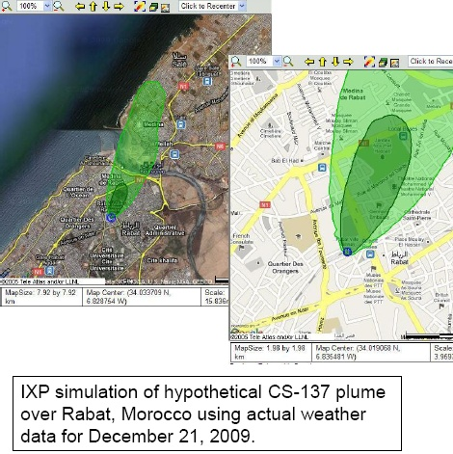
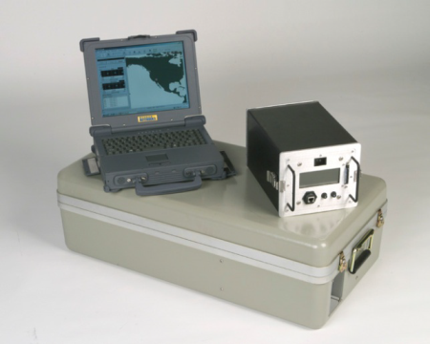
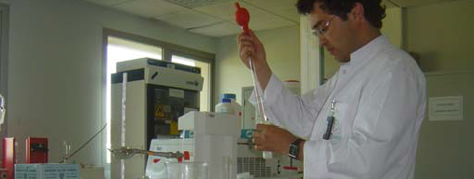
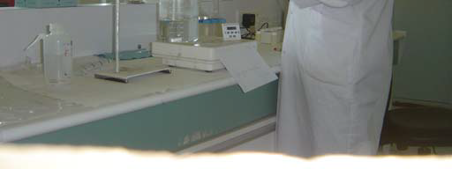
Technical Center Crisis (TCC)
Tools:
  Calculation codes and map visualization
    IXP / GIS
    HOTSPOT
    MICROSHIELD
  Detection equipment and PPE
  IAEA USIE interface for notification
  US/DOE online support
  Environmental monitoring laboratory
    Sampling
    Gamma spectrometry
    Gross alpha/bêta
  Others: phone, fax, internet, Visio

Slide 20
Technical Crisis Center (TCC)
Services provided:
  Technical support for radiological safety
  Radiological assessment and Recommendations
  Reports to NEC
  NWP

Slide 21
Conclusion
ConvEx-3 exercise (2013) : opportunity to identify improvements needed to respond to radiological emergencies resulting from a nuclear security event and requiring coordination between safety and security authorities
The preparation of the exercise requires the support of technical experts specialized in radiological safety to raise and address the issues resulting from a radiological emergency
Strong participation of the experts (mainly the TSO) in the preparation and the response phases : two different communities not used to work together discussed, prepared and responded to a radiological event from different perspectives, harmonizing their views and approaches, learning from and understanding each others.

Slide 22
Conclusion
Response organization and protocols ( safety, security, medical, public information, port activities, international cooperation, etc) discussed and agreed.
Main role of the TSO: provide information on radiological risk assessment based on field measurements and calculations and propose protective actions.
The TSO contributes to the safety response on the scene or in other locations (radiological search, radiation monitoring, radionuclide identification, )
The TSO acted/ supported the interface with technical organizations outside the country (IAEA, US DOE) for technical advice or assistance request or provision

Slide 23
THANK YOU

