Slide 1
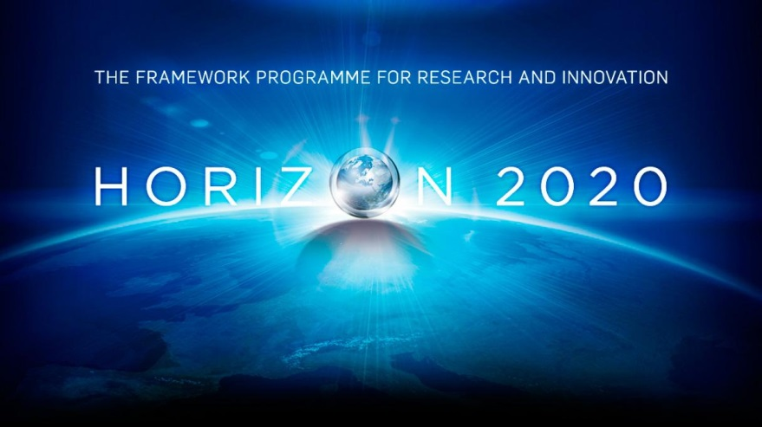
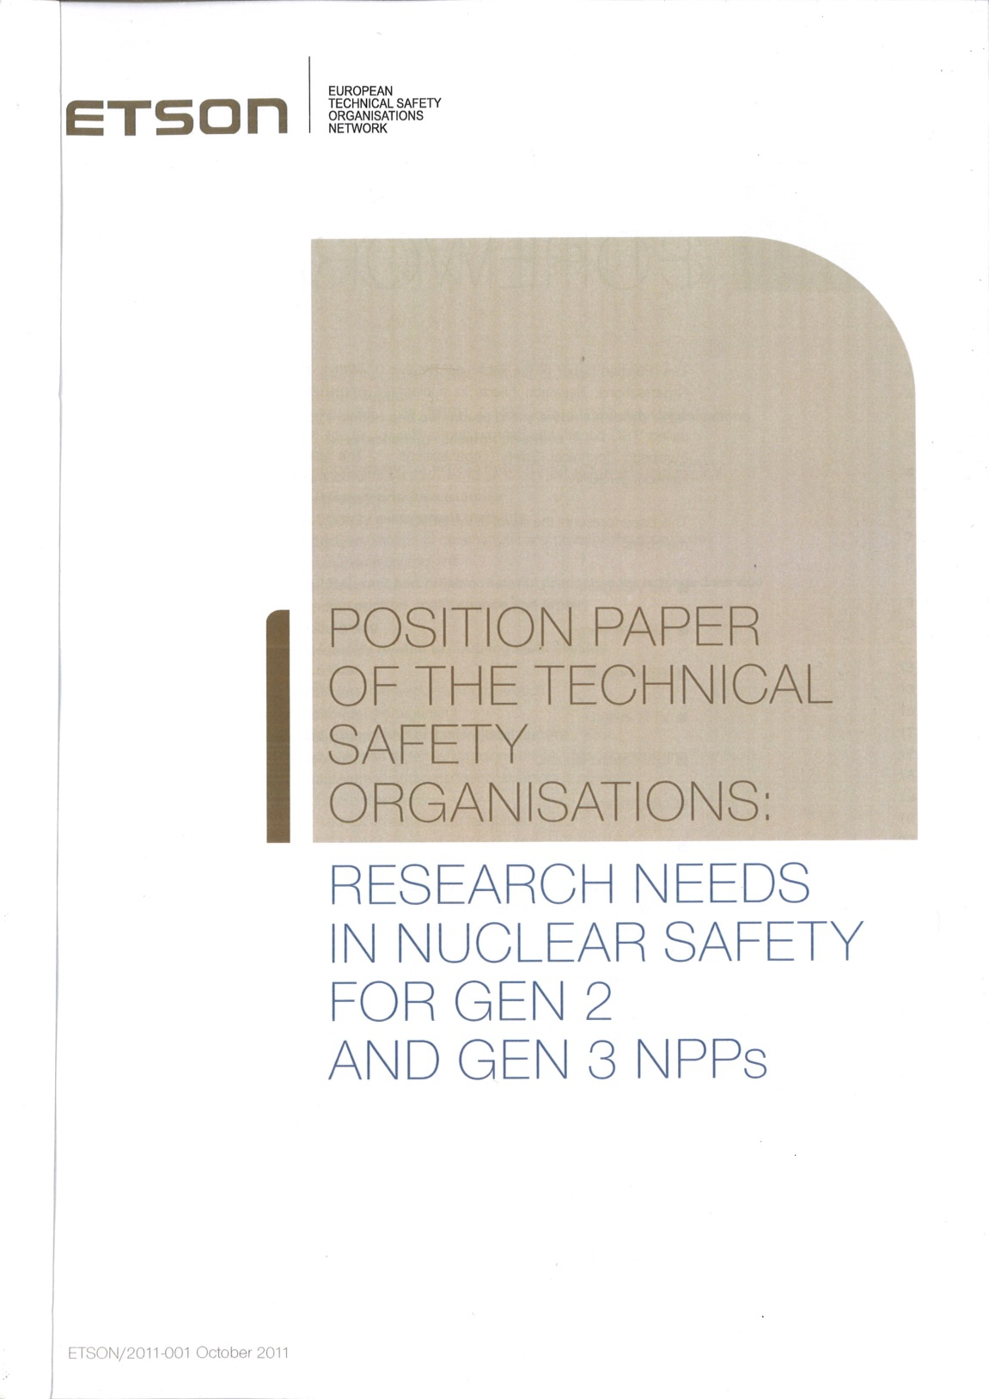
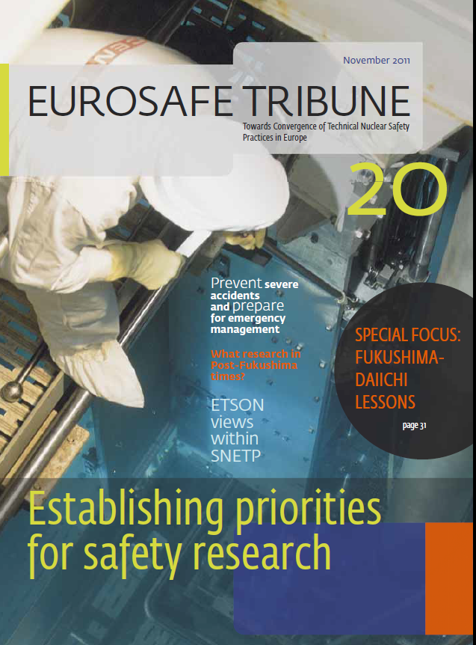
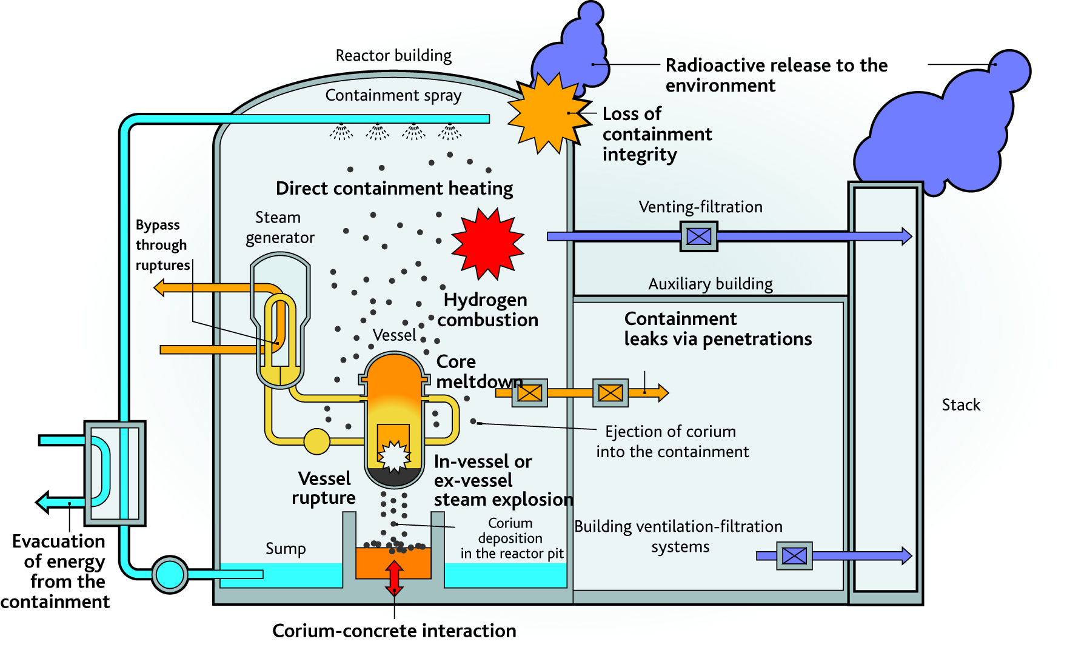
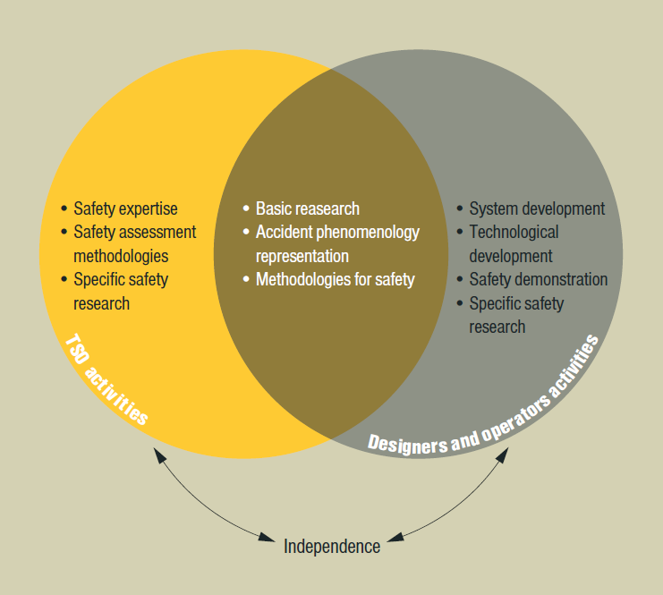
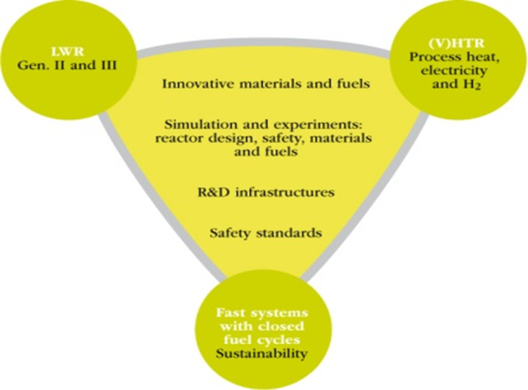
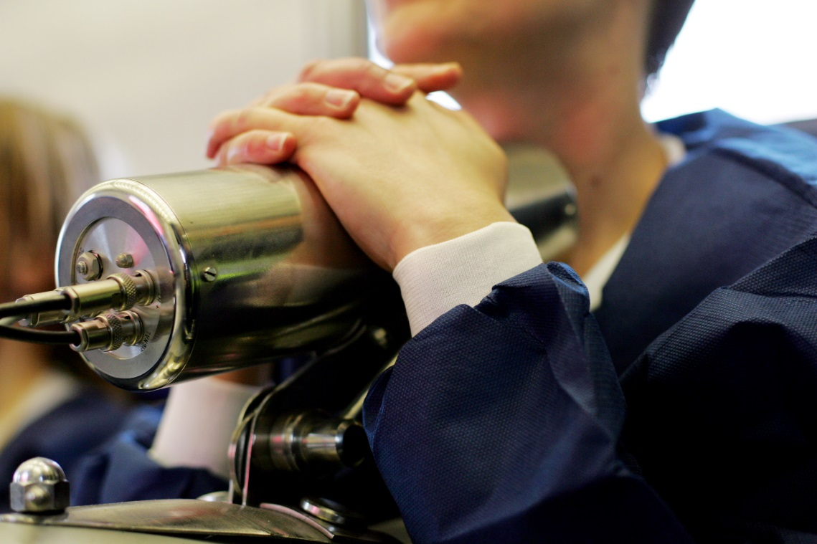
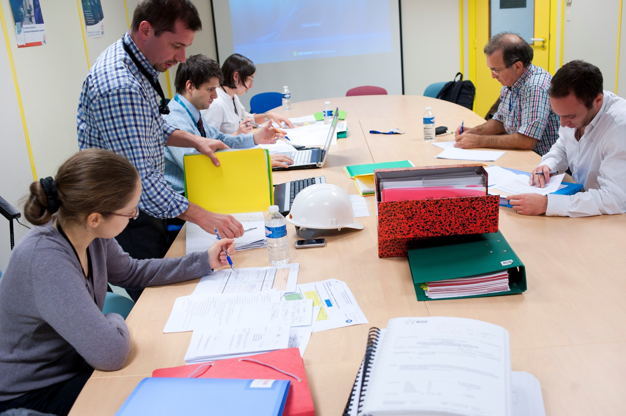
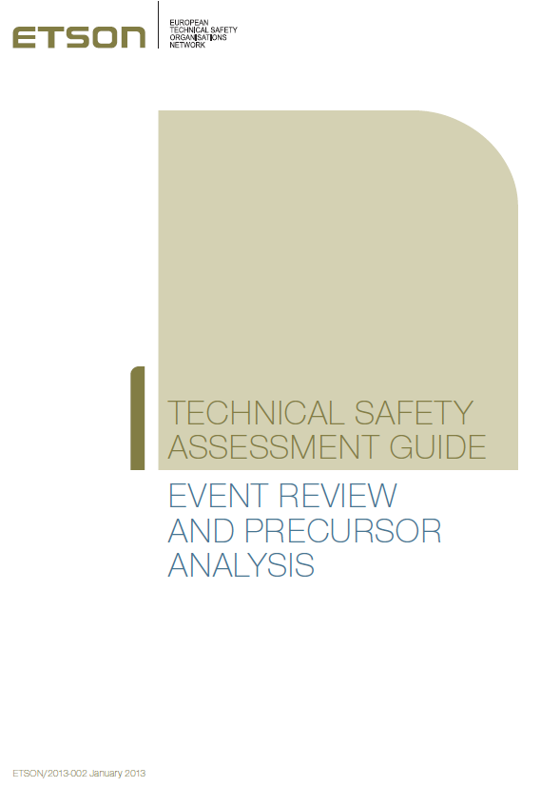
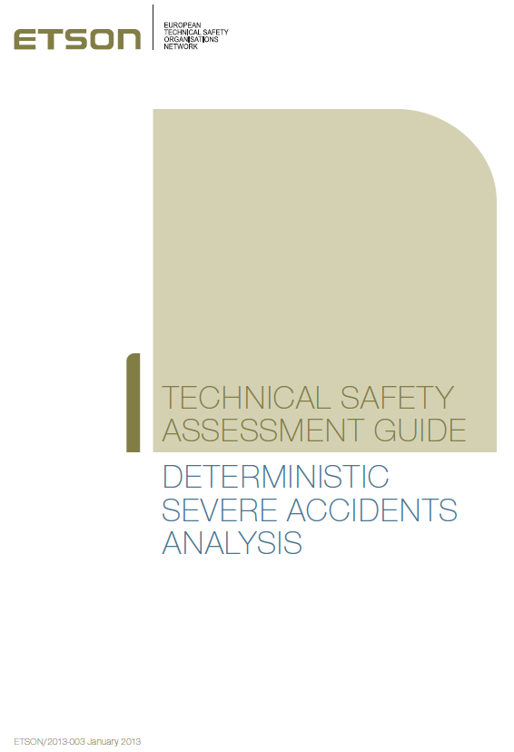
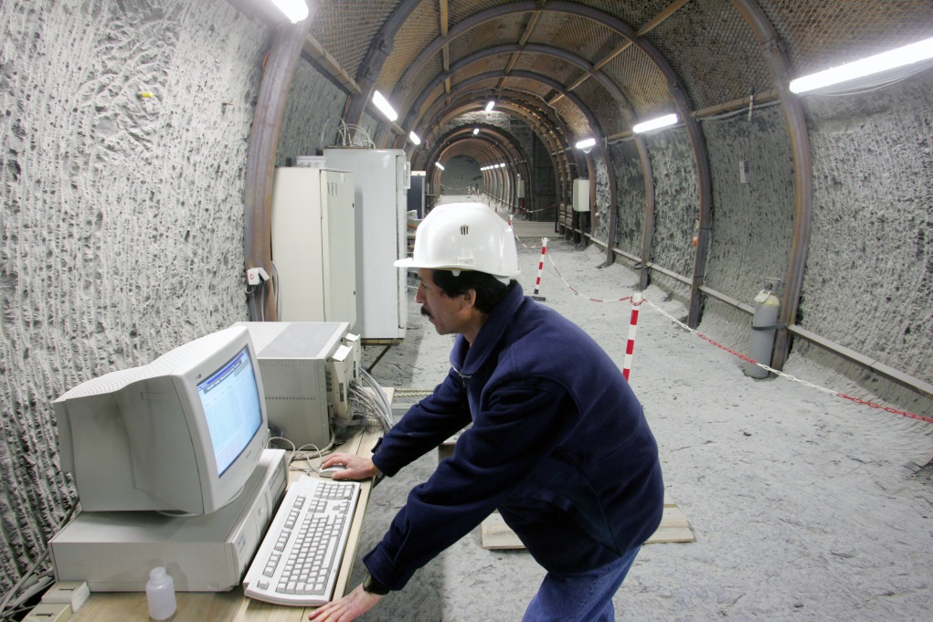
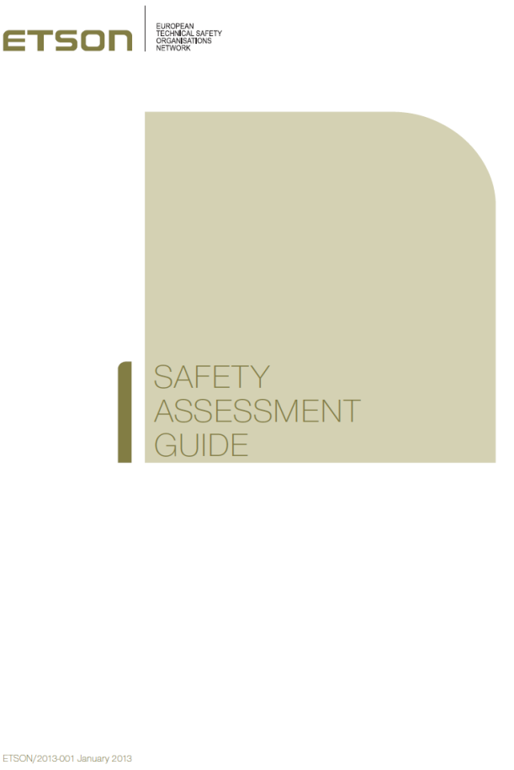
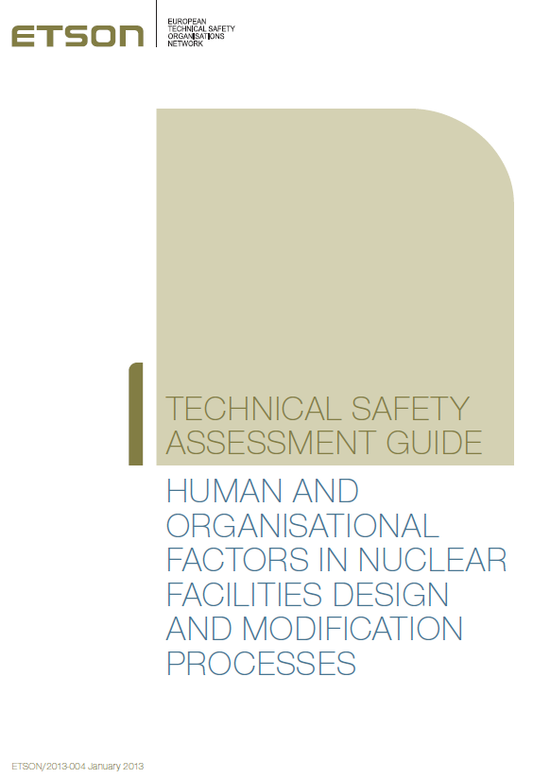
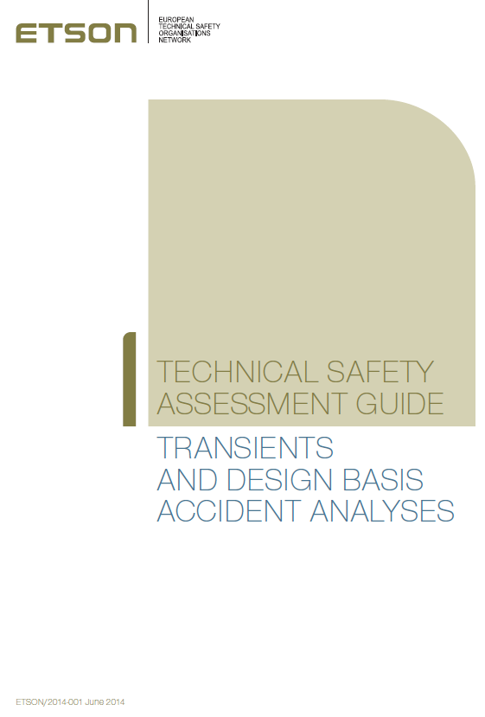
Contribution of the European TSOs to research in nuclear safety, radiation protection and waste disposal
Karim Ben Ouaghrem (IRSN), Jean-Pierre Van Dorsselaere (IRSN), Philippe Volant (IRSN), Mathilde Prevost (IRSN), Vincent Deledicque (Bel V), Sigitas Rimkevicius (LEI), Eija Karita-Puska (VTT), Wolfgang Luther (GRS), Walter Klein-Hessling (GRS), Miroslav Hrehor (CV Rez), Peter Liska (VUJE), Terttaliisa Lind (PSI), Leon Ciselj (JSI), Anatolii Shanchuk (SSTC NRS), Natalia Istomina (SEC-NRS), Yoshio Yamamoto (NRA)
Email contact of main author: karim.benouaghrem@irsn.fr IAEA-CN-214-paper34
Missions
Manages the nuclear fission research through Euratom Framework Programmes (FP7 and now H2020).
Favors the emergence of networks of excellence (NULIFE on nuclear plant life prediction, SARNET on severe accidents)
Supports the work done through research agendas of dedicated platforms
1
Call programming
2
Position paper
Nuclear safety
Projects:
Dedicated platforms: SNETP (NUGENIA, ESNII, NC2I)
ADRIANA | ADvanced Reactor Initiative And Network Arrangement
ALLIANCE | Preparation of ALLegro - Implementing Advanced Nuclear Fuel Cycle in Central Europe
ARCADIA | Assessment of Regional CApabilities for new reactors Development through an Integrated Approach
ARCHER | Advanced High-Temperature Reactors for Cogeneration of Heat and Electricity R&D
ASAMPSA_E | Advanced Safety Assessment : Extended PSA
ASAMPSA2 | Advanced safety assessment methodologies : level 2 PSA (European best practices L2 PSA guidelines)
CESAM | Code for European Severe Accident Management
CP-ESFR | Collaborative project on European sodium fast reactor
ERCOSAM | Containment thermal-hydraulics of current and future LWRs for severe accident management
EUROPAIRS | End User Requirement fOr Process heat Applications with Innovative Reactors for Sustainable energy supply
GOFASTR | European Gas Cooled Fast Reactor
JASMIN | Joint Advanced Severe accidents Modelling and Integration for Na-cooled fast neutron reactors
NC2I-R | Nuclear Cogeneration Industrial Initiative - Research and Development Coordination
NUGENIA-PLUS | Preparing NUGENIA for HORIZON2020
NURESAFE | Nuclear Reactor Safety Simulation Platform
NURISP | Nuclear reactor integrated simulation project
PASSAM | Passive and Active Systems on Severe Accident source term Mitigation
SARGEN_IV | Proposal for a harmonized European methodology for the safety assessment of innovative reactors with fast neutron spectrum planned to be built in Europe
SARNET2 | Severe accident research network of excellence 2 (confer Fig.2)
THINS | Thermal-hydraulics of Innovative Nuclear Systems
TSOs demonstrate independancy from licensees through separating safety assessment activities from safety demonstration
Fig. Phenomenology of severe accidents
(© Stéphane Jungers/IRSN-Source IRSN)
3
Mandate
NC2I
Nuclear Cogeneration Industrial Initiative
Results
ESNII
European Sustainable Nuclear Industrial Initiative
Fig. Pillars of SNETP - Sustainable Nuclear Energy Technology Platform (© SNETP)
4
Radiation protection
Projects:
Dedicated platforms: MELODI (radiation protection), ALLIANCE (radioecology)
CARDIORISK | The mechanisms of cardiovascular risks after low radiation doses
COMET | COordination and iMplementation of a pan-European instrumenT for radioecology
DOREMI | Low Dose Research towards Multidisciplinary Integration
EAGLE | Enhancing educAtion, traininG and communication processes for informed behaviours and decision-making reLatEd to ionizing radiation risks
EPI-CT | Epidemiological study to quantify risks for paediatric computerized tomography and to optimise doses.
OPERRA | Open Project for the European Radiation Research Area
ORAMED | Optimization of radiation protection of medical staff
PREPARE | Innovative integrative tools and platforms to be prepared for radiological emergencies and post-accident response in Europe
RENEB | Realizing the European Network in Biodosimetry
STAR | Strategy for Allied Radioecology
TENEB | Towards a European network of excellence in biological dosimetry
Safety assessment guidelines
Fig. Personal dose measurement
(© Olivier Seignette/Mikaël Lafontan/IRSN)
Waste disposal
Projects:
Dedicated platform: IGDTP
FORGE | Fate of repository gases
SACSESS | Safety of ACtinide Separation proceSSes
SITEX | Sustainable network of Independent Technical EXpertise for radioactive waste disposal
Fig. Tournemire facilities
(© Olivier Seignette/Mikaël Lafontan/IRSN)
Fig. Experts (© Grégoire Maisonneuve/IRSN)

