Slide 1
“Bridging required capabilities and training”
P. De Gelder, B. Bernard, P. Mignot, M. Roobaert (Bel V, Belgium)

Slide 2
Content
Introduction concerning Bel V
Organisation of Bel V
Important aspects for bridging required capabilities and training
Knowledge management
Application of SARCoN tool
Investment in non-technical skills

Slide 3
Introduction concerning Bel V
Since September 2001, FANC fulfils the role of Safety Authority
FANC created Bel V in September 2007, as a subsidiary
Since April 2008, Bel V is operational as Technical Safety Organisation of FANC
But large part of the staff has a (very) longstanding experience in NS & RP

Slide 4
Organisation Bel V
Hierarchical structure
With 3 technical departments (with Areas or Branches)
Transversal organisation by means of TRCs (Technical Responsibility Centres)
Cf. Centres of Competence; Communities of Practice
About 20 TRCs (see separate slide)
Non-hierarchical, but with a coordinator
Typically 4 to 8 persons involved
Members can be anywhere in Bel V; only condition is having expertise

Slide 5
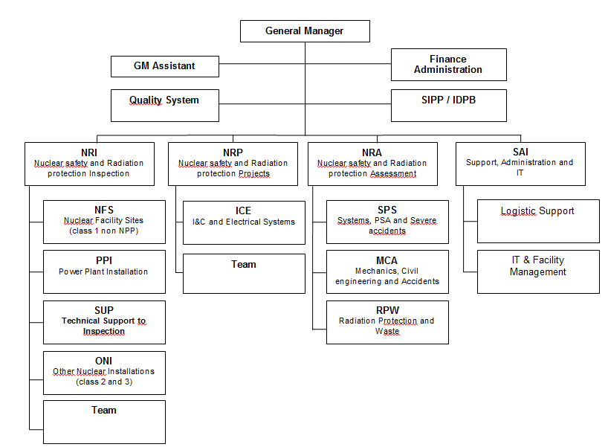

Slide 6
List of TRCs

Slide 7
Role of Bel V Management System
Bel V’s Management System is certified ISO 9001
goes beyond the requirements of ISO 9001 → IMS (Integrated Management System)
Following three processes are important for bridging required capabilities and training:
Deliver expert services in nuclear safety and radiation protection (Process A06);
Manage expertise and technical quality (Process A07);
Manage Human Resources (Process A08);

Slide 8
Knowledge Management aspects (1/2)
On individual scale:
Knowledge Transfer Form (part of Process A07)
Typically for people leaving or retiring
Starting from functions and roles
Inventory of knowledge, skills and attitudes
Technical and non-technical:
Legal bases and regulatory documents
Technical disciplines
Regulatory practices
Personal and interpersonal effectiveness
Candidates to take over
Tools for transfer

Slide 9
Knowledge Transfer Form
Functions and Tasks |  | Knowledge – Skills – Attitudes |  |  |  |  |  |  |  | Candidates to take over | Tools for transfer
 |  | Legal Basis and Regulatory Guides |  | Technical disciplines |  | Regulatory Practices |  | Personnal and Interpersonnal Effectiveness
 | H-M-L |  | E-G-B-NA |  | E-G-B-NA |  | E-G-B-NA |  | E-G-B-NA |  |  | M
H-M-L: Importance for Bel V: High – Medium – Low
E-G-B-NA: Expertise level of the leaving expert : Expert – General – Basic – Not-applicable
M = Months needed for acquisition

Slide 10
Knowledge Management aspects (2/2)
On TRC scale:
Recently: development of Knowledge Critical Grid
Applied in conjunction to TRC Annual Reports
Evaluation of knowledge and expertise with respect to:
Volatility issues
Vulnerability issues
Decision matrix
Suggestions for staffing, training, R&D, ...; to be approved by Bel V Steering Committee

Slide 11
Knowledge Critical Grid – Evaluation form

Slide 12
Knowledge Critical Grid – Decision matrix
Volatility | 4 | Action | Action | Priority Action
 | 3 | Monitor | Action
 | 2 | No action Recommendations possible |  | Action | Action
 | 1 |  |  | Monitor | Action
 |  | 1 | 2 | 3 | 4
 |  | Vulnerability

Slide 13
Application of SARCoN tool (1/6)
Process A08 on Human Resource Management
A08.02.01: Describe roles and qualification requirements with associated tasks
A08.02.02: Competence Gap Analysis
… and subsequent subprocesses (training, …)
For Competence Gap Analysis: Application of the SARCoN approach
SARCoN = Systematic Assessment of the Regulatory Competence Needs
Developed by IAEA

Slide 14
Level 1
A08 Human Resources Management
Level 2
A08.00: Manage Human Resources
A08.01:
Administrative and Social HRM
A08.02:
HRM & HRD by competences
A08.03: Assess the HRM Process
Level 3
A08.02.01: Description of roles
A08.02.02: Competence gap analysis
A08.02.03: Training programmes
A08.02.04: Implementation of training
A08.02.05: Individual development plans

Slide 15
Application of SARCoN tool (2/6) : Quadrant model

Slide 16
Application of SARCoN tool (3/6)
use of SARCoN quadrant model
For each of the 18 quadrant areas:
development of list of KSA (Knowledge, Skills, Attitudes)
In Bel V, a specific reference list of KSAs tailored to the individual characteristics of the organization

Slide 17
Application of SARCoN tool (4/6) – Pilot application
By using SARCoN tool
For 9 staff members, mostly recently recruited
With following steps:
Determine the existing KSA levels (self-assessment) (not for Quadrant 4)
Review with coach/supervisor
Competence Gap Analysis
Prioritize of gaps
Define actions to fill gaps

Slide 18
Application of SARCoN tool (5/6) – Shortlist from first feedback
Use of SARCoN tool: OK
Understanding of KSAs: some divergent interpretations
Some people have the feeling that they are evaluated (which is not the objective)
Review with coach/supervisor should be well done (takes time !)

Slide 19
Application of SARCoN tool (6/6) – Planned actions
Based on Pilot Project:
Revise list of KSAs (for Quadrant 1, 2 and 3) to reflect even better Bel V needs
Develop guidance for coaches and supervisors (for instance to “harmonise” ratings concerning “high-medium-basic”)
New evaluation (2015) and decision on further steps

Slide 20
Non-technical skills
With the help of external consultant, important effort was started: “Interpersonal Effectiveness Development Path”
Knowing my-self
Knowing my leadership style
Communicating with others
Integrating the generations
Motivating and leading my team
+/- 3000 man-hours, spread over 15 months

Slide 21
Conclusions
Bel V: compared to others, a relatively “small” TSO
Flexibility of utmost importance for effectiveness and efficiency
Continuous challenge for applying and developing tools and methods for Knowledge Management, Competence Gap Analysis, and related training

Slide 22
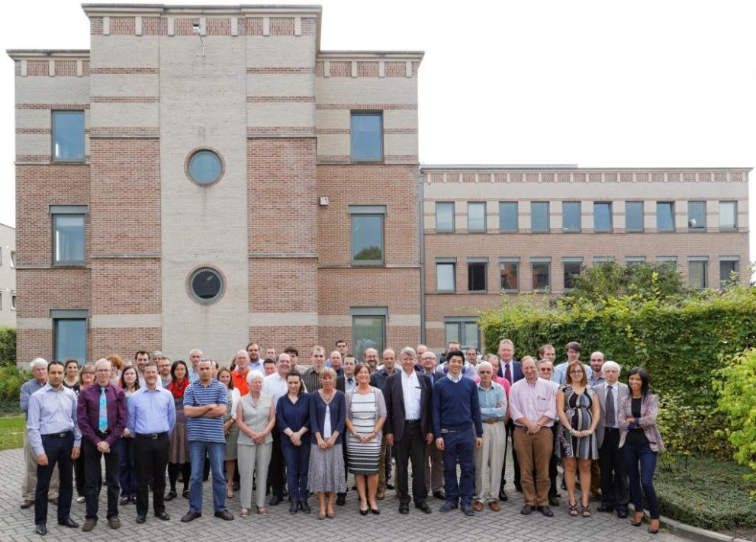
Any questions?

