Slide 1
K. Steven West and Brian Thomas U.S. Nuclear Regulatory Commission
A Strong and Viable
Technical Service Organization to
Meet Current and Future Regulatory Challenges:
The U.S. Nuclear Regulatory Commission’s Vision and Perspectives
October 27-31, 2014, Beijing, CPR
IAEA Symposium on “Challenges Faced By Technical and Scientific Support Organizations (TSOs) in Enhancing Nuclear Safety and Security: Strengthening Cooperation and Improving Capabilities”

Slide 2
Purpose
Discuss the USNRC Office of Nuclear Regulatory Research (RES) in its role as a TSO-like Organization
Discuss RES functions; expertise and capabilities; maintenance of these expertise and capabilities; knowledge management
Discuss future challenges envisioned for RES
The views expressed herein are those of the author. They do not constitute an official position of the USNRC.

Slide 3
Topics
NRC’s Authorities and Responsibilities as Provided by Statute
NRC’s Mission
RES Organization
Role of RES and Focus
Types of Research
RES Products and Quality Assurance
Domestic and International Collaboration
Key Research
Knowledge Management
Future Challenges
Summary

Slide 4
NRC’s Authorities and Responsibilities as Provided by Statute
The Energy Reorganization Act of 1974 established an independent regulatory commission to regulate commercial uses of nuclear material
Recognized the necessity for continuous improvement in our knowledge of a complex technology and technically challenging endeavor
42 USC § 5845 Established the Office of Nuclear Regulatory Research within the NRC and established the following requirements
Developing recommendations for research deemed necessary for performance by the Commission of its licensing and related regulatory functions
Engaging in or contracting for research which the Commission deems necessary for the performance of its licensing and related regulatory functions
The Commission shall develop a long-term plan for projects for the development of new or improved safety systems for nuclear power plants

Slide 5
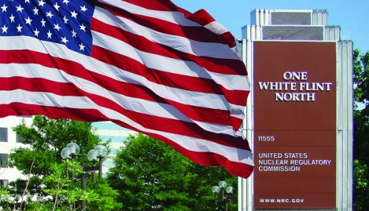
The NRC’s Mission
To regulate the nation's civilian use of byproduct, source, and special nuclear materials to ensure adequate protection of public health and safety, to promote the common defense and security, and to protect the environment.

Slide 6
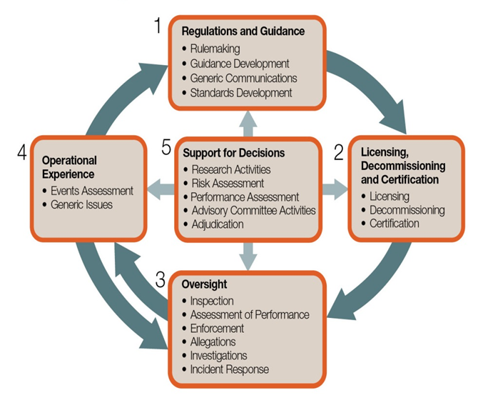
How We Regulate

Slide 7
NRC Technical Capabilities
*Per data available as of 2010
Notes:
NRC performs a majority of its technical support activities in-house by maintaining a highly skilled and competent workforce
NRC has salutatory authority to contract work to meet it’s the needs of the Commission but is not solely reliant upon contractors
Need correlation between NRC and other regulatory offices and their TSOs (may be of assistance to provide a contrast in how we operate but be wary of condemning someone like France who relies on external TSO )

Slide 8
RES Organization
Division of Engineering (DE)
material performance, natural hazards, digital instrumentation and controls (digital I&C), seismic and structural issues, reactor component integrity
Division of Systems Analysis (DSA)
criticality safety, thermal hydraulic and severe accident phenomenology, accident source terms, and accident sequences, quantifying margins, and reducing uncertainties for areas of potentially high risk or safety significance
Division of Risk Analysis (DRA)
probabilistic risk assessments (PRA), human factors and human reliability analysis, performance and reliability analysis, movement of radionuclides through environmental systems, operating experience, and fire safety
Program Management and Policy Development and Analysis (PMDA)
budget planning & execution, information technology needs, staff & resource planning
Notes:
RES houses and develops expertise in a variety of fields to ensure high quality products and maintain credibility as experts capable of resolving complex technical issues
Engineers, scientists, analysts, support staff
~ 30% Master’s and 30% PhDs.
Graduate Fellowship Program
NSPDP, Summer Hires

Slide 9
Role of RES
Plans, recommends, and implements research programs
NRC performs confirmatory research to support decisions about the adequacy of safety or security of a regulated function
Licensees and applicants have the primary responsibility to develop data to support their safety analyses and applications
NRC does not conduct development research designed to improve plant performance
Standards development
Coordinates NRC Participation international standards and national standards, including appointment of staff to committees
Resolution of generic safety issues
NRC does research to determine if a safety issue exists
NRC conducts confirmatory research to independently verify licensee or applicant’s data, determine safety margins, and explore uncertainties

Slide 10
Focus of RES
Unlike technical programs in some TSOs, the NRC research program aims to improve the knowledge where
uncertainties exist
safety margins not well characterized
resolution of technical issues needed to support regulatory decisions
Confirming the technical basis for regulatory decisions
Assessing technical issues
Developing methods and tools
Looking for emerging technologies and issues
Translating technical information into regulatory guidance

Slide 11
Types of Research
Confirmatory
Request by NRC’s regulatory offices to satisfy regulatory need
Coordinated well-defined product
Activities involve performing experiments or developing analytical tools to independently confirm licensee’s analyses
Shorter-duration (1-3 years)
Forward Looking
Anticipated regulatory needs within the next 3-5 years
Long Term
Scope out potential future (>5 years) regulatory needs

Slide 12
RES Products
RES provides the technical basis to support the Agency’s regulatory decisions
Enables determination of acceptance criteria
Provides recommendations to the Commission
Support is typically documented in the following products
NUREGS
Technical Reports
Regulatory Guides
12

Slide 13
Quality Assurance
Internal Evaluations
Staff coordinates work with Regulatory office
Staff obtain peer reviews
Staff conducts quality survey of RES products
Open to non-concurrence and differing professional opinions
External Evaluations
Obtained from Advisory Committee for Reactor Safeguards (ACRS)
Subjects work products to external peer reviews
DOE NE-7 FY 2014 Nuclear Reactor Technologies Program Review Germantown, MD. U.S.A. March 26, 2014
13

Slide 14
Domestic & International Collaborations
Leverage expertise and resources on key topics of common interest
Performed under shared financial responsibility
Includes a wide range of technical activities
Fukushima Activities
Halden Reactor Project
Zirconium Fire during Loss-of-coolant Accident
Fire Safety Research

Slide 15
Domestic & International Collaborations
Domestic Collaborations
US Department of Energy (Memorandum of Understanding (MOU))
Long term operation of light water reactors
Center for Radiation Protection Knowledge
Electric Power Research Institute, Inc. (EPRI)
advanced computational tools for assessing reactor component safety
aging and qualification of electrical cables
interface of digital instrumentation & controls and human factors
probabilistic research assessment
non destructive examination

Slide 16
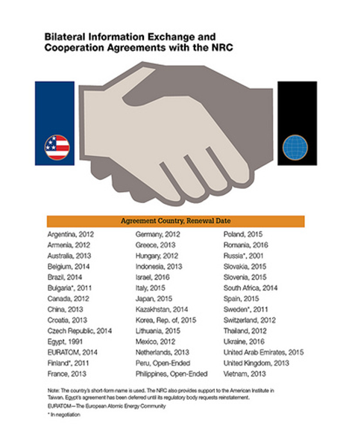
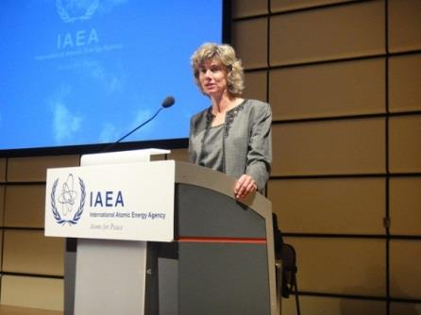
Domestic & International Collaborations
International Collaborations
Multilateral engagement
IAEA and NEA
Bilateral technical exchanges
40+ International Agreements
100+ International Research Agreements

Slide 17
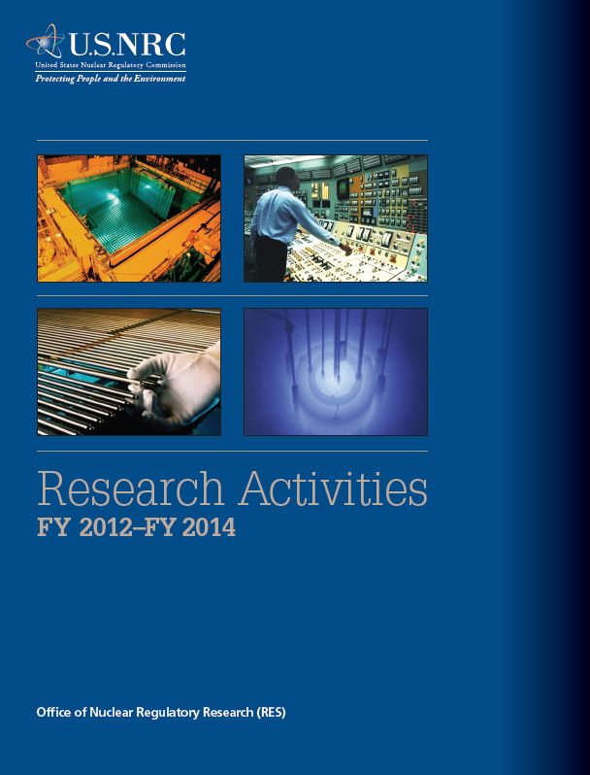
Key Research Areas
Reactor Safety Codes and Analysis
Severe Accident Research and Consequence Analysis
Radiation Protection, Health Effects, and Environmental Transport
Probabilistic Risk Analysis
Human Factors and Human Reliability
Fire Safety Research
Seismic and Structural Research
Materials Performance Research
Digital Instrumentation and Control and Electrical Research
Flooding Research
http://www.nrc.gov/reading-rm/doc-collections/nuregs/staff/sr1925/

Slide 18
Knowledge Management
Staff understand knowledge management is a fundamental part of the RES mission
The NRC knowledge base requires continuing maintenance and extension
Qualified staff are the key to maintaining the NRC knowledge base
Transferring knowledge into regulatory practice is a desired outcome of research
Develops NUREG/KM-series documents that capture historical events and highly significant technical and safety information
Holds technical exchanges through seminars and dissemination of technical information to stakeholders

Slide 19
Future Challenges
Enhancements based on lessons learned from the Fukushima Dai-ichi accident
Review of applications involving new technologies such as small modular reactors and advanced reactors
Improved understanding of rapidly evolving digital instrumentation and control systems
Materials degradation issues with aging nuclear fleet

Slide 20
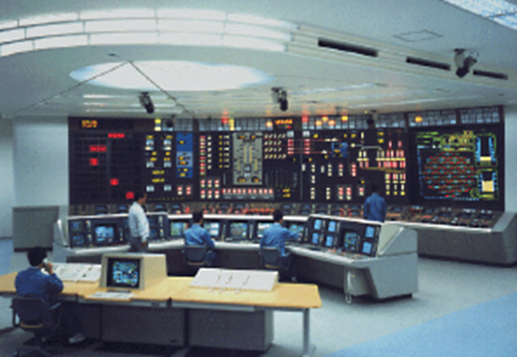
Digital Instrumentation & Controls
Safety Aspects of Digital Systems
Communications among digital systems
Safety assessment of software tools
Analytical assessment of Digital systems
Digital system reliability
Digital system risk analysis
Security Aspects of Digital Systems
Advanced Nuclear Power Concepts
Knowledge Management and
Research Collaboration

Slide 21
Materials Degradation Issues
Understanding of materials degradation enables sound technical basis for regulatory decisions
NRC has approved renewed license for 73 U.S. plants to operate 20 years beyond the initial 40 year operation
NRC is reviewing additional 11 applications for 19 units
34 units have entered the operating period beyond 40 years
Research focus (metallic):
Environmentally-assisted degradation and cracking (EAC)
Primary water stress corrosion cracking (PWSCC)
Irradiation-assisted stress corrosion cracking (IASCC)
Fatigue cracking
Thermal and radiation-induced embrittlement
Steam generator tube degradation and integrity assessment
Flaw Evaluation and Structural Integrity Assessment

Slide 22
Materials Degradation Issues
Ongoing research areas (concrete)
Irradiation effects on concrete strength
Concrete degradation due to alkali-silicate reaction (ASR)
Corrosion of liner plate on the concrete side
Boric acid attack on concrete in PWRs in Spent Fuel Pool and transfer canal
Corrosion of reinforcement in cooling tower
Creep of the post-tensioned concrete containment
Non-invasive and nondestructive evaluation of concrete
Ongoing research areas (cable)
Degradation mechanisms by better estimation of activation energy for specific cable materials in specific environment
Consequences of long-term wetting of both low- and medium-voltage cables
Effects of oxygen concentration in the atmosphere during a loss-of-coolant accident

Slide 23
Summary
NRC’s Office of Regulatory Research functions as follows:
Is a TSO-like organization with authorities and responsibilities mandated by the U.S. law
Is fully integrated within NRC and operates like a TSO for the regulatory offices and the Commission
Provides independent information and expertise needed to support NRC’s regulatory decision making process. Identifies and characterizes technical questions in anticipation of potential future safety issues

Slide 24
Summary cont’d
Establishes appropriate mechanisms and processes to initiate and drive research to fulfill the needs of regulatory offices and meet high quality standards
Maintains technical expertise and core capabilities for the conduct of research to meet the expectations of the regulatory offices and the Commission
In addition to maintaining in-house expertise, utilizes services provided by DOE laboratories and commercial contractors to extend its capabilities
Leverages support from various domestic and international collaborations to fulfill its mission

Slide 25
Thank You
Questions?

