Slide 1
Study on Severe Accident Progression and Source Terms in
Fukushima Dai-ichi NPPs
October 27, 2014
H. Hoshi, R. Kojo, A. Hotta, M. Hirano
Regulatory Standard and Research Department,
Secretariat of Nuclear Regulation Authority (S/NRA/R)
Notes:
I appreciate to have an opportunity to talk about our recent progress in Japan.
I’d like to thank the organizer of this conference for preparing this session.
I also appreciate all the support form international colleagues since Tohoku-Pacific Ocean Earthquake.
However, still, a lot of people have to evacuate from Fukushima prefecture. We need further effort for revival.
But, I believe our activities will contribute to enhancement of nuclear safety and a recovery of Fukushima.
Today, I’d like to talk about “New Regulatory Framework and Requirements for NPPs and Other Nuclear Facilities after Fukushima Dai-ichi NPP Accident ”

Slide 2
Contents
The Committee on Accident Analysis of Fukushima Daiichi Nuclear Power Station
Research Activities of S/NRA/R
Source Terms
Further Investigation
Conclusion
Notes:
This is contents of my talk.
First, I briefly explain regulatory reform in Japan
Second, I’ll focus on New Regulatory Requirements after Fukushima Dai-ichi NPP Accident
Third, I’ll show you Safety Review of NPPs and Other Nuclear Facilities
Finally, I’ll summarize my talk.

Slide 3
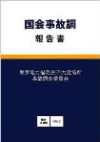
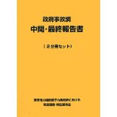
1. Investigation Reports
After Fukushima Daiichi accident, several investigation reports were published
These reports pointed out lessons learned from the accident
New regulation, reflecting the lessons, was enacted last year
NRA launched new committee to investigate unsolved issues
Notes:
After Fukushima Daiichi accident, several investigation reports were published
These reports pointed out lessons learned from the accident
New regulation, reflecting the lessons, was enacted last year. Reviewing process is in progress for both PWR and BWR plants. First evaluation report was published last month.
Due to lack of instrumentation or measurement, accident progression is still not clear. So, NRA launched new committee to investigate unsolved issues.

Slide 4
New Investigation Committee
Possibility of small break LOCA at Unit 1
Activation of S/RV at Unit 1
Flooding on 4th floor of Unit 1
Isolation condensers of Unit 1
SFP of Unit 3
Hydrogen explosion at R/B of Unit 4
Notes:
In the new investigation committee, unsolved issues are studied by computational analyses and onsite investigation.
These are examples already discussed in the committee.

Slide 5
Possibility of SBLOCA at Unit 1
Diet investigation report pointed out possibility of small break LOCA and S/RV was not activated
If SBLOCA occurs, RPV pressure decreases rapidly and is inconsistent with observed data
○Record
Leak area
800 mm²
900 mm²
Ref.: WWW.nsr.go.jp/comittee/yuushikisha/jiko_bunseki/data/004_05.pdf (in Japanese)
Notes:
Diet investigation report pointed out possibility of small break LOCA and S/RV was not activated
If SBLOCA occurs, RPV pressure decreases rapidly and is inconsistent with observed data

Slide 6
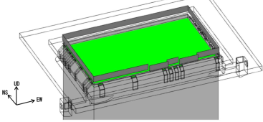
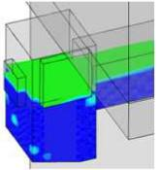
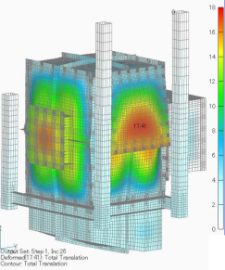
Flooding on 4th floor of Unit 1
S/NRA/R calculated sloshing of SFP (Unit 1) and structure
Analyses suggest below
  Water flooded from SFP to duct due to sloshing
  Water leaked from duct due to break by dynamic loading
Ref.: WWW.nsr.go.jp/comittee/yuushikisha/jiko_bunseki/data/003_01.pdf (in Japanese)
Notes:
NRA/Res calculated sloshing of SFP (Unit 1) and structure
Analyses suggest below
Water flooded from SFP to duct due to sloshing
Water leaked from duct due to break by dynamic loading

Slide 7
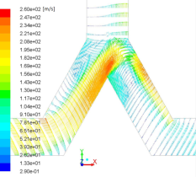

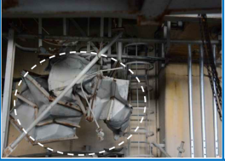
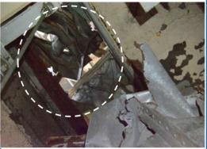
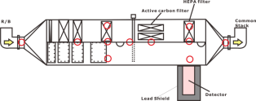
Hydrogen Explosion at Unit 4
CFD calculations suggest hydrogen flow from Unit 3 to Unit 4 through common stack
Outlet of STGS (Unit 4) was contaminated higher than inlet
NRA investigated R/B of Unit 4 and found ducts were significantly damaged
Ref.1
Unit 4
Unit 3
Dose rate of filters in Unit 4 were measured
Damaged ducts in Unit 4
4th floor
2nd floor
Ref.2
Ref.1: WWW.nsr.go.jp/archive/jnes/content/000125907.pdf
Ref.2: WWW.nsr.go.jp/comittee/yuushikisha/jiko_bunseki/data/004_01.pdf
Notes:
CFD calculations suggest hydrogen flow from Unit 3 to Unit 4 through common stack
Outlet of STGS (Unit 4) was contaminated higher than inlet
NRA investigated R/B of Unit 4 and found ducts were significantly damaged

Slide 8
2. Research on Fukushima in S/NRA/R
Experimental programs
  Pool scrubbing test
  Sea water injection
Computational analyses
  Accident progression (lumped parameter code)
  CFD approach
    Containment integrity
    Hydrogen distribution
    Diffusion of fission products
Notes:
Experimental programs
Pool scrubbing test
Sea water injection
Computational analyses
Accident progression (lumped parameter code)
CFD approach
Containment integrity
Hydrogen distribution
Diffusion of fission products

Slide 9
Thermal Stratification of S/P
Calculations of lumped S/P model (uniform temperature distribution) show significant difference from actual measurement
These calculations imply thermal stratification of S/P under long term SBO
Unit 2
Unit 3
S/RV open
Record
Calc.
RCIC operation
PCV
Calc.
PRV
Calc. shows D/W pressure quickly increases
Calc. shows slow pressurization
Ref.: Nuclear Emergency Response Headquarters Government of Japan, "Report of Japanese Government to the IAEA Ministerial Conference on Nuclear Safety - The Accident at TEPCO's Fukushima Nuclear Power Stations - ," June 2011
Notes:
Calculations of lumped S/P model (uniform temperature distribution) show significant difference from actual measurement
These calculations imply thermal stratification of S/P under long term SBO

Slide 10
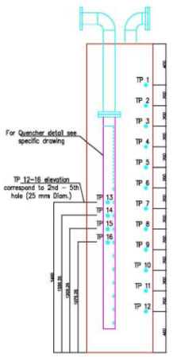
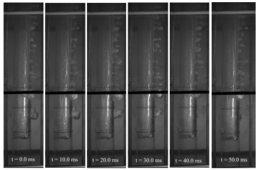
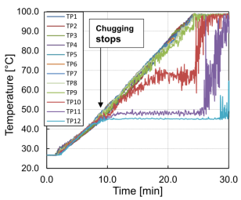
Early Pressurization of PCV
PCV is pressurized due to thermal stratification of S/P during RCIC operation
Horizontal steam discharge
RCIC exhaust
Experimental results show nonuniform temperature distribution
Ref.: M. Pellegrini, et al., “Suppression pool testing at the SIET labs (3) Experiments on Steam Direct Contact Condensation in a Vertical Multi-holes Sparger,” Proc. of The 10th International Topical Meeting on Nuclear Thermal-Hydraulics, Operation and Safety (NUTHOS-10), Okinawa, Japan, December 14-18, 2014 (provided by the senior author)
Notes:
It was possible that Thermal Stratification occurred in Units 2 and 3.
Thermal stratification could be formed by discharging steam which didn't contain non condensable gases such as Hydrogen.
In Unit2, HPCI was operated. In Unit3, RCIC and HPCI were operated.
Then,it was assumed that gases which were discharged from RCIC or HPCI to S/C were almost steam.
Steam are condensed by pool water.
Then, High temperature water spread, not only vertical direction but radial direction.
In this way, temperature distribution may also be formed for radial direction in S/C.
9

Slide 11
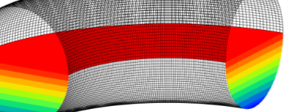
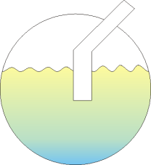
Depressurization of W/W
Depressurization of W/W due to activation of spray system
Discharge from D/W to W/W through vent pipe
Enhance mixing of S/P and break thermal stratification
Spray activation
Steam condensation
Depressurization
Discharge from D/W to W/W through vent pipe
Mixing of S/P
Break of thermal stratification of S/P
Notes:
Depressurization of W/W due to activation of spray system
Discharge from D/W to W/W through vent pipe
Enhance mixing of S/P and break thermal stratification
Spray activation
Steam condensation
Depressurization
Discharge from D/W to W/W through vent pipe
Mixing of S/P
Break of thermal stratification of S/P

Slide 12






New Attempt of S/C Nodalization
Divide Suppression chamber volume into 20 volumes for Unit 2,3.
10 radial
volumes
SC #10
SC #1
SC #1
Upper
SC #2_Upper
SC #3
Upper
SC #2
SC #9
SC #8
SC #3
SC #1
Lower
SC #3
Lower
SC #2_Lower
SC #4
Each radial volume is divided into 2 volumes for the vertical direction.
SC #7
SC #5
SC #6
HPCI exhaust
RCIC exhaust
Consider radial thermal distribution and vertical thermal stratification
Notes:
In order to take thermal stratification and radial thermal distribution in S/P into consideration,
we divided S/C into 18 volumes.
S/C were divided into 10 volumes in the radial direction
in order to consider formation of radial thermal distribution.
Then, we divided each volumes into 2 volumes for the vertical direction
in order to consider thermal stratification, except for RCIC steam outlet region and HPCI steam outlet region.

Slide 13
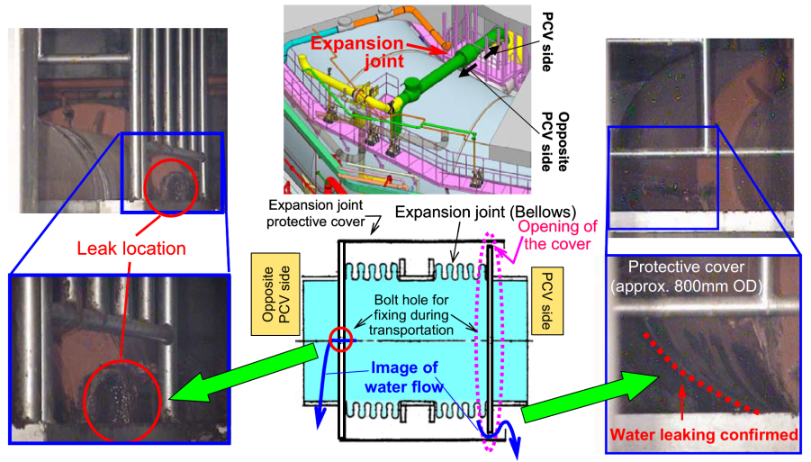
Leakage from PCV (1/2)
Ref.: TEPCO, “Evaluation of the situation of cores and containment vessels of Fukushima Daiichi Nuclear Power Station Units-1 to 3 and examination into unsolved issues in the accident progression Progress Report No. 2,” Aug. 6, 2014
Notes:
As you can see, TEPCO recently found actual leak location in Unit 1.
Water is leaked at bellows of vacuum breaker.

Slide 14
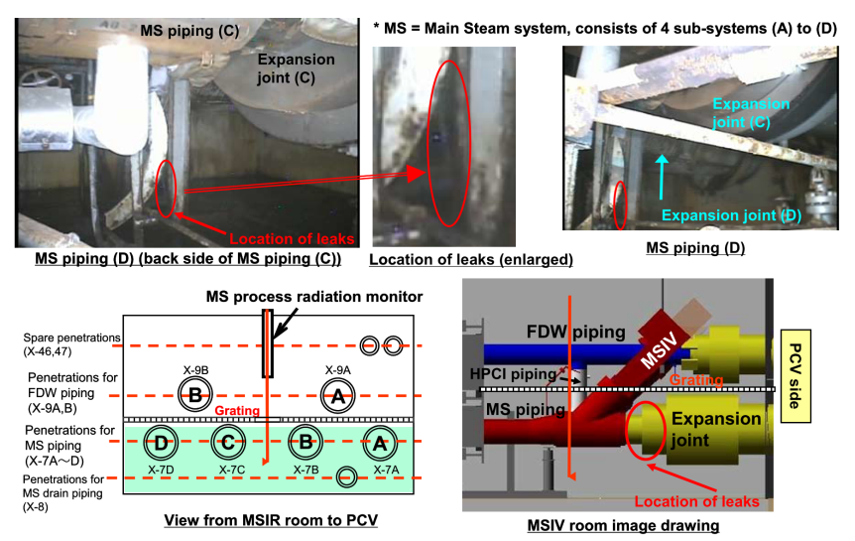
Leakage from PCV (2/2)
Ref: http://www.tepco.co.jp/en/press/corp-com/release/2014/1240140_5892.html
Notes:
These photos show leakage in Unit 3.
This figure shows the leak location, right side is PCV and left is turbine building.
This photo seems that water leaked from main steam line, but it is unclear whether water is leaked from main steam line or leaed through penetration around the main steam line.

Slide 15
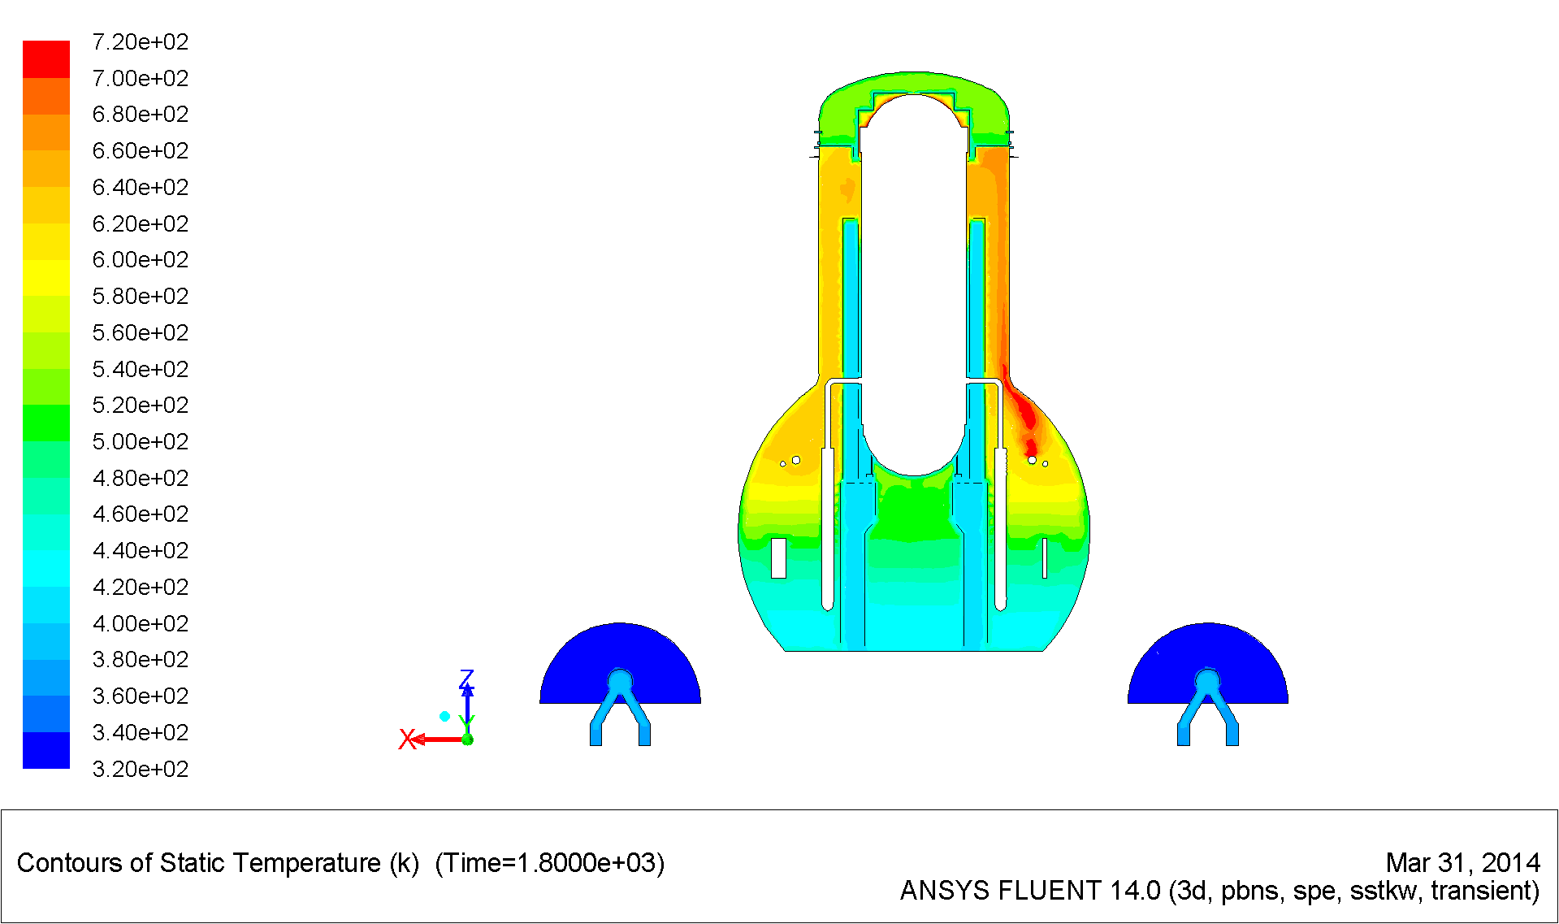
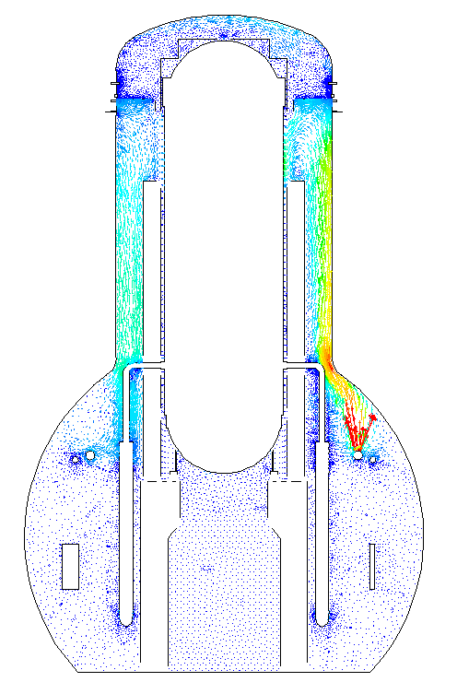
Leakage from PCV (Analysis)
Flow velocity
Temperature
PCV top head flange
Leakage from SRV gasket
1800 sec after leakage from S/RV gasket
Notes:
To identify leak location of PCV due to overtemperature, we apply computational fluid dynamics (CFD). These figures show example of calculation results.
Here, we assumed leakage from RPV to D/W at SRV gasket. As you can see, temperature of upper region of D/W is very high. This calculation suggests possibility of leakage due to overtemperature.

Slide 16
External Water Injection
External water injection
MCCI is important to estimate amount of external water injected to the core
Core status
Notes:
In this accident, sea water was injected to the core.
Estimation of external water injection is very important for accident progression analyses.
However, actual amount of external water, which is exactly injected to the core, is unknown.
On the contrary, observation of MCCI is important to estimate amount of external water injected to the core
Core status

Slide 17
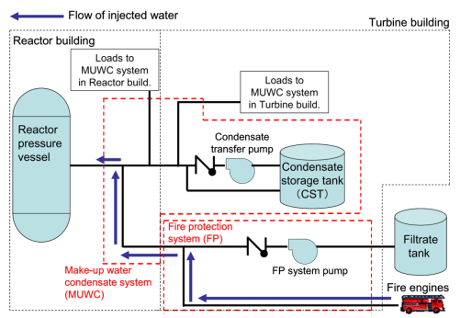
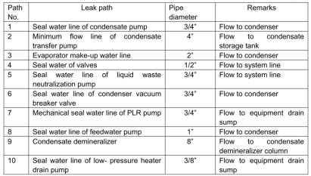
Bypass of External Water Injection
If whole external water, fed by fire engine, was injected to the core, core ought to have been cooled.
External water injection, to the core, is less than the record
TEPCO identified potential bypass path
e.g. 10 paths for unit 1
Actual amount injected to the core significantly affects core status, hydrogen generation, MCCI, etc.
Ref.: TEPCO, “Evaluation of the situation of cores and containment vessels of Fukushima Daiichi Nuclear Power Station Units-1 to 3 and examination into unsolved issues in the accident progression Progress Report No. 2,” Aug. 6, 2014
Notes:
If whole external water, fed by fire engine, was injected to the core, core ought to have been cooled.
But, actually, lower part of RPV is damaged, because RPV is not filled with water.
So, external water injection, to the core, is less than the record
Recently, TEPCO identified potential bypass path
e.g. 10 paths for unit 1, listed here with pipe diameter
Actual amount injected to the core significantly affects core status, hydrogen generation, MCCI, etc.

Slide 18
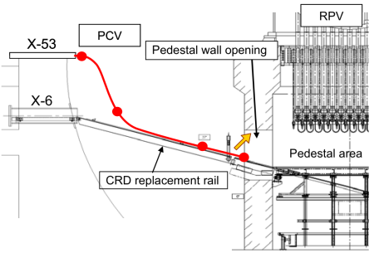
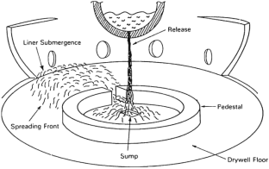
Melt Spread in PCV
Shell attack, direct melt-attack of the liner, is identified as one of the important PCV failure modes for Mark-I containment
Investigation of inside PCV is in progress by TEPCO
Investigation inside of PCV (Unit 2)
Ref.: TEPCO, “Evaluation of the situation of cores and containment vessels of Fukushima Daiichi Nuclear Power Station Units-1 to 3 and examination into unsolved issues in the accident progression Progress Report No. 2,” Aug. 6, 2014
Ref.: U. S. NRC, “Probability of Mark-I Containment Failure by Melt-Attack of the Liner,” NUREG/CR-6025, 1993
Notes:
After severe core degradation, molten core is dropped to the pedestal and spread to the D/W floor.
As shown hire, shell attack, direct melt-attack of the liner, is identified as one of the important PCV failure modes for Mark-I containment in NUREG report.
Investigation of inside PCV is in progress by TEPCO.
By CCD camera inspection, debris was not found around ,here, the opposite side of the opening.

Slide 19

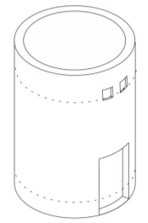
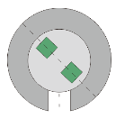
Nodalization to estimate melt spread
MELCOR nodalization is modified to estimate melt spread and MCCI
CV Nodalization
Drywell Head
Drywell1
Drywell
Upper Region
Control Rod Opening
Pedestal
Drywell2
Drywell2
Drywell1
CAV* Nodalization
Pedestal
Pedestal Doorway
DW Floor1
Pedestal
DW Floor2
DW Floor 1
DW Floor2
Pedestal
(CAV package)
Control Rod Opening
Transport Direction of Debris
Pedestal Doorway
Notes:
To study melt spread from pedestal to the D/W floor, we modified nodalization.
This slide shows nodalization of lower region of DW and Pedestal.
Pedestal region is connected with drywell by pedestal CRD pipe opening or pedestal doorway.
After lower head failure of RPV, melt drops and spreads to Pedestal region.
Then melt spreads to drywell region thorough pedestal doorway. (一般的な事項なので、現在形)
Therefore, we divided drywell floor into 2 regions for the purpose to model melt spread.

Slide 20
3. Estimation of Source Terms
Source terms suggest core degradation & PCV leakage
Isotope ratio is finger print of radionuclide source & leak paths
Notes:
Source terms suggest core degradation & PCV leakage
Isotope ratio is finger print of radionuclide source & leak paths

Slide 21
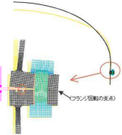
Possible Release from Unit 2
FP release, which corresponds to pressure peak of Unit2, was measured*
Aerosol, discharged from RPV to D/W, was released to the environment without pool scrubbing
PCV Top
Head Flange
FP Release corresponds to RPV pressure peak*
Steam/H₂ generation ≈ Leakage
Unit 2
PRV
Unit 1
PCV
*G. Katata, et al., “Detailed source term estimation of the atmospheric release for the Fukushima Daiichi Nuclear Power Station accident by coupling simulations of atmospheric dispersion model with improved deposition scheme and oceanic dispersion model,” Atmos. Chem. Phys. Discuss., 14, 14725–14832, 2014
Notes:
FP release, which corresponds to pressure peak of Unit2, was measured*
Aerosol, discharged from RPV to D/W, was released to the environment without pool scrubbing

Slide 22
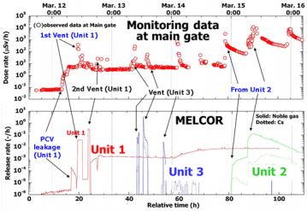
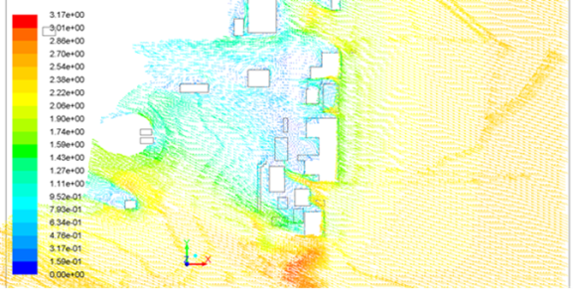
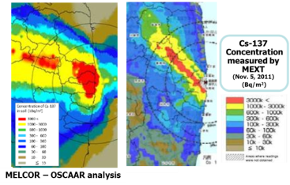
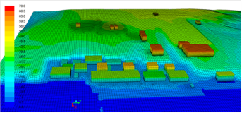
New Development for Source Terms
New development:
In order to compare the source terms obtained by MELCOR with the monitoring data at the main gate, CFD calculations are being done for airstream around the site by using the terrain data and GPV meteorological data (140km x 140 km).
Preliminary results of airstream around the site
Main gate
Terrain data
*
CFD resolution
5 m x 5 m x 1 m
(by the bldg.)
*H. Hoshi, et al., “Severe Accident Analyses of Fukushima-Daiichi Units 1 to 3,” Side Event “Updated activities about TEPCO’s Fukushima Dai-ichi NPS accident”
At Fukushima Ministerial Conference on Nuclear Safety, Dec. 16, 2012
10 m x 10 m x 1 m
(other region)
Notes:
In order to compare the source terms obtained by MELCOR with the monitoring data at the main gate, CFD calculations are being done for airstream around the site by using the terrain data and GPV meteorological data (140km x 140 km).

Slide 23
4. Further Investigation
Information from Onsite R&D
partially future
External Water Injection
MCCI
PCV Integrity
Core Degradation
Hydrogen Generation
Source Terms
Explosion
Inverse estimation
Notes:
From the observation of hydrogen explosion, source terms, or PCV integrity, severe accident phenomena inside the PCV, e.g. MCCI, hydrogen generation, core degradation, will be estimated.
From the inverse estimation like this, external water injection will be estimated quantitatively.

Slide 24
4. Further Investigation
Information from Onsite R&D
partially future
External Water Injection
MCCI
PCV Integrity
Core Degradation
Hydrogen Generation
Source Terms
Explosion
Reduce uncertainties of forward estimation
Notes:
After the inverse estimation, forward calculation to estimate source terms will be conducted.
To reduce uncertainties of forward estimation, these process will be repeated.

Slide 25
5. Conclusion
  In the light of Fukushima Dai-ichi NPP accident, the NRA developed the new design requirements and established the new regulatory framework to ensure the safety of NPPs and other nuclear facilities.
  NRA launched new investigation committee for Fukushima Daiichi accident.
  NRA examined R/B to investigate impact of tsunami, hydrogen explosion, etc.
  Various analyses are in progress to estimate core status, PCV integrity, source terms, etc.
  TEPCO continues investigation with decommissioning
  Further investigation is still needed. However, multiple approaches are applied to reduce uncertainty.
Notes:
Finally, I summarize my talk.
Regulatory body has been reinforced with integration of JNES into NRA.
In the light of Fukushima Dai-ichi NPP accident, the NRA developed the new design requirements and establish the new regulatory framework to ensure the safety of NPPs and other nuclear facilities.
Safety review on conformity to new regulatory requirements for NPPs and other nuclear facilities has been intensively conducted by NRA.
Sendai-1, 2 were selected for Model ‘Evaluation Report’ development

Slide 26
  Thank you for
  your kind attention

