Slide 1
Neutron Data Standards DDEP Roadmap for the next standard release (December 2026?)
Roberto Capote
Deputy Section Head Nuclear Data Section
STD meeting, 26-30 January 2026, IAEA HQ, Vienna, Austria

Slide 2
Outlook
Minimization methods: GLSQ, Chi² minim., MLE, MCMC
UQ: USU, cut-posterior, Bayesian method mix
R-matrix and GMA: Li-6(n,t), C,
TNC
Revision/compilation of experimental data (see Pronyaev, Carlson, new data presented from CSNS)

Slide 3
Minimization methods
Four minimization methods have been implemented in gmapy (see Georg pres) GLSQ
Chi-2
MLE
MCMC
GLSQ was used in previous standards
We could use results from different methods to estimate uncertainties

Slide 4
R-matrix and GMA
R-matrix fit undertaken for n+H up to 100 MeV (see Mark Paris pres)
Requires update of the data measured relative to H (eg Lisowski).
R-matrix fit undertaken for Li-7 and C-13 compound nuclei (see Mark Paris pres)
Two different R-matrix fits were combined in previous evaluations

Slide 5
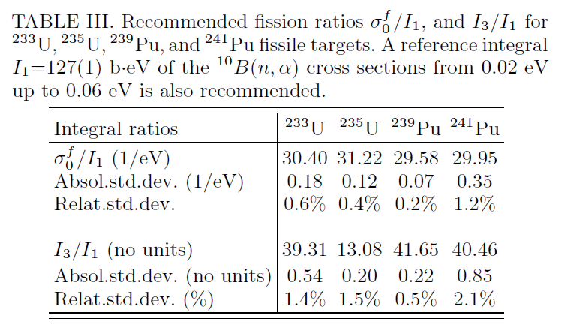
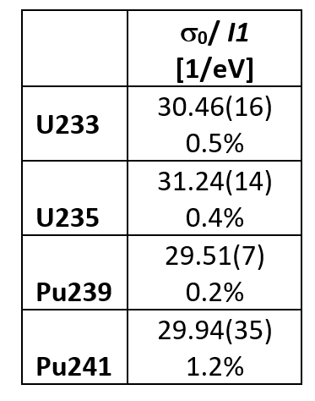

Duran et al, new n,f reference values?
NDST2025
revised
I1 is the integral from 20 to 60 meV
σ₀/I1 is independent of the flux

Slide 6
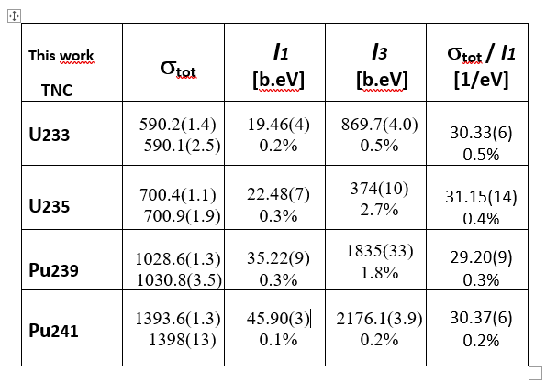
Duran et al, new n,tot reference values?
Duran et al, NDST2025 (to be submitted)
I1 is the integral from 20 to 60 meV
σ₀/I1 is independent of the flux

Slide 7
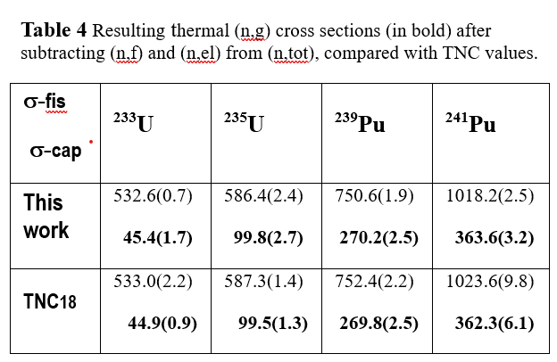
TNC, new fit
TNC input database revised, two independent fits (see Georg & Gilles pres.)
Duran et al, NDST2025 (to be submitted)

Slide 8
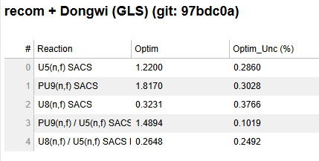
Study UQ method; SACS
SACS uncertainties too low due to weak correlations
With USU: ~1.2% uncertainty which is reasonable

Slide 9
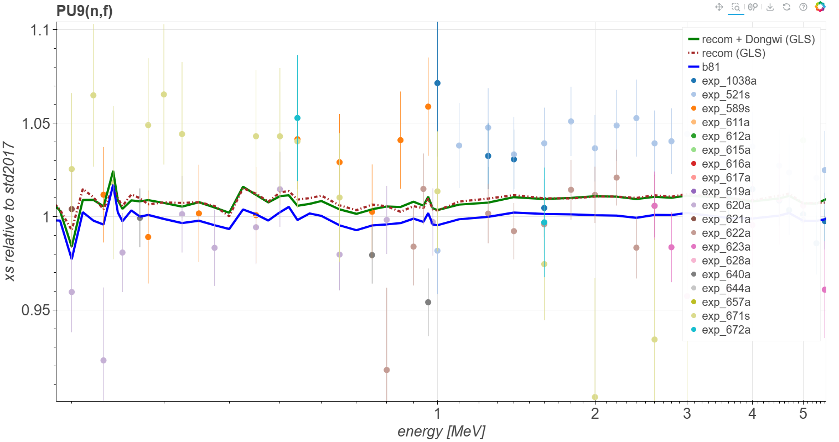
Do we trust TPC data? (see Neudecker, Carlson)
Questions about the thermal background raised
Silano (TUNL) data in contradiction
n_TOF data support STD 2017

Slide 10
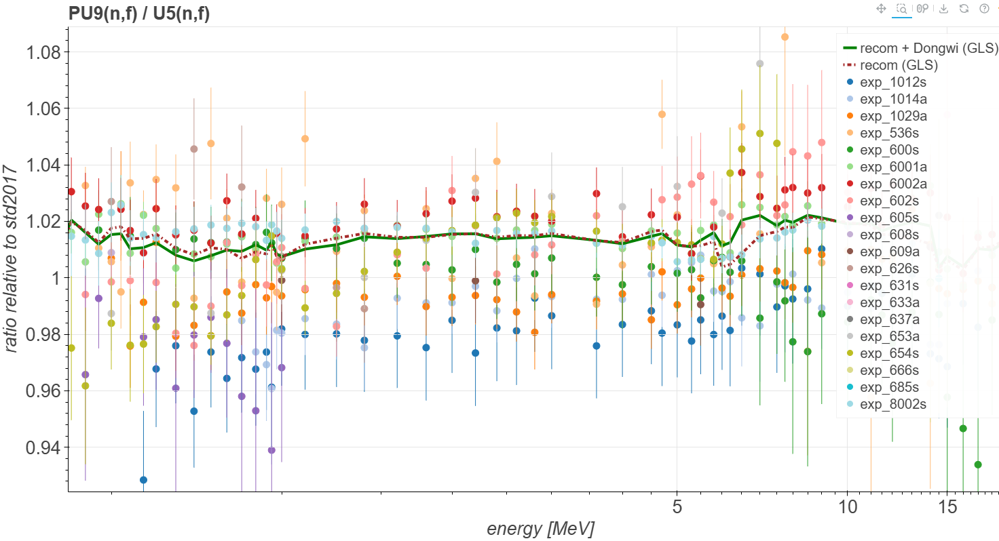
Do we trust TPC data? (see Neudecker, Carlson)

Slide 11
Proposed roadmap to release in 2026
Select minimization method(s): GLSQ, Chi² minim., MLE
Study UQ: USU, cut-posterior, Bayesian method mix
Decide on TNC
Finish revision of experimental data (new H, etc)
Finish compilation of new experimental data (cut-off March 2026?)
Distribute draft results in August 2026 for testing/validation (31 August)
RELEASE: November 2026

Slide 12
Thank you!
Notes:
Thank you!

