Slide 1
Neutron Standards
The Evolution of Methods with Time
Allan D. Carlson
NIST Associate
Presented at
The IAEA Standards Meeting
Jan. 26 2026

Slide 2
ENDF/B-IV
The evaluations were done by drawing smooth curves through plots contating the measured values.
Uncertainties were obtained in an approximate manner
there was no thought of covariances.
ENDF/B-V
Generalized Least Square was used for the ²³⁵U(n,f) evaluation for the energy range from 100keV to 20 MeV -Poenitz
ENDF/B-VI
The Generalized Least Square method was applied for all the standard cross section data except the ¹H(n.n) and ³He(n,p) standard. The code used is GMA by Poenitz
A rather complete set of measurement types were possible.
R-matrix evaluations were done for the ⁷Li and ¹¹B compound nuclei yielding ⁶Li(n,t), the ¹⁰B(n,α) and ¹⁰B(n,α₁γ) standard cross sections-Hale
A method was established to combine the GMA and R-matrix results
Also R-matrix evaluations were done for the ¹H(n,n), ³He(n,t) and C(n,c) standards

Slide 3
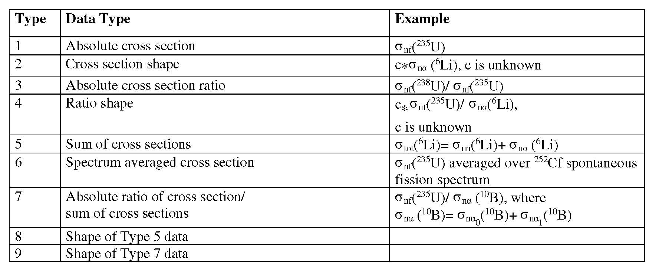
Data types used with GMA

Slide 4
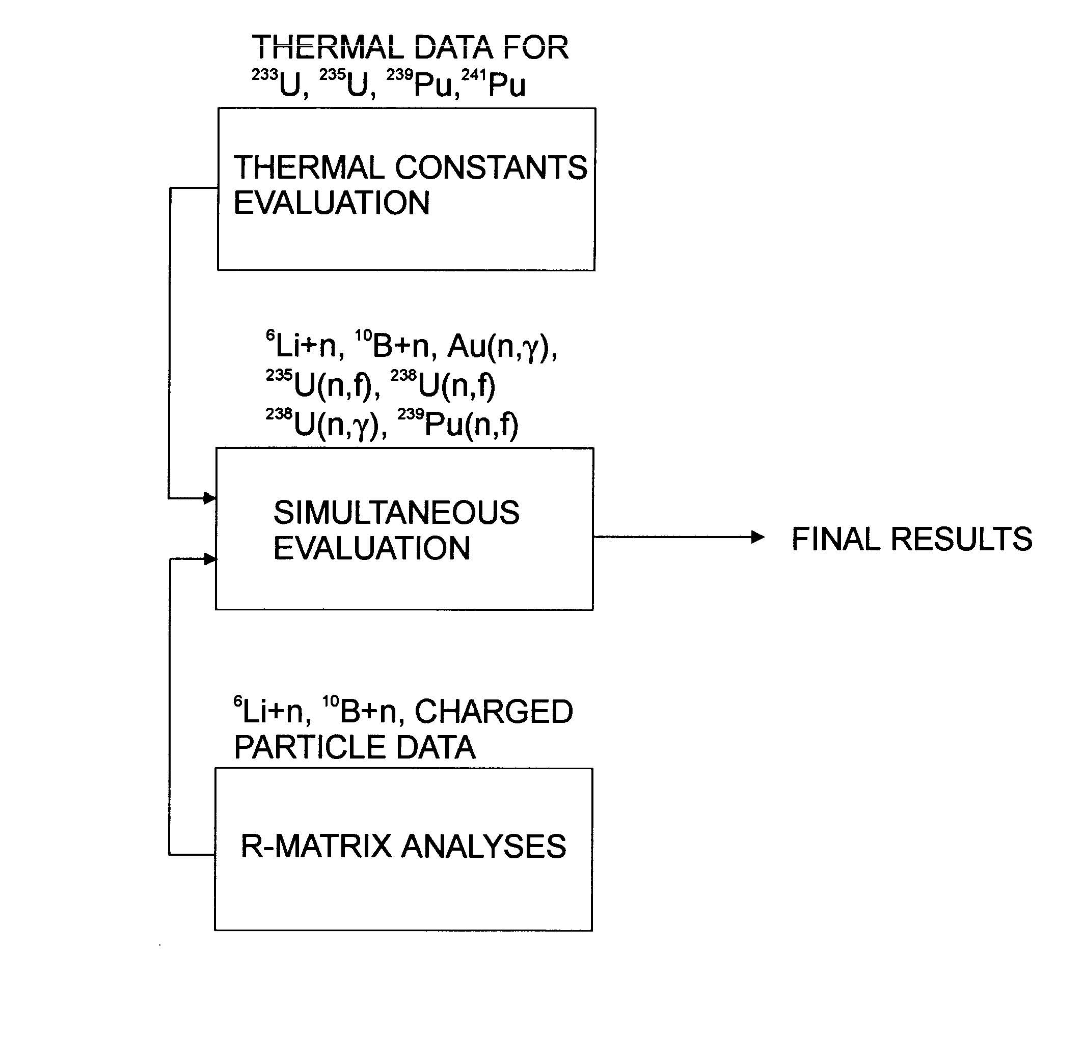
Evaluation Procedure

Slide 5
ENDF/B-VII – the 2006 Standards Evaluation
ENDF/B-VII evaluation was done realizing it was important to have international involvement to provide improved evaluations.
To make this happen, an IAEA Data Development Project was initiated focused on the maintenacce of the neutron cross section standards. This project should provide a method for obtaining standards evaluations that are up-to-date whenever they are needed by any nuclear data evaluation project, not just the ENDF/B files.
The IAEA provided a Coordinated Research Project with participants from several countries
We obtained mostly experimental support from the NEANDC WPEC.
Subgroup on Neutron Standards
The CSEWG supported the effort
Measurements Committee
Evaluation Committee
The IAEA support was very important in actually producing the ENDF/B-VII standards evaluations.
The methodology was very similar to that used for the ENDF/B-VI evaluations but two independent R-matrix codes were used.

Slide 6
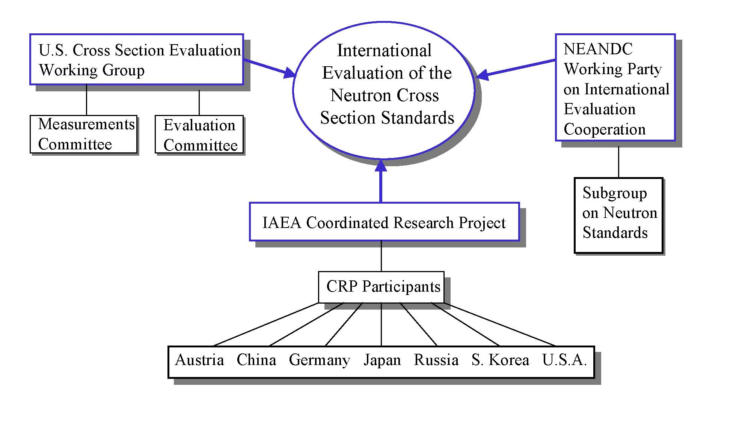
International Collaboration for the Standards Evaluation

Slide 7
ENDF/B-VII – the 2006 Standards Evaluation (cont.)
For this evaluation (ENDF/B-VII), many comparisons of codes were made to show consistency.
For the two codes used for the R-matrix analyses, EDA and RAC, the results for a simple ⁶Li+n
database were in agreement. The SAMMY code was instrumental in making some comparisons.
For the full database, the R-matrix codes gave slightly different results due to different forms of chi-square expression
For the ENDF/B-VI evaluations there were problems with unusual results combining inconsistent data that were highly correlated. In that case uncertainties were increased to remove the problem.
For ENDF/B-VII, the problem of inconsistent data that were highly correlated was looked at in detail leading to studies of different ways of treating the PPP effect.
It was decided to accept the Chiba-Smith method to minimize the effect (using percentage uncertainties )
This evaluation process produced results for all the standards except ¹H(n,n) which was an evaluation by Hale, and ³He(n,p) and C(n,n) that were not evaluated (but brought over from the previous evaluation).

Slide 8
ENDF/B-VIII (the 2017 Standards Evaluation)
The methodology was very similar to that used for the ENDF/B-VI evaluations.
New evaluiations were obtained for all the standards except ³He(n,p) which was carried over from the last evaluation.
It was noted that the 30 keV Maxwellian average cross section from this evaluation differed from the value used by the astrophysics community.
This led to an investigation that showed there were problems with the Ratyuski and Kaeppeler measurement that was the basis of the astrophysics result.
The astrophysics community now has accepted a value consistent with that obtained from our work.
The 30 keV Au(n,γ) MACS of our data is now a neutron cross section standard
Work was done on reference cross sections, that are not known as well as the standards but measurements can be made relative to them.
High energy reference fission cross section-up to 1 GeV
²³⁵U(n,f), ²³⁸U(n,f) and ²³⁹Pu(n,f)
Prompt gamma –ray production reference cross sections
¹⁰B(n,α₁γ) thermal to 1 MeV
⁷Li(n,n’γ) 0.8 MeV to 8 MeV
⁴⁸Ti(n,n’γ) 3 to 16 MeV

Slide 9
ENDF/B-VIII (the 2017 Standards) (cont.)
Fission Neutron Spectra
²³⁵U(n_{th},f) PFNS, an evaluation was produced
²⁵²Cf(sf) PFNS several measurements were investigated but no changes were suggested to the Mannhart evaluation.
Initial work on unrecognized systematic uncertainty (unidentified systematic uncertainty) was done (USU)
Assumed no energy dependence ( ok for Nu bar ²⁵²Cf)
New thermal constants evaluation using only microscopic data except a Maxwellian experiment by Lounsbury.
A new C(n,n) cross section evaluation by Hale was used
A new ¹H(n,n) cross section evaluation by Hale that extends to 20 MeV
The ³He(n,p) cross section evaluation was carried over from the previous evaluation.

Slide 10
Work Leading to a New Standards Evaluation
Important work was done so that ratios of SACS, that are known very well, could be used
GMAP can not use that data
Georg Schnabel has produced a Python based code that is in agreement with GMAP but can use ratios of SACS. It is GMAPy.
A number of different GMAPY minimization procedures are being examined with this code
Maximum Likelihood Estimation (MLE) and Markov Chain Monte Carlo (MCMC) have been investigated.
They are both valid and sound statistical approaches. The differences between them may provide as an estimate of the uncertainty due to the evaluation methods.
GMAPy will be investigated for possible estimates of energy dependent USU as well as the cross section evaluations
With GMAPy it was possible to determine the accuracy of the PPP correction used for the 2017 standards.
Note it was understood that the correction was minimized, not determined exactly, for previous standards evaluations.
The difference is in almost all cases less than 0.4%

Slide 11
Work Leading to a New Standards Evaluation (cont.)
Denise Neudecker may discuss the AIACHNE collaboration work on the evaluation of the ²⁵²Cf(sf) PFNS, I will only emphasize the importance of having that standard updated, agreeing with the Mannhart result and in a form that can conveniently updated in the future.
An updated evaluation of the thermal constants (TNC) is underway.
Noguere has made improvements to the TNC database established by Axton, including new measurements.
The present TNC database supports all quantity types and correlations that were in Axton’s work.
The TNC evaluation will use GMAPY with the TNC database and the existing GMAPY database.
This should lead to consistent results for ²³⁵U and ²³⁹Pu cross sections over a wide range of neutron energies.
Previously, rather than including the entire TNC database, the results of evaluations with the associated variance-covariance data, were used as a second independent data input subset to the analysis.
There are still concerns about whether high energy cross sections should impact the TNC.
The status of the TNC results is still under discussion.
This will be the first time we use IAEA Data Development Project focused on the maintenacce of the neutron cross section standards.
There will not be an ENDF/B-IX evaluation immediately associated with this evaluation.
Use of the standards from this evaluation requires associating the resulting cross sections with this process.

Slide 12
Work Leading to a New Standards Evaluation (cont.)
An R-matrix analysis is underway for the hydrogen standard, that has been limited to 20 MeV.
A database being developed by Paris and Hale at LANL will allow an evaluation with an extended energy range to be produced.
The present results are up to 100 MeV with the objective of extending the evaluation to 250 MeV.
Consideration must be given to a possible hydrogen “composite evaluation” that will allow data to as high as 1 GeV for use by experimenters.
Work continues on an R-matrix analysis for the ⁶Li(n,t) standard
Paris and Hale did an evaluation for ENDF/B-VIII.1 that extended beyond the standards energy region.
In the standards energy region, It agreed with the standard.
Initial efforts for an independent ⁶Li(n,t) evaluation at LLNL by Thompson are underway.
It is hoped that the ⁶Li(n,t) standard can be extended to above 1 MeV, the present maximum energy.
Additional R-matrix work is being considered.

Slide 13
Work Leading to a New Standards Evaluation (cont.)
An evaluation of the standards will be done by combining the results of R-matrix and GMAPY analyses.
A new R-matrix evaluation of the boron standards will not be done.
Some changes in that cross section may come from ratio data in the GMAPy fit
This will be the first time we will use the IAEA Data Development Project focused on the maintenacce of the neutron cross section standards.
There will not be an ENDF/B-IX evaluation immediately associated with this evaluation.
Use of the standards from this evaluation requires associating the resulting cross sections with this process.

